Slide 1

MOVEMENT OF PRODUCTION (INTERNATIONAL) FACTORS
Ingrid Majerova
World Economy
EVS/XXX
LESSON VIII

Slide 2

Outline of the lecture
The sources of movement of factors
Foreign Direct Investment
Technology Movement
Labour Migration

Slide 3
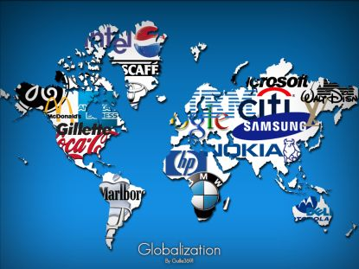
THE SOURCES OF MOVEMENT OF FACTORS
Factors:
Capital – mostly in the form of FDI
Technology
Labour
The sources – MULTINATIONAL ENTERPRISES

Slide 4
THE SOURCES OF MOVEMENT OF FACTORS
Multinational enterprise (MNE)
Operating in many host countries
Research and development (R&D) activities, and
  Manufacturing, mining, extraction, and business-service operations
Cross national borders
Directed from a company planning center
  Distant from the host country
Multinational stock ownership
Multinational company management
High ratio of foreign sales to total sales

Slide 5
THE SOURCES OF MOVEMENT OF FACTORS
Vertical diversification
Parent MNE - establish foreign subsidiaries
To produce intermediate goods or inputs that go into the production of a finished good
Horizontal diversification
Parent company producing a commodity in the source country
Sets up a subsidiary to produce an identical product in the host country
Conglomerate diversification
Diversify into nonrelated markets

Slide 6

THE SOURCES OF MOVEMENT OF FACTORS

Slide 7
FOREIGN DIRECT INVESTMENT
Foreign direct investment
Parent company obtains sufficient common stock in a foreign company to assume voting control
Parent company acquires or constructs new plants and equipment overseas
Parent company shifts funds abroad to finance an expansion of its foreign subsidiary
Earnings of the parent company’s foreign subsidiary are reinvested in plant expansion

Slide 8
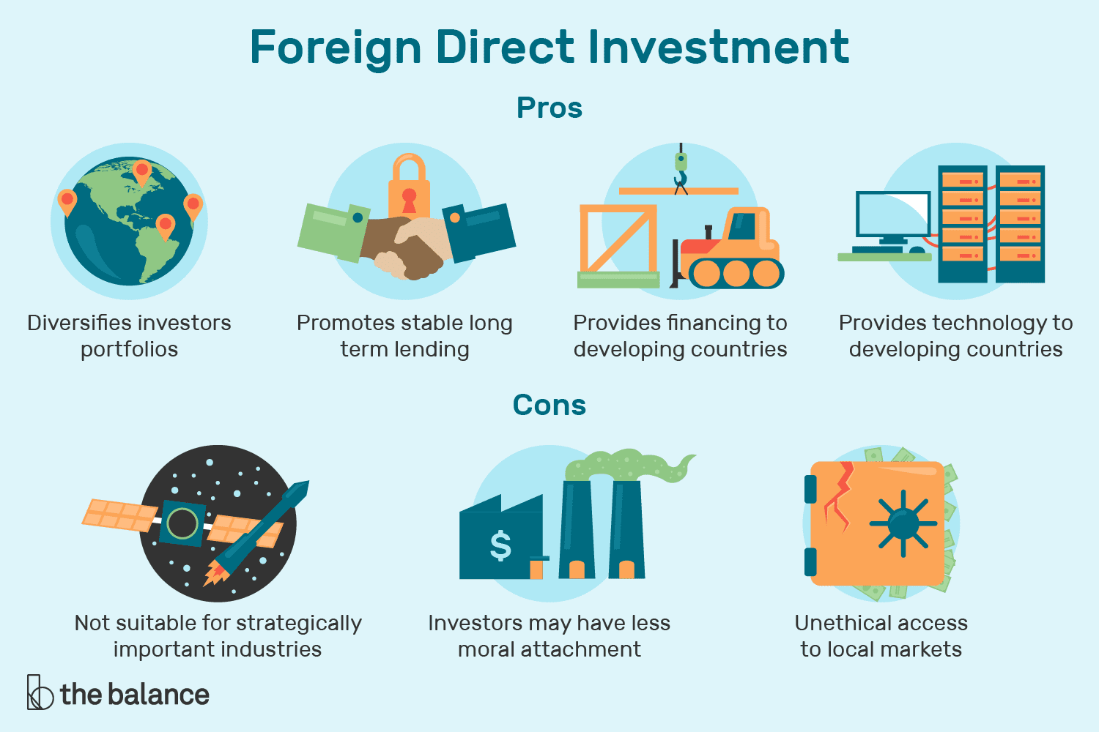
FOREIGN DIRECT INVESTMENT

Slide 9
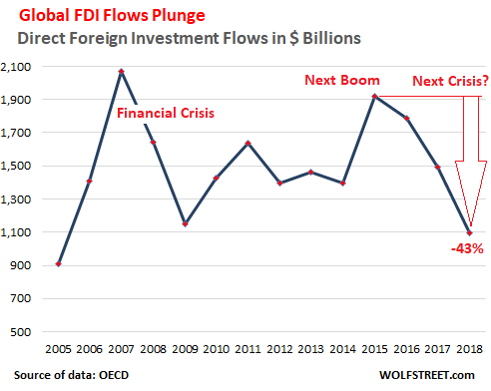
FOREIGN DIRECT INVESTMENT

Slide 10
FOREIGN DIRECT INVESTMENT
Opening markets to foreign direct investment
Higher rates of private investment
  Economic growth and job creation
Generates spillovers
  Improved management and better technology
Higher average labor productivity
Higher wages
Stimulates exports of machinery and other capital goods

Slide 11
FOREIGN DIRECT INVESTMENT
Foreign direct investment
Conducted in anticipation of future profits
Investment flows from regions of low anticipated profit to those of high anticipated profit
Other factors
  Market-demand conditions, trade restrictions,
  Investment regulations,
  Labor costs, and transportation costs

Slide 12
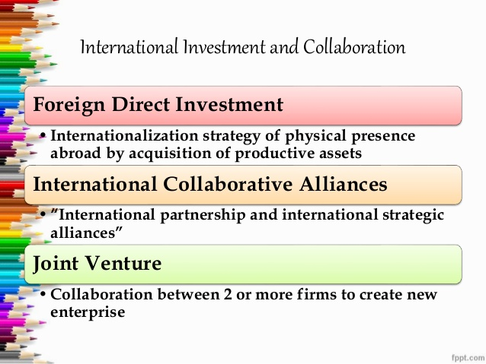
FOREIGN DIRECT INVESTMENT
Motives for Foreign direct investment
Demand factors
  New markets and sources of demand
  Tap foreign markets that cannot be maintained adequately by export products
  Parent company - productive capacity already sufficient to meet domestic demands
  Market competition
Cost factors
  Reductions in production costs
  Essential raw materials
  Labor costs
  Transportation costs
  Government policies

Slide 13
FOREIGN DIRECT INVESTMENT
Country Risk Analysis
Political risk analysis
To assess the political stability of a country
  Government stability, corruption, domestic conflict, religious tensions, and ethnic tensions
Financial risk analysis
Investigates a country’s ability to finance its debt obligations
  Foreign debt as a percentage of GDP, loan default, and exchange rate stability
Economic risk analysis
Determines a country’s current economic strengths and weaknesses
  Rate of growth in GDP, per capita GDP, inflation rate
Composite country risk rating
Overall assessment of the risk of doing business in some country

Slide 14
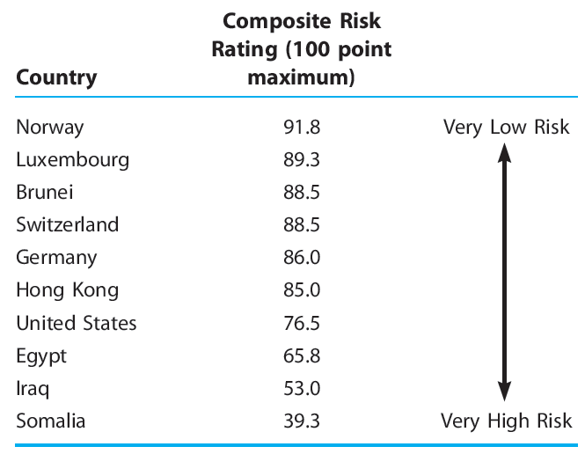
FOREIGN DIRECT INVESTMENT
International Country Risk Guide
Political risk factors - weighting of 50%
Financial and economic risk factors – 25% each
Low risk, 80–100 points
Moderate risk, 50–79 points
High risk, 0–49 points

Slide 15
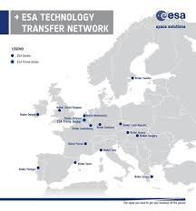
TECHNOLOGY TRANSFER
Technology transfer
Demonstration effect
Competition effect
Increase the productivity and competitiveness of recipient nations
Donor nations may react against it because it is detrimental their economic base
General Electric: trade-off for entry into the Chinese market
  Short-term sales for long-term competition

Slide 16
TECHNOLOGY TRANSFER
Technology transfer
First, there is foreign direct investment (FDI), which makes it possible to reach new technologies and use the existing models of their implementation or application
Second, through international cooperation, companies increase their R&D expenditure, thus boosting the technological intensity and technical advancement of their production
Third, international links allow enterprises to broaden the scope of application of new technologies onto a higher number of branches or sectors. In the long term, accumulation of resources and possibilities in less technologically developed branches prompts companies to search for new, more innovative forms or scopes of activities from processing to R&D

Slide 17
TECHNOLOGY TRANSFER
Technology transfer
This type of processes must go closely together with the development of human resources (knowledge, experience, skills, cooperation), because of their inevitable complementarity and the tendency towards greater share of R&D in entrepreneurial activity
Further steps towards higher levels of technological development require better efficiency at adopting new solutions.
In the long term, technology transfer is the main component of technical progress as it leads to increased productivity and helps to narrow the gap between less and more developed countries.

Slide 18
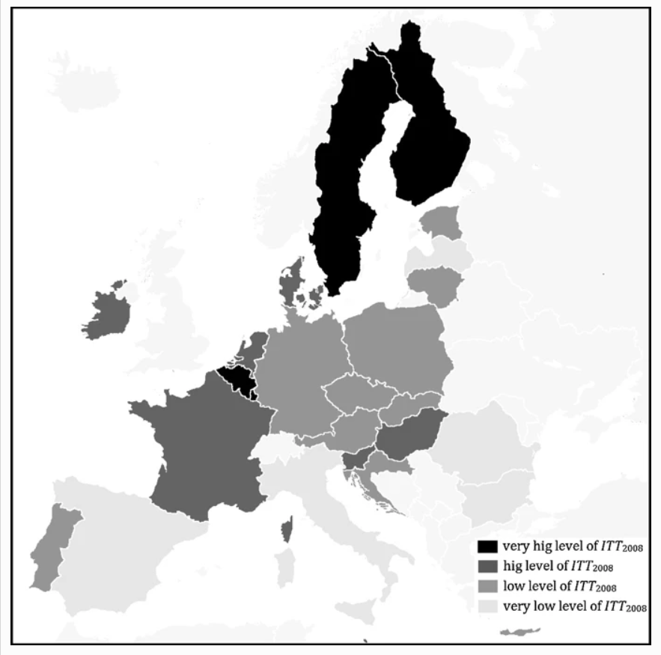
LABOUR MOBILITY
Division of EU countries into typological groups according to international technology transfer in 2008

Slide 19
LABOUR MOBILITY
International labour movements
Enhance the world economy’s efficiency
Restricted by government controls
Immigration Act of 1924
Restricting the overall flow of immigrants
Quota - limited the number of immigrants from each foreign country
Migrants - motivated by
Better economic opportunities
Noneconomic factors: politics, war, and religion

Slide 20
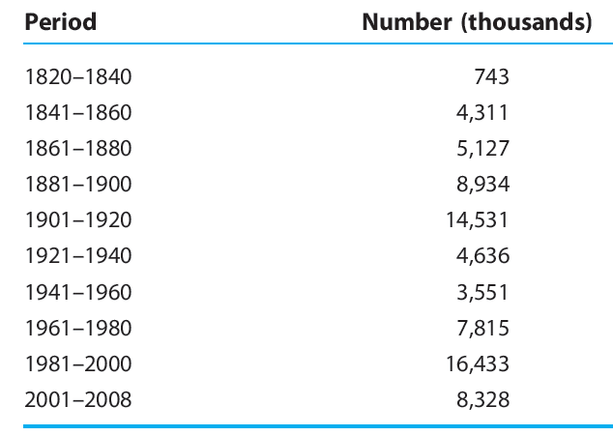
LABOUR MOBILITY
US Immigration between 1820 and 2008

Slide 21
LABOUR MOBILITY
Mexican workers immigrate to the U.S.
Workers migrate from uses of lower productivity to higher productivity
  World output expands
Mexican labor supply decreases
  Wages increase
U.S. labor supply increases - Wages decrease
Hurts native U.S. workers x helps Mexican workers
Helps U.S. owners of capital x hurts Mexican owners of capital
Increase overall world income
Redistribute income from labor to capital in the United States and redistribute income from capital to labor in Mexico

Slide 22
LABOUR MOBILITY
Immigration as an issue
Domestic labor groups prefer restrictions on immigration
Domestic manufacturers favor unrestricted immigration as a source of cheap labor
Drain on government resources
  Long-term calculations: immigrants make a net positive contribution to public coffers
Developing nations fear the brain drain
  Emigration of highly educated and skilled people from developing nations to industrial nations
  Limiting the growth potential of the developing nations
Guest workers
  Temporary migration
Illegal migration

Slide 23

LABOUR MOBILITY
Immigration as an issue
Immigrants
Diversify an economy
Contribute to economic growth
Lower prices for consumers
Domestically produce a wider variety of goods
Increase the supply of labor in the economy
  Similar skills – lower wage
  Complementing skills – higher wage
Human capital formation costs – native country
Contribution to social security

Slide 24
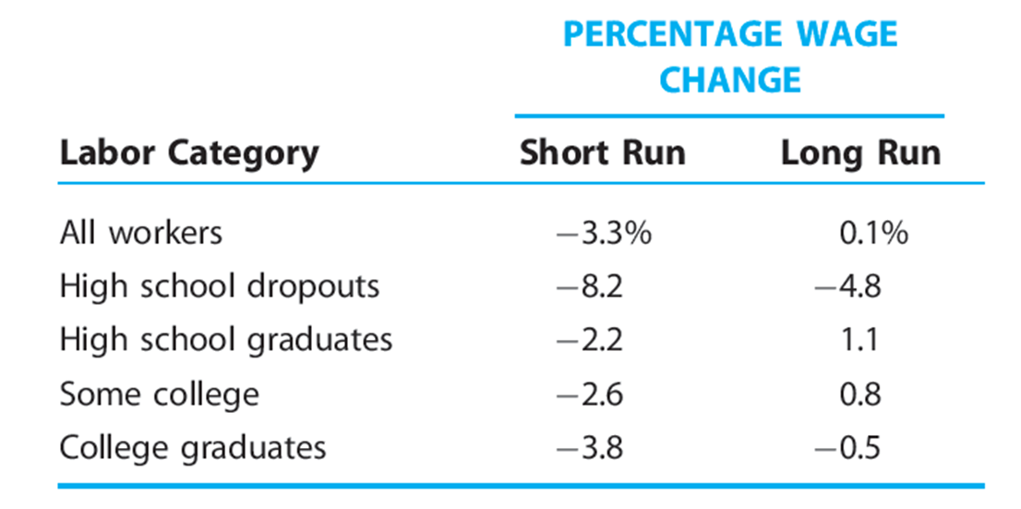
LABOUR MOBILITY
Labour markets change due immimgration in 1980 and 2000 (%)

Slide 25
WORLD ECONOMY
Thank you for your Attention!

