Slide 1

DEVELOPING COUNTRIES AND TRADE
Ingrid Majerova
World Economy
EVS/XXX
LESSON X

Slide 2

Outline of the lecture
Characteristic of Developing Countries
Trade Characteristics of Developing Countries
Trade problems of Developing Countries
Aiding the Developing Countries

Slide 3
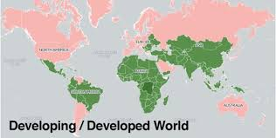
CHARACTERISTIC OF DEVELOPING COUNTRIES
Advanced nations
  North America, Western Europe, Australia, New Zealand, and Japan
  High levels of gross domestic product per capita
  Longer life expectancies
  Higher levels of adult literacy
Developing nations
  Africa, Asia, Latin America, and the Middle East
  Traditional or industrial sectoral structure of economy

Slide 4
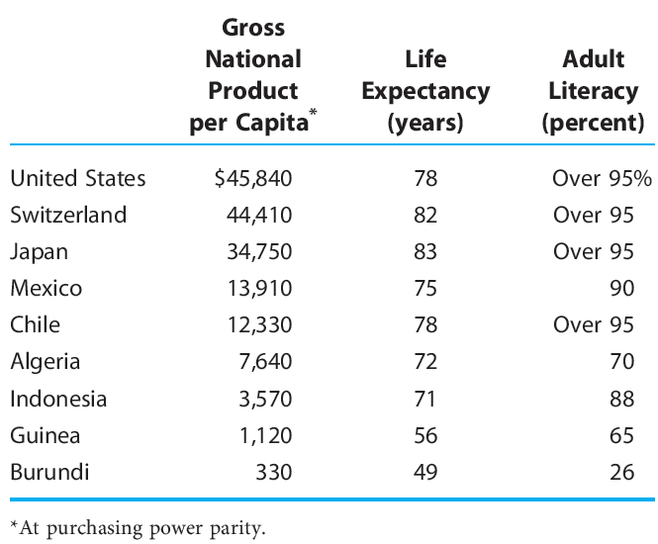
CHARACTERISTIC OF DEVELOPING COUNTRIES

Slide 5
CHARACTERISTIC OF DEVELOPING COUNTRIES
Low per capita real income
  Low per capita real income is one of the most defining characteristics of developing economies. They suffer from low per capita real income level, which results in low savings and low investments.
  It means the average person doesn’t earn enough money to invest or save money. They spend whatever they make. Thus, it creates a cycle of poverty that most of the population struggles to escape.
  The percentage of people in absolute poverty (the minimum income level) is high in developing countries.

Slide 6
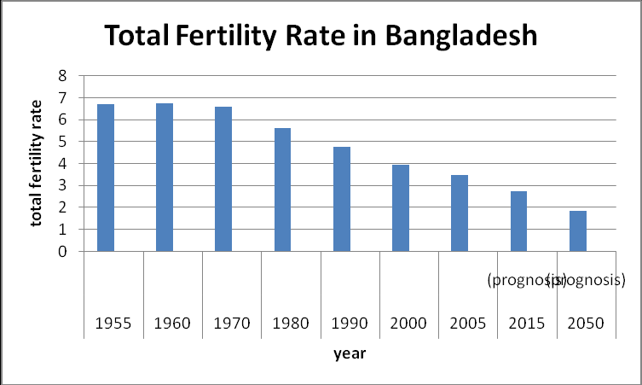
CHARACTERISTIC OF DEVELOPING COUNTRIES
High population growth rate/size
  they either have high population growth rates or large populations.
  Often, this is because of a lack of family planning options, lack of sex education and the belief that more children could result in a higher labor force for the family to earn income.
  This increase in recent decades could be because of higher birth rates and reduced death rates through improved health care.

Slide 7
CHARACTERISTIC OF DEVELOPING COUNTRIES
High rates of unemployment
  In rural areas, unemployment suffers from large seasonal variations. However, unemployment is a more complex problem requiring policies beyond traditional fixes.
Dependence on primary sector
  Almost 75% of the population of low-income countries is rurally based.
  As income levels rise, the structure of demand changes, which leads to a rise in the manufacturing sector and then the services sector.
Dependence on exports of primary commodities
  Since a significant portion of output originates from the primary sector, a large portion of exports is also from the primary sector.

Slide 8
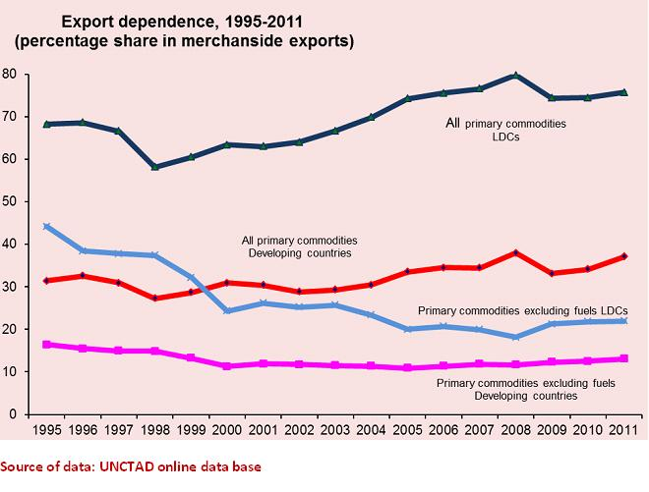
CHARACTERISTIC OF DEVELOPING COUNTRIES

Slide 9
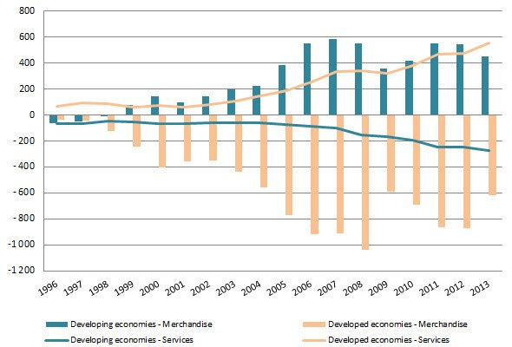
TRADE CHARACTERISTICS OF DEVELOPING COUNTRIES
Characteristics of developing-nation trade
Highly dependent on advanced nations
Exports go to the advanced nations
Imports originate in advanced nations
Trade among developing nations - relatively minor

Slide 10
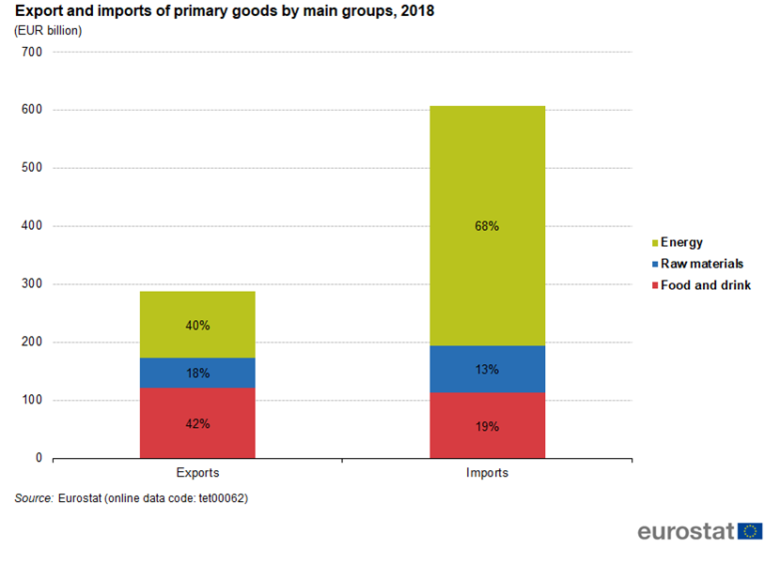
TRADE CHARACTERISTICS OF DEVELOPING COUNTRIES
Composition of developing-nations’ exports
Primary products
  Agricultural goods, raw materials, and fuels
Manufactured goods
  Textiles
  Labor intensive
  Modest amounts of technology in their production

Slide 11
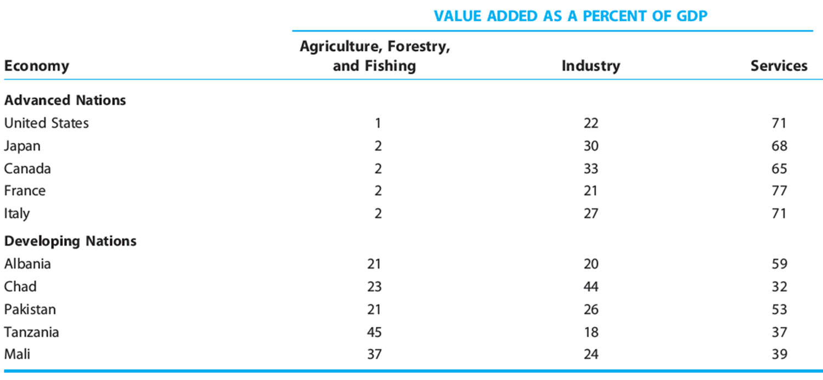
TRADE CHARACTERISTICS OF DEVELOPING COUNTRIES

Slide 12

TRADE CHARACTERISTICS OF DEVELOPING COUNTRIES
Developing countries – moving into exports of manufactured products
Investment in people and factories
  Higher educational levels
  Higher capital stock per worker
Improvements in transport and communications
Reforms
Liberalization of trade barriers

Slide 13
TRADE CHARACTERISTICS OF DEVELOPING COUNTRIES
Poor nation – to develop
Need to take advantage of international trade
Problem: advanced world – increased barriers to imports from these developing nations
Other problems:
  Structural weaknesses
  Nonexistent or inadequate institutions and policies
    Law and order, sustainable macroeconomic management, and public services

Slide 14
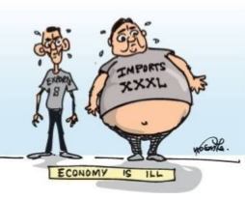
TRADE CHARACTERISTICS OF DEVELOPING COUNTRIES
Trade Problems
Unstable export markets
  Exports - concentrated in only one or a few primary products
  Instability of prices and producer revenues
  Low price elasticity of the demand and supply schedules

Slide 15
TRADE CHARACTERISTICS OF DEVELOPING COUNTRIES
Trade Problems
Worsening terms of trade
Prices of their exports relative to their imports have fallen
Import – manufactured goods
  Monopoly market
  Gains in productivity = higher earnings
Export – primary goods
  Competitive market
  Gains in productivity = lower prices
Prices they pay for imports
    Rise faster than the prices commanded by their exports
  As income rises
    People tend to spend more on manufactured goods than primary goods

Slide 16
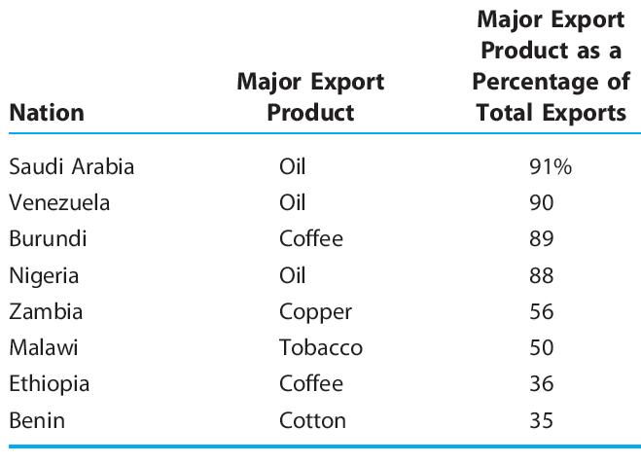
TRADE CHARACTERISTICS OF DEVELOPING COUNTRIES

Slide 17
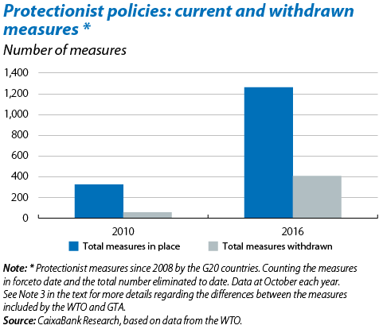
TRADE CHARACTERISTICS OF DEVELOPING COUNTRIES
Trade Problems
Limited market access
Global protectionism
  Agriculture
  Labor-intensive manufactured products
Higher tariffs
  Major trading blocks: EU, NAFTA
Tariff escalation
  By developed and developing nations
Quotas on imports

Slide 18
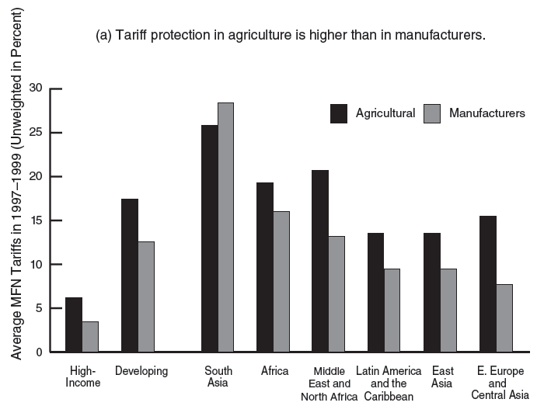
TRADE CHARACTERISTICS OF DEVELOPING COUNTRIES

Slide 19
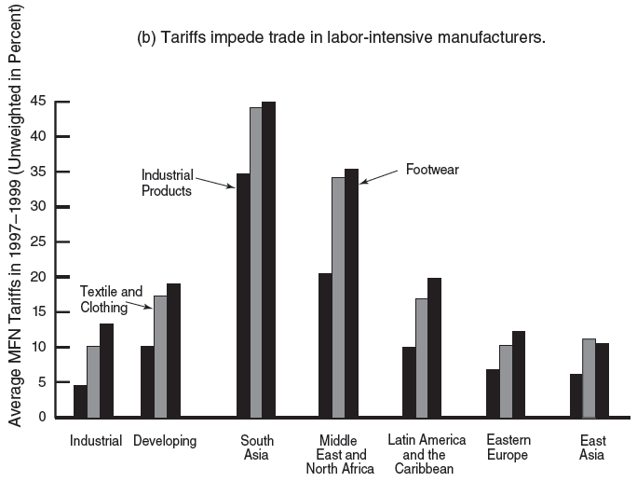
TRADE CHARACTERISTICS OF DEVELOPING COUNTRIES

Slide 20
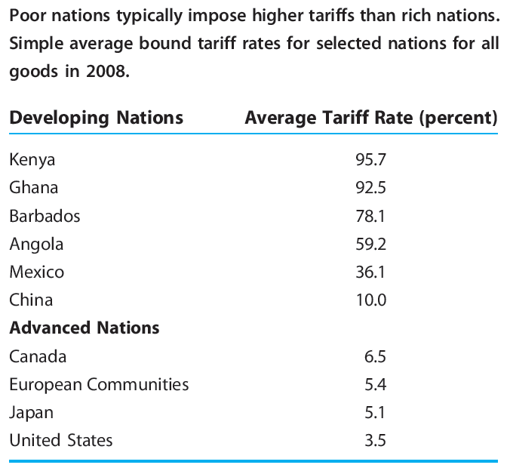
TRADE CHARACTERISTICS OF DEVELOPING COUNTRIES

Slide 21
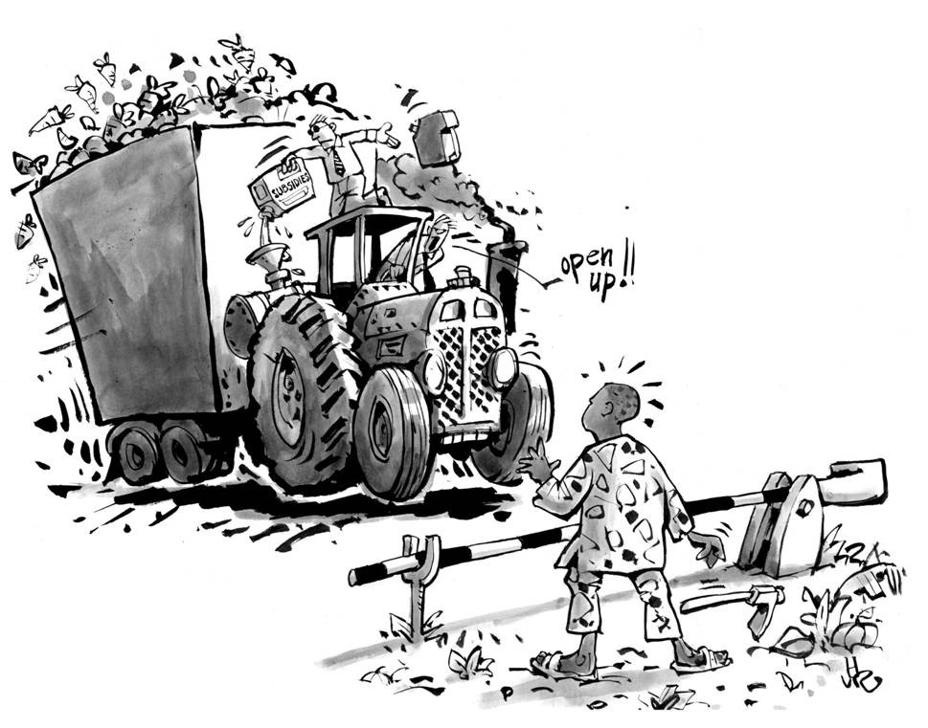
TRADE CHARACTERISTICS OF DEVELOPING COUNTRIES
Trade Problems
Agricultural export subsidies of advanced nations
Discourage agricultural imports
Displace developing-nation shipments to advanced-nation markets
Result in unwanted surpluses
  Often dumped onto world markets
  Decreasing prices for many agricultural commodities
  Reduces the revenues of developing nations

Slide 22
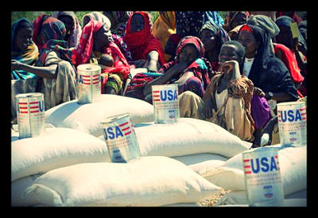
TRADE CHARACTERISTICS OF DEVELOPING COUNTRIES
Trade Problems
American food-aid policies
U.S. food donated to the developing world
  Saved millions of lives
Purchases surplus grain from American farmers (by law)
  Instead of purchasing what foreigners grow
  Supports American farmers, processors, and shippers, and the world’s hungry

Slide 23
TRADE CHARACTERISTICS OF DEVELOPING COUNTRIES
Stabilizing Primary-Product Prices
International commodity agreements (ICAs)
Among developing nations
Attempt to stabilize export prices and revenues of primary products
Agreements between leading producing and consuming nations of commodities
  Stabilizing prices
  Assuring adequate supplies to consumers
  Promoting economic development of producers
Promote stability in commodity markets
  Production and export controls
  Buffer stocks
  Multilateral contracts

Slide 24
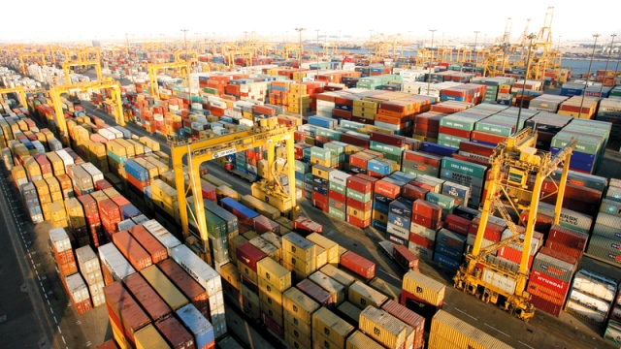
TRADE CHARACTERISTICS OF DEVELOPING COUNTRIES
Stabilizing Primary-Product Prices
Production and export controls
Affect the price - influence world supply
  Based on a target price
Obstacles:
  Distribution of the limits among producing nations
  Entrance of new producers
  Producers have the incentive to cheat on output restrictions
  Enforcement is difficult

Slide 25
TRADE CHARACTERISTICS OF DEVELOPING COUNTRIES
Stabilizing Primary-Product Prices
Buffer stock
A producers’ association (international agency)
  Prepared to buy and sell a commodity in large amounts
Supplies of a commodity
  Financed and held by the producers’ association
Buffer stock manager
  Buys from the market when prices are falling and sells from the buffer stock when prices are high
Buffer stock advantages (can promote economic efficiency and moderate the price inflation of the industrialized nations)
Buffer stock problems (agreeing on a target price, high costs of holding the stocks and poor decisions)

Slide 26
TRADE CHARACTERISTICS OF DEVELOPING COUNTRIES
Stabilizing Primary-Product Prices
Multilateral contracts
To hold the price within a target range
  Minimum price at which importers will purchase guaranteed quantities
  Maximum price at which producing nations will sell guaranteed amounts to the importers
Advantage
  Less distortion of the market mechanism and the allocation of resources
Tend to furnish only limited market stability

Slide 27
TRADE CHARACTERISTICS OF DEVELOPING COUNTRIES
Stabilizing Primary-Product Prices
Fair-trade coffee movement
Objective: to increase the income of poor farmers in developing nations
  Farmers can sell their beans directly to roasters and retailers ($1.26 per pound)
  Bypassing the traditional practice of selling to middlemen in their own nations ($0.40 per pound)
Farmers organize in cooperatives
  As many as 2,500 members
  Set prices
  Arrange for export directly to brokerage firms and other distributors
500,000 of the developing world’s 4 million coffee farmers

Slide 28

TRADE CHARACTERISTICS OF DEVELOPING COUNTRIES
Stabilizing Primary-Product Prices
Fair-trade coffee movement
Biggest winners
Not the farmers
Retailers
  Charge huge markups on fair-traded coffee
  Promote themselves as corporate citizens
  Can get away with it - consumers generally are given little or no information about how much of a product’s price goes to farmers

Slide 29
AIDING DEVELOPING COUNTRIES
Institutions and policies created to support developing nations
World Bank
International Monetary Fund
Generalized system of preferences (GSP)
  Nonreciprocal tariff preferences to exports of developing nations
  Attempts to promote economic development in developing nations through increased trade
  Factors that erode GSP effectiveness
    Preferences
      Apply to products that already face relatively low tariffs
    Tariff preferences
      Eroded by nontariff measures
    Products and nations
      Removed from GSP eligibility because of lobbying by domestic interest groups in importing nations

Slide 30

AIDING DEVELOPING COUNTRIES
Critics of aid programs
Aid:
  Fostered government bureaucracies
  Prolonged bad governments
  Favored the wealthy in poor nations
  Been squandered
40 years of aid – still widespread poverty
Aid programs
  Substantially altered, drastically cut, or eliminated altogether

Slide 31
AIDING DEVELOPING COUNTRIES
Proponents of aid programs
Aid:
  Enhanced poverty reduction
  Enhanced growth in some nations
  Prevented worse performance in other nations
Shortcomings of aid
  Have more to do with donors than beneficiaries
Aid for the development of infrastructure
  Transportation systems, communications, energy generation, and banking services
  Relatively strong effects on economic growth
  Growth-oriented aid
Aid for disaster and humanitarian relief
  Food supply, water sanitation
  Less immediate effects on economic growth

Slide 32
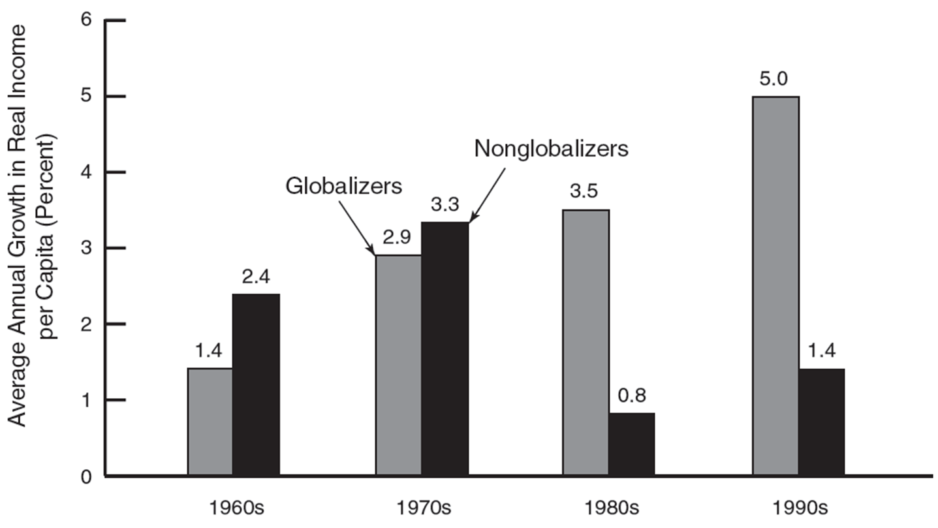
AIDING DEVELOPING COUNTRIES
Proponents of aid programs

Slide 33
WORLD ECONOMY
Thank you for your Attention!

