Slide 1
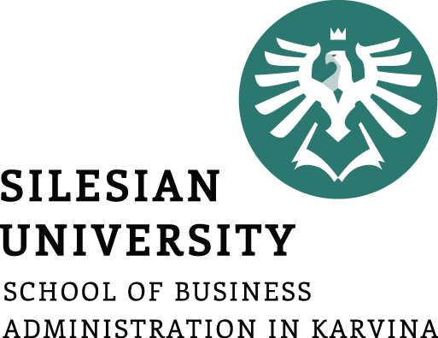
CENTRALLY PLANNED ECONOMIES
Ingrid Majerova
World Economy
EVS/XXX
LESSON XI

Slide 2

Outline of the lecture
Principle of CPE
History of CPE
German CPE
CPE Nowadays
CPE and Market Economy

Slide 3
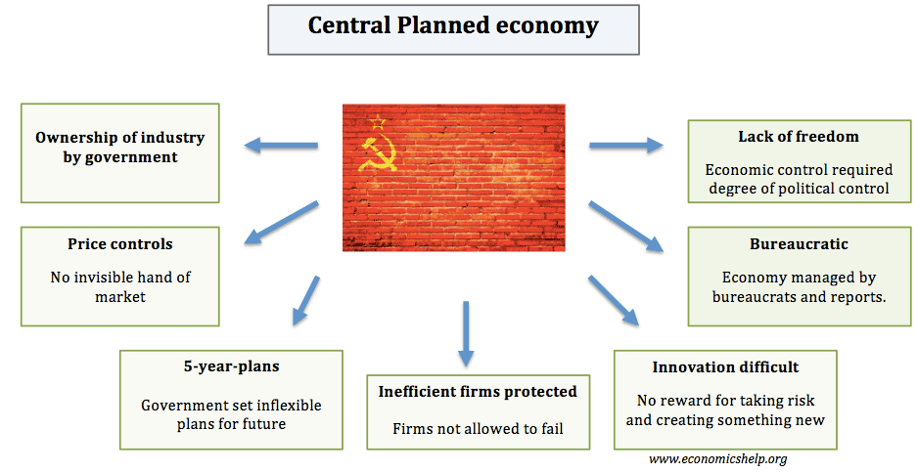
PRINCIPLE OF CPE

Slide 4
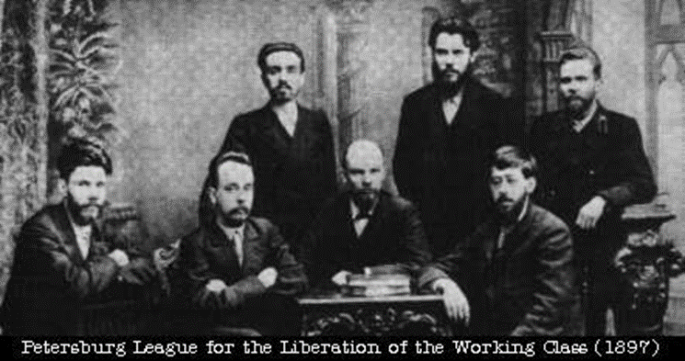
PRINCIPLE OF CPE
Centrally Planned Economy
The government, rather than the individual producers and consumers, answers the key economic questions.
A central bureaucracy makes all the decisions as to what to produce, how it shall be produced, and who gets to consume the products.
It is up to the bureaucracy to see that the production goals of the system are met.

Slide 5
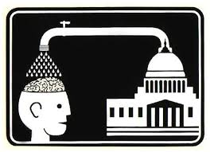
PRINCIPLE OF CPE
Government Control
The government owns both land and capital, and in some sense it owns the labor as well.
  It controls where individuals work and what wages they are paid.
The lack of a consumer voice in production and distribution indicates a lack of consumer sovereignty.

Slide 6
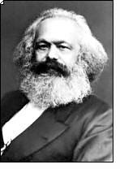
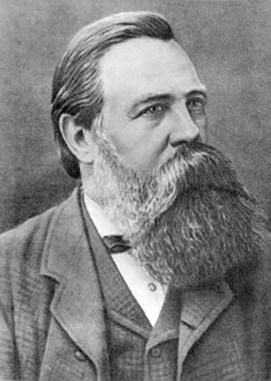
PRINCIPLE OF CPE
Communism
Karl Marx and Friedrich Engels
A centrally planned economy with all economic and political power resting in the hands of the central government.
Strictly authoritarian in nature, dominated by a single party or dictator.
Examples include the former U.S.S.R., China, North Korea, Vietnam, Laos and Cuba.

Slide 7
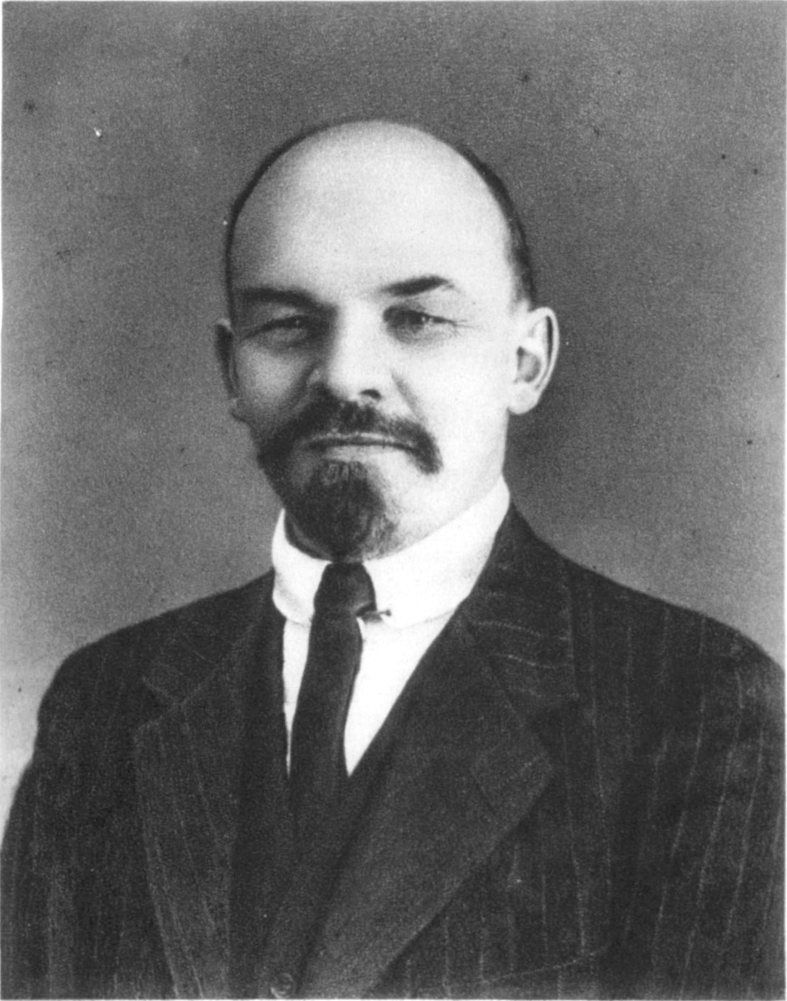
HISTORY OF CPE
November 1917 – Communist Revolution.
  Vladimir Iljic Lenin (Uljanov) and the Bolsheviks
  Central planning through the Communist Party
  A goal based system of power and prestige.
Soviet Agriculture
  State-owned farms and collectives
  peasants were obligated to give any surpluses to the government (this was called prodrazvyerstka) so they could be distributed among the whole population
  5 year plans were established though never
  Foreign trade was the monopoly of the state and private enterprise was banned
  The production was at a low level and many people moved from the cities back to their villages because the alimentation situation was a little bit better there

Slide 8
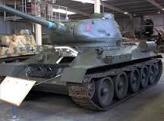
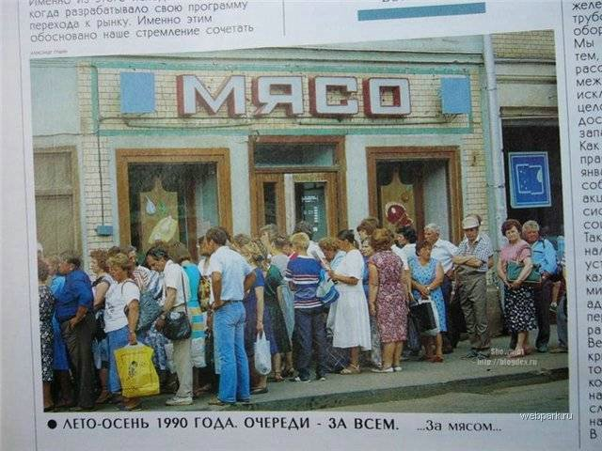
HISTORY OF CPE
Soviet Industry
Soviet factories were state owned
Planners favored the defense industry, space program, and heavy industry.
Production quotas were established.
Workers had little incentive to work harder or suggest innovation.
All of this came with an opportunity cost.
Soviet Consumers
Consumer goods were scarce and usually of poor quality.
Manufacturers focused on quantity, not quality.
Housing shortages and lines to purchase goods and services were commonplace.

Slide 9
HISTORY OF CPE
New Economic Policy (NEP)
  Idea of Lenin in 1921
  The answer to the difficult economic situation in the country.
    Production was at a minimum and dissatisfaction of population rose
    Peasants were opposing against the prodrazvyerstka
  Abolishing the prodrazvyerstka and introducing prodnalog - tax to be paid in raw materials and much lower than the prodrazvyerstka.
  Peasants could produce and sell to their own prices
    The possibility to become wealthy and meant a big increase in production, which outreached pre-war levels
  Entrepreneurs were allowed to run small businesses, “private property, private enterprise, and private profit largely restored in Lenin’s Russia”
    A new class of wealthy entrepreneurs and traders could emerge, called NEPmen

Slide 10
HISTORY OF CPE
Gosplan (Gosudarstvennyi Planovyi Komitet, State Planning Committee)
  1921
  Its purpose was to implement Goelro, the plan of the electrification of Russia
  Founded as a stopgap for one plan, it stayed and began to develop bigger plans, trying to estimate the development of the whole economy, but still its plans were rather estimations than mandatory plans that were to fulfil
The NEP was a step away from total state control over the economy, but it reached its goals in the terms of increasing agricultural production, increasing the well-being of the population and due to that strengthening the position of power of the party.

Slide 11
HISTORY OF CPE
Stalin Era
  When Stalin became the single leader of the communist party in 1928 the economic policy changed dramatically
  The NEP was abolished and in 1929 the first 5-year plan became reality
  The plan had the objective to raise the living standard and to establish a heavy industry that was supposed to protect the Soviet Union in case of war.
  The plan determined almost every economic activity in the country and therefore the communist party controlled a big part of the life, not to talk about the big importance of the intelligence service during Stalin’s times.
  Under Stalin’s reign the agriculture was collectivized with force and subordinated to state control

Slide 12
HISTORY OF CPE
Stalin Era
  The industrialization under Stalin played a big role in the Second World War as well as in the raise of the Soviet Union as a superpower after the Second World War
  The strong military position after the war gave it the opportunity to expand the borders and to establish a system of satellite states called the Warsaw Pact (Bulgaria, Czechoslovakia, Democratic Republic of Germany, Hungary, Poland, Romania + Albania and Yugoslavia).
    These satellite states stood under a heavy influence of the Soviet Union and had to adopt the Soviet central planning system to their own economies

Slide 13

HISTORY OF CPE
  In 1949 the Council of Mutual Economic Assistance was founded. It comprised the socialist countries in Europe and some more like Cuba, Mongolia and Vietnam. It became the main source of trade for the member countries.
  The Soviet Union had communist allies with centrally planned economies in China, Vietnam, Laos, North Korea and in several states in South America.
  During the cold war this communist bloc of countries was very strong politically, militarily and economically.

Slide 14
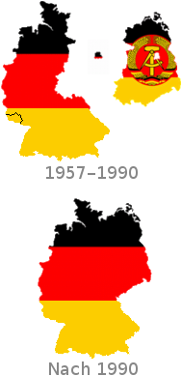
HISTORY OF CPE
For some time the socialist bloc could compete with the capitalist west, but due to many reasons, in 1989 the Berlin wall fell and the end of the socialist regimes (in Europe) became inevitable.
The fall didn’t happen suddenly, it was foregone by many political, social and economic processes in all socialist countries in Europe.
And the fall of the wall combined with the end of the political regimes meant the end of the centrally planned socialist economy systems.
  Reunification of Germany in 1990
  Collapse of the Soviet Union in 1991
All of them took the path of transformation into market economies.

Slide 15
HISTORY OF CPE
The failure of socialist economies has been blamed on the neglect of technological progress and inefficient investment.
These factors were complemented by the high and growing material intensity of production.
State enterprises operating with soft budget constraints maximized their investment allocations and intermediate inputs regardless of the expected returns.
  This evolved into a shortage economy, in which profit maximization was replaced by resource hunger that undermined productivity and innovation.
  Shortages emerging from poor allocation are believed to have become more disruptive as planned economies modernized.
Grey markets emerged to satisfy increasingly complex consumer demands and to reallocate intermediate inputs between firms.
Input–output data indicate that, on average, the material intensity of production was higher in socialist countries than in western market economies and that this gap widened after the mid‐1970s.

Slide 16
GERMANY´S CPE
The Nöspl (Neues ökonomisches System der Planung und Leitung)
Launched 1963
Reaction of the leaders of the German Democratic Republic and primarily Walter Ulbricht to the economic and political situation in the country
  The GDR was suffering from a low productivity and shortages that was becoming more and more visible by looking to the west of Germany.
  By making the economy work better he wanted to raise the living standard of the people and so his political position.
The changes were very radical
  The main point was that the factories now were allowed and supposed to generate profit and could, even though not entirely, command it instead of returning everything into the state budget.
  With this profit they could pay bonuses to the employees and create funds to refinance the factory itself instead of taking loans from the state bank.
  This profit orientation should make the work of the factories more efficient.

Slide 17
GERMANY´S CPE
The Nöspl (Neues ökonomisches System der Planung und Leitung)
To reach this goal the managers now could, within certain limits, decide what they produced, how much and for what price.
They still had to produce according to a plan for the structure-determining things, but not only.
Prices were not completely fixed anymore but were supposed to become more market-based. By setting their own prices the factories could equilibrate their expenses.
Workers were allowed to participate in the management, bonuses for the profit were paid and in general the economy should be led more by expertize than by ideology.
Some of changes were leading into the right direction and in 1963 the GDR could increase its productivity by 7 percent, but some problems remained unsolved.
  On one hand it proponed more economic freedom and less planning, but on the other hand needed to provide a structure policy.

Slide 18
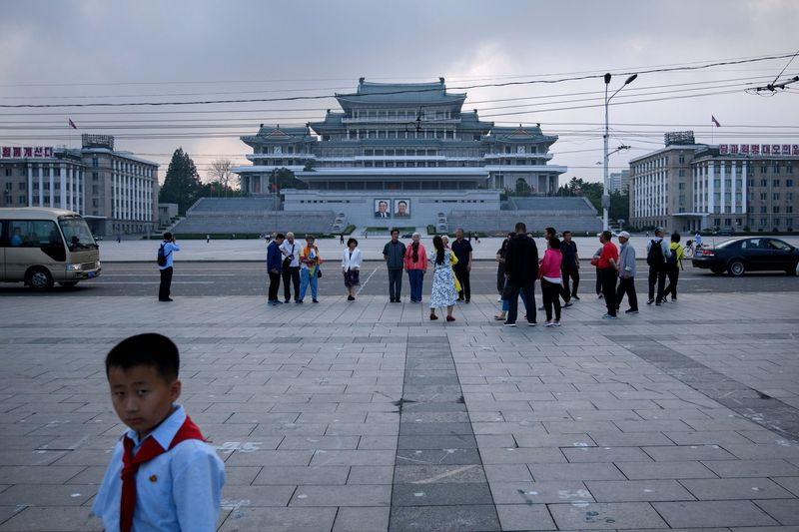
CPE NOWADAYS
Today there are only a few countries that develop their economies according to plans. These are China, Vietnam, Laos and North Korea.
North Korea
The country that has the most similar economy to the centrally planned one of the Soviet Union.
There is still a planning committee in charge of the economy combined with total power of the governing party.
North Korea is one of the poorest countries in the world and one with the least freedom.

Slide 19
CPE NOWADAYS
North Korea
North Korea’s economy hasn’t been in such bad shape since his father was battling floods, droughts and a famine that some estimates say killed as much as 10% of the population.
While North Korea’s isolation, secrecy and dearth of official statistics make estimates difficult, the economy probably contracted more than 5% last year.
North Korea is heavily reliant on China, which accounts for about 90% of the country’s trade. And Beijing’s decision to support tougher international sanctions against North Korea following its sixth nuclear test in September 2017 has put severe pressure on the economy.
North Korea’s oil consumption has fallen by about 80% from 1991 to 2017.
Less fuel has meant less diesel to run farm tractors and irrigation pumps, hitting farms already affected by droughts last summer. Last year, farmers had a little less than 90 milliliters (3 fluid ounces) of fuel a day to farm an area about the size of two soccer fields.

Slide 20
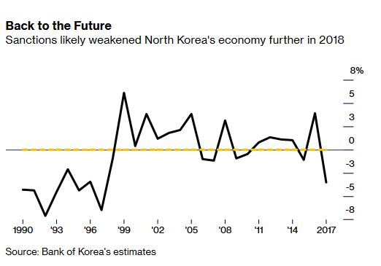
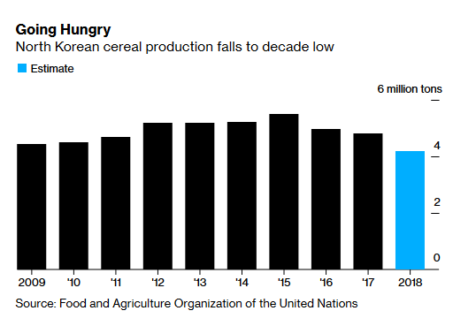
CPE NOWADAYS
North Korea

Slide 21
CPE NOWADAYS
China, Cuba, Vietnam or Laos are far more liberalized in an economical way and don’t try to oppose to capitalism like the Soviet Union did…
Cuba
Since the 1959 revolution, led by Fidel Castro and Che Guevara, Cuba has been a socialist republic.
The island of less than 12 million people is one of the last remaining socialist countries in the world. The Communist Party of Cuba is the only one allowed to rule.
The government in Cuba controls more than 90 percent of the country’s economy, rationing worker’s salaries in exchange for the free healthcare, education, and low cost transportation and housing.
The housing available to most Cubans, however, is not in good condition.
  In the capital city of Havana, over 1 million housing units are considered substandard. By the Cuban government’s own estimation they have around 6,000 houses too few. Many Cubans are currently living in shelters.

Slide 22
CPE NOWADAYS
Cuba
The government has not been efficient enough in some areas, which has led many Cubans take matters into their own hands.
  Cubans who own informal businesses — such as a handyman service – can capitalize on the government’s shortcomings.
  Some choose to run their small businesses without the complicated government license and heavy tax, and thus risk being shut down if caught.
  The Cuban government has begun encouraging privately owned businesses, but it’s unclear how much this will change the Cuban economy, or how long this change in policy will last.
Big poverty - except for some select government employees and private entrepreneurs, Cubans live off the state wage of 17 USD.
The Soviet Union collapsed in the 1990s and led to an economic depression known as the Special Period.
The unemployment rate is probably not accurately reported by the Cuban government. Experts estimate it is somewhere between 5 and 8 percent.

Slide 23
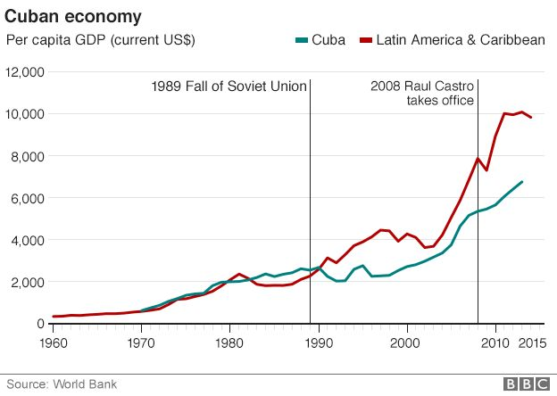
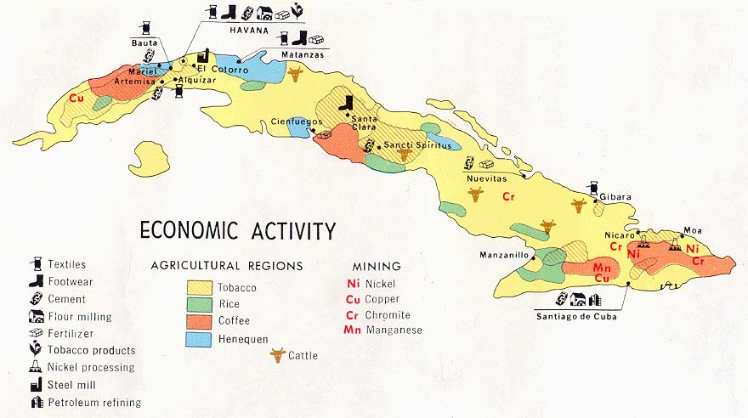
CPE NOWADAYS

Slide 24
CPE NOWADAYS
Vietnam
is a socialist-oriented market economy
Since the mid-1980s, through the Doi Moi (renovation) reform period Vietnam has made a shift from a highly centralized command economy to a mixed economy that uses both directive and indicative planning through five-year plans. Over that period, the economy has experienced rapid growth.
    These reforms introduced a greater role for market forces for the coordination of economic activity between enterprises and government agencies, and allowed for private ownership of small enterprises and the creation of a stock exchange for both state and non-state enterprises.
  From the late 1970s until the early 1990s, Vietnam was a member of the Comecon, and therefore was heavily dependent on trade with the Soviet Union and its allies.
  Following the dissolution of the Comecon and the loss of its traditional trading partners, Vietnam was forced to liberalize trade, devalue its exchange rate to increase exports, and embark on a policy of economic development.

Slide 25
CPE NOWADAYS
Vietnam
In the early 1990s, Vietnam accepted some World Bank reform advice for market liberalization, but rejected structural adjustment programs and conditional aid funding requiring privatization of state-owned enterprises.
  With the reforms, the number of private enterprises increased; and by 1996, there were 190 joint stock companies and 8,900 limited liability companies registered.
  The private sectors played an important role in the service industry, as the share in the retail trade activity increased from 41% to 76% in 1996.
Vietnam's membership in the ASEAN Free Trade Area (AFTA) and entry into force of the US-Vietnam Bilateral Trade Agreement in December 2001 have led to even more rapid changes in Vietnam's trade and economic regime. Vietnam's exports to the US increased 900% from 2001 to 2007.
Deep poverty (under $1 per day), has declined significantly and is now smaller than that of China, India, and the Philippines.
Vietnam is working to create jobs to meet the challenge of a labor force that is growing by more than one-and-a-half million people every year.

Slide 26
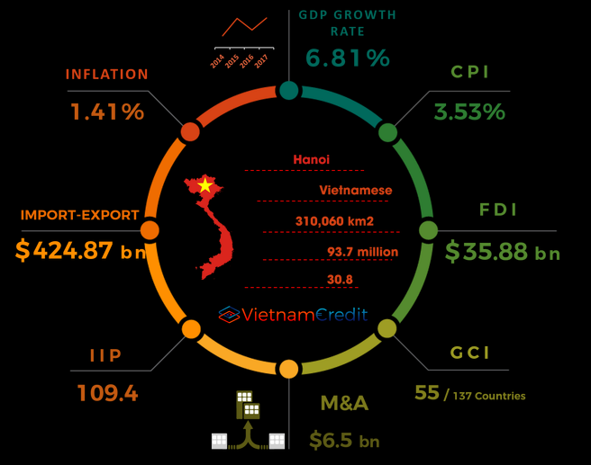
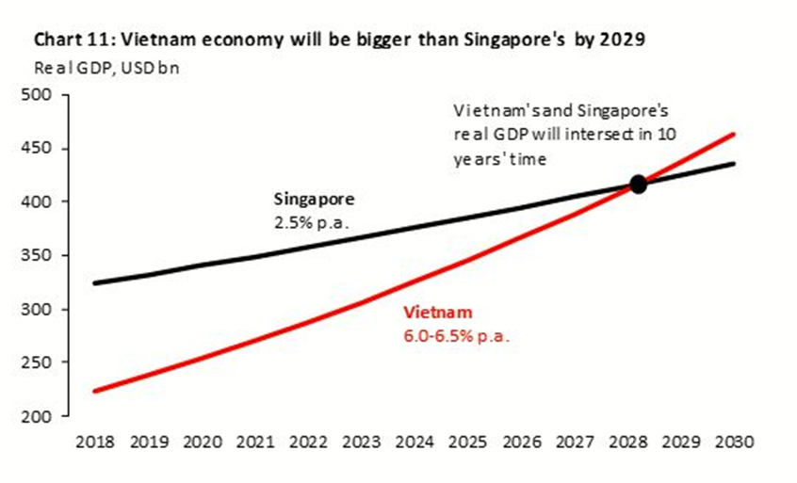
CPE NOWADAYS

Slide 27
CPE NOWADAYS
Laos
is a one-party state
The Communist government took power in 1975 and destroyed the economy in the early years of its rule.
Minimal liberalization (reforms called New Economic Mechanism) to advance its “state-managed, market-orientated economy,” begun in 1986.
Approximately 85 percent of the rural population works in subsistence farming – creating about 50% of GDP.
The economy relies heavily on such capital-intensive natural resource exports as copper, gold, and timber.
It also has benefited from high-profile foreign direct investment in hydropower dams along the environmentally sensitive Mekong River.
Tourism is the fastest growing industry in the economy and plays a vital role in the Lao economy.

Slide 28
CPE NOWADAYS
Laos
The poor regulatory infrastructure continues to impede private-sector development.
The labor market does not promote flexibility or economic diversification and does not provide dynamic employment opportunities for the growing labor supply.
The government influences many prices through subsidies and state-owned enterprises to advance its socialist “state-managed, market-orientated economy,” especially in the hydropower and mining sectors.
State-owned enterprises distort the economy, and foreign investors may not own land. The financial system is hampered by government involvement.
Laos ranks amongst the fastest growing economies in the world, averaging 8% a year in GDP growth.
Despite rapid growth, Laos remains one of the poorest countries in Southeast Asia. A landlocked country, it has inadequate infrastructure and a largely unskilled work force.

Slide 29
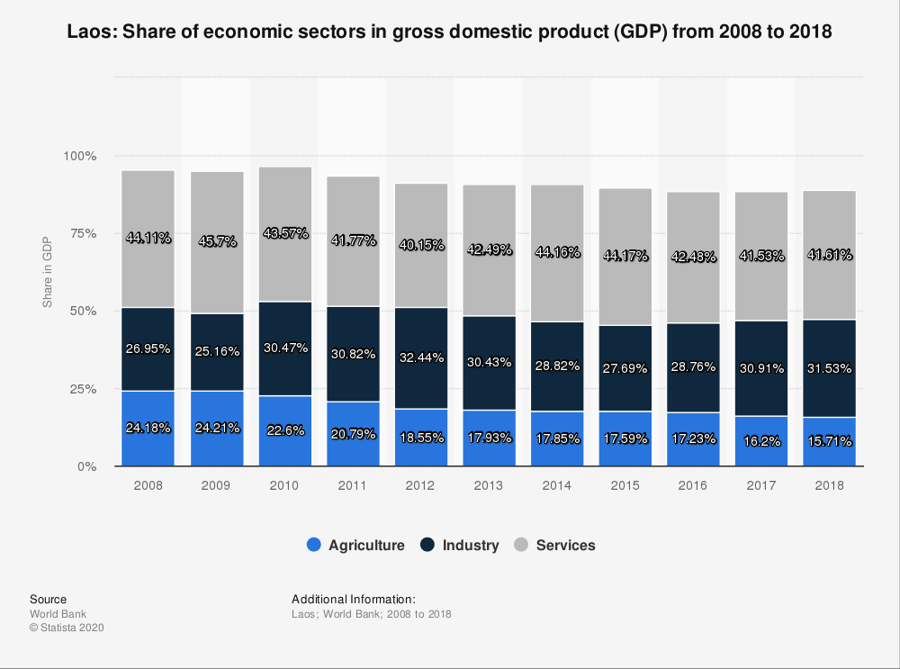
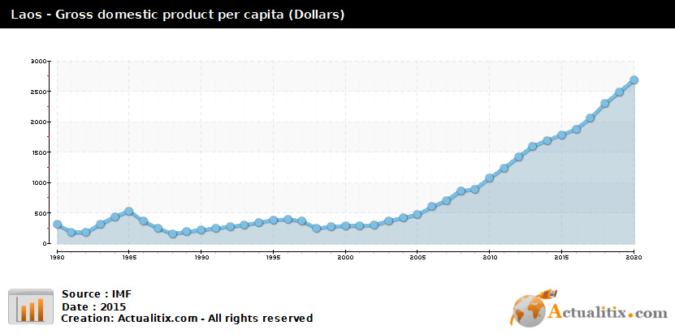
CPE NOWADAYS

Slide 30
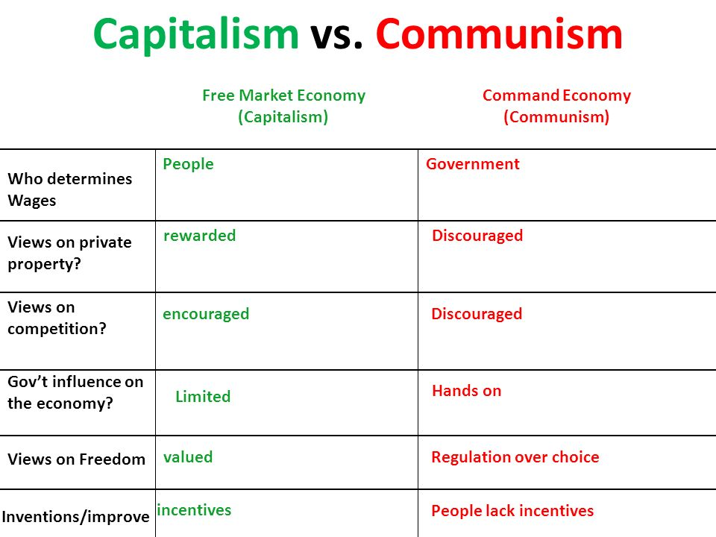
CENTRALLY PLANNED AND MARKET ECONOMY - COMPARISON

Slide 31
CENTRALLY PLANNED AND MARKET ECONOMY - COMPARISON
The biggest difference between the centrally planned economy and the market economy is that in the market economy the price is the all-determining measure unit.
  It signals scarcity by going up or plenty by going down through the interaction of supply and demand. Due to the free formation of prices the market will equilibrate.
  In accordance to the price the producers will allocate their resources and production.
  In contrast to the free economy the companies in the centrally planned economy had no chance to influence the price because it was given.
  Competition, an influence on the price in market-based economies, was not fully developed because often the competition is fought out by prices.
  But as all companies were owned and run by the state competition was not a strong characteristic of the centrally planned economies.

Slide 32
CENTRALLY PLANNED AND MARKET ECONOMY - COMPARISON
In the CPE there was only one bank, called Monobank.
  It had all the functions of the commercial banks as well as the functions of the central banks.
  The bank gave loans to the enterprises, but the latter were not free to take a loan in the bank, it was possible only for purposes documented in the plan.
  The interest rates were close to zero, but any surpluses had to be transferred to the state budget.
  The financial system therefore existed in a very different way. E.g. the enterprises can’t choose the way they want to finance themselves and nor do it themselves via funds or capital markets.
  Private people were not able to take a loan in the bank.
The planned system had some disadvantages on its own, to plan everything centrally is possible only in theory.
  In practice less centralization is better so people with the most knowledge on the topic can take decisions instead of the people further away from the realities in the factories.

Slide 33
WORLD ECONOMY
Thank you for your Attention!

