Slide 1

Financial Statements – Statement of Financial Position (Balance Sheet) and Income Statement
Ing. Markéta Šeligová, Ph.D.
Financial Statements – Statement of Financial Position (Balance Sheet) and Income Statement

Slide 2

Financial Statements
Companies prepare five financial statements from the summarized accounting data:
    An income statement
    A retained earnings statement
    A statement of financial position (balance sheet)
    A statement of cash flows
    A statement of stockholders´ equity

Slide 3
Financial Statements
  An income statement – presents the revenues and expenses and resulting net income or net loss for a specific period of time
  A retained earnings statement – summarizes the changes in retained earnings for a specific period of time
  A statement of financial position – sometimes referred to as a balance sheet; reports the assets, liabilities, and equity of a company at a specific date
  A statement of cash flows – summarizes information about the cash inflows (receipts) and outflows (payments) for a specific period of time

Slide 4
Statement of Financial Position – Balance Sheet
The balance sheet is a financial statement that presents the financial position of the company on a particular date.
The balance sheet reports assets, liabilities, and stockholder´s equity at a point in time, in contrast to the income statement which shows revenue and expense activities over an interval of time.
Balance sheet consists of assets and liabilities and equity.
The financial position of a company is summarized by the accounting equation:
Assets = Liabilities + Equity
Assets = Liabilities + Stockholders´ Equity
Resources = creditor´s claims + owners´s claims

Slide 5
Assets
Assets are the resources of company.
Assets are the resources a business owns.
The business uses its assets in carrying out such activities as production and sales.
The common characteristic possessed by all assets is the capacity to provide future services or benefits.
In a business, that service potential or future economic benefit eventually results in cash inflows (receipts).
For example, consider Taipai Pizza, a local restaurant. It owns a delivery truck that provides economic benefits from delivering pizzas.
Other assets of Taipai Pizza are tables, chairs, cash register, oven, tableware, and of course cash.

Slide 6
Assets
Assets include:
  Cash – is a resource because it can be used to make purchases
  Accounts receivable – is a resource because they represent the right to receive cash from customers that have already been provided products or services
  Supplies – include resources used to run for example the soccer academy, such as paper, cleaning supplies, and soccer balls
  Equipment – is a resource that can be used to provide services to customers

Slide 7
Liabilities
Liabilities are the amounts owed by a company.
Liabilities are claims against assets - that is, existing debts and obligations.
Businesses of all sizes usually borrow money and purchase merchandise on credit.
Liabilities include amounts owed to regular vendors (accounts payable), as well as amounts owed for other items such as employee salaries, utilities, interest, and bank borrowing (notes payable)
Many liabilities are referred to as payable, to signify amounts the company will pay in the future.

Slide 8
Liabilities
These economic activities result in payables of various sorts:
  Taipai Pizza, for instance, purchases cheese, sausage, flour; and beverages on credit from suppliers. These obligations are called accounts payable.
  Taipai Pizza also has a note payable to Fist National Bank for the money borrowed to purchase the delivery truck.
  Taipai Pizza may also have salaries and wages payable to employees and sales and real estate taxes payable to the local government.
  All of these persons or entities to whom Taipai Pizza owes money are its creditors.
  Creditors may legally force the liquidation of a business that does not pay its debts.
  In that case, the law requires that creditor claims be paid before ownership claims.

Slide 9
Equity
The ownership claim on a company´s total assets.
It is equal to total assets minus total liabilities
Why???:
  The assets of a business are claimed by either creditors or shareholders. To find out what belongs to shareholders, we subtract creditors´ claims (the liabilities) from the assets.
The remainder is the shareholders´ claim on the assets - equity.
It is often referred to as residual equity - that is, the equity left over after creditors´ claims are satisfied.

Slide 10
Equity
Equity generally consists of:
    share capital – ordinary
    and retained earnings.

Slide 11
Share Capital - Ordinary
A corporation may obtain funds by selling ordinary shares to investors.
Share capital – ordinary is the term used to describe the amounts paid in by shareholders for the ordinary shares they purchase.

Slide 12
Retained Earnings
Retained earnings is determined by three items:
    revenues - are the gross increases in equity resulting from business activities entered into for the purpose of earning income (that it selling merchandise and so on)
    expenses - are the cost of assets consumed or services used in the process of earning revenue (supplies, electric expense and so on)
    dividends - net income represents an increase in net assets which is then available to distribute to shareholders

Slide 13
Dividends
The distribution of cash or other assets to shareholders is called dividend.
Dividends reduce retained earnings.
However, dividends are not expenses.
A corporation first determines its revenues and expenses and then computes net income or net loss.
If it has net income, and decides it has no better use for that income, a corporation may decide to distribute a dividend to its owners (the shareholders).

Slide 14
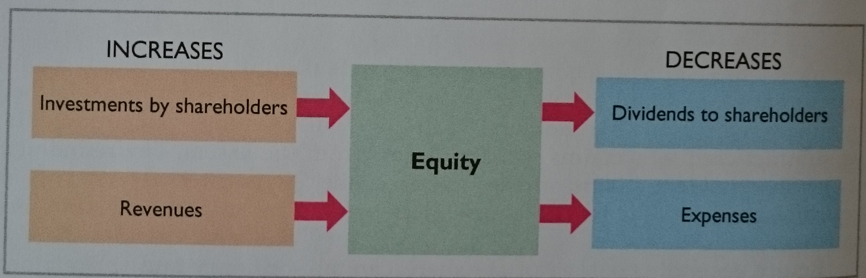
Dividends
In summary, the principal sources (increases) of equity are investments by shareholders and revenues from business operations.
In contrast, reductions (decreases) in equity result from expenses and dividends.

Slide 15
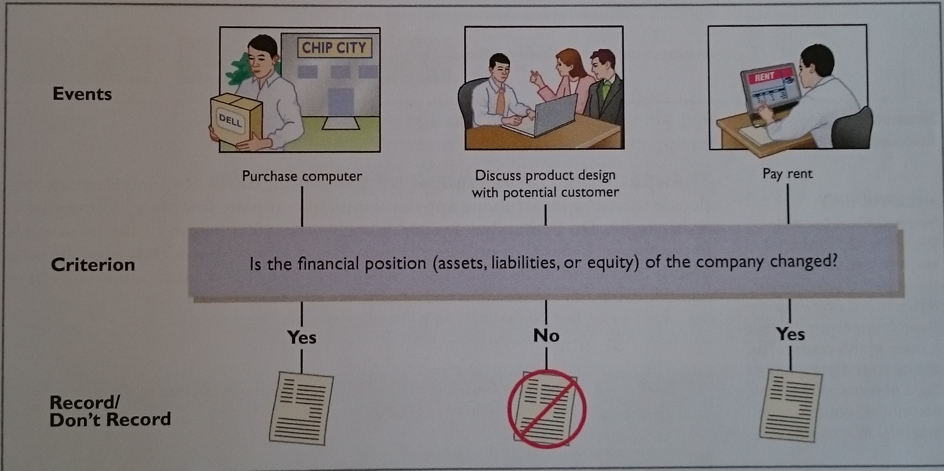
Dividends

Slide 16
Income Statement
The income statement is a financial statement that reports the comapny´s revenues and expenses over an interval of time.
The income statement reports the success or profitability of the company´s operations over a specific period of time.
It shows whether the company was able to generate enough revenue to cover the expenses of running the business.
Income statement consists of revenues and expenses.

Slide 17
Income Statement
Revenues – Expenses = Net income (Net loss)
If revenues exceed expenses, then the company reports net income.
If expenses exceed revenues (revenues do not exceed expenses), then the company reports net loss.

Slide 18
Revenues
Revenues are the amount recognized when the company sells products or provides services to customers.
  For example, when you or one of your employees provides soccer training to a customer, the company recognizes revenue.
However, as you´ve probably heard (It takes money to make money.)
To operate the company you´ll encounter many costs.

Slide 19
Revenues
Revenues are the gross increases in equity resulting from business activities entered into for the purpose of earning income.
Generally, revenues result from selling merchandise, performing services, renting property, and lending money.
Revenues usually result in an increase in an asset.
They may arise from different sources are called various names depending on the nature of the business.
  Taipai Pizza, for instance, has two categories of sales revenues - pizza sales and beverage sales.
Other title for and sources of revenue common to many business are sales, fees, services, commissions, interest, dividends, royalties, and rent.

Slide 20
Expenses
Expenses are the costs of providing products and services and other business activities during the current period.
  For example, to operate the soccer academy, you´ll have costs related to salaries, rent, supplies, and utilities.
These are typical expenses of most companies.

Slide 21
Expenses
Expenses are the cost of assets consumed or services used in the process of earning revenue.
They are decreases in equity that result from operating the business.
Like revenues, expenses take many forms and are called various names depending on the type of asset consumed or service used.

Slide 22
Expenses
For example, Taipai Pizza recognizes the following types of expenses:
  cost of ingredients (flour, cheese, tomato paste, meat, mushrooms, etc.),
  cost of beverages, wages expense,
  utilities expense (electric, gas, and water expense),
  telephone expense,
  delivery expense (gasoline, repairs, licenses, etc.),
  supplies expense (napkins, detergents, aprons, etc.),
  rent expense, interest expense, and property tax expense.

Slide 23
Net Income or Net Loss
Revenues – Expenses = Net income (Net loss)
Net income is difference between revenues and expenses.
All business want revenues to be greater than expenses, producing a positive net income and adding to stockholders´ equity in the business.
However, if expenses exceed revenues, as happens from time to time, the difference between them is a negative amount - a net loss.

Slide 24
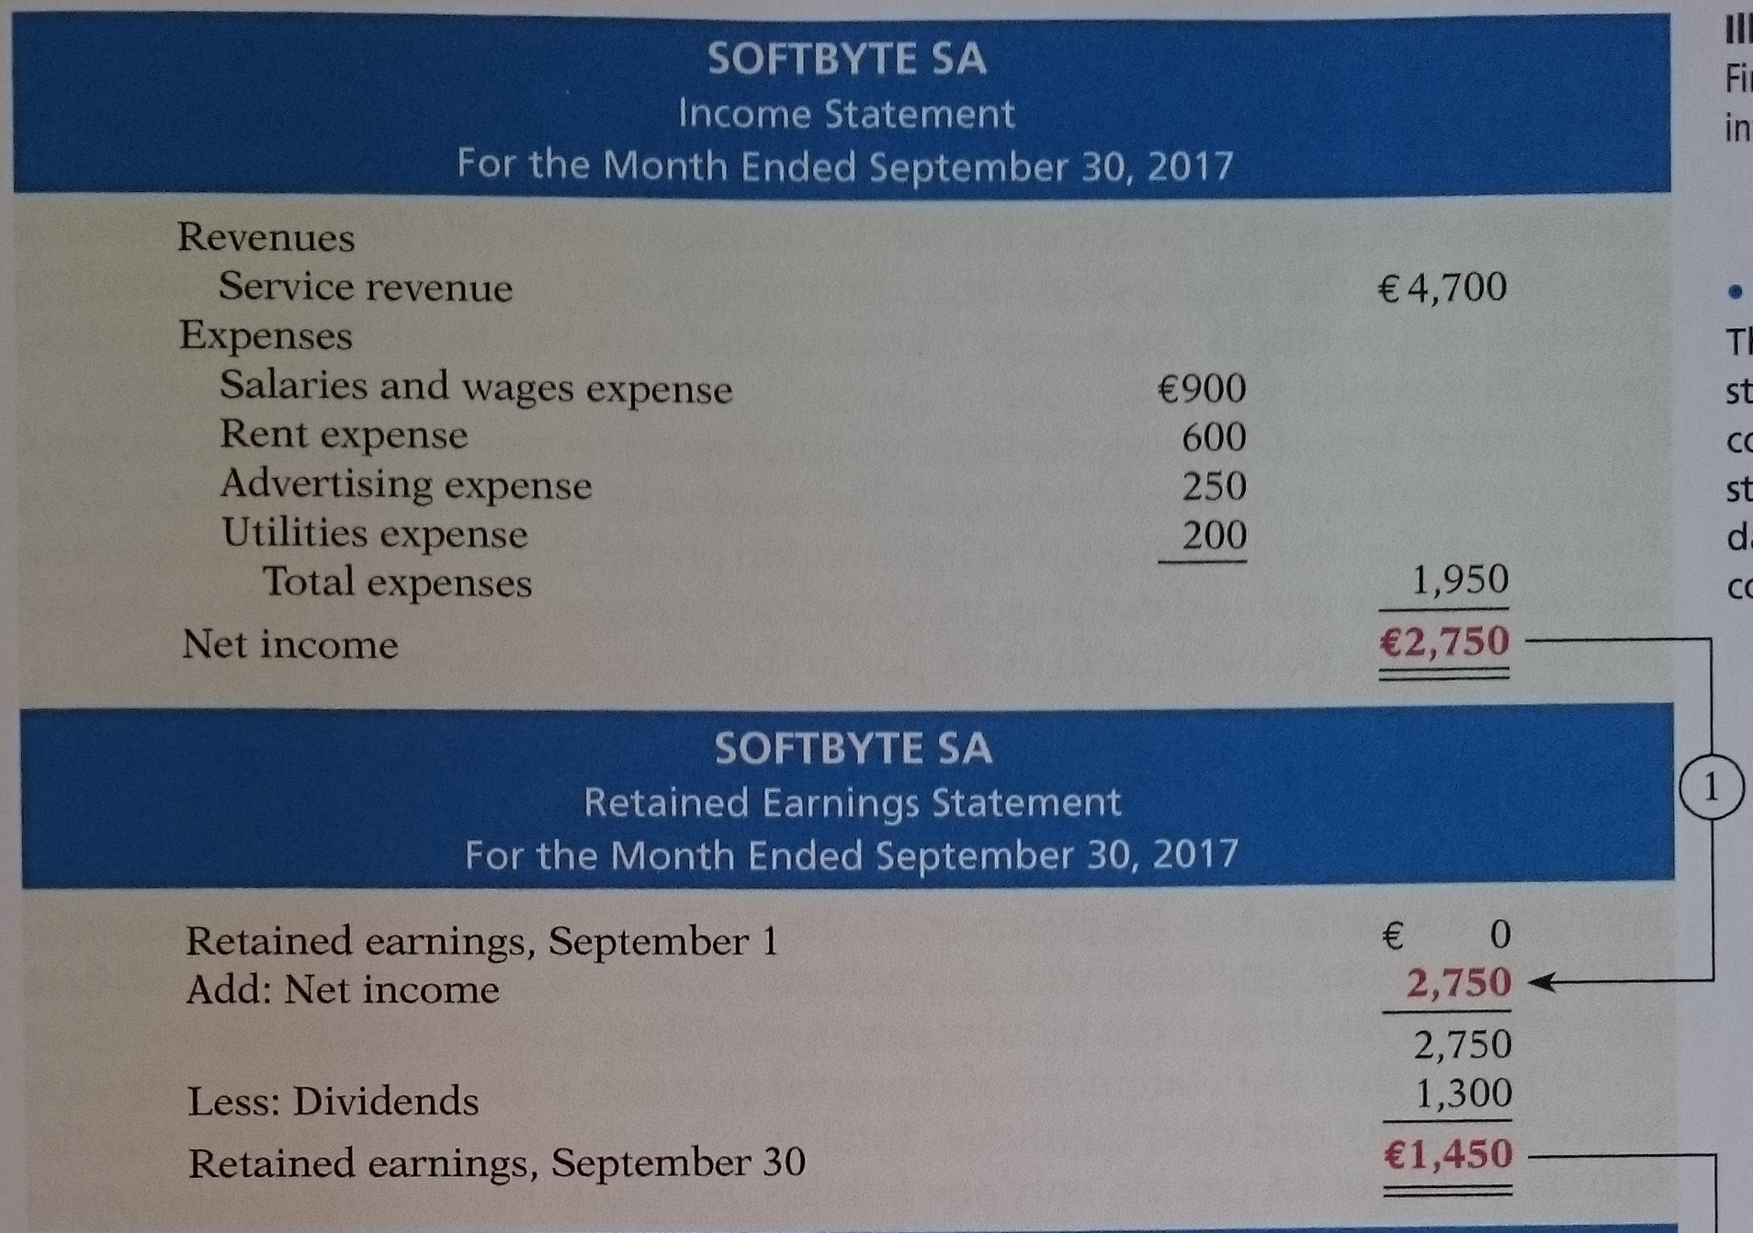
Financial Statements

Slide 25
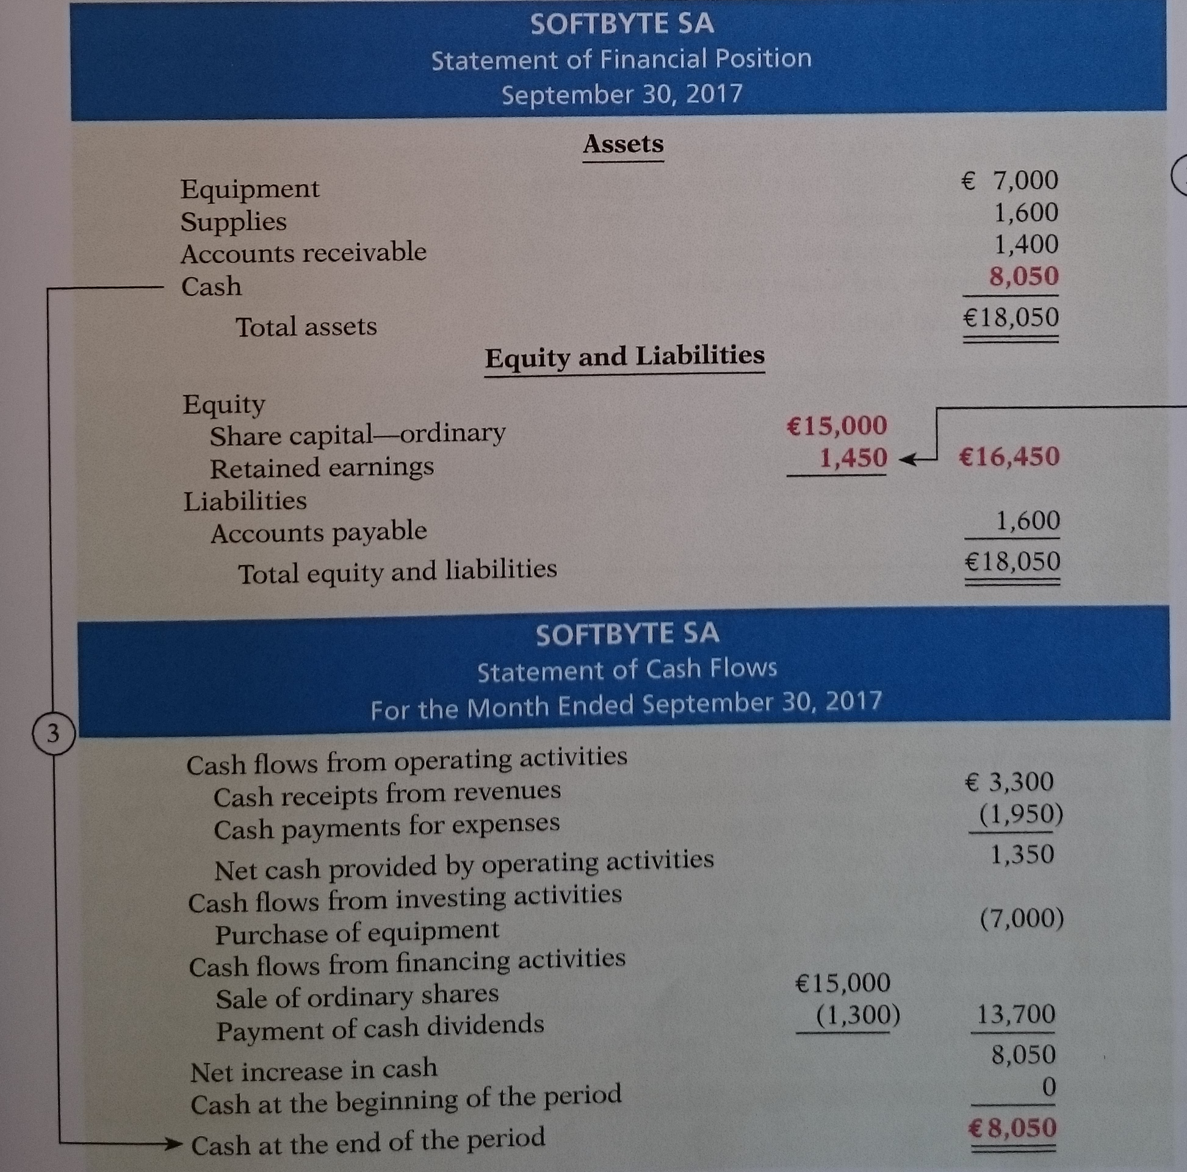
Financial Statements

Slide 26
Thank you for your attention.

