Slide 1

Master thesis seminar (2)
FT purpose, Methodology, thesis topic, citations
Ing. Michal Stoklasa, PhD
Business economics and managemen

Slide 2

Seminar agenda
1 Final thesis purpose and structure
2 Methodology – goals, methods
3 Thesis topic
4 Sources and citations

Slide 3
1 Final thesis purpose
It is a scientific work - its elaboration is guided by a certain logic, it is necessary to work with literature, to cite it appropriately, plan, conduct and evaluate research, draw conclusions and make recommendations.
Throughout this thesis, the author shows that they are able to identify an area suitable for research, are able to set a goal, study theoretical information, understand the current situation, plan and conduct own research, evaluate everything and make recommendations for solving the problem. Hence the structure, see further.

Slide 4
Final thesis purpose
There is a Dean‘s Decree No. 2/2020 (and 3/2020 and 5/2020) for writing the final thesis, for editing, publishing and storing thesis, and your supervisor for consultation.
Learn to work with time - write on time, consult on time, your superviser can have over 20 other students.
The work must be written in an impersonal style - it is a scientific work.

Slide 5
Structure
Introduction
1 Theoretical basis (20 p.)
2 Presentation of subjects (municipality, country, company) (5 p.)
3 Practical part (20 p.)
4 Suggestions and recommendations (10 p.)
Conclusion

Slide 6
Abstract
The abstract should describe the whole thesis in 15 lines (half of a page).
It should therefore include the aim of the work, its structure and chapters description, characteristics of the research carried out, main findings, main conclusions and recommendations.

Slide 7
Introduction
The introduction is structured - general introduction to the problem, the aim of the work (exact wording of the assignment!), methods and procedures for achieving the goal, description of chapters.
Common mistakes - you do not write impersonally, missing any introduction to the issue, the wording of the goal is completely different than in the thesis topic, there is no text explaining how you aim to achieve your thesis goal.

Slide 8
1st chapter – theoretical basis
The purpose of this chapter is to create a theoretical basis for your further efforts in this area. So you want to work with valuable resources (books by reputable authors), not just articles on the Internet.
The content of the first chapter must correspond to the issue in the third chapter.
The chapter must have a logical sequence - it must be clear why the author proceeds in a certain way and where they are heading - a frequent mistake is the text acting as copied disparate parts, where it is not clear why they are listed and where the text will lead.
Citations:
  We use the Harvard system - see. methodological instruction!
  We use direct quotations more sparingly than paraphrases, but both require reference.
  Most of the text of the first chapter is taken over from other sources, so each paragraph will have a reference.
  However, do not forget to work with the theory - to introduce different approaches of several authors and to define them (own view, which will be used in the work) - polemics.

Slide 9
2nd chapter – company characteristics
It contains the characteristics of the company (country, industry etc.) - characteristics (short history), organizational structure, subject of business, subjects, characteristics of competition or market (if specific), etc.
For this chapter, you cannot just copy information from the company website!
The second chapter must also have links to resources (web, company internal materials, etc.).

Slide 10
3rd chapter – own research (analysis)
The purpose of this chapter is to first characterize the current state of the researched issue, then plan your own research, conduct it, evaluate it and interprete it.
We follow the basic research logic - starting with secondary data, after we exhaust it, we plan to obtain primary data.
It is advisable to follow marketing research plan – e.g. Saunders, Kumar etc.
Questionnaire: Based on the results of the questionnaire survey you write your own suggestions and recommendations, so it is advisable to pay close attention to the development of the questionnaire. Use the Likert scale. After creating the questionnaire, try to pilot it - does it substantialy help to achieve the thesis goal, can you make valuable suggestions and recommendations?

Slide 11
4th chapter – suggestions and recommendations
Outline of suggestions and recommendations, the implementation of which in practice would help solve the problem identified in the thesis.
Proposals and recommendations must be formulated based on the results of the third chapter - the actual contribution of the work. (because this amount of respondents answered the question XY in this way, it is recommended that the company implements this …)
Justify the proposals and recommendations adequately, explain their benefits and costs (financial, human, time etc.). It is advisable to create a calculation for proposals directly, if not, we proceed at least in general. Everybody is able to create recommendations, you have to prove that yours are both appropriate and realistic.

Slide 12
Conclusion
In the conclusion, the main findings should be sufficiently justified, it is an overall evaluation of the thesis.
Conclusion therefore summarizes the main results of the work; moreover, the author should take into account that in the introduction they set the goal of their diploma thesis and all their efforts should be directed towards this goal.
If there are hypotheses set in the thesis, it is necessary to point out how they were accepted / rejected.
An important part of the conclusion is to define the contribution of the thesis or outline recommendations and proposals, the implementation of which would help solve the problem identified in the thesis.

Slide 13
2 Methodology
„Methodology is the systematic, theoretical analysis of the methods applied to a field of study.“ (Berg, 2009)
Simply – HOW we do our research (understand, plan, carry out, analyse, interprete, present).
Different fields of study use different methods! We are in Social sciences, we use our methodology.
General methods of social research – deduction and induction, analysis and synthesis, abstraction and generalization, analogy and modelling, etc.
Marketing research – qualitative and quantitative, secondary and primary data, research process and methods.
Notes:
Source: Berg, Bruce L., 2009, Qualitative Research Methods for the Social Sciences. Seventh Edition. Boston MA: Pearson Education Inc.

Slide 14
Marketing research
A company conducts primary marketing research by gathering original data.
Secondary marketing research is conducted on data published previously and usually by someone else. Secondary data may be internal to the firm, such as sales invoices and warranty cards, or may be external to the firm such as published data or commercially available data.
Qualitative marketing research - generally used for exploratory purposes - small number of respondents - not generalizable to the whole population - statistical significance and confidence not calculated - examples include focus groups and projective techniques.
Quantitative marketing research - generally used to draw conclusions - tests a specific hypothesis - uses random sampling techniques so as to infer from the sample to the population - involves a large number of respondents - examples include surveys and questionnaires.

Slide 15
Marketing research methods
Survey – based on the statements of recipients through communication, question-form (written – mail, e-mail, website, face-to-face, telephone).
Observation (hidden x noticeable) is focusing primarily on human behavior in the process of receiving marketing communications and subsequent behavior.
Experiment (often called Test Marketing) actively manipulates examined factors, it influences the situation and explores the reactions of people in natural or laboratory situation.

Slide 16
Marketing research process (Kozel, 2011, p. 73)
PREPARATORY STAGE
  Phase 1 - problem definition, objectives and research hypotheses.
  Phase 2 – orientation analysis.
  Phase 3 - marketing research plan - the type of data, methods and techniques for their collection, sample, time schedule, control.
  Phase 4 - pilot study.
IMPLEMENTATION STAGE
  Phase 5 - data collection.
  Phase 6 - data processing.
  Phase 7 - analysis of collected data - processing using MS Excel and SPSS.
  Phase 8 - the interpretation of the information obtained.
  Phase 9 - presentation of results.

Slide 17
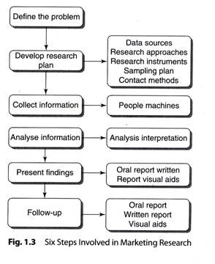
Research proces by Kotler

Slide 18
Methodology in Thesis
I recommend to have a chapter "3.1 Thesis Methodology" where you describe the whole proces of creating your thesis.
On the basis of secondary research - critical analysis of available literary sources (literature, articles, research, etc.) and the current state of the issue, primary research was planned - describe the method, technique, sample, etc. (where, who, with whom, why, how).
At the state exams you present your thesis in 10 minutes with a 10 minutes discussion. You need to explain how you wrote your thesis and why. So you started with a secondary research of theoretical resources to have an overview of the subject matter… description of what and how… then you needed to find out the current state of the subject in practice, again secondary data… description of what and how… and only after you have exhausted all available secondary data and there was still an information gap, you planned your primary research in a certain way because …, which aims to find out this and that. You want to explain the reasons and continuity of the thesis. All this leads to enough data, information and knowledge to create suggestions and recommendations.

Slide 19
3 Thesis topic
By 31 October it is necessary to submit an approved thesis topic.
Thesis topic consists of: schedule, topic, and literature.
It must comply with all formalities!
The aim of the thesis cannot be just to describe something, but you must also suggest, improve, create etc. - your contribution.
The wording “chapter describes” is wrong, the chapter is inanimate.
The literature style is obligatory and must be observed. Literature must be up-to-date (not older than 10 years). Alphabeticaly sorted.

Slide 20
Thesis topic example 1
Name of the topic: Your thesis topic name
Thesis timetable:
First two chapters by December 31, 2019.
Third chapter by February 28, 2020.
Finalised thesis by March 31 2020.
Submission of work to the department by May 4 2020.
Topic description:
The aim of this bachelor thesis is to research the current state of regional branding in selected regions, compare two selected regions in the Czech Republic and suggest the possibility of its improvement. In order to achieve this goal, the theoretical part will define the brand, regional marking and product protection markings. In the practical part, the perception of the brand by consumers in selected regions will be determined by the use of appropriate methods, mainly survey with questionnaire. An interview will also be conducted with the region's brand manager. Based on the findings, suggestions and recommendations will be formulated to improve the current situation.

Slide 21
Thesis topic example 2
Expected scope of work:
The expected scope of the thesis is 45-65 pages.
Other conditions for work preparation set by the supervisor:
No other conditions were set by the supervisor.
Literature
At least 7 books, not older than 10 years, sorted alphabetically. See the deans decree for examples.
HINDLS, R., S. HRONOVA, J. SEGER and J. FISCHER, 2007. Statistics for Economists.
8th ed. Prague: Professional Publishing. ISBN 978-80-86946-43-6.

Slide 22
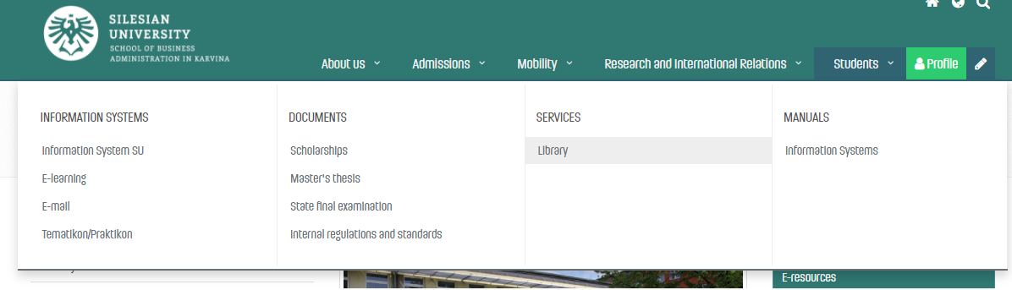
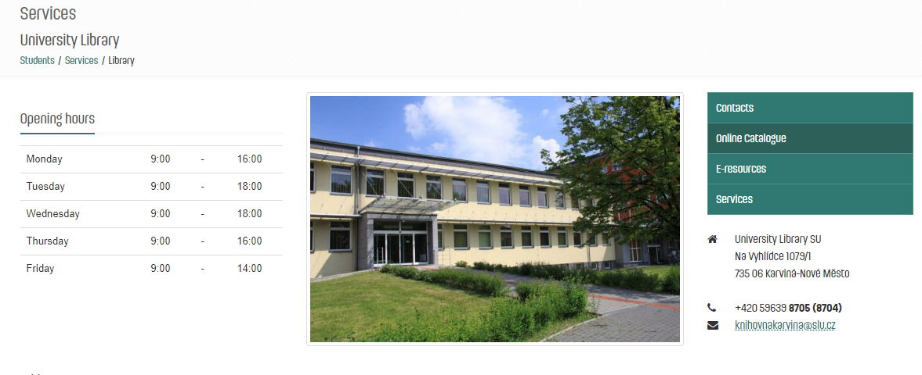
4 Sources and citations
Our library is full of sources.

Slide 23
Citations
DI 2/2020 states that „all that is stated in the References in the wording of full bibliographic citations, must be continuously cited in the text, and the student uses the abbreviated citation method (the Harvard citation system), i.e. the surname of the author or authors (year of publication, in the case of direct or indirect citations the page or the range of pages, is stated)“.
The taken text can be cited in the following forms (DI 2/2020):
  a) Direct citation - the text is taken literally from the original work and is in quotation marks.
  b) Indirect citation (paraphrase) - the text is interpreted from the original work in own words, without changing the meaning of the text.

