Slide 1
Family Business

Slide 2
Like big business…
70% of -UK businesses, other EU countries like 50% is family owned
Do you know these family firms:
Cadbury, Heinz, Ford, Disney, Pirelli, Levi Strauss,Lego?

Slide 3
Advantage of Family firms
Family force
Knowledge
Flexibility
Long-time planning
Stable culture
Quicker decisions
Good reputation

Slide 4
Definition of family business
Family members are owners and managers
Family members have majority ownership
25% of share is controlled by family

Slide 5
Potential for Conflict
Family | Business
Emotional | Unemotional
Loyal | Self interest
Caring | Task based
Sharing | Reward performance
Inward-looking | Perform or leave
Lifetime membership | Outward-looking

Slide 6
Success in family business
80% is managed by founder in first generation
1/3 survive to second generation
10% survive to third generation
5% reach to another generation

Slide 7
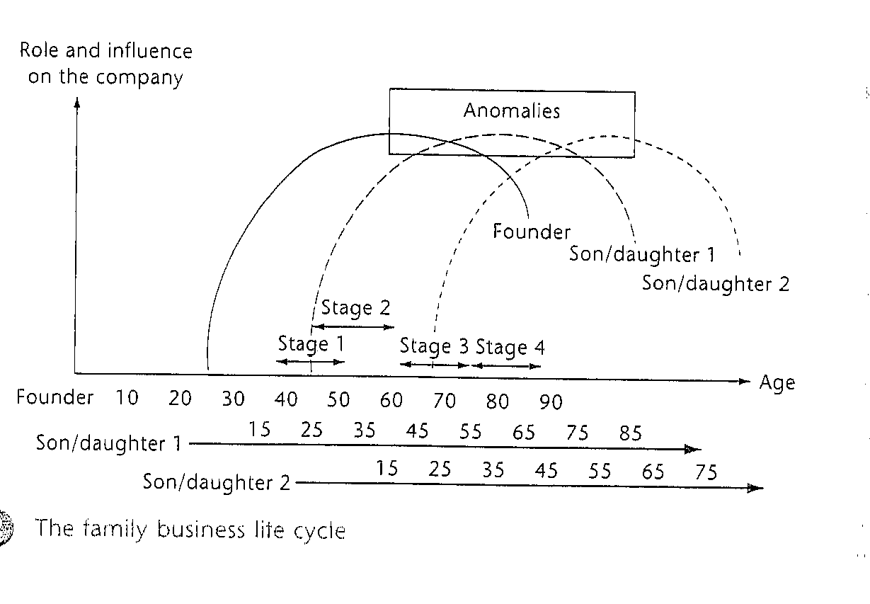
Life cycle of family business
Owner managed business
partnership
Power transfer
Training new generation

Slide 8
Leadership vs. Management
Leadership & management are distinct, yet complementary systems of action
Effective leadership
produces useful change
Effective management controls complexity
Effective leadership + good management = healthy organizations
Notes:
3

Slide 9
Management Process
Reduces uncertainty
Provides stability
Components
  Planning & budgeting
  Organizing and staffing
  Controlling & problem
  solving
Manager –
Most often an advocate for stability and the
status quo
Notes:
4

Slide 10
Leadership Process
Creates uncertainty
Creates change
Components
  Setting organizational direction
  Aligning people with the direction via communication
  Motivating people to action
    Empowerment
    Gratify needs
Leader –
an advocate for
change and new approaches to
problems
Notes:
5

Slide 11
Leaders and Managers
Personality Dimension | Manager | Leader
Attitudes toward goals | Impersonal, passive, functional; goals arise out of necessity, reality | Personal, active, goals arise from desire, imagination
Conceptions of work | Combines people, ideas, things; seeks moderate risk | Looks for fresh approaches to old problems; seeks high risk
Relationships with others | Prefers to work with others; avoids close relationships and conflicts | Comfortable in solitary work; encourages close relationships, not averse to conflict
Sense of self | Accepts life as it is; unquestioning | Questions life; struggles for sense of order
SOURCE: Reprinted by permission of Harvard Business Review. From A. Zaleznik, “Managers and Leaders: Are They Different?” Harvard Business Review 55 (1977): 67-77. Copyright © 1977 by the Harvard Business School Publishing Corporation; all rights reserved.

Slide 12
Leadership Behavioral Theory:
Lewin Studies
Autocratic Style - the leader uses strong, directive, controlling actions to enforce the rules, regulations, activities, & relationships; followers have little discretionary influence
Democratic Style - the leader takes collaborative, reciprocal, interactive actions with followers; followers have high degree of discretionary influence
Laissez-Faire Style - the leader fails to accept the responsibilities of the position; creates chaos in the work environment
Notes:
14

Slide 13
Leadership Behavioral Theory:
Ohio State Studies
Initiating Structure – Leader behavior aimed at defining and organizing work relationships and roles; establishing clear patterns of organization, communication, and ways of getting things done.
Consideration – Leader behavior aimed at nurturing friendly, warm working relationships, as well as encouraging mutual trust and interpersonal respect within the work unit.
Notes:
7

Slide 14
Leadership Behavioral Theory:
Michigan Studies
Production-Oriented Leader
  Constant leader influence
    Direct or close supervision
    Many written or unwritten rules and regulations
  Focus on getting work done
Employee-Oriented Leader
  Relationship-focused environment
    Less direct/close supervision
    Fewer written or unwritten rules and regulations
  Focus on employee concern and needs

Slide 15
Leadership Grid Definitions
Leadership Grid – an approach to understanding a leader’s or manager’s concern for results (production) and concern for people
“Organization Man” (5,5) – A middle-of-the-road leader
Authority Compliance Manager (9,1) – a leader who emphasizes efficient production
Country Club Manager (9,1) – a leader who creates a happy, comfortable work environment

Slide 16
Leadership Grid
Opportunistic
management
High
9
8
7
6
5
4
3
2
1
1,9
Country club
management
9,9
Team
management
Concern
for
People
Paternalism/
Maternalism
management
9+9
5,5
Organization man
management
Authority-
obedience
management
9,1
Impoverished
management
1,1
Low
1 2 3 4 5 6 7 8 9 High
Concern for production
SOURCE: The Leadership Grid® figure, Paternalism Figure and Opportunism from Leadership Dilemmas - Grid Solutions, by Robert R. Blake and Anne Adams McCanse. (Formerly the Manageerial Grid by Robert R. Blake and Jane S. Mouton). Houston: Gulf Publishing Company, (Grid Figure: p. 29, Paternalism Figure: p. 30, Opportunism Figure: p. 31). Copyright© 1991 by Blake and Mouton, and Scientific Methods, Inc. Reproduced by permission of the owners.
Notes:
17

Slide 17
Leadership Grid Definitions
Team Manager (9,9) – a leader who builds a highly productive team of committed people
Impoverished Manager (1,1) – A leader who exerts just enough effort to get by
Paternalistic “father knows best” Manager
(9+9) – a leader who promises reward and
threatens punishment
Opportunistic “what’s in it for me” Manager (Opp) – a leader whose style aims to maximize self-benefit

Slide 18
Path-Goal Theory of Leadership
Leader behavior styles
Directive
Supportive
Participative
Achievement oriented
Follower path
perceptions
Effort-Performance-
Reward linkages
Follower goals
Satisfaction
Rewards
Benefits
Follower
Characteristics
Ability level
Authoritarianism
Locus of control
Workplace
characteristics
Task structure
Work group
Authority system
Notes:
21

Slide 19


Vroom-Yetton-Jago Normative Decision Model
Decide
Use the decision method most appropriate for a given decision situation
Consult individually
Consult group
Facilitate
Delegate
Notes:
18

Slide 20
Hersey-Blanchard Situational
Leadership Model
Leader’s concern with task
Low
High
SOURCE: Adapted from P. Hersey and K. H. Blanchard, Management of Organizational Behavior: Utilizing Human Resources, 3rd ed. (Upper Saddle River, N.J.: Prentice-Hall, 1977),170.
High
Leader’s
concern
with
relationship
Low
Mature
Employees
Immature
Employees
Willing/Able Unwilling/able
Willing/unable Unwilling/unable
4 3 2 1
Notes:
22

Slide 21
Developments in
Leadership Theory
Leader-Member Exchange
In-groups
Members similar to leader
Given greater responsibilities, rewards, attention
Within leader’s inner circle
of communication
High job satisfaction and organizational commitment, low turnover
Stress from added responsibilities
Out-Groups
Managed by formal rules and policies
Less attention; fewer rewards
Outside the circle
More likely to retaliate against the organization
Stress from being left
out of communication
network

Slide 22
Developments in
Leadership Theory
Substitutes for Leadership
Satisfying task
Performance feedback
Employee’s high skill level
Team cohesiveness
Organization’s formal controls

Slide 23
Developments in
Leadership Theory
Transformational Leadership
As a
transactional leader,
I use formal rewards
& punishments.
As a
transformational leader,
I inspire and excite
followers to high levels
of performance.
Notes:
8

Slide 24
Charismatic Leadership
Charismatic Leadership - the use, by a leader, of personal abilities & talents in order to have profound & extraordinary effects on followers
Charisma - means “gift” in Greek
Charismatic leaders use referent power
Potential for high achievement & performance
Potential for destructive & harmful courses of action
Notes:
12

Slide 25
Emerging Issues in Leadership
Emotional Intelligence
Trust
Leading Virtual Teams
Women Leaders
Servant Leadership

Slide 26
Emergence of Women Leaders
Do men and women
lead differently?
Notes:
11

Slide 27
Five Types of Followers
Independent, critical thinking
Alienated
followers
Effective
followers
Passive
Survivors
Active
Yes
people
Sheep
SOURCE: Reprinted by permission of Harvard Business Review. From “In Praise of Followers,” by R. E. Kelley, Vol. 66 1988, p. 145. Copyright © 1988 by Harvard Business School Publishing Corporation.
Dependent, uncritical thinking
Notes:
24

Slide 28
Dynamic Follower
Responsible steward of his or her job
Effective in managing the relationship with the boss
Practices self-management
Notes:
25

Slide 29
Guidelines for Leadership
Unique attributes, predispositions, & talents of each leader should be appreciated
Organizations should select leaders who challenge but not destroy the organizational culture
Leader behaviors should demonstrate a concern for people; it enhances follower well-being
Different leadership situations call for different leadership talents & behaviors
Good leaders are likely to be good followers
Notes:
23

