Slide 1

Strategy Formulation
Šárka Zapletalová

Slide 2
Strategy Formulation
Outline of the lecture
Corporate Strategy
Business Strategies
Functional Strategies

Slide 3
Strategy Formulation
Objectives
Objectives
Objectives are the end results of planned activity.
They should be stated as action verbs and tell what is to be accomplished by when and quantified if possible.
The achievement of corporate objectives should result in the fulfillment of a corporation’s mission.
  In effect, this is what society gives back to the corporation when the corporation does a good job of fulfilling its mission.
The term goal is often used interchangeably with the term objective.
  We prefer to differentiate the two terms. In contrast to an objective, we consider a goal as an openended statement of what one wants to accomplish, with no quantification of what is to be achieved and no time criteria for completion. For example, a simple statement of “increased profitability” is thus a goal, not an objective, because it does not state how much profit the firm wants to make the next year. A good objective should be action-oriented and begin with the word to.

Slide 4
Strategy Formulation
Some of the areas in which a corporation might establish its goals and objectives are:
Profitability (net profits)
Efficiency (low costs, etc.)
Growth (increase in total assets, sales, etc.)
Shareholder wealth (dividends plus stock price appreciation)
Utilization of resources (ROE or ROI)
Reputation (being considered a “top” firm)
Contributions to employees
Contributions to society (taxes paid, participation in charities, providing a needed product or service)
Market leadership (market share)
Technological leadership (innovations, creativity)
Survival (avoiding bankruptcy)
Personal needs of top management

Slide 5
Strategy Formulation
Strategies
A strategy of a corporation forms a comprehensive master plan that states how the corporation will achieve its mission and objectives. It maximizes competitive advantage and minimizes competitive disadvantage.
Armed with a mission, objectives,and completed external and internal analyses, a firm is ready to make its strategic choices. That is, a firm is ready to choose its "theory of how to gain competitive advantage."
The typical business firm usually considers three types of strategy: corporate, business, and functional.

Slide 6
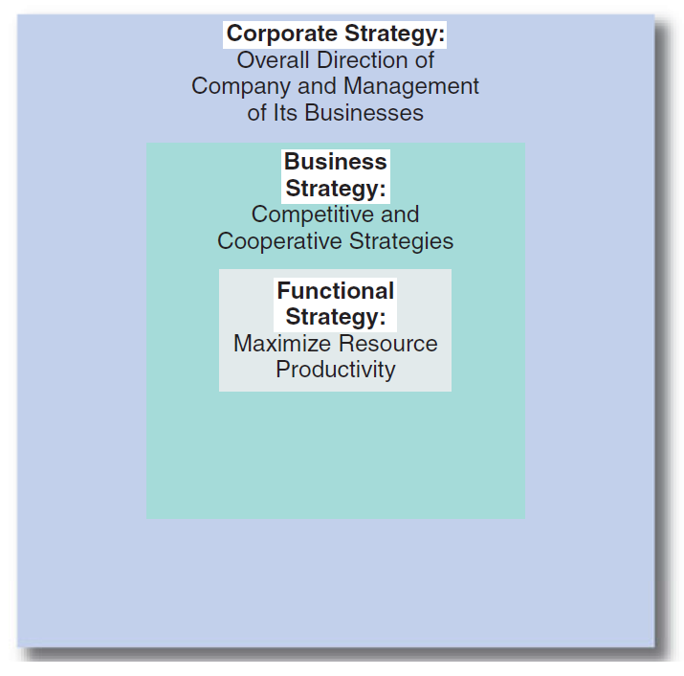
Strategy Formulation
Strategy formulation
Hierarchy of Strategy

Slide 7
Strategy Formulation
Strategy formulation
Corporate strategy
describes a company’s overall direction in terms of its general attitude toward growth and the management of its various businesses and product lines.
Corporate strategies typically fit within the three main categories of stability, growth, and retrenchment.
  Cadbury Schweppes, for example, was following a corporate strategy of retrenchment by selling its marginally profitable soft drink business and concentrating on its very successful confectionary business.

Slide 8
Strategy Formulation
Strategy formulation
Business strategy
usually occurs at the business unit or product level, and it emphasizes improvement of the competitive position of a corporation’s products or services in the specific industry or market segment served by that business unit.
Business strategies may fit within the two overall categories, competitive and cooperative strategies.
Cooperative strategy may thus be used to provide a competitive advantage.
  For example, Intel, a manufacturer of computer microprocessors, uses its alliance (cooperative strategy) with Microsoft to differentiate itself (competitive strategy) from AMD, its primary competitor.

Slide 9
Strategy Formulation
Strategy formulation
Functional strategy
is the approach taken by a functional area to achieve corporate and business unit objectives and strategies by maximizing resource productivity.
It is concerned with developing and nurturing a distinctive competence to provide a company or business unit with a competitive advantage.
Examples of research and Development (R&D) functional strategies are technological followership (imitation of the products of other companies) and technological leadership (pioneering an innovation).
  In terms of marketing functional strategies, Procter & Gamble (P&G) is a master of marketing “pull” - the process of spending huge amounts on advertising in order to create customer demand. This supports P&G’s competitive strategy of differentiating its products from those of its competitors.

Slide 10
Strategy Formulation
Corporate Strategy
Corporate strategy is primarily about the choice of direction for a firm as a whole and the management of its business or product portfolio.
This is true whether the firm is a small company or a large multinational corporation (MNC).
In a large multiple-business company, in particular, corporate strategy is concerned with managing various product lines and business units for maximumvalue. In this instance, corporate headquarters must play the role of the organizational “parent,” in that it must deal with various product and business unit “children“.

Slide 11
Strategy Formulation
Corporate Strategy
Corporate strategy, therefore, includes decisions regarding the flow of financial and other resources to and from a company’s product lines and business units.
Through a series of coordinating devices, a company transfers skills and capabilities developed in one unit to other units that need such resources.
In this way, it attempts to obtain synergy among numerous product lines and business units so that the corporate whole is greater than the sum of its individual business unit parts.

Slide 12
Strategy Formulation
Corporate Strategy
Corporate strategy deals with three key issues facing the corporation as a whole:
The firm’s overall orientation toward growth, stability, or retrenchment (directional strategy).
The industries or markets in which the firm competes through its products and business units (portfolio analysis).
The manner in which management coordinates activities and transfers resources and cultivates capabilities among product lines and business units (parenting strategy).

