Slide 1

Cizojazyčná příprava AJ 4
Money – interest rate
Janusz Karpeta
Cizojazyčná příprava 4

Slide 2

Outline of the presentation
Vocabulary
Interest rate
Conclusion

Slide 3
Vocabulary
Keywords in interest rate:
APR (annual percentage rate) – RPSN (roční procetní sazba nákladů)
Balance – zůstatek
Borrower - vypůjčovatel
Charge – účtovat
Checking account – běžný účet
Compound interest – složené úročení
Credit – úvěr
Debt – dluh
Depositer - vkladatel
Fee – poplatek
Fixed rates – fixní sazby
Lender – půjčovatel
Loan – půjčka
Mortgage – hypotéka
Principal – jistina
Repay – splácet
Savings account – spořící účet
Treasury note – státní pokladniční poukázka
Unpaid – nesplácený
Variable rates – variabilní sazby

Slide 4
Interest rate
An interest rate is the percent of principal charged by the lender for the use of its money.
The principal is the amount of money lent.
As a result, banks pay you an interest rate on deposits.
They are borrowing that money from you.
Anyone can lend money and charge interest, but it's usually banks.
They use the deposits from savings or checking accounts to fund loans.
They pay interest rates to encourage people to make deposits.

Slide 5
Interest rate
Banks charge borrowers a little higher interest rate than they pay depositors so they can profit.
At the same time, banks compete with each other for both depositors and borrowers.
The resulting competition keeps interest rates from all banks in a narrow range of each other.
How Interest Rates Work
The bank applies the interest rate to the total unpaid portion of your loan or credit card balance.

Slide 6
Interest rate
Although interest rates are very competitive, they aren't the same.
A bank will charge higher interest rates if it thinks there's a lower chance the debt will get repaid.
For that reason, banks will always assign a higher interest rate to revolving loans, like credit cards.
These types of loans are more expensive to manage.
Banks also charge higher rates to people they consider risky.
It's important to know what your credit score is and how to improve it.
The higher your score, the lower the interest rate you will have to pay.

Slide 7
Interest rate
Banks charge fixed rates or variable rates.
It depends on whether the loan is a mortgage, credit card, or unpaid bill.
The actual interest rates are determined by either the 10-year Treasury note or by the fed funds rate.
Fixed rates remain the same throughout the life of the loan.
Your initial payments consist mostly of interest payments.
As time goes on, you pay a higher and higher percentage of the debt principal.
If you make an extra payment, it all goes toward principal.
You can pay the debt off sooner that way. Most conventional mortgages are fixed-rate loans.

Slide 8
Interest rate
Variable rates change with the prime rate.
When the rate rises, so will the payment on your loan.
With these loans, you must pay attention to the prime rate, which is based on the fed funds rate.
If you make extra payments, it will also go toward paying off the principal.
Understanding APR
APR stands for annual percentage rate.

Slide 9
Interest rate
It allows you to compare the cost of different borrowing options.
The APR includes any fees a bank may charge.
These one-time fees are called "points" because they the bank calculates them as a percentage point of the total.
The APR can help you compare a loan that only charges an interest rate to one that charges a lower interest rate plus points.

Slide 10
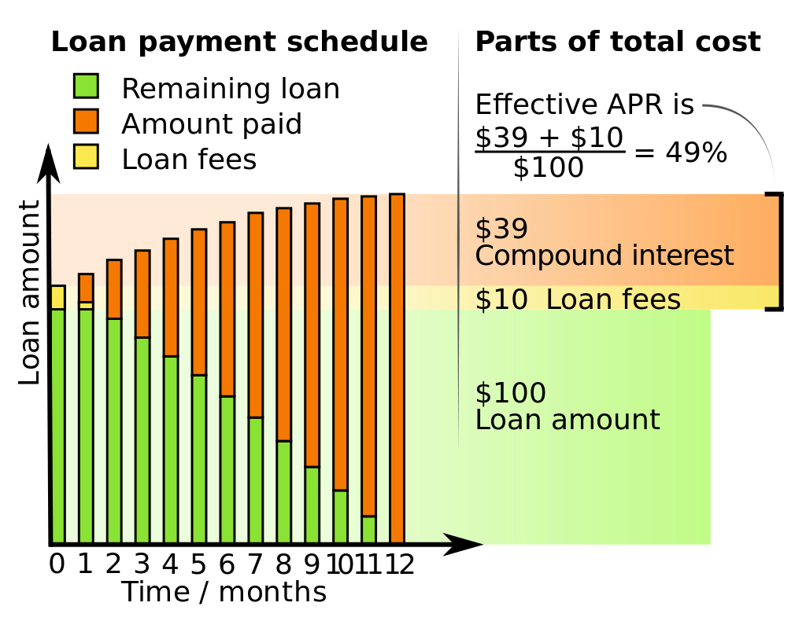
Parts of total cost and effective APR for a 12-month, 5% monthly interest, $100 loan paid off in equally sized monthly payments.

Slide 11
Conclusion
Keywords in interest rate
Interest rate

