Slide 1
MARKETINg SELLING ADVERTISING PERSUADING
BKJA2

Slide 2
advertising/commercial = reklama
to attract = nalákat, přilákat
(run a) campaign = (rozběhnout) kampaň
consumer = spotřebitel
encourage = podpořit, povzbudit
medium (media, mn.č.) = hromadný sdělovací prostředek
message = hlavní myšlenka, sdělení
persuading = přesvědčování
persuasive = přesvědčivý, přesvědčující
to persuade = přesvědčit
promotion = propagace
to promote = propagovat
objective/goal = cíl
salesperson = prodejce
skill = dovednost

Slide 3
ADVERTISING

Slide 4
ADVERTISING
the method of promotion
it promotes the product or service
to groups of people
through medias (TV, radio, cinema, online …)
Two types of advertising:
persuasive advertising = tries to attract and persuade a customer to buy the product
informative advertising = gives the customer information about a product (in campaigns, benefits …)
p. 22-23

Slide 5
p. 25/2.2
RAISE
BUY
OF MOUTH
PERSONAL RECOMMENDATIONS
OBTAIN
WORD
SPACE
AWARENESS
get opinions from customers
increase understanding about the product
one person tells another
pay for a place to advertise

Slide 6
p. 25/2.2
INCREASE
ENTER
MARKET
SHARE
A NEW PRODUCT
LAUNCH
RUN
A CAMPAIGN
A NEW
MARKET
publish a series of ads
make a larger amount of total sales
start selling to a different category
bring a new item to market

Slide 7
COUNTABLE AND UNCOUNTABLE NOUNS GRAMMAR

Slide 9
countable nouns - rules
How many customers does Amazon have?
2) I stayed just a few days in my job but I found out I didn´t like it.
3a) You should pay 30 crowns per one kilometer.
3b) It is only about five kilometres to get to the center of the city.

Slide 10
countable nouns - rules
1) How many customers does Amazon have? (=kolik)
2) I stayed just a few days in my job but I found out I didn´t like it. (=pár, několik)
3a) You should pay 30 crowns per one kilometer.
3b) It is only about five kilometres to get to the center of the city. (=tvoří jednotné i množné číslo)

Slide 12
uncountable nouns - rules
How much time do you have today?
2) We can´t go for a trip because we have only a little money.
3a) My car runs out of petrol.
3b) We don´t have petrol so we must go to a petrol station.

Slide 13
uncountable nouns - rules
1) How much time do you have today? (=kolik)
2) We can´t go for a trip because we have only a little money. (=trochu)
3a) My car runs out of petrol.
3b) We don´t have petrol so we must go to a petrol station. (=netvoří množné číslo)

Slide 14
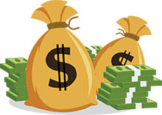
MONEY

Slide 15
COMPANY

Slide 16
TIME

Slide 17
NEWS

Slide 18
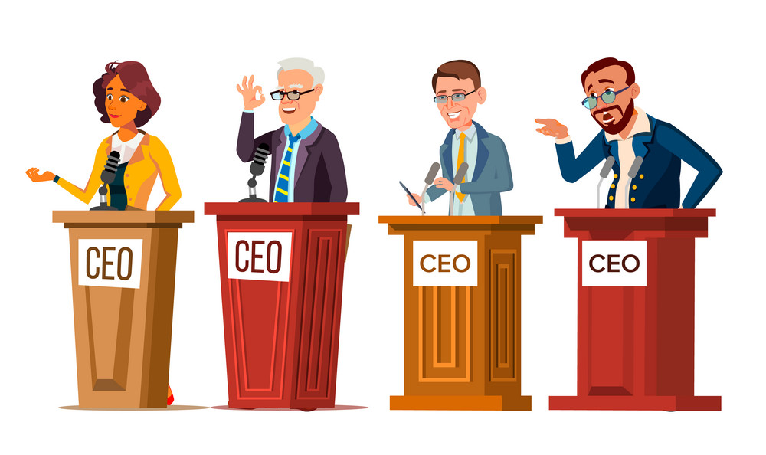
CEO

Slide 19
OFFICE

Slide 20
RESEARCH

Slide 21
PROGRESS

Slide 22
HOW MANY/HOW MUCH new offices do they open?
HOW MANY/HOW MUCH money do you need for buying a company?
HOW MANY/HOW MUCH time do you have today?
We did not expect so MUCH/MANY complaints before Christmas.

Slide 23
A LOT OF = hodně, mnoho; v kladné větě
There are a lot of companies in our city.
SOME = nějaký
Our accountant usually has some money in the office.
ANY = nějaký; v otázce a záporných větách
Are there any new opportunities in London?
There are not any new opportunities in London.

Slide 24
What was it?
Where did you buy it?
When did you buy it?
Why did you buy it?
How much did it cost?
How was is promoted?
THINK ABOUT
THE LAST PRODUCT YOU BOUGHT

Slide 25
persuading

Slide 26
PERSUADING
a skill that business people need to develop
behavioural elements of persuading:
active listening, eye contact
using personal stories
body language
empathy and tolerance
p. 25-26

Slide 27
How
to persuade people
to buy
your product?

Slide 28
selling changes p. 28/2.4

