Slide 1

INTERNATIONAL TRADE AND ORGANIZATIONS
Ingrid Majerova
World Economy
EVS/XXX
LESSON VI

Slide 2

Outline of the lecture
Trade Policy
Tools of Trade Policy
Trade Organizations
Intellectual property rights

Slide 3
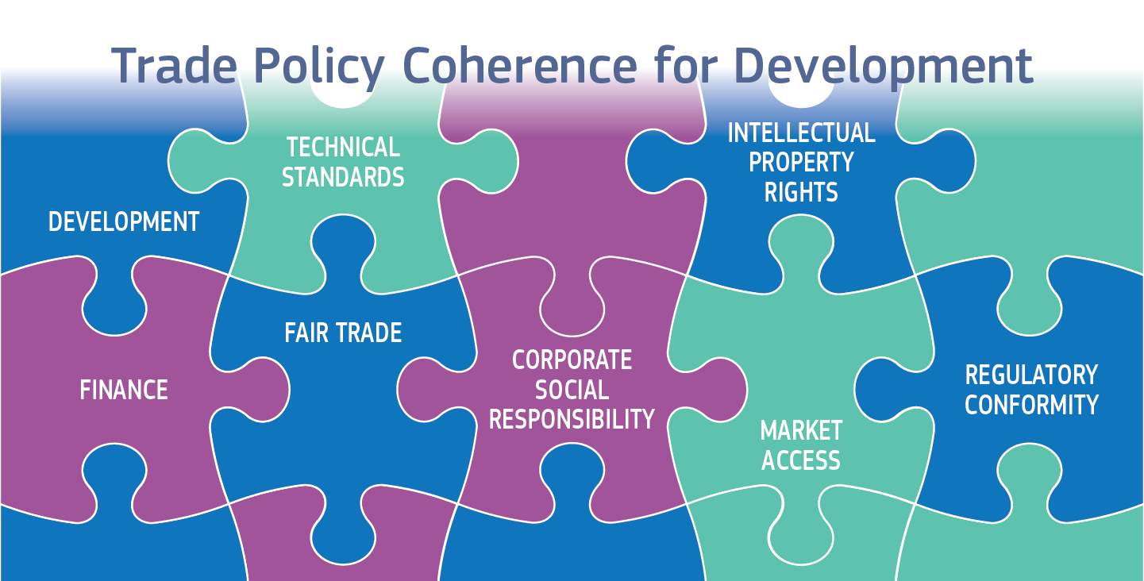
TRADE POLICY
Trade policy refers to the regulations and agreements that control imports and exports to foreign countries.
Trade policies come in many varieties. Generally they consist of either taxes or subsidies, quantitative restrictions or encouragements, on either imported or exported goods, services and assets.

Slide 4
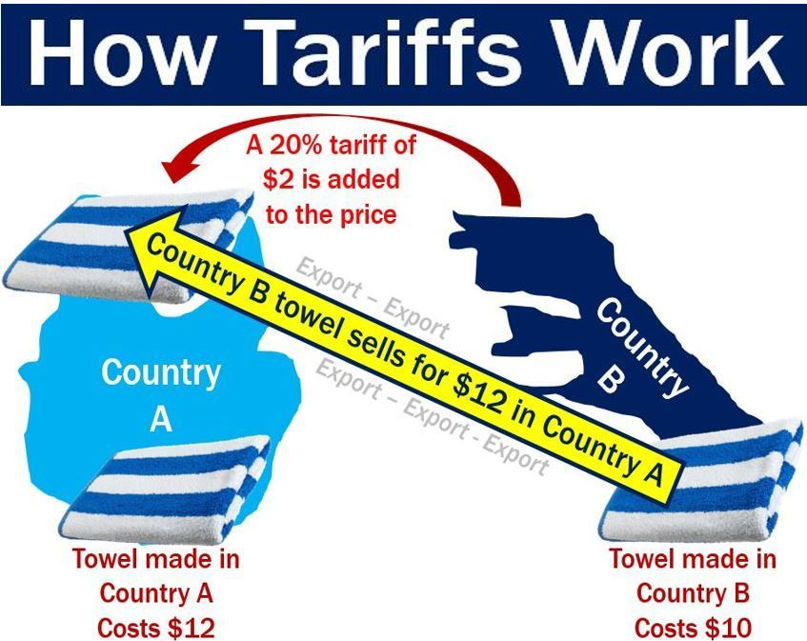
TOOLS OF TRADE POLICY
Tariff
  A tax (duty) levied on a product when it crosses national boundaries
Import tariff
  Tax levied on an imported product
Export tariff
  Tax imposed on an exported product
Often used by developing nations
Raise revenue, increase the world price

Slide 5
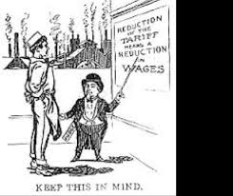
TOOLS OF TRADE POLICY
Protective tariff
  To reduce the amount of imports entering a country
  Insulating import-competing producers from foreign competition
  Allows an increase in the output of import-competing producers
Revenue tariff
  To generate tax revenues
  Placed on either exports or imports

Slide 6
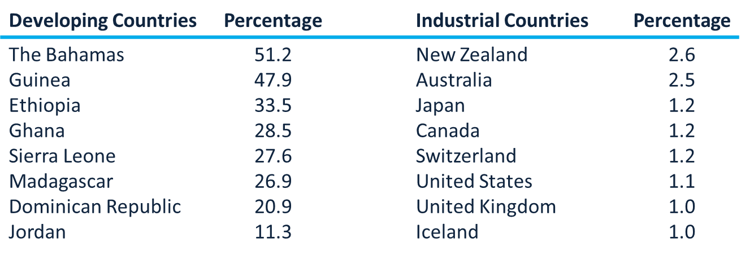
TOOLS OF TRADE POLICY
Tariff revenues as a percentage of government revenues

Slide 7
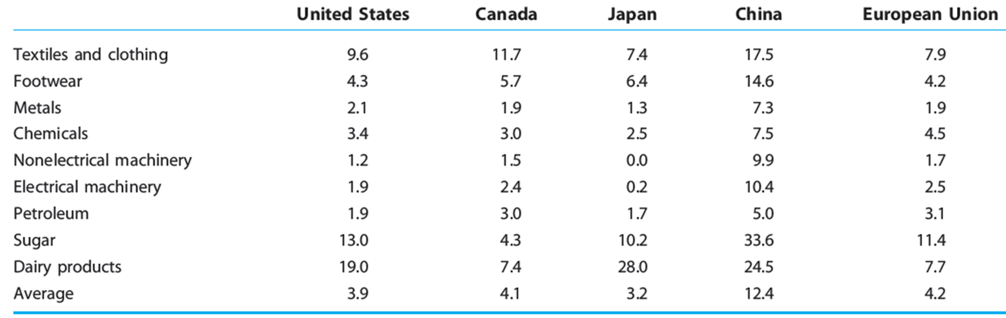
TOOLS OF TRADE POLICY
Examples of tariffs in selected countries (%)

Slide 8
TOOLS OF TRADE POLICY
Tariff - imposes costs to domestic economy
Buyers will pay more for their protected U.S.-made goods than they would have for the imported goods under free trade
Jobs will be lost at retail and shipping companies that import foreign-made goods
Jobs will be lost in any domestic industries that suffer from retaliatory tariffs
The extra cost of the goods gets passed on to whatever products and services that use these goods in the production process

Slide 9
TOOLS OF TRADE POLICY
Tariff effects
Higher price of imports
Lower demand for imports
Domestic suppliers expand output
Benefits
  Domestic producers
Tariffs are inequitable
Impose the most severe costs on low-income families
Higher tariffs on cheap goods than luxuries
Affect different countries in different ways
  Burdens countries that specialize in the cheapest goods
    Very poor countries in Asia and the Middle East

Slide 10
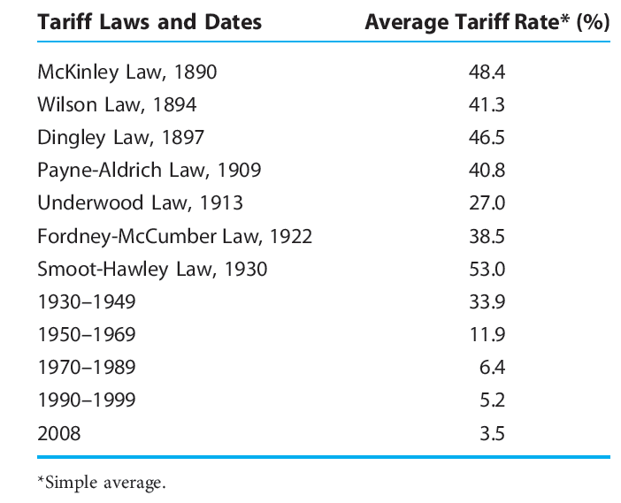
TOOLS OF TRADE POLICY
US tariff history – average tariff rates

Slide 11
TOOLS OF TRADE POLICY
Import quota
Physical restriction on the quantity of goods that can be imported during a specific time period
Require an import license
  Specifies the total volume of imports allowed
On manufactured goods
  Outlawed by the World Trade Organization
Global (for goods) x selective quota (allocated to specific countries)

Slide 12
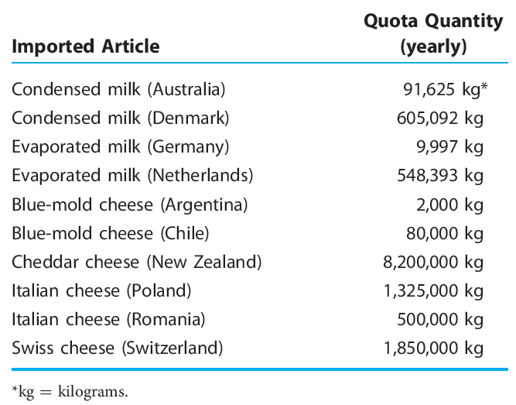
TOOLS OF TRADE POLICY
Examples of US import quotas

Slide 13
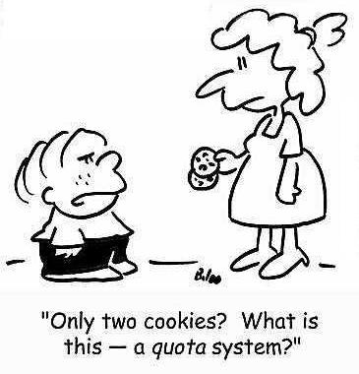
TOOLS OF TRADE POLICY
Effects of import quota on economy’s welfare
Price increase
Decrease in consumer surplus
  Redistributive effect
  Deadweight loss
    Protective effect
    Consumption effect
  Revenue effect
    Windfall profit
    Quota rent
An import quota restricts the volume of imports
Quota
  More restrictive than a tariff
  Suppresses competition

Slide 14
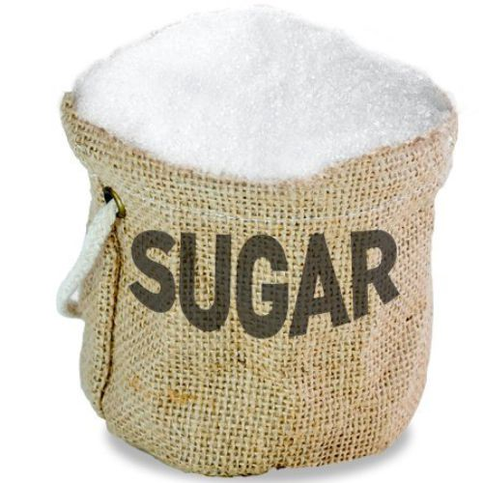
TOOLS OF TRADE POLICY
Export quotas
Market sharing pact, voluntary export restraint agreement
To moderate the intensity of international competition
Tend to be more costly than tariffs
Study: three major U.S. voluntary export restraint agreements of the 1980s
  Automobiles, steel, and textiles and apparel
  67% of the costs to American consumers - captured by foreign exporters as profit

Slide 15
TOOLS OF TRADE POLICY
Trade protectionism intensifies as global economy falls into recession
Global economic downturns - catalyst for trade protectionism; 2007–2009
  Decrease in the demand for goods and services
  Decline in international trade
  Shortfall of some $100 billion in trade finance – 90% of world trade
Indiscriminate decrease in trade
  Exports declined by 30 %
  China - targeted by the most governments for protectionist measures
Russia
  Increased tariffs on imported automobiles
India
  Raised tariffs on steel imports
  Argentina
New obstacles to imported auto parts and shoes

Slide 16
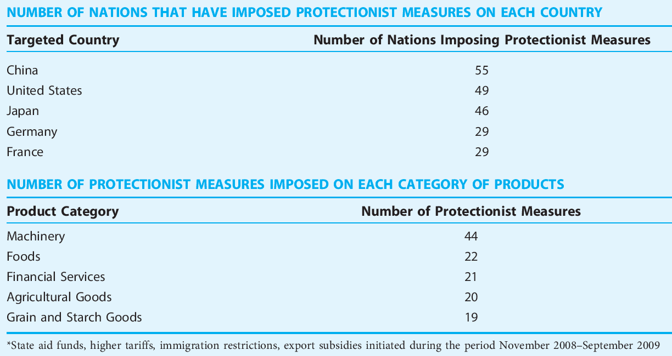
TOOLS OF TRADE POLICY
Creeping protectionism during recession 2007-2009

Slide 17
TOOLS OF TRADE POLICY
Subsidies
Outright cash disbursements, tax concessions, insurance arrangements, and loans at below-market interest rates
From the government for producers
To help improve their market position
Provide domestic firms a cost advantage
  Market products at prices lower than warranted by their actual cost or profit considerations
Net price received by the producer = price paid by the purchaser + subsidy
Domestic production subsidy
  Granted to producers of import-competing goods
Export subsidy
  Granted to producers of goods that are to be sold overseas

Slide 18
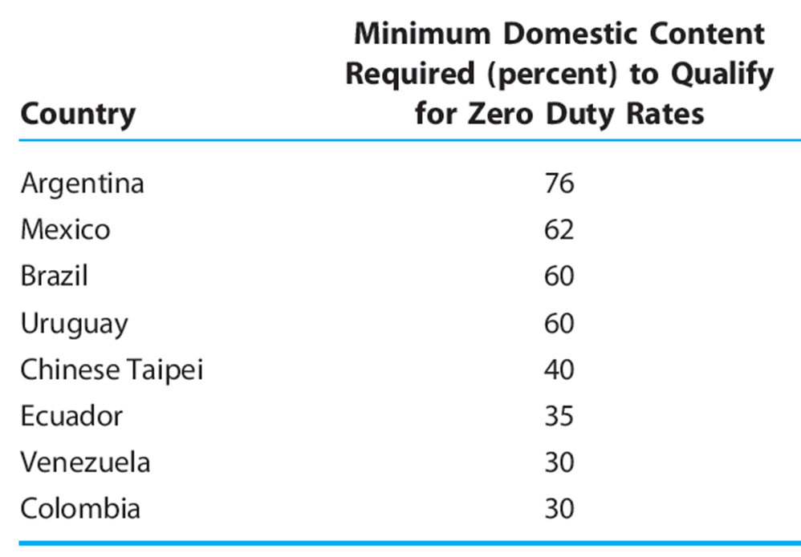
TOOLS OF TRADE POLICY
Domestic content requirements
Higher input prices
  Higher product prices
  Loss of competitiveness
Subsidizing by domestic consumers
of the domestic producer

Slide 19
TOOLS OF TRADE POLICY
Dumping
International price discrimination
Foreign producers charge lower prices than domestic producers for an identical product
After allowing for transportation costs and tariff duties
Selling in foreign markets at a price below the cost of production
Types:
  Sporadic dumping - result of misfortune or poor planning
  Persistent dumping - a producer may consistently sell abroad at lower prices than at home
  International price discrimination – different demand elasticity

Slide 20
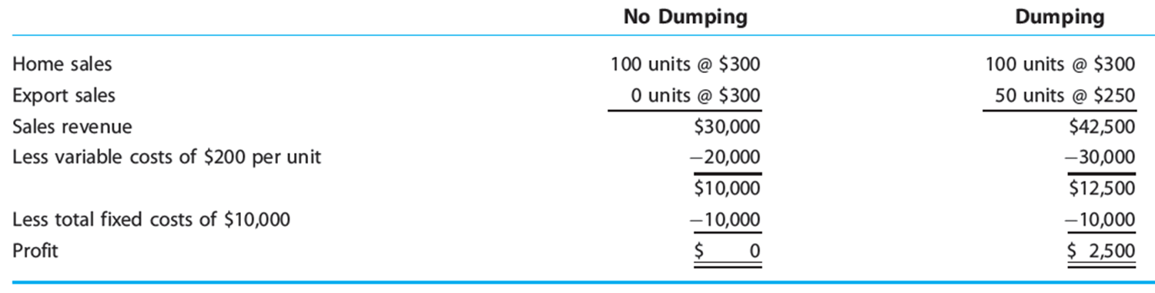
TOOLS OF TRADE POLICY
Dumping - example

Slide 21
TOOLS OF TRADE POLICY
Government Procurement Policies
  requires that a specified percentage of purchases by the federal or state governments be made from domestic firms rather than foreign firms
Health and Safety Standards
  Other countries governing the use of some goods, such as pharmaceuticals
  these regulations can have an effect upon trade patterns even though the policies are not designed based on their effects on trade
Red-Tape Barriers
  refers to costly administrative procedures required for the importation of foreign goods
  many forms: France once required that videocassete recorders enter the country through one small port facility in the south of France; because the port capacity was limited, it effectively restricted the number of VCRs that could enter the country
  may arise if multiple licences must be obtained from a variety of government sources before importation of a product is allowed. .

Slide 22
TOOLS OF TRADE POLICY
Export promotion
  Marketing information and technical assistance
  Trade missions
  Sponsoring exhibits of goods at international trade fairs
  Establish overseas trade centers
  Export trade associations
  Export trading companies
  Export subsidies: low-cost credit
Economic sanctions
  Government-mandated limitations placed on customary trade or financial relations among nations
    Protect the domestic economy and security
    Reduce nuclear proliferation
    Set compensation for property expropriated by foreign governments
    Combat international terrorism
    Protect human rights

Slide 23
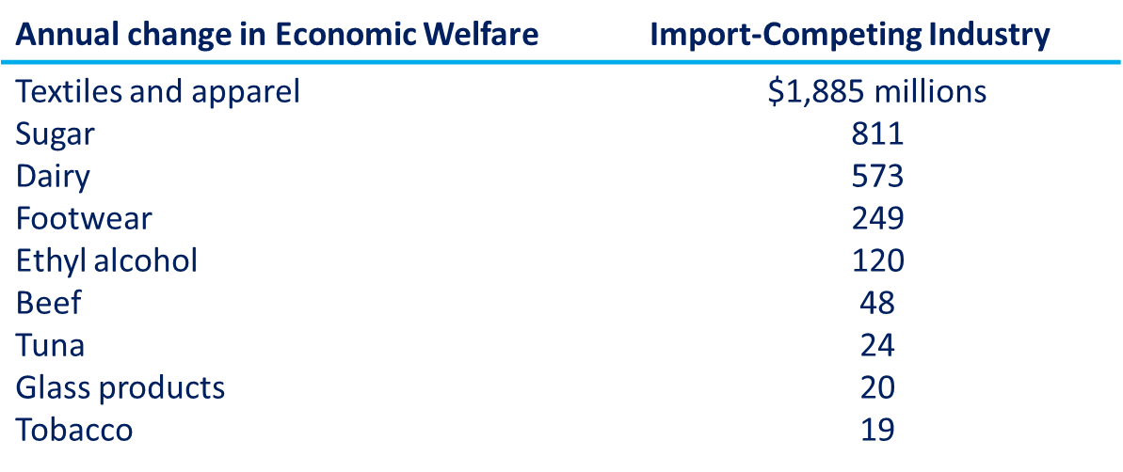
TOOLS OF TRADE POLICY
Economic welfare gains from liberalization of import restrains (tariffs, quotas)

Slide 24
TOOLS OF TRADE POLICY
Free-trade argument
If each nation produces what it does best and permits trade
In the long term
  Lower prices
  Higher levels of output, income, and consumption
  Little or no positive effect on the level of employment in the long run by protectionism
Argument for trade restrictions
  Trade benefits the domestic economy even if foreign nations impose trade restrictions
  Job losses spread across many industries
  Trading nations should temporarily shield their newly developing industries from foreign competition (infant industry)
  National security argument

Slide 25
TRADE ORGANIZATIONS
General Agreement on Tariffs and Trade
Agreement among the member nations
  To decrease trade barriers
  To place all nations on an equal footing in trading relations
Never intended to become an organization
1995, GATT - transformed into the World Trade Organization (WTO)
  Main provisions of GATT
  Include a mechanism intended to improve GATT’s process for resolving trade disputes among member nations

Slide 26
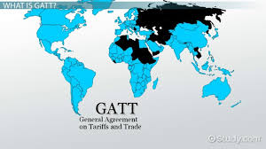
TRADE ORGANIZATIONS
Major principles of GATT system
Trade without discrimination
  MFN principle (normal trade relations)
  National treatment principle
Promoting freer trade
  Improved the dispute-resolution process
  Use tariffs rather than quotas
Binding and transparency
Multilateral trade negotiations

Slide 27
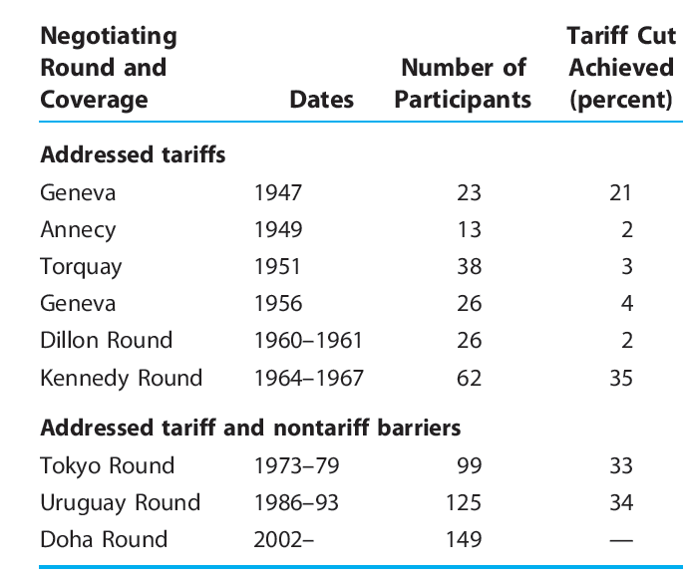
TRADE ORGANIZATIONS
GATT negotiating rounds

Slide 28
TRADE ORGANIZATIONS
WTO (World Trade Organization)
153 nations, 97% of world trade
International organization, headquartered in Geneva, Switzerland
Multilateral trading system
  Trade in services, intellectual property, and investment
Administers a unified package of agreements to which all members are committed
Oversees
  Implementation of the tariff cuts
  Reduction of nontariff measures
Watchdog of international trade
Database - trade measures and statistics

Slide 29
INTELLECTUAL PROPERTY RIGHTs
Intellectual property rights (IPRs) violations
  Pirates
  Counterfeiters
  Other infringers
Intellectual property
  An invention, idea, product, or process
  Registered with the government
  Awards the inventor (or author) exclusive rights to use the invention for a given time period
  Copyrights
    To protect works of original authorship
    For the remainder of the author’s life plus 50 years
  Trademarks
    To manufacturers
    Exclusive rights to a distinguishing name or symbol
  Patents
    Inventor - for a term (15 years or more) - exclusive right to make, use, or sell the invention

Slide 30
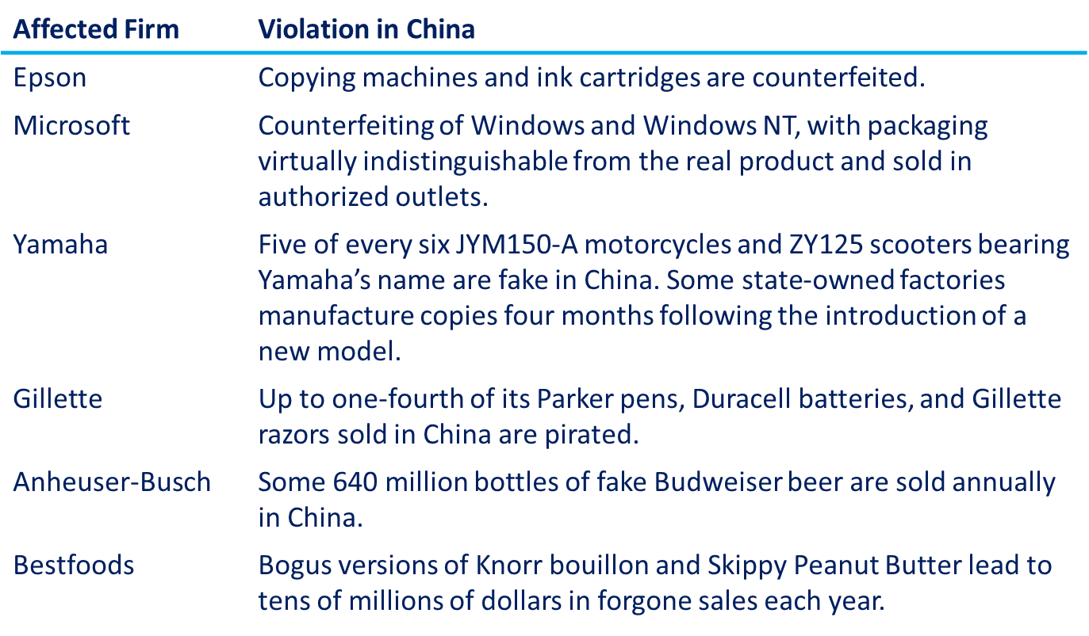
INTELLECTUAL PROPERTY RIGHTs
Examples of intellectual property right violations in China

Slide 31
WORLD ECONOMY
Thank you for your Attention!

