Slide 1

Financial Statements – Statement of Financial Position (Balance Sheet) and Income Statement
Ing. Markéta Šeligová, Ph.D.
Financial Statements – Statement of Financial Position (Balance Sheet) and Income Statement

Slide 2

Balance Sheet or Statement of Financial Position – Definition
The balance sheet (statement of financial position) is a statement (not an account) which shows financial position of an entity at a certain date.
It is one of the most important financial statements prepared by a business. It is a snapshot of what an organization owns (assets) and owes (liabilities) at a specific date.

Slide 3
Types of Balance Sheet
  There are two types of balance sheet. These are given below:
  (1) Balance Sheet – Horizontal Style
  (2) Balance Sheet – Vertical Style

Slide 4
(1) Balance Sheet – Horizontal Style and its Format
Though sometimes balance sheet is prepared in two sided format, but do not think that it is a ledger account.
It is presented in this format purely for ease of understanding. It is actually the expression of the accounting in a more detailed and organized form. We can see that balance sheet prepared below verifies the accounting equation.

Slide 5
(1) Balance Sheet – Horizontal Style and its Format
Though sometimes balance sheet is prepared in two sided format, but do not think that it is a ledger account.
It is presented in this format purely for ease of understanding. It is actually the expression of the accounting in a more detailed and organized form. We can see that balance sheet prepared below verifies the accounting equation.
It is called balance sheet because its two sides always balance. This makes sense as a business does not own anything at its own and it has to pay for all of its assets by either getting them from owner’s (capital/equity) or borrowing money (liabilities) from outsiders.

Slide 6
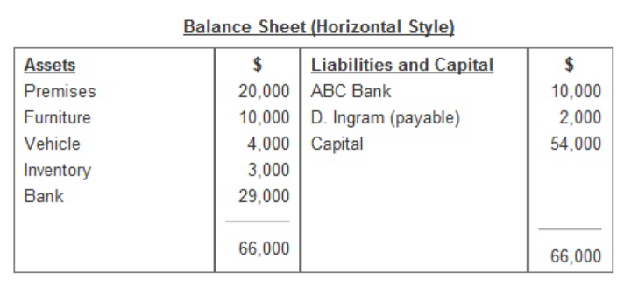
(1) Balance Sheet – Horizontal Style and its Format

Slide 7
(1) Balance Sheet –Vertical Style and its Format
This is in fact another way of expressing accounting equation. Instead of accounting equation being applied horizontally across the page, it may be written down the page.
The two totals are directly underneath instead of being side by side.

Slide 8
(1) Balance Sheet –Vertical Style and its Format
This is in fact another way of expressing accounting equation. Instead of accounting equation being applied horizontally across the page, it may be written down the page.
The two totals are directly underneath instead of being side by side.
An amount in parentheses indicates a negative amount.
In this case liabilities which are shown on the other side of the equation are subtracted from assets to determine amount of capital.

Slide 9
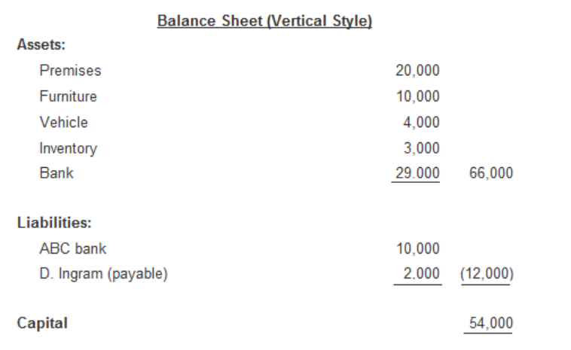
(1) Balance Sheet –Vertical Style and its Format

Slide 10
Accounting Equation
The whole system of accounting has developed from the same basic tenet of a single equation.
As a business does not own any thing at its own, so whatever resources, it owns may come from two sources as shown below:
    Resources of the business = Sources of resources

Slide 11
Method of Expressing Basic Accounting Equation:
Initially, all the assets may be provided to the business by the owner and some businesses solely rely on owner’s investment. In that case accounting equation may be expressed as:
    Assets = Capital
However, as it is usual for the business to borrow amounts from outsiders in addition to owner’s investment so in that case the basic accounting equation may be stated as follows:
    Assets = Liabilities + Equity

Slide 12
Method of Expressing Basic Accounting Equation:
The equation shows that at any given time the assets of any entity must be equal in monetary terms to the total amount of its liabilities and capital.
This also shows that an entity does not own any asset at its own rather these are provided by either of its owner or lenders. The lenders have a claim against the assets of the entity until the liabilities are paid. The owner, therefore, has a claim only on the remaining assets of the entity once lenders are paid off.
Another way of expressing this mathematical relationship involves a simple variation in the equation which shows that difference between what businesses own and what they owe represent owner’s capital.
    Equity = Assets – Liabilities

Slide 13
Understanding Terms in Accounting Equation:
In order to understand the relationship between assets, liabilities and capital, it is important to have some basic understanding of these accounting terms:
  (1) Assets, Definition and Example:
  (2) Liabilities, Definition and Example:
  (3) Equity, Definition and Example:
  (4) Drawings, Definition and Example:

Slide 14
(1) Assets, Definition and Example:
Assets are monetary or economic resources which are owned by an entity and are expressed to benefit it in future.
Moreover they must be quantified and expressed in monetary (dollar) terms.
Some items like company’s outstanding reputation, customers’ loyalty, its popular brands and its skilled and experienced work force etc., though benefit the business but cannot be quantified and expressed in monetary terms.

Slide 15
(1) Assets, Definition and Example:
In the absence of any objective monetary value these items are not reported as assets in the accounting records.
Examples of assets include land, buildings, equipment, vehicles, investments, inventory, accounts receivable, cash, etc.

Slide 16
(2) Liabilities, Definition and Example:
Liabilities are obligations of an organization to pay to other entities including individuals, government and financial institutions, or other business.
They represent amounts owed to lenders and suppliers. Examples of liabilities include bank overdrafts, loans taken out for the business.
Liabilities may also include advances from customers for a future sale or rendering a service in future.

Slide 17
(3) Equity, Definition and Example:
Equity is the investment made by the owner in his business including any accumulated profits and reduced by losses and withdrawals by him.
In most cases owner’s capital takes the form of cash or other assets brought by the owner into the business.
However, owner may introduce capital by paying a business liability out of his personal account.
Similar to liabilities capital is also an obligation of the business to pay to the owner; however business is not obligated to pay the amount of capital in the normal course of events.

Slide 18
(4) Drawings, Definition and Example:
Drawings represent the amounts of business cash or other assets withdrawn by the owner for his personal use.
Drawings also occur when business makes payment for owner’s private expenses.
In order to avoid unnecessary detail in the owner’s capital balance, a separate record is kept for drawings to include all the withdrawals made by the owner during the year.
At the end of accounting period, the total amount in the drawing account is closed and adjusted against the owner’s capital to determine the net value of owner’s investment left within the business after all withdrawals.

Slide 19
Thank you for your attention.

