Slide 1

Training of the 1st year students
Fire Protection, Occupational Safety and Health Protection
Ing. Dagmar Kloknerová
kloknerova@opf.slu.cz
September 2021

Slide 2
Notice
OSH and FP course is listed in the Faculty courses under the abbreviation OPFBAOPF.
According to the Study and Examination Regulations, students are obliged to enroll in the course themselves.
For students, training is provided within the scope of staff training.
Initial training of students – OSH and Fire Protection

Slide 3

Legislation
According to the applicable laws, newly admitted students are required to familiarize themselves with the regulations governing Fire Protection (abbreviation FP) and Occupational Safety and Health (OSH)
Source of information:
Study materials for the course „OPF:OPFBAOPF Initial training course in OSH and FP“ in the form of an interactive syllabus, which contains the text of the basic training, study materials, references to legislation and especially the TEST – a credit requirement (min. success rate of 60%, the test can be retaken).
Files and links to the regulations are available:
OSH and FP Initial Training for students
Rector’s Directive No. 20/2018 and No. 1/2015
Note.: The interactive syllabus (also for other courses) is accessible after logging into the IS SU using the „Student“ tile.
Initial training of students – OSH and Fire Protection

Slide 4
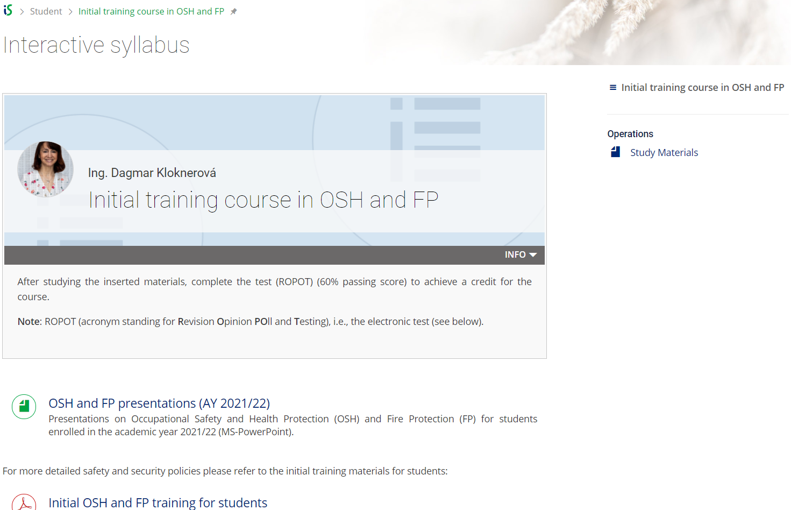
Initial training of students – OSH and Fire Protection

Slide 5
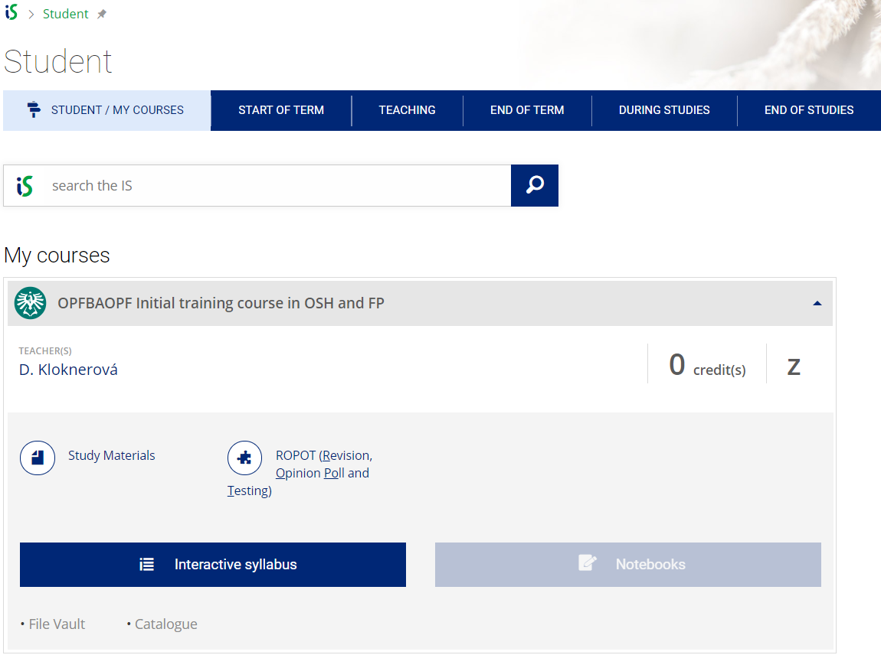
Initial training of students – OSH and Fire Protection

Slide 6
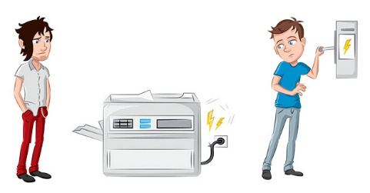
Fire Protection – Basic obligations under the Fire Protection Act No. 133/1985 Coll.
Everyone is obliged to act in such a way as not to cause a fire and to contribute to the proper performance of tasks in FP, especially by providing the necessary personal and material assistance.
Anyone who observes a fire that he or she cannot extinguish on his or her own is required to sound the alarm immediately in accordance with the displayed fire alarm guidelines posted in all SU facilities and to notify the fire brigade so that they can intervene as soon as possible.
Initial training of students – OSH and Fire Protection

Slide 7

Fire Protection
Rector’s Directive No. 20/2018 on the Provision of Fire Protection at the SU
Art. 6 – Students’ Obligations
to conduct themselves at work and study in such a way that they do not cause a fire, particularly when using thermal, electrical, gas and other appliances and chimneys, when storing, and using flammable or fire-hazardous substances or handling them or open flames or other sources of ignition; to observe regulations and instructions to ensure fire protection
participate in fire protection training
to report any defects that could jeopardize fire safety to the nearest University staff member and, to the greatest extent possible, to participate in their elimination
to maintain clear access to electrical, water and gas distribution facilities and clear escape routes
when observing a fire, take the necessary measures to rescue endangered persons, put out the fire or take the necessary measures to prevent its spread; if this is not possible, immediately report it in the manner specified by the fire alarm directives, or ensure its notification and provide personal and material assistance at the request of the intervention commander, the fire brigade commander or the municipality
Initial training of students – OSH and Fire Protection

Slide 8

Fire Protection
Students mustn’t
perform activities that may result in a fire
smoke and handle open fire in the buildings
damage or misuse fire extinguishers or other fire protection equipment
use their own appliances (except for portable audio equipment, an exception may be the provisions of the dormitory regulations)
deliberately call a fire brigade for no reason or use the emergency line inappropriately
Initial training of students – OSH and Fire Protection

Slide 9
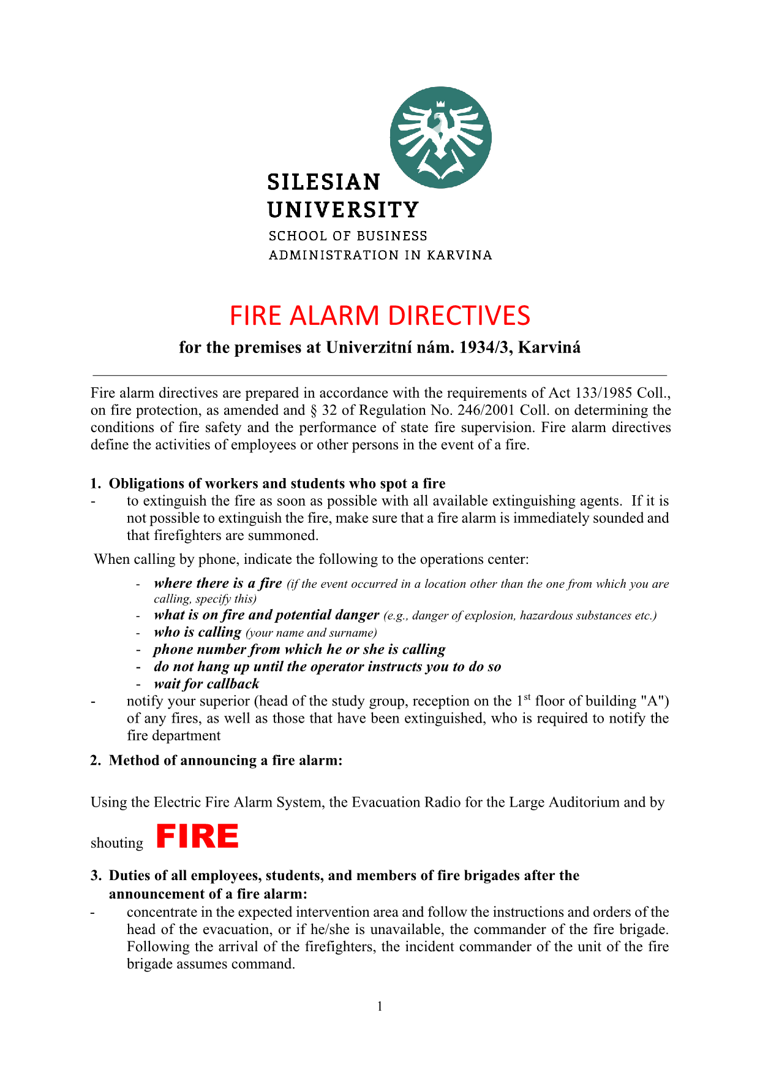
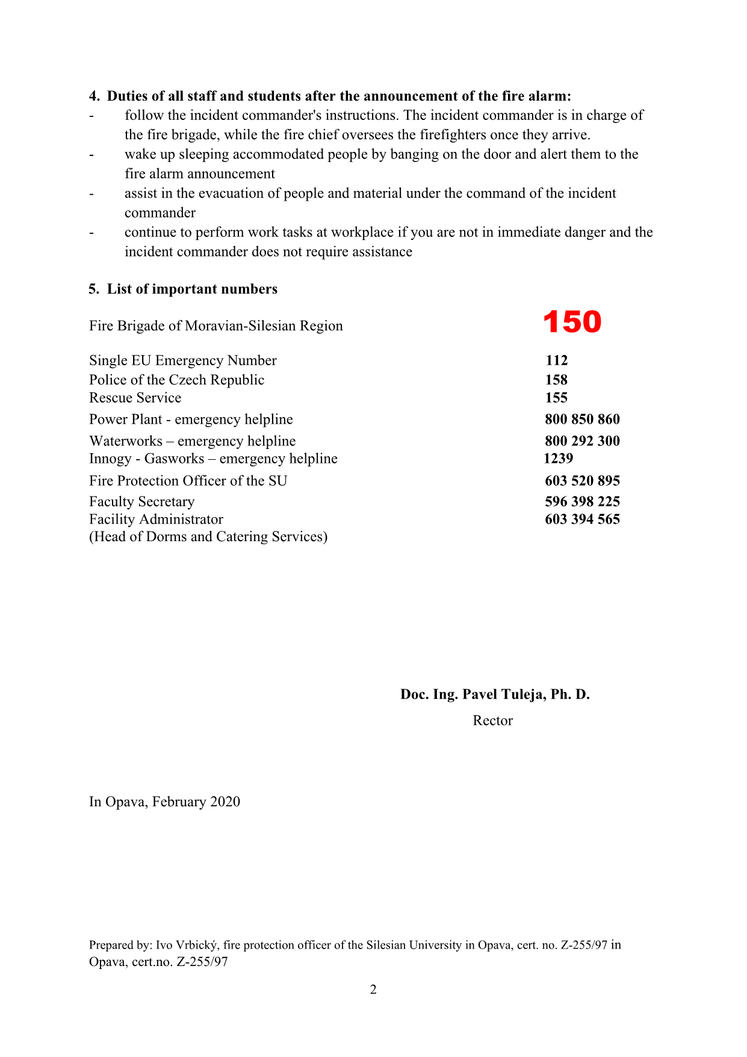
Fire Alarm Guidelines
Initial training of students – OSH and Fire Protection

Slide 10
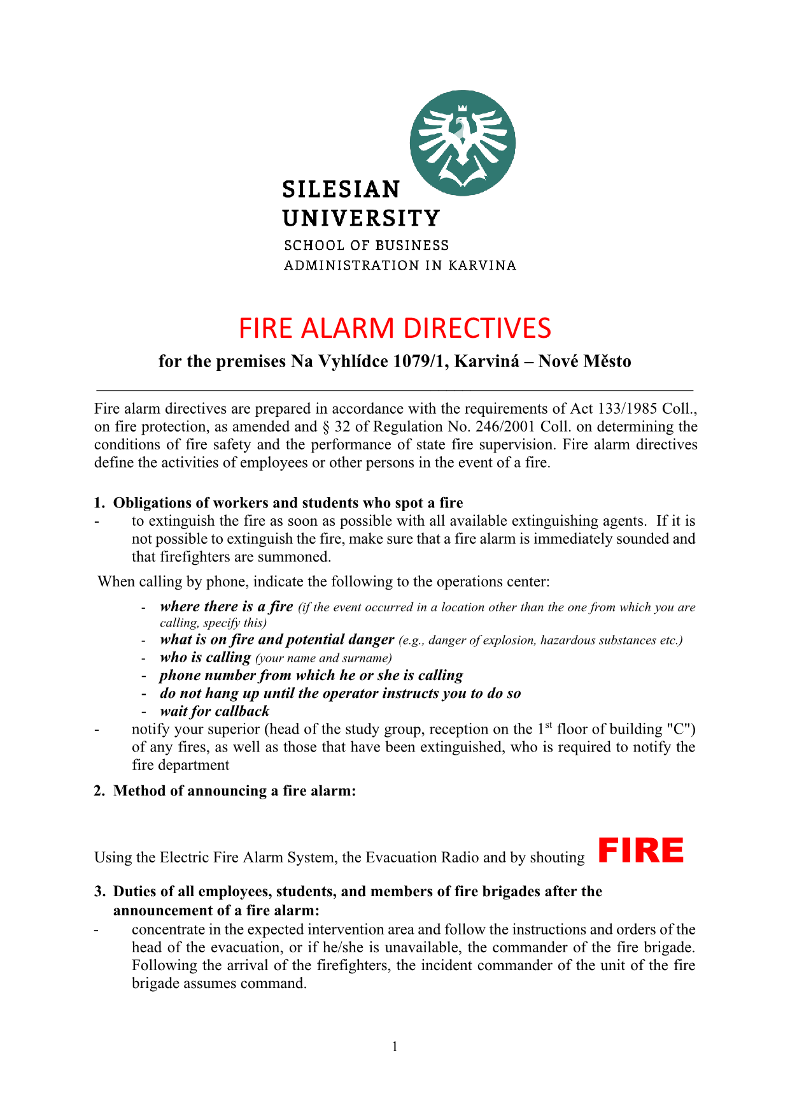
Fire Alarm Guidelines
Initial training of students – OSH and Fire Protection

Slide 11
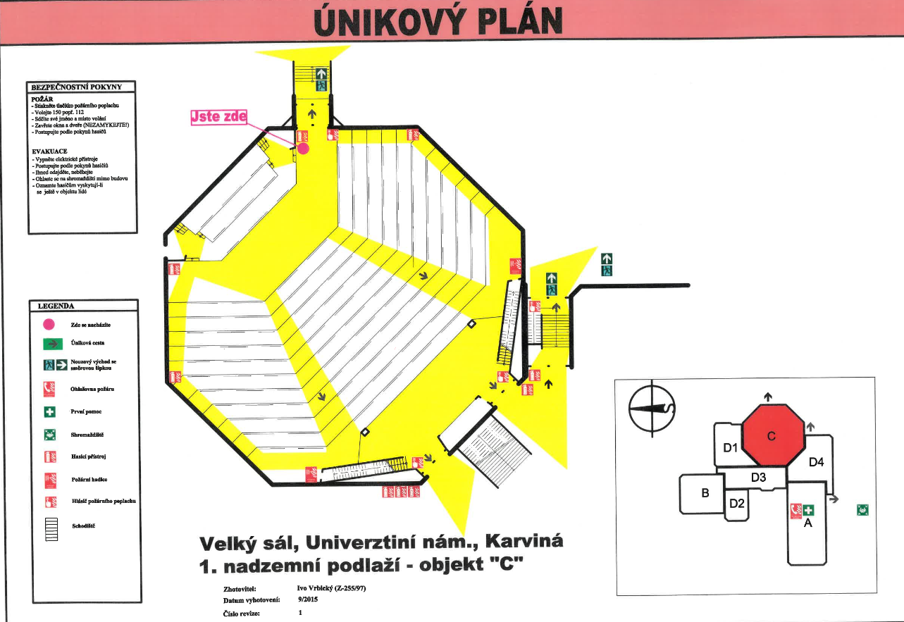
Evacuation Plan – Large Auditorium (Velký sál), Univerzitní náměstí
Initial training of students – OSH and Fire Protection

Slide 12
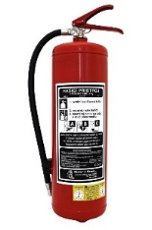
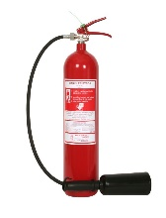
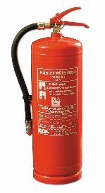
Portable fire extinguishers
1. Powder fire extinguisher
It is referred to as universal, as it is suitable for almost all types of fires, even for extinguishing fires of electrical equipment with a voltage of up to 1000 V.
2. Snow extinguisher
It is used for extinguishing electrical equipment of all kinds and liquid substances burning with a flame. It cannot be used to extinguish bulk substances that could be agitated by a gas stream.
3. Water fire extinguisher
Suitable for extinguishing burning solids - wood, paper, plastics, rubber, coal, straw, etc. Not suitable for flammable liquids, paints, tar, grease. Do not extinguish equipment under electrical voltage.
Initial training of students – OSH and Fire Protection

Slide 13
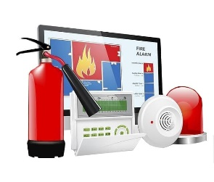
Occupational Safety and Health
Rector’s Directive No. 1/2015 on the Provision of OSH
A student who violates the provisions of this Directive or the provisions of legal regulations relating to OSH constitutes a serious breach of obligations arising from legal regulations relating to studies in accordance with the relevant provisions of the disciplinary rules.
Initial training of students – OSH and Fire Protection

Slide 14
OSH
Art. 7 – Students’ Obligations
To be mindful of his/her own safety, his/her health, and the safety and health of individuals directly affected by his/her actions as a student.
Comply with legal and other regulations to ensure occupational safety, safety of technical equipment and occupational health, as well as other regulations and instructions, the principles of safe conduct in the workplace and the established work procedures with which he/she has been duly acquainted.
Initial training of students – OSH and Fire Protection

Slide 15

OSH
Not to consume alcoholic beverages or other addictive substances on University premises and not to study under their influence.
Inform your teacher or another employee of the University about deficiencies and defects that could endanger people’s lives and health, and, to the best of your ability, help to eliminate them.
Undergo a screening conducted by the authorized government authority or senior staff member to assess whether the student is under the influence of alcohol or other addictive substances.
A student is liable for any damage caused to the University as a result of a culpable breach of his/her obligations in the performance of his/her study tasks or in direct connection with them.
Report any accidents occurring during the performance of tasks to the relevant Head of Department.
Initial training of students – OSH and Fire Protection

Slide 16


Measures
Measures to protect against damage caused by tobacco, alcohol and other addictive substances
Pursuant to Act No. 379/2005 Coll., on measures to protect against damage caused by tobacco products, alcohol and other addictive substances and on amendments to related acts, as amended, smoking is banned in all buildings and enclosed areas utilized and owned by the University.
If a person does not comply with the smoking ban in the above-mentioned locations, even after the operator (rector, authorized person, building manager, OSH officer or relevant senior employee) has asked him/her not to do so or to leave the premises, the operator has the right to request that the municipal police or the Police of the Czech Republic take action to enforce the ban.
An employee (student) who violates the provisions of this Annex to the Directive or the provisions of legislation relating to OSH fulfils the essence of a serious breach of an obligation arising from the legislation relating to the work (study) performed according to the related provisions of the Labor Code and the relevant disciplinary regulations.
Source: Annex No. 10 RD 1/2015
Initial training of students – OSH and Fire Protection

Slide 17

Knowledge test in IS SU (ROPOT)
A student can be successful if he/she obtains a min. of 60%.
The test can be retaken.
There is no time limit for the test.
The test is time-efficient, taking only a few minutes to complete.
Initial training of students – OSH and Fire Protection

Slide 18
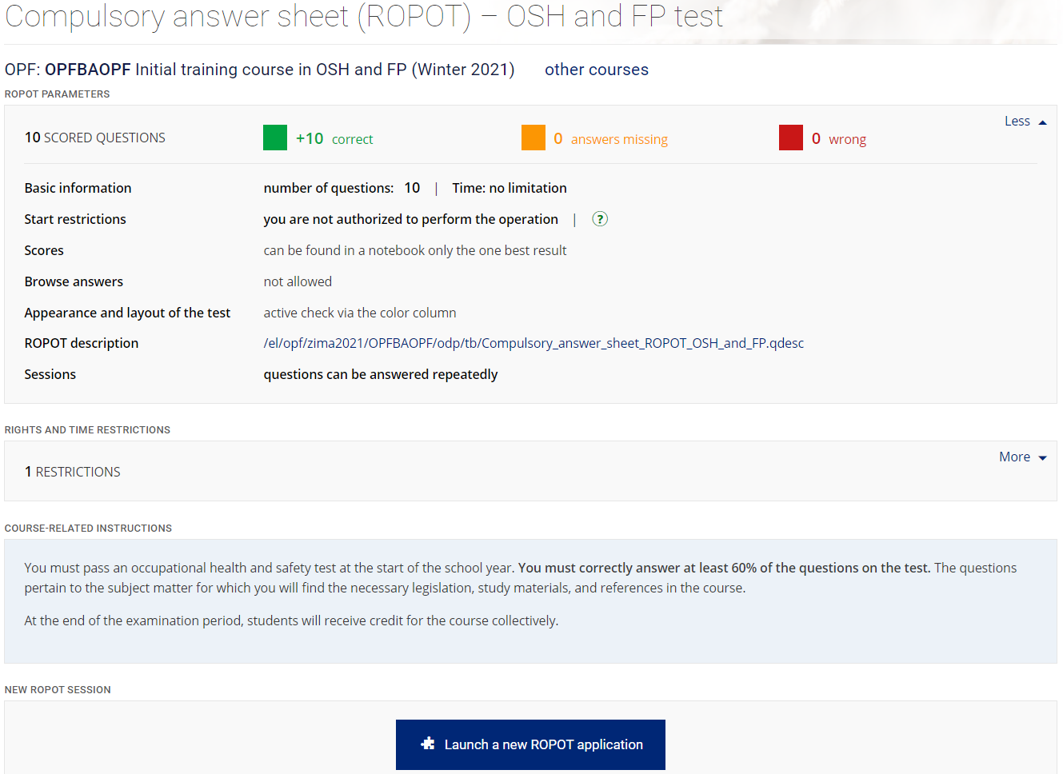
Knowledge test in IS SU (ROPOT)
Initial training of students – OSH and Fire Protection

Slide 19
Knowledge verification test
In case of a fire, an emergency, a natural disaster, the student is REQUIRED to:
provide adequate personal and material assistance, as long as this does not expose it to a serious danger or threat to oneself or a close person
inform the supervisor and take no action
take to his / her heels
Initial training of students – OSH and Fire Protection

Slide 20
Knowledge verification test
2. Students MUSTN‘T:
carry out activities that could result in a fire
damage or misuse fire extinguishers or other fire protection equipment
use their own appliances (except for portable audio equipment, an exception may be made in the dormitory regulations)
Initial training of students – OSH and Fire Protection

Slide 21
Knowledge verification test
3. Which injuries are considered work-related:
injuries arising out of or in direct connection with performing work tasks
all injuries arising solely in the workplace
all injuries occurring on the premises of the organization
Initial training of students – OSH and Fire Protection

Slide 22
Knowledge verification test
4. Smoking is permitted in the workplace, school or educational establishment:
anywhere
is not allowed in any case
only in designated areas
Initial training of students – OSH and Fire Protection

Slide 23
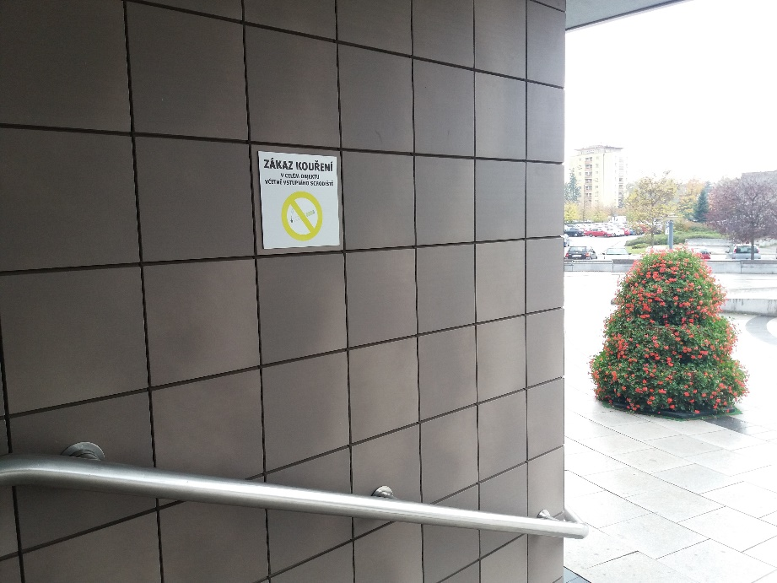
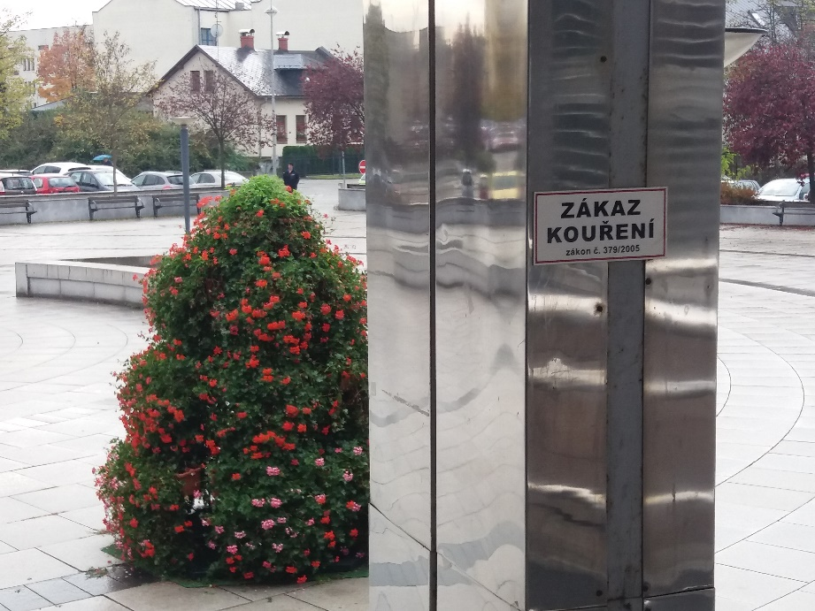

Signs
Initial training of students – OSH and Fire Protection

Slide 24
Knowledge verification test
5. Every workplace injury:
has to be reported
has to be reported immediately and entered in the accident report book
does not have to be reported, it suffices to treat it
Initial training of students – OSH and Fire Protection

Slide 25
Knowledge verification test
6. Own electrical and thermal appliances (e.g., kettles, hairdryers, etc.) are used:
as required
after approval by the State Fire Marshal
only with the permission of the landlord and employer and in designated areas
Initial training of students – OSH and Fire Protection

Slide 26
Knowledge verification test
7. The obligation of a proper initial training applies in OSH to:
employees transferred from another workplace
only employees newly admitted to the organization, apprentices, pupils and students coming to practice and part-time workers
senior staff only
Initial training of students – OSH and Fire Protection

Slide 27
Knowledge verification test
8. Who is responsible for the performance of tasks in the care of OSH and order at the workplace:
university staff members
senior staff at all levels of management
security technician
Initial training of students – OSH and Fire Protection

Slide 28
Knowledge verification test
9. The water extinguisher is suitable for extinguishing:
solid organic substances burning with flame or glow, in enclosed spaces
light and alkali metals
live electrical equipment
Initial training of students – OSH and Fire Protection

Slide 29
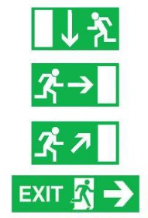
Knowledge verification test
10. Escape routes in the workplace:
permanently free
may be temporarily blocked
need not to be free
Initial training of students – OSH and Fire Protection

Slide 30
We wish you a successful entry into the academic year
2021/2022 in good health, without injuries and
adverse events.

