Slide 1
University information systems
Academic year 2021/2022
Information for the 1st year students
Ing. Andrea Valentíny
Bc. Veronika Novotná
September 2021

Slide 2
Information systems at SU SBA
CRO (central register of persons), Novell
Horde (email)
IS SU (study agenda)
ISKaM (dormitories and catering)
JIS (student ID cards)
Tritius (library)
Websites, Intranet
In case of any technical issues, please contact helpdesk@opf.slu.cz and/or international@opf.slu.cz from your faculty email address.

Slide 3
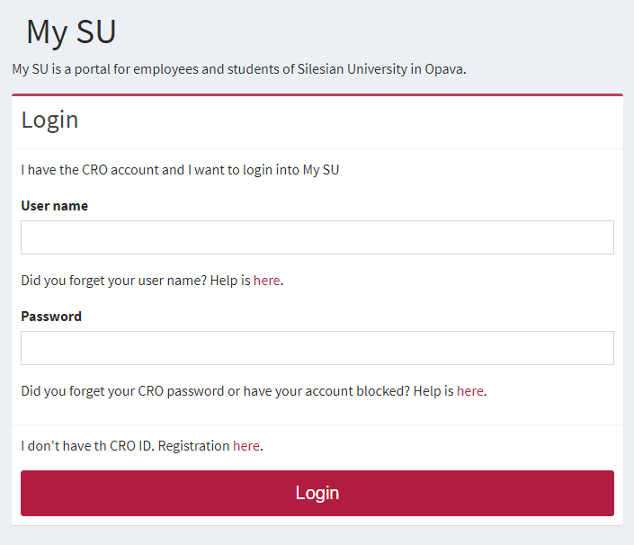
CRO single login system
Enables comfortable access to ICT services thanks to single login details – users use their electronic identity in CRO (Central Register of Persons), so they don’t need to memorize a large number of login details: moje.slu.cz
At moje.slu.cz:
You can create your university account.
You can recover your forgotten password.
Set up Eduroam Wi-Fi login details (in Settings menu).
Change your passwords.
You only have one CRO identity during your studies.
Remember your CRO login details well and don’t share them with anyone!

Slide 4
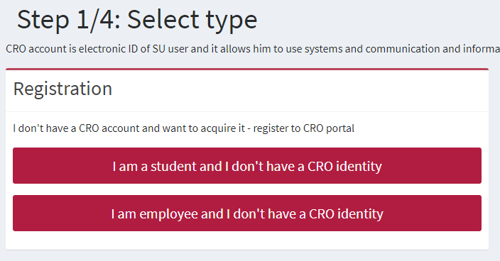
CRO set up – go to https://moje.slu.cz/
Registration is possible only after 2 days from your official enrollment to study!
If you don’t have a CRO identity yet, please click on „here“.

Slide 5
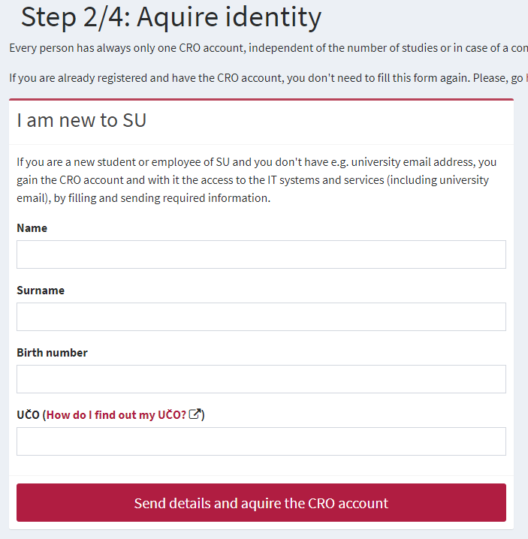
CRO set up – go to https://moje.slu.cz/
After sending the request to acquire the CRO account, you will be able to see your newly created CRO username (e.g. nov0216).
Please follow the next steps:
Enter your personal email address or a Czech phone number in order to receive a verification code.
Enter the 6-digit code that was sent to your personal email address or a Czech phone number. The validity of the code is just 5 minutes!
Create your CRO password. The password has to have at least 8 characters including lower-case and upper-case letters and a digit. No special characters are allowed.
You will receive a birth and UČO number on your personal email provided in your application. In case you haven’t received it, please contact us at international@opf.slu.cz. Degree students can also find their UČO inside their e-application in IS SU.

Slide 6
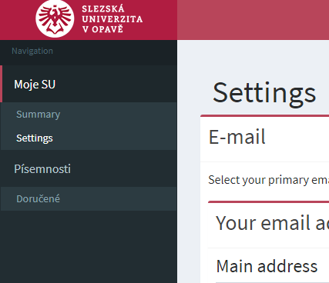
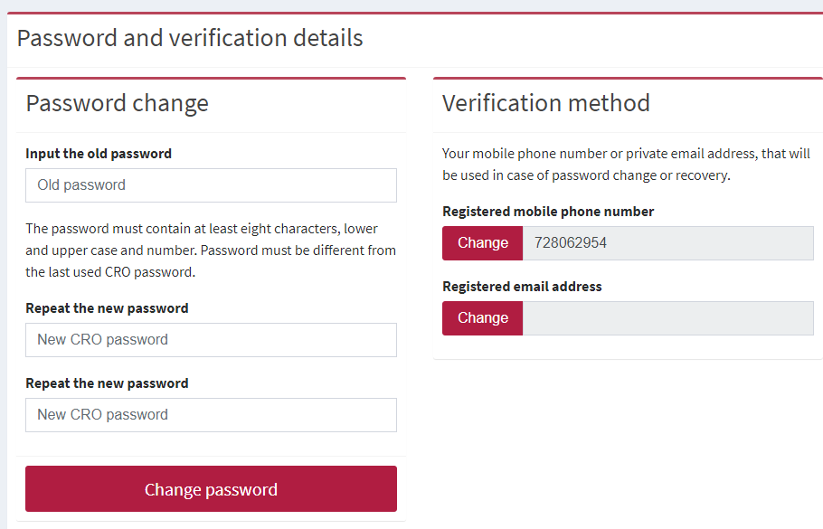
CRO account – password and verification contact change
You can change your CRO password at: https://moje.slu.cz/ in the Settings

Slide 7
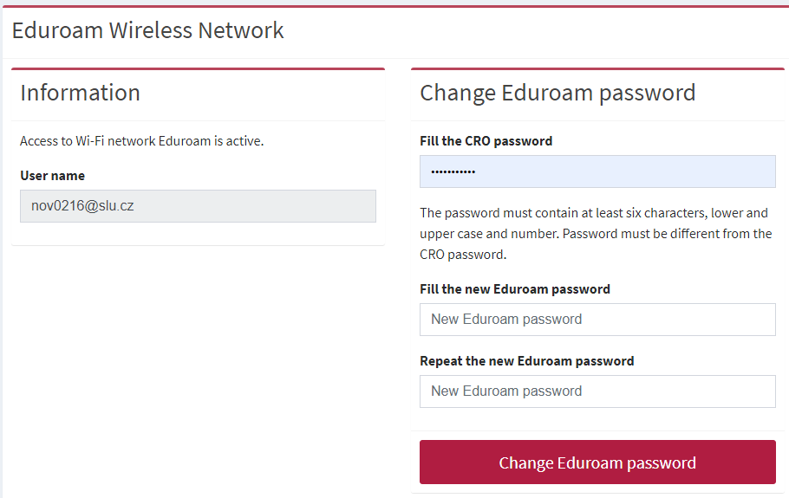
Eduroam Wi-Fi set up
Eduroam Wi-Fi is available at all university premises including the dormitory and campus for free. Eduroam is widely used at most of the higher education institutions and other public institutions. For more information on coverage, visit: https://www.eduroam.org/
Login at https://moje.slu.cz/ with your created CRO identity (username and password),
go to Settings and create (or change) your Eduroam password.

Slide 8
Eduroam Wi-Fi set up
To connect into Eduroam Wi-Fi, use your CROusername@slu.cz and your Eduroam password.
To set up Eduroam on your device, we recommend to download Eduroam CAT (Configuration Assistant Tool).
More information is available at: https://uit.opf.slu.cz/sluzby/wifi/visitors_information
In case of specific problems with connection, you can email helpdesk@opf.slu.cz or visit the IT staff in person in the room A428, main faculty building.
E.g.: abc0001@slu.cz

Slide 9
Horde – faculty email
Communication with teachers, academics and other faculty members is only possible via official faculty email address!
Access: https://horde.opf.slu.cz or https://mail.slu.cz/
please use your CRO username and password to login
Guides on how to:
set up forwarding to your personal email address: https://uit.opf.slu.cz/horde/preposilanien
set up external e-mail clients: https://uit.opf.slu.cz/horde/externien
After login into https://www.slu.cz/opf/en/, you can see the menu „Students“ and access „E-mail“ also in the „Services“ section.

Slide 10
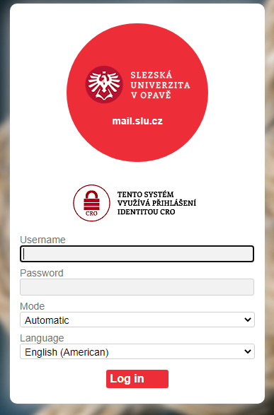
Horde – faculty email
Principles of email communication:
Fill out a subject – name of the topic or problem to which the email relates
Don’t forget to address the person formally inside the email body.
„Add Cc“ in case you want to send a copy to one’s address; „Add Bcc“ for a blind carbon copy.
Be brief and specific – send a maximum of around 25 lines, include the most important part in the first paragraph.
If necessary, „Add Attachment“– always mention in the text that you are attaching a file.
Formal closing (Best Regards etc.) + signature – for setting up an automatic signature, please see the following slide.
Reply – if your previous issue has not been resolved, it's a good idea to write an email in the reply, not a new message.

Slide 11
Horde – faculty email
Setting up an automatic signature
After login, go to „Settings“ > „Preferences“ > „Mail“ > „Personal information“ and set up „Your signature“
Don't forget to update your signature as you advance to the next year!
Example:
UČO: 6584 – John Brown
1st year, Master’s degree, full-time
Program: Economics and Management
Field of study: Business Economics and Management

Slide 12
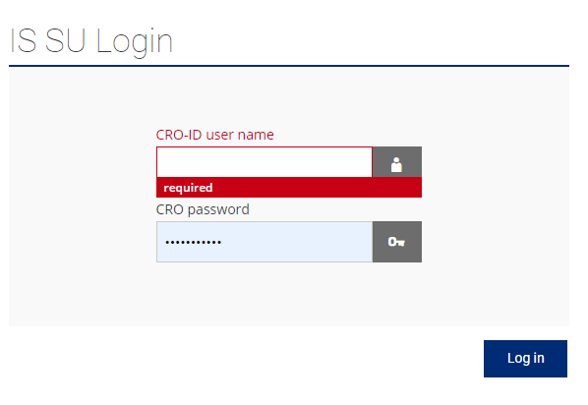
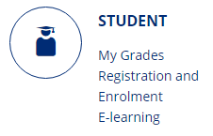
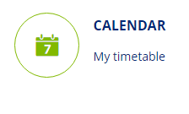
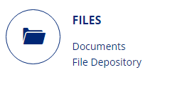
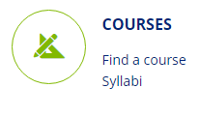
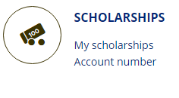
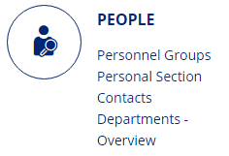
IS SU - study agenda
Access to IS SU: https://is.slu.cz
Includes information on the course of study in the following areas:
Enrollment and registration of courses, schedules
Study checks – according to the study plan template
Homework vaults – for submitting seminar papers
Registration for examination dates
End of studies – submission of Master thesis, registration for state final exams
Courses, teachers, classrooms
Scholarships, tuition fee payments
Document office – student applications, requests

Slide 13
IS SU - study agenda
Login to is.slu.cz with your CRO username and password. If you have/had more than one study, you still have only one account. After logging in, you can switch between your current studies (upper right corner).

Slide 14
IS SU - study agenda
Always make sure that you have the correct faculty and semester selected (in the upper right corner), e.g., when registering for courses or looking at timetables.
Help section is available in the footer of the page. For some tasks, there is a help icon , which you can expand to get more information.
Use the search field if looking for anything (hand glass icon)
UČO is your university personal number
It is necessary to log out when you finish working in IS SU. Shutting the computer down does not log you out!

Slide 15
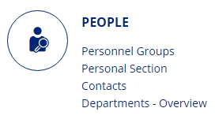
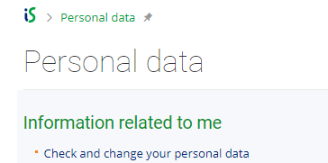
IS SU - study agenda
Check your personal data:
Go to PEOPLE/Personal Section. In case you can not see PEOPLE application, click on „More applications“.
In Personal Section/Personal Data, go to „Check and change your personal data“
In „Check and Apply for Changes in Personal Information/Records“ section, proceed according to the context help section (green parts).
After updating all information, click on „Submit the application for changes“.
Guide also available at: https://uit.opf.slu.cz/osobudajen

Slide 16
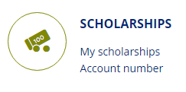
IS SU - study agenda
For MASTER DEGREE students only
Add your Czech bank account number:
In SCHOLARSHIPS application, you can add your account number, once you open one in the Czech Republic, after your arrival.
In case you can not see the application, click on „More applications“.
Please note that scholarships can only be paid on Czech bank accounts.

Slide 17
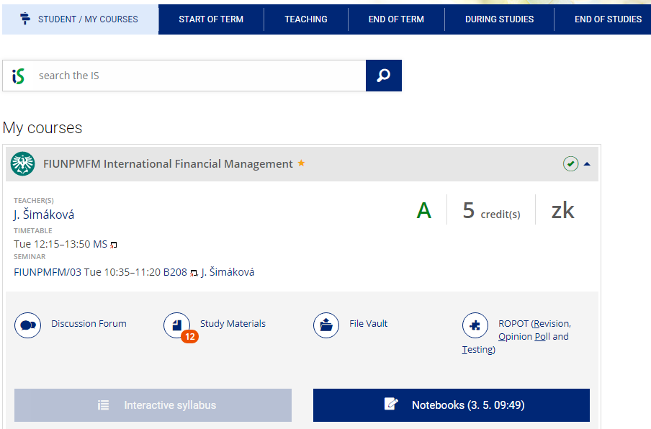
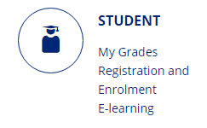
IS SU - study agenda
In STUDENT application, follow the blue bar referring to course of your study.
STUDENT/MY COURSES:
For enrolled courses, you can access:
Study materials
Interactive syllabus
Discussion forum
Seminar groups (overview)
Exams (registration for examination dates)
Catalogue (accreditation document)
Notebooks (test or exam scores)
Information about enrolled course

Slide 18
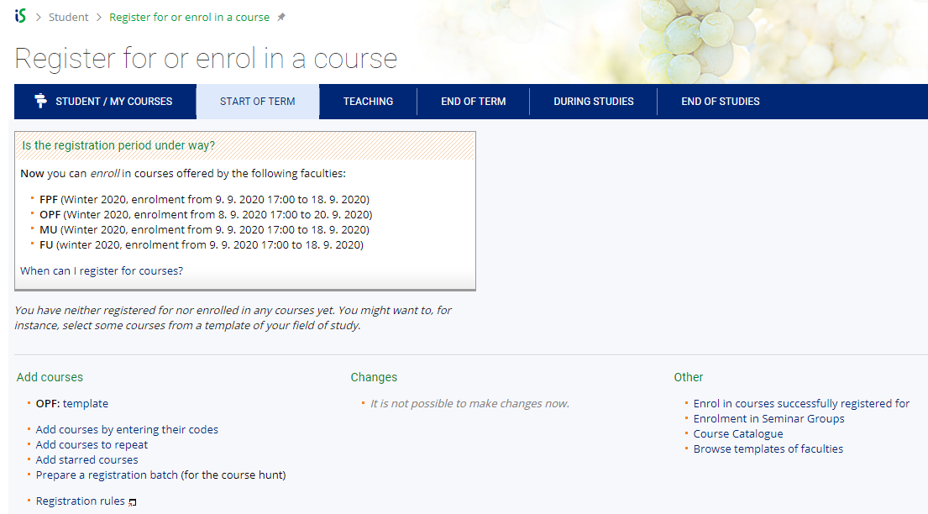
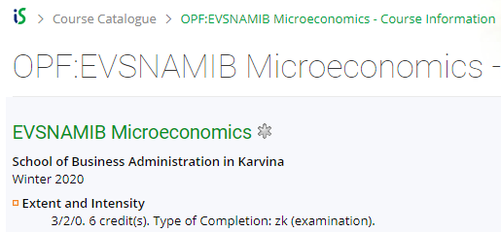
IS SU - study agenda
Registration for courses and enrolment:
Go to STUDENT > Registration and Enrolment > START OF TERM
OPF = SBA in Karvina
MASTER DEGREE students:
The best way how to register for courses is to register through
OPF: template
Do not forget to enroll for seminar groups as well. You can check whether your course has (apart from lecture) also a seminar, in the Course Catalogue below
(by searching the course code).
E.g.: Microeconomics course has 3 teaching hours of a lecture and 2 teaching hours of a seminar
EXCHANGE (e.g., Erasmus) + VISITING students:
The best way how to register for courses is to register by „adding courses by entering their codes“
List of courses: https://www.slu.cz/opf/en/listofcourses

Slide 19
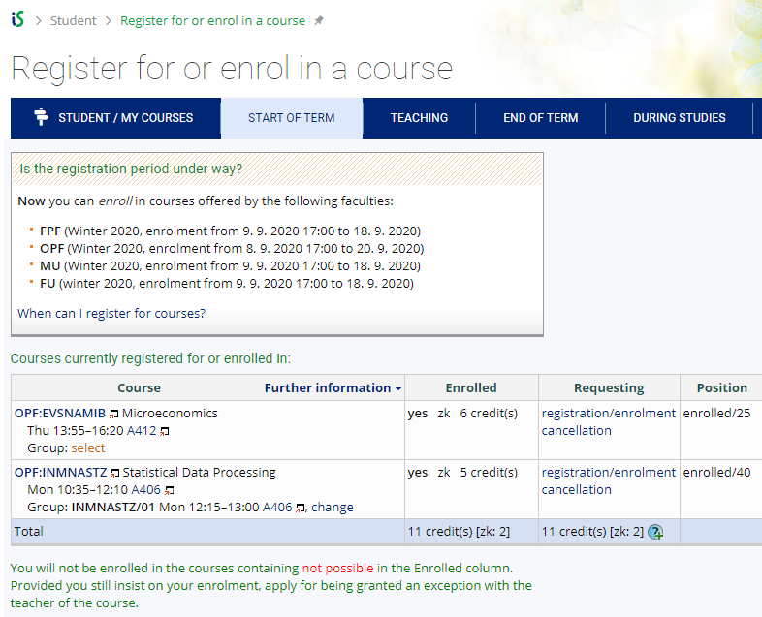
IS SU - study agenda
Not registered for a seminar group yet
In case you are having trouble registering for a course, submit an application for exception.
Registered for a seminar group

Slide 20
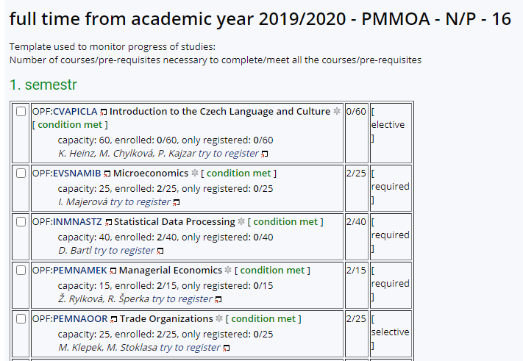
IS SU - study agenda
MASTER DEGREE students only: in OPF template you can see which courses are:
Required (P) = compulsory
Selective (PV) = compulsory elective
Elective (V) = facultative
Required and Selective
courses are mandatory
to register for.
Already passed courses are marked [condition met]
During your 2-year studies, you need to complete at least 13 ECTS credits from „elective“ courses.
During the first week of the semester, you can make changes to your timetable yourself or you can send an email to is@opf.slu.cz.
In your email, always include your UČO number and course code with seminar group number.
E.g.: EVSNAMIB/01
You can only request a change in your seminar group number in case your classes colide!
To register for a course,
click on „try to register“

Slide 21
IS SU - study agenda
All students shall enrol the course „OPFBAOPF Training course in OSH and FP“ in their first semester.
Couse syllabus: https://is.slu.cz/course/opf/winter2021/OPFBAOPF
There are no credits awarded for passing the course.
The course is mandatory for all students and is passed by completing an online test from safety and health protection measures applicable in the university buildings.
You will have several attempts to pass the online test.
There is no scheduled lecture nor a seminar group for this course. It only takes place in IS SU.

Slide 22
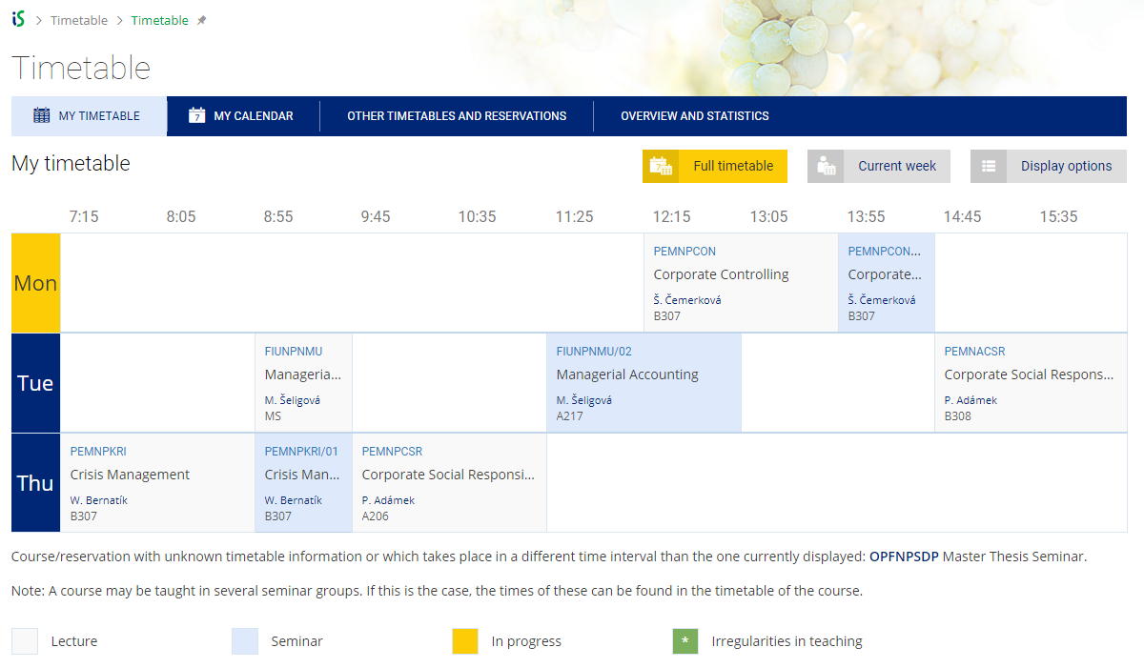
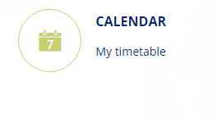
IS SU - study agenda
You can access your timetable at CALENDAR/ My timetable.
During the semester, there might be slight changes in the timetable. In case of changes, you will be informed by email.
After enrolment, you can print your timetable here:
Teacher’s name
Room numbers:
A, B, C, D – main faculty building (Univerzitní nám.)
V – Dormitory building „Na Vyhlídce“
MS – Small Hall (D104)
VS – Large Hall (C001- C004)
AULA – Auditorium/Aula (B115)

Slide 23
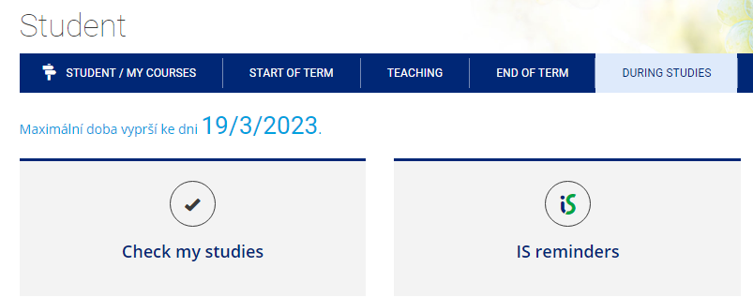
IS SU - study agenda
For MASTER DEGREE students only:
To check your studies according to the OPF template (study plan), go to:
STUDENT/DURING STUDIES/ Check my studies
Study plan template

Slide 24
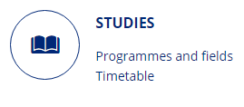
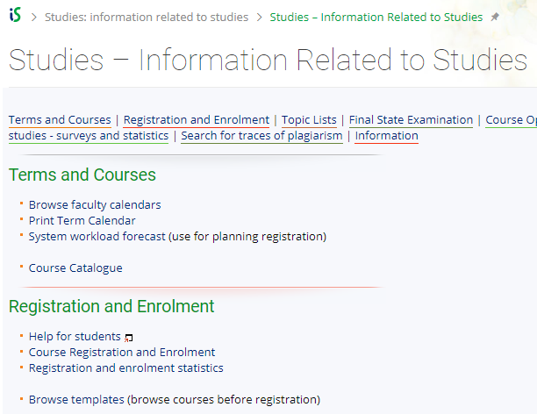
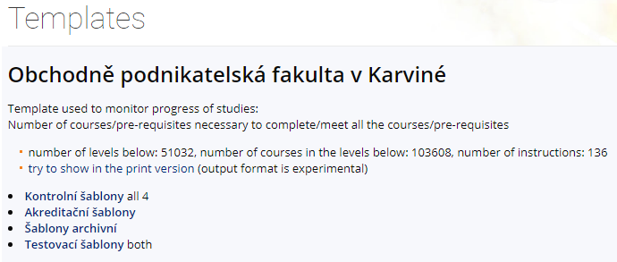
IS SU - study agenda
For MASTER DEGREE students only:
To access a study plan template, you can also go to STUDIES/ Registration and Enrolment/ Browse templates
We recommend to display the template in the print version.

Slide 25
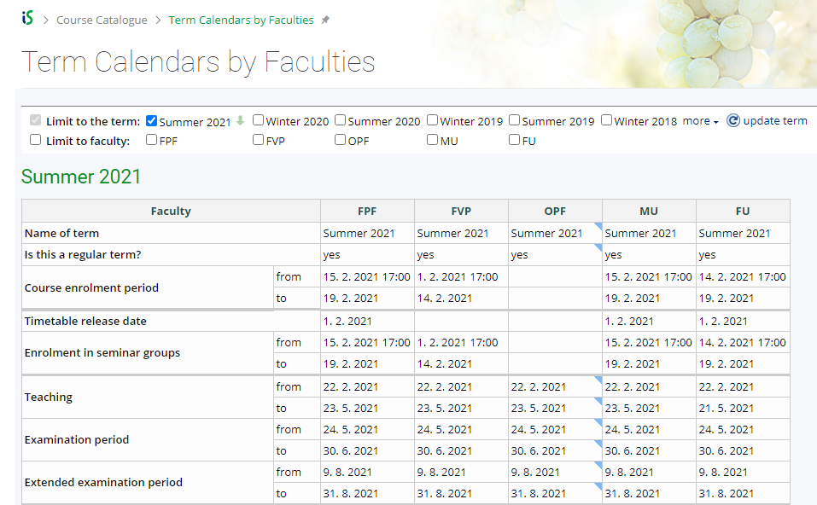
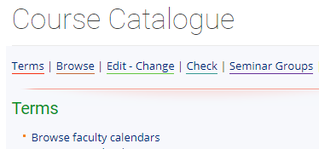
IS SU - study agenda
For MASTER DEGREE students only:
The date of enrolment and registration for courses of the summer semester will be announced later in January according to the calendar. You can see the important dates in Course Catalogue/ Browse faculty calendars or on our website: https://www.slu.cz/opf/en/quickfactsanddeadlines - Academic calendar
OPF = SBA in Karvina
Registration for :
Courses (lectures) starts at 5PM
Seminar groups starts at 6PM

Slide 26
IS SU - study agenda
Changes to your timetable or Learning Agreement
MASTER DEGREE students:
During the first week of the semester, you can make changes to your timetable yourself or you can send an email to is@opf.slu.cz or contact the International Relations Office in case of any issues.
In your email, always include your UČO number and course code with seminar group number.
EXCHANGE (Erasmus) and VISITING students:
You can make changes in your Learning Agreement (LA) and your timetable during the first 2 weeks of classes (within 2 weeks after the start of the semester).
To request a change in your LA, please contact your International Coordinators at your home and host institution.
Lecture/seminar dates and times for 1 course are usually given so students can not usually choose between more options for 1 course.

Slide 27
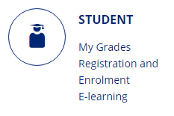
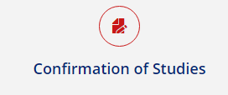
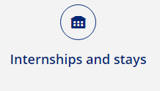
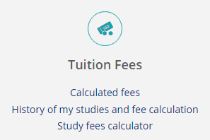
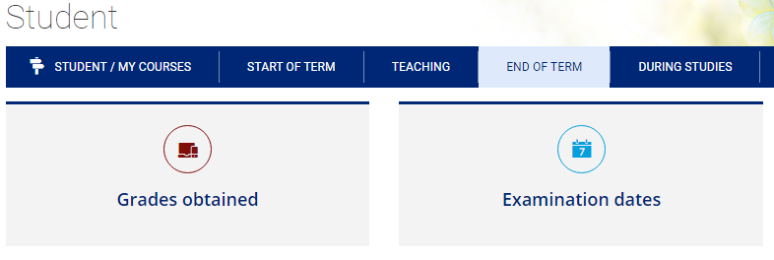
IS SU - study agenda
During your studies, you can access other applications, such as Internships and stays, Confirmation of Studies, or Tuition Fees
(mostly for DEGREE students)
In the END OF TERM section, you can access other applications, such as
Grades obtained or
Examination dates

Slide 28
IS SU - study agenda
Confirmation of Studies
The electronic confirmation of study is a full-fledged variant of the confirmation of study printed on paper, stamped and signed by the responsible person. Authenticity (who issued the certificate) and integrity (that the content of the certificate is not altered) is ensured in the electronic certificate by an electronic seal stored inside a PDF file. The electronic seal used complies with current EU legislation, and therefore the electronic confirmation has at least the same credibility as its paper version.
How to download your electronic confirmation? Go to STUDENT > DURING STUDIES > Confirmation of Studies
In case your confirmation can not be downloaded, please contact your international coordinator at the faculty or your study officer Mr. Steranka at steranka@opf.slu.cz (DEGREE students).

Slide 29
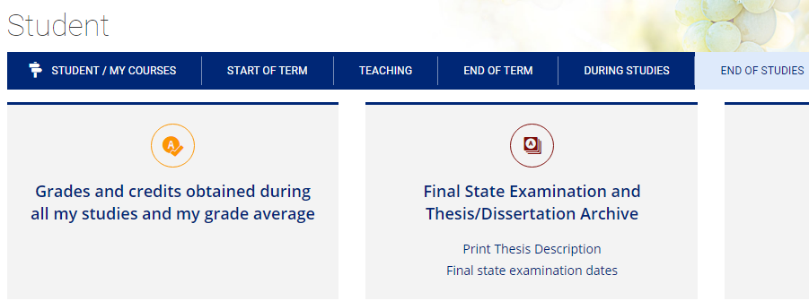
IS SU - study agenda
In END OF STUDIES, you can check your grades for all the semesters including your current or overall GPA (Weighted Grade Point Average).
There is also a section for Final State Examination and Thesis Archive (applies for final year Master degree students).

Slide 30
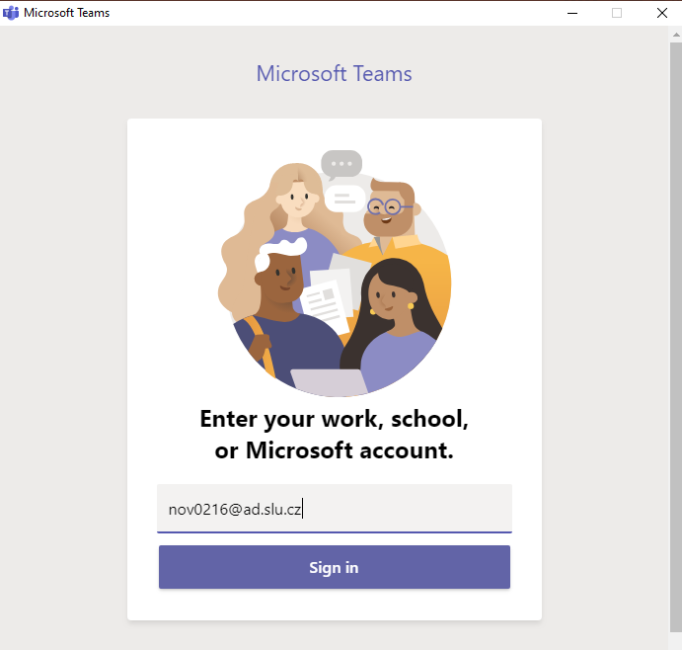
Microsoft Teams
MS Teams application can be used during online teaching at SU SBA.
Available for download at: https://teams.microsoft.com/downloads
Login with your CROusername@ad.slu.cz and CRO password.
For using MS Teams, you need to have a microphone and a camera available/connected to your device.
Microsoft support and video trainings are available here.
CRO username

Slide 31
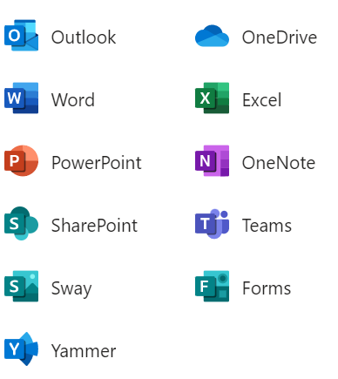
Other IT services for students
All students have free access to MS Office applications online at office.com
The applications can also be downloaded and installed on your PC.
At https://aka.ms/devtoolsforteaching, you can download other Microsoft products for free and install them on your PC (e.g.: Windows 10, Visual Studio Enterprise, Project Professional etc.).
Login with your CROusername@ad.slu.cz and CRO password.
Other services:
FileSender - share large files (up to 500 GB) safely, login with your CRO username and password
ownCloud – sync, share and backup your data (up to 100 GB)
For further information on available software and IT services, please contact the Institute of Information Technologies.

Slide 32
Login into university PC network
For an authorized access, enter the CRO username and password.
Possibilities:
in the classrooms/library/study room: single sign-on system called „Novell“
from home via the Internet (VMware Horizon)
from a laptop/cell phone in the faculty premises via the EDUROAM wireless network
from dormitories/campus Na Vyhlídce via the EDUROAM wi-fi

Slide 33
Printing
Credit system – for printing, it is necessary to make a deposit on your main student ISKaM account either in the library Na Vyhlídce (in cash), in the cash desk (room A109, only in cash), at the dormitory reception (cash/by card) or simply online by card (see the next slide for instructions). If you want to make a deposit in person, you need to take your student card with you.
Printing is possible from PCs available in the main faculty building and the library, after logging in to Novell network (with CRO identity). Before printing, please check the „printer settings” and the location of the printer you are printing to - it is listed in the printer’s name. There are printers located on the 4th floor (A431) in the main faculty building or in the library.
Black and white printing is 1 CZK/A4 page and printing in color is 2.50 CZK/A4 page.
You can use the multifunctional printers for scanning for free. Scanned files will be sent to your university email address.
You can use so-called secure printing - prints are sent to the selected printer, where you attach your student card to the scanner.
Check your printing account balance, upload the files and see the status of prints here: https://tisk.opf.slu.cz

Slide 34
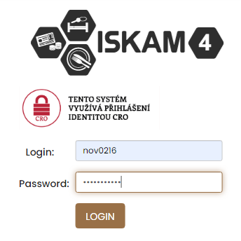
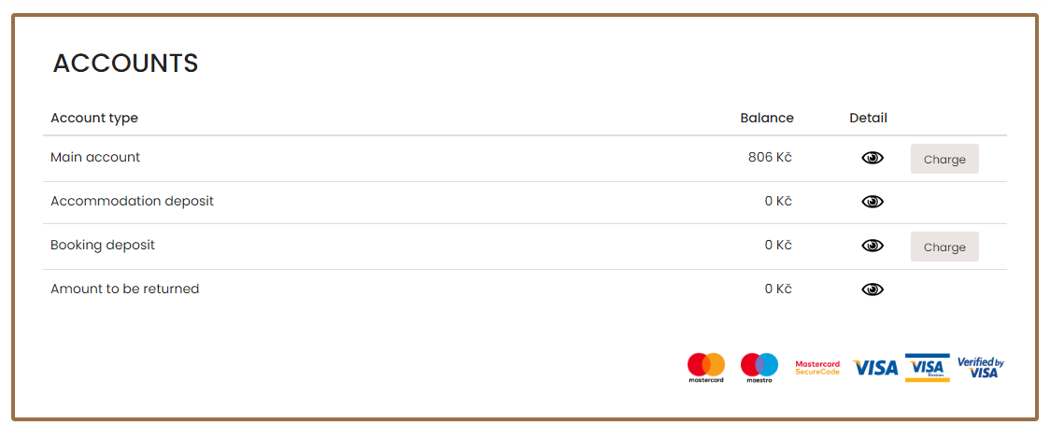
Printing – charging your ISKaM student account online by card
Go to iskam.opf.slu.cz (Dormitories and catering system) and login with your CRO username and password.
After login, you will be able to see your main account balance, its history ( ) and other deposits, such as booking or accommodation deposit. From your main account, you can pay for printing, housing as well as catering (lunches in partner restaurants – see the next slides).

Slide 35
ISKaM – dormitory and catering
Go to iskam.opf.slu.cz (Dormitories and catering system) and login with your CRO username and password.
ATTENTION: If you charge your main account and do not pay the dormitory rent in cash at the reception, the rent will be automatically deducted from your main account on the 15th of each month (in case you have a valid long-term accommodation contract).
After login, you will be able to see your main account balance, its history ( ) and other deposits, such as booking or accommodation deposit. From your main account, you can pay for printing, housing as well as catering (lunches in partner restaurants). The system does not allow the student to go into a debt/negative balance.

Slide 36
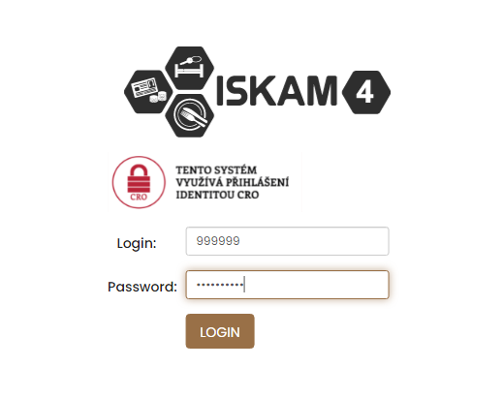
ISKaM – booking deposit payment before enrollment
In case you have not yet arrived in Karviná, not yet enrolled for study and therefore do not have a CRO username and password and are asked to pay the booking deposit for accommodation in advance, you can also do the payment online by card at iskam.opf.slu.cz.
Username: university number (6 digits)
Password: pseudo-birth code number (e.g., 94541919AB)
Charge your booking deposit online by card.
You will receive a university and a pseudo-birth code number on your personal email provided in your application. In case you haven’t received it, please contact us at international@opf.slu.cz.

Slide 37
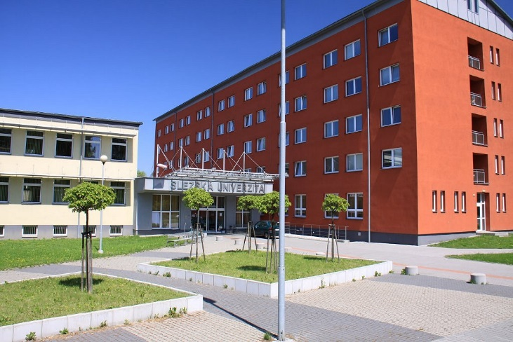
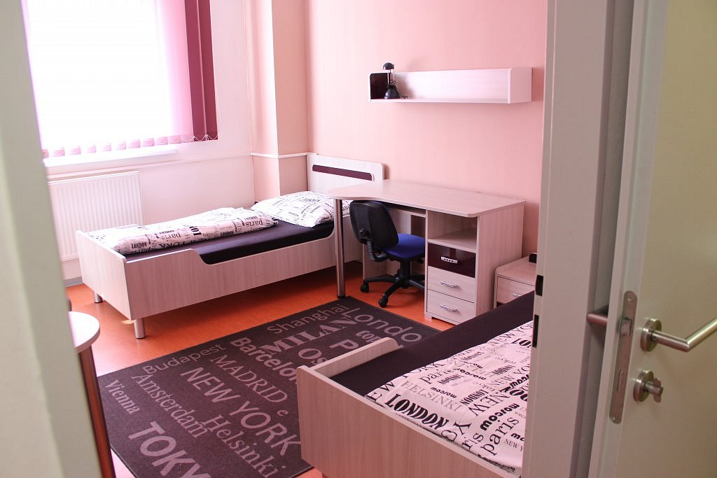
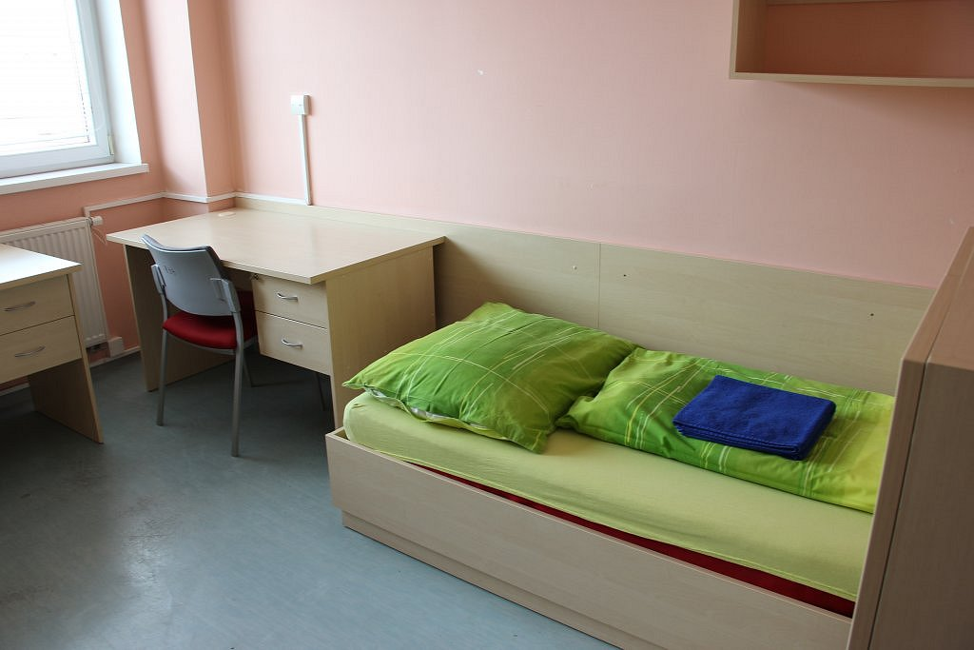
Accommodation (deposit and other rules)
All the applicants who duly submitted application for accommodation will be asked to pay the accommodation deposit by September 10 (students enrolling in winter semester) or by February 10 (enrollment in summer semester). The last possible date to pay the deposit is on the day of check-in at the reception (by card/ in cash – only CZK!)
Application for accommodation (including detailed instructions) is available for download at: https://www.slu.cz/opf/en/facultyandcampus
Accommodation contract template and other accommodation/catering regulations are available at: https://www.slu.cz/opf/cz/ovkmkestazeni
Please confirm the period for which you would like to be accommodated by September 10/February 10 (when arriving for the winter/summer semester) or as soon as your visa is issued, and itinerary known.

Slide 38
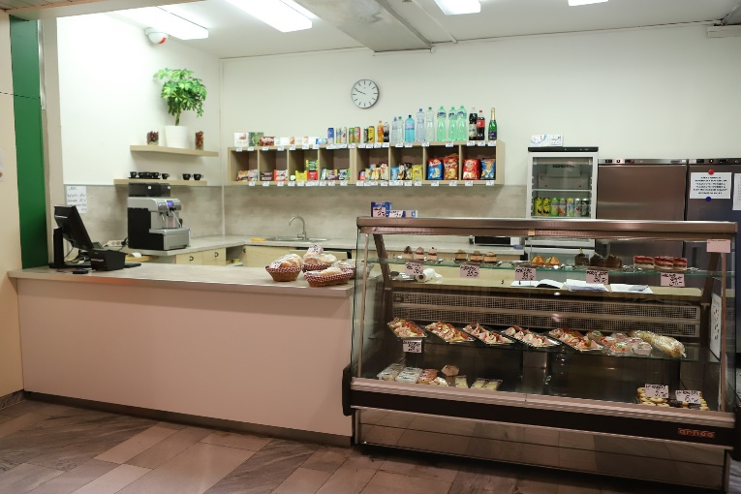
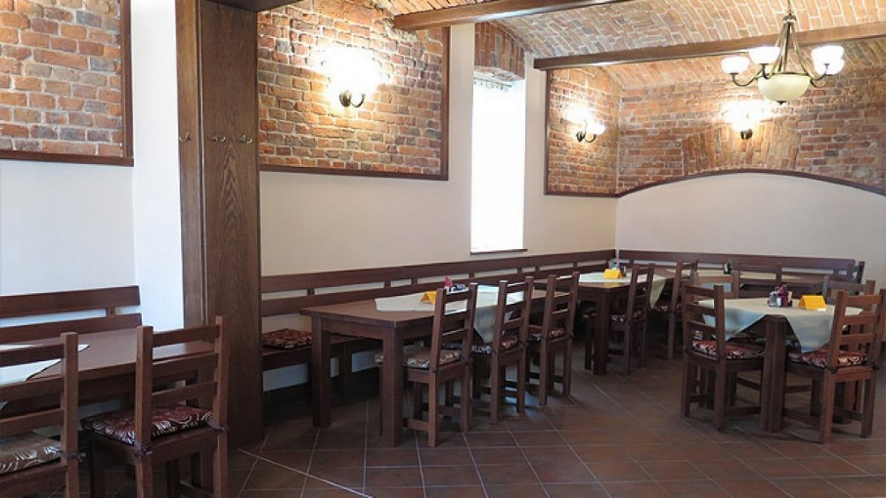
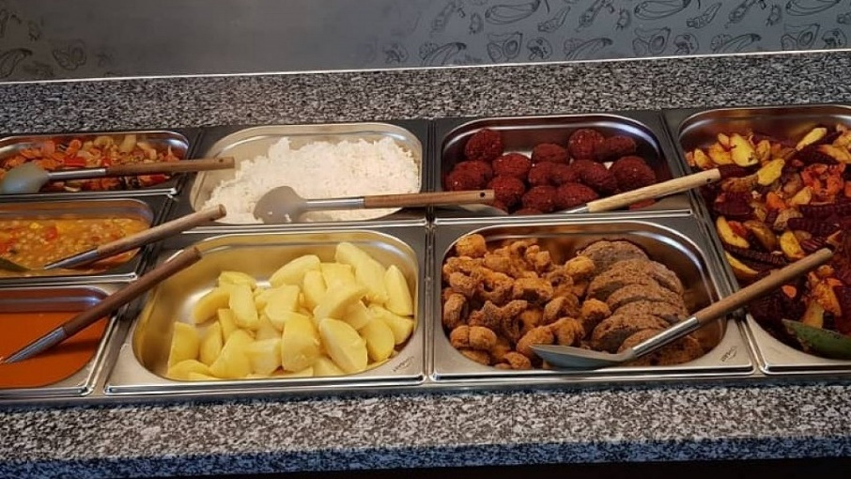
Catering
Students can enjoy 2 discounted meals daily (discount of 18 CZK for a warm meal, 8 CZK for a snack/cold meal) by presenting their student cards at selected restaurants located within a few meters from the faculty building:
café/snack bar (main faculty building, near the foyer, opposite the Large Hall)
restaurant Fryštátská chalupa (address: Fryštátská 135/28, Karviná)
restaurant FYTÓN Bistro (address: Fryštátská 151/15, Karviná)
Café/snack bar (8am – 3pm) Fryštátská chalupa FYTÓN Bistro (vegan)
Monday - Friday

Slide 39
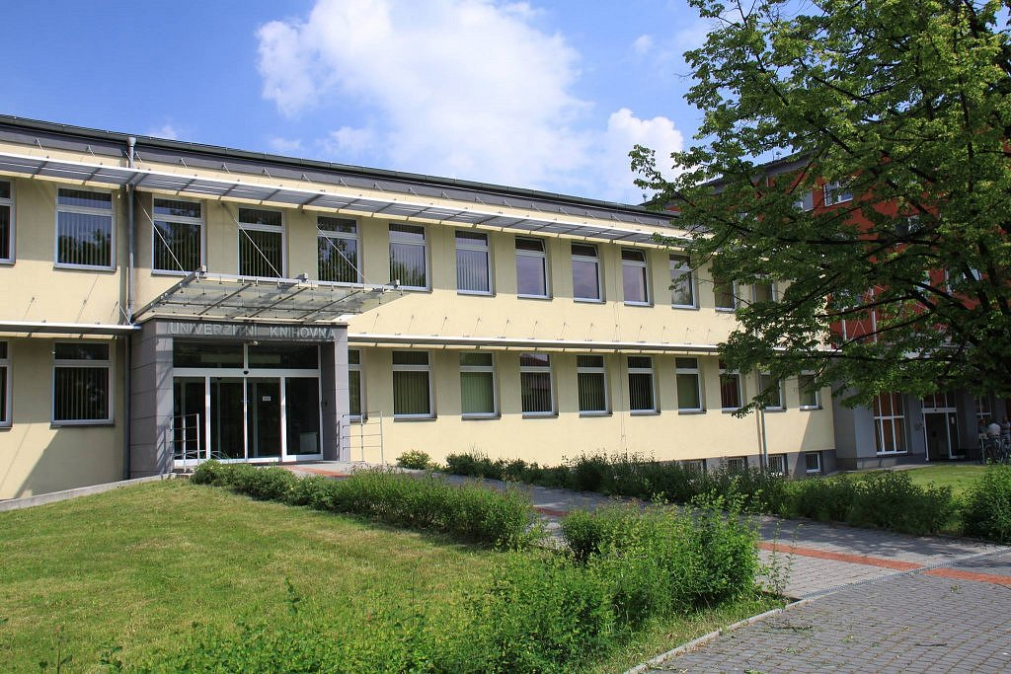
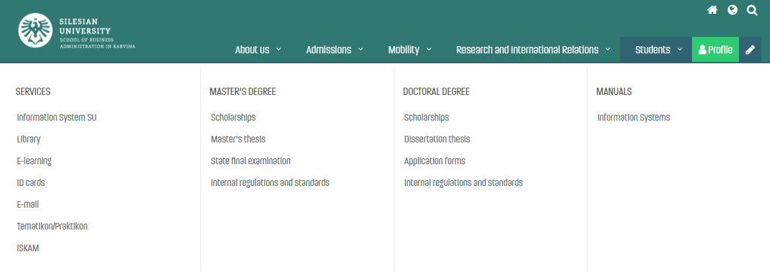
Library
Library is located on the university campus, in the dormitory building Na Vyhlídce.
More information on library services including contacts and electronic information resources is available at: https://www.slu.cz/opf/en/library
Printing and scanning is possible in the library. A student card (main student ISKaM account) has to be charged prior to printing.
Study rooms are available for the students in the library or in the main faculty building (in between Large and Small Hall).
After login into https://www.slu.cz/opf/en/, you can see the menu „Students“ and access „Library“ in the „Services“ section.

Slide 40
Faculty website - https://www.slu.cz/opf/en/
After login to the faculty website, with your CRO identity, you can access STUDENTS menu and other categories:
SERVICES
MASTER DEGREE section
DOCTORAL DEGREE section
MANUALS
FOR DEGREE STUDENTS: In Master‘s degree section, you can access documents related to your study, such as Dean‘s Decisions and Instructions concerning Scholarships, Tuition fees or final Master‘s thesis and State final exam.

Slide 41
Student card
The student ID card entitles you to enter the university buildings. It can be used for discounted catering, printing or scanning.
You can apply for your student card upon your arrival in Karvina and enrollment at https://karty.slu.cz/ Please note this site is currently run only in Czech language. Guide on how to apply for a card is available at: https://www.slu.cz/opf/en/idcards
You can pick up your card at the card center (room A422, main faculty building) during office hours. In case of further inquiries, please contact International Relations Office or bodsky@slu.cz.
MASTER DEGREE students: can choose from a basic university card (free of charge) or an ISIC card (180 CZK/year). For more information on ISIC cards and related discounts, please see: https://www.isic.cz/en/. ISIC card can be renewed each year by purchasing a re-validation stamp (180 CZK/year).
EXCHANGE and VISITING students: apply for a basic university card (free of charge).

Slide 42
Information systems overview
Silesian University website | www.slu.cz
School of Business Administration website | www.slu.cz/opf/
SU Information System | is.slu.cz
E-mail | horde.opf.slu.cz
ISKaM (Dormitories and catering) | iskam.opf.slu.cz
CRO identity/Eduroam set-up, password changes | moje.slu.cz

Slide 43
Any questions?
Contact us at international@opf.slu.cz
☺

