Slide 1

Understanding Project Management
Introduction to Project management
Pavel Adámek
Project management

Slide 2

Outline of the lecture
Definition of a project management
The project manager-line manager interface
Definition of the project
Classification of projects
Differing views of project management

Slide 3
Definition of a project management
Have a specific objective to be completed within certain specifications
Have defined start and end dates
Have funding limits (if applicable)
Consume human and nonhuman resources (i.e., money, people, equipment)
Are multifunctional (i.e., cut across several functional lines)
In order to understand project management, one must begin with the definition of a project.
A project can be considered to be any series of activities and tasks that:

Slide 4
Definition of a project management
Project management, on the other hand, involves project planning and project monitoring and includes such items as:
Project planning
Definition of work requirements
Definition of quantity and quality of work
Definition of resources needed
Project monitoring
Tracking progress
Comparing actual outcome to predicted outcome
Analyzing impact
Making adjustments

Slide 5
Definition of a project management
Successful project management can then be defined as having achieved the project
objectives:
Within time
Within cost
At the desired performance/technology level
While utilizing the assigned resources effectively and efficiently
Accepted by the customer

Slide 6
Definition of a project management
The potential benefits from project management are:
Identification of functional responsibilities to ensure that all activities are accounted for, regardless of personnel turnover
Minimizing the need for continuous reporting
Identification of time limits for scheduling
Identification of a methodology for trade-off analysis
Measurement of accomplishment against plans
Early identification of problems so that corrective action may follow
Improved estimating capability for future planning
Knowing when objectives cannot be met or will be exceeded

Slide 7
Definition of a project management
Unfortunately, the benefits cannot be achieved without overcoming obstacles such as:
Project complexity
Customer’s special requirements and scope changes
Organizational restructuring
Project risks
Changes in technology
Forward planning and pricing

Slide 8
Definition of a project management
Project management is designed to make better use of existing resource by getting work to flow horizontally as well as vertically within the company.
This approach does not really destroy the vertical, bureaucratic flow of work but simply requires that line organizations talk to one another horizontally so work will be accomplished more smoothly throughout the organization.
The vertical flow of work is still the responsibility of the line managers.
The horizontal flow of work is the responsibility of the project managers, and their primary effort is to communicate and coordinate activities horizontally between the line organizations.

Slide 9
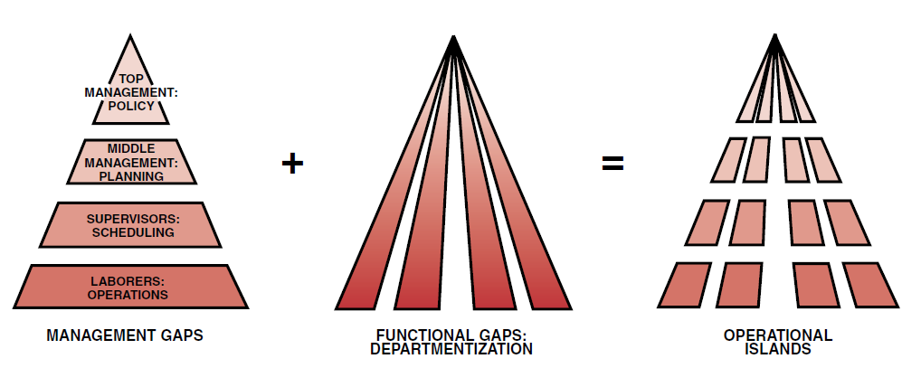
Definition of a project management
Why are systems necessary?
How many companies are structured?
There are always “class or prestige” gaps between various levels of management.
There are also functional gaps between working units of the organization.
Source: Kerzner, H. 2017. Project Management

Slide 10
Definition of a project management
The following would be an overview definition of project management:
Project management is the planning, organizing, directing, and controlling of company resources for a relatively short-term objective that has been established to complete specific goals and objectives.
Furthermore, project management utilizes the systems approach to management by having functional personnel (the vertical hierarchy) assigned to a specific project (the horizontal hierarchy).

Slide 11
Definition of a project management
The above definition requires further comment. Classical management is usually considered
to have five functions or principles:
Planning
Organizing
Staffing
Controlling
Directing

Slide 12
Definition of a project management
What is meant by a “relatively” short-term project?
Not all industries have the same definition for a short-term project.
In engineering, the project might be for six months or two years; in construction, three to five years; in nuclear components, ten years; and in insurance, two weeks.
Long-term projects, which consume Resources full-time, are usually set up as a separate division (if large enough) or simply as a line organization.

Slide 13
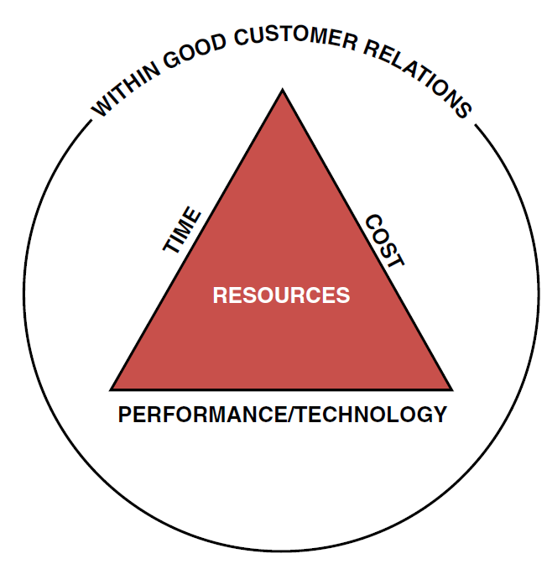
Definition of a project management
A pictorial representation of project management
The objective of the figure is to show that project management is designed to manage or control company Resources on a given activity, within time, within cost, and within performance.
Time, cost, and performance are the constraints on the project. If the project is to be accomplished for an outside customer, then the project has a fourth constraint: good customer relations.
Source: Kerzner, H. 2017. Project Management

Slide 14
Defining project success
Today, the definition of project success has been modified to include
completion:
Within the allocated time period
Within the budgeted cost
At the proper performance or specification level
With acceptance by the customer/user
With minimum or mutually agreed upon scope changes
Without disturbing the main work flow of the organization
Without changing the corporate culture

Slide 15
The project manager-line manager interface
Money
Manpower
Equipment
Facilities
Materials
Information/technology
We have stated that the project manager must control company resources within time, cost,
and performance.
Most companies have six resources:

Slide 16
The project manager-line manager interface
Actually, the project manager does not control any of these resources directly, except perhaps money (i.e., the project budget).
Resources are controlled by the line managers, functional managers, or, as they are often called, resources managers.
Project managers must, therefore, negotiate with line managers for all project resources.
When we say that project managers control project resources, we really mean that they control those Resources (which are temporarily loaned to them) through line managers.

Slide 17
The project manager-line manager interface
It should become obvious at this point that successful project management is strongly dependent on:
A good daily working relationship between the project manager and those line managers who directly assign resources to projects
The ability of functional employees to report vertically to line managers at the same time that they report horizontally to one or more project managers
These two items become critical. In the first item, functional employees who are assigned to a project manager still take technical direction from their line managers. Second, employees who report to multiple managers will always favour the manager who controls their purse strings.

Slide 18
Defining the project manager´s role
The project manager is responsible for coordinating and integrating activities across multiple,
functional lines. The integration activities performed by the project manager include:
Integrating the activities necessary to develop a project plan
Integrating the activities necessary to execute the plan
Integrating the activities necessary to make changes to the plan

Slide 19
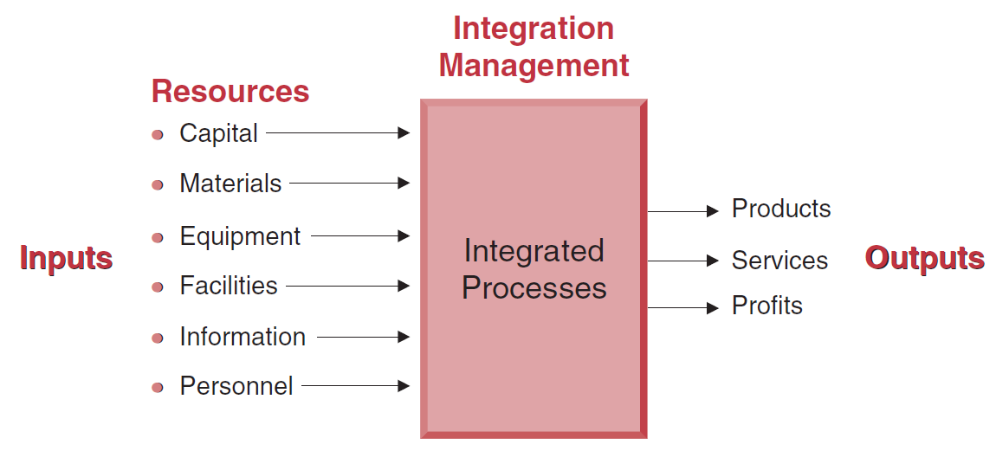
Definition of a project management
Integrative responsiblities
The project manager must convert the inputs (i.e., resources) into outputs of products, services, and ultimately profits.
The project manager needs strong communicative and interpersonal skills, must become familiar with the operations of each line organization, and must have knowledge of the technology being used.
Source: Kerzner, H. 2017. Project Management

Slide 20
Defining the project manager´s role
Project managers may have increasing responsibility, but very little authority. This lack of authority can force them to “negotiate” with upper-level management as well as functional management for control of company resources.
In the project environment, everything seems to revolve about the project manager. Although the project organization is a specialized, task-oriented entity, it cannot exist apart from the traditional structure of the organization. The project manager, therefore, must walk the fence between the two organizations. The term interface management is often used for this role, which can be described as managing relationships:
  Within the project team
  Between the project team and the functional organizations
  Between the project team and senior management
  Between the project team and the customer’s organization, whether an internal or external organization

Slide 21
Definition of the project
Unique product, service, or result. Projects are undertaken to fulfil objectives by producing deliverables.
An objective is defined as an outcome toward which work is to be directed, a strategic position to be attained, a purpose to be achieved, a result to be obtained, a product to be produced, or a service to be performed.
A deliverable is defined as any unique and verifiable product, result, or capability to perform a service that is required to be produced to complete a process, phase, or project. Deliverables may be tangible or intangible.
Project is a temporary endeavor undertaken to create a unique product, service, or result.

Slide 22
Definition of the project
Fulfilment of project objectives may produce one or more of the following deliverables:
A unique product that can be either a component of another item, an enhancement or correction to an item, or a new end item in itself (e.g., the correction of a defect in an end item);
A unique service or a capability to perform a service (e.g., a business function that supports production or distribution);
A unique result, such as an outcome or document (e.g., a research project that develops knowledge that can be used to determine whether a trend exists or a new process will benefit society); and
A unique combination of one or more products, services, or results (e.g., a software application, its associated documentation, and help desk services).

Slide 23
Definition of the project
Examples of projects include but are not limited to:
Developing a new pharmaceutical compound for market,
Expanding a tour guide service,
Merging two organizations,
Improving a business process within an organization,
Acquiring and installing a new computer hardware system for use in an organization,
Exploring for oil in a region,
Modifying a computer software program used in an organization,
Conducting research to develop a new manufacturing process, and
Constructing a building.

Slide 24
Definition of the project
Temporary endeavour. The temporary nature of projects indicates that a project has a definite beginning and end. Temporary does not necessarily mean a project has a short duration. The end of the project is reached when one or more of the following is true:
The project’s objectives have been achieved;
The objectives will not or cannot be met;
Funding is exhausted or no longer available for allocation to the project;
The need for the project no longer exists (e.g., the customer no longer wants the project completed, a change in strategy or priority ends the project, the organizational management provides direction to end the project);
The human or physical resources are no longer available; or
The project is terminated for legal cause or convenience

Slide 25
Classification of projects
The relative degree of importance of these principles can vary from project to project and industry to industry.
For those industries that are project-driven, such as aerospace and large construction, the high dollar value of the projects mandates a much more rigorous project management approach.
For non–project-driven industries, projects may be managed more informally than formally, especially if no immediate profit is involved.
The principles of project management can be applied to any type of project and to any industry.

Slide 26
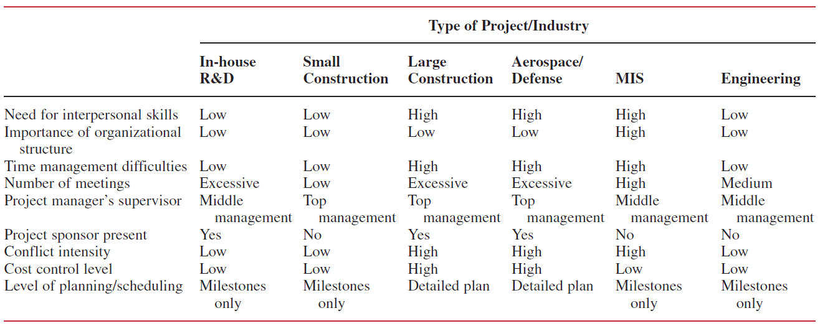
Classification of projects
Difference in classification of project/characteristics
There are the important differences withhin type of the projects.
Source: Kerzner, H. 2017. Project Management

Slide 27
Differing views of project management
Many companies, especially those with project-driven organizations, have differing views of project management.
Some people view project management as an excellent means to achieving objectives, while others view it as a threat. In project-driven organizations, there are three career paths that lead to executive management:
  Through project management
  Through project engineering
  Through line management

Slide 28
Differing views of project management
In project-driven organizations, the fast-track position is in project management, whereas in a non–project-driven organization, it would be line management.
Even though line managers support the project management approach, they resent the project manager because of his promotions and top-level visibility.
Executives may dislike project managers because more authority and control must be delegated. However, once executives realize that it is a sound business practice, it becomes important.
With this kind of encouragement, the organization can become a live thing—sensitive to problems and able to move in on them with much more speed and understanding tha would be normally expected in a large operation.

Slide 29
Differing views of project management
In the project environment, cause-and-effect relationships are almost always readily apparent.
Good project management will examine the effect in order to better understand the cause and possibly prevent it from occurring again.
Effects:
1. Late completion of activities
2. Cost overruns
3. Substandard performance
4. High turnover in project staff
5. High turnover in functional staff
6. Two functional departments performing the same activities on one project

Slide 30
Differing views of project management
Causes:
Top management not recognizing this activity as a project
Too many projects going on at one time
Impossible schedule commitments
No functional input into the planning phase
No one person responsible for the total project
Poor control of design changes
Poor control of customer changes
Poor understanding of the project manager’s job
Wrong person assigned as project manager
No integrated planning and control
Company resources are overcommitted
Unrealistic planning and scheduling
No project cost accounting ability
Conflicting project priorities
Poorly organized project office

Slide 31
RECAP
As jobs become vacant, executives pressure line managers to accomplish the same amount of work with fewer resources, either by improving efficiency or by upgrading performance requirements to a higher position on the learning curve.
Because people costs are more inflationary than the cost of equipment or facilities, executives are funding more and more capital equipment projects in an attempt to increase or improve productivity without increasing labour.
Almost all of today’s executives are in agreement that the solution to the majority of corporate problems involves obtaining better control and use of existing corporate resources, looking internally rather than externally for the solution. As part of the attempt to achieve an internal solution, executives are taking a hard look at the ways corporate activities are managed. Project management is one of the techniques under consideration.

