Slide 1
Agile Planning and Execution
Follow the Roadmap to Value, from vision to execution
Create working functionality and showcase it in iterations
Pavel Adámek
Project management

Slide 2
Outline of the lecture
Defining the Product Vision and Product Roadmap
Planning Releases and Sprints
Working throughout the Day
Showcasing Work, Inspecting, and Adapting

Slide 3
Introduction
Agile projects, in contrast, involve planning upfront and throughout the entire project. By planning at the last responsible moment, right before an activity starts, you know the most about that activity.
This type of planning, called just-in-time planning or a situationally informed strategy, is a key to agile project success.
Agile teams plan as much as, if not more than, traditional project teams. However, agile planning is more evenly distributed throughout the project and is done by the entire team that will be working on the project.
The agile focus on just-in-time planning allows you to accommodate real situations and to be well informed as you plan specific tasks.

Slide 4
Defining the Product Vision and Product Roadmap
Planning happens at a number of points in an agile project.
A great way to look at the planning activities in agile projects is with the Roadmap to Value.
Each stage in the Roadmap to Value is repeatable, and each stage contains planning activities. Agile planning, like agile development, is iterative.
You will plan not only the overall project but also every release, every sprint, and every day.
Planning is fundamental to agile project success.

Slide 5
Agile Planning
The Roadmap to Value has seven stages:
In stage 1, the product owner identifies the product vision. The product vision is your project’s destination or end goal. The product vision includes the outer boundary of what your product will be, how the product is different from the competition, how the product will support your company or organization’s strategy, who will use the product, and why people will use the product.
In stage 2, the product owner creates a product roadmap. The product roadmap is a high-level view of the product requirements, with a general time frame for when you will develop those requirements. It also gives context to the vision by showing the tangible features that will be produced during the project. Identifying product requirements and then prioritizing and roughly estimating the effort for those requirements allow you to establish requirement themes and identify requirement gaps.
In stage 3, the product owner creates a release plan. The release plan identifies a high-level timetable for the release of working functionality to the customer. The release serves as a mid-term boundary against which the scrum team can mobilize. An agile project will have many releases, with the highest-priority features appearing first. You create a release plan at the beginning of each release, which is usually at least quarterly.

Slide 6
Agile Planning
The Roadmap to Value has seven stages:
In stage 4, the product owner, the development team, and the scrum master will plan iterations, also called sprints, and start creating the product functionality in those sprints. Sprint planning sessions take place at the start of each sprint. During sprint planning, the scrum team determines a sprint goal, which establishes the immediate boundary of work that the team forecasts to accomplish during the sprint, with requirements that support the goal and can be completed in the sprint.
In stage 5, the development team has daily scrum meetings during each sprint to coordinate the day’s priorities. In the daily scrum meeting, you discuss what you completed yesterday, what you will work on today, and any roadblocks you have, so that you can address issues immediately.
In stage 6, the scrum team holds a sprint review at the end of every sprint. In the sprint review, you demonstrate the working functionality to the product stakeholders.
In stage 7, the scrum team holds a sprint retrospective. The sprint retrospective is a meeting where the scrum team discusses the completed sprint with regard to their processes and environment, and makes plans for proces improvements in the next sprint.

Slide 7
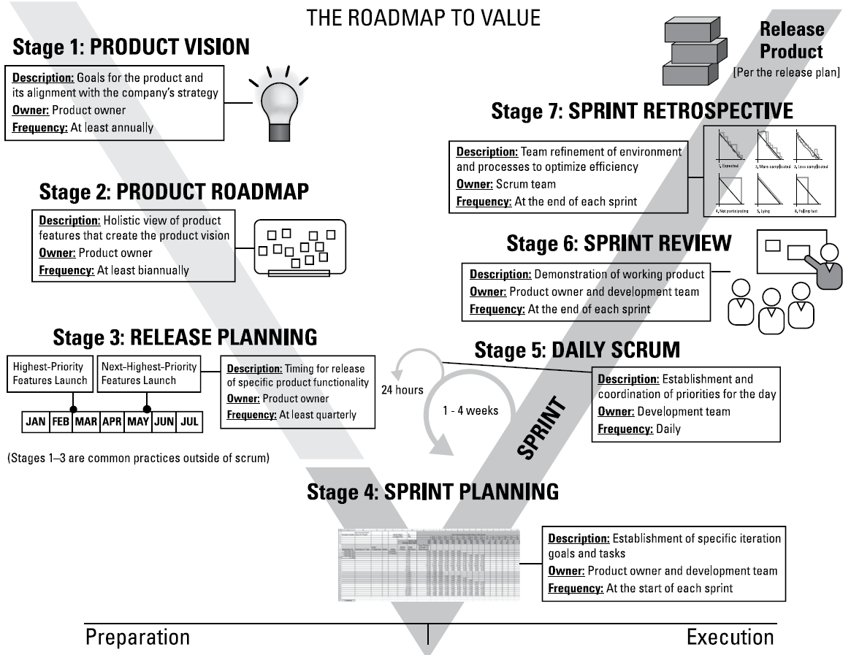
Agile Planning
Overview of the roadmap to value in agile project management
Source: Layton, M. C., Ostermiller S. J. 2017. Agile Project Management

Slide 8
Defining the Product Vision and Product Roadmap
The first stage in an agile project is defining your product vision. The product vision statement is an elevator pitch, or a quick summary, to communicate how your product supports the company’s or organization’s strategies. The vision statement must articulate the end state for the product.
The product might be a commercial product for release to the marketplace or an internal solution that will support your organization’s day-to-day functions.
When creating a product vision statement, follow these four steps:
Develop the product objective.
Create a draft vision statement.
Validate the vision statement with product and project stakeholders and revise it based on feedback.
Finalize the vision statement.

Slide 9
Defining the Product Vision and Product Roadmap
The product roadmap, stage 2 in the Roadmap to Value, is an overall view of the product’s requirements and a valuable tool for planning and organizing the journey of product development.
Use the product roadmap to categorize requirements, prioritize them, identify gaps and dependencies, and determine a timetable for releasing to the customer.
As he or she does with the product vision statement, the product owner creates the product roadmap, with help from the development team and stakeholders. The development team participates to a greater degree than it did during the creation of the vision statement.
To create your product roadmap, you do the following:
Identify stakeholders.
Establish product requirements and add them to the roadmap.
Arrange the product requirements based on values, risks, and dependencies.
Estimate the development effort at a high level and prioritize the product’s requirements.
Determine high-level time frames for releasing groups of functionality to the customer.

Slide 10
Defining the Product Vision and Product Roadmap
The product roadmap contains high level features and some tentative release timelines. The requirements on your product roadmap are the first version of your product backlog.
The product backlog is the list of all requirements associated with the project.
The product owner is responsible for creating and maintaining the product backlog by adding and prioritizing requirements.
The scrum team uses the prioritized product backlog throughout the project to plan its work - like a streamlined project plan.
At a minimum, when creating your product backlog, be sure to do the following:
Include a description of each requirement.
Order the requirements based on priority.
Add the effort estimate.

Slide 11
Planning Releases and
Sprints
You start agile projects with very large requirements.
As the project progresses and you get closer to developing those requirements, you will break them down into smaller parts - small enough to begin developing.
After you create a product roadmap for your agile project, it’s time to start elaborating on your product details.
The concept of breaking down requirements into smaller pieces is called decomposition.

Slide 12
Planning Releases and Sprints
Your customers and stakeholders provide requirements for the product owner to vet for placement on your product backlog. Your customers may or may not be the same people who will use your product.
Knowing who your end users are and how they will interact with your product drive how you define and implement each requirement on your product roadmap.
We like to define users using personas, or a written description about a type of user represented by a fictitious person.
Know who your users are, so you can develop features they’ll actually use.
Be sure to continuously add and prioritize new user stories to your product backlog. Keeping your product backlog up-to-date will help you have the highestpriority user stories when it is time to plan your sprint.

Slide 13
Planning Releases and Sprints
To decompose requirements, you’ll want to think about how to break down the requirement into individual actions.
You refine requirements many times throughout an agile project. For example:
When you create the product roadmap, you create features (capabilities your customers will have after you develop the features), as well as themes (logical groups of features). Although features are intentionally large, we require features at the product roadmap level to be no larger than 144 story points on the Fibonacci scale.
When you plan releases, you break down the features into more concise userstories. User stories at the release plan level can be either epics, very large user stories with multiple actions, or individual user stories, which contain a single action. For our clients, user stories at the release plan level should be no larger than 34 story points. You find out more about releases later in this chapter.
When you plan sprints, you can break down user stories even further. You also identify individual tasks associated with each user story in the sprint. For our clients, user stories at the sprint level should be no larger than eight story points. Tasks will be estimated in hours and should be no larger than what can be accomplished in a day.

Slide 14
Planning Releases and Sprints
A release is a group of usable product features that you deploy to the market.
A release does not need to include all the functionality outlined in the product roadmap but should include at least the minimal marketable features, the smallest group of product features that you can effectively deploy and promote in the marketplace.
Your early releases will exclude many of the medium- and low-priority requirements you identified during the product roadmap stage.
When planning a release, you establish the next set of minimal marketable features and identify an imminent product launch date around which the team can mobilize.
As when creating the vision statement and the product roadmap, the product owner is responsible for creating the release goal and establishing the release date. However, the development team’s estimates, with the scrum master’s facilitation, contribute to the process.

Slide 15
Planning Releases and Sprints
Release planning involves completing two key activities:
Revising the product backlog: the product backlog is a comprehensive list of all the user stories you currently know for your project, whether or not they belong in the current release. Keep in mind that your list of user stories will probably change throughout the project.
Creating the release plan: This activity consists of the release goal, release target date, and prioritization of product backlog items that support the release goal. The release plan provides a midrange goal that the team can accomplish.
Don’t create a new, separate backlog during release planning. The task is unnecessary and reduces the product owner’s flexibility. Prioritizing the existing product backlog based on the release goal is sufficient and enables the product owner to have the latest information when he or she commits to the scope during sprint planning.
The product backlog and release plan are some of the most important communication channels between the product owner and the development team.

Slide 16
Planning Releases and Sprints
In agile projects, a sprint is a consistent iteration of time in which the development team creates a specific group of product capabilities from start to finish.
At the end of each sprint, the functionality that the development team has created should be working, ready to demonstrate, and potentially shippable to the customer.
Sprints generally last one to four weeks. Four weeks is the longest amount of time any sprint should last; longer iterations make changes riskier, defeating the purpose of being agile. We rarely see sprints lasting longer than two weeks, and more often see sprints lasting a week.
One-week sprints are a natural cycle with the Monday-to-Friday business week that structurally prevents weekend work. Some scrum teams work in one-day sprints where priorities change on a daily basis.
Market and customer needs are changing more and more quickly, and the amount of time you can afford between opportunities to gather customer feedback only gets shorter. Our rule of thumb is that your sprint shouldn’t be longer than your stakeholders can consistently go without changes in priority regarding what the scrum team should be working on in the sprint.

Slide 17
Planning Releases and Sprints
Each sprint includes the following:
Sprint planning at the beginning of the sprint
Daily scrum meetings
Development time — the bulk of the sprint
A sprint review and a sprint retrospective at the end of the sprint
The sprint backlog is a list of user stories associated with the current sprint and related tasks. When planning your sprint, you do the following:
Establish goals for your sprint.
Choose the user stories that support those goals.
Break user stories into specific development tasks.
Create a sprint backlog. The sprint backlog consists of the following:
The list of user stories within the sprint in order of priority.
The relative effort estimate for each user story.
The tasks necessary to develop each user story.
The effort, in hours, to complete each task.

Slide 18
Working throughout the Day
On agile projects, you make plans throughout the entire project - and on a daily basis.
Agile development teams start each workday with a daily scrum meeting to note completed items, to identify impediments, or roadblocks, requiring scrum master involvement, and to synchronize and plan what each team member will do during the day to achieve the sprint goal.
The work that you will do every day as part of a scrum team: planning
and coordinating your day, tracking progress, creating and verifying usable functionality, and identifying and dealing with impediments to your work.

Slide 19
Working throughout the Day
The daily scrum is Stage 5 on the Roadmap to Value.
In the daily scrum meeting, each development team member makes the following three statements, which enable team coordination:
Yesterday, I completed (state items completed).
Today, I’m going to take on (state task).
My impediments are (state impediments, if any).
We also have the scrum master address these three statements regarding the team’s impediments:
Yesterday, I resolved to (state impediments completed).
Today, I’m going to work on removing (state impediment).
The impediments I’m going to escalate are (state impediments you need assistance with, if any).
Source: Layton, M. C., Ostermiller S. J. 2017. Agile Project Management

Slide 20
Working throughout the Day
You also need to track the progress of your sprint daily. This section discusses ways to keep track of the tasks in your sprint.
Two tools for tracking progress are the sprint backlog and a task board. Both the sprint backlog and the task board enable the scrum team to show the sprint’s progress to anyone at any given time.
The Agile Manifesto values individuals and interactions over processes and tools. Make sure your tools support, rather than hinder, your scrum team.
During sprint planning, you concentrate on adding user stories and tasks to the spring backlog. During the sprint itself, you update the sprint backlog daily, tracking progress of the development team’s tasks for each working day.
Make the sprint backlog available to the entire project team every day. That way, anyone who needs to know the sprint status can find it instantly.

Slide 21
Working throughout the Day
the sprint burndown chart, which shows the progress that the development team is making. You can see that the development team members have completed tasks close to the even burn rate of their available hours, and the product owner has accepted several user stories as complete.
You can include burndown charts on your sprint backlog and on your product backlog.
A burndown chart is a powerful tool for visualizing progress and the work remaining. The chart shows the following:
The outstanding work (in hours) on the first vertical axis
Time, in days along the horizontal axis
Source: Layton, M. C., Ostermiller S. J. 2017. Agile Project Management

Slide 22
Working throughout the Day
Although the sprint backlog is a great way to track and show project progress, it’s probably in an electronic format, so it might not be immediately accessible to anyone who wants to see it.
Some scrum development teams use a task board along with their sprint backlog.
A task board provides a quick, easy view of the items in the sprint that the development team is working on and has completed.
We like task boards because you can’t deny the status they show.
Like the product roadmap, the task board can be made up of sticky notes on a whiteboard.

Slide 23
Working throughout the Day
The task board will have at least the following four columns, from left to right:
To Do: The user stories and tasks that remain to be accomplished are in the far left column.
In Progress: User stories and tasks that the development team is currently working on are in the In Progress column. Only one user story should be in this column. Having more user stories in progress is an alert that development team members are not working cross-functionally and, instead, are hoarding desired tasks. You risk having multiple user stories partially done instead of more user stories completely done by the end of the sprint.
Accept: After the development team completes a user story, it moves it to the Accept column. User stories in the Accept column are ready for the product owner to review and either provide feedback or accept.
Done: When the product owner has reviewed a user story and verifies that the user story is complete, the product owner can move that user story to the Done column.

Slide 24
Working throughout the Day
A typical task board. As you can see, the task board is a strong visual representation of the work in progress.
The task board shows four user stories, each separated by a horizontal line called swim lanes.
The first user story is done.
All tasks are completed, and the product owner has accepted the work done.
For the second user story, the development work is completed but is waiting for acceptance by the product owner.
The third user story is in progress, and the fourth user story has not yet been started.
At a glance, the status of each user story is clear not only to the scrum team, making tactical coordination faster and easier, but also to interested stakeholders.
Source: Layton, M. C., Ostermiller S. J. 2017. Agile Project Management

Slide 25
Working throughout the Day
Limit your work in progress! Only select one task at a time. Leave other tasks available in the To Do column.
Ideally, a development team will work on only one user story at a time and swarm on the tasks of that user story to complete it quickly.
Because the task board is tactile - people physically move a user story card through its completion - it can engage the development team more than an electronic document ever could.
The task board encourages thought and action just by existing in the scrum team’s work area, where everyone can see the board.
At the end of each day, the development team reports on task progress by updating the sprint backlog with which tasks were completed and how much work, in hours, remains to be done on new tasks started.

Slide 26
Showcasing Work, Inspecting, and Adapting
The sprint review is where the product owner and the development team demonstrate the sprint’s completed, potentially shippable functionality to the stakeholders.
In the sprint retrospective, the scrum team (the product owner, development team, and scrum master) review how the sprint went and determine whether they need any adjustments for the next sprint.
Underpinning both of these events is the agile concept of inspect and adapt.
At the end of each sprint, the scrum team gets a chance to put the results of its hard work on display in the sprint review.

Slide 27
Showcasing Work, Inspecting, and Adapting
The sprint review is a meeting to review and demonstrate the functionality created from the user stories that the development team completed during the sprint, and for the product owner to collect feedback and update the product backlog accordingly.
The sprint review is open to anyone interested in reviewing the sprint’s accomplishments.
This means that all stakeholders get a chance to see product progress and accuracy, and provide feedback.
The sprint review is stage 6 in the Roadmap to Value.
Source: Layton, M. C., Ostermiller S. J. 2017. Agile Project Management

Slide 28
Showcasing Work, Inspecting, and Adapting
Preparation for the sprint review meeting should not take more than a few minutes at most. Even though the sprint review might sound formal, the essence of showcasing for agile teams is informality.
The meeting needs to be prepared and organized, but it doesn’t require a lot of flashy materials. Instead, the sprint review focuses on demonstrating what the development team has done.
The preparation for the sprint review meeting involves the product owner and the development team, facilitated by the scrum master as needed. The product owner needs to know which user stories the development team completed during the sprint. The development team needs to be ready to demonstrate completed, shippable functionality.
The time needed to prepare for a sprint review should not be more than 20 minutes - just enough time to make sure everyone knows who is doing what and when so the demonstration goes smoothly.

Slide 29
Showcasing Work, Inspecting, and Adapting
For the development team to demonstrate the code in the sprint review, it must be complete according to the definition of done. This means that the code is fully
Developed
Tested
Integrated
Documented
As user stories are moved to a status of done throughout the sprint, the product owner and development team should check that the functionality meets these standards. This continuous validation throughout the sprint reduces end-ofsprint risks and helps the scrum team spend as little time as possible preparing for the sprint review.
Sprint review meetings have two activities: demonstrate and showcase the scrum team’s finished work, and allow stakeholders to provide feedback on that work.

Slide 30
Showcasing Work, Inspecting, and Adapting
Each day, development team members work together in a collaborative environment that encourages feedback through peer reviews and informal communication.
Throughout each sprint, as soon as the development team completes each requirement, the product owner provides feedback by reviewing the working functionality for acceptance. The development team then immediately incorporates that feedback, if any, to satisfy the user story’s acceptance criteria.
At the end of each sprint, project stakeholders provide feedback about completed functionality in the sprint review meeting.
With each release, customers who use the product provide feedback about new working functionality.
Source: Layton, M. C., Ostermiller S. J. 2017. Agile Project Management

Slide 31
Showcasing Work, Inspecting, and Adapting
The sprint retrospective is a meeting in which the product owner, development team, and scrum master discuss how the sprint went and what they can do to improve the next sprint. The scrum team should conduct this meeting in a selfdirected way.
If managers or supervisors attend sprint retrospectives, scrum team members will avoid being open with each other, which limits the effectiveness of the team inspecting and adapting in a self-organizing way.
If the scrum team likes, members can invite other stakeholders to attend as well. If the scrum team regularly interacts with outside stakeholders, those stakeholders’ insights can be valuable.
The sprint retrospective is stage 7 in the Roadmap to Value.

Slide 32
Showcasing Work, Inspecting, and Adapting
The sprint retrospective is one of the best opportunities you have to put the ideas of inspect and adapt into action.
You came up with challenges and solutions during the retrospective. Don’t leave those solutions behind after the meeting; make the improvements part of your work every day.
You could record your recommendations for improvement informally. Some scrum teams post the actions identified during the retrospective meeting in the team area to ensure visibility and action on the items listed.
Many teams also add action items to the product backlog to ensure that they implement them during an upcoming sprint.
To become more agile, scrum teams focus on small changes with big value. We like teams to take at least one improvement into each sprint, a process sometimes referred to as scrumming the scrum.

Slide 33
RECAP
Agile projects involve planning upfront and throughout the entire project. By planning at the last responsible moment, right before an activity starts, you know the most about that activity. This type of planning, called just-in-time planning or a situationally informed strategy, is a key to agile project success.
Agile teams plan as much as, if not more than, traditional project teams. However, agile planning is more evenly distributed throughout the project and is done by the entire team that will be working on the project.
Each stage in the Roadmap to Value is repeatable, and each stage contains planning activities. Agile planning, like agile development, is iterative.
Day-to-day work on an agile project involves more than just planning and tracking progress. In the next section, you see what most of your day’s work will include, whether you’re a member of the development team, a product owner, or a scrum master.

