Slide 1
Organizing and Staffing the Project Office and Team
Requirements, Skills and Job Descripiton of Project Manager
Pavel Adámek
Project management

Slide 2
Outline of the lecture
The Staffing Environment
Selecting the Project Manager
Skill Requirements for Project and Program Managers
Duties and Job Descriptions

Slide 3
Introduction
Successful project management, regardless of the organizational structure, is only as good as the individuals and leaders who are managing the key functions.
Project management is not a one-person operation; it requires a group of individuals dedicated to the achievement of a specific goal. Project management includes:
A project manager
An assistant project manager
A project (home) office
A project team

Slide 4
Introduction
Generally, project office personnel are assigned full-time to the project and work out of the project office, whereas the project team members work out of the functional units and may spend only a small percentage of their time on the project.
Normally, project office personnel report directly to the project manager, but they may still be solid to their line function just for administrative control.
Before the staffing function begins, five basic questions are usually considered:
What are the requirements for an individual to become a successful project manager?
Who should be a member of the project team?
Who should be a member of the project office?
What problems can occur during recruiting activities?
What can happen downstream to cause the loss of key team members?

Slide 5
The Staffing Environment
Two major kinds of problems are related to the project environment: personnel performance problems and personnel policy problems.
Performance is difficult for many individuals in the project environment because it represents a change in the way of doing business.
Individuals, regardless of how competent they are, find it difficult to adapt continually to a changing situation in which they report to multiple managers.
To understand the problems that occur during staffing, we must first investigate the characteristics
of project management, including the project environment, the project management process, and the project manager.

Slide 6
The Staffing Environment
Many individuals thrive on temporary assignments because it gives them a “chance for glory.” Unfortunately, some employees might consider the chance for glory more important than the project.
For example, an employee may pay no attention to the instructions of the project manager and instead perform the task his own way. In this situation, the employee wants only to be recognized as an achiever and really does not care if the project is a success or failure.
The second major performance problem lies in the project–functional interface, where an individual suddenly finds himself reporting to two bosses, the functional manager and the project manager.
If the functional manager and the project manager are in agreement about the work to be accomplished, then performance may not be hampered.
Because each project is different, the project management process allows each project to have its own policies, procedures, rules, and standards, provided they fall within broad company guidelines. Each project must be recognized as a project by top management so that the project manager has the delegated authority necessary to enforce the policies, procedures, rules, and standards.

Slide 7
The Staffing Environment
Project management is successful only if the project manager and his team are totally dedicated to the successful completion of the project!
This requires each team member of the project team and office to have a good understanding of the fundamental project requirements, which include:
Customer liaison
Project direction
Project planning
Project control
Project evaluation
Project reporting

Slide 8
The Staffing Environment
Ultimately, the person with the greatest influence during the staffing phase is the project manager. The personal attributes and abilities of project managers will either attract or deter highly desirable individuals. Basic characteristics include:
Honesty and integrity
Understanding of personnel problems
Understanding of project technology
Business management competence
Management principles
Communications
Alertness and quickness
Versatility
Energy and toughness
Decision-making ability
Ability to evaluate risk and uncertainty

Slide 9
The Staffing Environment
Project managers should have both business management and technical expertise.
They must understand the fundamental principles of management, especially those involving the rapid development of temporary communication channels.
Project managers must understand the technical implications of a problem, since they are ultimately responsible for all decision-making.
However, many good technically oriented managers have failed because they have become too involved with the technical side of the project rather than the management side.
Because a project has a relatively short time duration, decision-making must be rapid and effective.

Slide 10
Selecting the Project Manager
The selection process for project managers is not easy. Five basic questions must be considered:
What are the internal and external sources?
How do we select?
How do we provide career development in project management?
How can we develop project management skills?
How do we evaluate project management performance?
Probably the most difficult decision facing upper-level management is the selection of project managers.

Slide 11
Selecting the Project Manager
The major responsibilities of the project manager include:
To produce the end-item with the available resources and within the constraints of time, cost, and performance/technology
To meet contractual profit objectives
To make all required decisions whether they be for alternatives or termination
To act as the customer (external) and upper-level and functional management (internal) communications focal point
To “negotiate” with all functional disciplines for accomplishment of the necessary work packages within the constraints of time, cost, and performance/technology
To resolve all conflicts

Slide 12
Selecting the Project Manager
In order for project managers to fulfill their responsibilities successfully, they are constantly
required to demonstrate their skills in interface, resource, and planning and control
management. These implicit responsibilities are shown below:
Interface Management
Product interfaces - Performance of parts or subsections; Physical connection of parts or subsections
Project interfaces
Customer
Management (functional and upper-level)
Change of responsibilities
Information flow
Material interfaces (inventory control)

Slide 13
Selecting the Project Manager
These implicit responsibilities are shown below:
Resource Management
Time (schedule)
Manpower
Money
Facilities
Equipment
Material
Information/technology
Planning and Control Management
Increased equipment utilization
Increased performance efficiency
Reduced risks
Identification of alternatives to problems
Identification of alternative resolutions to conflicts

Slide 14
Selecting the Project Manager
Finding the person with the right qualifications is not an easy task because the selection of project managers is based more on personal characteristics than on the job description.
A broader range of desired personal characteristics:
Flexibility and adaptability
Preference for significant initiative and leadership
Aggressiveness, confidence, persuasiveness, verbal fluency
Ambition, activity, forcefulness
Effectiveness as a communicator and integrator
Broad scope of personal interests
Poise, enthusiasm, imagination, spontaneity
Able to balance technical solutions with time, cost, and human factors
Well organized and disciplined
A generalist rather than a specialist
Able and willing to devote most of his time to planning and controlling
Able to identify problems
Willing to make decisions
Able to maintain proper balance in the use of time

Slide 15
Skill Requirements for Project and Program Managers
To get results, the project manager must relate to
(1) the people to be managed,
(2) the task to be done,
(3) the tools available,
(4) the organizational structure, and
(5) the organizational environment, including the customer community.
Managing complex programs represents a challenge requiring skills in team building, leadership,
conflict resolution, technical expertise, planning, organization, entrepreneurship,
administration, management support, and the allocation of resources.

Slide 16
Skill Requirements for Project and Program Managers
With an understanding of the interaction of corporate organization and behavior elements, the manager can build an environment conducive to the working team’s needs. The internal and external forces that impinge on the organization of the project must be reconciled to mutual goals.
Effective program management is directly related to proficiency in these ten skills:
Team building
Leadership
Conflict resolution
Technical expertise
Planning
Organization
Entrepreneurship
Administration
Management support
Resource allocation

Slide 17
Skill Requirements for Project and Program Managers
Team-Building Skills
Team building involves a whole spectrum of management skills required to identify, commit, and integrate the various task groups from the traditional functional organization into a single program management system.
Manager must nurture a climate with the following characteristics:
Team members committed to the program
Good interpersonal relations and team spirit
The necessary expertise and resources
Clearly defined goals and program objectives
Involved and supportive top management
Good program leadership
Open communication among team members and support organizations
A low degree of detrimental interpersonal and intergroup conflict
Three major considerations are involved in all of the above factors: (1) effective communications, (2) sincere interest in the professional growth of team members, and (3) commitment to the project.

Slide 18
Skill Requirements for Project and Program Managers
Leadership Skills
It involves dealing effectively with managers and supporting personnel across functional lines and the ability to collect and filter relevant data for decision-making in a dynamic environment.
An effective management style might be characterized this way:
Clear project leadership and direction
Assistance in problem-solving
Facilitating the integration of new members into the team
Ability to handle interpersonal conflict
Facilitating group decisions
Capability to plan and elicit commitments
Ability to communicate clearly
Presentation of the team to higher management
Ability to balance technical solutions against economic and human factors
The personal traits desirable and supportive of the above skills are:
Project management experience
Flexibility and change orientation
Innovative thinking
Initiative and enthusiasm
Charisma and persuasiveness
Organization and discipline

Slide 19
Skill Requirements for Project and Program Managers
Conflict Resolution Skills
Understanding the determinants of conflicts is important to the program manager’s ability to deal with conflicts effectively.
To successfully resolve conflict and improve overall program performance, program
managers must:
Understand interaction of the organizational and behavioral elements in order to build an environment conducive to their team’s motivational needs. This will enhance active participation and minimize unproductive conflict.
Communicate effectively with all organizational levels regarding both project objectives and decisions. Regularly scheduled status review meetings can be an important communication vehicle.
Recognize the determinants of conflict and their timing in the project life cycle. Effective project planning, contingency planning, securing of commitments, and involving top management can help to avoid or minimize many conflicts before they impede project performance.

Slide 20
Skill Requirements for Project and Program Managers
Technical Skills
The program manager rarely has all the technical, administrative, and marketing expertise needed to direct the program single-handedly. It is essential, however, for the program manager to understand the technology, the markets, and the environment of the business.
Technical expertise is composed of an understanding of the:
Technology involved
Engineering tools and techniques employed
Specific markets, their customers, and requirements
Product applications
Technological trends and evolutions
Relationship among supporting technologies
People who are part of the technical community

Slide 21
Skill Requirements for Project and Program Managers
Organizational Skills
The program manager must be a social architect; that is, he must understand how the organization works and how to work with the organization.
It requires defining the reporting relationships, responsibilities, lines of control, and information needs. A good program plan and a task matrix are useful organizational tools. In addition, the organizational effort is facilitated by clearly defined program objectives, open communication channels, good program leadership, and senior management support.
Entrepreneurial Skills
For example, economic considerations affect the organization’s financial performance, but objectives often are much broader than profits. Customer satisfaction, future growth, cultivation of related market activities, and minimum organizational disruptions of other programs might be equally important goals.

Slide 22
Skill Requirements for Project and Program Managers
Administrative Skills
The program manager must be experienced in planning, staffing, budgeting, scheduling, and other control techniques. In dealing with technical personnel, the problem is seldom to make people understand administrative techniques such as budgeting and scheduling, but to impress on them that costs and schedules are just as important as elegant technical solutions.
Some helpful tools for the manager in the administration of his program include: (1) the meeting, (2) the report, (3) the review, and (4) budget and schedule controls.
Resource Allocation Skills
Functional lines often shield support organizations from direct financial control by the project office.
Once a task has been authorized, it is often impossible to control the personnel assignments, priorities, and indirect manpower costs. In addition, profit accountability is difficult owing to the interdependencies of various support departments and the often changing work scope and contents.

Slide 23
Duties and Job Descriptions
As project management began to grow and mature, the project manager was converted from a technical manager to a business manager.
The primary skills needed to be an effective project manager in the twenty-first century are:
Knowledge of the business
Risk management
Integration skills
The project manager’s efforts are now heavily oriented toward integration of the function plans into a total project plan.

Slide 24
Duties and Job Descriptions
Project to project, it is not unusual for companies to struggle to provide reasonable job descriptions of the project manager and associated personnel.
Project management responsibilities include the coordination and completion of projects on time within budget and within scope. Oversee all aspects of projects. Set deadlines, assign responsibilities and monitor and summarize progress of project. Prepare reports for upper management regarding status of project.
Project managers ensure that a project is completed on time and within budget, that the project's objectives are met and that everyone else is doing their job properly.
Projects are usually separate to usual day-to-day business activities and require a group of people to work together to achieve a set of specific objectives.

Slide 25
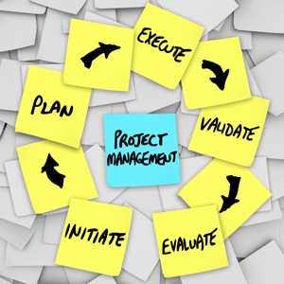
Duties and Job Descriptions
Typical responsibilities of project manager include:
agreeing project objectives
representing the client's or organisation's interests
providing advice on the management of projects
organising the various professional people working on a project
carrying out risk assessment
making sure that all the aims of the project are met
making sure the quality standards are met
using IT or other systems to keep track of people and progress
recruiting specialists and sub-contractors
monitoring sub-contractors to ensure guidelines are maintained
overseeing the accounting, costing and billing
reporting to the client or senior stakeholders on progress
evaluating the success of the project against its benchmarking and sharing lessons or best practice with other organisations or project managers.

Slide 26
Duties and Job Descriptions
Typical requirements of project manager include:
Great educational background, preferably in the fields of computer science or engineering for technical project managers
Proven working experience as a project administrator in the information technology sector
Solid technical background, with understanding or hands-on experience in software development and web technologies
Excellent client-facing and internal communication skills
Excellent written and verbal communication skills
Solid organizational skills including attention to detail and multi-tasking skills
Strong working knowledge of Microsoft Office
PMP / PRINCE II certification is a plus

Slide 27
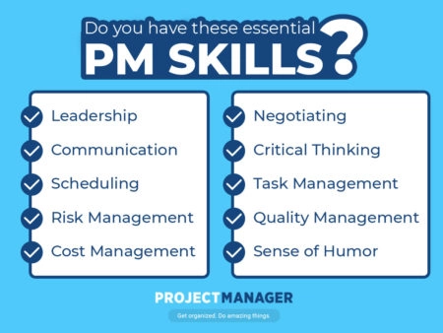
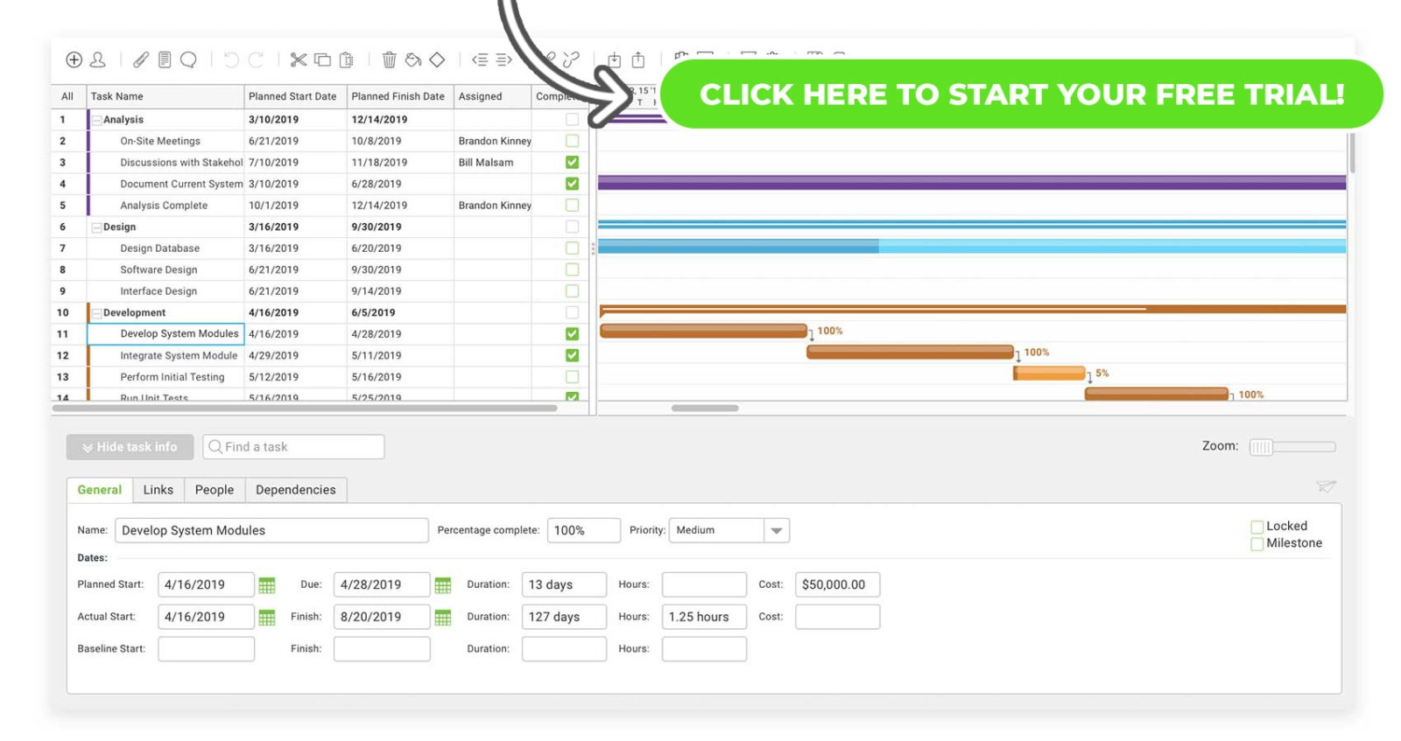
Duties and Job Descriptions
Typical skills for project managers
Organisational skills
Analytical skills
Well developed interpersonal skills
Numeracy skills
Commercial awareness
Communication skills
Teamworking skills
Diplomacy
Ability to motivate people
Management and leadership skills
Risk management
Critical Thinking

Slide 28
RECAP
With the Core Competencies Checklist companies will be able to determine which project manager has the best mix of knowledge, experience and personality for a specific project. By being able to select the right project manager for the project, companies will minimize project failures and maximize their project's return on investment.
Different roles in project management will require different competencies. Since the project management environment is characterized by change, responsibilities, and hence required knowledge and skill levels, continuously transform. One of the key competencies is therefore to be flexible and adaptive in any situation. Although certification does not qualify a project manager by itself, it does give an indication of the candidate's knowledge of concepts and methodologies.
Successful project managers have the ability to demonstrate the unbiased fairness of a judge, the skills of a diplomat, the authority of a general and the understanding of a parent.

