Slide 1

Network scheduling techniques
Network planning and estimating
Pavel Adámek
Project management

Slide 2

Outline of the lecture
Networking fundamentals
Graphic evaluation and review technique (GERT, PERT, CPM)
Dependencies
Slack time
Network replanning

Slide 3
Introduction
Management is continually seeking new and better control techniques to cope with the complexities, masses of data, and tight deadlines that are characteristic of highly competitive industries. Managers also want better methods for presenting technical and cost data to customers.
Scheduling techniques help achieve these goals. The most common techniques are:
Gantt or bar charts
Milestone charts
Line of balance
Networks
    Program Evaluation and Review Technique (PERT)
    Arrow Diagram Method (ADM) (Sometimes called the Critical Path Method (CPM))
    Precedence Diagram Method (PDM)
    Graphical Evaluation and Review Technique (GERT)

Slide 4
Introduction
The network scheduling techniques are useful.
They form the basis for all planning and predicting and help management decide how to use its resources to achieve time and cost goals.
They provide visibility and enable management to control “one-of-a-kind” programs.
They help management evaluate alternatives by answering such questions as how time delays will influence project completion, where slack exists between elements, and what elements are crucial to meet the completion date.
They provide a basis for obtaining facts for decision-making.
They utilize a so-called time network analysis as the basic method to determine manpower, material, and capital requirements, as well as to provide a means for checking progress.
They provide the basic structure for reporting information.
They reveal interdependencies of activities.
They facilitate “what if” exercises.
They identify the longest path or critical paths.
They aid in scheduling risk analysis.

Slide 5
Networking fundamentals
Interdependencies are shown through the construction of networks.
Network analysis can provide valuable information for planning, integration of plans, time studies, scheduling, and resource management.
The primary purpose of network planning is to eliminate the need for crisis management by providing a pictorial representation of the total program.
The major discrepancy with Gantt, milestone, or bubble charts is the inability to show the interdependencies between events and activities.
These interdependencies must be identified so that a master plan can be developed that provides an up-to-date picture of operations at all times.

Slide 6
Networking fundamentals
The following management information can be obtained from such a representation:
Interdependencies of activities
Project completion time
Impact of late starts
Impact of early starts
Trade-offs between resources and time
“What if” exercises
Cost of a crash program
Slippages in planning/performance
Evaluation of performance

Slide 7
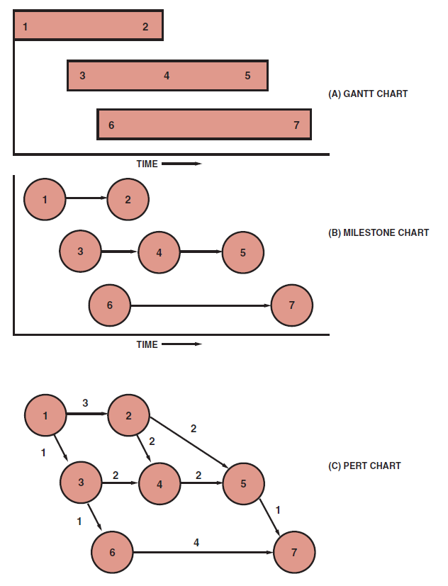
Networking fundamentals
Conversion from bar chart to PERT chart
Gantt charts, however, can be used to develop the PERT network.
The bar chart in 3A can be converted to the milestone chart in 3B. By then defining the relationship between the events on different bars in the milestone chart, we can construct the PERT chart in 3C.
Source: Kerzner, H. 2017. Project Management

Slide 8
Networking fundamentals
Large projects can easily be converted into PERT networks once the following questions are answered:
What job immediately precedes this job?
What job immediately follows this job?
What jobs can be run concurrently?

Slide 9
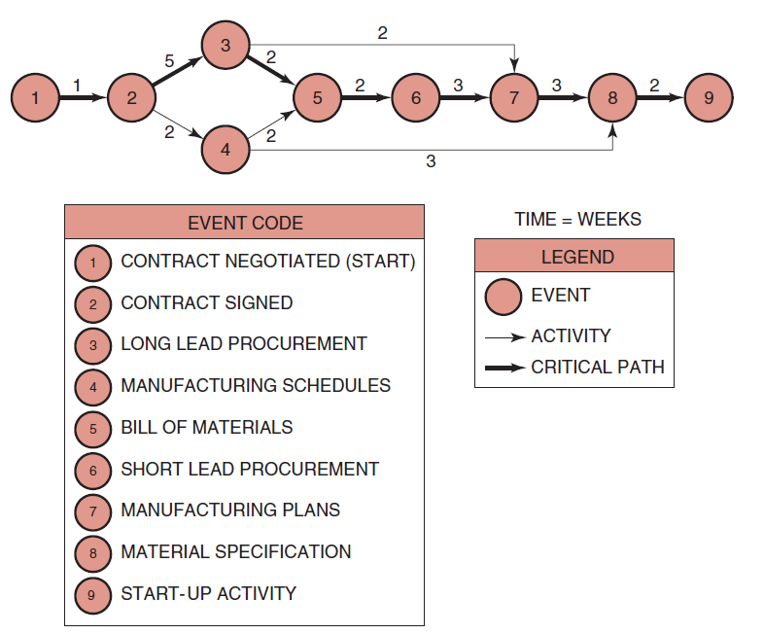
Networking fundamentals
PERT network
The bold line represents the critical path, which is established by the longest time span through the total system of events. The critical path is composed of events 1–2–3–5–6–7–8–9.
Source: Kerzner, H. 2017. Project Management

Slide 10
Networking fundamentals
The critical path is vital for successful control of the project because it tells management two things:
Because there is no slack time in any of the events on this path, any slippage will cause a corresponding slippage in the end date of the program unless this slippage can be recovered during any of the downstream events (on the critical path).
Because the events on this path are the most critical for the success of the project, management must take a hard look at these events in order to improve the total program.

Slide 11
Networking fundamentals
Using PERT we can now identify the earliest possible dates on which we can expect an event to occur, or an activity to start or end.
There is nothing overly mysterious about this type of calculation, but without a network analysis the information might be hard to obtain.
PERT charts can be managed from either the events or the activities.
For levels 1–3 of the Work Breakdown Structure (WBS), the project manager’s prime concerns are the milestones, and therefore, the events are of prime importance.
For levels 4–6 of the WBS, the project manager’s concerns are the activities.

Slide 12
Networking fundamentals
The principles - thus far apply to CPM. The nomenclature is the same and both techniques are often referred to as arrow diagramming methods, or activity-on-arrow networks. The differences between PERT and CPM are:
  PERT uses three time estimates (optimistic, most likely, and pessimistic) to derive an expected time. CPM uses one time estimate that represents the normal time (i.e., better estimate accuracy with CPM).
  PERT is probabilistic in nature, based on a beta distribution for each activity time and a normal distribution for expected time duration. This allows us to calculate the “risk” in completing a project. CPM is based on a single time estimate and is deterministic in nature.
  Both PERT and CPM permit the use of dummy activities in order to develop the logic.
  PERT is used for R&D projects where the risks in calculating time durations have a high variability. CPM is used for construction projects that are resource dependent and based on accurate time estimates.
  PERT is used on those projects, such as R&D, where percent complete is almost impossible to determine except at completed milestones. CPM is used for those projects, such as construction, where percent complete can be determined with reasonable accuracy and customer billing can be accomplished based on percent complete.

Slide 13
Graphic evaluation and review technique (GERT)
With PERT one cannot easily show that if a test fails, we may have to repeat the test several times.
With PERT, we cannot show that, based upon the results of a test, we can select one of several different branches to continue the project.
These problems are easily overcome using GERT.
Graphical evaluation and review techniques are similar to PERT but have the distinct advantages of allowing for looping, branching, and multiple project end results.

Slide 14
Dependencies
Mandatory dependencies (i.e., hard logic): These are dependencies that cannot change, such as erecting the walls of a house before putting up the roof.
Discretionary dependencies (i.e., soft logic): These are dependencies that may be at the discretion of the project manager or may simply change from project to project. As an example, one does not need to complete the entire bill of materials prior to beginning procurement.
External dependencies: These are dependencies that may be beyond the control of the project manager such as having contractors sit on your critical path.
There are three basic types of interrelationships or dependencies:

Slide 15
Slack time
The time differential between the scheduled completion date and the required date to meet critical path is referred to as the slack time.
The critical path is vital for resource scheduling and allocation because the project manager, with coordination from the functional manager, can reschedule those events not on the critical path for accomplishment during other time periods when maximum utilization of resources can be achieved, provided that the critical path time is not extended.
Since there exists only one path through the network that is the longest, the other paths must be either equal in length to or shorter than that path.

Slide 16
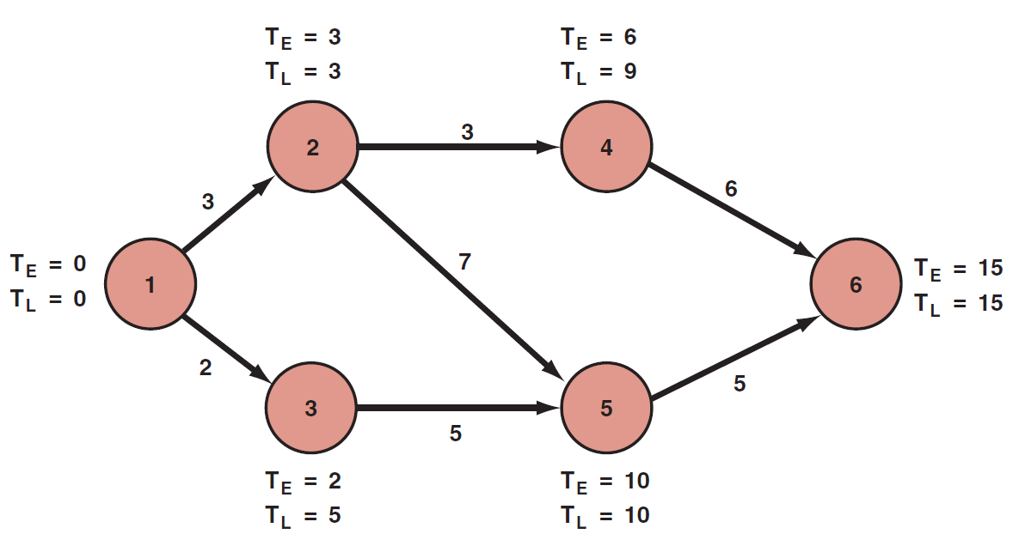
Slack time
PERT network
with slack time
Event 4 is not on the crucial path. To go from event 2 to event 5 on the critical path requires seven weeks taking the route 2–3–5.
If route 2–4–5 is taken, only four weeks are required. Therefore, event 4, which requires two weeks for completion, should begin anywhere from zero to three weeks after event 2 is complete.
During these three weeks, management might find another use for the resources of people, money, equipment, and facilities required to complete event 4.
Source: Kerzner, H. 2017. Project Management

Slide 17
Slack time
Slack can be defined as the difference between the latest allowable date and the earliest expected date based on the nomenclature below:
TE = the earliest time (date) on which an event can be expected to take place
TL = the latest date on which an event can take place without extending the completion date of the project
Slack time = TL - TE

Slide 18
Slack time
Some people prefer to calculate the earliest and latest times for each activity instead. Also, the earliest and latest times were identified simply as the time or date when an event can be expected to take place. To make full use of the capabilities of PERT/CPM, we could identify four values:
The earliest time when an activity can start (ES)
The earliest time when an activity can finish (EF)
The latest time when an activity can start (LS)
The latest time when an activity can finish (LF)

Slide 19
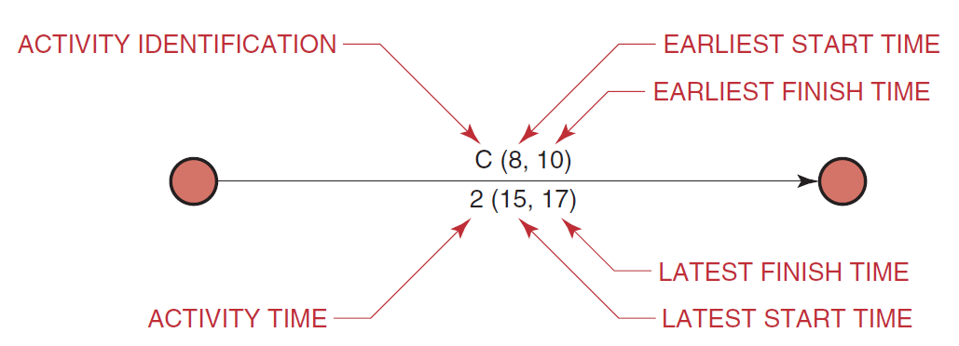
Slack time
The earliest and latest times identified on the activity
To calculate the earliest starting times, we must make a forward pass through the network (i.e., left to right).
The earliest starting time of a successor activity is the latest of the earliest finish dates of the predecessors. The latest starting time is the total of the earliest starting time and the activity duration.
To calculate the finishing times, we must make a backward pass through the network by calculating the latest finish time.
Source: Kerzner, H. 2017. Project Management

Slide 20
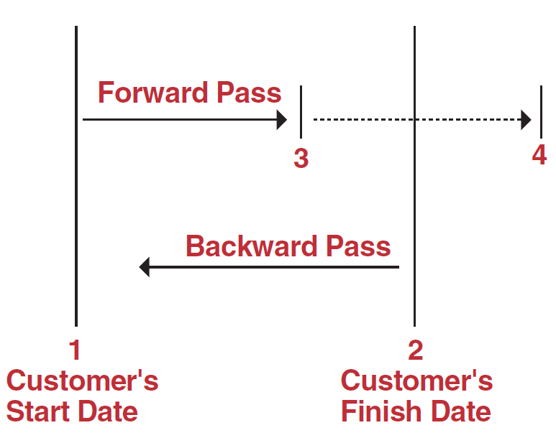
Slack time
What can cause the slack to be negative?
When performing a forward pass through a network, we work from left to right beginning at the customer’s starting milestone (position 1).
The backward pass, however, begins at the customer’s end date milestone (position 2), not (as is often taught in the classroom) where the forward pass ends.
If the forward pass ends at position 3, which is before the customer’s end date, it is possible to have slack on the critical path. This slack is often called reserve time.
Source: Kerzner, H. 2017. Project Management

Slide 21
Slack time
Negative slack usually occurs when the forward pass extends beyond the customer’s end date.
The backward pass is still measured from the customer’s completion date, thus creating negative slack. This is most likely to result when:
The original plan was highly optimistic, but unrealistic
The customer’s end date was unrealistic
One or more activities slipped during project execution
The assigned resources did not possess the correct skill levels
The required resources would not be available until a later date

Slide 22
Network replanning
All were to go according to schedule, then the original PERT/CPM chart would be unchanged for the duration of the project.
Many iterations, however, are normally made during the planning phase before the PERT/CPM chart is finished.
But, how many programs or projects follow an exact schedule from start to finish?
Network replanning is performed
either at the conception of the program in order to reduce the length of the critical path, or during the program, should the unexpected occur.

Slide 23
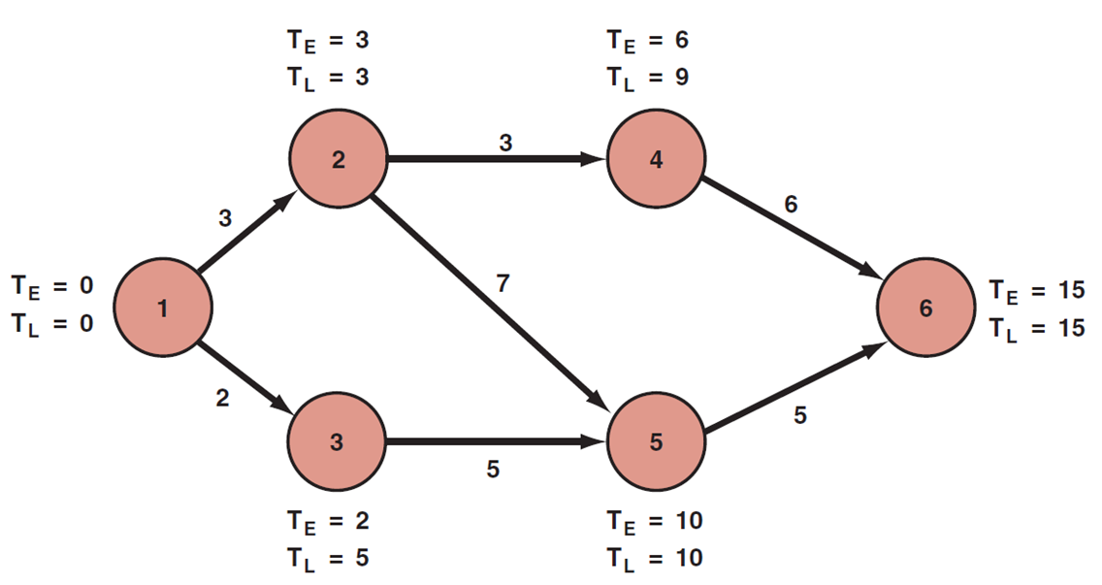
Network replanning
PERT schedule
Suppose that activities 1–2 and 1–3 irequire manpower from the same functional unit.
Upon inquiry by the project manager, the functional manager asserts that he can reduce activity 1–2 by one week if he shifts resources from activity 1–3 to aktivity 1–2.
Should this happen, however, activity 1–3 will increase in length by one week.
Source: Kerzner, H. 2017. Project Management

Slide 24
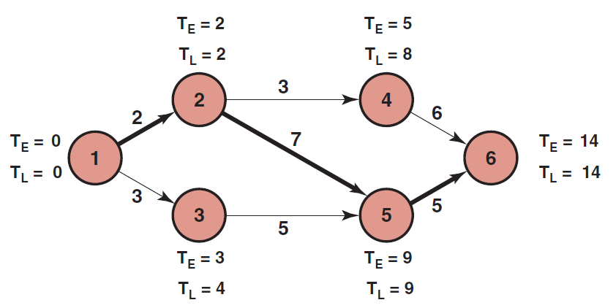
Network replanning
Network replanning - PERT schedule
Reconstructing the PERT/CPM networ, the length of the critical path is reduced by one week, and the corresponding slack events are likewise changed.
Source: Kerzner, H. 2017. Project Management

Slide 25
Network replanning
There are two network replanning techniques based almost entirely upon resources: resource leveling and resource allocation.
Resource leveling is an attempt to eliminate the manpower peaks and valleys by smoothing out the period-to-period resource requirements. The ideal situation is to do this without changing the end date. However, in reality, the end date moves out and additional costs are incurred.
Resource allocation is an attempt to find the shortest possible critical path based upon the available or fixed resources. The problem with this approach is that the employees may not be qualified technically to perform on more than one activity in a network.

Slide 26
Network replanning
Unfortunately, not all PERT/CPM networks permit such easy rescheduling of resources. Project managers should make every attempt to reallocate resources to reduce the critical path, provided that the slack was not intentionally planned as a safety valve.
Transferring resources from slack paths to more critical paths is only one method for reducing expected project time. Several other methods are available:
  Elimination of some parts of the project
  Addition of more resources
  Substitution of less time-consuming components or activities
  Parallelization of activities
  Shortening critical path activities
  Shortening early activities
  Shortening longest activities
  Shortening easiest activities
  Shortening activities that are least costly to speed up
  Shortening activities for which you have more resources
  Increasing the number of work hours per day

Slide 27
Network replanning
Under the ideal situation, the project start and end dates are fixed, and performance within this time scale must be completed within the guidelines described by the statement of work.
Should the scope of effort have to be reduced in order to meet other requirements, the contractor incurs a serious risk that the project may be canceled, or performance expectations may no longer be possible.
Adding resources is not always possible. If the activities requiring these added resources also call for certain expertise, then the contractor may not have qualified or experienced employees, and may avoid the risk.

Slide 28
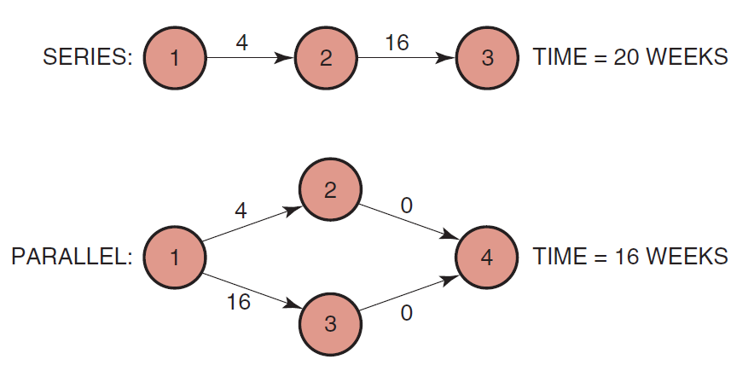
Network replanning
Parallelization of activities can be regarded as accepting a risk by assuming that a certain event can begin in parallel with a second event that would normally be in sequence with it.
Four weeks can be saved by sending out purchase orders after contract negotiations are completed, but before the one-month waiting period necessary to sign the contract. Here the contractor incurs a risk.
For example:
1 – Contrant negotiations completed
2 – Contract signed
3 – Material/tooling purchased
4 – Dummy event
Source: Kerzner, H. 2017. Project Management

Slide 29
RECAP
Network scheduling techniques have the advantages:
They form the basis for all planning and predicting and help management decide how to use its resources to achieve time and cost goals.
They provide visibility and enable management to control “one-of-a-kind” programs.
They help management evaluate alternatives by answering such questions as how time delays will influence project completion, where slack exists between elements, and what elements are crucial to meet the completion date.
They provide a basis for obtaining facts for decision-making.
They utilize a so-called time network analysis as the basic method to determine manpower, material, and capital requirements, as well as to provide a means for checking progress.
They provide the basic structure for reporting information.
They reveal interdependencies of activities.
They facilitate “what if” exercises.
They identify the longest path or critical paths.
They aid in scheduling risk analysis.

