Slide 1

CORPORATE social performance – case studies in csr reporting
CSP APPROACHES AND EVALUATION
Ing. Pavel Adámek, Ph.D.
CORPORATE SOCIAL RESPONSIBILITY

Slide 2
CORPORATE social performance – case studies in csr reporting
Outline of the lecture
The impact of corporate responsibility
Frameworks for CSR evaluation
Case studies – CSR reports

Slide 3
CORPORATE social performance – case studies in csr reporting
INTRODUCTION
Continuous measurement and evaluation of corporate performance is necessary for business success and the Corporate Social Responsibility (CSR) movement is has been rapidly growing in signification as a strategic management instrument over the past number of years.
There exists as an examples:
  CSR ratings and rankings, CSR prizes and competitions, CSR-tests (i.e. by consumer associations, suppliers),
  existing publication by stakeholder that addresses CSR (e. g. public statement on CSR, discussion paper, petition).
  This structure could be combine with categorized stakeholders: political actors (e.g. national governments, the European Commission, IGOs), NGOs (environmental NGOs, consumer association etc.), for profit organizations (e.g. ranking agencies, consultancy companies and labour unions.

Slide 4
CORPORATE social performance – case studies in csr reporting
INTRODUCTION
Among the better known international instruments which global influence are:
  OECD Guidelines for Multinational Enterprises; AA 1000 AccountAbility/Assurance Standard; Social Audit Network; ETHIBEL; EFQM; SA 8000 – Social Accountability International; ISO 26000, ISO 8000, ISO 9000, ISO 14000, IQNet SR 10; IASE 3000; Global Reporting Initiative (GRI); London Benchmarking Group; Corporate Responsibility Index; Corporate Giving Standard; Corporate Community Involvement Index; Dow Jones Sustainability Index; FTSE4GOOD.
Wartick and Cochran's (1985) definition of CSP:
  „a business organization's configuration of principles of social responsibility, processes of social responsiveness, and policies, programs, and observable outcomes as they relate to the firm's societal relationships“.

Slide 5
CORPORATE social performance – case studies in csr reporting
1. The impact of corporate responsibility
CSP – Steg et al. Models of CSP_{narrow}
Economic performance: profitability/market value
  Drivers of economic value added
  Drivers of economic performance
  Value chain performance
  Profitability/market value
  Economic externalities
Social performance: Impacts on and relations with stakeholder
  Well-being of Employees
  Well-being of Customers
  Well-being of Community
  Well-being of Suppliers
  Well-being of Competitors
Environmental performance
  Resource/land use
  Emissions and Waste
  Effects on life support system
  Chain Effects

Slide 6
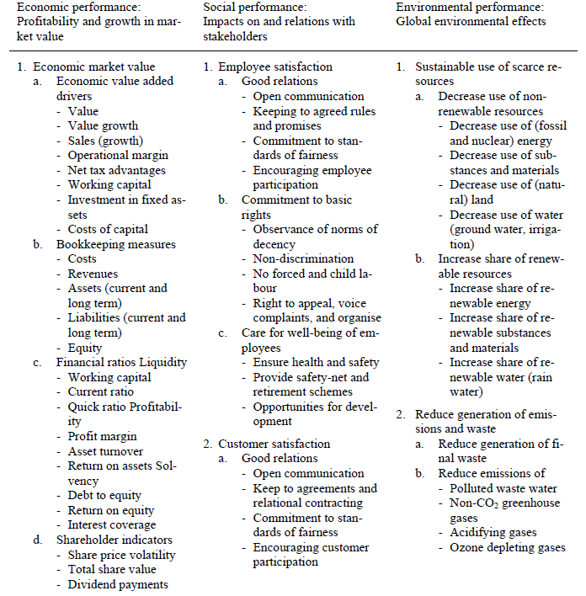
CORPORATE social performance – case studies in csr reporting
1. The impact of corporate responsibility
Steg et al.´s operationalisation of CSP_{broad}

Slide 7
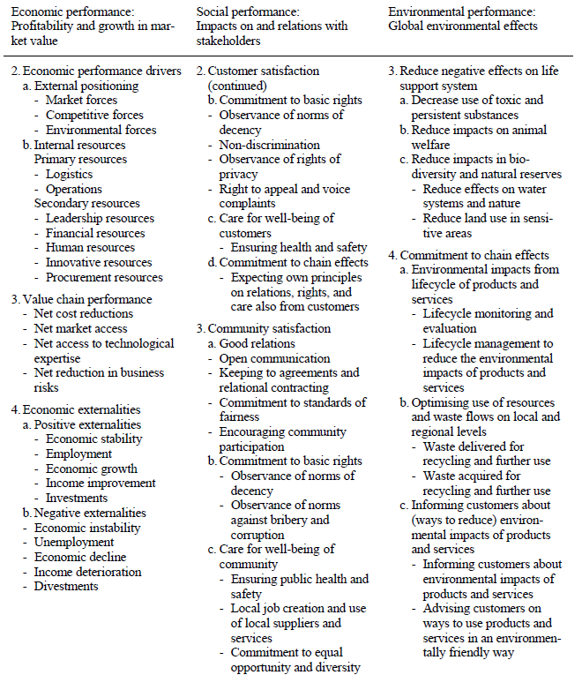
CORPORATE social performance – case studies in csr reporting
1. The impact of corporate responsibility
Steg et al.´s operationalisation of CSP_{broad}

Slide 8
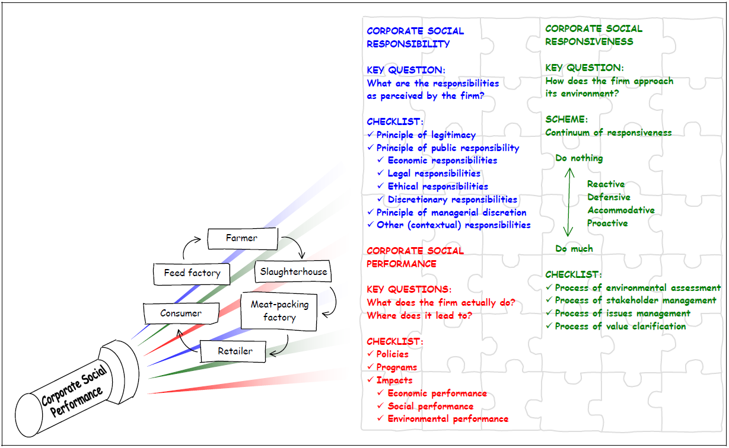
CORPORATE social performance – case studies in csr reporting
1. The impact of corporate responsibility
Framework for analysing the social, environmental, and economic activities of a firm or chain
A framework for analysing corporate social performance; Beyond the Wood model, 2004.
Pierick, E. ten, V. Beekman, C.N. van der Weele, M.J.G. Meeusen and R.P.M. de Graaff

Slide 9
CORPORATE social performance – case studies in csr reporting
2. Frameworks for CSR evaluation
There exists a high number of frameworks and approaches to evaluate CSR, differing e.g. territory of competence, countries, international activities, the concept of stakeholders...
There are three readily available sources of information relating to the impact of corporate responsibility:
  CSR reports – including social, environmental, and sustainability reports;
  Ratings of companies such as FTSE4Good, the Ethibel Sustainability Index, the KLD Indexes, the ARESE social ratings, and the Dow Jones Sustainability Indexes,
  And case studies of companies undertaken by companies, corporate Responsibility organizations, and others.

Slide 10
CORPORATE social performance – case studies in csr reporting
2. Frameworks for CSR evaluation
Other approach could be divided by categorized stakeholders:
  political actors (e.g. national governments, the European Commission, IGOs),
  NGOs (environmental NGOs, consumer association etc.),
  for profit organizations (e.g. ranking agencies, consultancy companies and labour unions.

Slide 11
CORPORATE social performance – case studies in csr reporting
2. Frameworks for CSR evaluation
Among the better known international instruments which global influence are:
  OECD Guidelines for Multinational Enterprises
  Global Reporting Initiative (GRI)
  AA 1000 AccountAbility/Assurance Standard
  Social Audit Network
  ETHIBEL
  EFQM
  SA 8000 – Social Accountability International
  ISO 26000, ISO 8000, ISO 9000, ISO 14000
  IASE 3000
  London Benchmarking Group
  Corporate Responsibility Index, Corporate Giving Standard, Corporate Community Involvement Index

Slide 12
CORPORATE social performance – case studies in csr reporting
2. Frameworks for CSR evaluation
The London Benchmarking Group (LBG) which is implicated in the Czech Republic as “Standard odpovědná firma” (SOF). The project SOF is realized in cooperation with British Corporate Citizenship Company which based the LBG methodology.
  These is using for data verification into list “TOP Firemní Filantrop” in Czech and Slovak Republic, also for Giving List in Great Britain and reporting about all CSR activities either.
The SA8000 standard is a central document.
  It is one of the world’s first auditable social certification standards for decent workplaces, across all industrial sectors, which has adopted policies and procedures that protect workers’ basic human rights.
For international companies with CSR monitoring, the OECD Guidelines for multinational Enterprises could be used.

Slide 13
CORPORATE social performance – case studies in csr reporting
2. Frameworks for CSR evaluation
AA 1000 AccountAbility/Assurance Standards are norms which help organisations to become more responsible and sustainable.
SAN Ltd. (Social Audit Network) is a method suitable for any organisation from the private or public sector.
The KORP method is developed for evaluating CSR in Czech organizations. It judges organizations in three pillars – economic, environmental and social for internal and external application.
  In the year 2011 the national programme for the evaluation agreement of the management system of CSR was made by the Quality Council of the Ministry of Industry and Trade of the Czech Republic

Slide 14
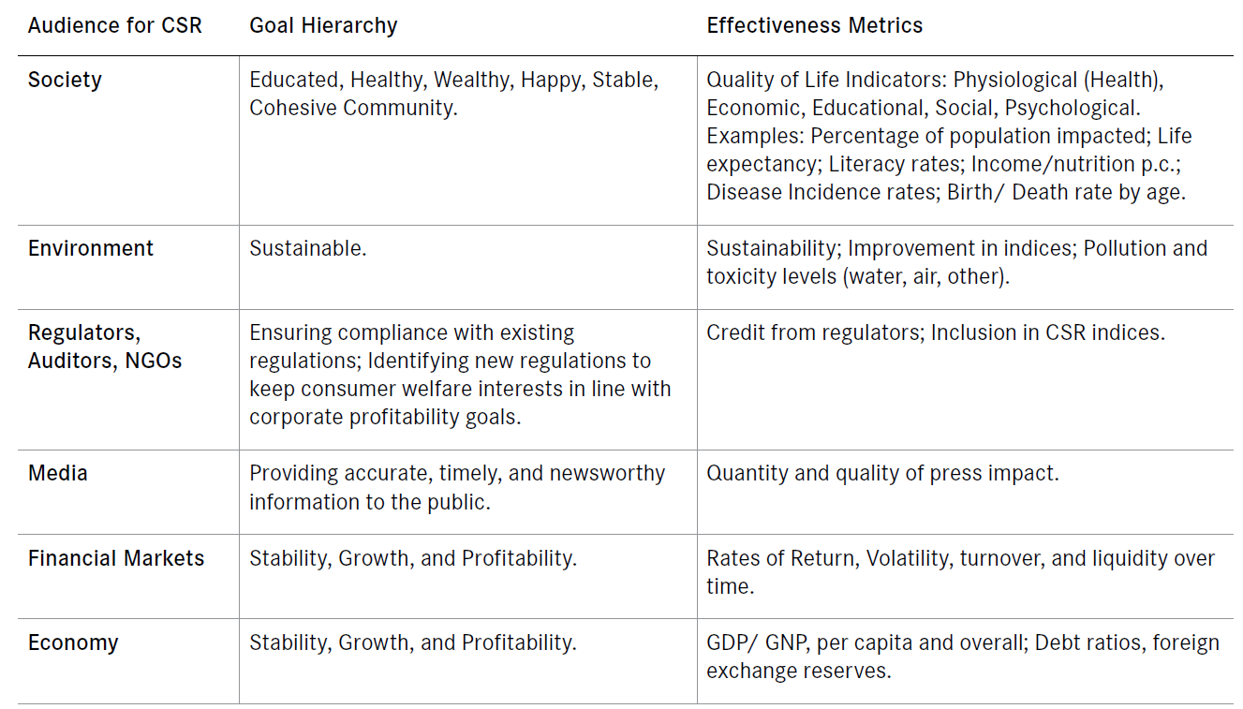
CORPORATE social performance – case studies in csr reporting
2. Frameworks for CSR evaluation
Examples of stakeholder metrics
Source: The Conference Board – Trusted Insights for Business Worldwide. Measuring the effects of CSR, 2011, Volume 3, Number 7

Slide 15
CORPORATE social performance – case studies in csr reporting
2. Frameworks for CSR evaluation
A Framework for understanding impact
What emerges are 5 dimensions on whih corporatre Responsibility practice is held to have an impact.
  The social, environmental, and governance impact. This refers to large social and environmental issues, including global warming, human rights, economic growth, and poverty reduction.
  Instrumental benefits – this covers the connection between fianncial performance and ESG performance, including of making the business case for corporate Responsibility.
  Business attitudes, awareness, and practices – these refers to the impact on the way in which companies think about the non-financial aspects of business operations.
  Non-business stakeholders
  The impact of corporate Responsibility on itself – this area covers the way in which CR evolution and growth has affected how we think about and practise corporate responsibility today.

Slide 16
CORPORATE social performance – case studies in csr reporting
3. Case studies – CSR reports
GRI has pioneered the creation of the world's most widely used concept that provides organizations with guidance on how to generate reports focused on sustainable development, which are publicly published and accessible to all interested parties in order to provide a detailed overview of the activities of the organization, in the above-mentioned areas.
These reports are an appropriate measure for comparison of activities of socially responsible organizations.
In the Czech Republic, companies publishing quality reports on social responsibility stated in the TOP Responsible Company in the category of Responsible reporting.

Slide 17
CORPORATE social performance – case studies in csr reporting
3. Case studies – CSR reports
A case study is focused on reporting activities of firms falling within the concept of social responsibility.
A case study is a compilation of criteria for reporting on CSR and their assessment of the selected companies. Established criteria help other managers to efficiently processing reports and also to achieve the relevant awards.
Criteria of the CSR reports

Slide 18
CORPORATE social performance – case studies in csr reporting
3. Case studies – CSR reports
Plzeňský Prazdroj, a.s
Fulfilling environmental criteria
  In the field of process solutions to reduce emissions, water consumption and energy Pilsner Urquell engaged in activities related to the reduction of water consumption. The company fulfills the criteria for reducing water consumption in the production of beer, tank cleaning etc. In the area of reducing energy consumption and emission levels, the company aims to reduce the results of 2008 to 50%. Responsible waste policies show using recycled materials and packaging waste sorting and politics tend to operate with zero waste.
Fulfilling economic criteria
  The company respecsts human rights and transparent and ethical business founded by the ethics committee of Plzeňský Prazdroj and uses three ombudsmen ethics. The company prides itself on negotiations and cooperation with the relevant supplier. Concludes multi-year contracts, prefers Czech suppliers and inform them of market development.

Slide 19
CORPORATE social performance – case studies in csr reporting
3. Case studies – CSR reports
Plzeňský Prazdroj, a.s
Fulfilling social criteria
  Employment policy is to be a priority for Pilsner Urquell.
  Fair play, fair remuneration, gender equality, workplace safety, pro-family policy and healthy working environment and anti-discrimination are commonplace for him.
  The company is a member of Memoranda Diversity 2013+, which affirmed equal access to employment for men and women.
  Support for local communities is realized through corporate volunteering program Prazdroj to people or ENGAGE, Volunteer Day Give & Gain 2013 and other projects, which support non-profit projects and thus development of the regions.

Slide 20
CORPORATE social performance – case studies in csr reporting
3. Case studies – CSR reports
KPMG Česká republika, s.r.o. - is a global network of professional firms providing audit, tax and advisory services.
Fulfilling environmental criteria
  The company addresses the reduction of water consumption, energy and emission levels for policies to minimize the impact of business activities on the environment. All offices prefer to consume tap water, reducing the carbon footprint of all employees and use ecological means of transport. Among the priority areas of environmental companies also include waste policy that focuses on reducing the consumption of office paper and waste sorting.
Fulfilling the economic criteria
  Entrepreneurial activity according to a report on CSR governed by strict rules of ethics, transparency and independence. Corporate culture sums up a code of ethics. They communicate with their stakeholders through ethical code of supply, which must be observed by all suppliers. The company cooperates only with responsible business partners.

Slide 21
CORPORATE social performance – case studies in csr reporting
3. Case studies – CSR reports
KPMG Česká republika, s.r.o.
Fulfilling social criteria
  The company encourages its employees flexible working hours, the possibility of yoga in the workplace.
  Implementing a program Healthy Company collaborates with health insurance companies and their employees want to strike a balance and health, sport and entertainment.
  In support of the local community is committed to improving the financial literacy of older people, providing training and pro bono services to various non-profit organizations and projects.

Slide 22
CORPORATE social performance – case studies in csr reporting
3. Case studies – CSR reports
O2 Czech Republic a. s. is the largest integrated telecommunications operator in the Czech Republic.
Fulfilling environmental criteria
  To care for the environment, the company focuses on reducing consumption of energy, fuel, water and reduction of waste production.
  Limiting consumption of plastic bottles and heed the recycling of used mobile phones. Its environmental policy also regularly updated. Thus fulfills both the criteria set.
Fulfilling economic criteria
  Although the report does not mention a code of ethics, but the company adheres to principles of responsible business, which were inspired by the ethical codes of other companies.
  The company does not meet the criterion of communication with stakeholders, since the report this information to gather.

Slide 23
CORPORATE social performance – case studies in csr reporting
3. Case studies – CSR reports
O2 Czech Republic a. s.
Fulfilling social criteria
  Employees are available incentive programs, employee benefits, health care and education.
  The local community is supported mainly by the Think Big program, which is under the auspices of the Foundation O2 and enables the realization of ideas and projects for young people.
  The company also supports projects for the deaf, schools, seniors, runs a help line.
  Employees working in the framework of volunteering and donating blood.

Slide 24
CORPORATE social performance – case studies in csr reporting
3. Case studies – CSR reports
Evaluation of the performance criteria selected companies
Selected companies / Criteria | Availability | Regularity | CSR pillars | Planning | Energy, emissions | Waste | Code of Ethics | Stakeholders | Employees | Local community
 | 1 | 2 | 3 | 4 | 5 | 6 | 7 | 8 | 9 | 10
Plzeňský Prazdroj, a.s. | x | x | x | x | x | x | x | x | x | x
KPMG Česká republika, s.r.o. | x | - | x | - | x | x | x | x | x | x
Vodafone Czech Republic, a.s. | x | - | - | x | x | x | - | x | - | x
HEINEKEN Česká republika, a.s. | x | x | x | - | x | x | - | x | x | x
O2 Czech Republic a.s. | - | x | x | - | x | x | x | - | x | x
Johnson&Johnson s.r.o. | x | x | x | - | x | x | x | - | x | x
GlaxoSmithKline s.r.o. | - | - | - | - | - | - | - | - | - | -
Pivovary Staropramen s.r.o. | x | x | x | - | x | x | x | - | x | x
Accenture Central Europe B.V. | - | - | - | - | - | - | - | - | - | -

Slide 25
CORPORATE social performance – case studies in csr reporting
summary of the lecture
It is recommended that in the analysis of the social, environmental, and economic activities of a firm or chain attention is paid not only to the actual outcomes but also to the principles and processes (on which these outcomes are based).
In corporat Responsibility, impact is essential if corporate Responsibility move from being a „feel-good thing“ to being recognized as a „good thing“.
All the approaches are based on a voluntary approach, it means that the motivation engine is the “allowance” of the companies according to the market condition (e. g. influenced by all stakeholders and shareholders).

Slide 26
CORPORATE social performance – case studies in csr reporting
summary of the lecture
Especially in the Czech Republic most of the stakeholders who are involved in CSR performance assessments have international background, including organizations like the UNDP, World Bank, ILO etc.; multinational consulting firms like KPMG; non-profit international organizations like CSR Europe.
The social contract between mangers and society and stakeholders of the company and for responsible and accountable behaviour that is why is important to use properly instruments, methods, and frameworks suitable for specific area of business in which companies operates.

