Slide 1

Strategy-Making Process
Ing. Šárka Zapletalová, Ph.D.
Department of Business Economics and Management
STRATEGIC MANAGEMENT

Slide 2

Basic information
Course: Strategic Management PEMNASMA
Tutor: Šárka Zapletalová
Office: building B202
Contact: zapletalova@opf.slu.cz
Requirements on students (total sum of points 100)
Active participation in seminars – 5% of points
Seminar paper – 10% of points
Continuous test (in the week 25. 10. – 29. 10.) – 15% of points
Final written exam – 70% of points

Slide 3
Outline of the lecture
Strategic Management
Strategic Management: Impact of Globalization
Strategic Management: Impact of Environmental Sustainability
Strategic Decision Making
Strategic Decision Making Process
Strategy Formulation
Initiation of Strategy: Triggering Events

Slide 4
Introduction
General Electric, one of the pioneers of strategic planning, led the transition from strategic planning to strategic management during the 1980s. By the 1990s, most other corporations around the world had also begun the conversion to strategic management.
Strategic management emphasizes long-term performance. Many companies can manager short-term bursts of high performance, but only a few can sustain it over a longer period of time.
To be successful in the long-run, companies must not only be able to execute current activities to satisfy an existing market, but they must also adapt those activities to satisfy new and changing markets.
The three most highly rated benefits of strategic management to be:
  Clearer sense of strategic vision for the firm.
  Sharper focus on what is strategically important.
  Improved understanding of a rapidly changing environment.

Slide 5
Strategic Management
Strategic management is a set of managerial decisions and actions that determines the longrun performance of a corporation. It includes environmental scanning (both external and internal), strategy formulation (strategic or long-range planning), strategy implementation, and evaluation and control.
The study of strategic management, therefore, emphasizes the monitoring and evaluating of external opportunities and threats in light of a corporation’s strengths and weaknesses.
Originally called business policy, strategic management incorporates such topics as strategic planning, environmental scanning, and industry analysis.
Many of the concepts and techniques that deal with strategic management have been developed and used successfully by business corporations such as General Electric and the Boston Consulting Group.

Slide 6
Strategic Management
To be successful in the long-run, companies must not only be able to execute current activities to satisfy an existing market, but they must also adapt those activities to satisfy new and changing markets.
Strategic management is a broader term that includes not only the stages already identified but also the earlier steps of determining the mission and objectives of an organization within the context of its external environment.
Initially, strategic management was of most use to large corporations operating in multiple industries. Increasing risks of error, costly mistakes, and even economic ruin are causing today’s professional managers in all organizations to take strategic management seriously in order to keep their companies competitive in an increasingly volatile environment.

Slide 7
Strategic Management
As managers attempt to better deal with their changing world, a firm generally evolves through the following four phases of strategic management.
Phase 1 - Basic financial planning: Managers initiate serious planning when they are requested to propose the following year’s budget.
  Projects are proposed on the basis of very little analysis, with most information coming from within the firm.
  The sales force usually provides the small amount of environmental information. Such simplistic operational planning only pretends to be strategic management, yet it is quite time consuming.
  Normal company activities are often suspended for weeks while managers try to cram ideas into the proposed budget. The time horizon is usually one year.

Slide 8
Strategic Management
Phase 2 - Forecast-based planning: As annual budgets become less useful at stimulating long-term planning, managers attempt to propose five-year plans.
  In addition to internal information, managers gather any available environmental data - usually on an ad hoc basis - and extrapolate current trends five years into the future.
  This phase is also time consuming, often involving a full month of managerial activity to make sure all the proposed budgets fit together.
  The process gets very political as managers compete for larger shares of funds. Endless meetings take place to evaluate proposals and justify assumptions. The time horizon is usually three to five years.

Slide 9
Strategic Management
Phase 3 - Externally oriented (strategic) planning: Top management takes control of the planning process by initiating strategic planning.
  The company seeks to increase its responsiveness to changing markets and competition by thinking strategically.
  Planning is taken out of the hands of lower-level managers and concentrated in a planning staff whose task is to develop strategic plans for the corporation. Consultants often provide the sophisticated and innovative techniques that the planning staff uses to gather information and forecast future trends.
  Upper-level managers meet once a year at a resort “retreat” led by key members of the planning staff to evaluate and update the current strategic plan.
  Top management typically develops five-year plans with help from consultants but minimal input from lower levels.

Slide 10
Strategic Management
Phase 4 - Strategic management: Realizing that even the best strategic plans are worthless without the input and commitment of lower-level managers, top management forms planning groups of managers and key employees at many levels.
  Strategic plans at this point detail the implementation, evaluation, and control issues. Rather than attempting to perfectly forecast the future, the plans emphasize probable scenarios and contingency strategies.
  The sophisticated annual five-year strategic plan is replaced with strategic thinking at all levels of the organization throughout the year. Strategic information, previously available only centrally to top management, is available via local area networks and intranets to people throughout the organization.
  Planning is typically interactive across levels and is no longer top down. People at all levels are now involved.

Slide 11
Strategic Management: Impact of Globalization
Sustainability, as a term, was used to describe competitive advantage, not the environment.
Globalization, the integrated internationalization of markets and corporations, has changed the way modern corporations do business.
As Thomas Friedman points out in The World Is Flat, jobs, knowledge, and capital are now able to move across borders with far greater speed and far less friction than was possible only a few years ago.
To reach the economies of scale necessary to achieve the low costs, and thus the low prices, needed to be competitive, companies are now thinking of a global market instead of national markets.

Slide 12
Strategic Management: Impact of Globalization
As more industries become global, strategic management is becoming an increasingly important way to keep track of international developments and position a company for long-term competitive advantage.
The formation of regional trade associations and agreements, such as the European Union, NAFTA, Mercosur, Andean Community, CAFTA, and ASEAN, is changing how international business is being conducted.
These associations have led to the increasing harmonization of standards so that products can more easily be sold and moved across national boundaries.

Slide 13
Strategic Management: Impact of Environmental Sustainability
Environmental sustainability refers to the use of business practices to reduce a company’s impact upon the natural, physical environment. Climate change is playing a growing role in business decisions.
Porter and Reinhardt warn that “in addition to understanding its emissions costs, ever firm needs to evaluate its vulnerability to climate-related effects such as regional shifts in the availability of energy and water, the reliability of infrastructures and supply chains, and the prevalence of infectious diseases.“
The effects of climate change on industries and companies throughout the world can be grouped into six categories of risks: regulatory, supply chain, product and technology, litigation, reputational, and physical.

Slide 14
Strategic Decision Making
As organizations grow larger and more complex, with more uncertain environments, decisions become increasingly complicated and difficult to make.
Strategic decisions deal with the long-run future of an entire organization and have three characteristics:
  Rare: Strategic decisions are unusual and typically have no precedent to follow.
  Consequential: Strategic decisions commit substantial resources and demand a great deal of commitment from people at all levels.
  Directive: Strategic decisions set precedents for lesser decisions and future actions throughout an organization.

Slide 15
Strategic Decision Making
According to Henry Mintzberg, the three most typical approaches, or modes, of strategic decision making are entrepreneurial, adaptive, and planning (a fourth mode, logical incrementalism, was added later by Quinn).
Entrepreneurial mode
  Strategy is made by one powerful individual.
  The focus is on opportunities; problems are secondary.
  Strategy is guided by the founder’s own vision of direction and is exemplified by large, bold decisions.
  The dominant goal is growth of the corporation.
    Amazon.com, founded by Jeff Bezos, is an example of this mode of strategic decision making. Although Amazon’s clear growth strategy was certainly an advantage of the entrepreneurial mode, Bezos’ eccentric management style made it difficult to retain senior executives.

Slide 16
Strategic Decision Making
Adaptive mode
Sometimes referred to as “muddling through,” this decision-making mode is characterized by reactive solutions to existing problems, rather than a proactive search for new opportunities.
Much bargaining goes on concerning priorities of objectives. Strategy is fragmented and is developed to move a corporation forward incrementally.
  This mode is typical of most universities, many large hospitals, a large number of governmental agencies, and a surprising number of large corporations.

Slide 17
Strategic Decision Making
Planning mode
This decision-making mode involves the systematic gathering of appropriate information for situation analysis, the generation of feasible alternative strategies, and the rational selection of the most appropriate strategy.
It includes both the proactive search for new opportunities and the reactive solution of existing problems.

Slide 18
Strategic Decision Making
Logical incrementalism
A fourth decision-making mode can be viewed as a synthesis of the planning, adaptive, and, to a lesser extent, the entrepreneurial modes.
  Top management has a reasonably clear idea of the corporation’s mission and objectives, but, in its development of strategies, it chooses to use “an interactive process in which the organization probes the future, experiments and learns from a series of partial (incremental) commitments rather than through global formulations of total strategies“.
  This approach appears to be useful when the environment is changing rapidly and when it is important to build consensus and develop needed resources before committing an entire corporation to a specific strategy.

Slide 19
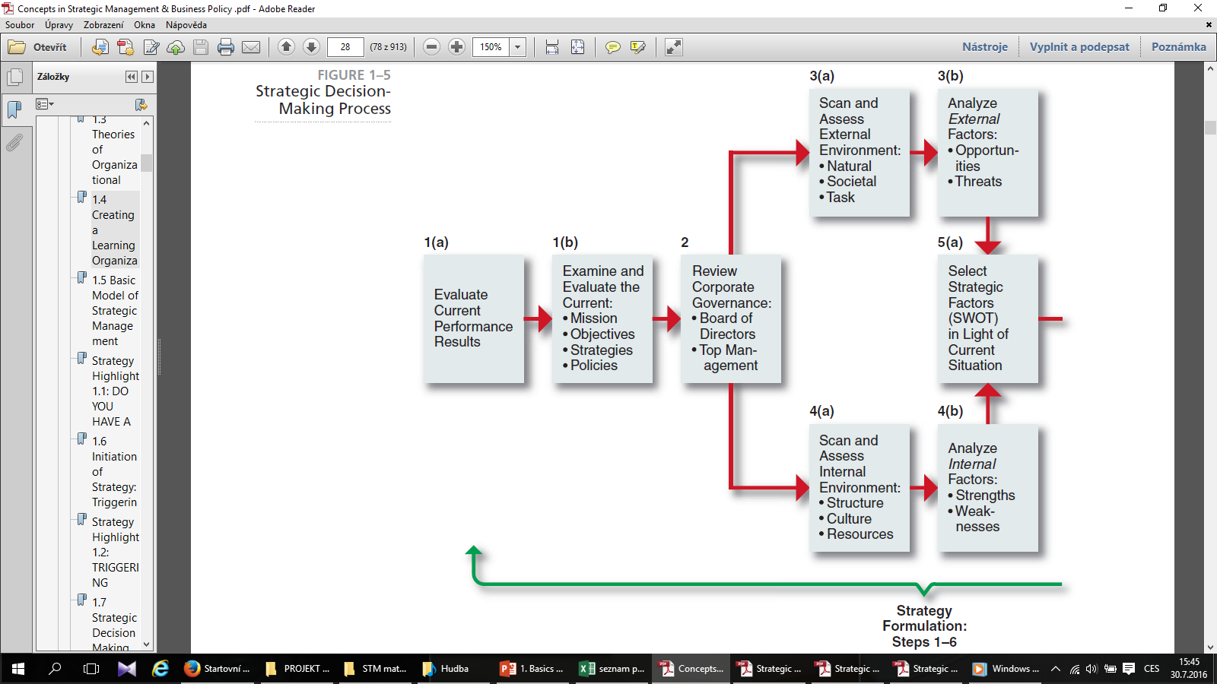
Strategic Decision Making Process
SOURCE: T. L. Wheelen and J. D. Hunger, Strategic Decision-Making Process.

Slide 20
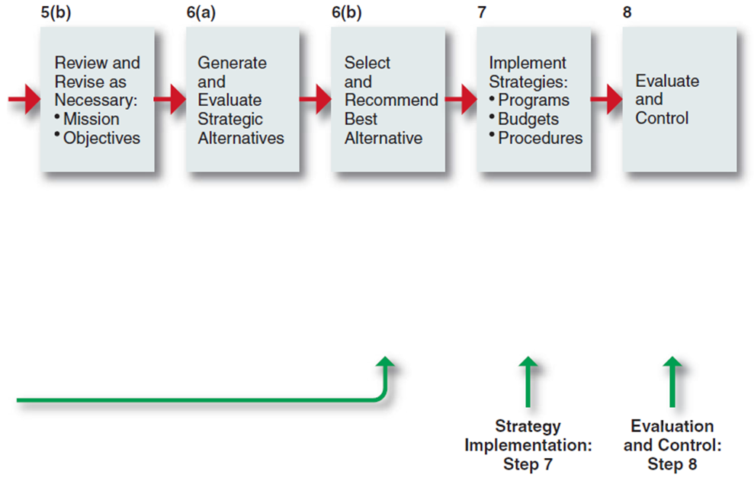
Strategic Decision Making Process
This rational approach to strategic decision making has been used successfully by Corporations such as Warner-Lambert, Target, General Electric, IBM, Avon Products, Bechtel Group Inc., and Taisei Corporation.
SOURCE: T. L. Wheelen and J. D. Hunger, Strategic Decision-Making Process.

Slide 21
Strategic Decision Making Process
Strategic decision-making process to improve the making of strategic decisions
Evaluate current performance results in terms of (a) return on investment, profitability, and so forth, and (b) the current mission, objectives, strategies, and policies.
Review corporate governance - that is, the performance of the firm’s board of directors and top management.
Scan and assess the external environment to determine the strategic factors that pose Opportunities and Threats.
Scan and assess the internal corporate environment to determine the strategic factors that are Strengths (especially core competencies) and Weaknesses.

Slide 22
Strategic Decision Making Process
Analyze strategic (SWOT) factors to (a) pinpoint problem areas and (b) review and revise the corporate mission and objectives, as necessary.
Generate, evaluate, and select the best alternative strategy in light of the analysis conducted in step 5.
Implement selected strategies via programs, budgets, and procedures.
Evaluate implemented strategies via feedback systems, and the control of activities to ensure their minimum deviation from plans.

Slide 23
Strategy Formulation
Strategic management is a broader term that includes not only the stages already identified but also the earlier steps of determining the mission and objectives of an organization within the context of its external environment.
Strategy formulation is the development of long-range plans for the effective management of environmental opportunities and threats, in light of corporate strengths and weaknesses.
It includes defining the corporate mission, specifying achievable objectives, developing strategies, and setting policy guidelines.
An organization’s mission is the purpose or reason for the organization’s existence. Mission describes what the organization is now.
Vision describes what the organization would like to become.

Slide 24
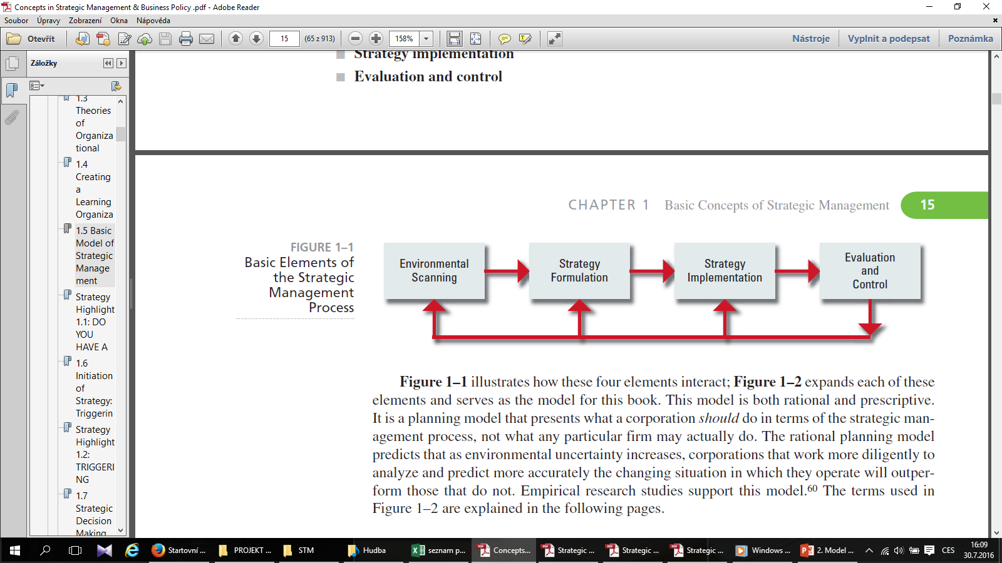
Strategic Management Process
Strategic management consists of four basic elements:
Environmental scanning
Strategy formulation
Strategy implementation
Evaluation and control
SOURCE: T. L. Wheelen, “Strategic Management Model,” adapted from “Concepts of Management,” presented to Society for Advancement of Management (SAM)

Slide 25
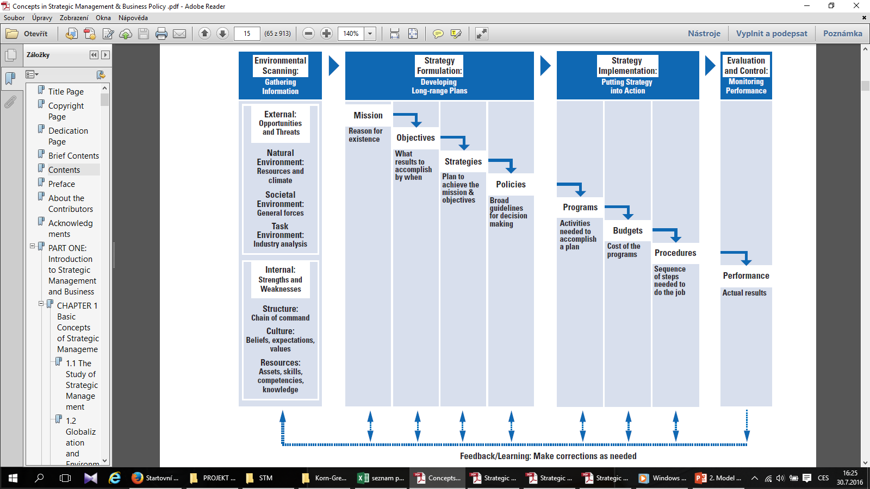
Strategic Management Model
SOURCE: T. L. Wheelen, “Strategic Management Model,” adapted from “Concepts of Management,” presented to Society for Advancement of Management (SAM)

Slide 26
Strategy Formulation
Strategy scholars Donald Hambrick and James Fredrickson propose that a good strategy has five elements, providing answers to five questions:
Arenas: Where will we be active?
Vehicles: How will we get there?
Differentiators: How will we win in the marketplace?
Staging: What will be our speed and sequence of moves?
Economic logic: How will we obtain our returns?

Slide 27
Initiation of Strategy: Triggering Events
A triggering event is something that acts as a stimulus for a change in strategy. Some possible triggering events are:
  New CEO: By asking a series of embarrassing questions, a new CEO cuts through the veil of complacency and forces people to question the very reason for the corporation’s existence.
  External intervention: A firm’s bank suddenly refuses to approve a new loan or suddenly demands payment in full on an old one. A key customer complains about a serious product defect.
  Threat of a change in ownership: Another firm may initiate a takeover by buying a company’s common stock.

Slide 28
Initiation of Strategy: Triggering Events
A triggering event is something that acts as a stimulus for a change in strategy. Some possible triggering events are:
  Performance gap: A performance gap exists when performance does not meet expectations. Sales and profits either are no longer increasing or may even be falling.
  Strategic inflection point: Coined by Andy Grove, past-CEO of Intel Corporation, a strategic inflection point is what happens to a business when a major change takes place due to the introduction of new technologies, a different regulatory environment, a change in customers’ values, or a change in what customers prefer.

