Slide 1
Strategic Analysis
Ing. Šárka Zapletalová, Ph.D.
Department of Business Economics and Management
STRATEGIC MANAGEMENT

Slide 2
Outline of the lecture
Environmental Scanning
External Environment: Macroenvironment
External Environment: Task (Market) Environment
Industry
Market
Internal Environment

Slide 3
Introduction
Before an organization can begin strategy formulation, it must scan the external environment to identify possible opportunities and threats and its internal environment for strengths and weaknesses.
Environmental scanning is the monitoring, evaluation, and dissemination of information from the external and internal environments to key people within the corporation.
A corporation uses this tool to avoid strategic surprise and to ensure its long-term health.
Research has found a positive relationship between environmental scanning and profits.

Slide 4
Environmental Scanning
Environmental scanning involves monitoring, collecting, and evaluating information in order to understand the current trends in the natural, societal, and task environments.
The information is then used to forecast whether these trends will continue or whether others will take their place.
How will developments in the natural environment affect the world?
What kind of developments can we expect in the societal environment to affect our industry?
What will an industry look like in 10 to 20 years?
Who will be the key competitors?
Who is likely to fall by the wayside?

Slide 5
Environmental Scanning
Company´s environment – general forces and trends within the natural or societal environments or specific factors that affect company.

Slide 6
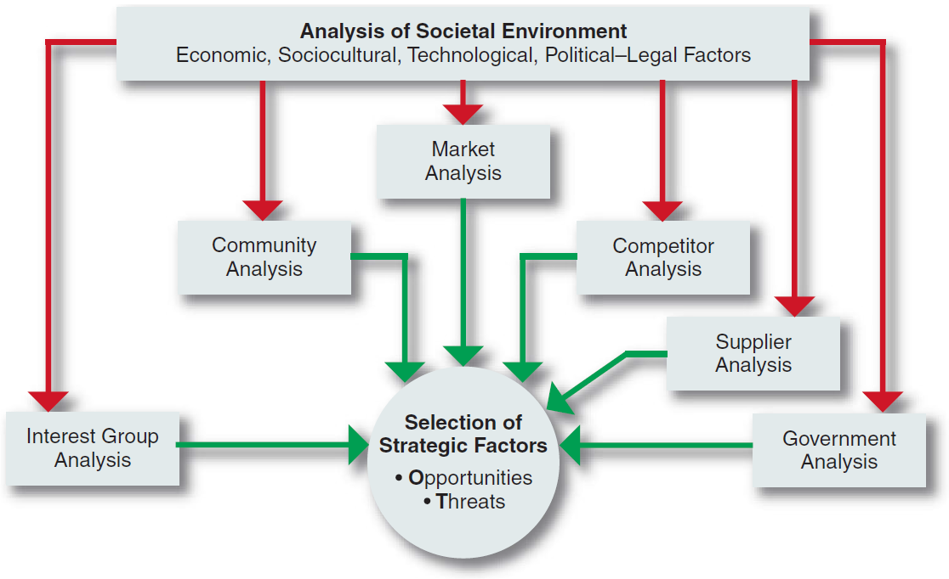
Environmental Scanning
Environmental scanning is the monitoring, evaluating, and disseminating of information from the external and internal environments to key people within the corporation.
A corporation’s scanning of the environment includes analyses of all the relevant elements in the task environment.

Slide 7
External Environment
In undertaking environmental scanning, strategic managers must first be aware of the many variables within a corporation’s natural, societal, and task environments.
The natural environment includes physical resources, wildlife, and climate that are an inherent part of existence on Earth. These factors form an ecological system of interrelated life.
The societal environment is mankind’s social system that includes general forces that do not directly touch on the short-run activities of the organization that can, and often do, influence its long-run decisions.

Slide 8
External Environment: Macroenvironment
Macroenvironment consists of large-scale fundamental forces that shape opportunities and pose threats to the organization. These forces are largely uncontrollable but must be monitored for purposes of both short- and long-term planning.
Macroenvironment concerns events and systems that operate on a large scale and form a backdrop to day-to-day business decisions. The macro environment also contains issues and events which are beyond the capacity of individual organizations to influence or control.
The macro environment is affecting all organizations in the economy/industry and over which no individual organization has much (if any) influence or control.
These forces affect companies and are as follows:
Economic forces that regulate the exchange of materials, money, energy, and information.
Technological forces that generate problem-solving inventions.
Political–legal forces that allocate power and provide constraining and protecting laws and regulations.
Sociocultural forces that regulate the values, mores, and customs of society.

Slide 9
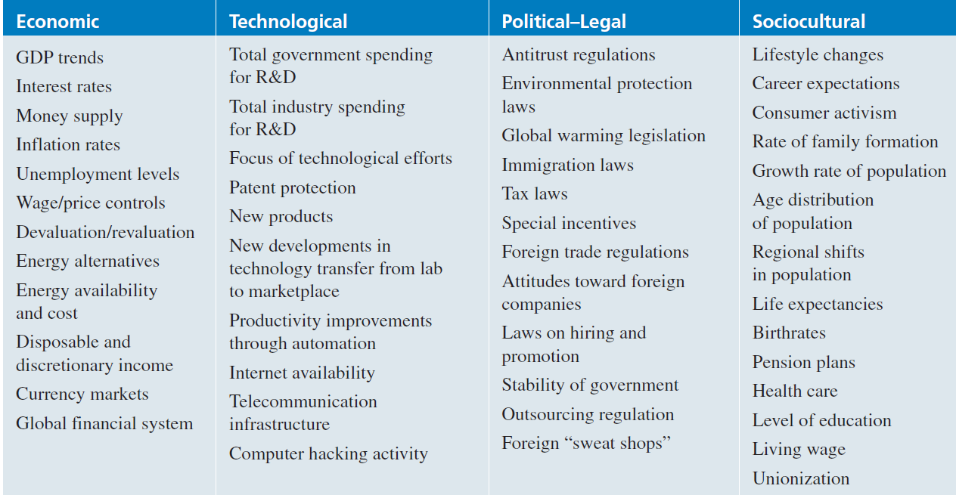
External Environmental Variables: Macroenvironment
Some important variables in the environment

Slide 10
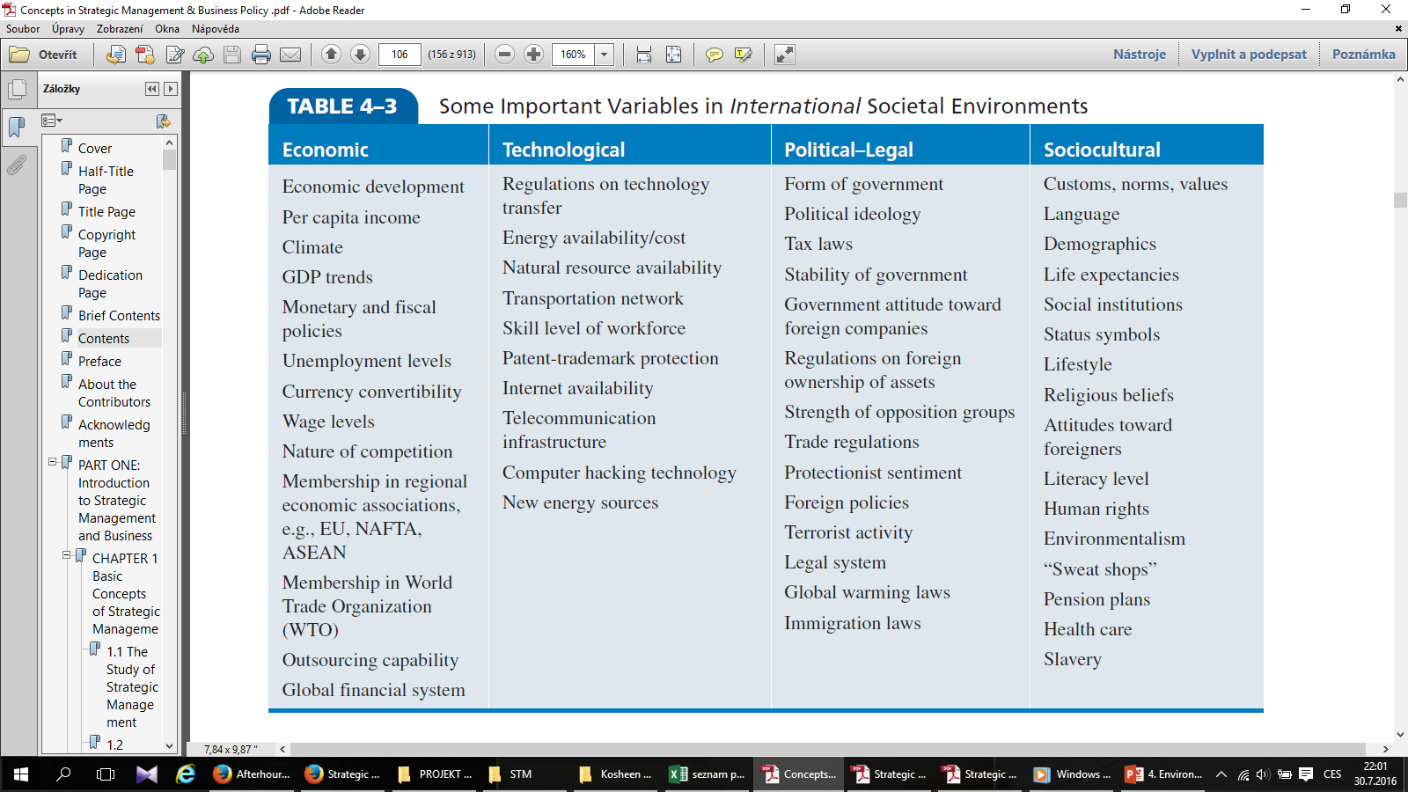
External Environmental Variables: Macroenvironment
Some important variables in the international environment

Slide 11
External Environment: Task (Market) Environment
The task environment includes those elements or groups that directly affect a corporation and, in turn, are affected by it.
These are governments, local communities, suppliers, competitors, customers, creditors, employees/labor unions, special-interest groups, and trade associations.
A corporation’s task environment is typically the environment within which the firm operates.
Industry
Market

Slide 12
Industry
An industry is a group of firms that produces a similar product or service, such as soft drinks or financial services. An examination of the important stakeholder groups, such as suppliers and customers, in a particular corporation’s task environment is a part of industry analysis.
Dozens of industry classifications exist, and these are typically grouped into larger categories known as sectors.
Organizations operating in the same industry can also be compared to each other to evaluate the relative attractiveness of a organization within that industry.

Slide 13
Industry
Typology of industries
Industries according to dependence on the economic cycle:
Cyclical industry;
Anti-cyclical industry;
Neutral industry.
Industries according to the intensity of production factors:
Labor intensive;
Capitally intensive;
Investment intensive.
Industries according to the number of available competitive advantages:
Volumetric;
At an impasse;
Fragmented;
Specialized.

Slide 14
Industry
Dozens of industry classifications exist, and these are typically grouped into larger categories known as sectors. A sector is a group of closely related industries.
Economic sectors:
Primary sector – agriculture, mining and other natural resource industries;
Secondary sector – covering manufacturing, engineering and construction;
Tertiary sector – service industries;
Quarternary sector – intellectual activities involving education and research;
Quinary sector – high level decision makers in government and industry.

Slide 15
International Industries
According to Porter, world industries vary on a continuum from multidomestic to global.

Slide 16
International Industries
Multidomestic industries are specific to each country or group of countries. This type of international industry is a collection of essentially domestic industries, such as retailing and insurance.
The activities in a subsidiary of a multinational corporation (MNC) in this type of industry are essentially independent of the activities of the MNC’s subsidiaries in other countries.
Within each country, it has a manufacturing facility to produce goods for sale within that country.
The MNC is thus able to tailor its products or services to the very specific needs of consumers in a particular country or group of countries having similar societal environments.

Slide 17
International Industries
Global industries, in contrast, operate worldwide, with MNCs making only small adjustments for country-specific circumstances.
In a global industry an MNC’s activities in one country are significantly affected by its activities in other countries.
MNCs in global industries produce products or services in various locations throughout the world and sell them, making only minor adjustments for specific country requirements.
Examples of global industries are commercial aircraft, television sets, semiconductors, copiers, automobiles, watches, and tires.

Slide 18
International Industries
The factors that tend to determine whether an industry will be primarily multidomestic or primarily global are:
Pressure for coordination within the MNCs operating in that industry.
Pressure for local responsiveness on the part of individual country markets.
Between these two extremes lie a number of industries with varying characteristics of both multidomestic and global industries. These are regional industries, in which MNCs primarily coordinate their activities within regions, such as the Americas or Asia.

Slide 19
Market
Market consists of individuals and organizations which are interested and willing to buy a particular product to obtain benefits that will satisfy a specific need or want and who have the resources to engage in such a transaction.
In the market we can to find these market subjects: buyers, organizational buyers, competition, publics
Market is usually measured by dollar (euro) sales and/or unit sales for a defined product-market and specified time period. For measurement of market we can use these three measures:
Market potential is an estimate of the maximum possible sales of a product, a group of products or a service for an entire industry during a specified time period.
Market size (market capacity) is total sales of product, a group of product or a service of the defined industry during a specified time period.
Market share is defined as the sales of product, a group of product or a service of the particular company in the defined industry during a specified time period.

Slide 20
Market
Market segments are distinct groups of customers within a market that can be differentiated from each other on the basis of their distinct attributes and specific demands.
Each segment contains people who are relatively homogenous in their needs, wants and the product benefits they seek. Also, each segment seeks a different set of benefits from the same product category.
The aim of segmentation is to identify groups within a heterogeneous market who share distinctive needs, preferences and behaviors.

Slide 21
Internal Environment
Internal business environment refers to the environment within the organization.
Internal business environment (internal environmental factors) is within the control of organization. The environment is related to the core competencies and competitive advantages of organization.
The internal environment, associated with the employees of the organization, defines the relation between the organization as a social system and the organizational members with their individual attributes. The internal business environment is composed of strategic factors and organizational factors.

Slide 22
Internal Environment: Resources and Capabilities
Resources are an organization’s assets and are thus the basic building blocks of the organization.
They include tangible assets, such as its plant, equipment, finances, and location, human assets, in terms of the number of employees, their skills, and motivation, and intangible assets, such as its technology (patents and copyrights), culture, and reputation.
Capabilities refer to a corporation’s ability to exploit its resources.
A capability is functionally based and is resident in a particular function. Thus, there are marketing capabilities, manufacturing capabilities, and human resource management capabilities. When these capabilities are constantly being changed and reconfigured to make them more adaptive to an uncertain environment, they are called dynamic capabilities.

Slide 23
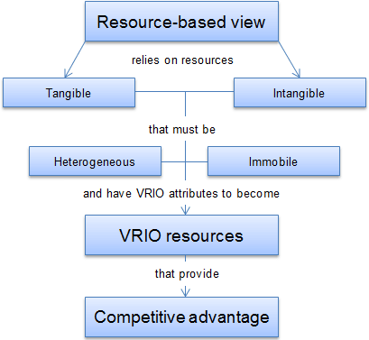
Resources
Prostor pro doplňující informace, poznámky

Slide 24
Resources and Capabilities
Resources
Core Competencies
Activities
Competitive Advantage
Performance
Capabilities
Prostor pro doplňující informace, poznámky

Slide 25
Internal Environment: Core Competencies and Competitive Advantage
Core competencies are those assets that are valuable for improving business, are difficult for competitors to imitate and can be extended as a value-creating capability for use in other product or geographic markets.
Core competencies are usually classified into one of three basic groups:
Superior technological know-how;
Reliable innovative processes;
Close relationships with external parties.
Competitive advantage is an advantage that a organization has over its competitors, allowing it to generate greater sales or margins and/or retain more customers than its competition.
Competitive advantage is a sustainable advantage. The advantage is sustainable for long term.

Slide 26
Internal Environment: Resources and Capabilities
Examples of core competencies
Company | Core competencies | Application examples
Amazon.com | Superior IT capabilities | Online retailing: largest selection of items online
Apple | Superior marketing and retailing experience Superior industrial design in integration of hardware and software | Creation of innovative and category-defining mobile devices and software services
Coca-Cola | Superior marketing and distribution | Leveraging one of the world´s most recognized brands Gloal availability of products
Honda | Superior engineering of small but powerful and highly reliable internal combustion enegines | Motorcycles, cars, sporting boats, snowmobiles, small aircraft

Slide 27
Internal Environmental Factors
Internal environmental factors are events that occur within an organization.
We distinguish between two groups of internal environmental factors:
Strategic factors
Strategy;
Organizational structure;
Competitiveness.
Organizational factors
Managerial team;
Organizational resources;
Business culture.

