Slide 1

Analytical Methods of External Environment
Ing. Šárka Zapletalová, Ph.D.
Department of Business Economics and Management
STRATEGIC MANAGEMENT

Slide 2

Outline of the lecture
Methods of macroenvironment analysis
Methods of industry analysis
Methods of market analysis
Identifying external strategic factors

Slide 3
Introduction
Environmental scanning involves monitoring, collecting, and evaluating information in order to understand the current trends in the natural, societal, and task environments.
The objective of analysis of macroenvironment is to determine the factors affecting the organization.
Analysing industries involves building up a detailed knowledge of the competing organizations in the industry and the products (goods and services) they are selling.

Slide 4
Methods of Macroenvironment Analysis
The objective of analysis of macro environment is to determine the factors affecting the organization.
Information resources for analysis of macro environment are secondary resources.
Fundamental methods for the analysis of macro environment:
  PEST analysis;
  LoNGPEST analysis;
  Forecasting methods;
  Methods of scenarios.

Slide 5
PEST Analysis
The creator of PEST analysis is the Harvard professor Francis Aguilar. He included the tool in his 1967 book „Scanning the Business Environment“.
PEST is an acronym for the Political, Economic, Social and Technological factors which fashion the environment within which organization operates.
This analysis is used to identify Opportunities and Threats which can be combined with an internal analysis of a organization´s strengths and weaknesses to produce a SWOT analysis.
The analysis enables managers to assemble a logical and comprehensive picture of macro environment. Managers can use PEST analysis to understand and adapt to future business environment.

Slide 6
PEST Analysis
The creator of PEST analysis is the Harvard professor Francis Aguilar. He included the tool in his 1967 book „Scanning the Business Environment“.
PEST is an acronym for the Political, Economic, Social and Technological factors which fashion the environment within which organization operates.
This analysis is used to identify Opportunities and Threats which can be combined with an internal analysis of a organization´s strengths and weaknesses to produce a SWOT analysis.
The analysis enables managers to assemble a logical and comprehensive picture of macro environment. Managers can use PEST analysis to understand and adapt to future business environment.

Slide 7
PEST Analysis
PEST factors
Political factors – include political stability, tax guidelines, trade regulations, safety regulations, and employment laws.
Economic factors – include factors like inflation, interest rates, economic growth, the unemployment rate and policies, and the business cycle followed in the country.
Social factors – company can understand how consumer needs are shaped and what brings them to the market for a purchase.
Technological factors – include technological advancements, lifecycle of technologies, the role of the Internet, and the spending on technology research by the government.

Slide 8
PEST Analysis
Variations of PEST analysis
There are variations on this basic type, such:
  PESTLE analysis – Political, Economic, Social, Technological, Legial, Ecological factors;
  PESTLEE analysis – Political, Economic, Social, Technological, Legal, Ecological, Ethical factors;
  SLEPT analysis – Social, Legal, Economic, Political, Technological;
  STEEP analysis – Social, Technological, Economic, Ecological, Political;
  STEEPLED analysis – Social, Technological, Economic, Ecological, Political, Legal, Ethics, Demographic;
  STEER analysis – Social, Technological, Economic, Ecological, Regulators.

Slide 9
LoNGPEST Analysis
LoNGPEST analysis is a two-dimensional analysis (the traditional PEST analysis is a one-dimensional view of the external business environment).
LoNGPEST is an acronym for Local, National and Global PEST analysis. The analysis represents the view that these external influential elements, whether political, economic, sociocultural or technological, all exist at local, national and global levels. The political, economic and sociocultural influences are easily identified at the three different levels.
Benefits:
  Greater understanding of influences generating change;
  Better anticipation of threats and opportunities within a time-scale of long enough duration to allow responses to be considered.

Slide 10
Forecasting Methods
Forecasting is concerned with the estimation of direction and intensity of change in environmental factors. In forecasting, changes in future are identified. Forecasting is an essential element in the environmental analysis.
Forecasting of various components of business environment helps in formulating plans and strategies.
Different quantitative and qualitative forecasting techniques are used for environmental forecasting. The main methods of environmental forecasting are as follows:
  According to the degree of subjectivity – subjective methods, objective methods, systematic methods;
  According to the approach to forecasting – quantitative methods, qualitative methods.

Slide 11
Classification of Forecasting Methods
The main methods of environmental forecasting can be divided according to the approach to forecasting:
  Qualitative methods – these methods have rather a subjective character
    Heuristic methods – executive opinion method, Delphi method, brainstorming, etc.
  Quantitative methods – these methods have rather an objective character
    Statistical methods – regression analysis, naive models, time series forecast, econometrics, cluster analysis, factor analysis, relevance trees etc;
    Methods of operation research – simulation models, mathematical programming etc;
    Methods of simulated experiments – structural analysis etc.

Slide 12
Scenarios Methods
Scenarios are instruments for ordering people´s perceptions about alternative future environments in which today´s decisions might play out. In practice, scenarios resemble a set of stories built around carefully constructed plots.
Scenarios usually have four dimensions:
  „status quo“ – assumes that the present will continue into the future;
  „collapse“ – results when the system cannot sustain continued growth;
  „steady state“ – is based upon a return to some previous time;
  „transformation“ – presumes some fundamental change that may be spiritual, technological, political or economic.

Slide 13
Types of Scenarios Methods
At the risk of oversimplification, the scenario construction can be divided into two basic forms:
  Future backward;
  Future forward.
Borjeson scenario typology:
  Predictive – forecasts, what-if;
  Explorative – external, strategic;
  Normative – preserving, transforming.
Other ways in which scenarios can be categorized :
  Global scenarios;
  Industry scenarios;
  Competitor scenarios;
  Technology scenarios.

Slide 14
Methods of Industry Analysis: Porter`s Five Forces
Porter´s five forces model can be used to identify and evaluate the main threats to the organizations in an industry.
The model helps identify the attractiveness of an industry in terms of five forces:
  Competitive rivalry/Industry rivalry;
  Potential entrants/Competition from new entrants;
  Substitutes;
  Buyers/Customers;
  Suppliers.
Michael Porter, an authority on competitive strategy, contends that a corporation is most concerned with the intensity of competition within its industry. The level of this intensity is determined by basic competitive forces.

Slide 15
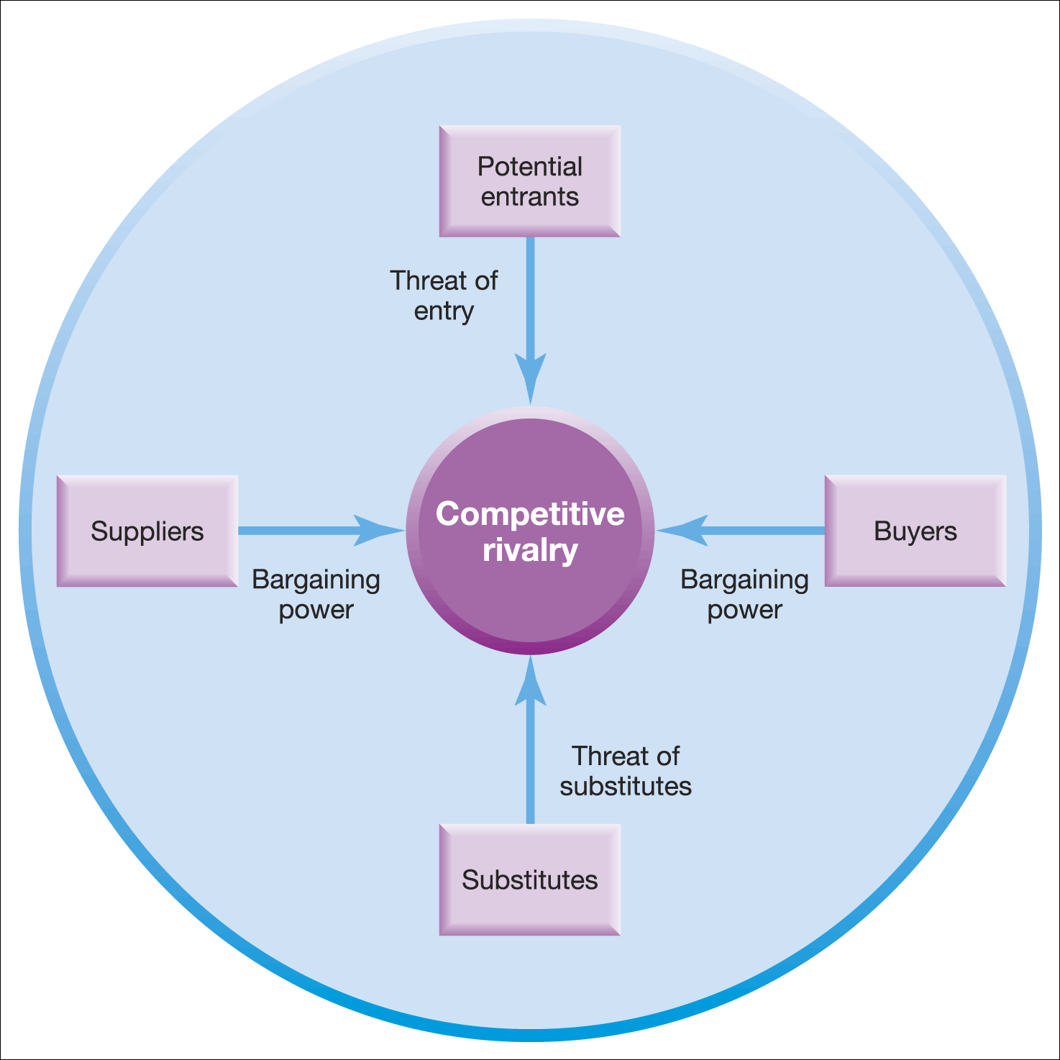
Porter`s Five Forces

Slide 16
Competitive Rivalry
Competitive rivalry (industry rivalry), rivalry among existing competitors, can vary in form and intensity from one industry to another and in particular industries over time. Rivalry can also take the form of a struggle for resources.
Rivalry among existing competitors takes many familiar forms: price discounting, new product introductions, advertising campaigns, service escalation and so forth.
The degree to which rivalry undermines an industry´ s profit potential depends:
  On the basis on which organizations compete;
  On the intensity with which organizations compete.

Slide 17
Potential (New) Entrans
The entry of new organizations (potential entrants) is another threat to established organizations in the industry. New entrants will be attracted into industries by the prospects of high profits and growth.
New entrants to an industry bring new capacity and a desire to gain market share. The threat of new entry puts a cap on the profit potential of an industry. When the threat is high, profits cannot rise too high without attracting new competitors.
Entry increases the number of organizations and if it takes the form of greenfield investment, adds to industry capacity. As a result, competition could become more intense.
The probability of new entrants to the industry is dependent on the height of barriers to entry.

Slide 18
Barriers to Entry
Supply-side economies of scale – these economies arise when organizations that produce at larger volumes enjoy lower costs per unit, organizations can spread fixed costs over more units.
Demand-side benefits of scale – also known as network effects, they arise in industries where a buyer´s willingness to pay for a organization´s product increases with the number of other buyers who also patronize the organization.
Customer switching costs – switching costs are fixed costs that buyers face when they change suppliers.
Capital requirements – the need to invest large financial resources in order to compete creates a barrier to entry.
Incumbency advantages independent of size – incumbent organizations may have cost or quality advantages not available to potential rivals, no matter whatever is their size.
Unequal access to distribution channels – the newcomer on the block must secure distribution of its products.

Slide 19
Substitutes
Substitutes are goods or services produced by organizations in an apparently different industry and delivering a similar service to the customer but in a different way. Substitutes are easy to overlook because they may look very different from the industry´s product. Substitutes nearly always exist. In many times, one substitute is to do without a product, and another is for customers to perform a service for themselves.
Threat from substitutes will be influenced by the cost and ease with which customers can switch to the substitute product.
Substitute products deserving the most strategic attention are those that:
  Are subjects to trends improving their price-performance trade-off with the industry´s product,
  Are produced by industries reaping high profits that may erode with competition.

Slide 20
Buyers
Powerful buyers can force down prices, demand higher quality or more service, and play competitors off against each other, all at the expense of industry profits. Groups of buyers may differ in their bargaining power.
Customers are powerful if:
  they have clout relative to industry participants and especially;
  they emphasize price reductions as the means to exercise their clout.
Power relationships that organizations have with their customers depend on a combination of factors:
  The number and size of organizations;
  The proportion of customer costs constituted by the product;
  The extent of product differentiation;
  The ability of customers to integrate vertically.

Slide 21
Suppliers
Suppliers refer to organizations selling inputs, such as fuel, raw materials and components to the organizations in an industry. The position of suppliers can be analyzed in a similar way to those of buyers, but in reverse.
Suppliers can exert bargaining power by raising prices, shifting costs downstream to industry participants or limiting the quality of the products they provide.
Powerful suppliers can thereby squeeze profitability out of an industry that is unable to pass on cost increases in its own prices.
An industry will depend on multiple groups of suppliers. The power of each important supplier group depends on a number of structural characteristics of the industry. A supplier group is powerful if:
  It is more concentrated than the industry it sells to;
  Industry participants face switching costs in changing suppliers;
  Suppliers offer products that are differentiated;
  There are no substitutes to what the supplier group provides;
  The supplier group can credibly threaten to integrate forward into the industry;
  The supplier group does not depend heavily on the industry.

Slide 22
Complementary Products – Sixth Force
Complementary products are those that are used together by customers. They do not compete with each other but operate in tandem. It does not deal with the complementary relationship that can exist between products.
The Porter model pays particular attention to the relationships between competitors´ products and also to the threat from substitute products.
The suppliers of complementary products can play an important role in the competitive environment for organizations in an industry because:
  The organizations making products depend on the efforts of the other in relation to product development;
  There can be conflict over who gets most of the spoils.

Slide 23
Implications and Issues of Porter`s Five Forces Model
Implications:
Identifies the attractiveness of industries – which industries to enter of leave.
Identifies strategies to influence the impact of the forces, which happens, for example, in case of building barriers to entry by becoming more vertically integrated.
The forces may have a different impact on different organizations. Large organizations can deal with barriers to entry more easily than small organizations.
Issues:
Apply at the most appropriate level – not necessarily the whole industry.
Note the convergence of industries – particularly in the high tech sectors.
Note the importance of complementary goods and services.

Slide 24
Methods of Industry Analysis: Strategic Groups Analysis
Strategic groups are organizations within an industry or sector with similar strategic characteristics, following similar strategies or competing on similar bases.
Strategic characteristics are different from those in other strategic groups in the same industry or sector. There are many different characteristics that distinguish between strategic groups. Strategic groups can be mapped on to two dimensional maps – positioning maps. These can be useful tools of analysis.
Uses of strategic groups analysis:
  Understanding competition – enables focus on direct competitors within a strategic group, rather than on the whole industry.
  Analysis of strategic opportunities – helps identify attractive strategic spaces (gaps) within an industry.
  Analysis of mobility barriers – obstacles to movement from one strategic group to another. These barriers can be overcome to enter more attractive groups. Barriers can be built to defend an attractive position in a strategic group.

Slide 25
Characteristics for Identifying Strategic Groups
Scope of activities
  Extent of product diversity;
  Extent of geographical coverage;
  Number of market segments served;
  Distribution channels used.
Resource commitment:
  Extent of branding;
  Marketing effort;
  Extent of vertical integration;
  Goods and services quality;
  Technological leadership;
  Size of organizations.

Slide 26
Methods of Market Analysis
A market is a group of customers for specific goods or services that are essentially the same. Analyzing market involves building up a detailed knowledge of the customer and customer groups.
Basic tool for market analysis is market research.
The goal of market analysis is to determine the attractiveness of a market and to understand its evolving opportunities and threats of the organization.
Dimensions of a market analysis:
  Market size;
  Market growth rate;
  Market profitability;
  Market trends.

Slide 27
Methods of Market Analysis
Customer analysis provides the collection and evaluation of data associated with customer needs and market trends, through market research, customer satisfaction measurement, field testing etc.
Customer analysis can be usefully partitioned into an understanding of how the market segments to behave, an analysis of customer motivations and an exploration of unmet needs.
Market research is the method for monitoring and analyzing of markets, subject of markets, companies etc.
We can define market research as the systematic design, collection, analysis and reporting of data and findings relevant to a specific marketing situation facing the organization, and to enhance decision making throughout the strategic process.
Market research aims to help managers make better decisions or to develop a marketing plan for new target groups or which customer service components should be improved.

Slide 28
Methods of Market Analysis: Market Research Process
The marketing research process has been described as a set of standardized stages:
Determination of the research problem
  Determine and clarify management´s information needs;
  Redefine the decision problem as a research problem;
  Establish research objectives.
Development of the appropriate research design
  Determine the research design and data sources;
  Determine the sample plan and sample size;
  Determine the measurement issues and scales.
Execution of the research design
  Collect and process data;
  Analyze data;
  Transform data structures into information.
Communication of the results

Slide 29
Identifying External Strategic Factors
One way to identify and analyze developments in the external environment is to use the issues priority matrix as follows:
Identify a number of likely trends emerging in the natural, societal, and task environments.
  These are strategic environmental issues those important trends that, if they occur, determine what the industry or the world will look like in the near future.
Assess the probability of these trends actually occurring, from low to medium to high.
Attempt to ascertain the likely impact (from low to high) of each of these trends on the corporation being examined.
The issues priority matrix can then be used to help managers decide which environmental trends should be merely scanned (low priority) and which should be monitored as strategic factors (high priority).

Slide 30
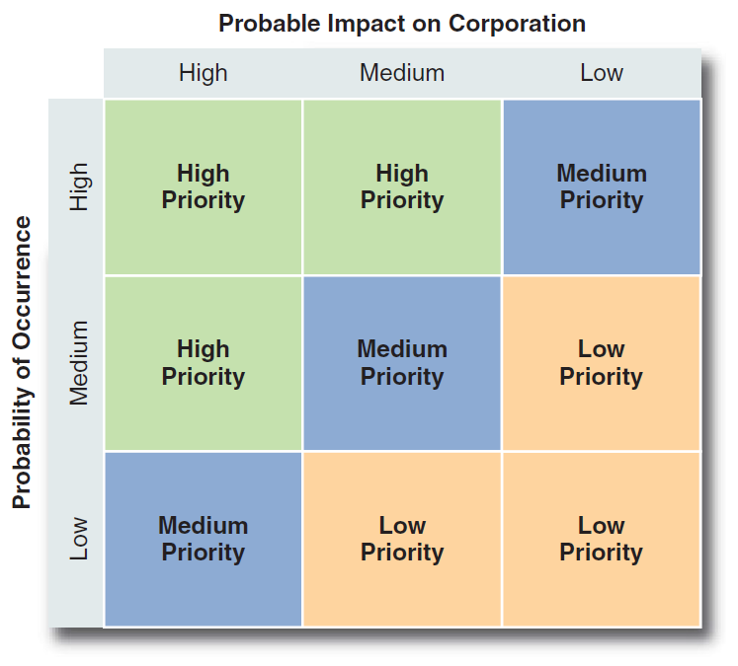
Identifying External Strategic Factors
SOURCE: Reprinted from Long-Range Planning, Vol. 17, No. 3, 1984,

