Slide 1

External Micro Analysis
Ing. Michal Stoklasa, Ph.D.
Strategic Marketing/subject code

Slide 2
External Micro Analysis
Outline of the lecture
The STP process.
External Micro Analyses.
Specific Analyses.

Slide 3
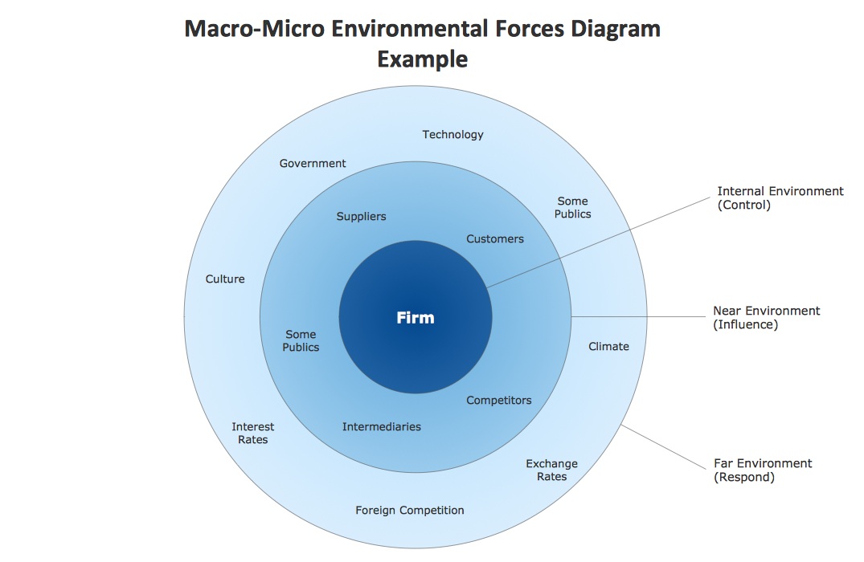
External Micro Analysis
MARKETING ENVIRONMENT

Slide 4
External Micro Analysis
1. STP PROCESS – A. SEGMENTATION
STP Process = Segmentation – Targeting – Positioning.
Segment = part of market.
Groups that have similar characteristics and behavior are called market segments.
Development of technologies enables better adjusting of services offer according to the different segments requirements.
The segments should be:
  enough large,
  measurable,
  stable,
  similar (homogeneous) within the group,
  and dissimilar (heterogeneous) across the different group.

Slide 5
External Micro Analysis
SEGMENTATION CRITERIA
Demographic – organization provides products and services only to segments chosen on the bases of age, gender, marital status, education, disposable income, occupation, religion etc.
Geographic – organization decides to provide the products only in limited area (cities x villages, seaside area x inland etc.).
Psychographic - social class, lifestyle, personality.
Behavioural – buying opportunity (regular purchases, special occasion), expected utility (quality, service, savings), user status (non-users, ex-users, potential users, inexperienced users, regular users), frequency of use (rare, medium often, frequently), loyalty (none, medium, strong, absolute), readiness to buy (ignorant of the product, realizing the existence of product, informed, concerned with option to purchase, wishing to buy, decided to buy), attitude to the product (enthusiastic, positive, indifferent, negative, hostile).

Slide 6
External Micro Analysis
B. TARGETING
Target segment – part of market which is selected by the company.
Target marketing, in other words, is where the organization identifies market segments, selects one or more of them, and develops products and marketing mixes tailored to each.
In evaluating different market segments, an organization should examine two broad issues: market attractiveness and the company´s capability to compete in the segment.

Slide 7
External Micro Analysis
TARGETING – MARKET ATTRACTIVENESS
Competitive factors (nature of competition, new entrants, competitive differentiation).
Political, social and environmental factors (trends).
Market factors:
  Segment size
  Segment´s rate of growth
  Segment´s profitability
  Customers´ price sensitivity
  Stage of industry life cycle
  Predictability
  Pattern of demand
  Potential of substitution

Slide 8
External Micro Analysis
TARGETING STRATEGIES
Undifferentiated targeting, through which the firm directs the same marketing mix (same product, price, distribution, marketing communication) at all potential customers.
Differentiated targeting, through which the firm offers a unique marketing mix to each distinct segment, a mix tailored to the needs and wants of consumers in those segments.
Concentrated (Niche) targeting, through which the firm picks out a single segment or very limited number of similar segments on which to concentrate its efforts.
Customized targeting, a more recent strategy through which the firm crafts specific offers for each individual consumer. (Automarketing – customers search info themselves)
Notes:
Source: Čichovský, 2013, s. 15-17

Slide 9
External Micro Analysis
C. POSITIONING
It is the placing of a product (brand) in the mind of a customer, in relation to other products (brands) in the market.
Marketing positioning is arranging for a brand or product to occupy a clear, distinctive and desirable place in the minds of targeted customers relative to competing products or brands.
Positional map (perceptual map) – graphic presentation how consumer feels the similarity or disimilarity of brand of specific product in comparison with competitive products in the marketplace.

Slide 10
External Micro Analysis
POSITIONING EXAMPLES 1
Product attributes: Heinz positions its products on the attributes of no artificial colouring, flavouring or preservatives.
Product benefits: Volvo positions itself using the product benefits of safety and durability.
Usage occasions: The convenience store SPAR eight-till-late shops are positioned on the usage occasion. Customers use the shops when they need to shop out of normal hours or near to their home.
Users: Ecover cleaning products are positioned as environmentally friendly products for the green customer.
Activities: Lucozade is positioned as an isotonic drink for sporting activities.

Slide 11
External Micro Analysis
POSITIONING EXAMPLES 2
Personality: Harley Davidson motorbikes are positioned as a macho product with a free spirit.
Origin: Audi clearly illustrates its German origins in the UK market by the use of the “Vorsprung durch technik” slogan. The hope is the product will be linked to the German reputation for quality engineering.
Competitors: Pepsi-Cola positions itself as the choice of the next generation, reflecting the fact that in blind tasting tests younger people preferred Pepsi over competitors´ offerings.
Product class: Kellogg´s Nutrigrain bars are positioned as “morning bars”, a substitute for the traditional breakfast.
Symbol: Esso petrol has used the symbol of the tiger to position itself in the market.

Slide 12
External Micro Analysis
FACTORS FOR SUCCESFUL POSITIONING
Credence: The attributes used to position the product have to be perceived to be credible by the target customers.
Competiveness: The product should offer the consumer benefits which competitors are not supplying.
Consistency: A consistent message over time is invaluable in helping to establish a position against all the other products and services fighting for a share of the consumer´s mind.
Clarity: The positioning statement an organization chooses has to create a clearly differentiated position for the product in the minds of the target market. Complicated positioning statements are unlikely to be remembered.

Slide 13
External Micro Analysis
FAILED POSITIONING
Underpositioning – there is no sufficient difference among competitive products (Kia, Hyundai – very similar!)
Overpositioning - excessive pointing out to only one benefit of certain product (IKEA, Lidl – cheap, price!)
Confused – result of the inadequate marketing communication or the choice of bad distribution channels (branded goods – supermarket, discont outlets!)

Slide 14
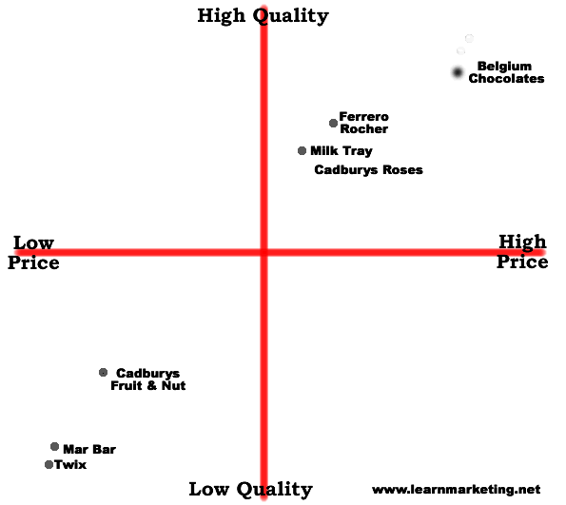
External Micro Analysis
SOLUTION? REPOSITIONING!
It responds to the change of market demand or it´s aimed to reach more profitable segments.
It uses the same tools as positioning, i.e. marketing communication in order to establish new image or product.

Slide 15
External Micro Analysis
2 EXTERNAL MICRO ANALYSIS
There are many concepts of how to analyze microenvironment!
Marketing micro environment involves according to Kotler and Armstrong following factors:
  Corporate environment.
  Supplier-customer relationships.
  Service providers.
  Features of the target market.
  Competition.
  Public relations.
We will use the co-called 3C analyses that consits of:
  Consumers - Consumers (A).
  Collaborators - Collaborators (B).
  Competitors - Competitors (C).

Slide 16
External Micro Analysis
A. CONSUMERS
Consumers are individuals or organizations who purchase products for their own use or for its further integration into another product. However, it does not involve actions of buying for resale.
We thought about consumers during segmentation!
Customers - consumers, producers, traders, state, foreign customers. (motivation to buy, place, time)
Furthermore, we are interested in:
  selection process,
  shopping process,
  use and consumption process.

Slide 17
External Micro Analysis
ISSUES RELATED TO CUSTOMERS 1
Who is the decision-making unit? Who plays what role in deciding and also who plays what role in the purchase? Who actually uses the product in the end? Indeed it may well be someone completely different than the one who purchased or made the decisions!
What is the product? What is the functional point of view, what emotions does it create? Where does its use classify us within the society? Is the product environmentally friendly?
Why are customers buying? Why the product is used or consumed? I it a generic product, basic goods, FMCG or a long-term sophisticated product?

Slide 18
External Micro Analysis
ISSUES RELATED TO CUSTOMERS 2
How does the proces of decision / purchase work? What process leads to the selection and purchase? What was the initial impulse and where was its source? And what happened during decision-making process? And how the product was used, consumed and ultimately disposed of? Was it then replaced by a new one?
When (at what time in life, during the year, month, week, day), people make decisions or are they buying? When the product is used, consumed, disposed of?
Where are decisions being made? In what store (type of business) people buy? Where is the product used, consumed, destroyed?

Slide 19
External Micro Analysis
DECISION-MAKING PROCESS
1. Phase - discovering the problem.
2. Phase - finding information.
3. Phase - evaluation.
4. Phase - decision to purchase.
5. Phase - after purchase experience.
6. Phase - rejection.
Whether the customer goes through all the phases of the buying process and how much time they spend at various stages, depends on the product type / situation.
Influencing factors: perceived risk, alternatives, mistakes, experience, frequency of purchase, emotions etc.

Slide 20
External Micro Analysis
ANALYSIS OF CUSTOMER BEHAVIOR
Analysis of customer behavior is systematic analysis of behavior, thoughts and feelings of consumers in connection with the properties of the product.
Factors that may affect this behavior:
  cultural factors (culture, subculture, social class),
  social factors (family, family life cycle, reference groups, influencers),
  individual factors (employment, income, personality, values, lifestyles),
  psychological factors (motivation, perception, learning, attitude).

Slide 21
External Micro Analysis
SOCIAL INFLUENCE - ROGERS ADOPTION CURVE
Innovators - about 2.5% of customers are pioneers who must always have the latest products first.
Highly adaptable - about 13.5% of customers who are often influencers. Adopt product quickly, but evaluate it very well before purchase. Therefore, they can provide further relevant information.
Early most - about 34% of customers. They are cautious people who are often influenced by opinion leaders. In terms of marketing communication is a very important group.
Late most - also about 34%, it is the skeptics who buy the new product only when it was already bought by the majority. Therefore it is important to obtain the two previous groups.
Latecomers - conservatives, people who have an aversion to change. Prefer those products that have become part of the tradition.

Slide 22
External Micro Analysis
PERSONAS AND NARRATIVES
But that's not all! It is no longer enough to process segmentation based on basic characteristics – we would rather like to work with so called personas, i.e. one typical representative of a given segment (e.g. this is Klara, 23, studies universtiy, likes horses, spends 300 on cofee each week, likes to hang out with girl friends).
Later on, whole stories (Narratives) were added to personas, which take a persona and assign it a whole specific life and put it in a specific context, so that it is clearly visible what tasks it solves in life, what problems arise there, and what value it is therefore looking for (see the value canvas from the previous lectures).
Templates!

Slide 23
External Micro Analysis
PURCHASE ROLES
Initiator: a person who initiates the first purchase.
Influencer: consultant whose views have some weight in the selection process.
The decision maker: the person who makes the final decision and who decides whether to buy or not. If yes, then what, how and where.
Buyer: the person who performs the purchase of the product.
User: the person who ultimately uses, or consumes the product.
Preparer: the person who prepares the product for use or consumption.

Slide 24
External Micro Analysis
B. COLLABORATORS
Collaborators: all entities that assist us in ensuring the operation of our company and achieving our goals.
These include:
  Intermediaries (brokers) - distributors, dealers, agents and commission.
  Suppliers - related companies that may also be competitors. (speed, quality, reliability, etc.)
  Marketing agencies - collaboration with various marketing agencies, which include advertising agencies, companies providing sales support, direct shipment, public relations activities etc.
  Logistics companies – company may rely on these specialized companies in the field of shipping, transportation and storage.
We are interested in:
  Suppliers - references, quality, certification, price, terms, contract terms, speed, availability, counseling, guarantees.
  Distributors - logistics, traders, the same things at suppliers.

Slide 25
External Micro Analysis
ANALYSIS OF 5 FORCES - PORTER
Analysis 5F is the work of Michael E. Porter. It is a way to analyze the industry and its risks. The model works with five elements. The essence of the method is forecasting the competitive situation in the surveyed sector based on estimates of the possible behavior of these subjects and objects operating in a given market and the risks threatening the company from their side:
  Existing competitors - their ability to influence the price offered and the quantity of the product / service.
  Potential competitors - the possibility to enter the market and affect the price and offered quantity of the product / service.
  Suppliers - their ability to influence the price offered and the number of necessary inputs.
  Buyers - their ability to influence the price and quantity demanded of the product / service.
  Substitutes - the price and quantity of offered products / services or at least partially able to replace the product / service.

Slide 26
External Micro Analysis
C. COMPETITION
Competitors - offer products satisfying the same need. (where to get data sources?, benchmarking, Porter's five forces analysis)
"Competition is the engine of developed markets.„
Competitors need to be monitored.
The principles of fair play.
The problem of ethics and the unavailability of information vs. the need for rapid response.
For many industries, competition is maintained by apparatus of supervisory bodies - monopolization is better for companies.

Slide 27
External Micro Analysis
ANALYSIS OF COMPETITION
The performance of competitors - what are their results in terms of market share, turnover, profit and share of purchases.
Target group of competitors – what segment do they target? Are they connected to the whole market, several attractive segments or only to one segment?
Marketing mix strategies by competitors – „what marketing efforts“ do they utilize to realize their performance in these target groups? What is their budget? How do they use it? Do they have a wide or narrow range of products, high or low quality, high or low price? Is their distribution carried out by many or few channels?
Commercial strength / weakness of competitors - what are the relative strengths and weaknesses of the competition? What are their advantages and disadvantages?

Slide 28
External Micro Analysis
BENCHMARKING
Benchmarking is a method based on systematic measurement and comparison of selected indicators.
Its use is not limited to strategic management but it can be used at any level of management and for almost any indicator (indicators).
The basis for the comparison of selected indicators to other reference values, which can be either historical, or can be compared against another reference entity (e.g. different departments or similar organization). Comparison is always relative, you can not say that higher or lower values of the indicators are good or bad.
The biggest benefit of benchmarking is that these different values are provoking questions about what is causing them, and this cause should undergo further investigation.

Slide 29
External Micro Analysis
TASK FOR NEXT TIME
PEST – choose a company and a country, try doing PEST.
Customer analysis - choose a company and try to do customer analysis any way you want.
Choose a company and create personas for them.

Slide 30
External Micro Analysis
MARKET ANALYSIS
Market - a place where forces of demand and supply operate, and where buyers and sellers interact (directly or through intermediaries) to trade goods, services, or contracts or instruments, for money or barter.
Market analysis in practice reflects an overall analysis of demand and competition, customer behavior and needs.
Industry analysis is often used - industry structure, specifics and relationships, inputs / outputs of the sector, the business cycle, regulation of the industry, competitive, innovative performance etc.

Slide 31
External Micro Analysis
DETERMINING AND CALCULATING THE SIZE OF THE MARKET
Market potential = total absorption capacity of the market.
Market share = turnover of the company: the turnover of the total market.
Relative market share = turnover of the company: turnover of its main competitor.
Market growth = market size in the current period: market size in the base period.
The attractiveness of the market = sum of critical success factors, respectively failures.
The penetration rate = in% how many consumers own product.

Slide 32
External Micro Analysis
3.X SPECIFIC ANALYSES
In the following sections 3.x, you can find specific analyses that the company is forced to make because it has specific information needs.
Within the macro and micro analysis, we found some information, but some areas we surveyed only superficially. In the operation of our company we have some very specific needs – that is why we need to do some analyses aimed at a deeper understanding of context.
E.g. We have a company in the IT industry. In the macro environment, we examined the technology, but only superficially, we need literally daily update of what's new, so we are able to create revolutionary products for our customers.

Slide 33
External Micro Analysis
3.1 ANALYSIS OF SCIENTIFIC AND TECHNOLOGICAL DEVELOPMENT
Identifying the direction of current developments.
What new insights are in our field.
What is going to come out in the future and will it somehow be useful for us?
Charting techniques that are used by competing firms (competition analysis).
Considering own options.
How? Where? How much?

Slide 34
External Micro Analysis
3.2 ANALYSIS OF REGION
Demographic and geographic options.
Employment.
Natural sites - NP, PLA.
Collaboration with various environmental and governmental agencies.
Possibilities of energy and infrastructure networks.
Consideration of ecological approach-spending vs. environmental resources.

Slide 35
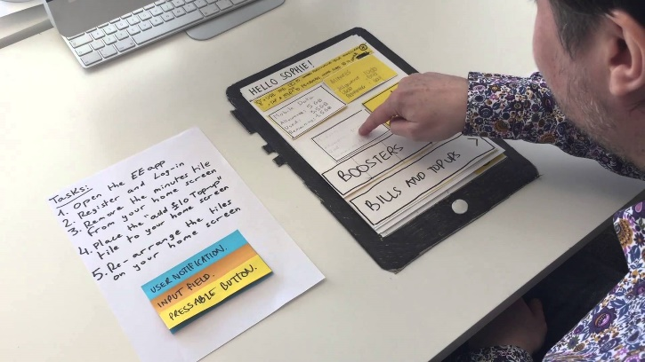
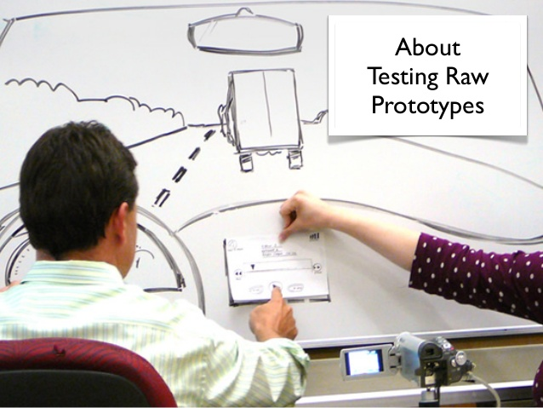

External Micro Analysis
3.3 SPECIFIC PRODUCT ANALYSES
New product ideas, prototypes.
Packaging testing.
Brand analyses.
Senzorical analyses.
Benchmarking our products to market/competitors.
Perception analyses.
Market analyses – size, shares etc.

Slide 36

External Micro Analysis
3.4 SPECIFIC PRICE ANALYSES
Price perception analyses.
Price elasticity analyses.
Price bariers analyses.
Price positioning analyses.
Price acceptation analyses.

Slide 37
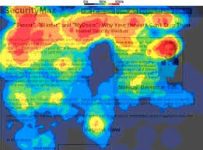
External Micro Analysis
3.5 SPECIFIC DISTRIBUTION ANALYSES
Logistics analyses, aimed at warehouse locations, routes, packaging etc.
Stores locations analyses.
Analysis of products inside the stores.
Distribution channel analysis.

Slide 38
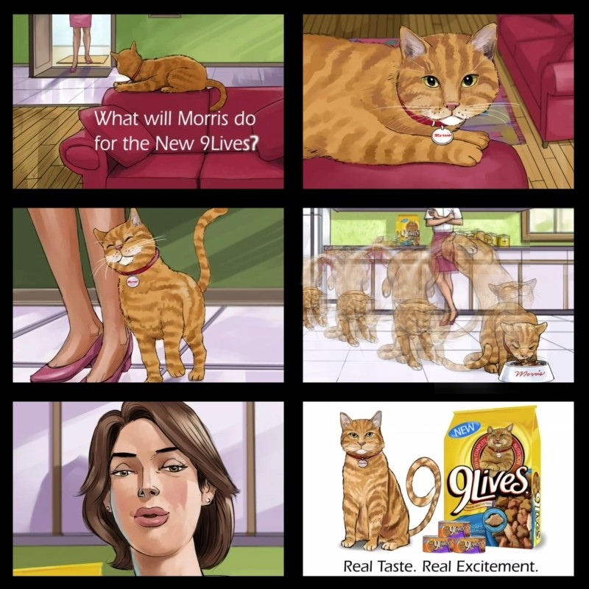
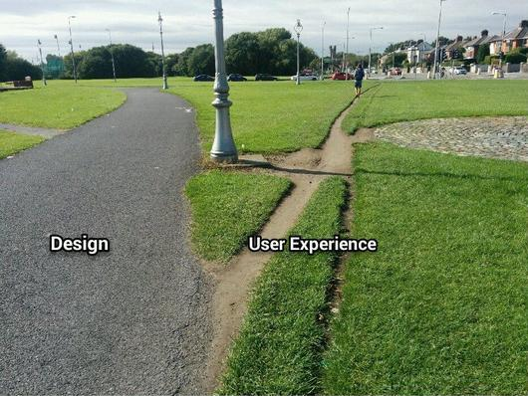
External Micro Analysis
3.6 SPECIFIC COMMUNICATION ANALYSES
Analysis of media channels.
Analysis of perception of communication tools.
Analysis of messages, message sources, graphical designs, logos, advertisements, radio spots etc.
UX testing.

Slide 39
External Micro Analysis
3.7 BRAND ANALYSIS
Brand = "brand name, title, character, creative expression, or a combination of the preceding elements. Its purpose is to distinguish the goods or services of one seller or group of sellers of goods or services from competing vendors.„ (Vysekalová, 2011, p. 136) Brand has emotional and rational part (brand name, logo, slogan, story, message).
Tracking studies - monitors the strength / brand health over time (life cycle), sometimes compares with the competition. The study should therefore include steady questions and be on a sample of current customers. Based on four indicators, see further.
Brand audit - a comprehensive brand audit, covers all parts of brand. The audit is performed on end-use customers, employees, but also in the actual premises of the company (reveal internal / external view of the brand).

Slide 40
External Micro Analysis
BRAND AUDIT SHOULD FOCUS ON
Logo - association with images (Renault). Association test with all other conceivable alternatives, test characteristics of likebility.
Brand name - word association. Association test, comparing variations, hidden meanings.
Slogan - suitability, hidden meanings.
Story - created history and stories with which the brand operates.
Message - basic communication message, which the brand uses (both to the user and about the user).

Slide 41
External Micro Analysis
WHAT DO I WANT TO MEASURE
Ideally, everything, but it's not realistic, so I measure at least the important parts (Kozel, 2011, p. 254):
  Brand awareness - knowledge (spontaneous / aided), TOM, popularity, knowledge of communication / campaigns.
  Emotional evaluation of the brand - credibility, likeability, respect, innovation.
  Rational assessment of brands - reliability, satisfaction, relevance, differentiation from competitors.
  Preference of brands - brands that consumers prefer and why.
The result is a perceptual map (map of positioning), or brand pyramid.

Slide 42
External Micro Analysis
TRACKING STUDY INDICATORS
Awareness – TOM, spontaneous/aided knowledge.
Usage – usage how, where, why, frequency etc.
Brand Attitudes and Perceptions – brand image, satisfaction, loyalty, perception etc.
Purchase intent – the intent to purchase brand now, in the future, after seeing our communication, willingness to refer to a friend.

Slide 43
External Micro Analysis
3.8 MARKET ANALYSIS (DEMAND)
Market – the place, where we realize the exchange of goods and services. Supply meats demand.
In practice – market analysis is about the demand, competition, consumer behaviour.
Often we use indsutry analysis as our basis, where we measure the industry structure, relationships, inputs and outputs, economic cycle, regulation, competitiveness, inovation potential etc.
We can measure market from three perspectives:
  Producer – production + import – export.
  Trade – amount of stores x average turnover x share of turnover of store in %.
  Consumer – number of consumers x average consumption.

Slide 44
External Micro Analysis
MARKET INDICATORS
Market potential = total absorption capacity of the market. (But available market = have the money for it) (overall potential / regional)
Market share = turnover of the company: the turnover of the total market.
Relative market share = turnover of the company sales: its main competitor.
Market growth = market size in the current period: market size in the base period.
Attractiveness of the market = sum of critical success factors, respectively. failures.
The penetration rate in % = how many consumers own the product.

Slide 45
External Micro Analysis
HOW DO WE DO THAT?
Estimating demand can be done in-house (we do it ourselves) or bought from an agency – GlobalData, Euromonitor, AC Nielsen.
We do macro forecast, then the development of the industry, sales of the company.
We survey consumers - research on purchasing intents.
Expert estimates of sellers - personal selling advantage is the contact with the customer.
Opinions of experts - experts, dealers, consultants, suppliers, industry associations.
Analysis of historical sales - time series analysis + prognosis for the future.
The market test - experiment!

Slide 46
External Micro Analysis
THE END
Thank you for your attention.
☺

