Slide 1

Product Policy
Ing. Michal Stoklasa, Ph.D.
Strategic Marketing/subject code

Slide 2
Product Policy
Outline of the lecture
Product - definition, total product value for customers.
Product life cycle.
Strategies in product - portfolio, lines, specific strategies, blue oceans, crowdsourcing.
Ansoff matrix, innovation.

Slide 3
Product Policy
1. PRODUCT DEFINITION
"Anything that can be offered on the market to attract attention, for purchase or consumption that can satisfy the desires, wishes or needs; They include physical objects, services, people, places, organizations and ideas.„ (Kotler, 2007)
Tangible product, service or idea which is subject of exchange in the market.
That means whatever supply to satisfy customer´s demands and needs.
There are 2 distinctive types of products – goods (tangible) and services (intangible).
Characteristics of the product - two parts:
  Functional: tangible (performance, consumption of energy, speed, …) or services (complement the product – home delivery, or make the product – traveling agency)
  Image: brand, design etc.

Slide 4
Product Policy
WHOLE PRODUCT MODEL
Core component (principal function) - Why do we buy it? What do we need it for?
Packaging component – How should the product look like?
Support services component – What accompanying services are connected with product?

Slide 5
Product Policy
WHOLE PRODUCT MODEL
A
B
Installation
Warranty
Design
Package
Spare
parts
Deliveries
Principal function
Brand name
Repair and maintenance
Financial services
Quality
Styling
Instructions
C

Slide 6
Product Policy
THE WHOLE PRODUCT MODEL IN SERVICES
Generic product: fulfils the basic function of the product (Bank Account: the basic function)
Expected product: minimal requirements expected by customer (BA: credit card, internet banking)
Augmented product: offers more than usually expected by customer (BA: international banking free, ATM free, loan, discount card)
Potential product: everything that can make the product perfect and ultimately increase the utility (BA: everything that is on the market and everything that is possible to offer)

Slide 7
Product Policy
VALUE FOR THE CUSTOMER
Customer: value is a good price? Technological advancement? An emotional affair?
The value of the product is always determined by the customer, not the company. The company has to try for it to be the highest as possible.
Value = the expected benefits - perceived cost.
The expected benefit is not only material, it can be social status, brand loyalty, belonging to a group like.
Cost is not only the price, but also time, effort, etc.

Slide 8
Product Policy
VALUE FOR THE CUSTOMER
Product value is always determined by the customer!
Each segment may perceive value differently (bike).
T. Cook – you only need iPhone and iPad Pro.
Ask customers? "Ford - they want faster horses." Sony – year long cycle before production - slow. Apple - we invented the phone!
Jakubíková - map of perceived value = perceived benefits vs. perceived costs.
Another view - the ratio of price vs. quality.
The value curve - blue oceans.
My view - the product has a functional and emotional value. Each segment requires a different "mix", so I use a different marketing mix.

Slide 9
Product Policy
TWPM IN SERVICES WITH VALUE IN MIND
Core benefit: a service or benefit that the customer actually purchased. Hotel guest buys rest and sleep.
Transform core benefit into a basic product. The hotel room is equipped with a bed, bathroom, towels, desk, chest of drawers and cabinets.
Expected product is set of attributes and conditions that buyers normally expect when buying this type of product. Guests atleast expect clean beds, clean towels, lamp, and a relative measure of peace and comfort.
Augmented product that exceeds customer expectations. In developed countries customers expect brand positioning. In developing and emerging markets such as India and Brazil, a fight takes place mostly on the expected level of product.
Potential product, which encompasses all possible improvements and future tech.

Slide 10
Product Policy
PRODUCT CLASSIFICATION
Products can be divided into many categories, based on their function, purpose, part of company etc.
Products
Consumer
products
Capital
product
Standard
products
Special
products
Luxury
products
Material
Parts
Fixed capital
Subsidiary material

Slide 11
Product Policy
PRODUCT LIFE CYCLE
Product life cycle (PLC) - time when the product is on the market.
It can be too long, too short. And of course optimal.
The phase of product development:
  Thoughts, ideas, impulses - what is missing in the market, what can be done better.
  Product development.
  High costs of modifications.
  Testing.
  Zero sales.
  The most common causes of failure - exhaustion of our budget, changing market.
  Creating market space.

Slide 12
Product Policy
PRODUCT LIFE CYCLE
Maturnity
Saturation
Growth
Decline
Introduction
Sales
Profit

Slide 13
Product Policy
THE PHASE OF MARKET INTRODUCTION
Launch of the product – beginning of sales.
Revenue inflows.
Emphasis is placed on marketing communication - massive promotion / WOM.
The introduction of distribution channels.
The key is pricing: innovators, highly adaptive, early majority, late majority, laggards. Exclusive / penetration price.
Potential service costs.

Slide 14
Product Policy
THE PHASE OF GROWTH
Significant sales growth: often times companies overstate / undervalue how good / bad the growth is.
Costs can be amortized but strategic development of the company may not be secured!
Competitors are entering the market.
Expenditures on marketing communication are not increased.
Less investment in raising awareness about the product.
It is possible to expand assortment (new lines in portfolio) and product modifications.

Slide 15
Product Policy
THE PHASE OF MATURITY
If the company in the previous phase has invested in the development of successor it actually only starts earning in this stage.
Extending the life cycle can be done through:
  Product variants (updates, facelift, changing design, extending the line, modifications).
  Entering new markets.
Market growth comes to a halt.
Competitors with weaker position are often times leaving the market.

Slide 16
Product Policy
THE PHASE OF DECLINE
No life cycle can be extended forever. The key question is when and how to end the sale of the product.
Easiest (but not most efficient) is quick exit from the market.
Or we can stay as long as variable costs are covered.
Reduce the price – sale out, quit.
Caution in price formation - spoiling the image of premium products (in our other lines).

Slide 17
Product Policy
SPECIAL FORMS OF PLC
RECYCLE/STYLE
WAVY CYCLE
FASHION HIT
FASHION

Slide 18
Product Policy
SUBSTITUTES AND COMPLEMENTS
Perfect substitutes: product is essentially the same as another product.
General substitutes: product is different from another product but it serves the same general purpose.
Perfect complements: products that consumers must purchase because their originally purchased product does not function without it.
General complements: are products sold in conjunction with other products because they supplement the original purchase in some way.

Slide 19
Product Policy
PRODUCT BRANDING
It is a process of adding value to the product by use of its packaging, brand name, promotion, and position in the minds of the consumers.
  NO-NAME PRODUCT: (unadvertised, low cost)
  COMPANY BRAND: (product lines that are produced, owned, controlled and distributed by manufactures – e.g. IBM)
  PRIVATE (STORE) BRAND: (product lines that are owned, controlled, merchandised and sold through the retailer´s own outlets)
Differentiating factors:
  Brand name – part of brand which can be pronounced
  Logo, symbol – visual part of brand
  Colour
  Style of sign

Slide 20
Product Policy
BRAND NAME
It should catch customer´s attention.
It should be memorable.
It should create good association.
It should communicate something about the product.
It should have good graphics processing.
It should be pronounced easily in many foreign languages.
It should be dateless.

Slide 21
Product Policy
PRODUCT STANDARDIZATION VS. ADAPTATION
Standardization: „world product“ which is suitable for all markets and takes into account local needs (Colgate, Coca-Cola, Levi´s, McDonald).
Adaptation: the products are adapted to needs of various countries or production of completely new products for particular countries.

Slide 22
Product Policy
MARKETING STRATEGIES FOR PRODUCTS
We must have a strategy for:
Individual product - coupled with the necessary product lifecycle categories which characterize the various stages of the movement of market presence.
Product Line – for a line to work properly there has to be a balance among strategies for each individual product. There are two possible alternatives, and those are either shortening or extending product lines in order to achieve its optimum length for the strategic period.
Product mix – product class / family of products.

Slide 23
Product Policy
PRODUCT STRATEGY (POLICY)
Product policy (strategy) includes all decisions related to the type of product, its market, its characteristics, etc.
Product strategies are based on the goals for the product.
Assortement policy (A) - what range (portfolio) of products we produce. (Vertical / horizontal trading-up / down, up-selling / cross-selling).
Policy of product groups (B) - addition, modification, termination of product groups.
Policy of product attributes (C) - brand, packaging, warranty and quality etc.

Slide 24
Product Policy
A. ASSORTEMENT POLICY
I need to know the classification of products (consumer / industrial, short / medium / long-term, way of purchase, opportunities, etc.).
Evaluate existing range of products, forecast, formulate policies, terminate unsuitable products.
  The length of the product mix - the total number of items in product mix.
  The width of product mix - the number of product lines.
  The depth of product mix - the number of product variants in the product line.
Expansion of product lines (Product Line Stretching) - Down, Up, in both directions.
Completing the product line (Product Line Filling).

Slide 25
Product Policy
B. POLICY OF PRODUCT GROUPS
Internal and external evaluation of the existing product groups.
"Internal" means determining the extent to which each type of product contributes to the turnover and profit, and the expected growth of this product.
"External" evaluation means that marketing expert must put all our products in comparison with competing types, and then analyze, if product mix some has some "gaps".
After the process: expansion (up / down), innovation, modernization, re-pricing, re-cycle, and the like.

Slide 26
Product Policy
C. POLICY OF PRODUCT ATTRIBUTES
Common objectives: brand, quality, packaging, service and warranty, price, price, price ...
Brand - what it brings to the customers.
Quality - objective and subjective.
Packaging – function of packaging: attention, recognizability, information, emotion, protection, ecology, added value.
Service and warranty - services prior to purchase, during the purchase, and after purchase.

Slide 27
Product Policy
SPECIFIC PRODUCT STRATEGIES
Strategies for reducing the cost of the product - based on cost benchmarking we produce more cheaply.
Strategy of increasing sales - P * Q - working with P for Q to grow.
Strategies to increase profit from sales - work with P, reducing costs.
Strategy of improving product lines - innovation, complex line offer, modification, individualized offer.
Classic "low / mid / high budget / cost" product strategy.
Strategy focused on generating the same turnover / profit - for a stable company not focused on expansion.

Slide 28
Product Policy
BLUE OCEANS. AND RED
The book by W. Chan Kim and Renée Mauborgne „Blue Ocean Strategy“. BOS characterizes both the strategic logic that is for creating a new market space and a practical framework for the systematic development and use of blue oceans.
Red oceans - these are all existing branches operating in the familiar market space. In red oceans, limits are defined and accepted across industries and rules of the competitive game are known. As the market space gets increasingly packed with competitors, prospects for profits and growth are increasingly limited. Tough, fierce competition leads to the fact that businesses are bleeding - hence the term red ocean.
Blue oceans - these are the sectors that do not yet exist, it is the unknown market space without competition. In blue oceans, demand is created instead of received. And there is plenty of opportunity for growth.

Slide 29
Product Policy
SWIMMING IN THE OCEANS
The main idea – I am not competing but creating my own new market space - the blue ocean - I am ahead, I am a leader and I set the rules.
In the red ocean, there is a constant fight of my old sharks - classic battle of efficiency (cost / income).
What's the trick? - I bring "value innovation" - a step (jump) increase to customer value.
Using the value curve, I analyze the value of the entire industry - seeking opportunities to excel - eliminating unnecessary features and adding new ones.
Examples: iPhone, iPad, Tesla car, Google Glass, Cirque de Soleil, 3D print, experience adventures etc.

Slide 30
Product Policy
BOS PROCESS STEP BY STEP 1
Define the existing market area. What products do you offer? In what market segment are you active? What are your core competencies?
Find the key factors within the industry. According to what the customer decides when choosing a product? What qualities of the product are expected? What needs do they want to satisfy through our product or service?
Create value curve. How well do competing products stand against each other in a variety of factors? In what areas are competing products strong and weak? How much value each factor brings to the customer?

Slide 31
Product Policy
BOS PROCESS STEP BY STEP 2
Select the factors increasing value. Which of the weak competitors factors can be improved? Which of them increase the value for the customer?
Select the factors reducing costs. Which factors will enable to significantly reduce costs? How valuable are those for the customer?
Add new factors increasing customer value. What other neglected factors greatly increase the value for the customer?
Define a new product. Based on the limitations and enhancing existing and new factors describe the new product.

Slide 32
Product Policy
PRODUCT ECOSYSTEMS
Businesses that offer customers not only lone products, but whole product ecosystems, are much more successful. The very word “ecosystem” has an amazing content in relation to the product, it is an extension of the original product lines, product families. We can imagine this in practice as a physical product that fits within a family / product family, but mainly fits into a large ecosystem of downstream services, digital content and support. All this fits into the brand philosophy and its positioning.
A typical example are Apple's products - I have an iPhone, turn on iTunes, buy music, a book, a movie, then I want more iFeatures and I can never go to the competition again.

Slide 33
Product Policy
PRODUCT ECOSYSTEMS BENEFITS
Not only the added value of the product, why I buy it…
… but also creating customer loyalty.
Visible in the evolution of the battle Apple vs. Samsung. Customers do not care so much about the technical specifications, but want additional services and ease of use.

Slide 34
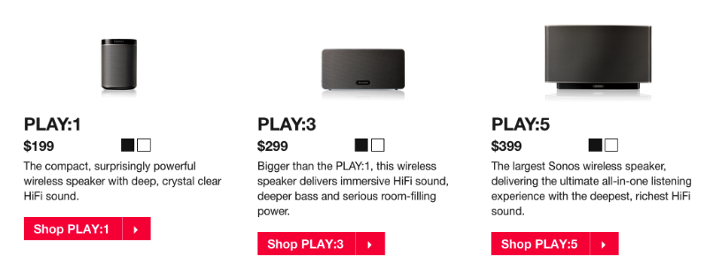
Product Policy
Ecosystem development example - SONOS 1

Slide 35
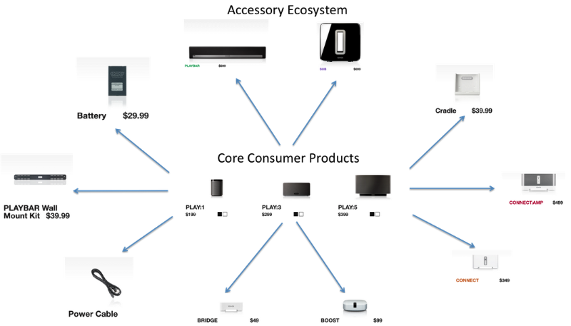
Product Policy
Ecosystem development example - SONOS 2

Slide 36
Product Policy
CROWDSOURCING
We'll put our heads together and come up with something ☺
Utilization of previously undefined group of people to work (create).
"It is simply common efforts, join forces and ideas of individuals, which allows to achieve the desired goals more effectively. It is said that more heads are better than one, and crowdsourcing is based on this. It is often used in scientific and technological communities. „
The perfect case study here.

Slide 37
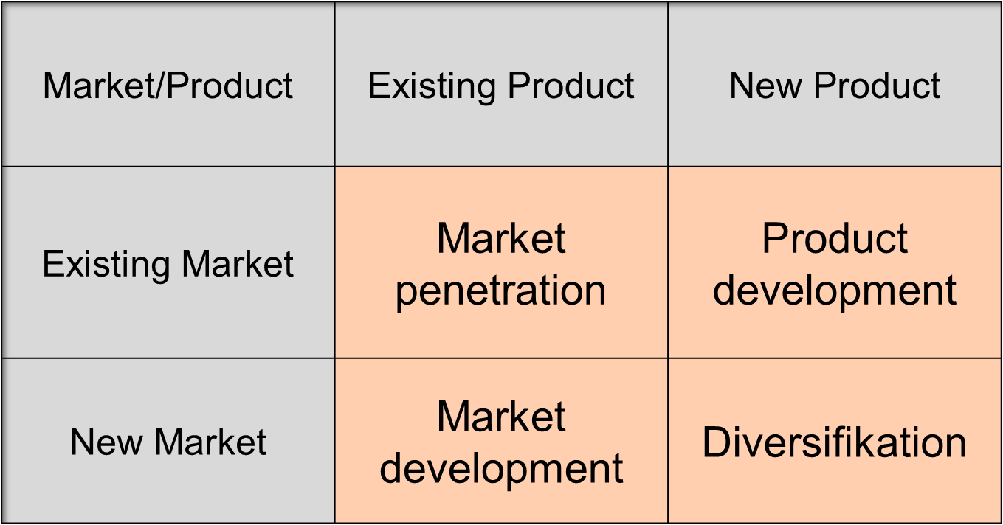
Product Policy
ANSOFF MATRIX
The Ansoff Matrix is a strategic planning tool that provides a framework to help executives, senior managers, and marketers devise strategies for future growth.

Slide 38
Product Policy
MARKET PENETRATION
The company tries to grow in existing markets with existing products and services, i.e. trying to increase the market share with current sources. The goal is to sell more or find new segments.
Penetration pricing and other methods of sales promotion. Investments intoaggressive promotion and distribution.
The strategy of the current market penetration is typical for saturation stage in life cycle of the product.
Its good on the markets that are expanding. In stagnating markets or markets with decreasing size, the penetration strategy is not effective.

Slide 39
Product Policy
PRODUCT DEVELOPMENT
New product at existing market.
Two options:
  Innovation in terms of actualy a new product solution.
  Development of additional versions of the product.
Usually it is a new product that is a substitute to the current product.
This strategy is effective, de facto necessary if the existing product is in the stage of saturation (maturity).
We have to invest into research and development, or licensing.
Crucial to the success of a new product in an existing market is therefore a communication mix.

Slide 40
Product Policy
MARKET DEVELOPMENT
Existing product at new market.
Finding one or more new markets for current products:
  Getting additional markets through regional, national or international expansion.
  New market segments through: special versions of products designed for specific target groups, or psychological product differentiation through advertising. (expansion to B2B)
Company may be succesful thanks to having unique technology, economy of scale, closenes of the market etc.
It may be a niche strategy - occupying a market gap in the same sub-market (market the same product).

Slide 41
Product Policy
DIVERSIFICATION
New product at new market.
Technological and commercial risk! We need to both, develop a product and market.
Horizontal diversification - means extending the existing production program with products associated with it.
Vertical diversification - it represents a deepening of the program both in the sales of existing products as well as towards raw materials and means of production.
Lateral diversification - is an attack on an entirely new products and markets, the company escapes from the scope of its current business activities into remote areas.

Slide 42
Product Policy
PRODUCT INNOVATION 1
It is the introduction of the goods or services that are new or significantly improved with respect to their characteristics or intended use. This includes significant improvements in technical specifications, components and materials, software, user friendliness or other functional characteristics.
Product innovations can utilize new knowledge or technologies, or can be based on new uses of combinations of existing knowledge or technologies. Product innovations include both the introduction of new goods and services and significant improvements in the functional or user characteristics of existing goods and services.

Slide 43
Product Policy
PRODUCT INNOVATION 2
New products are goods and services that differ significantly in their characteristics or intended uses from products previously produced by the firm.
Significant improvements to existing products can occur through changes in materials, components and other characteristics that enhance performance.
Product innovations in services can include significant improvements in how they are provided (for example in terms of their efficiency or speed), the addition of new functions or characteristics to existing services, or the introduction of entirely new services.

Slide 44
Product Policy
4 PHASES OF NEW PRODUCT DEVELOPMENT
The creation of ideas, idea generation (internal and external sources).
Sorting through ideas (topics) and selection of a specific one.
Preliminary testing and estimate of the profitability of the project (market research, cost evaluation, study the legal environment, piloting).
Product development and commercialization (defining marketing mix and marketing strategies, development of the schedule, preparation and staff training, business activity plan for the first year, the final launch).

Slide 45
Product Policy
TASKS FOR ONLINE SEMINAR
WPM for a product of your choice – break the product into features, assign value, costs.
What is the life cycle for various products (food products, shoes, technological devices, cars etc.)? (Google)
Break down portfolio for Samsung/Nike/McDonalds/etc. – what product lines, products, and why.
Blue ocean for e-shops.
Product ecosystem – which one do you use, why, what is the value there?
Crowdfunding – find crowdfunding portals in your country, analyse their projects, what makes them un/succesful.

Slide 46
Product Policy
THE END
Thank you for your attention.
☺

