Slide 1

Pricing Policy
Ing. Michal Stoklasa, Ph.D.
Strategic Marketing/subject code

Slide 2
Pricing Policy
Outline of the lecture
Meaning of price for various market entities.
Types of markets and pricing practices.
Calculation equation.
Types of pricing strategies.
The proces of pricing strategy.
Price elasticity.

Slide 3
Pricing Policy
1. INTRODUCTION TO PRICE
This element determines what the company is paid.
Even when the marketer produces the right product, promotes it correctly and initiates the proper channel of distribution, the effort fails if the product is not properly priced.
Setting the right price for a product can be the key to success or failure. Too high? Too low?
A product price must reflect the quality/value the consumer perceives in the product (part of positioning). It is further complicated when the company sells its product to customers in different country markets.
Internet changes the way of perceiving a price. Price was flexible, then hard set, now again flexible.

Slide 4
Pricing Policy
PRICE DEFINITION
Price is the amount of money agreed on in the purchase and sale of goods and services provided as consideration for the provided performance.
Price is controlled by:
  Market – if there is a lot of competition then manufacturers have little effect and the customer can always select the lowest price.
  The company - if it has sufficiently different products from competitors.
  State - controlling prices of sensitive products.
Compared to the product distribution and communication is highly flexible tool.
Affects the firm's market position.
It affects the company's financial result.
Critical is a joint pricing policy with other elements of the marketing mix.

Slide 5
Pricing Policy
2. THE MEANING OF PRICE FOR VARIOUS SUBJECTS
Seller:
The only element of the marketing mix that generates revenue (other produce costs).
It manifests externally corporate culture.
Purchaser:
It is a means to obtain the desired product.
The price for the customer is often a measure of quality.
It is an important element in the multi-criteria decision making of consumers.

Slide 6
Pricing Policy
THE FACTORS INFLUENCING PRICING
External:
Features of the market.
Features of the demand.
Price elasticity of supply.
Competition.
Customers.
Internal:
Strategic and marketing goals.
Organization of pricing policy (who determines).
Marketing mix.
Product differentiation.

Slide 7
Pricing Policy
PRICING OBJECTIVES 1
The customer buys a particular product after comparing the relationship of price and performance for other competitive offerings. The customer pays more for better value (whatever it is).
Once the company has determined the performance of the product / service, it may determine the price. That is done with price targets, which are then pursued in the form of strategies.
Financial objectives:
  Return on investment.
  Profit optimization.
  Generating cash flow.
Marketing objectives:
  Survival.
  Maximum market share.
  Maximum market skimming.
  Product-quality leadership.

Slide 8
Pricing Policy
PRICING OBJECTIVES 2
In terms of profit - % of turnover / investment / max.
In terms of turnover. (we can combine both objectives)
Viewpoint of continued company existence – sale out.
The perception of prices - cheap / expensive.
Viewpoint of competition - defending, displacing.
Viewpoint of image.
Goals can be combined according to their suitability.

Slide 9
Pricing Policy
WHEN AM I SETTING PRICE?
Launching new product.
Change of market conditions (inflation, tax, disposable income, fashion etc.).
Change of costs within my company.
Change of costs outside of my company, e.g. suppliers, materials etc.
B2B – price is set for each contract differently. Very hard negotiations.
B2C – fixed prices for all customers. Prices are public and known.
B2G - price determined as part of tenders and procurement.

Slide 10
Pricing Policy
PRICE EFFECTS
Substitution effect.
Veblen effect – luxury (Gibson Guitars).
Guttenberg effect - discounts.
Leverage (speculative) effect.
Price takers (can not influence market prices) & Prize makers (determine the market price):
  Monopoly.
  Oligopoly.
  Monopolistic competition.
  Perfect competition.

Slide 11


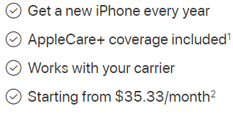

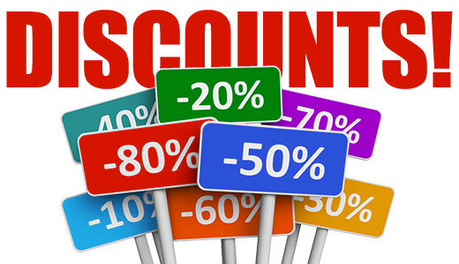
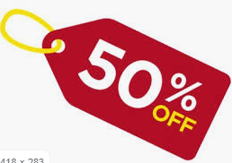
Pricing Policy
INTERNET CHANGED PRICING
Dynamic pricing.
I can order from anywhere.
Price comparison.
Open source solutions.
New business models C2B and C2C.

Slide 12
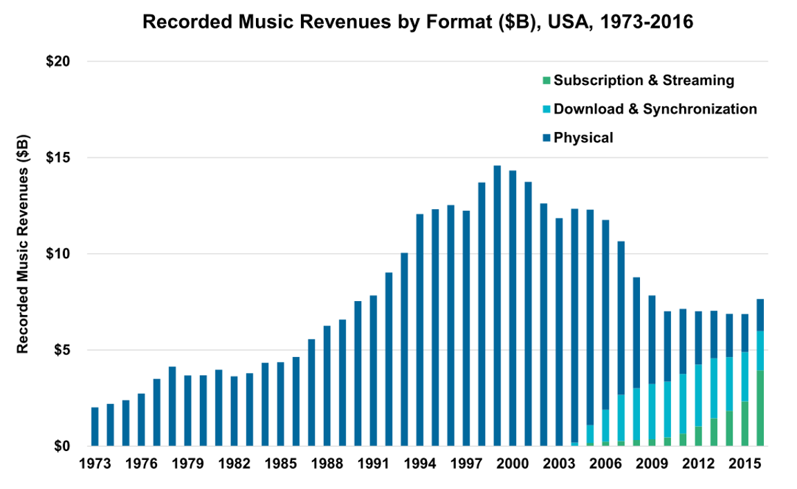
Pricing Policy
PRICE OF MUSIC INDUSTRY

Slide 13
Pricing Policy
3. CALCULATION EQUATION
Direct material (material immediately needed for production).
Direct wages (wages of workers producing the product).
Manufacturing overhead (overhead = joint production costs).
TOTAL 1 + 2 + 3: OWN COSTS OF PRODUCTION
Administrative overheads (common costs on the administrative apparatus).
Supply arrangement (et al. Supply costs for the enterprise).
TOTAL 4 + 5 + 6: OWN COSTS OF PERFORMANCE
Distribution costs / overheads (linked to sales - sales).
TOTAL 7 + 8: FULL OWN COSTS OF PERFORMANCE
Profit.
TOTAL 9 + 10: PRICE BEFORE TAX
VAT.
SUM 11 + 12: FINAL PRICE

Slide 14
Pricing Policy
4. BASIC PRICING STRATEGIES
Methods oriented on costs:
  Often used in practice.
  Costs determine the lower limit of price.
  It leads to a mismatch between the interests of the customer and the company.
  Adaptation of prices to costs.
Methods oriented on competition:
  Concentrating on monitoring and matching competitors' prices.
  Frequent on markets with the price leader.
Methods oriented on demand:
  Based on psychological and behavioral processes in the purchasing decisions of consumers.

Slide 15
Pricing Policy
PRICE / QUALITY STRATEGY
 | Price
Quality |  | High | Mid | Low
 | High | 1. Leading strategy | 2. Strategy of high value | 3. Strategy of extra value
 | Mid | 4. Overpricing strategy | 5. Strategy of average value | 6 .Strategy of good value
 | Low | 7. Blackmailing strategy | 8. Strategy of false economy | 9. Strategy of economy

Slide 16
Pricing Policy
STRATEGY OF ACTIVE PRICING COMPETITION
Pricing policy focused on the competition.
The risk of price wars.
Prices oscillate around the demand curve.
The more unique the product is, the higher the price that can be set by the seller.
Price reduction in order to protect market space is possible.
Typicall for retail, food etc.

Slide 17
Pricing Policy
BASIC PRICING STRATEGIES
Strategy of low prices and costs.
Strategy of high prices and product image.
Combined Strategy.
Strategy of market leaders adaptation.
Strategy of price vs. quality.
Active vs. passive price competition.

Slide 18
Pricing Policy
TYPES OF PRICES
Cream price
Penetration price
Competitive price/Price leader
Current market price
Segmented price
Price accepted by customer
Cost price
Discount price
Geographic price

Slide 19
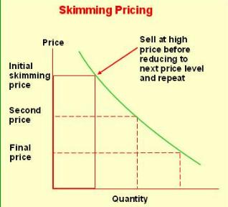
Pricing Policy
SKIMMING PRICING
"Skim the cream” pricing involves selling at a high price to those who are willing to pay before aiming at more price-sensitive consumers.
This expression comes from the farming practice of milking cows - the cream rises to the top and you skim it off.
The advantage of using a Skimming price policy is that you can theoretically get the maximum profit from each level of customer.

Slide 20
Pricing Policy
SKIMMING AND PENETRATION PRICING
Based on how much we spend on marketing communications and how high our price is, we can distinguish 4 different strategies.
Marketing Communications
Rapid-skimming strategy
Slow-skimming strategy
Price
Rapid-penetration strategy
Slow-penetration strategy

Slide 21
Pricing Policy
„FORBIDDEN“ STRATEGIES
Transfer price - big international companies make use of different costs of production inputs (e.g. raw materials, labour force, financial resources) and tax expense.
Dumping - The products are sold below their costs of production. Selling goods in a foreign market below the price of the same goods in the home market. EU has had anti-dumping legislation from its inception.
Cartels - Various companies producing similar products cooperate to control markets. The cartel association may use formal agreements to set prices, establish levels of production and sales for the participating companies, allocate market territories and even redistribute profits. Its illegal!

Slide 22
Pricing Policy
BARTER
The direct exchange of goods between two parties in a transaction without the use of a medium, such as money.
It is said that barter is 'inefficient' because:
  There needs to be a 'double coincidence of wants‚.
  There is no common measure of value.
  Indivisibility of certain goods.
  Lack of standards for deferred payments.
  Difficulty in storing wealth.
BUT! Around 20% of global trade is done by barter.

Slide 23
Pricing Policy
5. SETTING THE PRICE – IN DEPTH LOOK
1. Pricing objectives
2. Determining demand
3. Estimating costs
4. Analysing competitors costs, prices and offers
5. Selecting a pricing method
6. Selecting final price

Slide 24
Pricing Policy
STEP 1: SELECTING THE PRICING OBJECTIVE
What is the organisation trying to achieve?
FINANCIAL OBJECTIVES
Return on investment
Profit optimization
Generating cash flow
MARKETING OBJECTIVES
Survival
Maximum market share
Maximum market skimming
Product-quality leadership

Slide 25
Pricing Policy
STEP 2: DETERMINING DEMAND
All pricing decisions are, in the end, dependant on the level of market demand, and on “what the market will bear”.
The market demand for luxury products, such as Rolls Royce cars, is very small, and so is the supply. Supply and demand meet at a very high price, because there are a few customers that are willing to pay a lot extra for a luxury product because of its prestige value, etc.
On the other hand, most customers for toothpaste are only prepared to pay a relatively small amount for each tube, rationalising that there is a limit to the value added potential of the product, which in any case they purchase relatively frequently.

Slide 26
Pricing Policy
STEP 3: ESTIMATING COSTS
Full cost pricing: this type of cost pricing calculates all costs together, fixed costs and variable costs per unit, and adds a margin (profit for the company). It also takes into account sales estimates that are used as a dividing number. After a certain breakpoint, be it a month, a quarter year, or a year, the total costs of production are calculated and the price is set accordingly.
Direct cost pricing: direct cost pricing is sometimes called marginal cost pricing. It includes the calculation of only those costs that are likely to rise as output increases. The obvious problem is that this price does not cover full costs and so the company would be making a loss selling a product at this low price.

Slide 27
Pricing Policy
STEP 4: ANALYSING COMPETITORS COSTS, PRICES, AND OFFERS
Within the range of possible prices determined by market demand and company costs, the firm must take competitor’s costs, prices, and possible price reactions into account. If the firms offer contains features not offered by the nearest competitor, it should evaluate their worth to the customer and add that value to the competitor’s price. If the competitors offer contains some features not offered by the firm, the firm should subtract their value from its own price. Now the firm can decide whether it can charge more, the same, or less than the competitor.
The introduction or change of any price can provoke a response from customers, competitors, distributors, suppliers, and even government.

Slide 28
Pricing Policy
STEP 5: SELECTING A PRICING METHOD
Given the customers demand schedule, the cost function, and competitors’ prices, the company is now ready to select a price. Costs set a floor to the price. Competitors’ prices and the price of substitutes provide an orienting point. Customers’ assessment of unique features establishes the price ceiling. Companies select a pricing method that includes one or more of these three considerations.
There are 6 basic price-setting methods: mark-up pricing (adding a standard mark-up to the products cost), target-return pricing (the firm determines the price that yields its target rate of return on investment), perceived-value pricing (based on the value perceived by the customer), value pricing (offering a good value for low price), going-rate pricing (the firm bases its price largely on competitors prices), and auction-type pricing (price is settled in an auction).

Slide 29
Pricing Policy
STEP 6: SELECTING THE FINAL PRICE
Pricing methods narrow the range from which the company must select its final price. In selecting that price, the company must consider additional factors, including the impact of other marketing activities, company pricing policies, gain-and-risk-sharing pricing, and the impact of price on other parties.

Slide 30
Pricing Policy
PRICE ADAPTATION 1
Companies usually develop a pricing structure that reflects variations in geographical demand and costs, market-segment requirements, purchase timing, order levels, delivery frequency, guarantees, service contracts, and other factors. As a result of discounts, allowances, and promotional support, a company rarely realizes the same profit from each unit of a product that it sells.
Geographical pricing: the company decides how to price its products to different customers in different locations and countries. The effects of distance and market strategy take effect. Another issue closely connected is how to get paid, this leads to barter, compensation deals, offsets and buyback arrangements.

Slide 31
Pricing Policy
PRICE ADAPTATION 1
Price discounts and allowances: companies can use discounts in many ways, for example for early payment, volume purchases, off-season buying, etc. Company must never forget that it may attract new customers but it may also harm the image and it definitely decreases income.
Promotional pricing: this includes special event pricing, cash rebates, longer payment terms, etc. These strategies get often copied by the competition and lose their effectiveness early.
Differentiated pricing: also called price discrimination. It occurs when a company sells a product or service at two or more prices that do not reflect a proportional difference in costs. The pricing can be differentiated: customer-segment pricing, product-form pricing, image pricing, channel pricing, location pricing, time pricing.

Slide 32
Pricing Policy
PRICING AND ETHICAL ISSUES
Price fixing: it can be in the interests of producers to agree among themselves not to compete on price (cartel). This is an act of collusion and is banned in many countries and regions.
Predatory pricing: a firm cuts its prices with the aim of driving out the competition. The firm is content to incur losses with the intent that high profits will be generated through higher prices once the competition is eliminated.
Deceptive pricing: occurs when consumers are misled by the price deals offered by companies. Two examples are misleading price comparisons (a store sets high prices for short time and then claims to lower them later) and “bait and switch” (customer is baited in a store on discounted prices but the salesperson persuades to switch to higher-priced product).
Price discrimination: occurs when a supplier offers a better price for the same product to one buyer and not to another, resulting in an unfair competitive advantage.

Slide 33
Pricing Policy
PSYCHOLOGICAL EFFECTS IN PRICING
Psychological meaning of numbers
Using 1.99 instead of 2.
Everything for XX.
Monthly payments instead of the total price.
Sale! X + 1 free.
High prices and a subsequent "drastic" discount.
Consumers generally perceive the first number of the price and how many digit the number has.
This effect is further enhanced with price tags where these items are printed in smaller letters (€ 3.⁹⁸).
Prices quoted to the penny suggest to the consumer that the goods are sold at the lowest possible price.
The importance of setting the right price is growing with the development of web sites for comparison goods.

Slide 34
Pricing Policy
DISCRIMINATION PRICING
Prices can be set to be better for certain customers while discriminating other.
Based on segments: students, seniors etc.
Based on place: movie theaters, stadiums, aeroplanes etc.
Based on time: seasonal vacations, elektricity tarifs, monile operator services etc.
Loss leader! Selling with a price set under the costs = losing money on each sold product …. but gaining profit somewhere else. Example – Sony Playstation, Amazon Kindle Fire etc.

Slide 35
Pricing Policy
6. PRICE ELASTICITY
The change of demand quantity because of price change.
EP = % quantity change (Demand)
% price change
EP = (Q₂ - Q₁ ) : (P₂ - P₁)
(Q₁ + Q₂ )/2 (P₁ + P₂)/2
ￜEPￜ > 1 flexible demand
0 < ￜEPￜ < 1 non-flexible demand
ￜEPￜ = 1 unit flexible
ￜEPￜ = 0 totally non-flexible demand

Slide 36
Pricing Policy
THE END
Thank you for your attention.
☺

