Slide 1
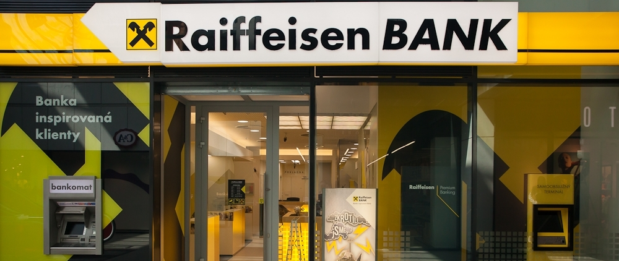
Compliance & financial crime managment
Březinová Michaela

Slide 2

What is Raiffeisenbank?
Financial instituion
Founder: Friedrich Wilhelm Raiffeisen
Major shareholder: Raiffeisen Bank International AG
One of the five biggest czech banks

Slide 3
Types of financial crime
Personal purchases
Theft
Skimming
Payroll schemes
Billing schemes
Forgery

Slide 4
COMPLIANCE
Process of ensuring that your organization and clients meet standards, policies and regulations that apply to your industry and organization.
Currency and Foreign Transactions Reporting Act (BSA)
The USA PATRIOT Act
Know Your Customer (KYC)

Slide 5
FCRM system
Detect threats in real time
01
Uncover anomalous user behavior
02
Improve investigation efficiency and results
03
Provide analytics and reporting
04

Slide 6
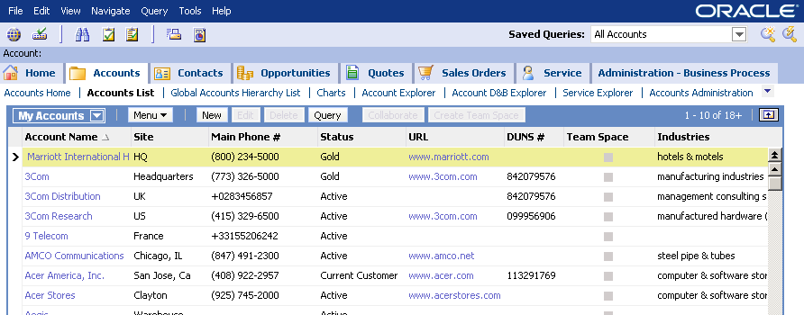
SIEBEL & CRS & FATCA

Slide 7
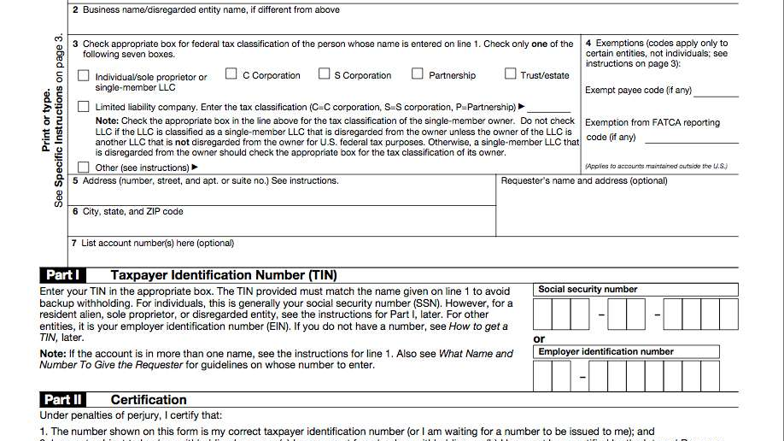
W-9, W-8BEN and W-8BEN-E forms

Slide 8
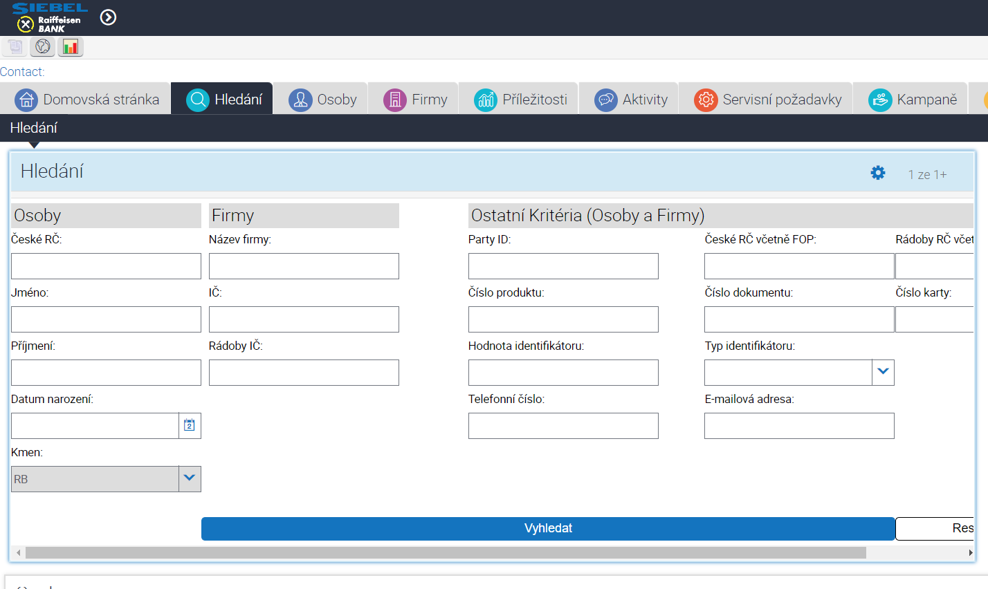

Slide 9
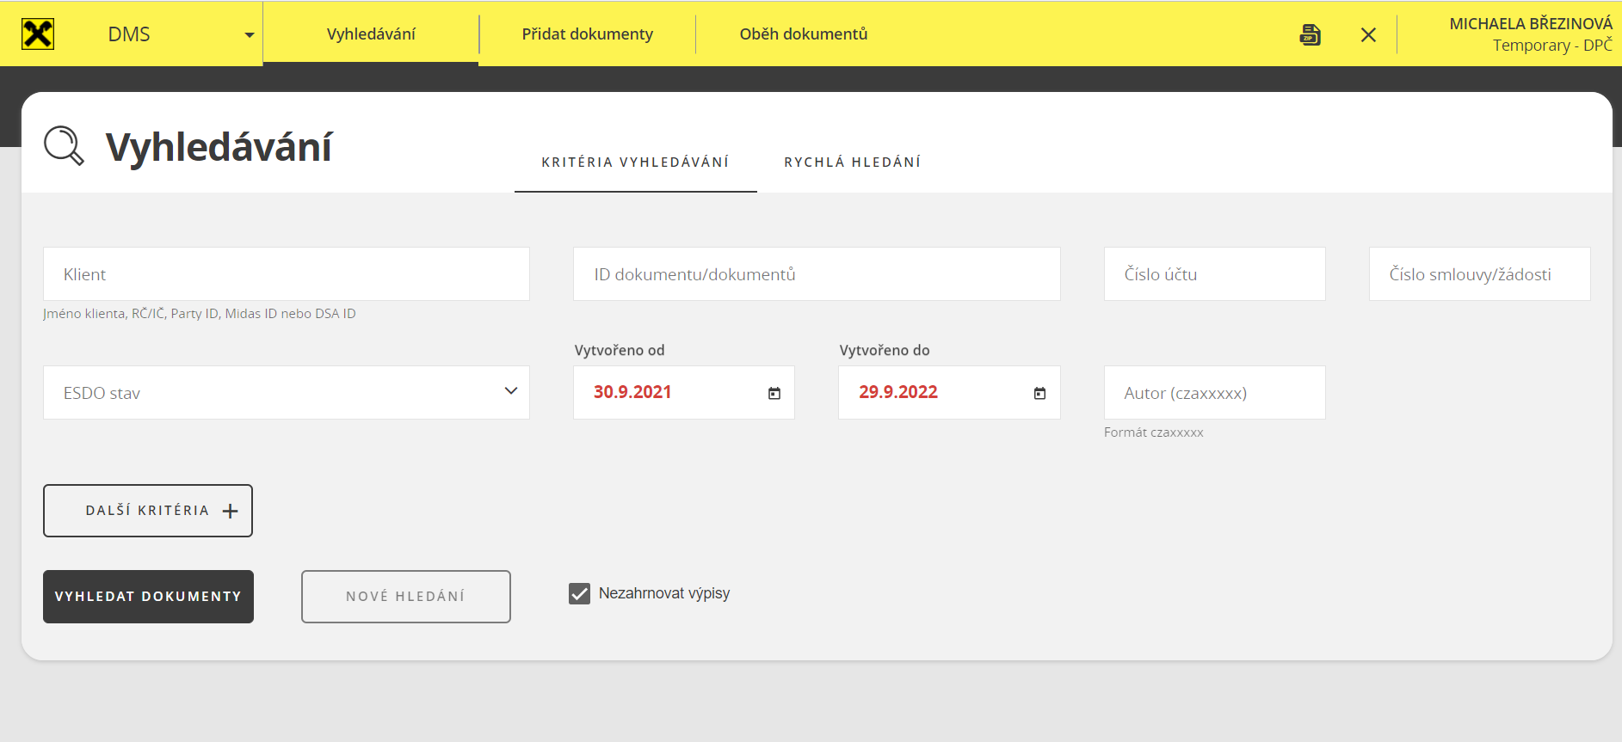

Slide 10
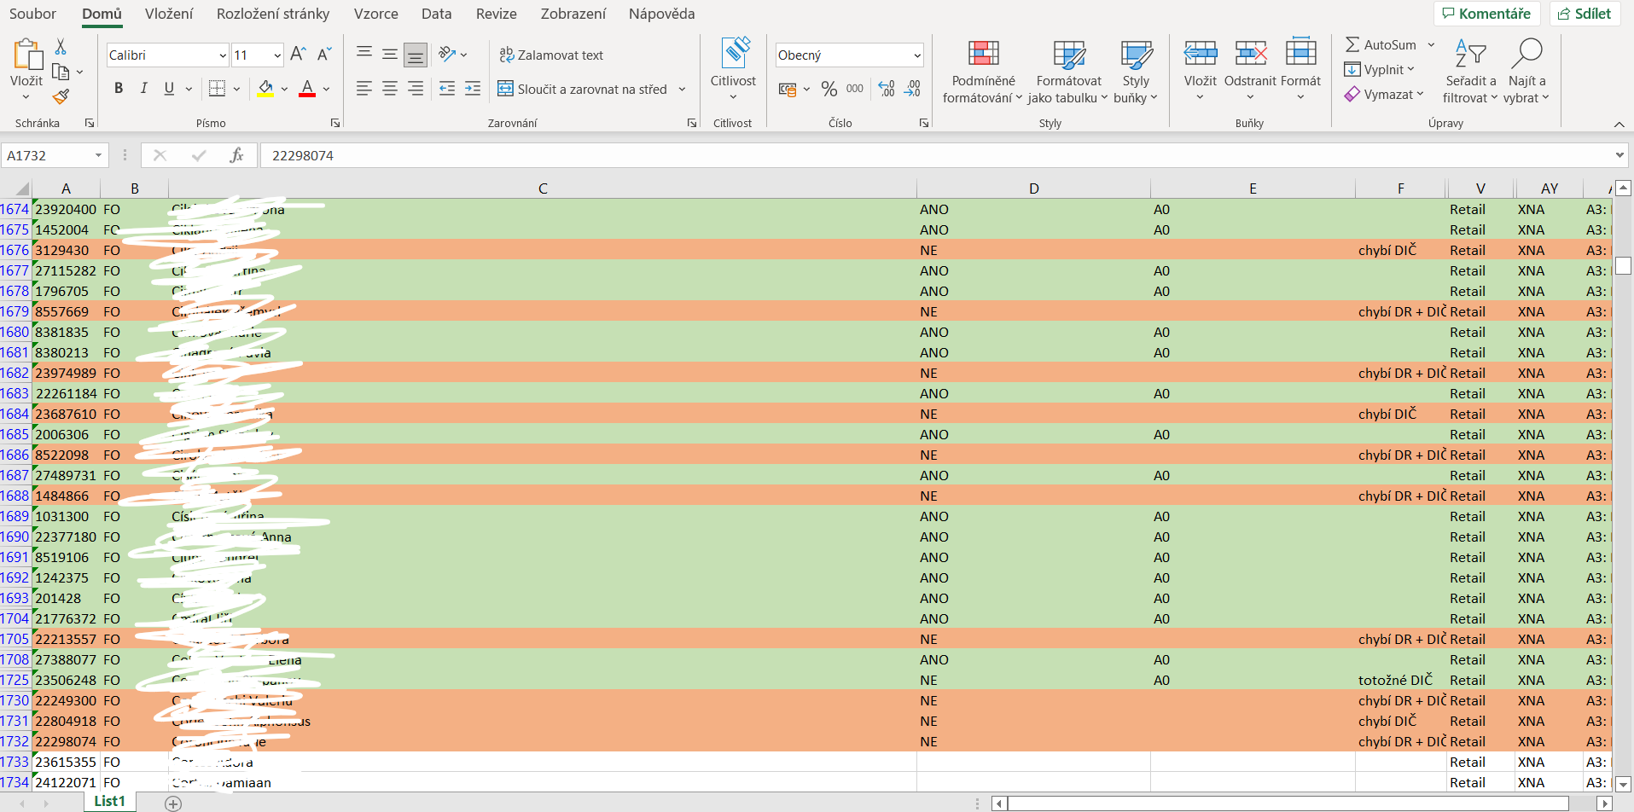

Slide 11
Thank you for your attention and I wish you a nice day!

