Slide 1
OBCHODNĚ PODNIKATELSKÁ FAKULTA V KARVINÉ
UNEMPLOYMENT
NIKOLA ŠKOVRANOVÁ, SÁRA KIEDROŇOVÁ
PROFESIONAL ENGLISH III-

Slide 2
CONTENT
1. UNEMPLOYMENT
2. TYPES OF UNEMPLOYMENT
3. CAUSES OF UNEMPLOYMENT
4. RISK GROUP OF UNEMPLOYMENT
5. CONSEQENCES OF UNEMPLOYMENT
6. GRAPHS

Slide 3
UNEMPLOYMENT
WHAT IT MEANS?
The term unemployment refers to a situation where a person actively searches for employment but is unable to find work.

Slide 4
UNEMPLOYED
A person older than 15 years, looking for work, ready to start work within 14 days at the latest.
A person registered at the Labor Office.
Does not have a paid employment or self-employment.

Slide 5
TYPES OF UNEMPLOYMENT
1. FRICTIONAL
2. SEASONAL
3. CYCLICAL
4. STRUCTURAL

Slide 6
FRICTIONAL UNEMPLOYMENT
SEASONAL UNEMPLOYMENT
This term refers to temporary unemployment of people who are out of work for a short time while waiting to start a new job.
It is caused by changes in areas where the demand for jobs rises or falls in accordance with periods of high or low economic activity.

Slide 7
CYCLICAL UNEMPLOYMENT
STRUCTURAL UNEMPLOYMENT
It results from the difference between the existing qualifications of workers and the new requirements for jobs.
Is the downturn in employment caused a corresponding fluctuation in the business cycle.

Slide 8
VOLUNTARY AND INVOLUNTARY UNEMPLOYMENT
Voluntary
Termination of employment due to taking up another job
Unemployed are not interested in jobs for various reasons
Involuntary
Lack of jobs
Inflexible wages

Slide 9
SHORT-TERM AND LONG-TERM UNEMPLOYMET
SHORT-TERM (NORMAL)
Up to 1 year
Voluntary departure from employment
Seasonal unemployment (construction)
LONG -TERM
Over 1 year
Serious economic problem

Slide 10
1
LACK OF JOBS, POOR INFORMATION ABOUT JOBS
2
MINIMUM WAGE LAW
CAUSES OF UNEMPLOYMENT
3
DEPENDENCE ON STATE AID (SOCIAL BENEFITS), HIGH UNEMPLOYMENT BENEFITS
4
LACK OF WORK EXPERIENCE
5
RELUCTANCE TO COMMUTE TO ANOTHER REGION FOR WORK

Slide 11
1
GRADUATES
2
OLDER PEOPLE (55+)
RISK GROUPS FOR THE LABOUR MARKET
3
YOUNG PEOPLE (LACK OF EXPERIENCE)
4
WOMEN (PREGNANCY)
5
PEOPLE WITH DISABILITIES
6
PEOPLE WITHOUT SUFFICIENT EDUCATION, WITH LOW QUALIFICATIONS

Slide 12
CONSEQUENCES OF UNEMPLOYMENT
ECONOMIC
SOCIAL
Social welfare expenditure
Expenditure on retraining
Loss of what those out of work could produce
Decline in living standards
Stress, health problems
Loss of skills

Slide 13
Unemployment is measured by the unemployment rate
Is the proportion of the unemployed to all persons able to work (employed and unemployed)
UNEMPLOYMENT RATE

Slide 14
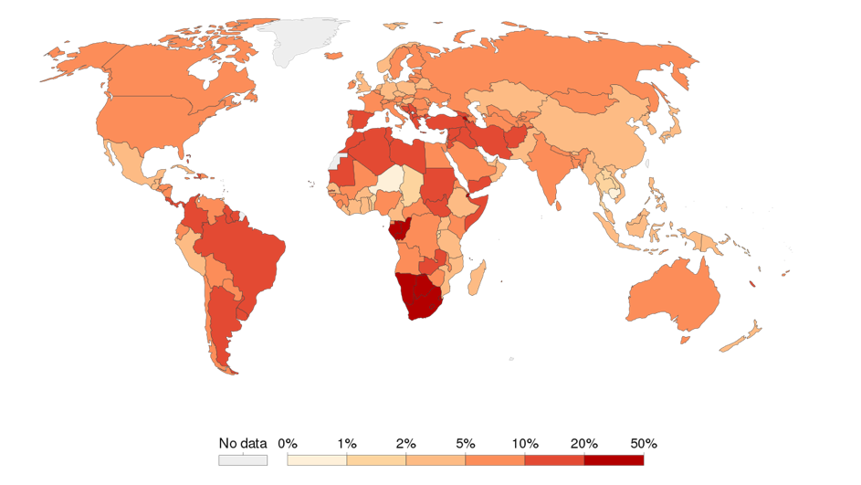
UNEMPLOYMENT RATE 2021

Slide 15
UNEMPLOYMENT IN THE CZECH REPUBLIC BY YEAR

Slide 16
UNEMPLOYMENT IN THE CZECH REPUBLIC BY YEAR 2021

Slide 17
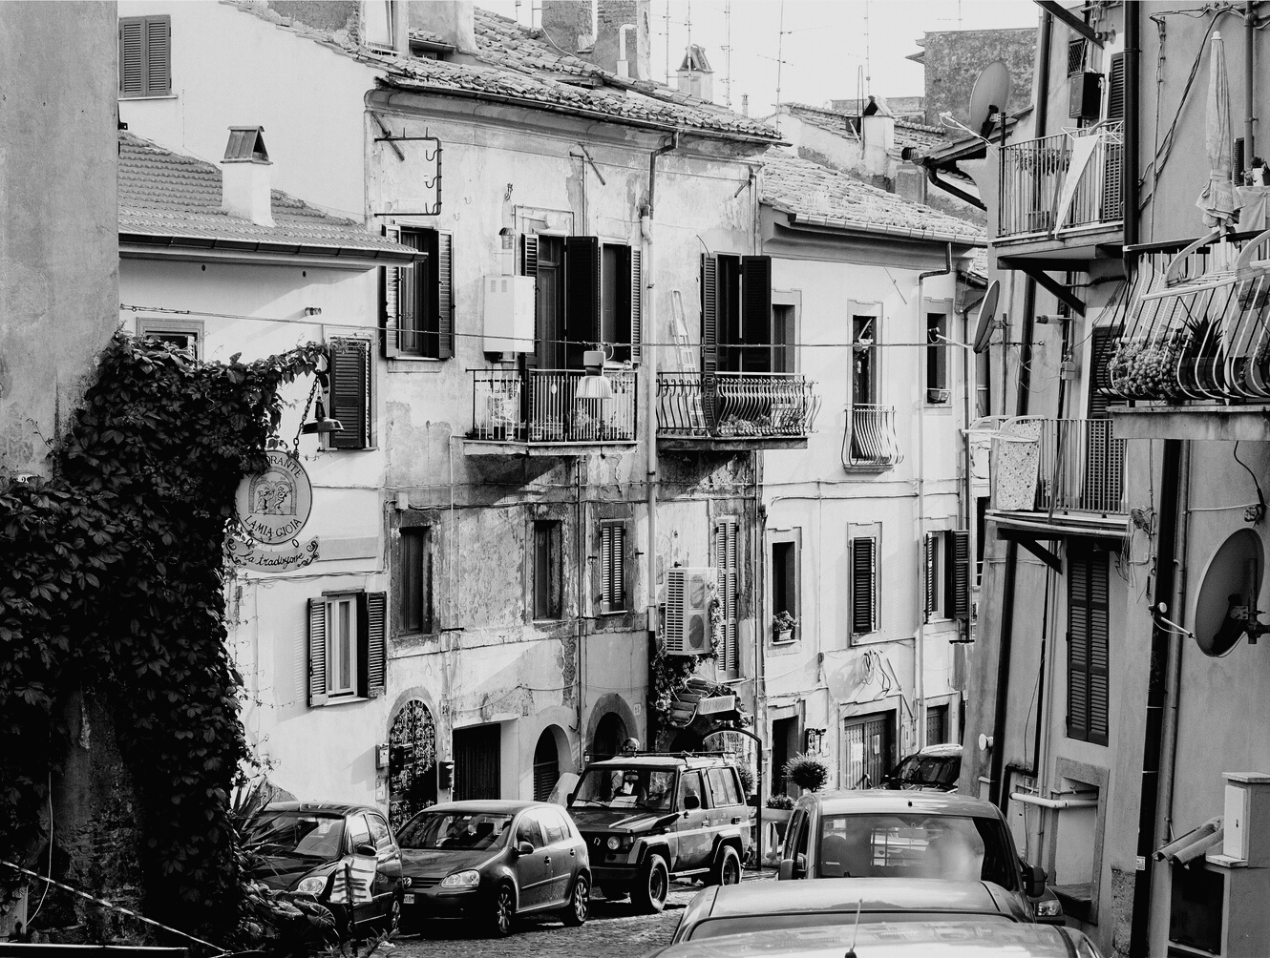
THANK YOU!

Slide 18
https://en.wikipedia.org/wiki/Unemployment
https://www.czso.cz/
http://www.jobmanual.cz/cs/dlouhodoba-nezamestnanost.html
https://cs.wikipedia.org/wiki/Nezam%C4%9Bstnanost
https://www.miras.cz/seminarky/makroekonomie-n10-nezamestnanost.php

