Slide 1

MARKET AND ITS BASIC ELEMENTS
LESSON II
Dr. Ingrid Majerova
Basic Microeconomics
EVS/xxxx

Slide 2

Outline of the Lecture
Characteristic of Market
Supply and Demand
Formation of Price
Competition
Function of Market

Slide 3
MARKET
WHAT IS MARKET?
Market is a place where supply and demand are confronted.
The quantitative relationship in which the commodities (goods and services) are exchanged, is called the exchange value.
The exchange value expressed in money is called ..........?
Commodities - goods and services that were produced for exchange.
ON THE MARKET OPERATE THE MARKET ENTITIES, WHICH CREATE DEMAND AND SUPPLY

Slide 4
MARKET
FUNCTIONS OF MARKET
The market economy has its clearly defined functions, which consist in finding answers to the following questions:
What? - It solves the competition on the demand side (money, crown votes)
How? - It determines the competition on the supply side (cost, quality, technical level)
For whom? - It determines pensions, which are formed on the market of production factors (wages, rents, profits and interest).
Perfectly competitive market (mostly abstract model) would be able to answer these questions itself (without other influences and interventions).

Slide 5
MARKET
KINDS OF MARKET
The imperfections of the market mechanism necessitate additional state intervention in the economy.
Socially oriented market economy (Sweden) - these theories promoted significant government interventions in the market mechanism in order to maintain economic stability and social reconciliation.
Market (pure) economy (USA) - promoted no or minimal state intervention in the market mechanism.
The present system of developed countries is a compromise between market and state regulations.

Slide 6
MARKET
TYPES OF MARKET
Teritorial aspects
  Local market - local shops in cities.
  Notebook market in KARVINA
  National market - the market within the polity. Formed by merger (sum) of the local markets.
  Notebook market in CZECH REPUBLIC
  International Market – (every product enters the global Marketplace)
    Formed by merger (sum) of the national markets.
  The global notebook market
Factual aspects
  Sectional market - market which sells and buys a one kind of commodity
  Aggregate market - the market of all commodities

Slide 7
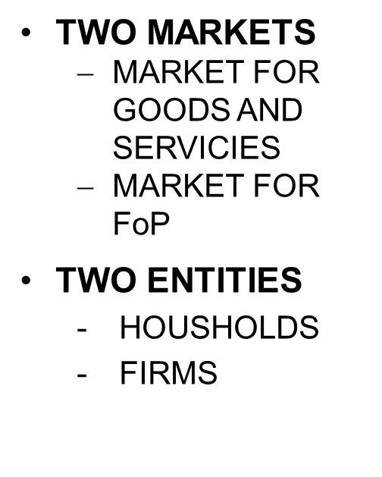
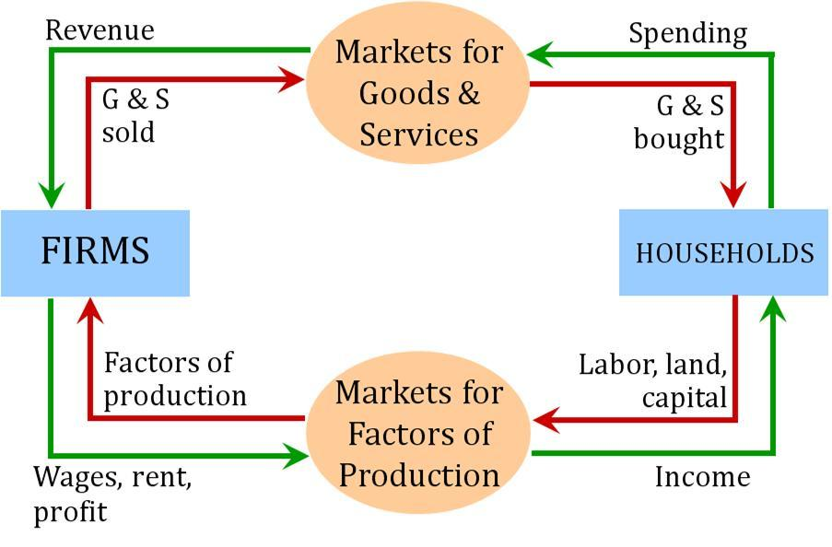
MARKET
ECONOMIC CIRCLE

Slide 8
MARKET
MARKET ENTITIES
Households (target: to satisfy their needs, UTILITY MAXIMALIZATION)
  they want to obtain the useful rare commodities for their needs
  they offer FACTORS OF PRODUCTION to firms
Firms (target: MAXIMIZE THE PROFITS)
  They enter the market to transform products into money
State (goal: INFLUENCE OF MARKET)
  it removes the negative impact of the market influences and stimulates positive influences

Slide 9
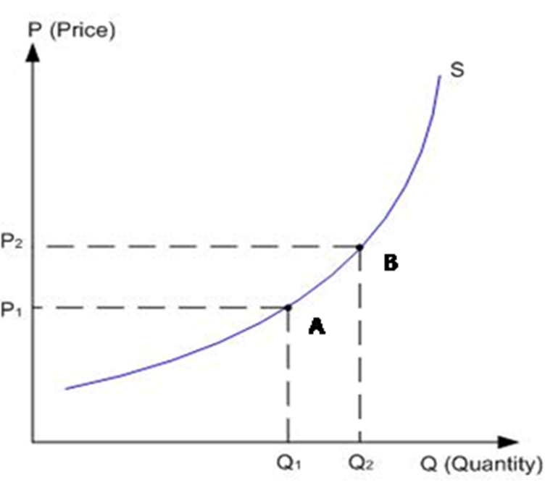
MARKET
SUPPLY CURVE
The volume of supply (Q) is dependent on the price (P).
The price is therefore independent and the quantity the dependent variable.
The relationship between these two variables reflects the supply curve.

Slide 10

MARKET
LAW OF INCREASING SUPPLY
The law of increasing supply – price growth causes an increase in the supply, the price drop causes a decrease in the supply.
Price growth causes an increased interest in the production, it will attract other producers and the interest for production growth in those who previously produced less.
Price growth higher prices higher incomes possibility to buy more additional factors of production expansion of production.

Slide 11
MARKET
! THE SUPPLIED QUANTITY vs. SUPPLY !
From the term of supply we must distinguish the term the supplied quantity.
Supply – is shown by the whole supply curve.
Supplied quantity - a graphical representation of a point on the curve (supply volume at a particular price).
We have clearly distinguished the terms:
  Shift along the curve (change of supplied quantity due to price changes).
  Shift of the curve (supply change caused by other than price effects).

Slide 12
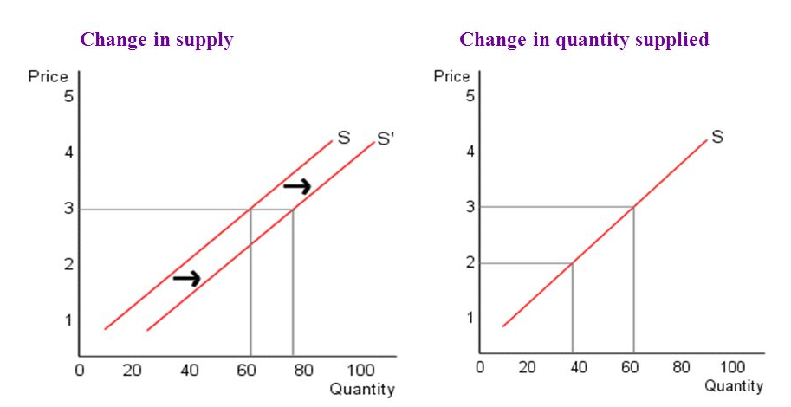
MARKET
SUPPLY CURVE

Slide 13
MARKET
DEMAND
Aggregate Demand - AD
  it is a summary of all planned purchases in the market
  it is determined by the volume of demanded products and their prices.
Individual demand – d - the demand of a one buyer (the demand for the production of a one producer).
Market Demand - MD, respectively. D - the demand for one product.
Economic theory is interested only in just demand within the budgetary limitations = efficient purchasing power demand.

Slide 14
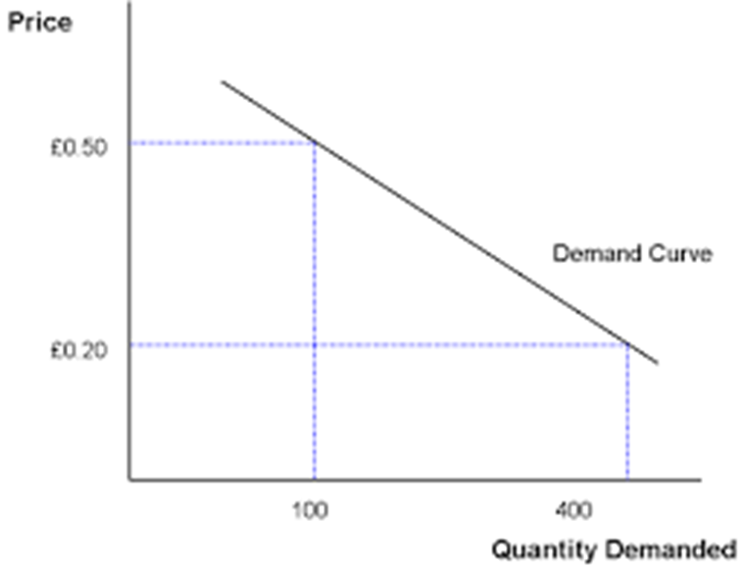
MARKET
DEMAND CURVE
The volume of demand (Q) is dependent on the price (P).
The price is therefore independent and the quantity the dependent variable.
The relationship between these two variables reflects the demand curve.

Slide 15
MARKET
LAW OF DIMISHING DEMAND
The law of diminishing demand - when the price rises, demand falls, when the price drops, demand rises.
When the price falls, commodity is cheaper, and thus more appealing to demand.
A lower price will also enable within unchanged budgetary limitations to buy more goods to those who previously shopped less.
For some kinds of goods that anyone buys, a price reduction will attract more buyers.
Low price makes available the commodities and is a major psychological factor, which causes an increase in demand.

Slide 16
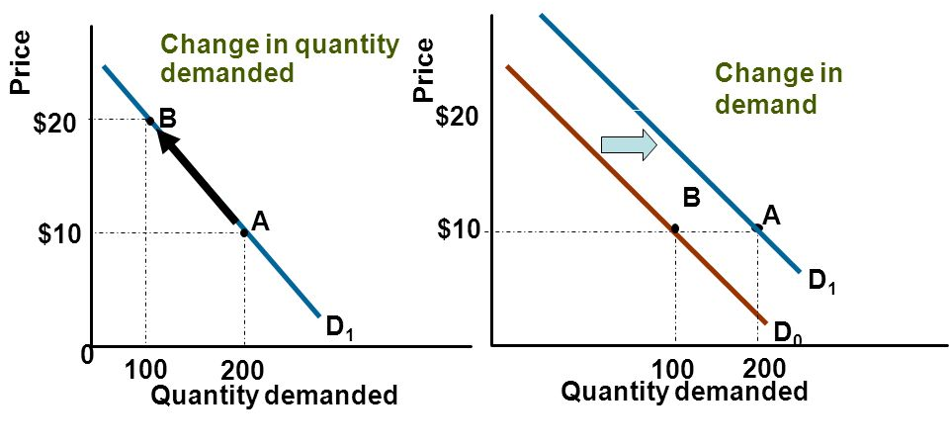
MARKET
DEMAND CURVE

Slide 17
MARKET
PRICE
The market is in equilibrium when the supply equals the demand.
The equilibrium price - the price at which trades in case of equality of supply and demand.
Equilibrium state is very rare and exceptional - there is a constant confrontation of supply and demand.
Market price - the price that arises in the market at current supply and demand conditions.

Slide 18
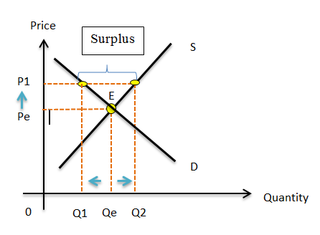
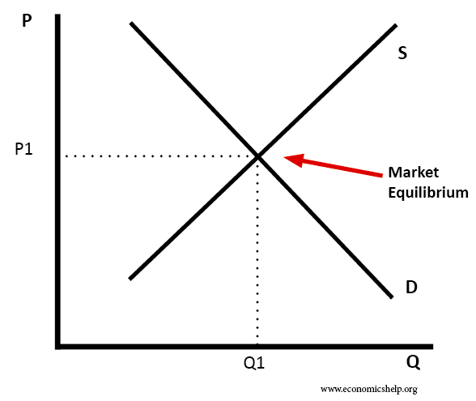
MARKET
FORMATION OF THE PRICE – MARKET EQUILIBRIUM
FORMATION OF PRICE
FORMATION OF PRICE

Slide 19
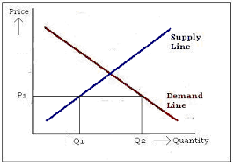
MARKET
COMPETITION
Market competition - is a process where the two different interests of the various market subjects are confronted.
Competition between supply and demand - the producers want to sell the commodities with the greatest profit, consumers want to satisfy their needs as cheap as possible.
Competition on the demand side - every consumer wants to buy the most commodity as cheap as possible, even at the expense of other consumers.
It arises in the case where D> S shortages on the market.

Slide 20
MARKET
COMPETITION
Competition on the supply side - every producer is trying to get the greatest possible market share PROFIT.
S > D - competition becomes a fight for survival, who reduces the price, will lose, the point is who will lose the least.
S < D – the point is who can best take advantage of the prices growth and makes the most profit. This firm then creates the best conditions to dominate the greater part of the market.

Slide 21
MARKET
PRICE AND NON-PRICE COMPETITION
Basic forms of competition on the supply side:
Price competition - voluntary price cuts by manufacturers, without being forced to excess supply over demand attracting the consumers.
Non-price competition - attracting demand, but with other (non-price) methods (quality, advertising, packaging, discounts, service, additional services).
Competition on the supply side = connection the price and non-price competition.

Slide 22
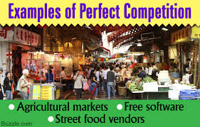
MARKET
PERFECT AND IMPERFECT COMPETITION
Perfect competition - abstract economic theory (in the real world we seek it hard, but still exists).
Perfect competition = absolutely equal conditions for all its participants
  free entry to the sector
  the same level of information for all market subjects
  many manufacturers on the market of one product
  homogeneous production

Slide 23


MARKET
PERFECT COMPETITION
The producer can not influence the market price of production (market price changes when the price of all other products on the market are changed).
The only method to maximize profit in perfect competition in the uchanged scale of production is the elimination of unnecessary production costs.
Perfect competition = producer are directly interested in the searching of savings in it is its perfection.

Slide 24
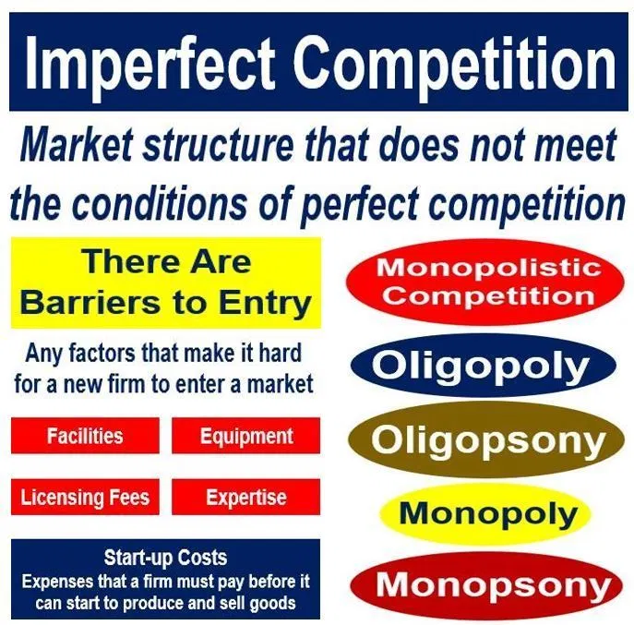
MARKET
IMPERFECT COMPETITION
In the real world we meet with various forms of imperfect competition
Monopolistic competition
Oligopoly
Monopoly

Slide 25

MARKET
FUNCTION OF THE MARKET
The market, in spite of all its imperfections, is the only tool that can answer the questions:
  what?
  how?
  for whom?
The market is therefore required.
The market is so far the most advanced identified regulator
and stimulator of economic development.

Slide 26
THE END
THANK YOU FOR YOUR ATTENTION . . .

