Slide 1
PRODUCTION AND TECHNOLOGY CHOICE
LESSON V
Dr. Ingrid Majerova
Basic Microeconomics
EVS/xxxx

Slide 2
Outline of the Lecture
Existence of the Firm
Technological Constraints
Short Run and Long Run Production
Isoquant and Isocost
Firm Optimum

Slide 3
PRODUCTION AND TECHNOLOGY CHOICE
FIRM
Consumers in the market of goods and services
formation of demand in this market
Subject which creates the main part of the supply on the market products and services FIRM
Causes of the existence of the firm:
the benefits of teamwork
reducing the costs associated with entering into contracts
Transaction costs (author of Harry Ronald Coase, development of neoclassical theory of the firm)

Slide 4
PRODUCTION AND TECHNOLOGY CHOICE
FIRM
Neoclassical theory of the firm - analysis of behavior in the marketplace with an emphasis on deciding the amount and cost of production and of technology choice
Limitations:
Market - level of demand for farm-produced
Economic - on the cost side (limitations in terms of competition)
Techologically - a limited number of technologies and natural conditions
The main objective of the firm is to MAXIMIZE THE PROFIT (first used by Antoine Augustin Cournot)

Slide 5
PRODUCTION AND TECHNOLOGY CHOICE
TECHNOLOGICAL CONSTRAINTS
The firm is in production limited to those production plans that are technologically feasible SET OF PRODUCTION
All combinations of input and output, which is given firm able to produce with the technology - maximum – PRODUCTION FUNCTION
Q$=f(A, L, K, t)$

Slide 6

PRODUCTION AND TECHNOLOGY CHOICE
PRODUCTION
The original equation Q$=f(A, L, K, t)$ - too complicated for analysis - simplification
$$Q=f (K, L)$$
Expression of the maximum output:
immediate - short-term production function
future - long-term production function
We distinguish very short run production, short and long run production (Alfred Marshall).

Slide 7
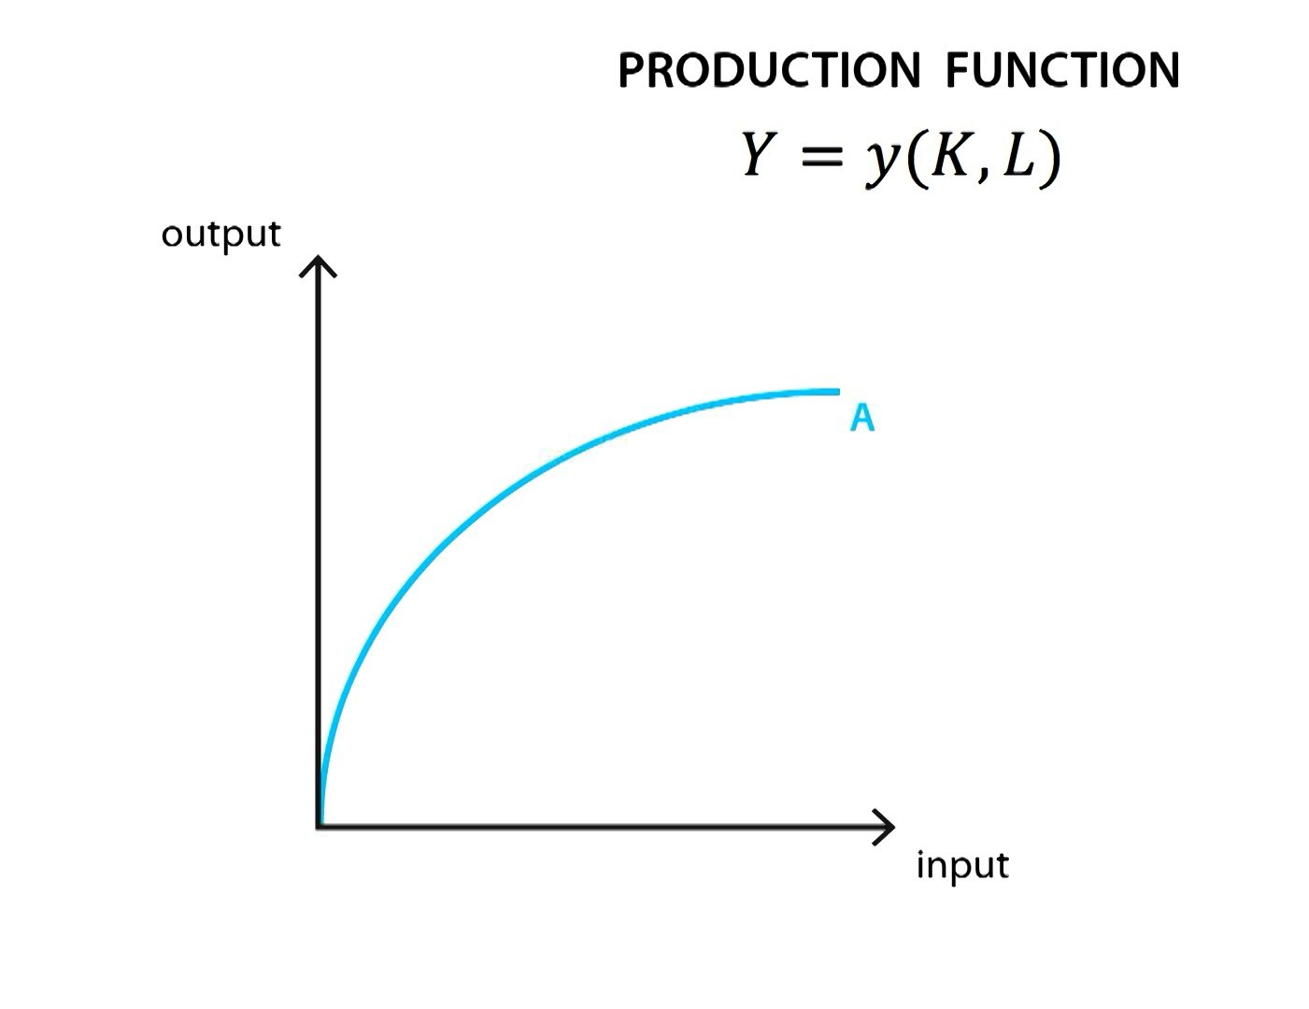
PRODUCTION AND TECHNOLOGY CHOICE
PRODUCTION FUNCTION
Law of diminishing returns from the production factor
Under the curve is the set of production

Slide 8
PRODUCTION AND TECHNOLOGY CHOICE
SHORT RUN PRODUCTION
SHORT RUN?
It is not determined by the time range but by the existence of only one production factor, which can be changed (VARIABLE inputs), other factors are FIXED
we can change only LABOR, capital remains fixed
WHY?
Mathematical expression
$$Q=f (Ko, L)$$

Slide 9
PRODUCTION AND TECHNOLOGY CHOICE
SHORT RUN PRODUCTION
Production function = TOTAL PRODUCT TP
TP - the total quantity of output produced by a firm in the given inputs
TP = Q
Very important is the MARGINAL PRODUCT of production MP
MP - the net change in total production by using the additional units of input

Slide 10
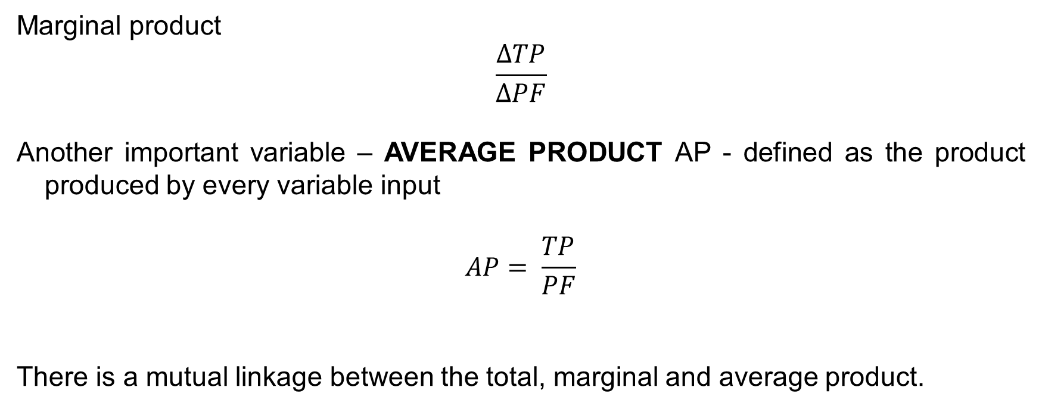
PRODUCTION AND TECHNOLOGY CHOICE
SHORT RUN PRODUCTION
Marginal product
$$\frac{ΔTP}{ΔPF}$$
Another important variable – AVERAGE PRODUCT AP - defined as the product produced by every variable input
$$AP= \frac{TP}{PF}$$
There is a mutual linkage between the total, marginal and average product.

Slide 11
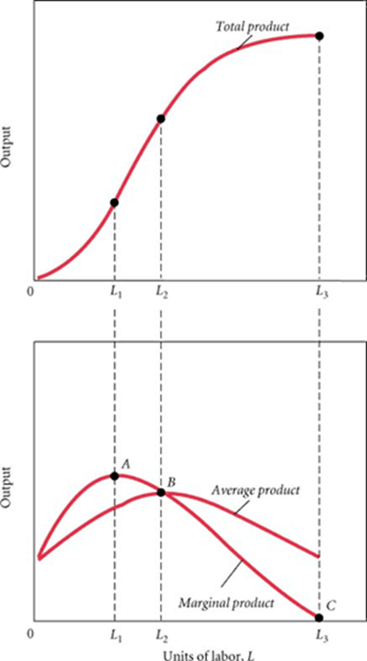
PRODUCTION AND TECHNOLOGY CHOICE
SHORT RUN PRODUCTION
Total product
Marginal and average product

Slide 12
PRODUCTION AND TECHNOLOGY CHOICE
SHORT RUN PRODUCTION
Point A - maximizing the marginal product (maximum return), law of diminishing returns (J. B. Clark)
Point B - maximizing the average product
(a decline in labor productivity) and
between points A and B – first production stage
Point C - maximizing total production (zero marginal product, average product is maximum)
between points B and C – second production
stage

Slide 13
PRODUCTION AND TECHNOLOGY CHOICE
LONG RUN PRODUCTION
In the long run are all production factors variable
Q = f (K, L)
Production function in the long term measures the maximum volume of production which the firm is able to produce various combinations of inputs
Graphical representation ISOQUANT (ISOPRODUCT CURVE IQ)
IQ represents a certain level of production and shows all possible combinations of two inputs that can be used to achieve a given output
ISOQUANT MAP

Slide 14
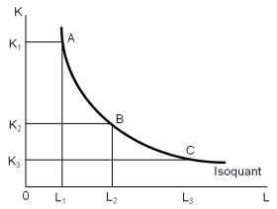
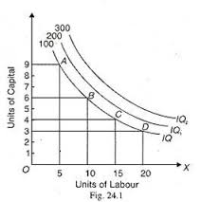
PRODUCTION AND TECHNOLOGY CHOICE
LONG RUN PRODUCTION
ISOQUANT ISOQUANT MAP

Slide 15
PRODUCTION AND TECHNOLOGY CHOICE
LONG RUN PRODUCTION
TECHNICAL SUBSTITUTION
The firm produces some production with various techniques - various combinations of labor and capital
If there is one production technology, production factors are COMPLEMENTS (usually in short run)
In the long run we can always find a combination of inputs and they are SUBSTITUTES

Slide 16
PRODUCTION AND TECHNOLOGY CHOICE
LONG RUN PRODUCTION
The bigger the firm, the greater the possibility of substitution
The ratio at which the mutually substitution of production factor is occurred RATE OF TECHNICAL SUBSTITUTION
The ratio at which one unit is replaced by another entry input so that production remained unchanged MARGINAL RATE OF TECHNICAL SUBSTITUTION
$MRTS= \frac{ΔK}{ΔL}$ = $\frac{MPl}{MPk}$

Slide 17
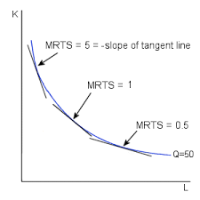
PRODUCTION AND TECHNOLOGY CHOICE
LONG RUN PRODUCTION
MRTS gives to the curve its characteristic shape - if we increasingly substitute one input to other, MRTS increases
MRTS at each point of isoquant is given by the slope of the tangent to the isoquant at this point

Slide 18
PRODUCTION AND TECHNOLOGY CHOICE
LONG RUN PRODUCTION
The main target of the firm is PROFIT MAXIMIZATION
the largest production output at least cost
The total costs (TC) of firm are dependent on the volume of output and input prices
Mathematical expression
TC = pL x L + pK x K
Graphical expression
TC is isocost (equal line costs) CL

Slide 19
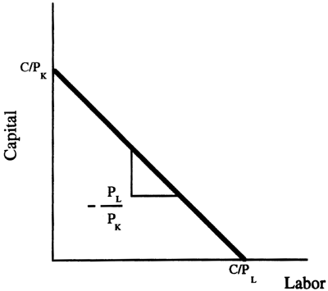
PRODUCTION AND TECHNOLOGY CHOICE
LONG RUN PRODUCTION
The combinations of inputs that cost the producer the same amount of money
For given input prices, isocosts farther from the origin are associated with higher costs

Slide 20
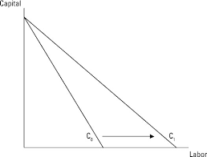
PRODUCTION AND TECHNOLOGY CHOICE
LONG RUN PRODUCTION
Changes in input prices change the slope of the isocost line
the firm's ability to replace one factor of production to others in the manufacturing process, so that does not change the amount of costs
TC = pL x L + pK x K
S = - $\frac{ΔK}{ΔL}$ = $\frac{Pl}{Pk}$

Slide 21
PRODUCTION AND TECHNOLOGY CHOICE
FIRM OPTIMUM
We solved the problem:
HOW THE FIRM DETERMINES THE MOST EFFICIENT PRODUCTION
HOW THE FIRM STATES THAT THE PRODUCTION IS AVAILABLE BY THAT AMOUNT OF COSTS
It remains to be solved: how much production will be least expensive?
FIRM COST OPTIMUM
If the last monetary unit spent on hire of individual inputs brings the same gowth of production.

Slide 22
PRODUCTION AND TECHNOLOGY CHOICE
FIRM OPTIMUM
Mathematical expression:
$$MRTS= \frac{pL}{pK}$$
$\frac{MPl}{MPk}$ = $\frac{pL}{pK}$
$\frac{MPl}{pK}$ = $\frac{MPk}{pK}$

Slide 23
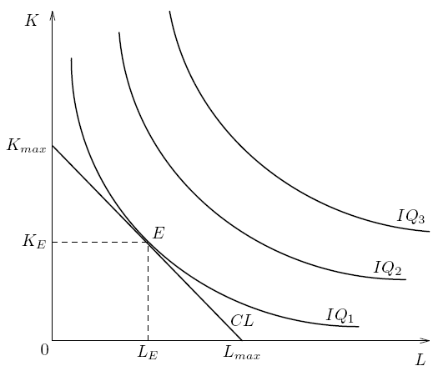
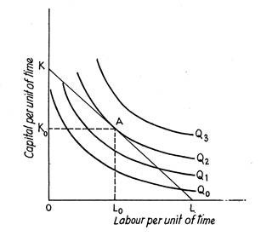
PRODUCTION AND TECHNOLOGY CHOICE
LONG RUN PRODUCTION
Problem of finding an optimal production
MINIMIZING OF COSTS MAXIMIZING OF PRODUCTION

Slide 24
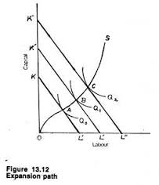
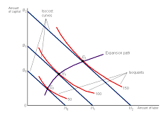
PRODUCTION AND TECHNOLOGY CHOICE
EXPANSION PATH
The effiecient (least-cost) input combinations for every level of output
EXPANSION PATH
Along expansion path, input-price ratio is constant ad equals to the MRTS

Slide 25
PRODUCTION AND TECHNOLOGY CHOICE
LONG EXPANSION PATH (LEP)
LEP shows how the volume output changes when the firm changes leased quantities of inputs
relation to returns to scale:
Increasing returns to scale
the volume of output grows faster than the amount of inputs
the growth rate of output exceeds the growth rate of total costs
Constant returns to scale
output volume grows at the same rate as the number of inputs
the growth rate of production corresponds to the growth rate of costs
Decreasing returns to scale
the volume of output grows more slowly than the number of inputs
the growth rate of production is lower than the growth of costs

Slide 26
PRODUCTION AND TECHNOLOGY CHOICE
LONG EXPANSION PATH
DIFFERENT SHAPES OF ISOQUANTS

Slide 27
THE END
THANK YOU FOR YOUR ATTENTION . . .

