Slide 1
MARKET and GOVERNMENT FAILURE
LESSON XI
Dr. Ingrid Majerova
Basic Microeconomics
EVS/xxxx

Slide 2
Outline of the Lecture
Causes of Limited Market Efficiency
Public goods
Externalities
Information Assymetry
Monopoly Power
Government Failure

Slide 3
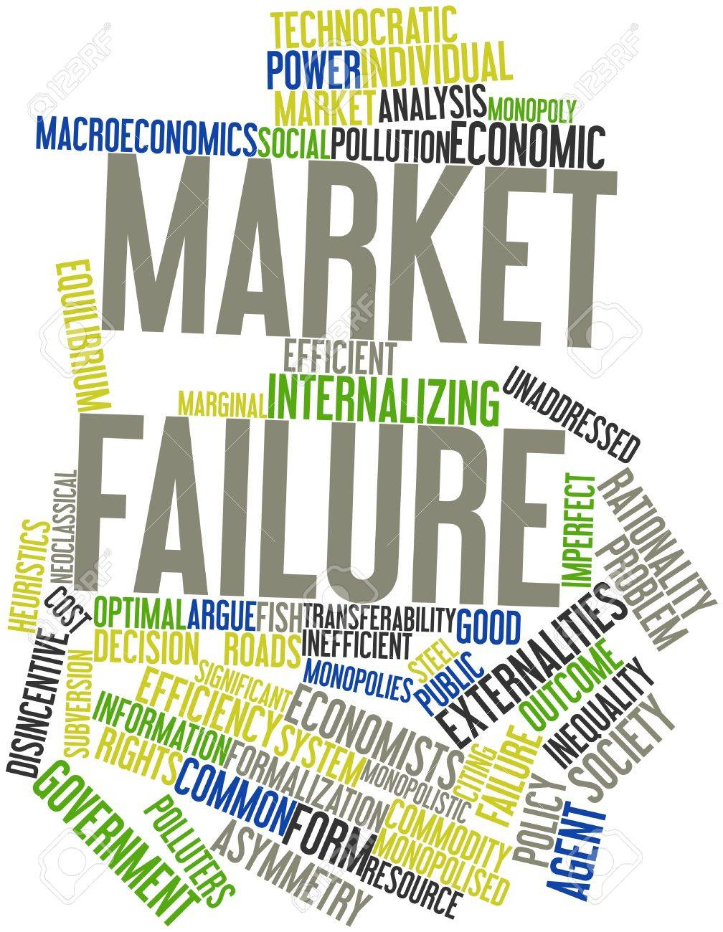
MARKET FAILURE
? MARKET FAILURE
The market allocation of goods is not efficient, so the position of some participants can be improved without deteriorating the position of others.
The result of the market allocation does not therefore correspond to the Pareto optimum.

Slide 4
MARKET FAILURE
CAUSES OF MARKET FAILURE

Slide 5
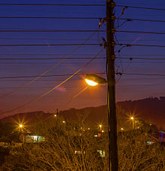
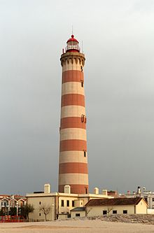
MARKET FAILURE
PUBLIC GOOD
Good that is both
non-excludable - individuals cannot be excluded from use or could be enjoyed without paying for it
and non-rivalrous in that, and where use by one individual does not reduce availability to others or the goods can be effectively consumed simultaneously by more than one person
Examples: knowledge, official statistics, national security, common language(s), flood control systems, lighthouses, and street lighting

Slide 6
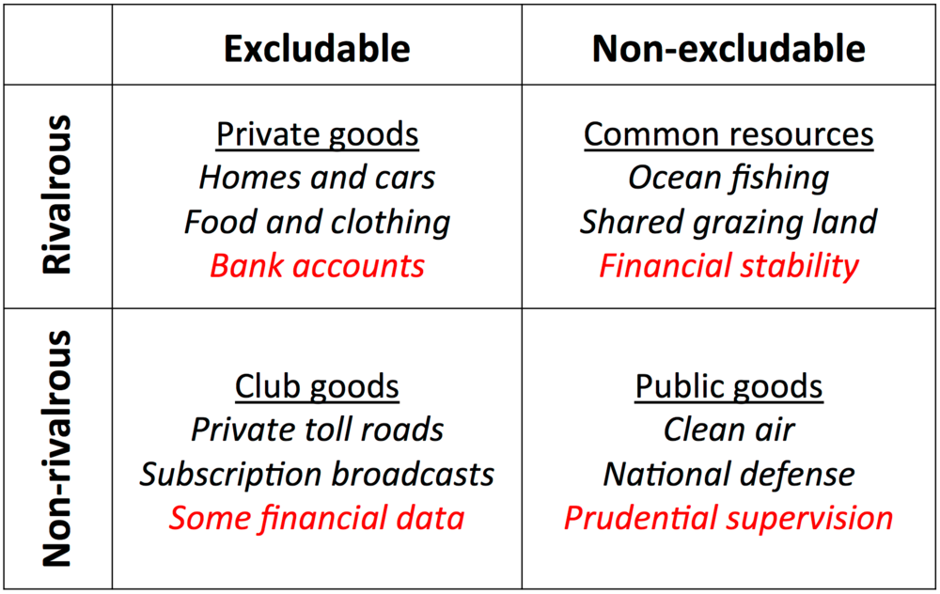
MARKET FAILURE
PUBLIC GOOD

Slide 7
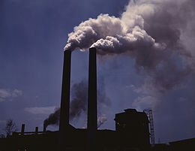
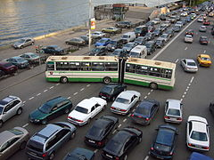
MARKET FAILURE
PUBLIC GOOD
Many public goods may at times be subject to excessive use resulting in negative externalities affecting all users (air pollution and traffic congestion)
Public goods problems are often closely related to the "free-rider" problem, in which people not paying for the good may continue to access it. Thus, the good may be under-produced, overused or degraded.

Slide 8
MARKET FAILURE
EXTERNALITIES
Externality is the cost or benefit that affects a party who did not choose to incur that cost or benefit
Externalities often occur when a product or service's price equilibrium cannot reflect the true costs and benefits of that product or service
Externalities can be both positive or negative…

Slide 9
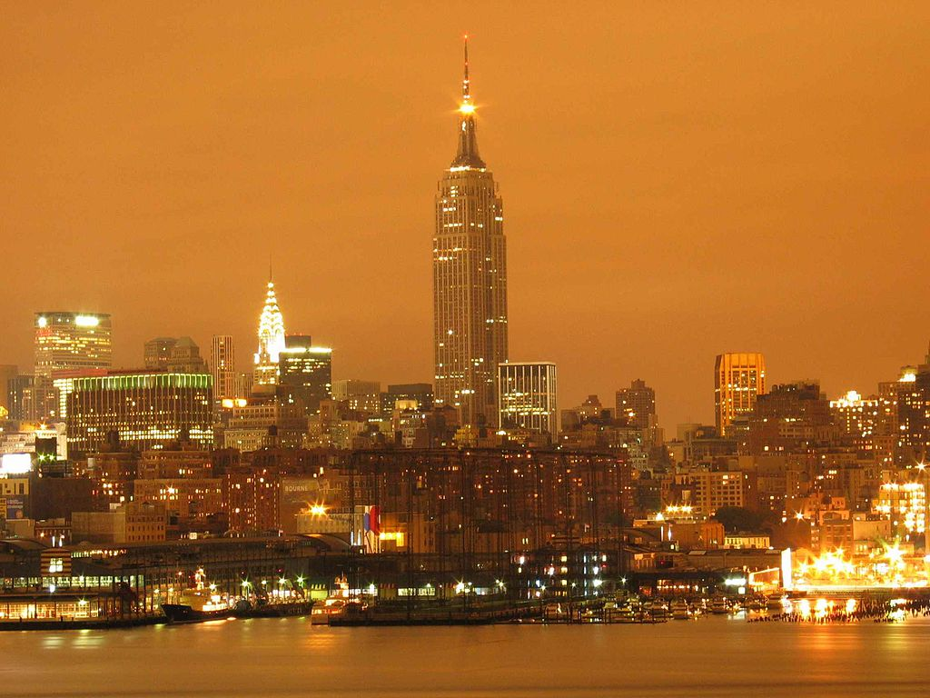
MARKET FAILURE
EXTERNALITIES
A negative externality ( "external cost" or "external diseconomy") an economic activity that imposes a negative effect on an unrelated third party.
It can arise either during the production or the consumption of a good or service

Slide 10
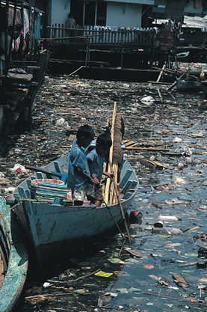
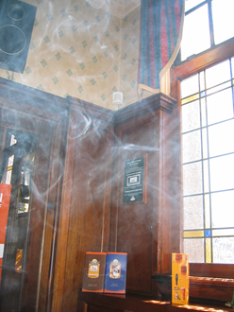
MARKET FAILURE
EXTERNALITIES
Negative production externalities
Air, light and water pollution, systemic risk
(moral hazard), climate changes, overfishing,
nuclear waste or spams….
Negative consumption externalities
Noise pollution, antibiotic resistence,
passive smoking, traffic congestion,
price increase (pecuniary externalities)

Slide 11
MARKET FAILURE
EXTERNALITIES
Positive production externalities
Beekeeper, free software, restored historic
buildings, inovations of foreign firms
Positive consumption externalities
Good quater (for living), vaccination,
increasing education, smart grids (phones ect)

Slide 12
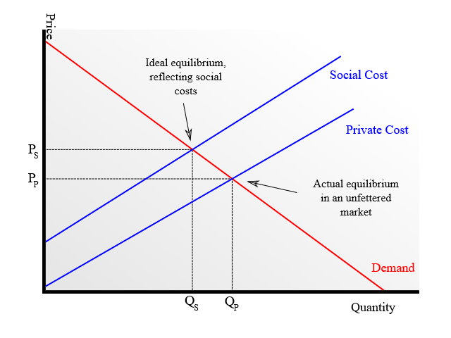
MARKET FAILURE
EXTERNALITIES
External Costs
Demand curve with external costs
if social costs are not accounted for price is too low to cover all costs and hence quantity produced is unnecessarily high (because the producers of the good and their customers are essentially underpaying the total, real factors of production)

Slide 13
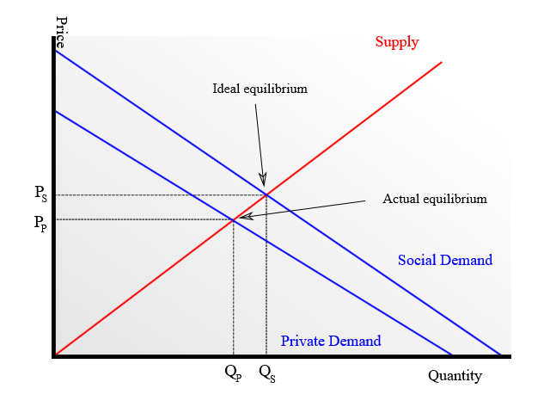
MARKET FAILURE
EXTERNALITIES
External Benefits
Supply curve with external benefits
when the market does not account for the additional social benefits of a good both the price for the good and the quantity produced are lower than the market could bear.

Slide 14
MARKET FAILURE
EXTERNALITIES
Solutions (?)
Corporations or partnerships will allow confidential sharing of information among members, reducing the positive externalities that would occur if the information were shared in an economy consisting only of individuals.
Pigouvian taxes or subsidies intended to redress economic injustices or imbalances.
Regulation to limit activity that might cause negative externalities
Government provision of services with positive externalities
Lawsuits to compensate affected parties for negative externalities
Mediation or negotiation between those affected by externalities and those causing them

Slide 15
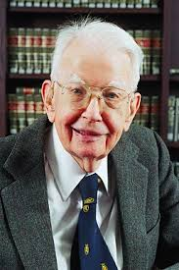
MARKET FAILURE
EXTERNALITIES
Solutions (?)
Ronald Coase argued that an efficient outcome can sometimes be reached without government intervention.
Coase theorem requires that:
Property rights be well-defined
People act rationally
Transaction costs be minimal (costless bargaining)
Complete information

Slide 16
MARKET FAILURE
AsymMetric Informations
Information asymmetry
One party has more or better information than the other
Examples of this problem are
Adverse selection
describes a situation where the type of product is hidden from one party in a transaction
mostly in insurance – smokers vs. nonsmokers

Slide 17
MARKET FAILURE
AsymMetric Informations
Moral hazard
the party with more information about its actions or intentions has a tendency or incentive to behave inappropriately from the perspective of the party with less information
principal-agent problem, where one party, called an agent, acts on behalf of another party, called the principal. The agent usually has more information about his or her actions or intentions than the principal does, because the principal usually cannot completely monitor the agent
subprime loans, the provision of loans to people who may have difficulty maintaining the repayment schedule (higher interest rates, poor quality collateral, and less favorable terms in

Slide 18
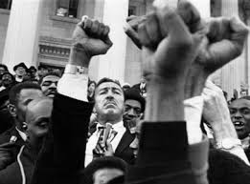
MARKET FAILURE
AsymMetric Informations
Monopolies of knowledge
the ruling class maintains political power through control of key communications technologies
suggests that monopolies of knowledge gradually suppress new ways of thinking

Slide 19
MARKET FAILURE
ABUSE OF MARKET POWER
Occurs when a dominant firm or a dominant group of firms engages in a practice of anti‑competitive acts, with the result that competition has been, is being or is likely to be prevented or lessened substantially.
The size of a business, even one that dominates a particular market, is not, of itself, a cause for concern.
Businesses may need to become large to achieve lower production costs or to compete against foreign and domestic competitors. However, when a dominant company exploits its market power in a way that hurts competition in the marketplace the Competition Act may come into play.

Slide 20
MARKET FAILURE
ABUSE OF MARKET POWER
Criteria of the abuse of dominant position:
The dominant firm or firms have market power — that is the ability to set prices above competitive levels.
The dominant firm or firms engage in anti‑competitive acts — business practices that are intended to reduce competition.
buying up a competitor's customers or suppliers; using "fighting brands" (discount brands) to discipline or keep out competitors; cutting off essential supplies to rival companies; using long-term contracts to stop customers from changing suppliers; and overstepping authority granted by intellectual property rights such as trade-marks and patents.
The anti‑competitive acts have substantially lessened competition, or are likely to do so.
This can happen when anti‑competitive acts eliminate a rival or prevent such things as a rival's entry into a market, potential competition, product innovation and lower prices.

Slide 21
MARKET FAILURE
ABUSE OF MARKET POWER

Slide 22
GOVERNMENT FAILURE
Government Failure
Situation where allocative efficience may have been reduced following governemnt intervention in markets designed to correct market failure

Slide 23
GOVERNMENT FAILURE

Slide 24
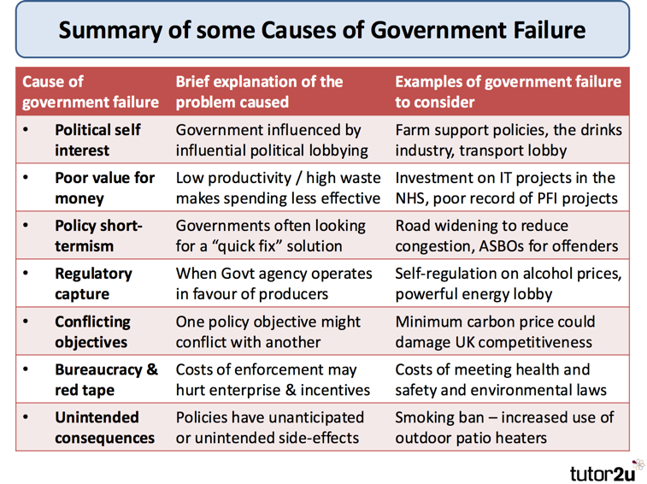
GOVERNMENT FAILURE

Slide 25
THE END
THANK YOU FOR YOUR ATTENTION . . .

