Slide 1
MANAGERIAL ACCOUNTING
Ing. Markéta Šeligová, Ph.D.
MANAGERIAL ACCOUNTING/NANMU

Slide 2
MANAGERIAL ACCOUNTING
Outline of the lecture
Managerial accounting
Financial accounting versus managerial accounting
Pillars of managerial accounting
A strategic management perspective
An enterprise risk management perspective

Slide 3
MANAGERIAL ACCOUNTING
MANAGERIAL ACCOUNTING
Financial accounting
is concerned with reporting financial information to external parties (such as stockholders, creditors, regulators)
Managerial accounting
is concerned with providing information to managers for use within the organization

Slide 4
MANAGERIAL ACCOUNTING
FINANCIAL ACCOUNTING
Reports to those outside the organization:
Owners
Creditors
Tax authorities
Regulators
Emphasizes financial consequences of past activities
Emphasizes objectivity and verifiability
Emphasizes predictions
Emphasizes companywide reports
Must follow GAAP/IFRS
Mandatory for external reports

Slide 5
MANAGERIAL ACCOUNTING
MANAGERIAL ACCOUNTING
Reposts to managers inside the organization for:
Planning
Controlling
Decision making
Emphasizes decisions affecting the future
Emphasizes relevance
Emphasizes timeliness
Emphasizes segment reports
Need not follow GAAP/IFRS
Not mandatory

Slide 6
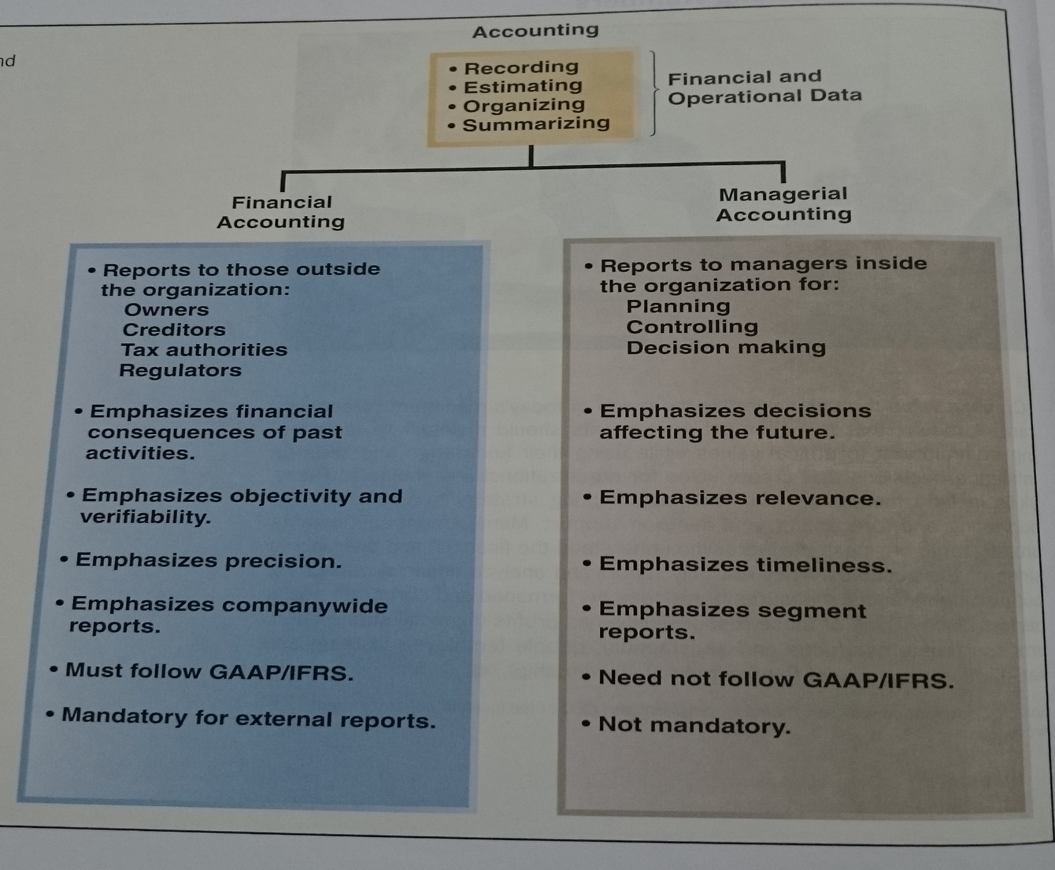
MANAGERIAL ACCOUNTING

Slide 7
MANAGERIAL ACCOUNTING
THREE PILLARS OF MANAGERIAL ACCOUNTING
Planning
Controlling
Decision making

Slide 8
MANAGERIAL ACCOUNTING
PLANNING
involves establishing goals and specifying how to achieve them
includes establishing plans
Plans are often accompanied by a budget.
Budget is a detailed plan for the future that is usually expressed in formal quantitative terms.

Slide 9
MANAGERIAL ACCOUNTING
CONTROLLING
involves gathering feedback to ensure that the plan is being properly executed or modified as circumstances change
Once you established and started implementing plan, you would transition to the control process
Part of control process includes preparing performance reports
Performance report compares budgeted data to actual data in an effort to identify and learn from excellent performance and to identify and eliminate sources of unsatisfactory performance.
Performance reports can also be used as one of many inputs to help evaluate and reward employees.

Slide 10
MANAGERIAL ACCOUNTING
DECISION MAKING
involves selecting a course of action from competing alternatives
perhaps the most basic managerial sklil is the ability to make inteligent, data-driven decision
many decisions revolve around the following three questions
What should we be selling?
Who should we be serving?
How should we execute?

Slide 11
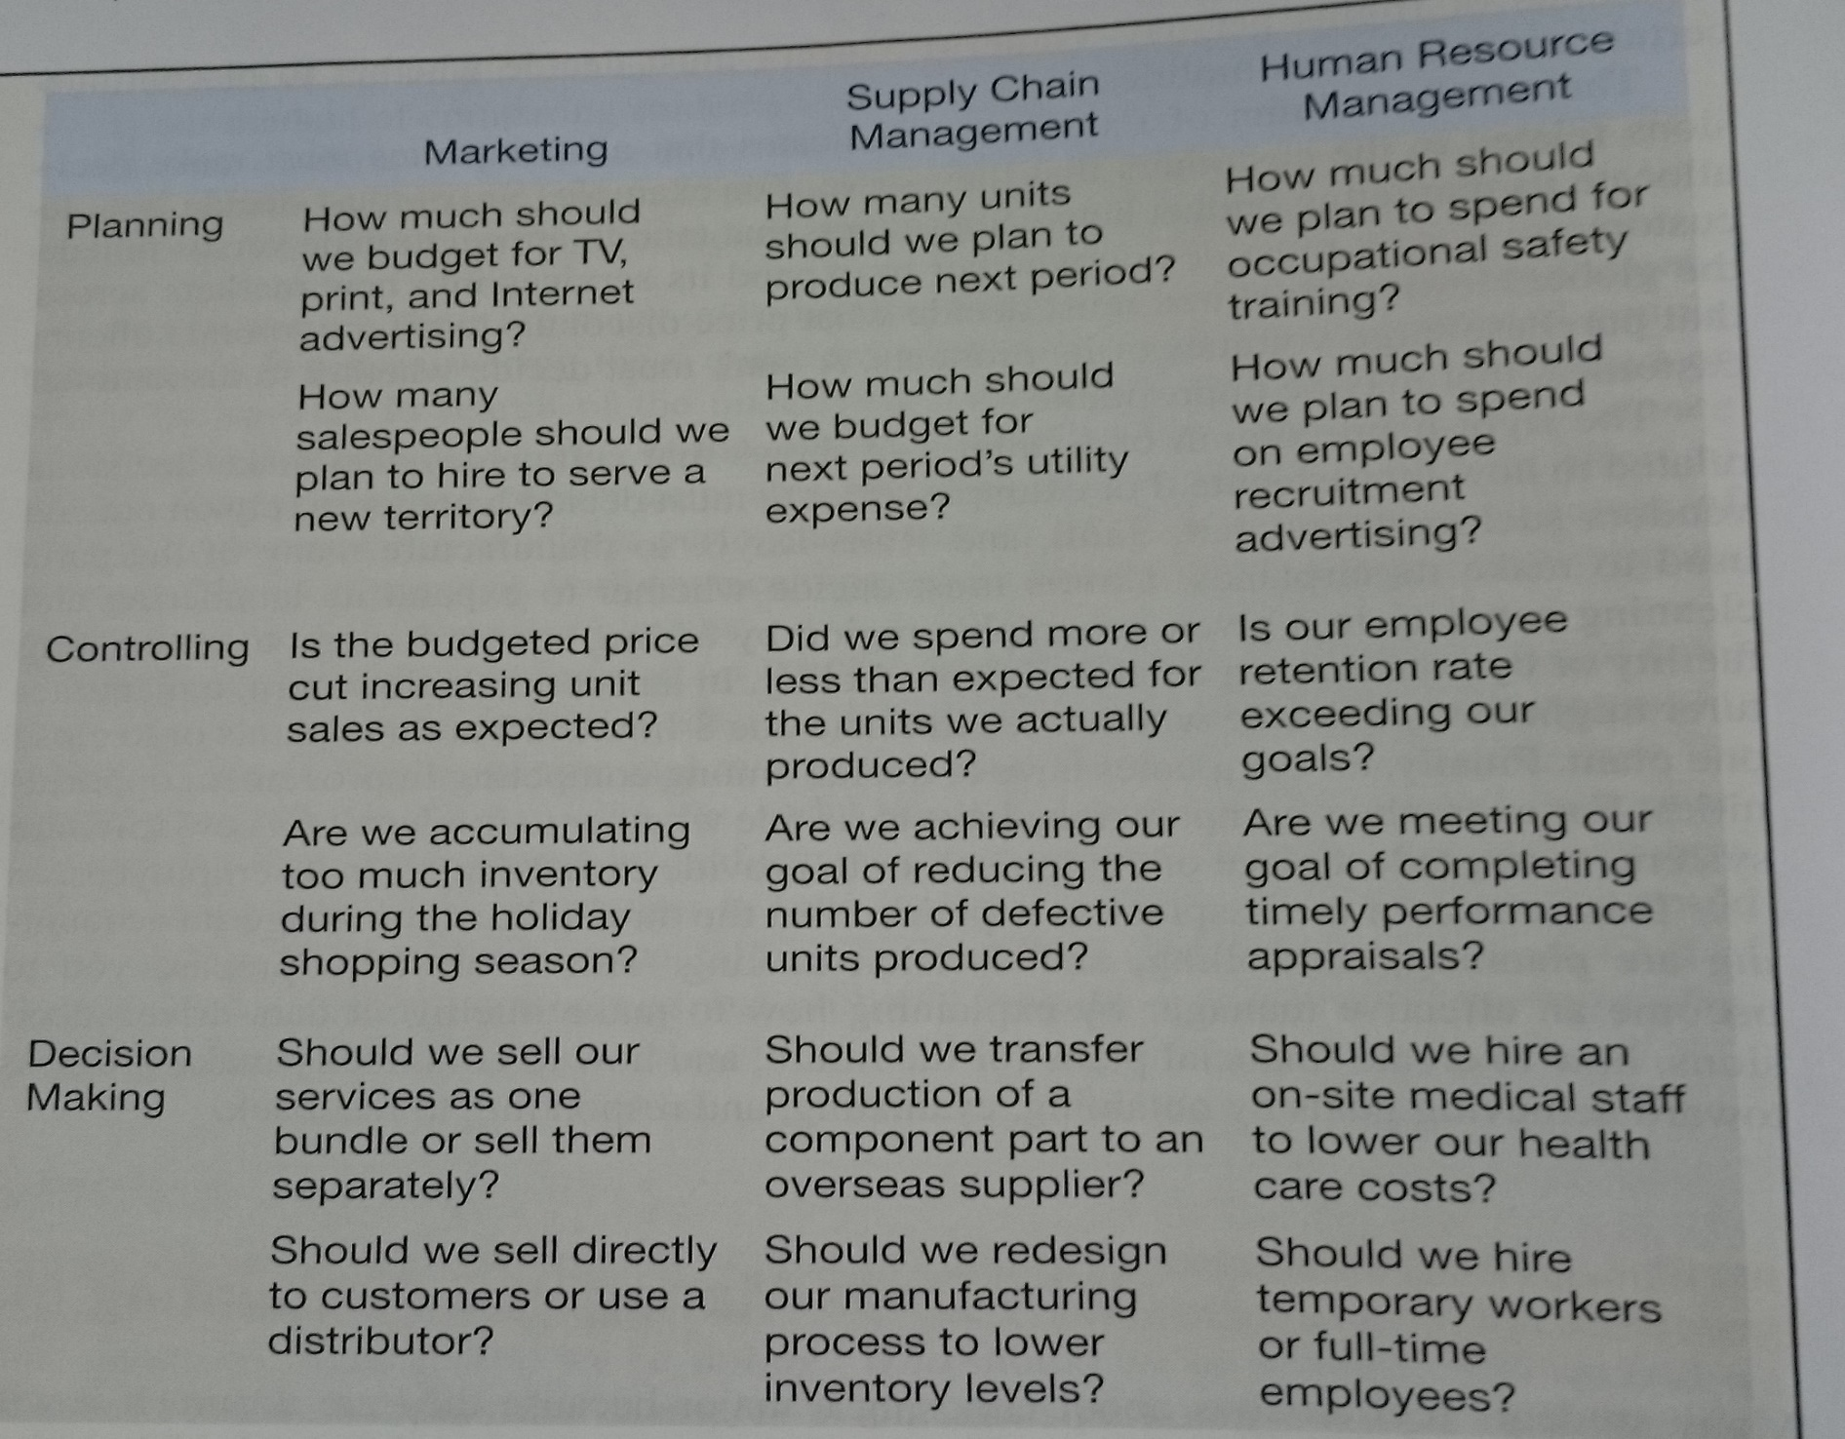
MANAGERIAL ACCOUNTING

Slide 12
MANAGERIAL ACCOUNTING
WHAT SHOULD WE BE SELLING?
What products and services should be the focus of our marketing efforts?
What new products and services should we offer?
What prices should we charge for our products and services?
What products and services should we discontinue?

Slide 13
MANAGERIAL ACCOUNTING
WHO SHOULD WE BE SERVING?
Who should be the focus of our marketing efforts?
Who should we start serving?
Who should pay price premiums or receive price discounts?
Who should we stop serving?

Slide 14
MANAGERIAL ACCOUNTING
HOW SHOULD WE EXECUTE?
How should we supply our parts and services?
How should we expand our capacity?
How should we reduce our capacity?
How should we improve our efficiency and effectiveness?

Slide 15
MANAGERIAL ACCOUNTING
A STRATEGIC MANAGEMENT PERSPECTIVE (1)
Companies do not succeed by sheer luck. They need to develop a strategy that defines how they intend to succeed in the Marketplace.
Strategy is a game plan that enables a company to attract customers by distinguishing itself from competitors.
The focal point of a company´s strategy should be its target customers.
The essence of strategy is customer value propositions

Slide 16
MANAGERIAL ACCOUNTING
A STRATEGIC MANAGEMENT PERSPECTIVE (2)
Customer value propositions tend to fall into three broad categories:
Customer intimacy
Operational excellence
Product leadership

Slide 17
MANAGERIAL ACCOUNTING
AN ENTERPRISE RISK MANAGEMENT PERSPECTIVE
Every strategy, plan and decision involves risks.
Enterprise risk management is a process used by a company to identify those risks and develop responses to them that enable it to be reasonably assured of meeting its goals.
Risks range from risks that relate to the weather to risks associated with computer hackers, complying with the law, employee theft and products harming customers.
In managerial accounting, companies use controls to reduce the risk that their plans will not be achieved.

Slide 18
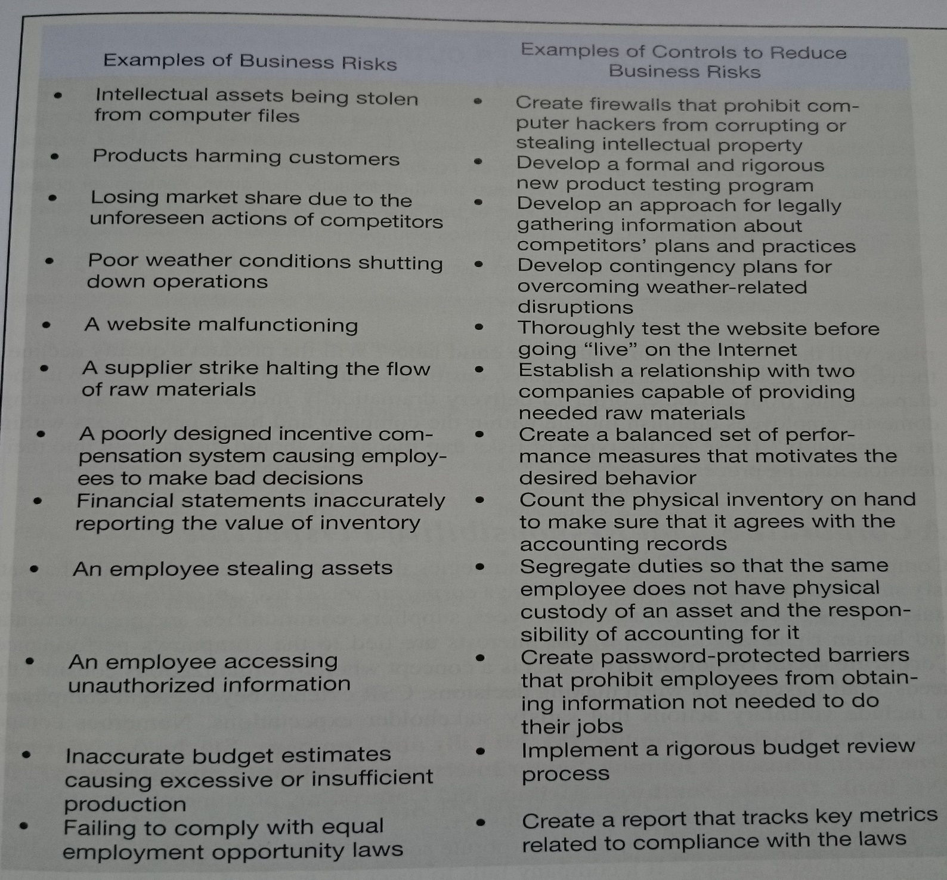
MANAGERIAL ACCOUNTING

Slide 19
MANAGERIAL ACCOUNTING
A CORPORATE SOCIAL RESPONSIBILITY PERSPECTIVE
Companies have a corporate social responsibility (CSR) to serve other stakeholders (such as customers, employees, suppliers)
Corporate social responsibility is a concept whereby organizations consider the needs of all stakeholders when making decisions.
Corporate social responsibility extends beyond legal compliance to include voluntary actions that satisfy stakeholder expectations.

Slide 20
MANAGERIAL ACCOUNTING
A PROCESS MANAGEMENT PERSPECTIVE (1)
Business processes serve the needs of a company´s most important stakeholders – it customers.
Business process is a series of steps that are followed in order to carry out some task in a business.
Value chain is often used to describe how an organization´s functional departments interact wit one another to form business processes.
A value chain consists of the major business functions that add value to a company´s products and services.
Managers need to understand the value chain to be effective in terms of planning, control and decision making.

Slide 21
MANAGERIAL ACCOUNTING
A PROCESS MANAGEMENT PERSPECTIVE (2)
Managers use a process management method known as lean thinking or what is called Lean Production.
Lean Production is a management approach that organizes resources such as people and machines around the flow of business processes and that only produces units in response to customer orders.
It is often called just-in-time production (JIT) – products are only manufactured in response to customer orders and they are completed just-in-time to be shipped to customers.

Slide 22
MANAGERIAL ACCOUNTING
A LEADERSHIP PERSPECTIVE (1)
An important role for organizational leaders is to unite the behaviors of their fellow employees around two commnon themes – pursuing strategic goals and making optimal decisions.
Leaders need to understand how intrinsic motivation, extrinsic incentives and cognitive bias influence human behavior.
Intrinsic Motivation
intrinsic motivation refers to motivation that comes from within us; stop for a moment and identify the greatest accomplishment of your life
a leader, who employees perceive as credible and respectful of their value to the organization, can increase the extent to which those employees are intrinsically motivated to pursue strategic goals

Slide 23
MANAGERIAL ACCOUNTING
A LEADERSHIP PERSPECTIVE (2)
Extrinsic incentives
many organizations use extrinsic incentives to highlight important goals and to motivate employees to achieve them
the bonus system motivates employees to attain the time reduction goal

Slide 24
MANAGERIAL ACCOUNTING
A LEADERSHIP PERSPECTIVE (3)
Cognitive Bias
leaders need to be aware that all people (including themselves) possess cognitive biases, or distorted thought processes, that can adversely affect planning, controlling, and decision making
while cognitive biases cannot be eliminated, effective leaders should take two steps to reduce their negative impacts - they should acknowledge their own susceptibility to cognitive bias and they should acknowledge the presence of cognitive bias in other and introduce techniques to minimize their adverse consequences

Slide 25
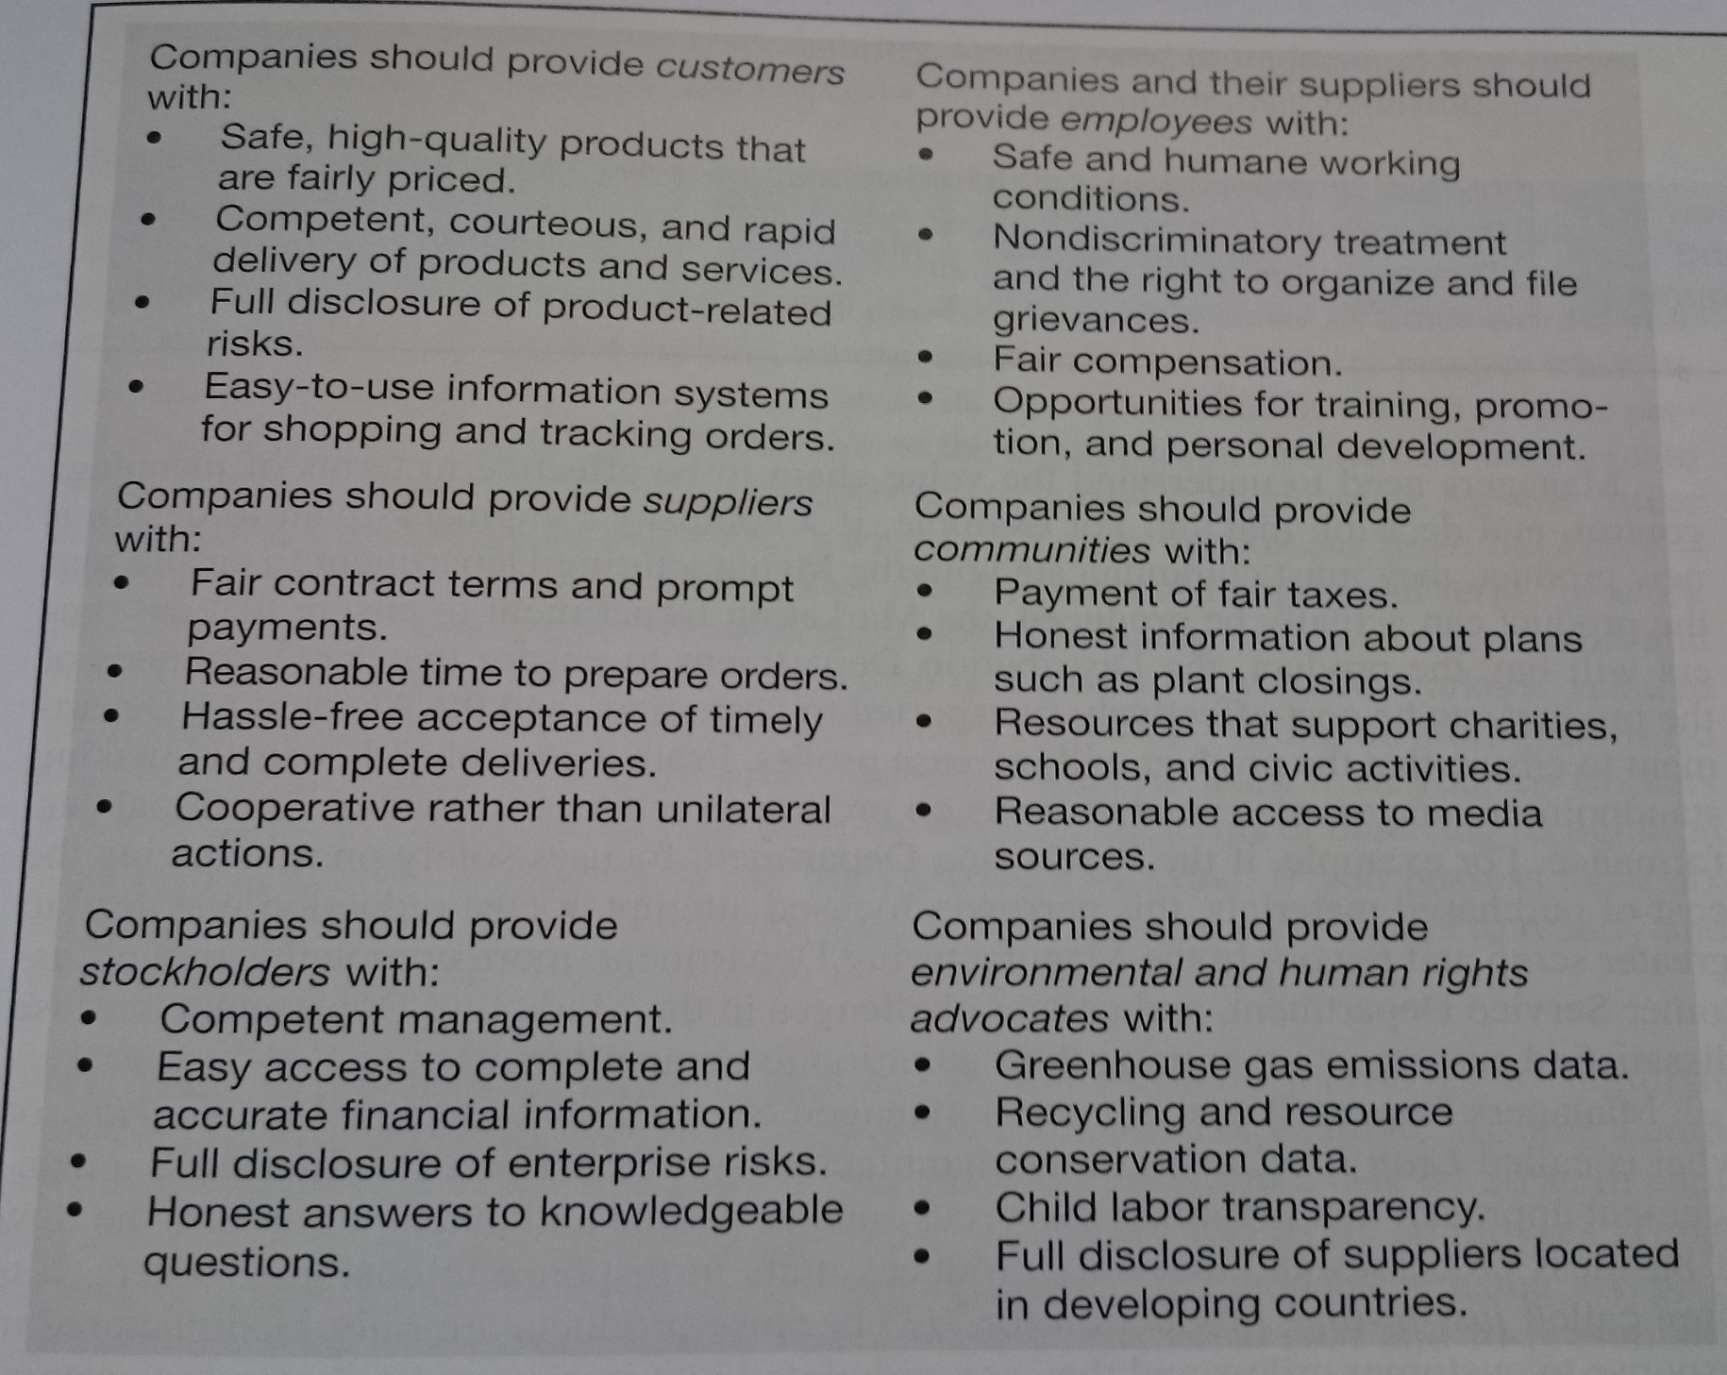
MANAGERIAL ACCOUNTING

Slide 26
Thank you for your attention.

