Slide 1
Master thesis seminar (1)
Final thesis (FT) roadmap, Seminar agenda, Topics, Documents and forms
Assoc. Prof. Dr. Roman Šperka, PhD
Head of Business economics and management program and department

Slide 2
Seminar agenda
2nd Seminar – What is FT?
3rd Seminar – Description of FT
Schedule
4th Seminar – FT template, presentation
Word template of FT
Communication with supervisor
Purpose of FT
1st Seminar – FT roadmap
Roadmap for February examination
Roadmap for June examination
Seminar agenda
Proofreading
Sample FT, FT topics
Revisions
Documents and forms on webpage
Presentation template for FT defence
Goals, methodology, methods, outputs
Plagiarism, citations
Library and e-resources
Content
IS SU explanation
Insertion into IS
Assoc. Prof. Šperka
October 4, 2022
Dr. Stoklasa
October 11, 2022
Assoc. Prof. Palečková
October 18, 2022
Dr. Stoklasa
November 8, 2022

Slide 3
Seminar agenda
6th Seminar – Research methods II
Analysing qualitative data
5th Seminar – Research methods I
Critically reviewing the literature
Statistical analysis of quantitative data
Writing convincing conclusions
Collecting primary data
Using secondary data
Presentation skills
Dr. Klepek
November 15, 2022
Dr. Klepek
November 22, 2022

Slide 4
Sample FT and topics
The impact of digital marketing on consumer behavior in the modern world (dr. Klepek)
Impact of green marketing on consumer behaviour(dr. Stoklasa)
Evaluation of economic situation of selected company (dr. Šeligová)
Sales promotion and satisfaction of dealers: A case of Havells India Ltd. (dr. Majerová)
VAT schemes for small business (dr. Sobotovičová)
The recommendation of marketing activities for Czech university to attract foreign students (Assoc. Prof. Šperka)
Evaluation of the company´s competitiveness (dr. Adámek)
Strategy for small and medium-sized enterprise (dr. Zapletalová)
Management of foreign exchange exposure of the selected company (dr. Šimáková)
Packing problem (Assoc. Prof. Bartl)
Marketing Strategy for Large Enterprise in International Markets(dr. Zapletalová)
The effect of exchange rate development on foreign direct investments in selected economy (dr. Šimáková)
Trade of small and medium enterprises and its support in the Czech Republic and India (dr. Majerová)
Social media and brand communication (dr. Klepek)
Integrated marketing communication (dr. Matušínská)
A project of a crowdfunding campaign (Assoc. Prof. Šebestová)

Slide 5
Final theses roadmap - examinations in June (for students who enrolled in September)
by March 31
Consult the topic of FT with teachers
Supervisor inserts topic into Tematikon
by May 31
Select the topic in Tematikon
Supervisor assigns the topic to the student
by November 30
by October 30
Consultation of description of FT
Matching of description with student
Student inserts description into IS
Department ensures signatures of supervisor and head of program
in January
Student receives credits for the Master Thesis Seminar course
by May 4
Student uploads digital FT into IS
June
State final examination
Defence of FT
Find supervisor
Further discussion might be required
1st year
2nd year
Recommended activity

Slide 6
Final theses roadmap - examinations in February (for students who enrolled in February)
by October 31
Consult the topic of FT with teachers
Supervisor inserts topic into Tematikon
by December 31
Select the topic in Tematikon
Supervisor assigns the topic to the student
in May
by March 31
Consultation of description of FT
Matching of description with student
Student inserts description into IS
Department ensures signatures of supervisor and head of program
in May
Student receives credits for the Master Thesis Seminar course
in December
Student uploads digital FT into IS
in February
State final examination
Defence of FT
Find supervisor
Further discussion might be required
1st year
2nd year
Recommended activity

Slide 7
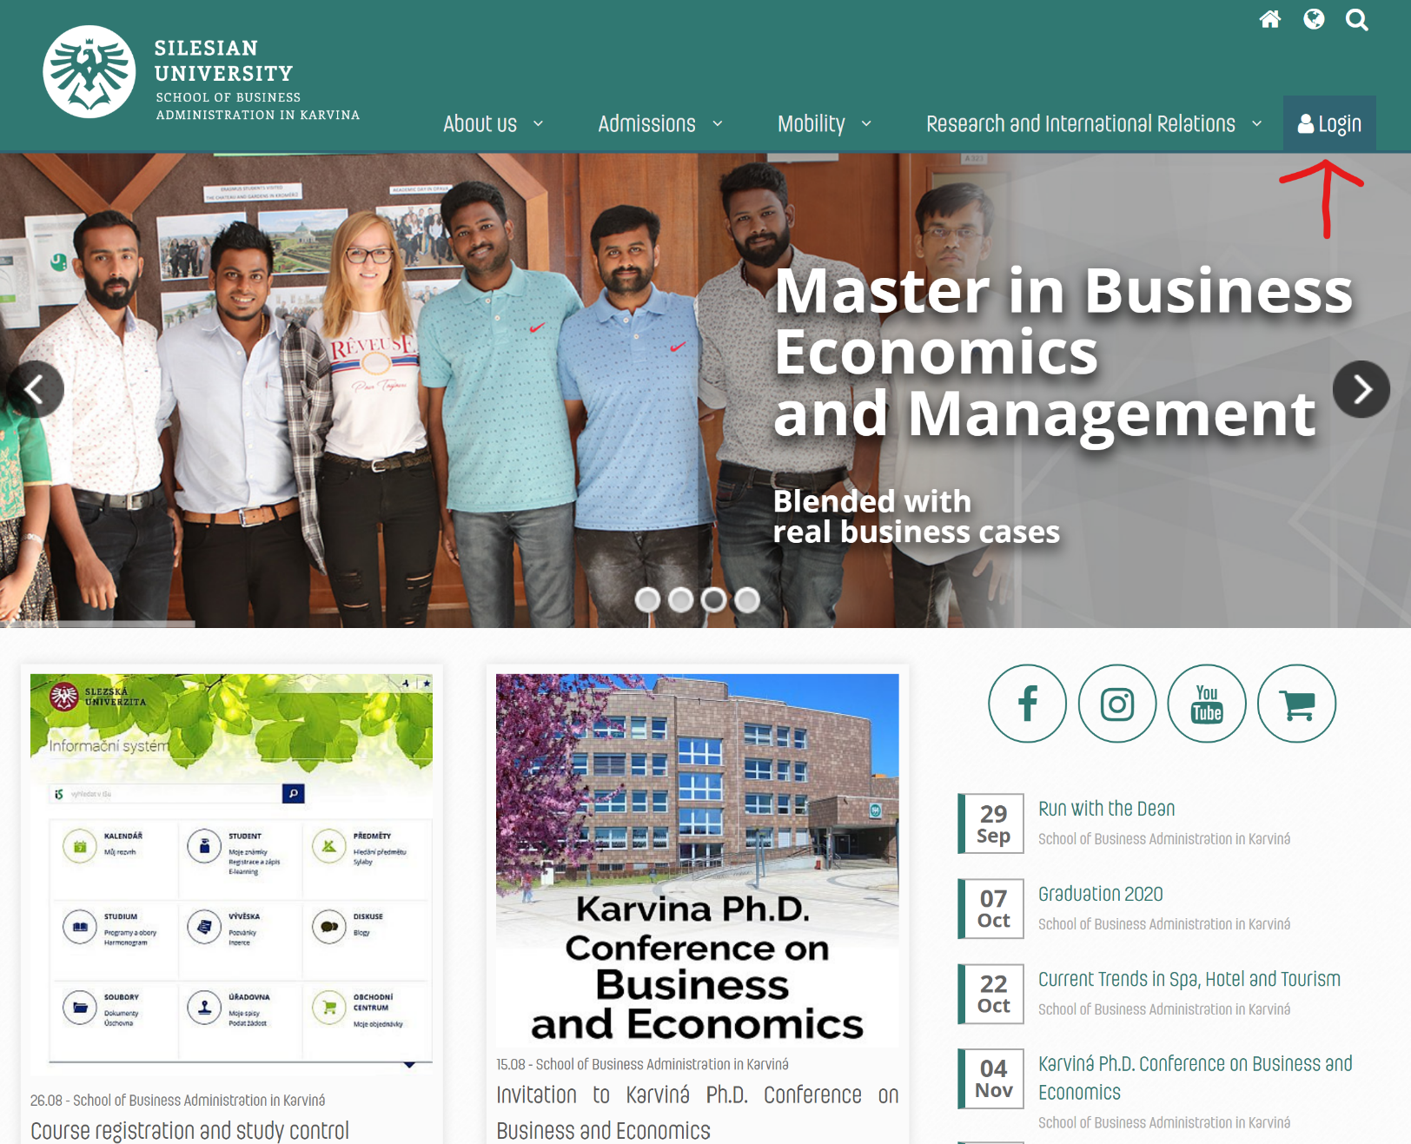
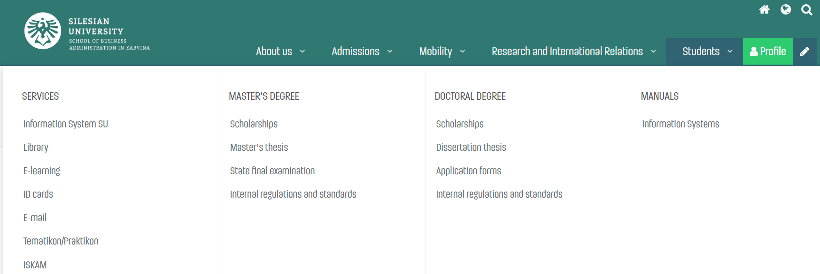
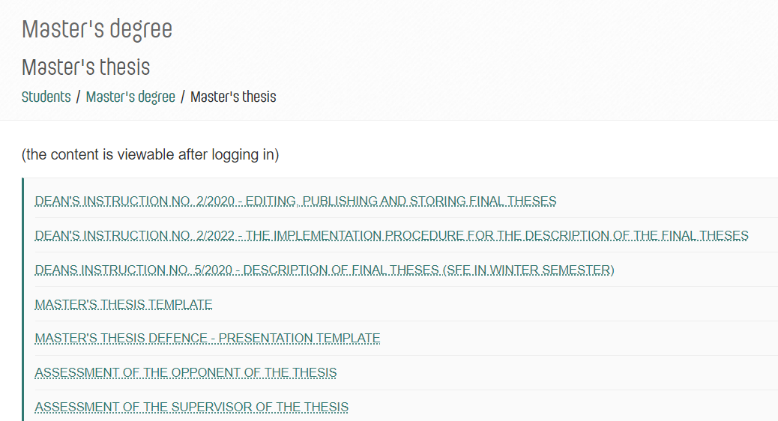
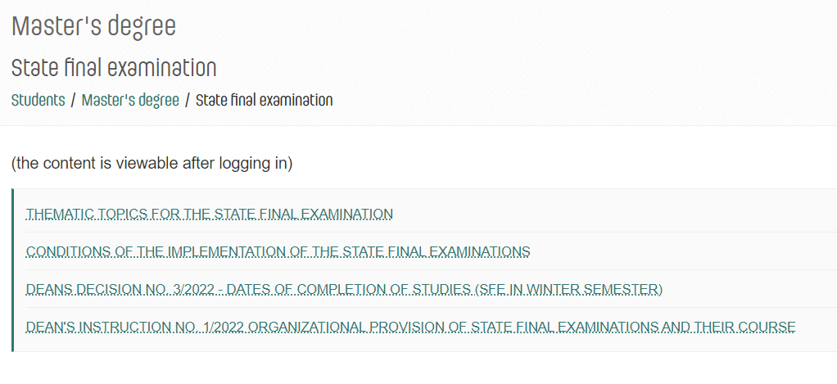
Documents, forms, templates, Tematikon

