Slide 1
Defining Project and Project Management
What is project management
Project management evolution
What is project and project types
Project Management

Slide 2
How the lecture will be conducted?
The lecture is divided into three blocks, where each block introduces an issue (1. What is a project and project management, Who is project manager and their role 2. Project management evolution 3. The main elements of a project, types of projects)
After each block there is a quiz for feedback on whether you have understood everything.
We use MS Teams, a shared whiteboard for your engagement and reactions. Also we are working with MS Project.
The class is supplemented with quizzes in vevox, the link is always in the presentation.

Slide 3
Contents
PART (20 min.)
What is project management
Who is project manager and their role
2. PART (20 min.)
Project management evolution
3. PART (40 min.)
What is a project
Types of projects
The main elements of a project

Slide 4
Learning objectives
On the end of this lecture you should be able to understand and explain:
What is a project and project management,
The main elements of a project,
The project types,
The main evolution stages of project management,
Who is project manager and their role.

Slide 5
Key readings
You can find support in the following sources:
Chapter 1. Overview
Kerzner, H. (2017). Project Management: A Systems Approach to Planning, Scheduling, and Controlling. Hoboken, New Jersey: John Wiley & Sons, Inc. ISBN 978-1-119-16535-4.
Chapter 1. An overview of project management
Haegney, J. (2016). Fundamentals of project management. AMACOM
Chapter 1 & 2 & 3
Grit, R. (2021). Project management : A practical approach. Taylor & Francis Group.

Slide 6
PART 1
Definition of a project management
The following would be an overview definition of project management:
Project management is the planning, organizing, directing, and controlling of company resources for a relatively short-term objective that has been established to complete specific goals and objectives.
Furthermore, project management utilizes the systems approach to management by having functional personnel (the vertical hierarchy) assigned to a specific project (the horizontal hierarchy).

Slide 7
Definition of a project management
Project management is designed to make better use of existing resources by getting work to flow horizontally as well as vertically within the company.
This approach does not really destroy the vertical, bureaucratic flow of work but simply requires that line organizations talk to one another horizontally so work will be accomplished more smoothly throughout the organization.
The vertical flow of work is still the responsibility of the line managers.
The horizontal flow of work is the responsibility of the project managers, and their primary effort is to communicate and coordinate activities horizontally between the line organizations.

Slide 8
Project management versus management
Project management is a simply management of change.
(Lester, 2021)
Management means running a functional business as a continuum or ‘business-as-usual’.
Notes:
Project management is not applicable to running a factory making sausage pies, but it will be the right system when there is a requirement to relocate the factory, build an extension, or produce a different product requiring new machinery, skills, staff training, and even marketing techniques.

Slide 9
The benefits of a project management
Identification of functional responsibilities to ensure that all activities are accounted for, regardless of personnel turnover
Minimizing the need for continuous reporting
Identification of time limits for scheduling
Identification of a methodology for trade-off analysis
Measurement of accomplishment against plans
Early identification of problems so that corrective action may follow
Improved estimating capability for future planning
Knowing when objectives cannot be met or will be exceeded

Slide 10
Some obstacles of a project management
Project complexity
Customer’s special requirements and scope changes
Organizational restructuring
Project risks
Changes in technology
Forward planning and pricing
Notes:
Unfortunately, the benefits cannot be achieved without overcoming obstacles such as:

Slide 11
Why projects fail?
Poor planning
Too optimistic planning
Failure to track progress
Starting an activity too late
Project members are not competent enough
The project is being sabotaged
project members have much ‘on their mind’
project workers aiming at too much perfection
Stakeholders are insufficiently involved
Little delays all add up
Late delivery of purchased materials
No provision for rectifying mistakes
Ignoring preliminary and finishing off activities
Calamities
Unclear objectives
Changes of definition
The changing world
Interest costs
Notes:
Chapter 3 pg. 83

Slide 12
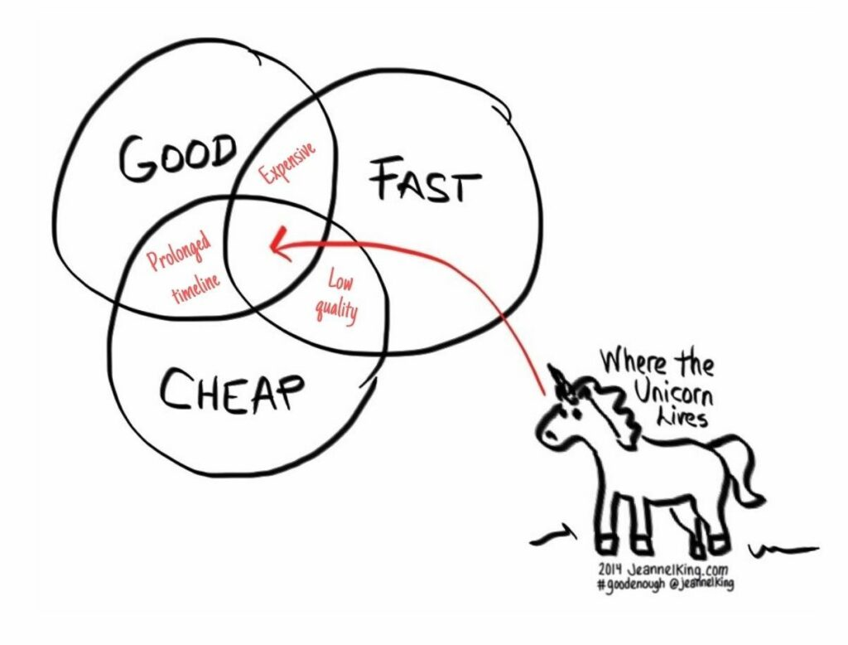
The success of the project
A successful project satisfies the sponsor, and it is project that meet following:
Has achieved its objectives (delivered the project result) and is of the desired quality,
Is concluded on time,
Has not cost more than was agreed on.

Slide 13
Project triangle
These criteria can be presented as triangle imperative also known as project triangle.
A pictorial representation of project management
The objective of the figure is to show that project management is designed to manage or control company Resources on a given activity, within time, within cost, and within performance.
Time, cost, and performance are the constraints on the project. If the project is to be accomplished for an outside customer, then the project has a fourth constraint: good customer relations.

Slide 14
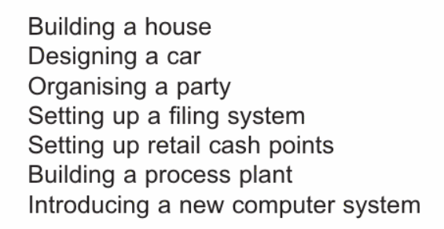
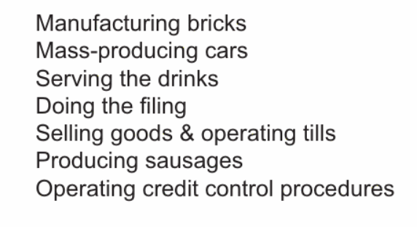
What type of operations are suitable for a project management?
Project organisation Functional/line organisation
Project management techniques are equally suitable for moving a house as for moving a government department!

Slide 15
Who is a project manager?
a project manager is the temporary boss of his project team.
to be an effective project manager, he or she requires a good number of competences *.
A competence is a combination of the knowledge, skills, attitude and behavior needed to be able to function well in a particular professional situation.
In addition to general management skills, a project manager must be able:
To work in a systematic and result-oriented fashion.
To be stress-resistant and have a good understanding of company policy.
Capabilities needed:
leadership abilities,
a result-oriented working style
abilities to negotiate, to formulate a project plan, to monitor quality, to manage finances etc.

Slide 16
Project manager versus manager
Project manager is proactive to change.
Line manager is reactive to change and does not like disruption.

Slide 17
Defining the project manager´s role
Project managers may have high responsibility, but very little authority. This lack of authority can force them to “negotiate” with upper-level management as well as functional management for control of company resources.
Although the project organisation is a specialized, task-oriented entity, it cannot exist apart from the traditional structure of the organization.
The project manager, therefore, must walk the fence between the two organizations. The term interface management is often used for this role, which can be described as managing relationships:
Within the project team
Between the project team and the functional organizations
Between the project team and senior management
Between the project team and the customer’s organization, whether an internal or external organization

Slide 18
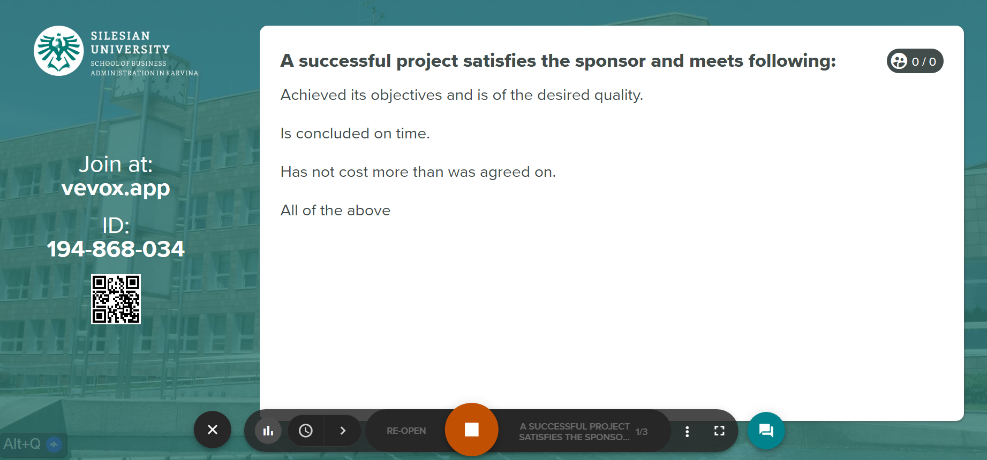
Vevox questions

Slide 19
PART 2
Project management evolution
What do you consider the greatest projects in humans’ history?

Slide 20
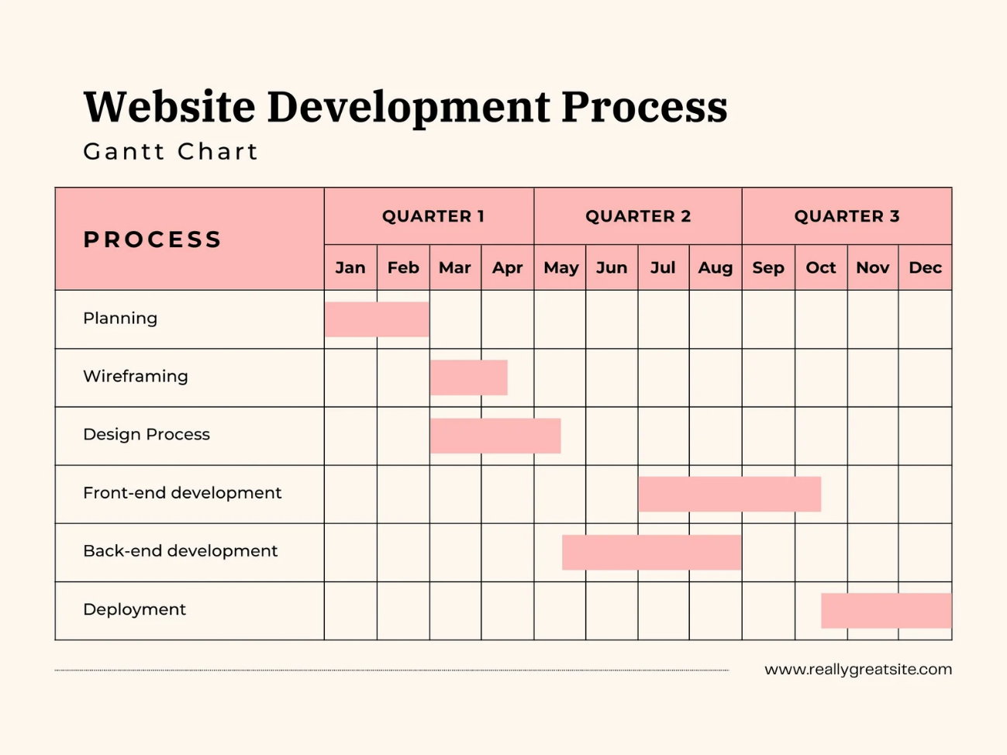
Project management evolution
Phase – informal method of managing projects (1917 - 1964)
1917 - Gantt chart developed,
Author is Henry Gantt,
it is scheduling diagram
used in project management today,

Slide 21
Project management evolution
Phase – informal method of managing projects (1917 - 1964)
1957 - The Critical Path Method (CPM) Invented by the Dupont Corporation
used to predict project duration by analysing which sequence of activities has the least amount of scheduling flexibility.

Slide 22
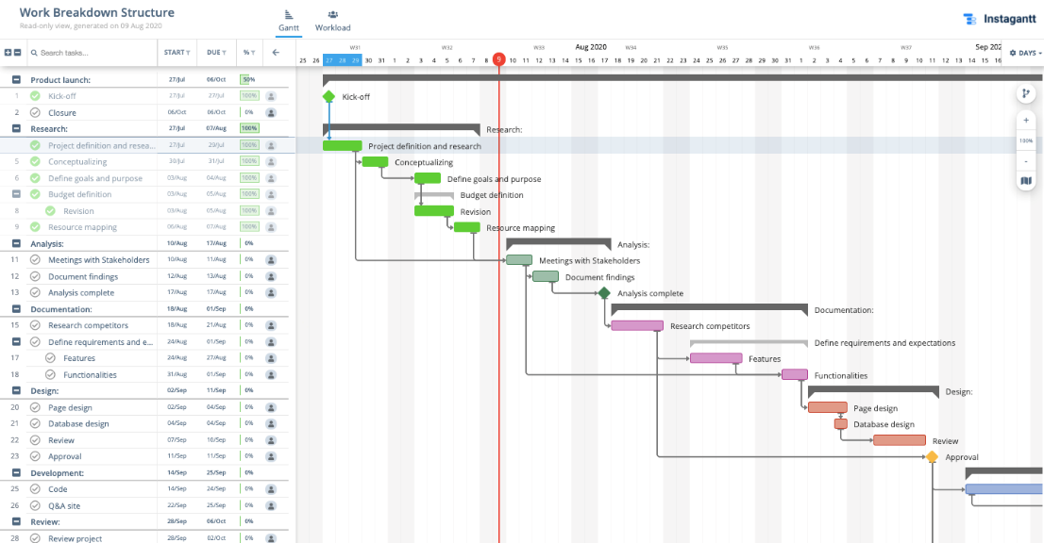
Project management evolution
Phase – informal method of managing projects (1917 - 1964)
1962 - United States Department of Defense Mandate the Work Breakdown Structure (WBS) Approach
hierarchical tree structure of tasks that need to be performed to
complete a project.
the most common and valuable
project management tool.

Slide 23
Project management evolution
2. Phase – project management (1965 – today)
1965 - The International Project Management Association (IPMA) Founded.
the world's first project management association, started in Vienna by a group as a forum for project managers to network and share information.

Slide 24
Project management evolution
2. Phase – project management (1965 – today)
1969 - Project Management Institute (PMI) Launched to Promote the Project Management Profession (USA)
non-profit professional organisation dedicated to advancing project management practice, science, and profession.
the publisher of 'A Guide to the Project Management Body of Knowledge (PMBOK)’ first published in 1987

Slide 25
Project management evolution
2. Phase – project management (1965 – today)
1989 - PRINCE Method Developed From PROMPTII
Published by the UK Government agency CCTA, PRojects IN Controlled Environments (PRINCE) became the UK standard for all government information systems projects.
1996 - PRINCE2 Published by CCTA

Slide 26
Project management evolution
2. Phase – project management (1965 – today)
1998 - PMBOK Becomes an ANSI Standard
The American National Standards Institute (ANSI) recognised PMBOK as a standard
2001 - The Agile Manifesto Written
the Manifesto for Agile Software Development to define the approach now known by the same name
2012 - ISO 21500:2012 Guidance on Project Management

Slide 27
Project management evolution
2. Phase – project management (1965 – today)
2012 - ISO 21500:2012 Guidance on Project Management
designed for any organisation. These include public, private or community groups and any project, regardless of complexity, size and duration.

Slide 28
Project management evolution
2. Phase – project management (1965 – today)
2017 - PRINCE2 Second Major Revision by AXELOS
2018 - PRINCE2 Agile
2021 - 7th Edition of PMBOK Guide Released
What will be next?

Slide 29
Project management evolution
What will be next?
The Challenges of globalisation:
Projects become larger, more complex and challenging to manage.
Teams are more diverse and spread across the world.
Cost pressures push work offshore to low-cost countries, which itself presents several issues.
The world is changing, and project management will need to change with it -> HOW?
Possibility of new techniques and better practices will arise.

Slide 30
Vevox questions

Slide 31
PART 3
What is a project?
“A unique process, consisting of a set of co-ordinated and controlled activities with start and finish dates, undertaken to achieve an objective conforming to specific requirements, including constraints of a time, cost and resources.” (Lester, 2021)

Slide 32
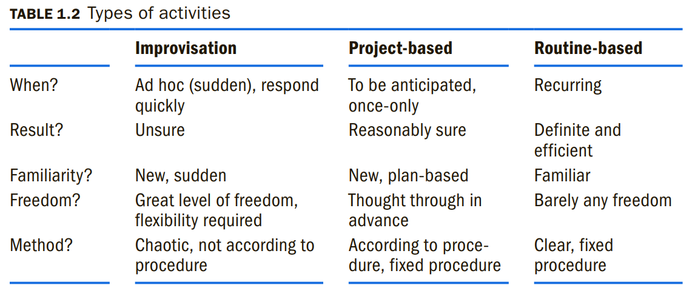
Type of activities taking place in the organisation

Slide 33
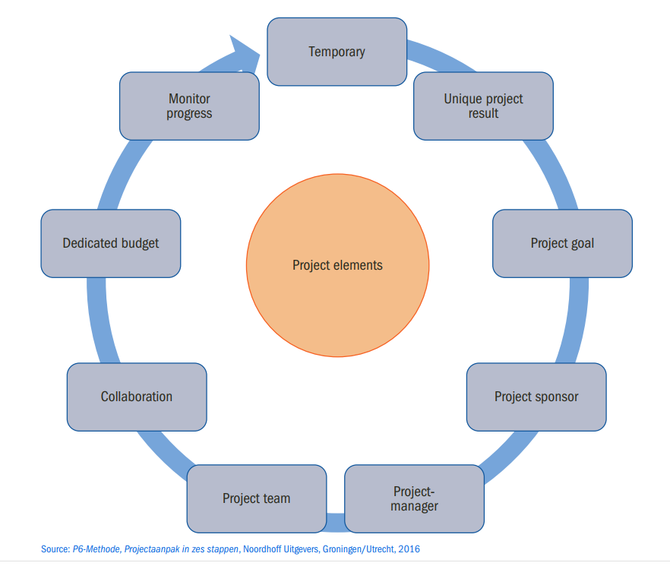
Project
elements

Slide 34
The most important elements of a project:
specific objective to be completed within certain specifications
defined start and end dates
funding limits (if applicable)
Consume human and nonhuman resources (i.e., money, people, equipment)
multifunctional (i.e., cut across several functional lines)

Slide 35
What does the project deliver?
A unique product that can be either a component of another item, an enhancement or correction to an item, or a new end item in itself (e.g., the correction of a defect in an end item);
A unique service or a capability to perform a service (e.g., a business function that supports production or distribution);
A unique result, such as an outcome or document (e.g., a research project that develops knowledge that can be used to determine whether a trend exists or a new process will benefit society); and
A unique combination of one or more products, services, or results (e.g., a software application, its associated documentation, and help desk services).

Slide 36
Temporary view of a project
Temporary endeavour a project has a definite beginning and end.
The end of the project is reached when one or more of the following is true:
The project’s objectives have been achieved;
The objectives will not or cannot be met;
Funding is exhausted or no longer available for allocation to the project;
The need for the project no longer exists (e.g., the customer no longer wants the project completed, a change in strategy or priority ends the project, the organizational management provides direction to end the project);
The human or physical resources are no longer available; or
The project is terminated for legal cause or convenience

Slide 37
How long does the project takes?
What is meant by a “relatively” short-term project?
Not all industries have the same definition for a short-term project.
In engineering, the project might be for six months to two years; in construction, three to five years; in nuclear components, ten years; and in insurance, two weeks.
Long-term projects, which consume resources full-time, are usually set up as a separate division (if large enough) or simply as a line organization.

Slide 38
Types of project
Technical projects
Social projects
Commercial projects
Mixed projects
Events
Other ways how to categorize projects are according to content (internal sponsor vs external sponsor), or providing a service (course, event) or product (building, bridge).

Slide 39
Types of project
Technical projects
aim is to effect some change in technology or to come up with a new product.
Usually easy to plan.
Also known as ‘hard’ projects.
End result is obvious.
Examples: construction of a building, a bridge, a road, a pipeline, a railway line

Slide 40
Types of project
Social projects
Outcome is not that obvious.
The aim is to change the corporate culture or organisational structure of a company.
They deal with the way people work together.
Known as ‘soft’ projects.
More difficult to execute as people tend to resist to change
Examples: reorganisation of a firm, adaptation of work procedures.

Slide 41
Types of project
Commercial projects
The goal is to earn money.
Examples: conducting marketing research, developing a new product or introducing a new product on the market.

Slide 42
Types of project
Mixed projects
combine some aspects of the both technical and social projects.
Example: the design, programming, and installation of an extensive computer program is an example of a mixed project.
complicated since the project team members come from variety of areas of expertise and do not always use the ‘same language’.

Slide 43
Types of project
Events
special kind of projects.
the end result only appears at a certain point in time.
Example: a computer fair, pop festival, car show.

Slide 44
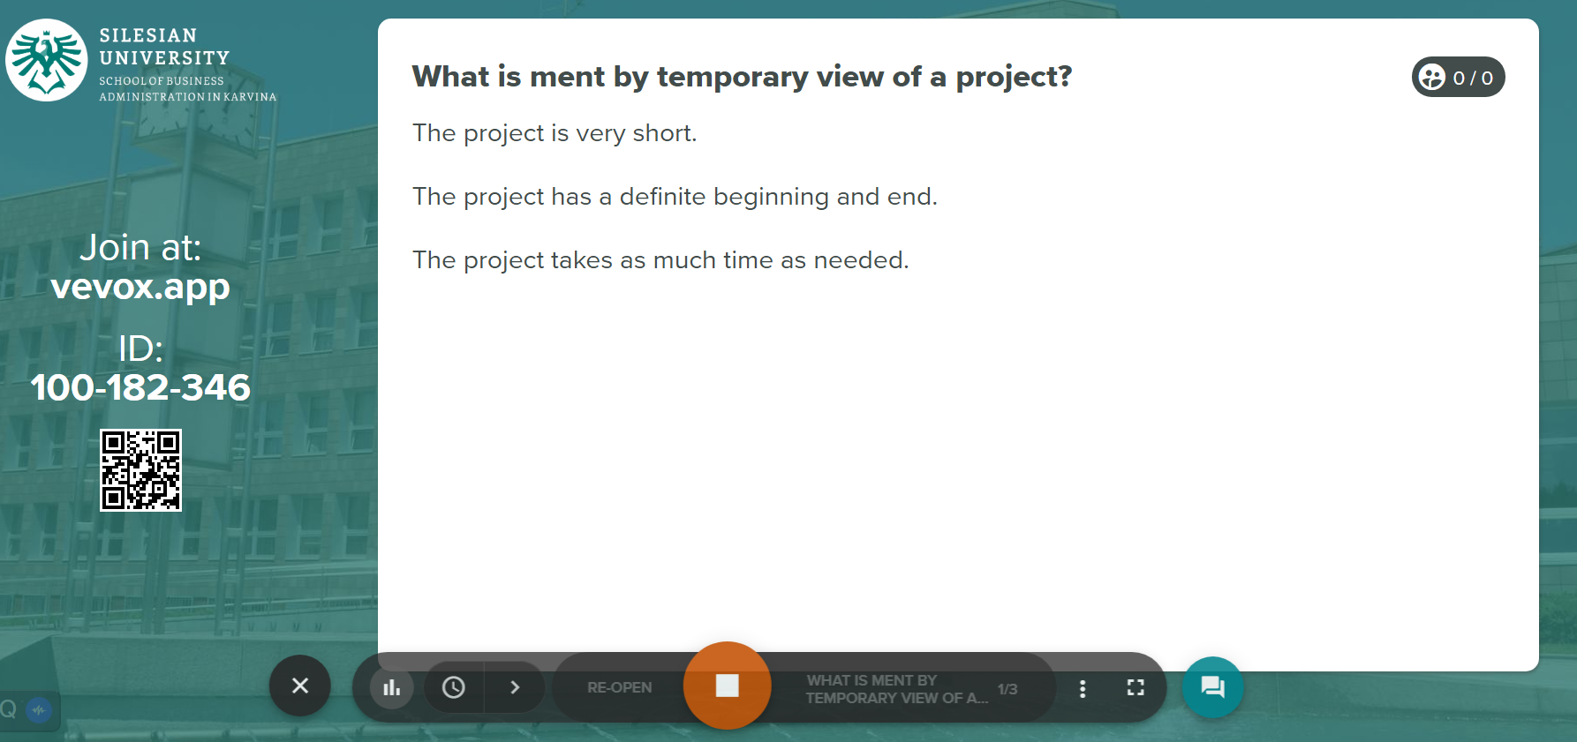
Vevox questions

Slide 45
References
Grit, R. (2021). Project management : A practical approach. Taylor & Francis Group.
Haegney, J. (2016). Fundamentals of project management. AMACOM
Kerzner, H. (2017). Project Management: A Systems Approach to Planning, Scheduling, and Controlling. Hoboken, New Jersey: John Wiley & Sons, Inc. ISBN 978-1-119-16535-4.
https://www.projectsmart.co.uk/history-of-project-management/brief-history-of-project-management.php

