Slide 1
Logical Framework of Your Project
Point 1.6 of the seminar work template
Project Management

Slide 2
Content
PART (10-20 min.)
Feedback on sections 1.1 to 1.5, check if the group completed all of the sections from previous seminar (1.1 Project name, 1.2 Default conditions, 1.3 Project goals, 1.4 Outpus, result, benefits of the project, 1.5 Organizational structure of the project) (10 - 20mis according to the size of the class)
2. PART (60 min.)
Working in project teams on the Logical Framework Matrix - horizontal and vertical logic in the matrix (achieving the goal, dividing the project into parts, identification of outputs) (60mins)
3. PART (5 min.)
Vevox quiz (5mins)
There will be feedback as needed during the time of the groups working on each section of their project and according to the needs of each group/students)

Slide 3
Seminar Outline
The seminar will be delivered through MS Team - sharing all tutor's material for the seminar
Main communication with remote students will be through MS Teams
Using whiteboard for working as a class together
Using MS Teams breakout rooms and whiteboard for team work on projects. The tutor will visit each breakout room for check up and for feedback during the group work
Using Vevox for recap
Any questions and discussions will also be carried out through MS Teams

Slide 4
Learning and practice objectives
On the end of this seminar, you should be able to:
Answer what are we trying to accomplish and why.
Know how to measure the success.
Identify what other conditions must exist.
Identify how do we get there.

Slide 5
Feedback, answering any questions, and discussion on sections 1.1 to 1.5

Slide 6
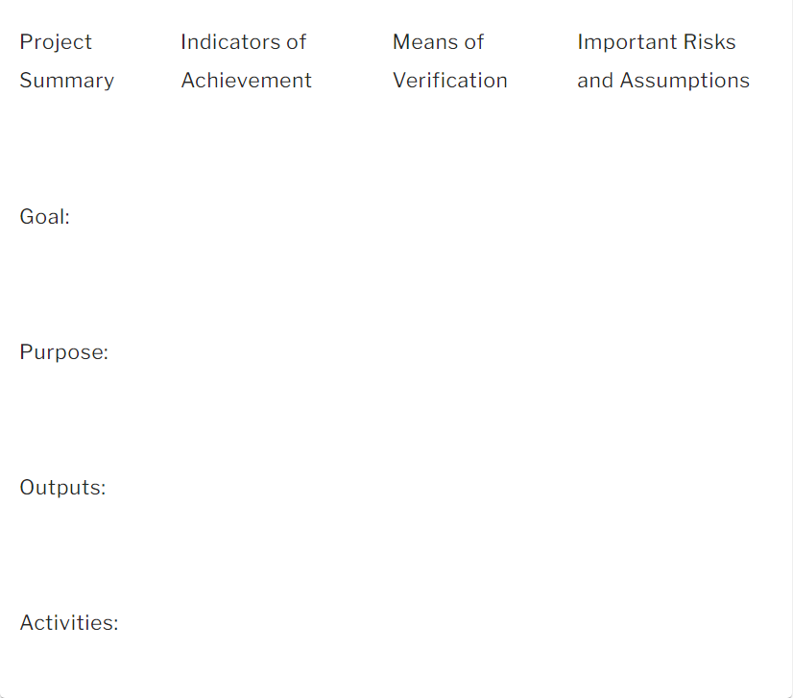
Working in project teams on the Logical Framework Matrix
What assumptions underlie the structure of our project and what is the risk they will not prevail?
How will we know we've been successful?
How will we check our reported results?
What results do we expect?
Why are we doing this?
What are the deliverables?
What will we do to deliver the outputs?

Slide 7
Vevox questions

