Slide 1

Financial analysis and Economic Value Added
Ing. Žaneta Rylková, Ph.D.
Managerial Economics

Slide 2

Outline of the lecture
Financial Analysis
  Explaining purpose and type
  Distinguishing indicators of performance
  Calculating ratios
  Interpreting the scores
Economic Value Added
  Calculating the indicator

Slide 3
Finantial analysis
Vertical analysis – this method compares several items to one certain item in the same accounting period, for example, operating expenses versus sales or cash versus total assets.
Horizontal analysis – the method compares the absolute dollar amounts of, or percentage difference in, certain specific items of financial statement over a period of time so as to determine the trend in spending.
Ratio analysis – normal ratios are mathematical relationships between one quantity and another. Financial ratios are financial analysis comparisons in which certain financial statement items are divided by one another to reveal their logical inter-relationships.

Slide 4
Finantial analysis
Two groups of financial analysis users are:
  Internal users such as company managers and staff whose personal fortunes are closely tied with the company´s present and future well-being. In many cases, they are also the company stockholders.
  External users, primarily investors and creditors, but also suppliers and customers, who all hope for various revenues and simultaneously face certain risks.

Slide 5
Finantial analysis
Standard of judgement: the main advantage of a solid analysis is its value for well-based forecasting and for the identification of deficiencies which are to be corrected. The usual standards by which financial performances are judged are:
  Rule-of-thumb measures: most of the „golden rules“ in this category are closely related to ratios. What they all have in common, however, is that these rules have no universal application and other relevant details also have to be carefully examined.
  Past performance: records of past achievements have good information value, particularly if they cover a longer period of time, but it is also true that a successful performance in the past is no guarantee of future success if conditions change.
  Industry norms tell us about the performances of other companies working in the same industry and, particularly, their average performance may serve as a good basis for comparisons.

Slide 6
Finantial analysis
Financial standing – the financial position of a firm in business.
Industry norms – a level of achievement prevailing in an industry.
Rule-of-thumb – any practical method that can be relied on for an acceptable result.

Slide 7
Distinguishing indicators of performance
Developments in diverse areas of the company and business are measured mostly by statistic instruments called indicators. They are commonly understood to be mathematical constructs which are conveniently used to measure past performances or current conditions, as well as to forecast trends.
Indicators are of various types:
  Common general economic indicators are, for example, the unemployment rate, new housing starts and consumer price index (CPI)
  Key performance indicators (KPIs) are another large group of indicators which companies use to evaluate how they perform vis-a-vis their targeted values.

Slide 8
Key Performance Indicators
Should only monitor those activities that are vital for the firm´s core business and do so in all the departments whose work is wholly or partly of such nature. Experts suggest that the Pareto principle should also be applied to the KPIs: in order not to be overhelmed by details, measure the 20 % of activities that really do make a difference.
The KPIs can involve, for example:
  Marketing – cost per lead, total leads, new customers
  Sales – lead conversion rate, average sales value, total order value paid
  Operations – output value/hour, returns, order backlog
  Finance – actual versus budget, profitability, debtor book

Slide 9
Key Performance Indicators
In business language, indicators are often combined with adjectives specifying their nature or objective, such as directional or actionable indicators. There are also financial indicators, used in performance measurement, which are a subcategory of quantitative indicators reffering to countable facts and expressed in numbers.

Slide 10
Key Performance Indicators
Actionable indicator – indicators with narrow and more explicit definitions (e.g. Audit delays in months) showing if an organization is able to control changes or is susceptible to extraneous influences.
Directional indicator – specifies upward or downward movements, i.e. whether an organization is getting better or worse.
Lead (also: trade lead) – a piece of useful information, particulary one indicating a business opportunity.
Lead conversion – number or percentage of leads turned into contracts.
Backlog – a quantity of unfinished business that has accumulated over a period of time.

Slide 11
Calculating ratios
Most ratios are calculated from information provided by the company´s financial statements, they are used to analyze the company´s finances and are categorized according to the various financial aspects of a company´s operations. The average figures, whenever available, should be given preference as they are not so much influenced by seasonal factors.

Slide 12
Calculating ratios
While ratios generally have no maning by themselves, they are important in allowing comparisons with other subjects, industries and time periods against which they are benchmarked in areas such as liquidity or profitability, etc.
Benchmark – a standard against which something can be measured or assessed. To measure against a standard (e.g. An industry norm).
Finances – the money at the disposal of a person or organization.

Slide 13
Financial ratios
Liquidity
Debt
Profitability
Efficiency
Market

Slide 14
Financial ratios
Liquidity ratios demonstrate a company´s ability to pay its current obligations. In other words, they relate to the availability of cash and other assets to cover accounts payable, short-term debt, and other liabilities.
Current ratio = current assets – current liabilities
Acid test ratio = current assets – inventory/current liabilities
„current“ is usually defined as within one year. The ratio should be at least 2:1. a lower current ratio means that the company may not be able to pay its bills on time, while a higher ratio means that the company has money in cash or safe investments that could be put to better use in the business.

Slide 15
Financial ratios
Debt (also called leverage) ratios look at the extent that a company has depended upon borrowing to finance its operations. Most leverage ratios compare assets or net worth with liabilities. A high leverage ratio may increase a company´s exposure to risk and business downturns, but along with this higer risk also comes the potential for higher return.
  Debt-to-equity ratio = total debt/total owners´equity
  In general, debt should be between 50 and 80 percent of equity.
  Debt-to-assets ratio = total debt/total assets
  This ratio measures the portion of a company´s capital that is provided by borrowing. A debt ratio greater than 1.0 means the company has negative net worth, and is technically bankrupt.
  Interest coverage ratio = EBIT/annual interest costs
  The ratio indicates how comfortably the company can handle its interest payments. In general, a higher interest coverage ratio means that the firm is able to take on additional debt.
Leverage ratios show the extent of external financing and are based on total debt, i.e. short-term debt (loans and due payments) plus long-term debt (bonds and leases).

Slide 16
Financial ratios
Profitability (also called return on investment) ratios provide information about the management´s performance in using the firm´s resources (assets) and control of its expenses to generate an acceptable rate of return.
Gross profitability (profit margin) = gross profit/sales *100
The ratio measures the margin on sales the company is achieving. Strong gross profitability combined with weak net profitability may indicate a problem with indirect operating expenses or non-operating items, such as interest expense.
Net profitability (profit margin) = profit after taxes/sales * 100
The ratio measures the overlall profitability of the company and shows the effectiveness of management.
Return on assets (ROA) = profit after taxes/total assets
The ratio indicates how effectively the company is deploying its assets.

Slide 17
Financial ratios
Return on investment (ROI) = profit after taxes/equity
The indicator shows how wll the company is utilizing its equity investment. Depending on circumstances, the equity can be the owners´equity or the shareholders´equity. Companies usually need at least 10-14 percent ROI in order to fund future growth.
Earnings per common share (EPS) = (profit after taxes – preferred dividend)/Value of common shares outstanding
The ration gives the company´s profitson a per share basis. It can be helpful in further comparison to the market price or the stock.

Slide 18
Financial ratios
Efficiency (also called asset turnover) ratios can show how quickly the company is collecting money for its credit sales or how many times inventory turns over in a given period. This information can help management decide whether the company´s credit terms are appropriate and whether its purchasing efforts are handled in an efficinet manner.

Slide 19
Financial ratios
Inventory turnover = costs of goods sold/average inventory
The ratio shows efficiently the company is managing its production, warehousing, and product distribution, considering its volume of sales. A regular ratio should be over six or seven time per year. Extremely high inventory turnover may indicate a narrow selection and possibly lost sales. A low inventory turnover rate, on the other hand, means that the company is paying to keep a large inventory, and may be overstocking or carrying obsolete items.
Inventory to assets ratio = inventory/total assets
The indicator shows the portion of assets tied up in inventory. Generally, a lower ratio is considered better.
Inventory holding period = 365/annual inventory turnover
It calculates the number of days, on average, that elapse between finished goods production and sale of product.
Accounts receivable turnover = net(credit) sales/average accounts receivable
The ratio gives a measure of how quickly credit sales are turned into cash.
Collection period = 365/accounts receivable turnover
This ratio measures the average number of days the company´s receivable are outstanding, between the date of credit sale and collection of cash.

Slide 20
Financial ratios
Market (also called value) ratio relate the stock price as the observable market value to book values obtained from the firm´s financial statements. They intend to show the value of the company´s stock. Their basic component is the Current Market Price per Share.

Slide 21
Financial ratios
Price-to-earnings (P/E) ratio = current market price per share/after-tax earnings per share (EPS)
Earnings per share are calculated by dividing net income by the number of shares outstanding. The ratio indicates how much inventors are willing to pay per dollar of current earnings. Companies with high P/E ratios (over 17) are more likely to be considered „risky“ investments than those with low P/E ratios, since a high P/E ratio signifies high expectations. EPS is usually from the last four quarters (trailing P/E), but sometimes it can be taken from the estimates of earnings expected in the next foru quarters (projected or forward P/E). Try to find out the P/E values of some popular stocks.
Market-to-book ratio = current market price per share/book value per share
Book value per share is calculated by dividing total owners´equity by the number of shares outsanding. The ratio indicates management´s success in creating value for stockholders.
Dividend yield = annual dividends per share/current market price share

Slide 22
Financial ratios
Return – financial term for profit made on an investment
Leverage – debt financing which utilizes external sources
Yield – a part of a return on investment coming from the receipt of interest or dividends.
Collection – a sum of money paid by a debtor.
Inventory – the term in American English, equivalent to „stock“ in British English, considered as an asset.

Slide 23
Interpreting the scores
Many organizations post various suggestions and guides on their websites how to perepare meaningful analyses identifying roads towards the company´s financial health.
The whole range of financial areas can, in fact, be analyzed: budgets, costs, revenues, expenses, cash flow, as well as invoicing, etc.
Reports based on financial analyses are capable of assessingthe firm´s solvency, liquidity, stability and profitability. The main sources of data for the analyses are financial statements, particularly the balance sheet and the profit and loss account.

Slide 24
Interpreting the scores
The scores of financial analyses can also be represented in a graphic form. For this purpose, a form of vertical analysis uses various financial statement items as percentages of an iterm chosen as a benchmark and compares their relative values over different time periods. This measurement tool is called the common size analysis. For example, for an income statement, the benchmark is sales and each item in that particular statement is restarted as a percentage of sales. The same technique is applied to total assets in the balance sheet.

Slide 25
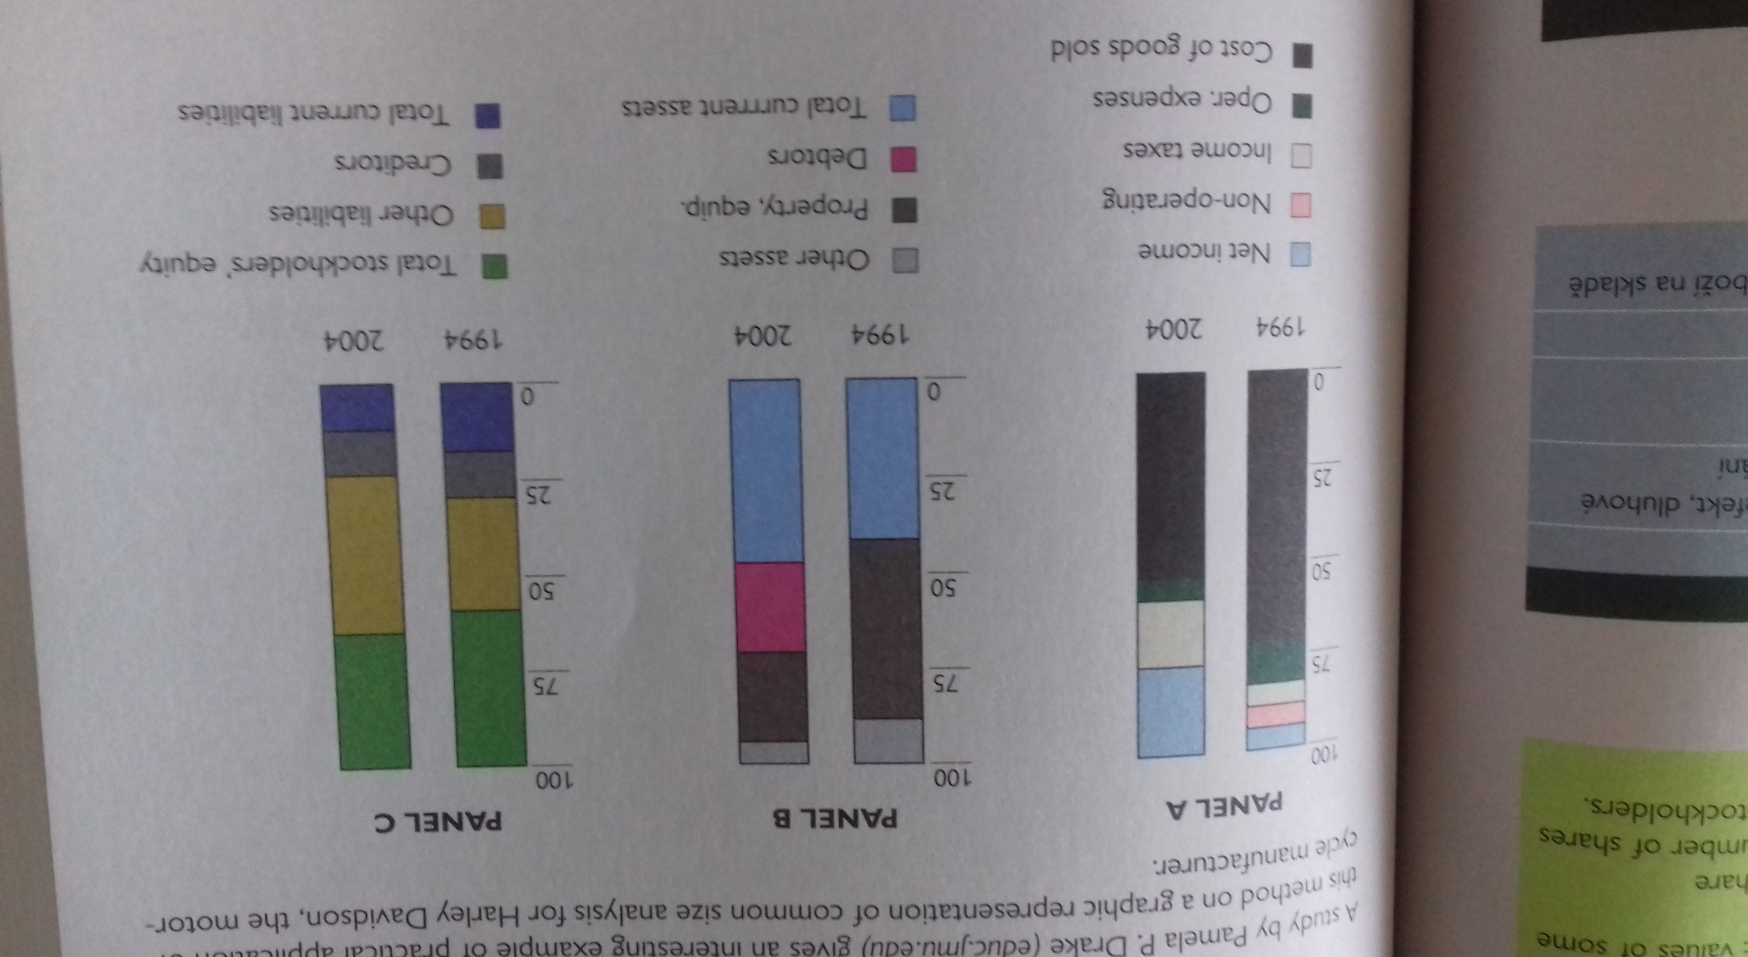
Interpreting the scores
A study by Pamela P. Drake (educ.jmu.edu) gives an interesting example of practical application of this method on a graphic representation of common size analysis for Harley Davidson, the motorcycle manufacturer.

Slide 26
Interpreting the scores
Conclusions:
According to Panel A, based on the income statement, profitability (net income) increased, while the cost of goods sold declined. The records of business operations revealed the cause as a shift from the sale of motorcycles to a change in financing.
The shift is also obvious in Panel B, based on figures from the balance sheet, which clearly shows the change in the asset composition over time. Trade receivables (BR Debtors) have become increasingly important as a source of funds.
Panel C, which is the representation of the company´s liabilities and equity, indicates that the capital structure (i.e. how the company chooses to finance its business) was rather stable over the whole time.

Slide 27
Basic Financial Analysis (Abridged article) Prof. Harvey B. Lermack
Step 1: Acquire the company´s financial statement for at least 3 to 5 years.
Step 2: Quickly scan all of the statements to look for large movements in specific items form one year to the next. Did revenues have a big jump, or a big fall, from one particular year to the next? Did total or fixed assets grow or fall? Did the company purchase a new division, or sell off part of its operations, that year?
Step 3: Review the notes accompaning the financial statements for additional information that may be significant to your analysis.
Step 4: Examine the balance sheet. Look for large changes in the overal components of the company´s assets, liabilities or equity.

Slide 28
Basic Financial Analysis (Abridged article) Prof. Harvey B. Lermack
Step 5: Examine the income statement. Look for trends overtime. Calculate and graph the growth of the important entries over the past several years in sales and net profit.
Step 6: Examine the shareholder´s equity statement.
Step 7: Examine the cash flow statement
Step 8: Calculate financial ratios in each of the main categories, for each year. Graph the ratios over time, to find the trends in the ratios from year to year.
Step 9: Obtain data for the company´s key competitors, and data about the industry. Compare the ratios for the competitors and the industry to the company being studied.

Slide 29
Basic Financial Analysis (Abridged article) Prof. Harvey B. Lermack
Step 10: Review the market data you have about the company´s stock price, and the price-to-earnings (P/E) ratio.
Step 11: Review the dividend payout. Graph the payout over several years.
Step 12: Review all of the data that you have generated.

Slide 30
Economic Value Added
Is based on the concept of economic profit.
This indicator aims to motivate managers to focus on value growth for shareholders.
Measures how a company contributed with its activities to an increase or decrease of value for its owners in a given period.
Calculation is based on the available data and cost of capital determination.
Two basic calculation versions are: EVA based on income and on the basis of narrow value range.

Slide 31
Economic Value Added
EVA = EBIT * (1 – t) – C * WACC
WACC = kd * (1-t) * D/C + ke * E/C
WACC – weighted average cost of capital,
EBIT – earnings before interest and (income) taxes
t- margine rate of tax applicable
C – capital
kd – pre-tax cost of debt
ke- cost of equity capital
E – equity capital
D – debt capital

Slide 32
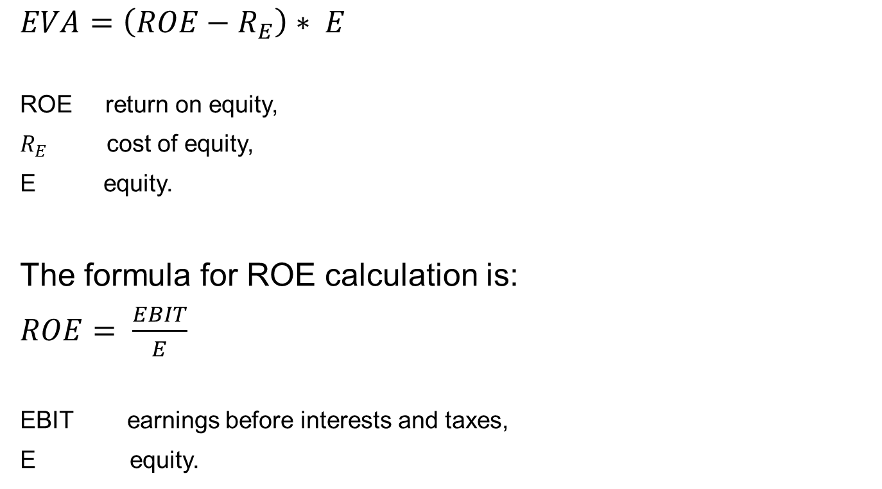
Economic Value Added
Economic Value Added
EVA-Equity calculation
$EVA=\left(ROE−R_{E}\right)∗ E$
ROE return on equity,
$R_{E}$cost of equity,
E equity.
The formula for ROE calculation is:
$ROE= \frac{EBIT}{E}$
EBIT earnings before interests and taxes,
E equity.

Slide 33
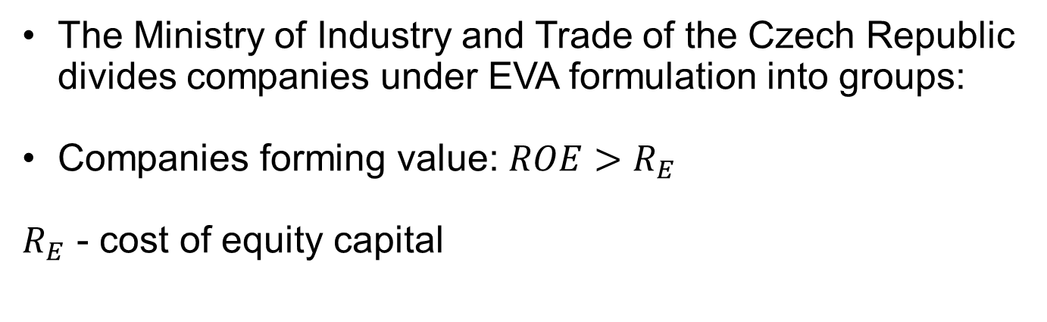
Economic Value Added
The Ministry of Industry and Trade of the Czech Republic divides companies under EVA formulation into groups:
Companies forming value: $ROE>R_{E}$
$R_{E}$ - cost of equity capital

Slide 34
Economic Value Added
EVA = EBIT . (1- t) – C .WACC
EVA = NOPAT – C . WACC(k_{O})
Where: EBIT earings before interest and tax (operational profit)
t tax rate (year 2019: 19 %, 0,19)
C invested capital
NOPAT net operational profit after taxation
WACC weighted cost of capital

Slide 35
Comparison EVA vs. Economic Result
EVA = EBIT(1 – t) – cost of debt capital – cost of equity capital
ER = EBIT(1 – t) – cost of debt capital
ER converted into common reporting:
ER = (EBIT – interest)(1 – t)

Slide 36
Czech Companies
Czech companies use the following financial indicators:
  EBIT (87 %)
  Net income (89 %)
  ROA (53 %)
  ROE (57 %)
  EVA (36 %)

Slide 37
Optimal Capital Structure
  Model Example:
  Calculate at what level of indebtedness there is an optimal capital structure, if the values of the cost of owned and foreign capital for the respective level of indebtedness are known. (see table below). Income tax is 24%.

Slide 38
Optimal Capital Structure
Indebtedness % | 0 | 10 | 20 | 30 | 40 | 50 | 60 | 70
Cost of equity % | 10,4 | 10,6 | 11 | 12,5 | 12,5 | 13,2 | 14 | 17
Cost of debt % | - | 8 | 8,6 | 8,8 | 9 | 11 | 13 | 16
WACC = ko
k_{O} (or WACC) = k_{d} ∙ (1 – t)∙D/C + k_{e} ∙ E/C

