Slide 1

Inventory management
Ing. Žaneta Rylková, Ph.D.
Managerial Economics

Slide 2

Outline of the lecture
Supply chain
Types of stock
Inventory management
Inventory optimization

Slide 3
Supply chain
Supply chain includes all atcitivies in transforming natural resources, raw materials and components into finished products and delivering to the end customer.
Supply chain is a sequence of suppliers, transporters, warehouses, manufacturers, wholesalers/distributors, retailers and final customers.

Slide 4
Supplier partnership
An organization (or customer) purchases its requirements, raw materials, components, and services, from supplier.
Better supplier´s quality → better product´s quality
A partnership betweeen customer and supplier is one of the keys to obtain high quality products and services. Customers and suppliers have the same goal – to satisfy the end user. They must work together as partners to maximize the return on investment because they have limited resources.

Slide 5
Supply chain management
Material flow is a significant factor in a design of macufacturing systems. Material flow in manufacturing process can be characterized as a meterial movement:
from its receipt to the warehouse (warehouse of production material),
through the individual phases of production cycle,
up to the entry of finished products in the finished production warehouse.
From the point of view of the management of the production process and the supply activity (purchase), the following form of inventory cathegories can be specified (Stocks are also known as inventories). There are 3 categories of stock:

Slide 6
Types of stock
Raw Materials and components: these are waiting to be used in the production process. Purchased materials – raw materials, components, spare parts, and items that are used and usually they do not appear in the end product.
Work-in-Progress or unfinished goods: stocks of goods in the process of being manufactured, materials that are in the semi-finished stage.
Finished Goods: goods produced and ready to be sold.

Slide 7
Objective of inventory management
To meet unforeseen future demand due to variation in forecast figures and actual figures.
To meet the customer requirement timely, effectively, efficiently and smoothly.
To smoothen the production process.
To facilitate intermittent production of several products on the same facility.

Slide 8
Inventory management
The mission of inventory management is to ensure trouble-free and smooth delivery of stored items to consumption. The inventory level is determined by the performance of the production equipment, the supply conditions (in the case of production stocks), and the factor of protection against failures in storage. Defects in storage can crop up.
delivery fluctuation or delivery failure (by supplier, by a production facility from one production stage to the next stage of production, when products are removed from the production process to a finished product warehouse), volume or time factor for inventory creation.

Slide 9
Inventory management
Classification of stocks:
Generic classification of stocks
  Production stocks,
  Unfinished production, Bookkeeping
  Spare parts…
Functional items of stocks
  Common stock level,
  Safety stock,
  Technical stock, Operative management
  Seasonal stock,
  Speculative stock.

Slide 10
Inventory management
In terms of operational inventory management, the functional classification of stocks is applied to:
Common stock level (turnover), which covers material delivery requirements between two deliveries. During the delivery cycle, the normal inventory is reduced from the maximum value at the time of delivery to the minimum value before the next delivery.
  minimum stock level
  reorder level
  maximum stock level

Slide 11
Common stock level
minimum stock level - below this level the operations is effected and we can secure reaching this level by setting a reordering point.
reorder level - a minimum amount of an item which a company holds in stock, such that, when stock falls to this amount, the item must be reordered. Reorder point formula = (average daily unit sales x delivery lead time)+safety stock
maximum stock level - is the quantity of material above which the stock of an item should not normally be allowed to go. This level is fixed after taking into account such factors as: capital, rate of consumption of materials, storage space available, insurance cost, risk of deterioration and obsolescence and economic order quantity, etc.

Slide 12
Basic concepts of inventory management
Technical stocks - before usage in production process,
Seasonal stocks – the performance of these stocks fluctuates with the seasnons. For example, retail companies´sales and profits often increase at Christmas and the start of the school year.
Emergency stock - Quantity of a material, parts, or supplies that must be kept on hand at all times to provide for an effective response to an emergency.
Speculative stock - a stock with a high degree of risk. A speculative stock may offer the possibility of substantial returns to compensate for its higher risk profile, tend to be clustered in sectors such as mining, energy and biotechnology.

Slide 13
Safety stock
Safety stock, covers deviations from planned average daily usage (s), from planned delivery cycle time (c), from planned delivery level (D).
Safety stock level is object of standardization.
Because lead times and usage rates are not precise, most firms hold safety stock – extra inventory that is held to prevent stockouts of important items.
The reorder point is the point at which to reorder inventory, expressed as days of lead time x daily usage

Slide 14
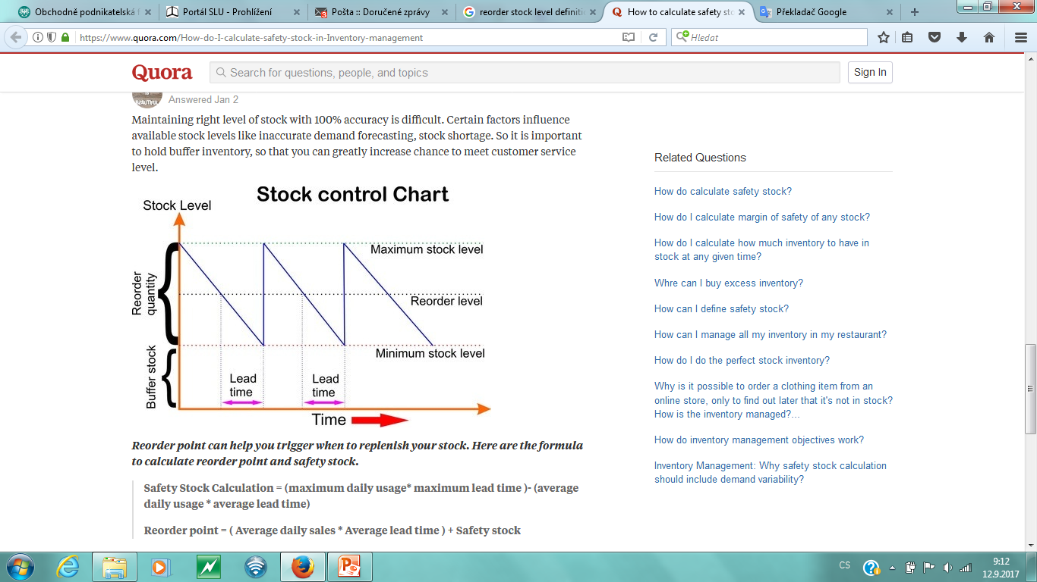
Stock control

Slide 15
Process of common stock level (ZC)in time

Slide 16
Development of common and technical stocks

Slide 17
Safety stock

Slide 18
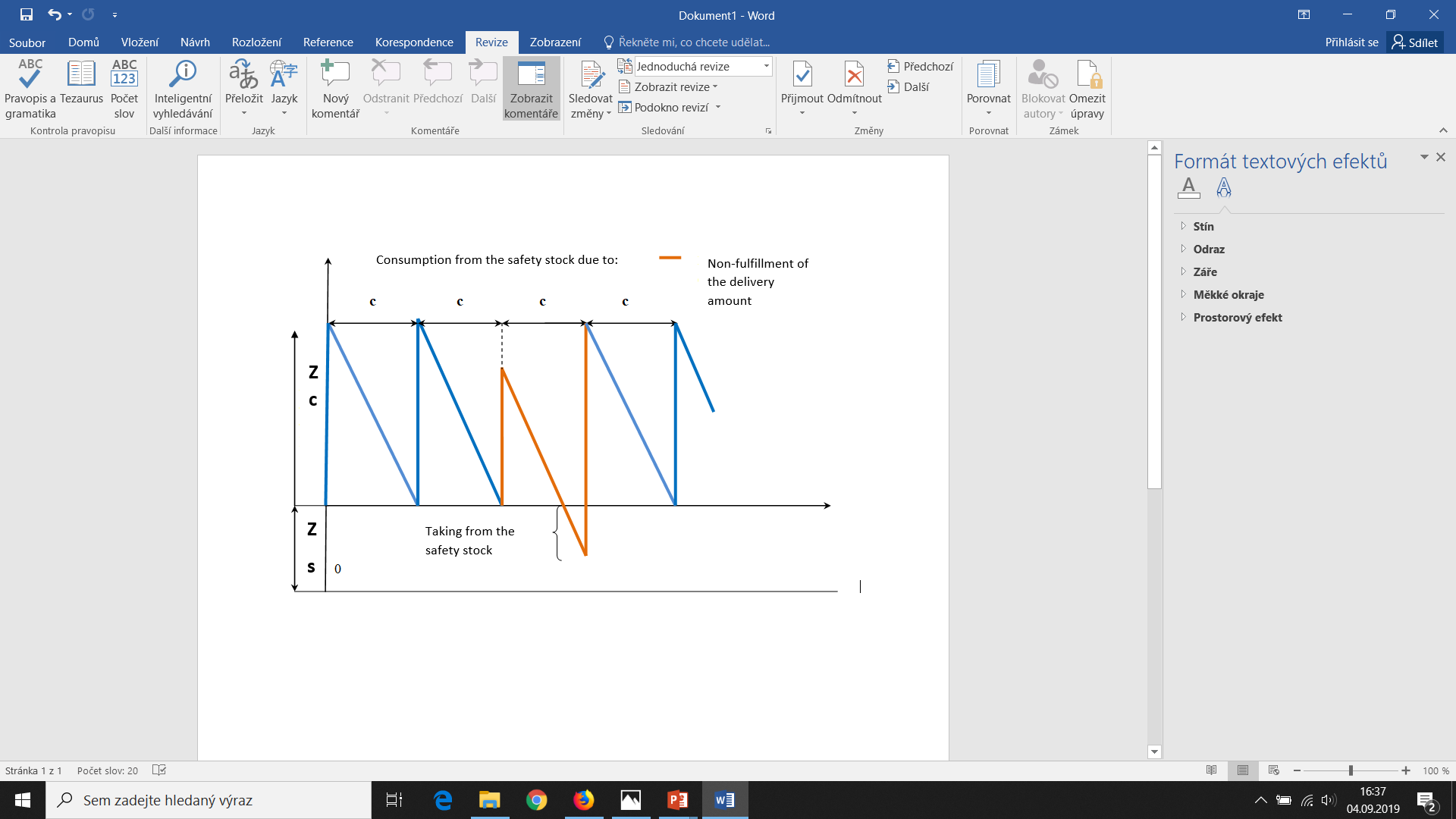
Safety stock

Slide 19
Safety stock example

Slide 20
Safety stock calculation

Slide 21
Operational purchasing planning
The aim of purchasing planning is to determine the need for material(to meet the requirements of the production process). Planning is realized through the balance method. It solves the balance between resources and requirement.
Resources: stock of the relevant material item at the beginning of the refrerence period (stock at the beginning of the planned period) and supplies of the relevant material item from the supplier.
Requirement: consumption of the relevant material item for the period and the expected (required) stock level at the end of the reference period (may be at the amount of the safe stock).
Note: In terms of used terminology it is necessary to distinguish between the terms „consumption“ and „need“

Slide 22
Operational purchasing planning
The following balance equation applies:
Resources = Requirements
Stock_{INITIAL} + Delivery = Consumption + Stock_{FINAL}
Z_{I} + D = C + Z_{F}
Note: in the Framework of the planning mechanism, it is sometimes assumed that the final stock Z_{F} is at the amount of the safety stock Z_{S}.

Slide 23
Operational purchasing planning– stock planning for November
Table Balance of resources and requirements
Z_{INITIAL} _{NOVEMBER} = Z_{FINAL OCTOBER}
Resources | Requirements
Stock_{INITIAL} 125 000 pcs | Consumption 617 000 pcs
Delivery 562 000 pcs | Stock_{FINAL} 70 000 pcs
Total resources 687 000 pcs | Total requirements 687 000 pcs
Z_{FINAL NOVEMBER} = Z_{INITIAL DECEMBER}

Slide 24
Operational purchasing planning
In accordance with the balancing rule in the table Balance of resources and requirements:
Z_{I} + D = C + Z_{F}
Where:
Z_{I} Inital stock (in natural units)
D Delivery (purchase) of required material (natural units)
C Consumption of material in production process or in service process (natural units)
Z_{F} Final stock in a certain period (natural units)

Slide 25
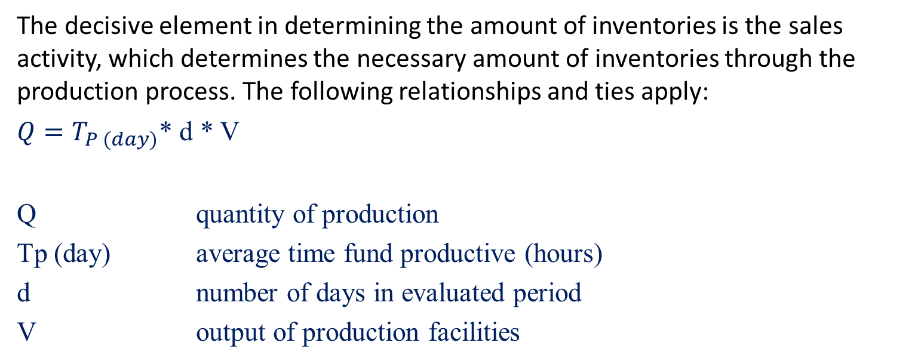
Inventory management
The decisive element in determining the amount of inventories is the sales activity, which determines the necessary amount of inventories through the production process. The following relationships and ties apply:
$Q=T_{P (day)}$* d * V
Q quantity of production
Tp (day) average time fund productive (hours)
d number of days in evaluated period
V output of production facilities

Slide 26
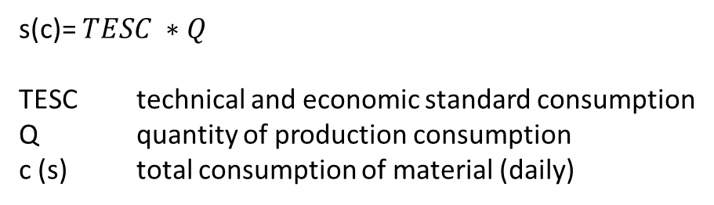
Inventory management
s(c)= $TESC ∗Q$
TESC technical and economic standard consumption
Q quantity of production consumption
c (s) total consumption of material (daily)

Slide 27

Inventory management
The amount of material required is dependent on:
the amount of 1 day consumption
delivery conditions, and the length of the delivery cycle
  $Z_{Cmax}$= s*$t_{c}$ maximum common stock
  $Z_{max}$= s*${(t}_{c}$+$t_{t}$+$t_{s})$ maximum total stock
  $t_{c}$ material delivery cycle (days)
  $t_{t}$ technical stock (days), for example for drying wood
  $t_{s}$ safety stock (days)

Slide 28
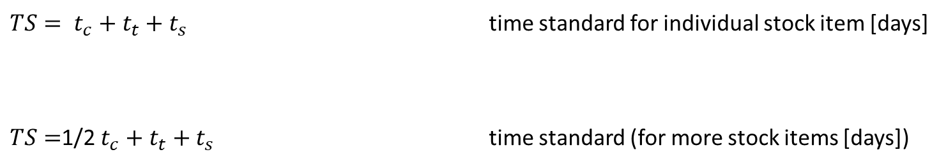
Inventory management
$TS= t_{c}+t_{t}+t_{s}$ time standard for individual stock item [days]
$TS=$1/2$t_{c}+t_{t}+t_{s}$ time standard (for more stock items [days])

Slide 29
Process of common stock level (ZC)in time

Slide 30

Inventory management
$${number of deliveries \left(orders\right) \left[number\right] n}_{o}=\frac{P}{D}$$
P demand (natural units)
D delivery of required material per year (natural units)
$t_{c}=\frac{360}{n_{o}}$=$\frac{360}{\frac{P}{D}}$= $\frac{360 ∗D}{P}$ tc delivery cycle (days)
Inventory turnover rate
$n_{turnover}$=$\frac{C}{Z_{ø}}$
C(S) year-round consumption
Inventory turnover time
$t_{turnover}$=$\frac{360}{n_{turnover}}$= $\frac{360∗Z_{ø}}{C}$

Slide 31
Operative inventory management
The amount of stocks can be expressed through:
  Time expression (Time standard of stock TS),
  Natural units (kg, cm3, ks, l, m2, etc.),
  Value evaluation – cash equivalent (CZK),

Slide 32
Inventory management and inventory optimization

Slide 33
Inventory management and inventory optimization

Slide 34
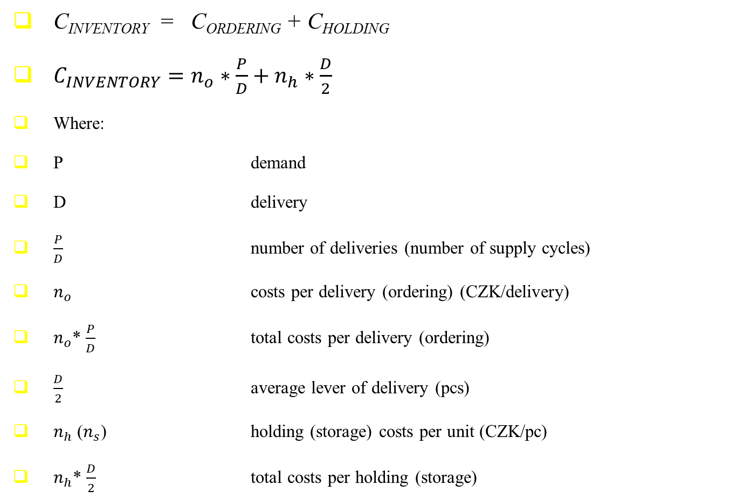
Inventory management and optimization
C_{INVENTORY} = C_{ORDERING} + C_{HOLDING}
$C_{INVENTORY}=n_{o}∗\frac{P}{D}+n_{h}∗\frac{D}{2}$
Where:
P demand
D delivery
$\frac{P}{D}$ number of deliveries (number of supply cycles)
$n_{o}$ costs per delivery (ordering) (CZK/delivery)
$n_{o}$* $\frac{P}{D}$ total costs per delivery (ordering)
$\frac{D}{2}$ average lever of delivery (pcs)
$n_{h}$ ($n_{s}$) holding (storage) costs per unit (CZK/pc)
$n_{h}$* $\frac{D}{2}$ total costs per holding (storage)

Slide 35
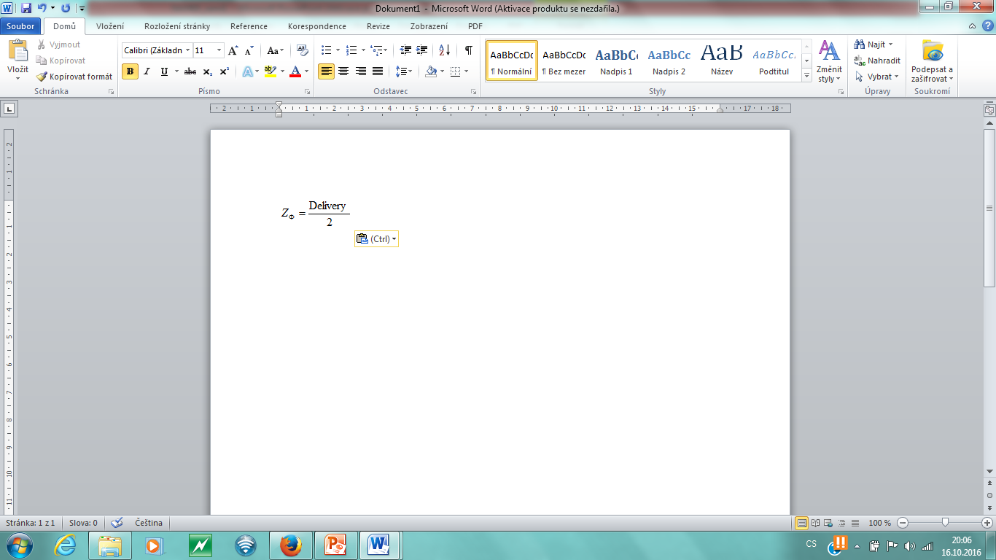
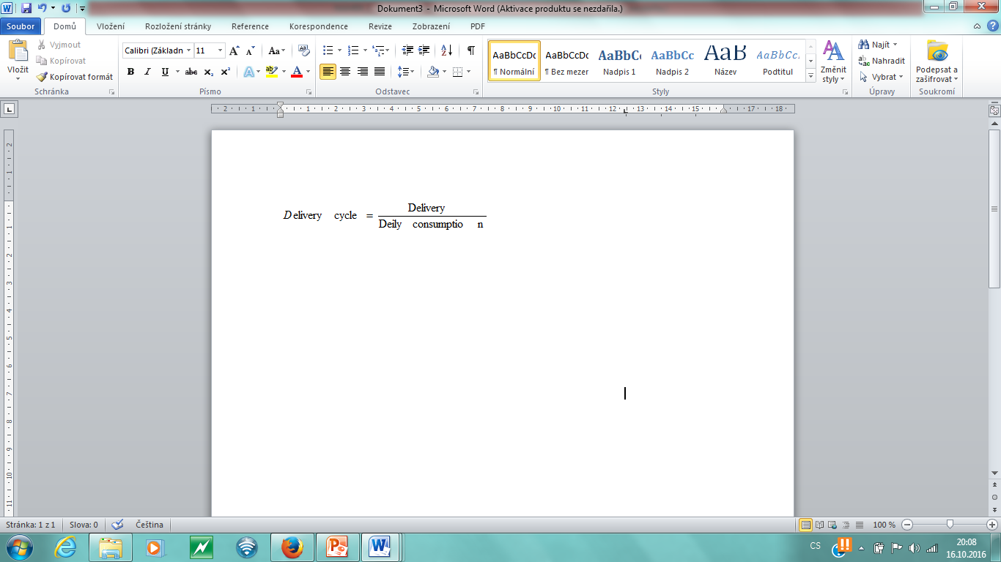
Inventory management
Average stock (Z_{Ø})
=> Delivery= 2·Z_{Ø}

Slide 36
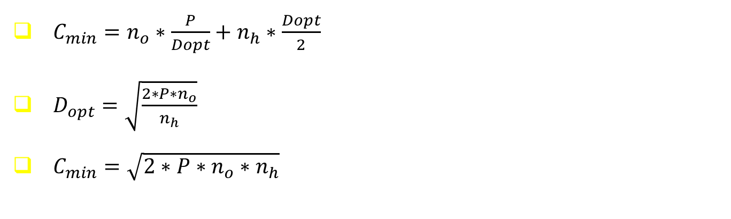
Inventory management and optimization
$C_{min}=n_{o}∗\frac{P}{Dopt}+n_{h}∗\frac{Dopt}{2}$
$D_{opt}=\sqrt{\frac{2∗P∗n_{o}}{n_{h}}}$
$C_{min}=\sqrt{2∗P∗n_{o}∗n_{h}}$

Slide 37
Conclusions
The primary role of inventory is to buffer against uncertainty.
There are conflicting forces, i.e. some forces for large inventory and others for small inventory level. Therefore, it is possible to find out an optimal inventory level. In fact, a company is supposed to identify such an optimal point.
Optimum delivery calculation also known as EOQ (economic order quantity), minimum cost of inventory management are examples of analytical models to help a company determine an optimal inventory level by trading off the conflicting forces.
Excessive inventory dampens the company´s innovation speed and also deters its learning capability.

