Slide 1

Trade Organizations
Introduction

Slide 2
Content
Consumer and retail trends
Basic concepts in retail

Slide 3
Consumer trends in general

Slide 4
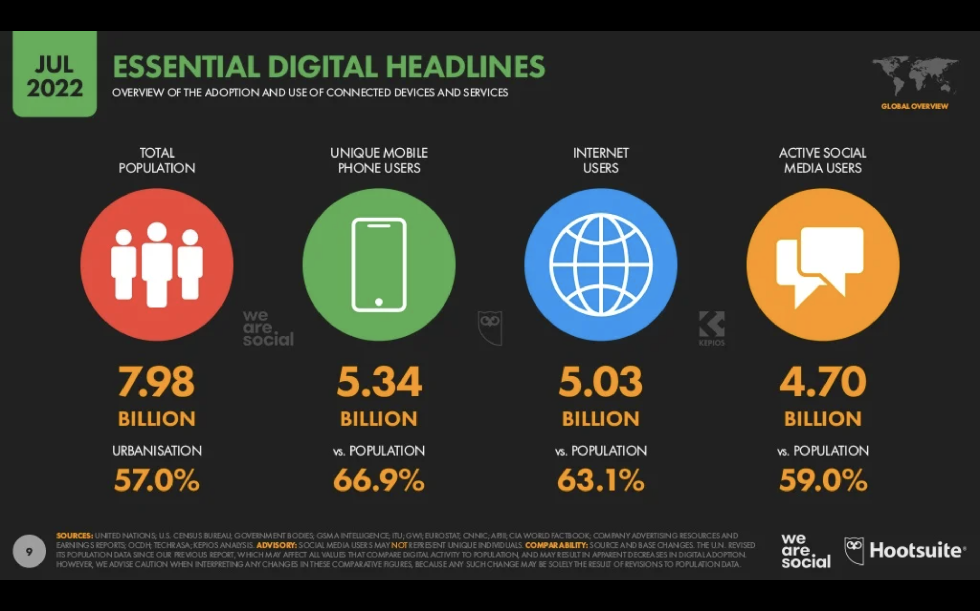
Title

Slide 5
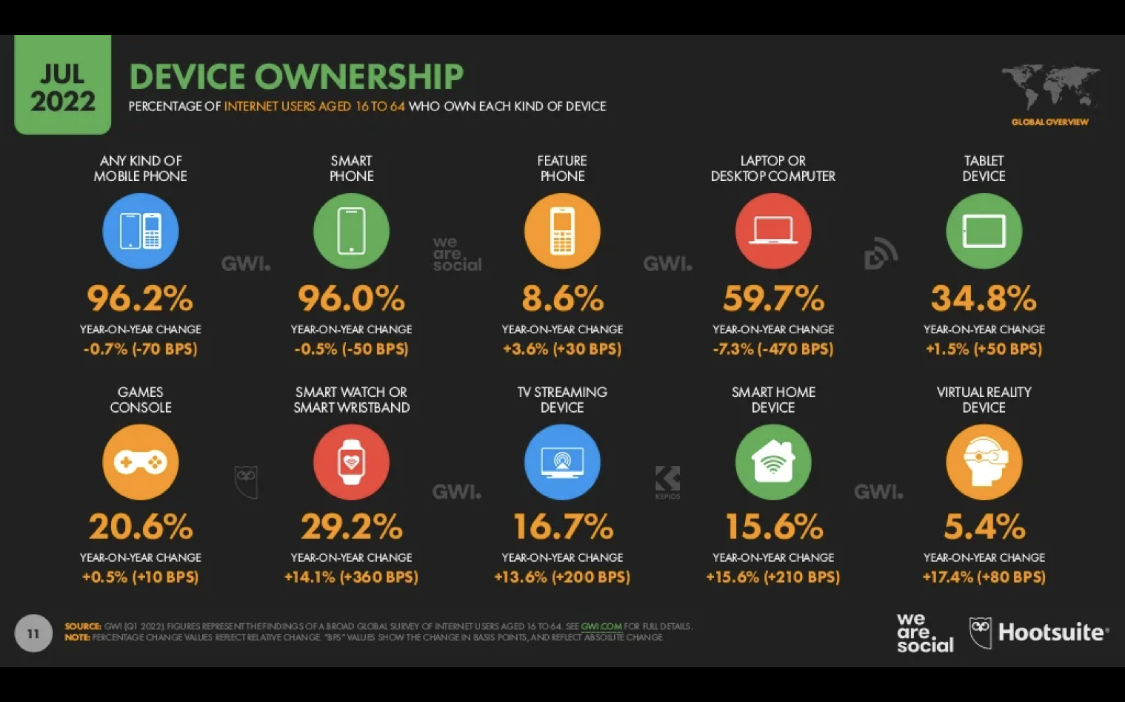
Title

Slide 6
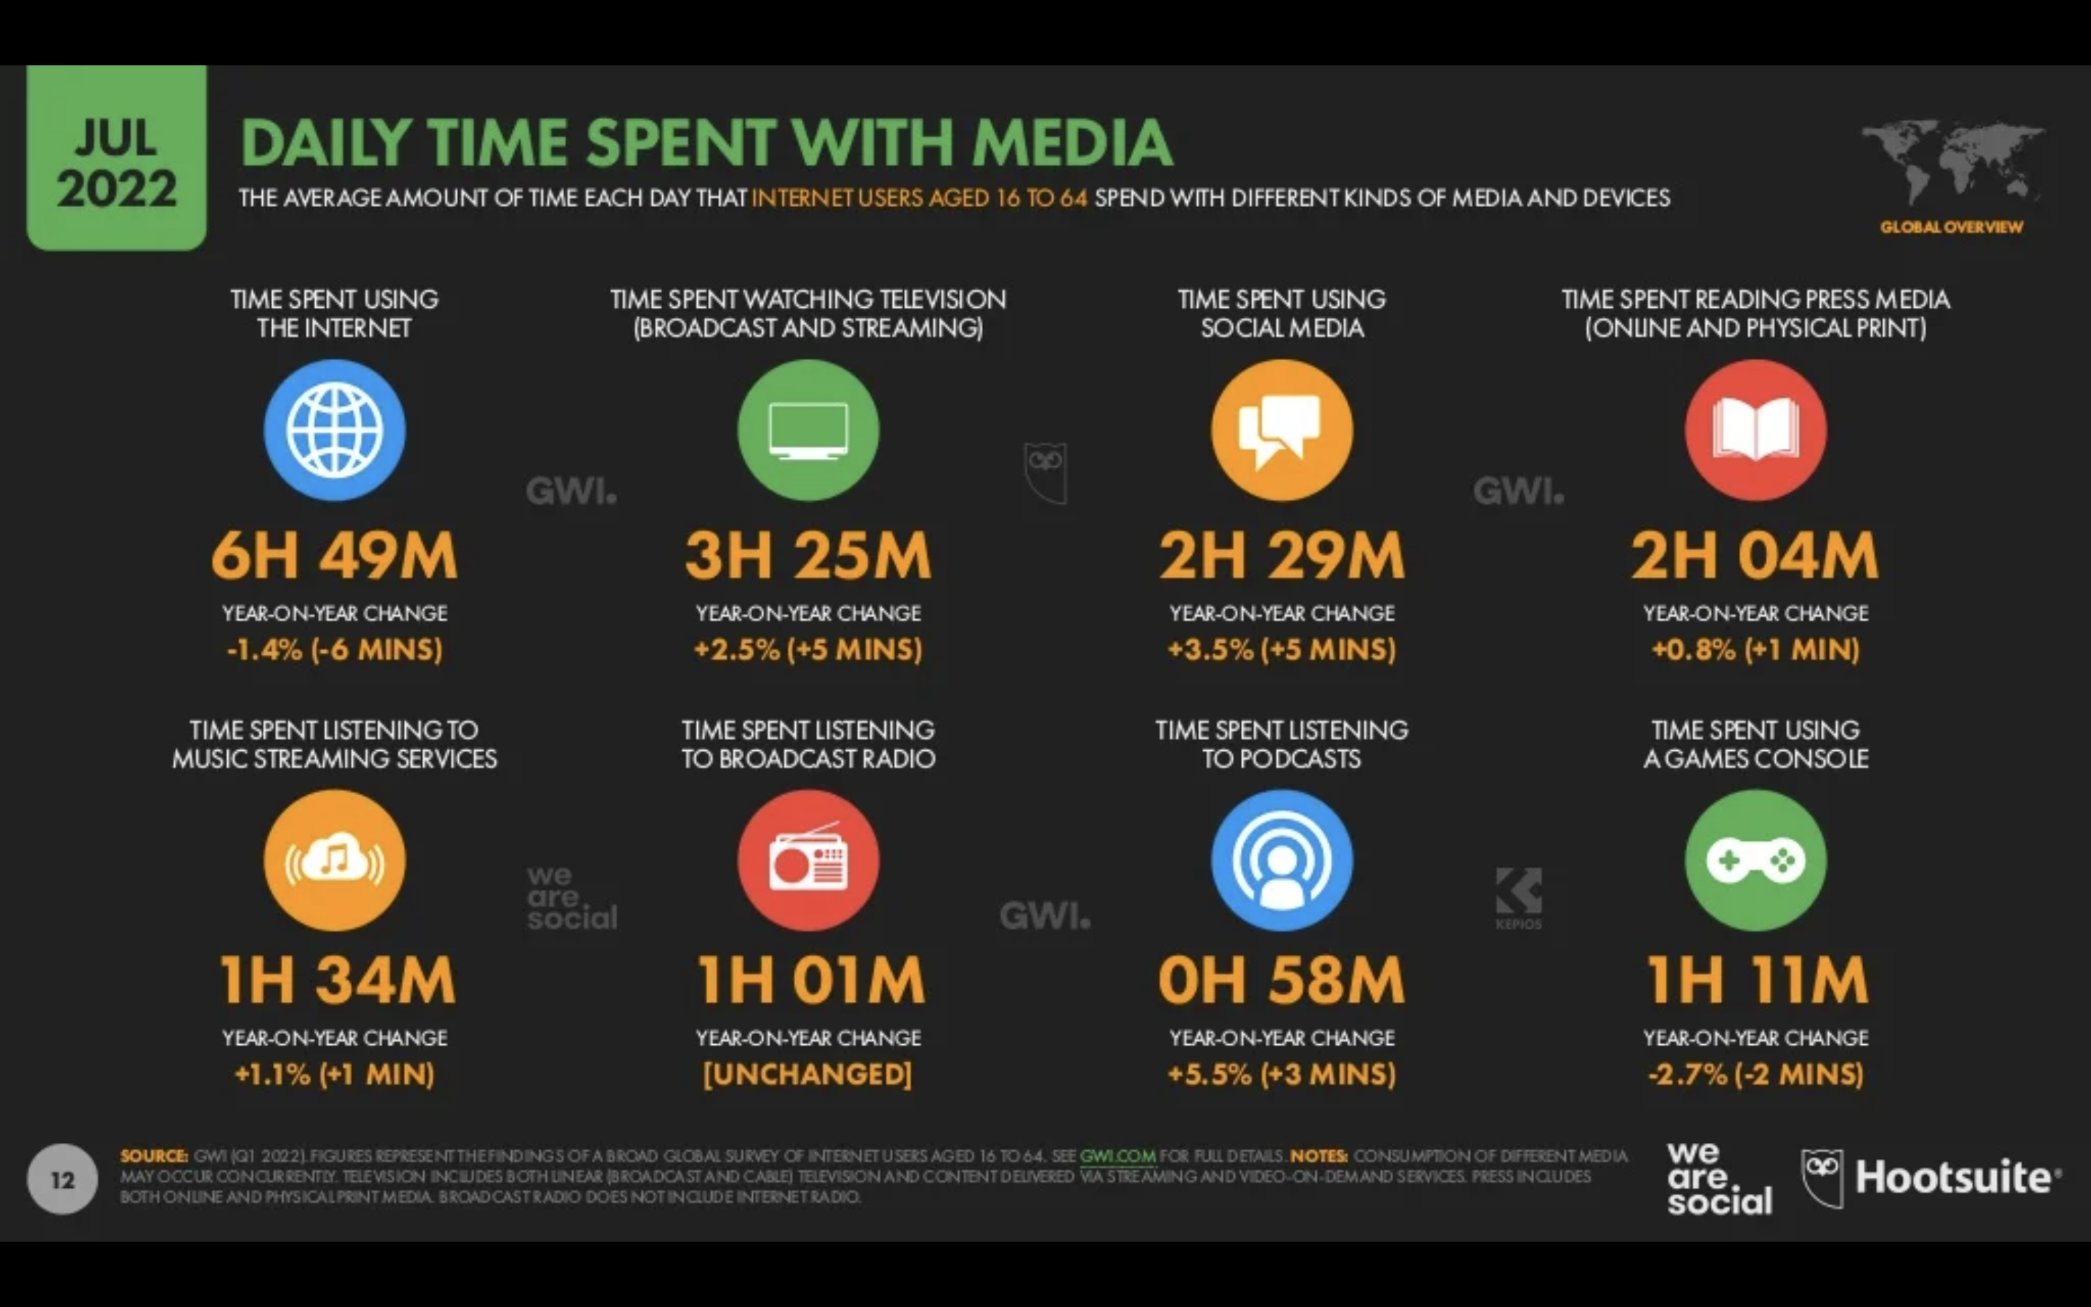
Title

Slide 7
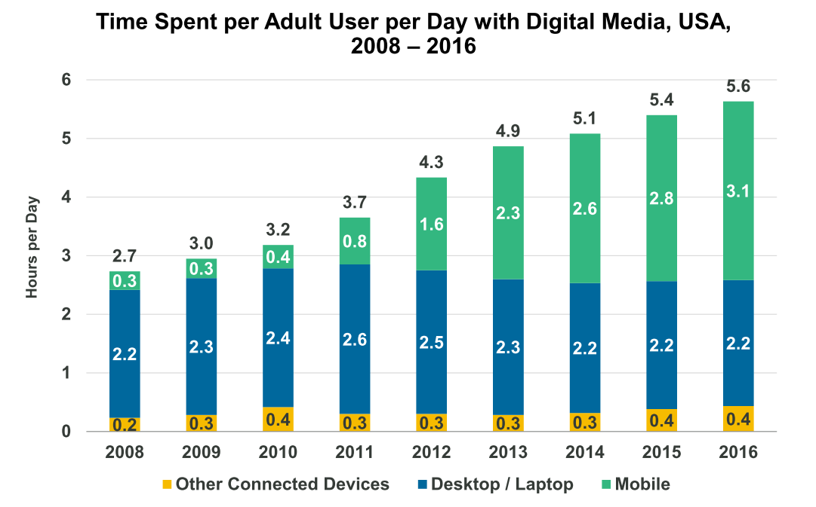

Slide 8
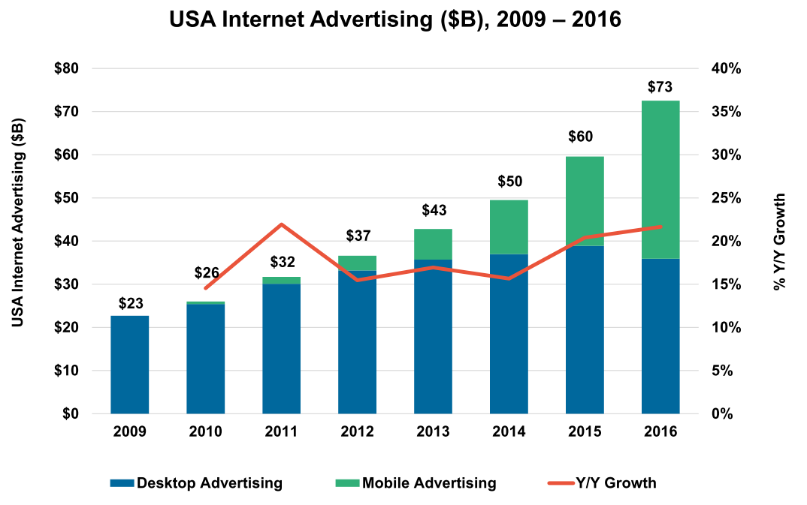
Marketing trends in general

Slide 9
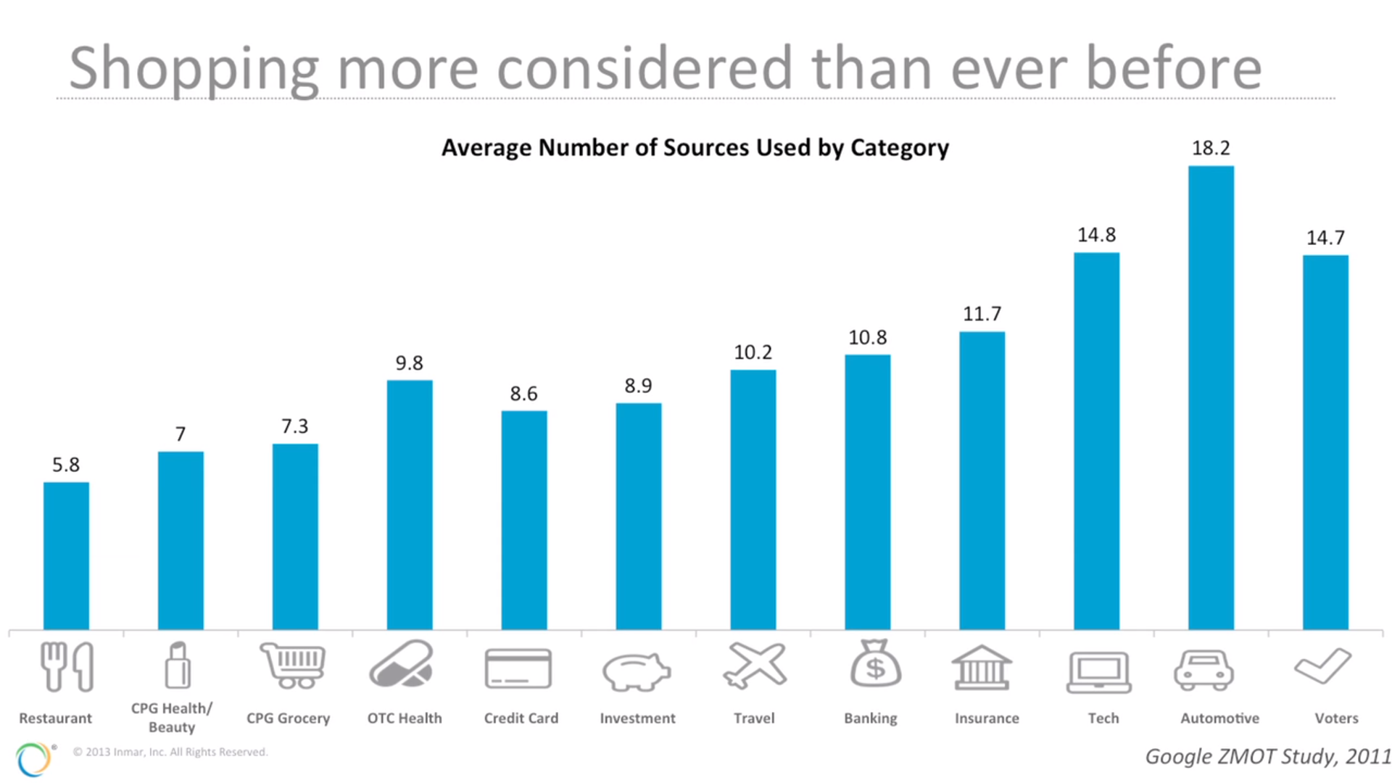

Slide 10
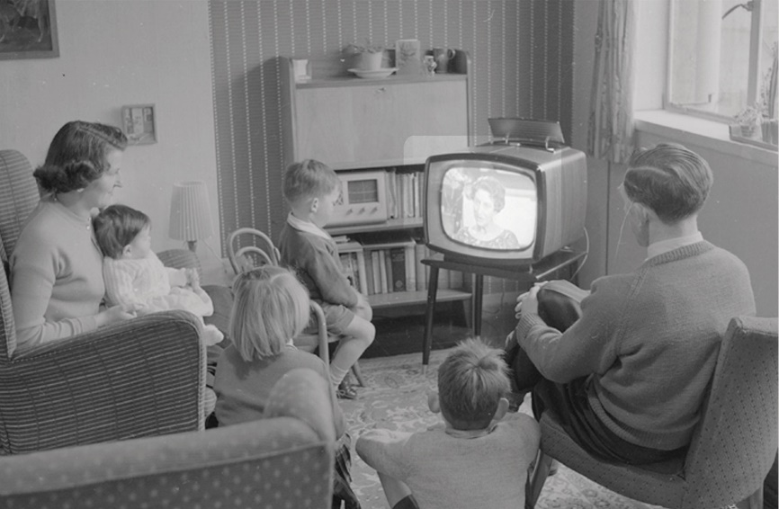
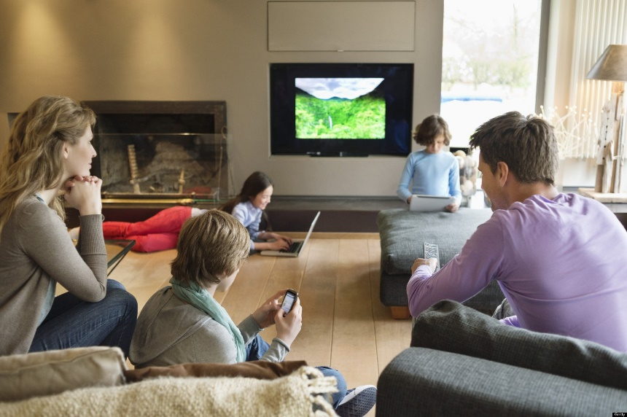
Consumer media consumption development
1st, 2nd, 3rd screen – TV, notebook, mobile
  All connected and consumed at the same time

Slide 11
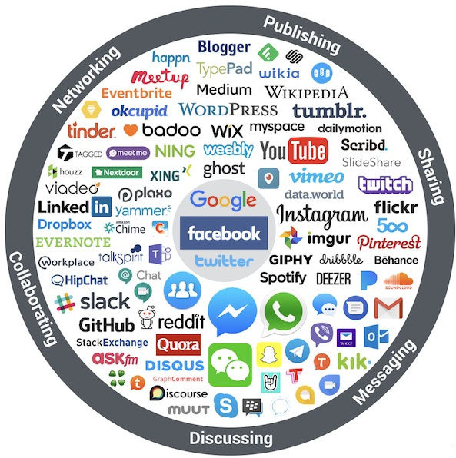

Slide 12
Retail trends (megatrends)

Slide 13
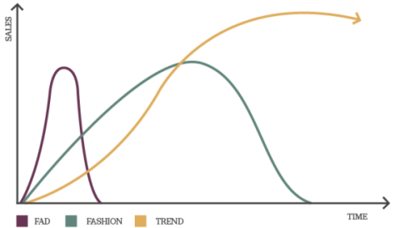

Slide 14
Globalization
The concept of globalization was first used by the American economist Theodore Levitt in 1985 to describe the development of world economy in the previous decade.
Many of the definitions agree on the basis that the term globalization is actually the collective name for a set of interrelated economic, ideological, technological and cultural changes.
Notes:
(Jeníček, 2002).

Slide 15
Globalization effects
The economic changes include internationalization of production, capital mobility, economic interdependence and others.
Because of these changes new effects can be observed such as:
  spread of the standardized goods across the globe,
  the increased mobility of labour,
  reorganization of production and
  mutual penetration of sectors across borders.
Notes:
(Huntington, 2001)

Slide 16
THE PROCESS OF INTERNATIONALIZATION IS FULFILLED BY:
Companies - their strategies and plans.
Customers - their interests and tastes.
Unification of needs, lifestyle, preferences of global brands
  (Tourism development, the influence of mass media and Technological Development).

Slide 17
Internationalization
The essence is to expand the activities from the domestic country abroad.
The situation at home versus the situation abroad.
Internationalization theory - causes of expansion.

Slide 18
Internationalization
1st stage: trouble on the original internal market, expansion mainly to neighboring countries with similar or identical demands of both consumers and business environments, through exporting and importing.
2nd stage: requirement still applies for geographic and cultural proximity, but the number of foreign participations expands, based on contracts.
3rd stage: the emphasis on market opportunities in individual countries, not on cultural and consumer proximity to the domestic market, based on capital investments and new branches.

Slide 19
Consumer ethnocentrism
Shimp and Sharma (1987)
Based on sociology and Sumner (1906) theory of ingroups and outgroups.
  Based on ethnocentrism:
  View own group as the center of the universe.
  Interpreting other social units from the perspective of their own group.
  Rejecting persons who are culturally dissimilar while blindly accepting those who are culturally like themselves.
CE – Purchasing imported products is wrong, because, in consumer mind, it hurts the domestic economy.

Slide 20
Demographics
The demographic developments have a major impact on retail. It influences the development and structure of demand and consumption patterns of the population.
In countries with higher standards of living, the population has a tendency towards an aging population and single household growth.
Demographic changes affect the level of household equipment, requirements for consumer packaging and increase the popularity of weekly shopping, retail chain structure and stores type preferences.

Slide 21
Everyday consumer behaviour
Individual value system is changing due to changes in the broader context of the living standards of the population. Companies must estimate in advance the future demands of our customers, in order to be ready in time to changes in their needs.
Money rich time poor families.
Higher awareness of environmental problems
Homogenization of needs worldwide
Smaller families in rich countries.
Singles.

Slide 22
Financial crisis and discount stores
The crisis is beneficial for discount stores.
An example can be found in Germany (as well as all around Europe). The slump in the German economy and the coming recession have their winners - German discount chains.
According to a recent study, the market share of discount stores specialized in low prices increased from 25.8% to 41.3% in the past 15 years. Especially strongly growing in sales of food. Just last year, the number of food chains stores increased from 14,806 to 15,219.

Slide 23
E-tail
Retail trade develops outside the shopping area and its importance is growing. One of the main trends here is purchasing over the Internet. It has its limitations, mainly in food, but those are being overcomed with new technology (Tesco Express delivery, Amazon drone programme). Other types are catalogue sales, mail sales etc.
How much sales are generated in etail globally?
  6,3%
Nearly 40% of global production is not even available online!
Notes:
https://www.irozhlas.cz/ekonomika/ceske-e-shopy-hlasi-rekordni-trzby-lide-v-nich-nakupuji-potraviny-leky-i_1707260725_dbr

Slide 24
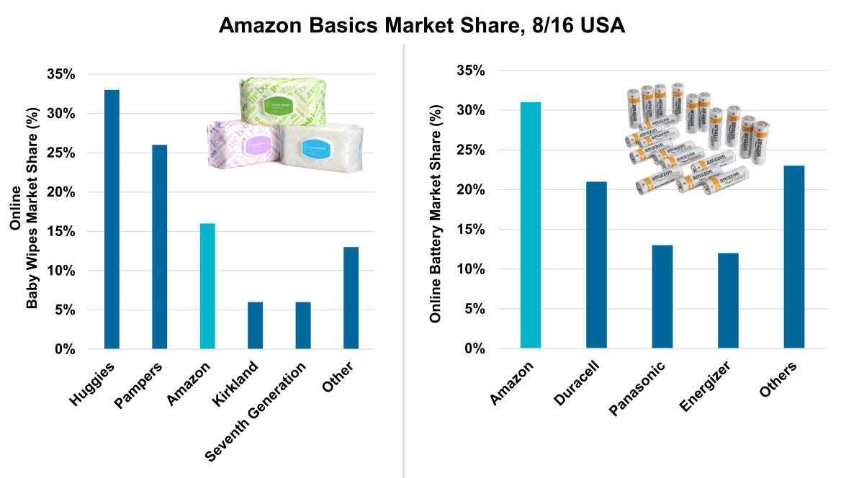

Slide 25
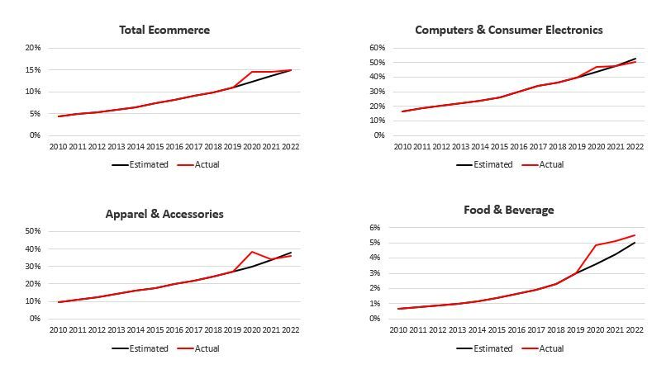
Growing but…

Slide 26
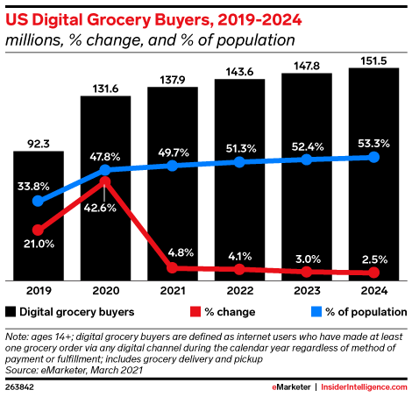

Slide 27
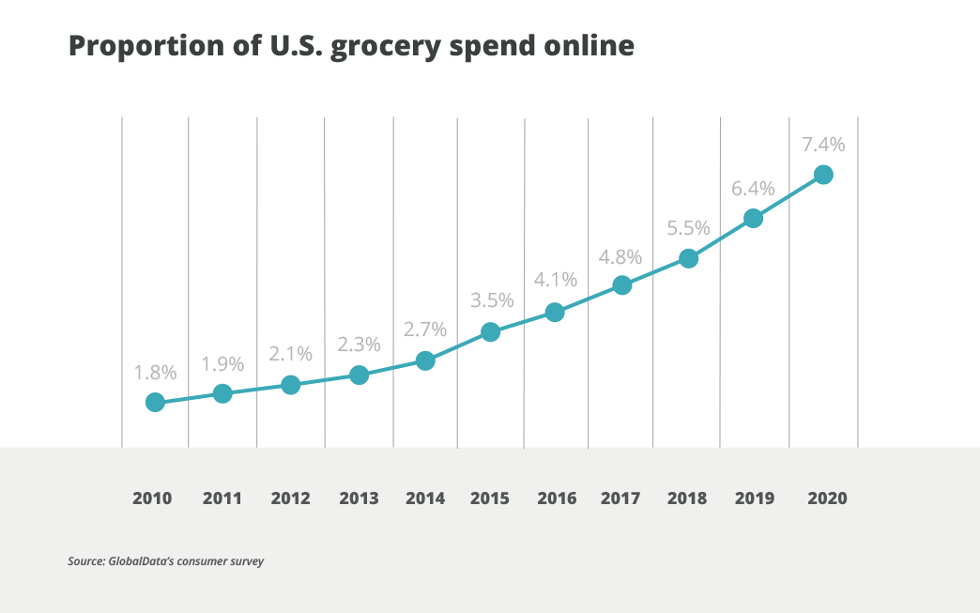

Slide 28
Business and in-store technology
Development of progressive business and storage technology means in particular the use of computer technology for the creation of perfect information files for sales forecasting, inventory management and ordering of goods.
New electronic cash register systems, expanding cashless transfers of funds and improved systems of handling of goods using barcodes.
Cooperation with suppliers is developed using new methods: ECR (Efficient Consumer Response), EDI (Electronic Data Interchange), CD (Cross Docking), MM (Micro Merchandising), DW (Data Warehousing), CRM (Customer Relationship Management) etc.

Slide 29

Why Walmart was so scuccesful?

Slide 30
Walmart use of technology
Success of Walmart was in change of the rules.
Paradigm:
  You cannot build supermarket in the city with less than 20 000 inhabitants.
Well thanks to technology they did not build supermarket but they build network.
Barcodes, predictive algorithms, precise logistics.

Slide 31
Basic concepts in retail

Slide 32
Retail and wholesale
Retailing is a way of selling usually smaller volume to the final end consumer – i.e. doing „small sales“. In the retail sector, there are many different forms of store types, such as the sale rack, self-service stores, supermarkets, hypermarkets, department stores, outlets etc.
The opposite to a retail is wholesaler who represents the sale and distribution of goods on a large scale, often just to retail sales network and NOT the final end consumer. It may be a direct trade between producers and other traders or trade between specialty shops of particular assortment and retailers. Wholesale sales units are mostly supplying other wholesale or retail network.

Slide 33
Retailing
Retail environment has a high degree of competition (depending on assortment) and a significant downward pressure on consumer prices.
Depending on the field and assortment it may not be decided purely by price, but also by other factors (luxury, prestige, brand, current trends, different bonuses, competitions and previous positive experiences, etc.).

Slide 34
Wholesale
It is largely a trade between businesses (business to business, B2B).
Wholesale prices are always lower than retail prices, which are increased by the appropriate retail margin. This margin must cover transportation to stores, fixed costs for a place in shops, storage, electricity, salaries of clerks, in some cases funds for sales promotion (advertising).
The partnership of wholesale supplier and retail purchaser is advantageous for both parties, because the supplier gets specific number of sales of its products (easy to plan production). The concern that the goods in question are sold is taken over by the buyer, who buys it at wholesale prices and aims to sell at retail prices thus generating revenue.

Slide 35
Wholesale
Wholesale units usually have the form of large warehouses, storage of raw materials, transshipment of goods and materials, supplemented by any necessary administrative and operational background.
They are sometimes supplemented by a retail store intended for the local population and employees of the company. Some wholesale equipment may also be linked to commercial packaging premises, devices designed for drying vegetables, fruit ripening (bananas), nuts roaster, additional adjusting of goods, etc., including a number of additional technical services (e.g. transport, logistics, handling, maintenance, etc.).

Slide 36
Supply Chain
Material | Parts | Producer | Retailer | Consumer
Plastic | Intel processor |  | CZC | David
Aluminium | USB ports | Lenovo | Okay | James
Copper | Microsoft software |  | Alza | Melanie
Silicon | Seagate HDD |  | Datart | Petr
Supplier network |  |  | Distribution channels

Slide 37
Distribution channels
PRODUCER |  |  |  | CUSTOMER
PRODUCER |  |  | RETAIL | CUSTOMER
PRODUCER |  | WHOLESALE |  | CUSTOMER
PRODUCER |  | WHOLESALE | RETAIL | CUSTOMER
PRODUCER | WHOLESALE | MIDDLEMAN OR BROKER | RETAIL | CUSTOMER
DIRECT DISTRIBUTION – own stores, door-to-door, direct marketing
INDIRECT DISTRIBUTION – one or more intermediator

Slide 38
What are advantages and disadvantages of the two?

Slide 39
Direct distribution
Direct contact with the customer.
Feedback and possibility for individual approach.
No margin for intermediator.
Need for establishing many contacts.
Storage and logistic cost.
Hard to cover whole market.

Slide 40
Indirect distribution
Less processes for producer.
Intermediary experience and contacts.
Lower costs for storage and supplies.
Producer is partly loosing control over the distribution.
Information barrier between producer and customer.
Need for motivation system for intermediaries
Dependency on retail and wholesale marketing strategy.
Transaction risks.

Slide 41
PUSH Strategy
Communication
Distribution
Producent
Wholesaler
Retail
Customer

Slide 42
PULL Strategy
Communication
Distribution
Producent
Wholesaler
Retail
Customer

Slide 43


Slide 44
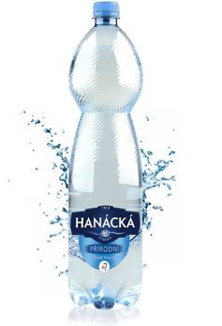

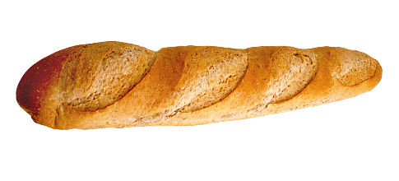
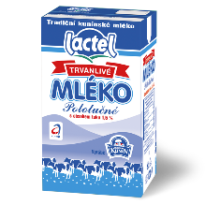
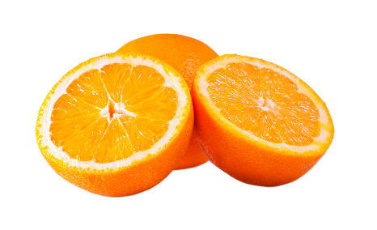
Distribution strategies
Intensive distribution
sales through as many stores as possible
in order to make the product commercially available
FMCG – fast moving consumer goods
  Frequent consumption items that are cheap and expensive
  purchased habitually or goods of an emergency character

Slide 45
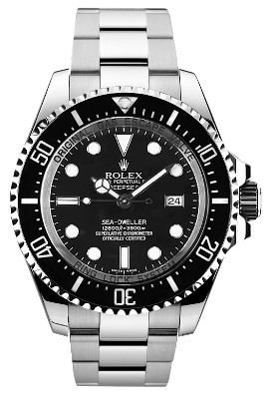
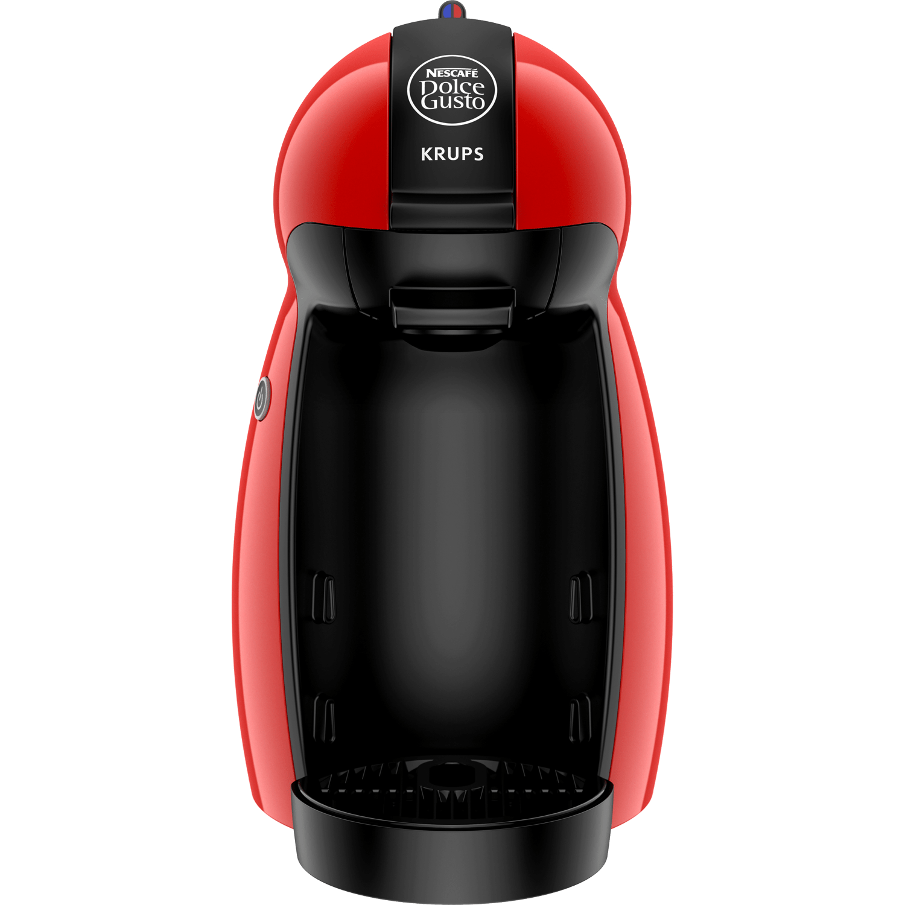
Exclusive distribution
sales of products through a very limited number of retailers
  expensive, luxury goods,
  it has its psychological justification, because it promotes the exceptional nature of the goods
Selective distribution
the manufacturer cooperates with a larger number of distributors who expect a good partnership relationship and above average sales effort
  occasional consumer goods that are bought after careful comparison
  clothing, footwear, consumer electronics

Slide 46

Thank you for your attention

