Slide 1

Trade Organizations
Merchandising and category management

Slide 2
Merchandise mix
Retailer‘s total product offering is called a merchandise mix or product range.
Two levels – strategic and operational:
  Strategic: merchandise management includes the process of selecting the right items for the store.
  Operational: ensuring the items are available when consumer want to purchase them.

Slide 3
Category
Items in the assortment are organised into groups: categories
Merchandise planning encompasses selecting the right categories and the items within it.
This selection refers to a breadth and depth of the assortment, quality level and brand portfolio.

Slide 4
Stock keeping unit - SKU
Lowest level of detail identifying product in the retailer‘s assortment is stock keeping unit.
For example pair of pants of particular brand, in particular style, colour, and size, is one SKU.
Number of SKU varies:
  Discount store could have only 1 000 SKUs
  Hypermarket could have up to 100 000 SKUs

Slide 5

Items in assortment
Staple merchandise
Fashion merchandise
Seasonal merchandise
Fad merchandise

Slide 6
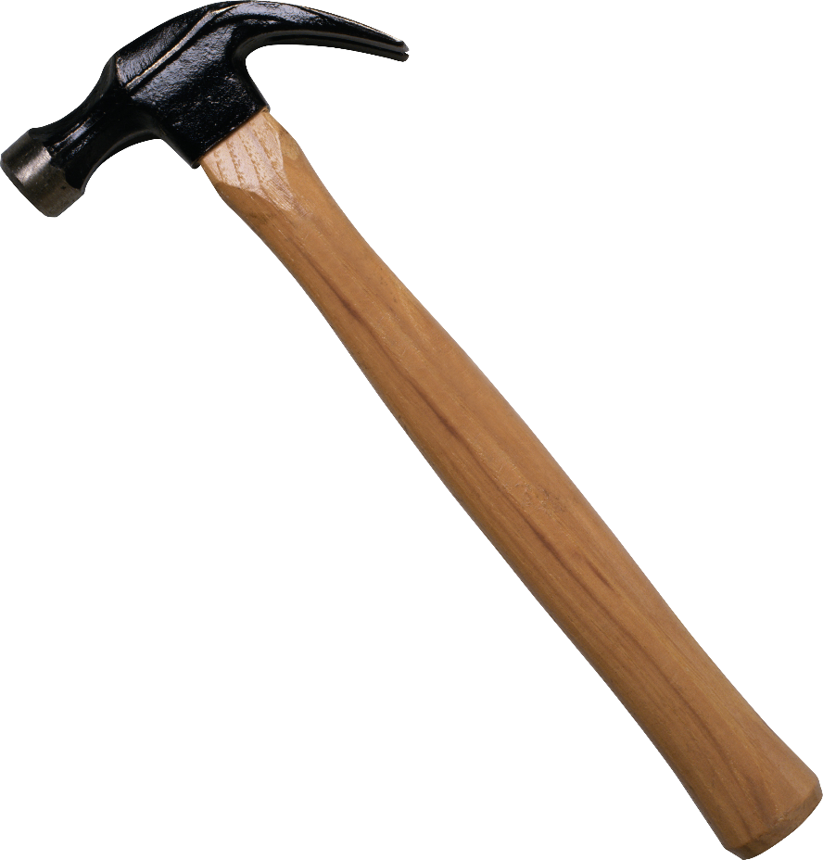
Staple merchandise
Products that are carried permanently by the retailer and that have relatively stable sales over time.
A hammer or a paint-brush at a DIY retailer on a jeans and white T-shirt at a department store would be example of staple goods.

Slide 7
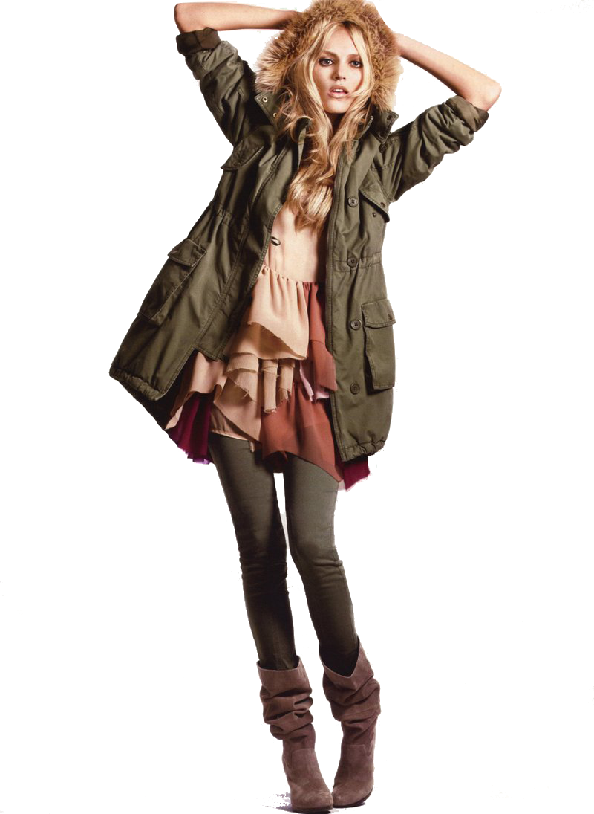
Fashion merchandise
Products that have cyclical sales due to changing tastes and lifestyles.
Colors and cuts of clothing change and merchandise offered this year is usually out of date next year.

Slide 8
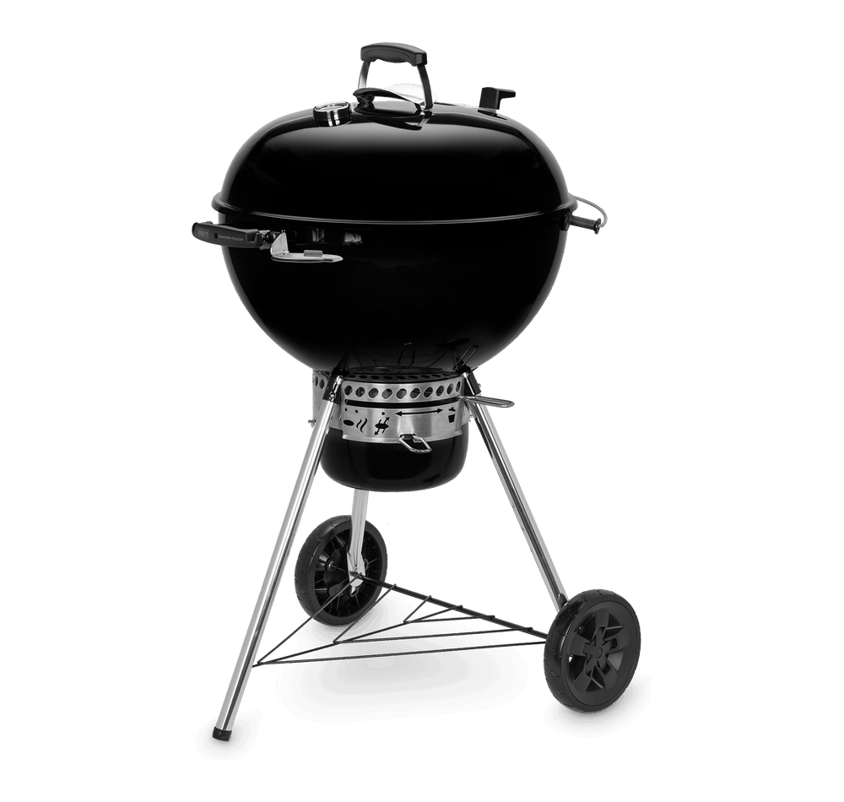
Seasonal merchandise
Products that do not sell equally well over consecutive time period.
Barbecue grills, skiing equipment, short pants and similar products have very high sales during one season of the year, but are not sold at all in other seasons.

Slide 9

Fad merchandise
Products that generates very high sales for a short time period. Often, toys and games, certain clothing accessories are fads.
Tamagochis and Pokemon were classic fads. Movie merchandise also constitute classic fads.
Price sensitivity is often very low and ensuring supply, while demand is high is crucial for success.

Slide 10
Product portfolio / assortment
The number of product lines (or categories) the retailer offers is referred to as the breadth (width) of the assortment.
Wide assortment usually has the advantage of appealing to many customers and it makes one-stop-shopping possible.
The number of SKUs in a particular category is called depth of the assortment.
Deep assortment have the advantage of giving customer a good choice within the categories, but shallow assortment can focus better on the fast-selling items in a category.

Slide 11


Product portfolio / assortment
In the food store, the breakdown of meat and sausages, milk and dairy products, pastries, fruits and vegetables etc. is the width of the assortment.
The division of milk and dairy products into milk, cheese, yoghurt, etc. is still the width of the assortment.
The division of yoghurts according to flavours, brands, etc. is the depth of the assortment.

Slide 12
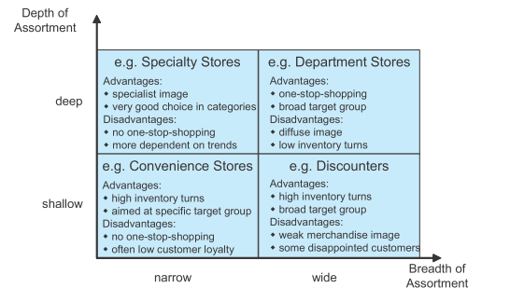
Product portfolio / assortment

Slide 13
Product portfolio / assortment
Demand for items is interrelated.
It is more convenient to do all the food shopping for the week in one store.
Products are consumed together, and it is convenient to purchase them together because they can be matched.
Shirt and tie.
Paint and paint-brush.

Slide 14
Category migration
An increasing number of retailers use a combination of specialist and generalist approaches within their product offer.
They are specialist in one or a few categories but add other categories in which they only offer a shallow assortment.
Retailers also diversify by adding new products to their assortment, which do not belong to their traditional merchandise.
Supermarkets sell non-food
DIY stores offer furniture
Sport stores offer food

Slide 15
Reduction of Variety
Variety of assortment is an important determinant of attitude towards the store and store choice, ranking only behind location and price.
Shoppers are often looking for very specific items.
A great variety and larger assortment increases the probability of finding what they really want.
On the other hand, one of the most valuable assets of the retailer is selling space.
Retailer has to make choices.

Slide 16
Reduction of Variety
An increasing number of SKUs usually increases retailing costs.
Assortment complexity raises various cost including those of sales, shelf space, planning, advertising, inventory and logistics.
Many alternatives within a category can lead to confusion and make the shopping process more complicated. Consumer often prefer mental convenience.

Slide 17
Reduction of Variety
Studies shown that even radical reductions of assortment do not necessarily reduce customer visits to the store and sales may remain stable.
It is not the actual number of difference products in a category that matters, but the consumers' perception of variety that is relevant for store choice behavior.
The elimination of different, but similar versions of the same product in the assortment is often not perceived negatively.

Slide 18
Manufacturer Brands and Store Brands
Manufacturer brands are owned, produced, managed and marketed by manufacturer.
Store brands (also called private labels) encompass all product brands owned managed and marketed by retailers.
Property rights for the brand in this case, are held by the retailer.

Slide 19
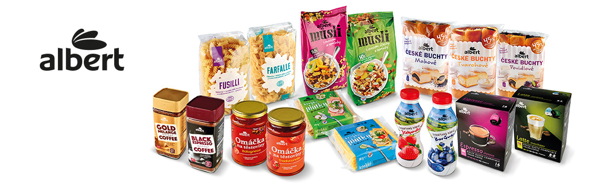
Manufacturer Brands and Store Brands

Slide 20
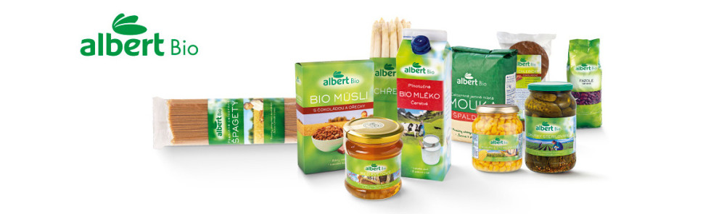
Manufacturer Brands and Store Brands

Slide 21
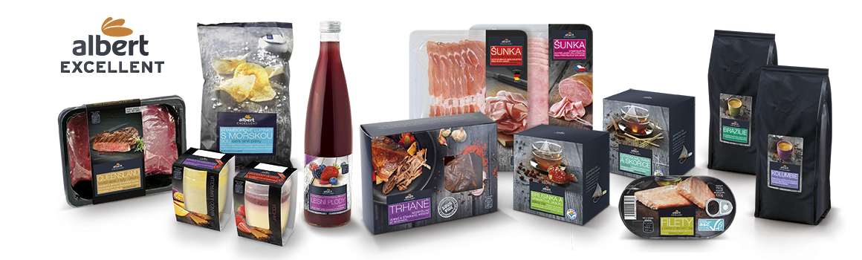
Manufacturer Brands and Store Brands

Slide 22
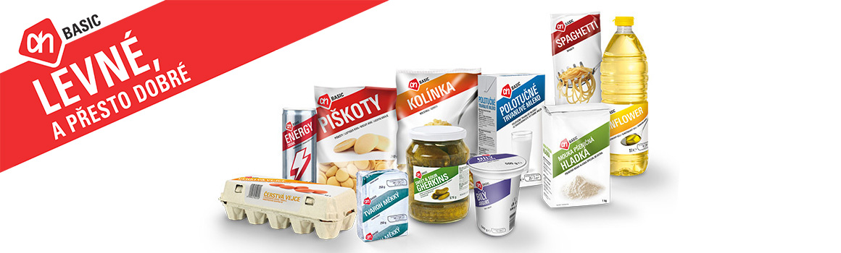
Manufacturer Brands and Store Brands

Slide 23
Manufacturer Brands and Store Brands
Manufacturer brands usually comprise the main part of the merchandise.
Danone, Black&Decker, Adidas, Mars, Samsung
Two main advantages
  Pull effect – strong brands have more customers which are slightly more loyal
  Image transfer – retailer store image can be improved when it is associated with manufacturer brands.

Slide 24
Store brands and its functions
Store brands popularity among retailers in many product categories is one of the major developments in retail merchandising strategy.
From skepticism of customers regarding quality to widely accepted substitutes for manufacturer brands.
Store brands around the world:
  Around 50% of retail assortment in Switzerland
  Around 40% of retail in United Kingdom and in Germany
  Around 30% in Spain and France
Notes:
www.plmainternational.com

Slide 25
Category management
Retailer-supplier process of managing categories as strategic business units, producing enhanced business results by focusing on delivering customer value.
Each category follows a specific strategy, which is embedded in the retailers overall strategy.
Manufacturer uses his knowledge about product possibilities and retailer uses his knowledge about customers and market.

Slide 26
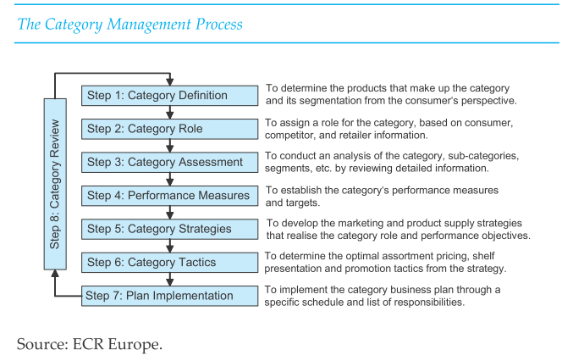
Category management

Slide 27
Category strategies
Traffic building
Transaction building
Profit generating
Image creating

Slide 28
Category strategies – Traffic building
Attracting many customers to the store, for example, by offering price promotions for frequently purchased products.

Slide 29
Category strategies – Transaction building
Enhancing the average size of the shopping basket, for example, by exploiting demand interrelationship in the space allocation in stores or encouraging impulse purchases.

Slide 30
Category strategies – Profit generating
Enhancing profitability of customers' shopping baskets, by offering products with high margins.

Slide 31
Category strategies – Image creating
Improving the retailer's image, by offering products that are sold uniquely at the retailer or offering an outstanding choice in the category.

Slide 32
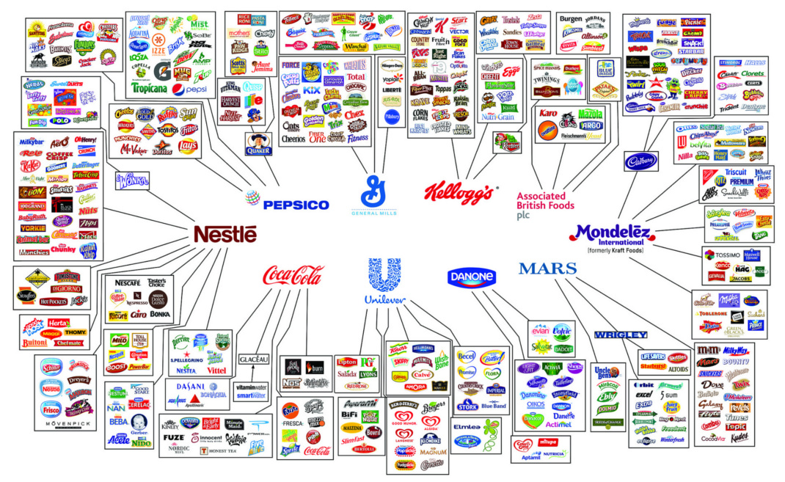
Notes:
Illusion of choice

Slide 33
BCG Matrix
Question marks
Dogs
Stars
Cash cows
Most famous portfolio analysis is Boston Consulting Group Matrix .
Logic: profitability of different strategic business units is aligned with share and growth.
Result: Model BCG which sort SBU

Slide 34
BCG Model
Market growth rate | High | STARS Growing profit | QESTION MARKS Low profit
 | Low | CASH COWS Highest profit | DOGS Lowest profit
 |  | High | Low
 |  | Relative market share
20%
10%
0%
10x
1x
0,1x

Slide 35
BCG Model
Stars
  Requieres lots of investments and managing effort
  Strong competition in the segments
Cash Cows
  Established well functioning units.
  Generates valuable profits for other unists.

Slide 36
BCG Model
Question marks
  Requires extensive investments to maintain market share.
  Management have to decide which of these will progress to Stars.
Dogs
  Can generate sufficient amount of profits to survive.
  Has no bright future ahead of them.

Slide 37
Excercise for BCG Matrix
P&G porduct portfolio:
 | Relative market share | Market growth rate | Profit | Liquidity
Gilette | 3,2 | 6% | 1 560 | 2,2
Old Spice | 1,5 | 10% | 752 | 1,2
Vicks | 0,7 | 15% | 25 | 5,7
Braun | 0,2 | 2% | 44 | 4,3
Garnier | 1,2 | 11% | 82 | 0,2
Lacoste | 0,4 | 2% | 405 | 1,1

Slide 38
BCG model and lifecycle
Question
marks
Stars
Cash cows
Dogs
Sales
Introduction
Growth
Maturity
Decline
Time

Slide 39
BCG model and lifecycle
Stars
Question mark
Market growth rate
Cash cow
Dogs
Relative market share

Slide 40

Thank you for your attention

