Slide 1

Trade Organizations
Strategy, tactics and operations

Slide 2
Outline of the lecture
Strategic marketing
Marketing objectives

Slide 3
PART 1

Slide 4
PART1: Strategic marketing
Strategy and strategic marketing.
Levels of strategy formulation.
Mostly used business strategies of trade organizations.

Slide 5
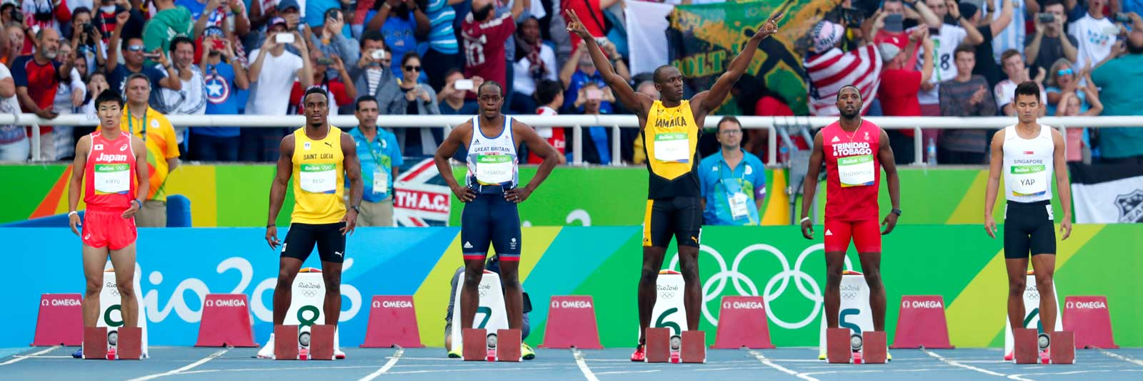
Who will win?

Slide 6
Strategy
Is a process that can allow an organization to concentrate its resources on the optimal opportunities with the goals of increasing sales and achieving a sustainable competitive advantage.

Slide 7
STRATEGY AND STRATEGIC MARKETING
Strategic marketing is associated with the search for long-term sustainability of business.
Competitive advantage and results of marketing situational analysis are key elements for selecting and formulating appropriate marketing strategies.
Strategy is generally a way how to achieve goals under specific circumstances.
To create the right strategy, we must know the objective that we want to achieve through it.

Slide 8
Stakeholders in retail
Owners (shareholders): strive for security and some capital appreciation.
Managers: prefer a dynamic company development.
Employees: interested in satisfying their needs.
Customers: require adequate supply in the right structure and price, service.
Suppliers: strive to optimize purchases and serious relationships, financial solvency and compliance with contractual terms.

Slide 9
Stakeholders in retail
Creditors: require the agreed repayment obligations.
Competitors: seek better market position, market share and extend into the territories of other companies.
Government: prefers compliance with laws and regulations, and government programs in line with national trade policy.
Trade unions: seek participation in government programs, so that they can help create an environment for business.
Labour unions: they have the same interests as other companies (comparability of wages, employment stability, working conditions).

Slide 10
Role of strategy in todays fast changing, dynamic and unpredictible world?
Notes:
Je tedy nutné v dnešním rychle se měnícím světě dělat nějaké strategie?

Slide 11
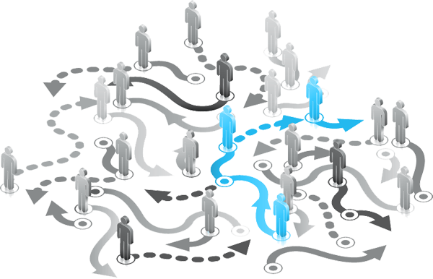
What is strategy?
Strategy asnwers three key questions
  Where are we now?
  Where do we want to go?
  How are we going to get there?
Is strategy connected with action?
„I‘m gonna wait for the next big thing“
Steve Jobs
Notes:
Strategie je také něco nedělat, nechat firmu přežít a čekat. Jobs v situaci pokraje bankrotu nemohl mít ambice, jinak by Apple zničil. Počkal na další velkou věc a to byl iPod

Slide 12
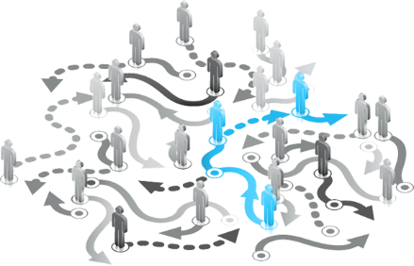
Strategy consist of three key areas
  Diagnosis
    That defines or explains nature of the challenge.
    Good diagnosis simplify overwhelming complexity of reality by identifying certain aspects as critical.
  Guiding policy
    Overall approach chosen to cope with or overcome the obstacles identified in the diagnosis.
  Coherent actions
    Designed to carry out the guiding policy.
    Steps coordinated with one another to work together in accomplishing the guiding policy.
Notes:
Rumelt in his book Good Strategy Bad Strategy

Slide 13
Steps of Strategic Marketing Management
Company Vision
Company Mission
Strategic Objectives
Situation Analysis
SWOT Analysis
Marketing Objectives
Marketing Strategy
Controlling
What we want to achieve in the Future.
What do we have Now?
Continuous processes to get to the desired future.
Did we get there?

Slide 14
Vision without action is dreaming.
Action without vision is nightmare.

Slide 15
Company Vision
Companies that enjoy enduring success have core values and a core purpose that remain fixed while their business strategies and practices endlessly adapt to a changing world.
Vision provides guidance about what core to preserve and what future to stimulate progress toward.
A well-conceived vision consists of two major components: core ideology and envisioned future.

Slide 16
Company Mission
A mission statement is a statement of the purpose of a company, organization or person, its reason for existance.
The mission statement should guide the actions of the organization, spell out its overall goal, provide a path, and guide decision-making.
It provides "the framework or context within which the company's strategies are formulated."

Slide 17

A: We produce mobile phones.
B: We enabe people to communicate.
C: We want to earn 54% of the global mobile market in 2018.

Slide 18
Mission
Business mission has to be market oriented, not product oriented!
Products come and go but human needs will last forever.
Marketing approach: Process of satysfying consumer needs not the production process of goods and services.
This approach ensures adaptability to market changes.

Slide 19
Strategic Objectives
Strategic objectives are long-term, continuous strategic areas that help you connect your mission to your vision.
Holistic objectives encompass four areas: financial, customer, operational, and people.
What are the key activities that you need to perform in order to achieve your vision?

Slide 20
Strategic goals
Broader perspective than marketing goals
Ansoff growth matrix can be utilised as one of very effective way of setting up the general direction of the business
There are two fundamental questions:
  Which customers?
  What products?

Slide 21
Ansoff matrix development
Product
Existing
New
Market penetration
Product development
Existing
Market
Market development
Diversification
New

Slide 22
Goals
S.M.A.R.T.
Notes:
SPECIFIC, MEASURED, ACCEPTABLE, REALISTIC, TIME RELATED

Slide 23
SMART Goals example
Our goal is to improve our branding
  No specific – what is branding, what is to improve.
  No measurable – how we can assess it has been done?
  No achievable or realistic – you cannot assess if the goal is achievable since there is no change specified.
  No timely – there is no time frame in which the goal should be met.

Slide 24
SMART Goals example
Our goal is to improve our branding
By the end of 2021, brand XY will have brand awareness measured by brand recognition among all customers in Czech Republic on the level of 45 % from the current 35 %.

Slide 25
Marketing audit (situational analysis)
External analysis
  Macro-environment (PESTLE)
  Micro-environment (3C, 5 competitive forces)
Internal analysis

Slide 26
SWOT analysis design
Positive
Negative
S
W
Strenghts
Weaknesses
Internal
O
T
Opportunities
Threats
External

Slide 27

Common mistakes SWOT
It does not reflect situational analysis results
Confused strenghts and opportunities as well as weaknesses and threats
Unballanced number of specific SWOT elements
Matrix is not evaluated, in that case it is only overview not strategic tool
Highly subjective or indefinite
There is no connection to marketing objectives in next step of the strategic process

Slide 28
Create your personal SWOT analysis

Slide 29
Tactics 4C / 4P
Tactical decision making in range of months or quarters is dominantly done through marketing mix:
What solution do we provide to customer?
  (CUSTOMER / product)
What cost does the customer have?
  (COSTS / price)
How convenient is our delivery and service?
  (CONVENIENCE / place)
How do we communicate the value to the customer?
  (COMMUNICATION / promotion)

Slide 30
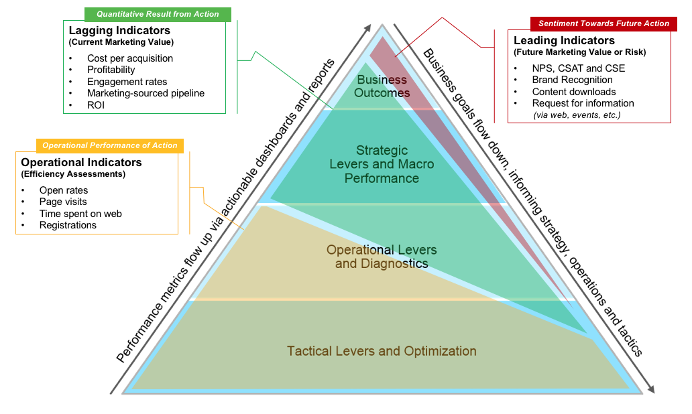
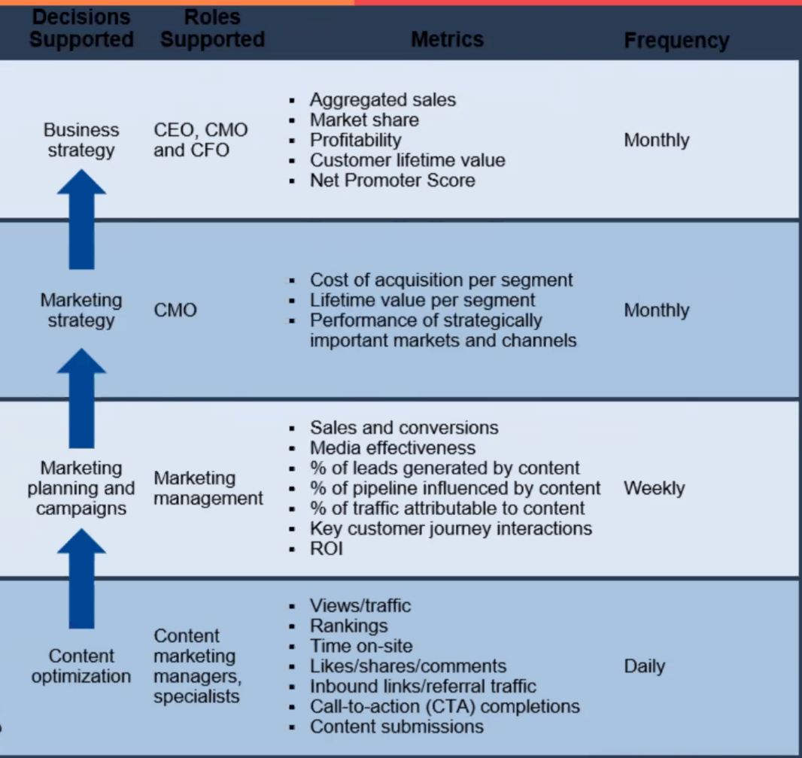

Slide 31
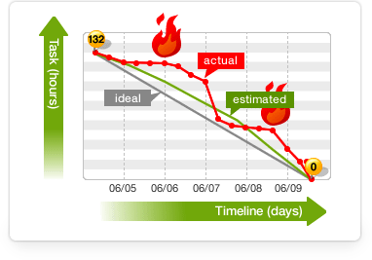
Control
Strategic control
  Year
  Month
  Week
  Day
Definition of metrics to be measured and controled in order to achieve strategic goals while fulfilling business mission
Evaluation and ongoing adjustments

Slide 32
Retail strategies examples – trading up
Trading up is a strategy, which the company uses when the consumer demand is growing.
The company expands and deepens the range of products offered, for which there is currently an increased interest of customers, and provides a high level of purchasing conditions for perfect operation with qualified personnel.
Increased costs can be covered through higher selling price and higher profit margins.

Slide 33
Retail strategies examples – trading down
Trading down strategy will be used during a downturn in demand for goods, reduction in the width and depth of assortment is necessary, mainly including simplified maintenance or move the range to stores with lower service levels.
We respond by lowering prices to the decline in demand, which at the same time forces us to reduce operating costs in order to limit own losses.

Slide 34
PART 2

Slide 35
PART 2 : Marketing objectives
Intro into Strategic business units and exercise.
Marketing objectives and retailers decisions.
International retailing development strategy.

Slide 36
Strategy procedure
Every business entity in the market has some goals, arising from the company mission.
The company analyzes its surroundings to set these goals and formulate a strategy.
This strategy then governs marketing objectives, including marketing mix.
Every retail company should follow this procedure.

Slide 37
The marketing strategy of retail business focuses on the following areas:
A. Decision on the target market.
B. Decisions on assortment and services.
C. Decisions on price.
D. Decision on promotion and communications.
E. Decision on location.

Slide 38
A. DECISION ON THE TARGET MARKET
Selecting a target market stems from the segmentation of the market and may have different criteria, such as solvency of customers, social status, age group, gender, location-specific etc.
Company must identify key customers and decide on the form of entry.

Slide 39
B. DECISIONS ON ASSORTMENT AND SERVICES
Decisions on assortment and services must conform to the expectations of the target market.
Assortment of goods – width, depth, quality.
Services and differentiation strategy - fashion shows, gift wrapping, free parking, childcare, refreshments, etc. Differentiation strategy may represent a competitive advantage for merchants selling the same products,
Store atmosphere and form of sale.

Slide 40
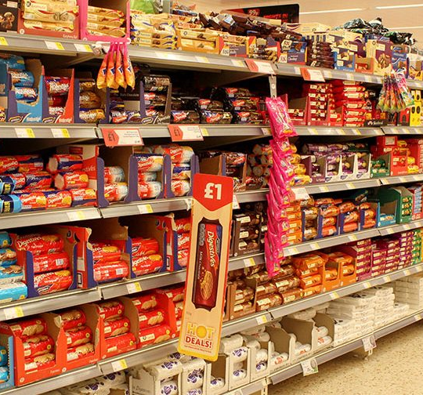
POS presentation
It is related to the atmosphere of the store, as it represents the point of purchase, personnel training, etc.
Atmosphere should attract target customers.
It is not only the spatial layout and interior design (music, colors, shapes), but also the staff who co-create the first impression obtained from the store.

Slide 41
C. DECIDING ON PRICE
In terms of deciding the price, the majority of retailers fall into two basic groups, which utilize higher or lower price than the average market price:
  The first group realizes high profit margins (higher purchase prices, higher operating costs, lower sales volumes). Luxury goods, specialty and designer shops.
  The second group realizes low profit margin (lower purchase prices, lower operating costs and higher sales volumes). Large-scale retail supermarkets, hypermarkets and discount stores.

Slide 42
C. DECIDING ON PRICE
Deciding on a price is based on the pricing objectives, which are fully subject to the marketing strategy of the company. E.g. increasing traffic to stores, increased sales volumes, sales of slowly turning goods, market penetration, win customers from competitors etc.
The prices are a key factor in positioning and must be referenced to a market targeting, product mix and competition.

Slide 43
What is typical margin in retail?
Notes:
30%

Slide 44
D. DECISION ON COMMUNICATIONS
Also, the decision on communication is a reflection of the target market. E.g. stores with cheap goods use simple promotional materials and fewer trained personnel, whereas the luxury shops and businesses do not use mass media that often, but they are putting their ads in prestigious magazines that are read by their customers, also have highly trained staff.

Slide 45
D. DECISION ON COMMUNICATIONS
Decisions on communications is nowadays much more complicated task as we have to include the whole communication mix, which does not consist of only advertising but also other elements, such as sales support, public relations, direct marketing and other.
Our communication also has to be integrated – it has synergistic effect.

Slide 46
E. DECISION ON LOCATION
Store location can be divided into selection of continent, country, region, settlement unit and a particular place in it.
Localization is based on an analysis of the territorial aspects of trade enterprise and competition.
In the framework of territorial and market analysis, we define an area of interest and estimate the sales potential of the site, which influenced the decision of companies about specific store location.

Slide 47
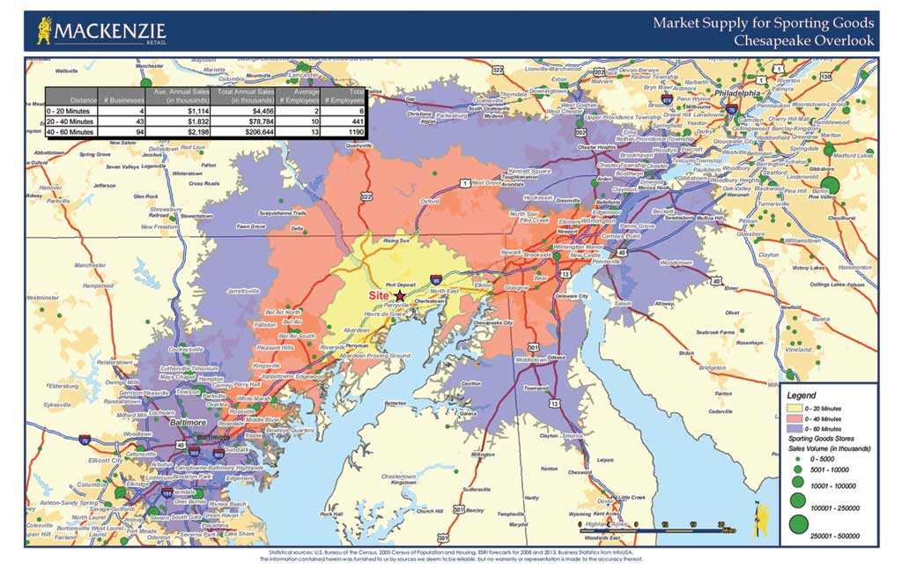

Slide 48
INTERNATIONAL RETAILING DEVELOPMENT STRATEGY
The success rate of entry into foreign markets is influenced by many factors.
Most important is the selection of an appropriate strategy, assess its benefits and risks.
Meffert talks about three kinds of strategies that the international business benefit: international, multinational and global.

Slide 49
Multinational strategy
Multinational strategy is a strategy of expanding retail activities with strict adaptation of assortment, services, and market behavior to local conditions.
This activity is associated with relatively high costs and does not allow an aggressive pricing policy.
New market entry is quite easy, but in terms of the level of prices, further expansion of the company is difficult.

Slide 50
Transnational strategy
Transnational strategy is a unified strategy with respect for fundamental particularities of national markets and the local conditions and the use of global knowledge and expertise.
Applying this strategy is very challenging and progressively leads to the understanding of global markets.
Among the best-known companies include e.g. C & A, selling clothes in different countries, in which it holds various positions.

Slide 51
Global strategy
Global strategy represents the consistent application of own domestic approach to foreign markets. Companies reach a relatively low cost (bulk purchase, unified know-how, other joint activities).
Prevalent ignorance of national and local differences.
Among the best known businesses include McDonald, Ikea, Benneton etc.
Companies seek to offer products with strong globalization potential, e.g. consumer electronics, mobile phones, furniture, etc.

Slide 52

Thank you for your attention

