Slide 1

Business Strategy
Ing. Šárka Zapletalová, Ph.D.
Department of Business Economics and Management
STRATEGIC MANAGEMENT

Slide 2

Outline of the lecture
Business strategy
Competitive strategy
Generic competitive strategies
Cooperative strategies

Slide 3
Introduction
Business strategy is focused on improving the competitive position of a company’s or business unit’s products or services within the specific industry or market segment that the company or business unit serves.
Business strategy can be competitive (battling against all competitors for advantage) and/or cooperative (working with one or more companies to gain advantage against other competitors).
Michael Porter proposes two “generic” competitive strategies for outperforming other corporations in a particular industry: lower cost and differentiation.

Slide 4
Business Strategy
Business strategy usually occurs at the business unit or product level, and it emphasizes improvement of the competitive position of a corporation’s products or services in the specific industry or market segment served by that business unit.
Business strategies may fit within the two overall categories, competitive and cooperative strategies.
Cooperative strategy may thus be used to provide a competitive advantage.
  For example, Intel, a manufacturer of computer microprocessors, uses its alliance (cooperative strategy) with Microsoft to differentiate itself (competitive strategy) from AMD, its primary competitor.

Slide 5
Business Strategy
Business strategy is focused on improving the competitive position of a company’s or business unit’s products or services within the specific industry or market segment that the company or business unit serves.
Business strategy is extremely important because research shows that business unit effects have double the impact on overall company performance than do either corporate or industry effects.
Business strategy can be competitive (battling against all competitors for advantage) and/or cooperative (working with one or more companies to gain advantage against other competitors).
Just as corporate strategy asks what industry(ies) the company should be in, business strategy asks how the company or its units should compete or cooperate in each industry.

Slide 6
Competitive Strategy
Porter´s competitive strategy raises the following questions:
  Should we compete on the basis of lower cost (and thus price), or should we differentiate our products or services on some basis other than cost, such as quality or service?
  Should we compete head to head with our major competitors for the biggest but most sought-after share of the market, or should we focus on a niche in which we can satisfy a less sought-after but also profitable segment of the market?
Michael Porter proposes two “generic” competitive strategies for outperforming other corporations in a particular industry: lower cost and differentiation.

Slide 7
Competitive Strategy
These strategies are called generic because they can be pursued by any type or size of business firm, even by nonfor- profit organizations:
  Lower cost strategy is the ability of a company or a business unit to design, produce, and market a comparable product more efficiently than its competitors.
  Differentiation strategy is the ability of a company to provide unique and superior value to the buyer in terms of product quality, special features, or after-sale service.
Porter further proposes that a firm’s competitive advantage in an industry is determined by its competitive scope, that is, the breadth of the company’s or business unit’s target market.

Slide 8
Competitive Strategy
Before using one of the two generic competitive strategies (lower cost or differentiation), the firm or unit must choose the range of product varieties it will produce, the distribution channels it will employ, the types of buyers it will serve, the geographic areas in which it will sell, and the array of related industries in which it will also compete.
Acompany or business unit can choose a broad target (that is, aim at the middle of the mass market) or a narrow target (that is, aim at a market niche).
Combining these two types of target markets with the two competitive strategies results in the four variations of generic strategies.

Slide 9
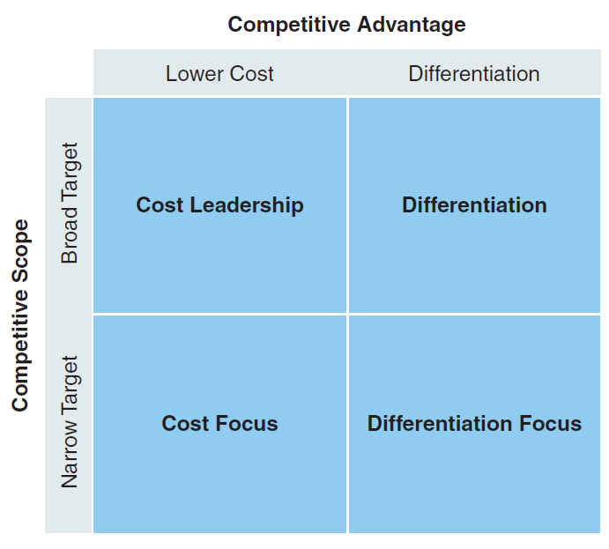
Competitive Strategy
Porter’s Generic Competitive Strategies
When the lower-cost and differentiation strategies have a broad mass-market target, they are simply called cost leadership and differentiation.
When they are focused on a market niche (narrow target), however, they are called cost focus and differentiation focus.

Slide 10
Generic Competitive Strategies
Cost leadership
Cost leadership is a lower-cost competitive strategy that aims at the broad mass market and requires “aggressive construction of efficient-scale facilities, vigorous pursuit of cost reductions from experience, tight cost and overhead control, avoidance of marginal customer accounts, and cost minimization in areas like R&D, service, sales force, advertising, and so on.
  Because of its lower costs, the cost leader is able to charge a lower price for its products than its competitors and still make a satisfactory profit. Although it may not necessarily have the lowest costs in the industry, it has lower costs than its competitors.
  Some companies successfully following this strategy are Wal-Mart (discount retailing), McDonald’s (fast-food restaurants), Dell (computers), Alamo (rental cars), Aldi (grocery stores), Southwest Airlines, and Timex (watches).

Slide 11
Generic Competitive Strategies
Having a lower-cost position also gives a company or business unit a defense against rivals.
Lower costs allow it to continue to earn profits during times of heavy competition. High market share means that it will have high bargaining power relative to its suppliers (because it buys in large quantities).
Low price will also serve as a barrier to entry because few new entrants will be able to match the leader’s cost advantage. As a result, cost leaders are likely to earn above-average returns on investment.

Slide 12
Generic Competitive Strategies
Differentation strategy
Differentiation is aimed at the broad mass market and involves the creation of a product or service that is perceived throughout its industry as unique.
The company or business unit may then charge a premium for its product. This specialty can be associated with design or brand image, technology, features, a dealer network, or customer service.
Differentiation is a viable strategy for earning above-average returns in a specific business because the resulting brand loyalty lowers customers’ sensitivity to price. Increased costs can usually be passed on to the buyers.

Slide 13
Generic Competitive Strategies
Buyer loyalty also serves as an entry barrier; new firms must develop their own distinctive competence to differentiate their products in some way in order to compete successfully.
  Examples of companies that successfully use a differentiation strategy are Walt Disney Productions (entertainment), BMW (automobiles), Nike (athletic shoes), Apple Computer (computers and smart phones), and Pacar (trucks).
Research does suggest that a differentiation strategy is more likely to generate higher profits than does a low-cost strategy because differentiation creates a better entry barrier.
A low-cost strategy is more likely, however, to generate increases in market share.

Slide 14
Generic Competitive Strategies
Cost focus
Cost focus is a low-cost competitive strategy that focuses on a particular buyer group or geographic market and attempts to serve only this niche, to the exclusion of others.
  In using cost focus, the company or business unit seeks a cost advantage in its target segment.
Differentiation focus
Differentiation focus, like cost focus, concentrates on a particular buyer group, product line segment, or geographic market.
  In using differentiation focus, a company or business unit seeks differentiation in a targeted market segment.
  This strategy is valued by those who believe that a company or a unit that focuses its efforts is better able to serve the special needs of a narrow strategic target more effectively than can its competition.

Slide 15
Blue Ocean Strategy
Competitive scope |  | Competitive advantage
 |  | Lower cost | Differentiation
 | Broad target | Cost leadership | Differentiation
 | Narrow target | Cost focus | Differentiation focus
Blue ocean strategy
vs.
Stuck in the middle
Prostor pro doplňující informace, poznámky

Slide 16
Blue Ocean Strategy
costs
total perceived consumer benefits
value innovation
Prostor pro doplňující informace, poznámky

Slide 17
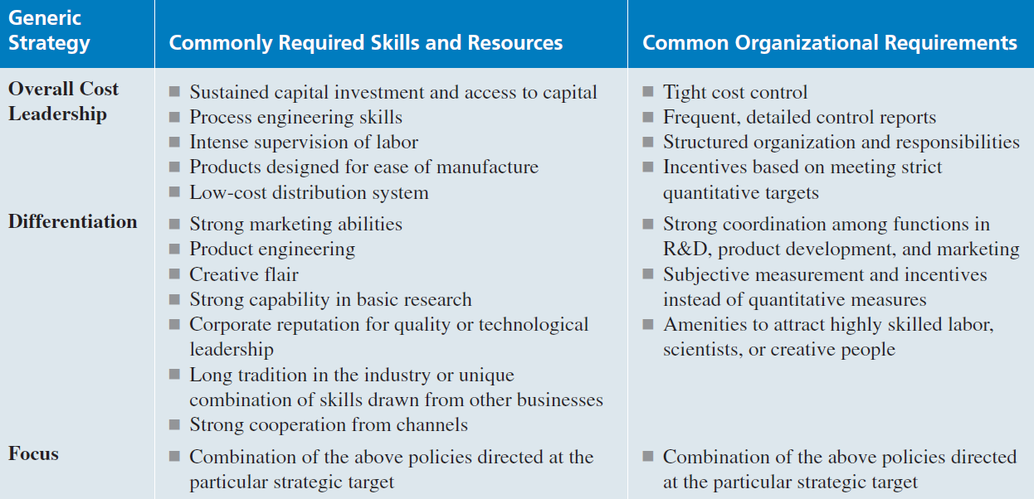
Generic Competitive Strategies
Requirements for Generic Competitive Strategies

Slide 18
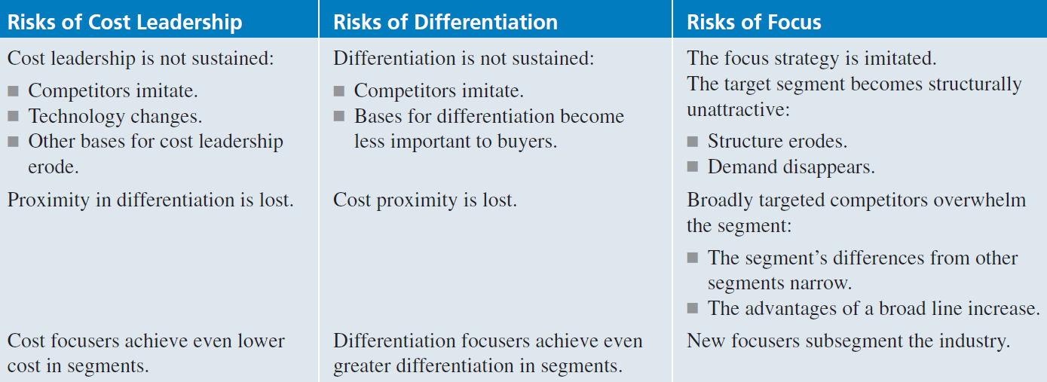
Generic Competitive Strategies
Risks in Competitive Strategies
Each of the generic strategies has risks.
  For example, a company following a differentiation strategy must ensure that the higher price it charges for its higher quality is not too far above the price of the competition; otherwise customers will not see the extra quality as worth the extra cost. This is what is meant in by the term cost proximity.

Slide 19
Competitive Strategies
Issues in Competitive Strategies
Porter argues that to be successful, a company or business unit must achieve one of the previously mentioned generic competitive strategies.
Otherwise, the company or business unit is stuck in the middle of the competitive marketplace with no competitive advantage and is doomed to below-average performance.
  The Toyota and Honda auto companies are often presented as examples of successful firms able to achieve both of these generic competitive strategies. Thanks to advances in technology, a company may be able to design quality into a product or service in such a way that it can achieve both high quality and high market share - thus lowering costs.

Slide 20
Competitive Strategies
Although there is generally room for only one company to successfully pursue the massmarket cost leadership strategy (because it is so dependent on achieving dominant market share), there is room for an almost unlimited number of differentiation and focus strategies (depending on the range of possible desirable features and the number of identifiable market niches).
Quality, alone, has eight different dimensions each with the potential of providing a product with a competitive advantage.
  Most entrepreneurial ventures follow focus strategies. The successful ones differentiate their product from those of other competitors in the areas of quality and service, and they focus the product on customer needs in a segment of the market, thereby achieving a dominant share of that part of the market.

Slide 21
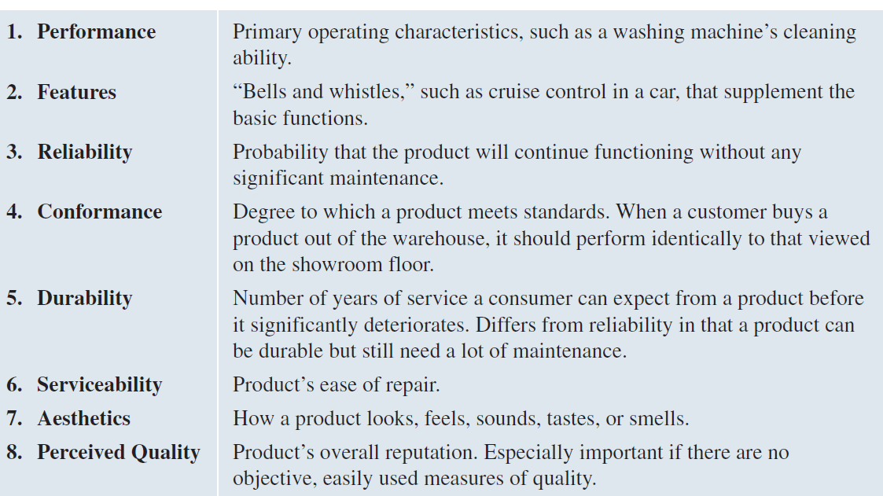
Competitive Strategies
Issues in Competitive Strategies: Quality
The Eight Dimensions of Quality

Slide 22
Competitive Strategies
Industry Structure and Competitive Strategy
In a fragmented industry, for example, where many small- and medium-sized local companies compete for relatively small shares of the total market, focus strategies will likely predominate.
Fragmented industries are typical for products in the early stages of their life cycles. If few economies are to be gained through size, no large firms will emerge and entry barriers will be low - allowing a stream of new entrants into the industry.
  Chinese restaurants, veterinary care, used-car sales, ethnic grocery stores, and funeral homes are examples.
  If a company is able to overcome the limitations of a fragmented market, however, it can reap the benefits of a broadly targeted cost-leadership or differentiation strategy.
  Until Pizza Hut was able to use advertising to differentiate itself from local competitors, the pizza fastfood business was a fragmented industry composed primarily of locally owned pizza parlors, each with its own distinctive product and service offering.

Slide 23
Competitive Strategies
Industry Structure and Competitive Strategy
As an industry matures, fragmentation is overcome, and the industry tends to become a consolidated industry dominated by a few large companies.
Although many industries start out being fragmented, battles for market share and creative attempts to overcome local or niche market boundaries often increase the market share of a few companies.
After product standards become established for minimum quality and features, competition shifts to a greater emphasis on cost and service.
  Slower growth, overcapacity, and knowledgeable buyers combine to put a premium on a firm’s ability to achieve cost leadership or differentiation along the dimensions most desired by the market. R&D shifts from product to process improvements. Overall product quality improves, and costs are reduced significantly.

Slide 24
Competitive Strategies
Industry Structure and Competitive Strategy
The strategic rollup was developed in the mid-1990s as an efficient way to quickly consolidate a fragmented industry.
  With the aid of money from venture capitalists, an entrepreneur acquires hundreds of owner-operated small businesses.
  The resulting large firm creates economies of scale by building regional or national brands, applies best practices across all aspects of marketing and operations, and hires more sophisticated managers than the small businesses could previously afford.
Rollups differ from conventional mergers and acquisitions in three ways:
  they involve large numbers of firms,
  the acquired firms are typically owner operated,
  the objective is not to gain incremental advantage, but to reinvent an entire industry.

Slide 25
Competitive Strategies
Industry Structure and Competitive Strategy
Once consolidated, an industry has become one in which cost leadership and differentiation tend to be combined to various degrees, even though one competitive strategy may be primarily emphasized.
A firm can no longer gain and keep high market share simply through low price.
The buyers are more sophisticated and demand a certain minimum level of quality for price paid.
  Even Mc-Donald’s, long the leader in low-cost fast-food restaurants, has been forced to add healthier and more upscale food items, such as Asian chicken salad, comfortable chairs, and Wi-Fi Internet access in order to keep its increasingly sophisticated customer base.

Slide 26
Cooperative Strategies
Collusion
Collusion is the active cooperation of firms within an industry to reduce output and raise prices in order to get around the normal economic law of supply and demand.
Collusion may be explicit, in which case firms cooperate through direct communication and negotiation, or tacit, in which case firms cooperate indirectly through an informal system of signals.
Explicit collusion is illegal in most countries and in a number of regional trade associations, such as the European Union.

Slide 27
Cooperative Strategies
Strategic Alliances
A strategic alliance is a long-term cooperative arrangement between two or more independent firms or business units that engage in business activities for mutual economic gain.
Alliances between companies or business units have become a fact of life in modern business.
Some alliances are very short term, only lasting long enough for one partner to establish a beachhead in a new market.
Many alliances do increase profitability of the members and have a positive effect on firm value.

Slide 28
Cooperative Strategies
Mutual Service Consortia
A mutual service consortium is a partnership of similar companies in similar industries that pool their resources to gain a benefit that is too expensive to develop alone, such as access to advanced technology.
The mutual service consortia is a fairly weak and distant alliance - appropriate for partners that wish to work together but not share their core competencies. There is very little interaction or communication among the partners.

Slide 29
Cooperative Strategies
Joint Venture
A joint venture is a cooperative business activity, formed by two or more separate organizations for strategic purposes, that creates an independent business entity and allocates ownership, operational responsibilities, and financial risks and rewards to each member, while preserving their separate identity/autonomy.
Joint ventures are the most popular form of strategic alliance. They often occur because the companies involved do not want to or cannot legally merge permanently.
Joint ventures provide a way to temporarily combine the different strengths of partners to achieve an outcome of value to all.

Slide 30
Cooperative Strategies
Joint Venture
Extremely popular in international undertakings because of financial and political–legal constraints, forming joint ventures is a convenient way for corporations to work together without losing their independence.
Disadvantages of joint ventures include loss of control, lower profits, probability of conflicts with partners, and the likely transfer of technological advantage to the partner.
Joint ventures are often meant to be temporary, especially by some companies that may view them as a way to rectify a competitive weakness until they can achieve long-term dominance in the partnership.

Slide 31
Cooperative Strategies
Licensing Arrangements
A licensing arrangement is an agreement in which the licensing firm grants rights to another firm in another country or market to produce and/or sell a product.
The licensee pays compensation to the licensing firm in return for technical expertise.
Licensing is an especially useful strategy if the trademark or brand name is well known but the MNC does not have sufficient funds to finance its entering the country directly.

Slide 32
Cooperative Strategies
Value-Chain Partnerships
A value-chain partnership is a strong and close alliance in which one company or unit forms a long-term arrangement with a key supplier or distributor for mutual advantage.
  To improve the quality of parts it purchases, companies in the U.S. auto industry, for example, have decided to work more closely with fewer suppliers and to involve them more in product design decisions.
  Activities that had previously been done internally by an automaker are being outsourced to suppliers specializing in those activities.

