Slide 1

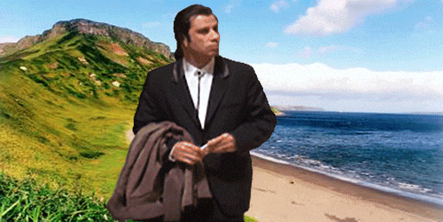
Online and Content Marketing
Ing. Michal Stoklasa, Ph.D.
Marketing Communication
GIFs and MEMEs 4 lyfe! xD

Slide 2
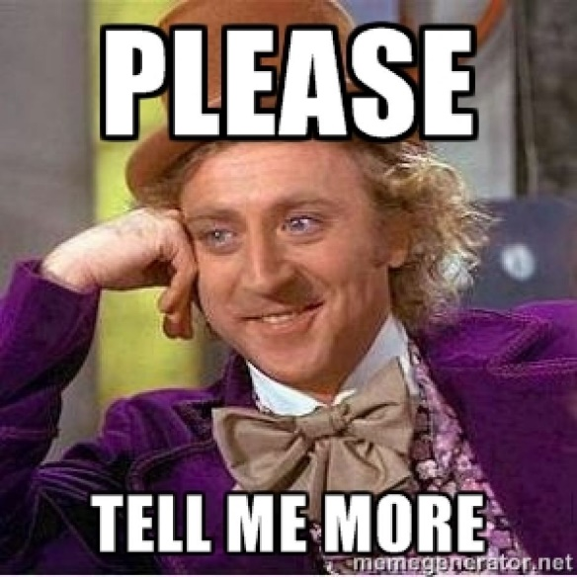
Content
1 Online Marketing Communication tools.
2 Content Marketing – tools, advantages, disadvantages.
3 Tools of Content Marketingu.
4 Designing a Content Marketing Campaign.
Notes:
csvukrs

Slide 3
1 Online Marketing Communication tools
Website
Social media
SEO
Mobile marketing
Webinar
Content marketing
Online ads
Email Campaign
Newsletter
Notes:
csvukrs

Slide 4
Website
This is our main communication tool on the internet!
Many other tools are usable only thanks to our website (PPC, SEO, ads etc.).
If we include e-shop – web is our main tool for e-commerce.
Notes:
csvukrs

Slide 5
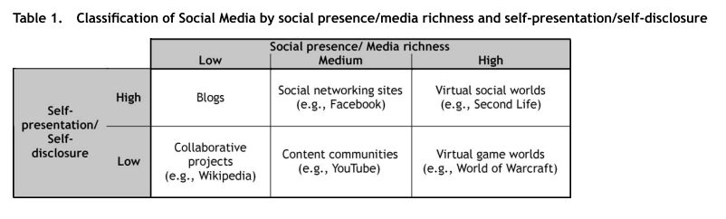
Social Media

Slide 6
SEO
SEO – search engine optimization.
We are trying to be up high in the Google ranking.
SEO means a set of activities on my website to place higher in the Google search.
Usually its things connected with text, audio-video, the whole wireframe of the page.
Notes:
csvukrs

Slide 7
Webinars
A highly effective tool for products with which some expertise is associated: consulting services, financial services, coaching and mentoring, education, B2B industries, web design and IT in general.
A possible means of overcoming the inaccuracy of the service - free trial.
For complex products it can be a tool that explains the problem and describes the value and benefits for the customer.
Effective on the B2B market as a tool for gaining feedback.
Notes:
csvukrs

Slide 8
Online Ads
Banners, popups, buttons
Catalog entries
PPC - pay per click systems (Adwords, Etarget, Facebook)
Notes:
csvukrs

Slide 9
2 Content Marketing
Content marketing is based on the creation and placement of useful and valuable content that will attract and engage in communication our desired customers, and also bring them to action that will lead to a sale. Excellent explanations and definitions here.
Content marketing is basically the ability to communicate with your prospects without pushing/forcing them. Instead of expensive advertising for your products and services, you bring valuable and interesting information that helps and educates your buyers.
Content marketing is more than just internet marketing or online marketing. The essence of content marketing is the fact that if you regularly and deliberately provide valuable information to buyers, they will reward you with their purchases and loyalty.
Notes:
csvukrs

Slide 10
Definition of content marketing
Doing content marketing means creating free and regular high quality content that your listeners will share and will be useful or enjoyable. The quality of the content will attract some of them and they will begin to understand your business in more detail. They can then become customers. And if you set the processes well and customers will be satisfied, customers will become returning clients. By publishing high-quality educational content, customers trust you, like you and want to trade with you. – from Copyblogger.
Content =/= Content strategy =/= Content Marketing.
Content has been here since ever, but the Internet has allowed us to easily share tons of content, that has transformed consumer behavior and the customer requires it.

Slide 11
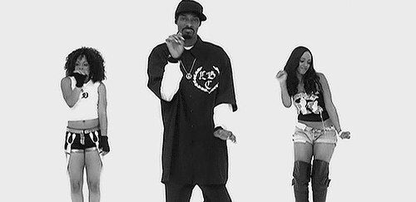
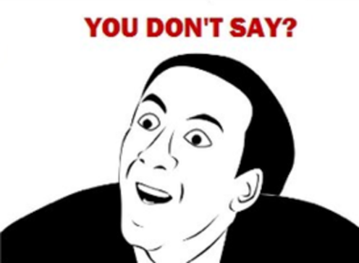
Content marketing tools
Text - article, story, post, blog, e-book, etc.
Image (audio-video) - image, video, audio track, podcast, vodcast, GIF, meme, flash, banner, pop-up, QR, infographics etc.
(list is not exhaustive!)

Slide 12
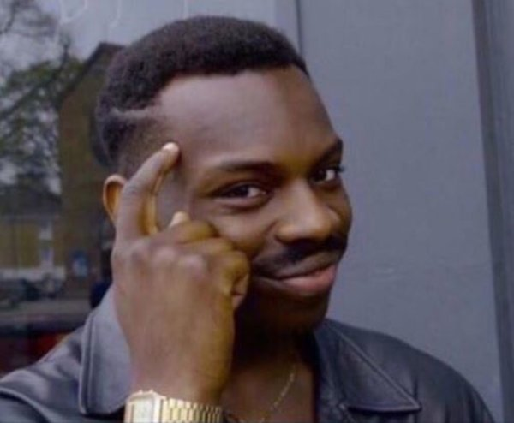
Content marketing
The main idea is to create interesting content, not direct pressure on sales.
Content marketing is also important for SEO - search engine optimization. (not just text, but also videos and pictures that we correctly text!)
Most companies already do it without realizing it. Today we are trying to do it conceptually. Consequently, content marketing is a long-term conceptual approach to content creation, everything has its own order, its idea, and it is directed to the set goal.

Slide 13
The essence of content marketing
The essence is interesting content. This article sums it up very well - indeed, the content can not be done by anyone without the appropriate skills, it will not fast and it will not be cheap. It will help with communication (we can use it for PR, social media, advertising), it builds the community, it is the only way how to do SEO, and slowly it will build conversions (but it is very slow, also hard to measure).
Content is closely related to SEO - search - keyword analysis. I have to understand what people are looking for to be able to bring them to me.
We will need a lot of people for a decent content strategy! Someone on the back end - SEO, PPC, and someone on the "front end" - copywriter, graphic designer (photo, video), marketing specialist (strategy and creative).

Slide 14

The benefits of content marketing (Řezníček and Procházka, 2014, p. 30-32)
It supports the growth of the entire business - sales, we grow as a content-making team.
Helps create new demand - quality content attracts new customers.
We'll save on advertising - quality content will attract people.
Consumers are interested in us - we attract visitors organically.
We become the go to proffesionals in the field - we create educational content, we advise consumers, we become indispensable.
We will get valuable natural backlinks - sharing + SEO.
Our social networks will grow - quality content = more faithful fans.
We build confidence - we share our identity (corporate culture) within the content, creating a good relationship with the customer.

Slide 15
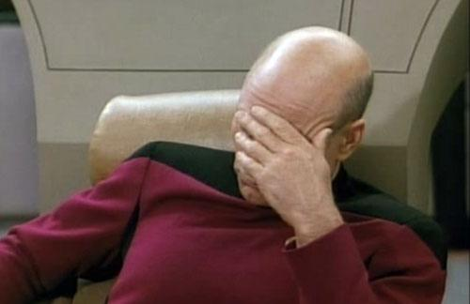
Disadvantages of content marketing (Řezníček and Procházka, 2014, p. 32-34)
It's time-consuming - there is a delay between content and some effect. Furthermore, the creation of content is substantially more demanding.
Difficult measurability - for PPC tools, we are able to instantly measure the effect, but it is not that easy for content.
Quality writers - content is often based on texts but also on quality videos.
Content needs to be promoted - content created must be able to reach people.
Content marketing is not flexible - due to trends and hits, existing content may be outdated very quickly.

Slide 16
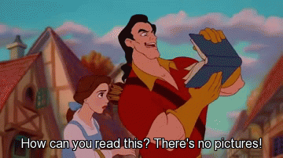
Task – 1st part
Choose one of your favorite companies and analyze what content they are doing.
Why do you think they do this type of content?
10 minutes.

Slide 17
3 Tools of content marketing - (Řezníček and Procházka, 2014, p. 99-108)
Content for beginners - thematic tutorials for absolute beginners, classic "how to" tutorials.
Content explaining basic questions - how, why, when, where? Helps readers understand our field, our work, our offer.
Contest Presentations - competitions are relatively popular and always generate action.
Interview with authority in the industry - a renowned expert will give us an interview, it is a favorite reader's content, but the expert himself helps us to spread the content.
News in the field - current news about what's happening in the industry. People like to share these articles.

Slide 18
Tools of content marketing - (Řezníček and Procházka, 2014, p. 99-108)
Controversial views - attract attention.
Infographics - present hard data in a simpler visual form. Ideally, if we can get our offer into this infographic.
Case studies - they capture a real example from practice, readers can get first-hand experience of a situation and how it was solved.
Guest posting - is an article prepared for another site that has the task of attracting attention and attracting new readers.
Resource lists - interesting information sources from the industry.
Backstage news - what's happening in the company, looking behind the curtain.

Slide 19
Tools of content marketing - (Řezníček and Procházka, 2014, p. 99-108)
Videos - time-consuming to prepare, but help us get to some segments. (Microsoft is a boring firm, is not it?)
Photographs and galleries - image is worth a thousand words, this content is preferred by some groups.
Electronic books - it does not need to be extensive from the beginning, but it can be, for example, 10 recipes and exercises; it will gradually grow with your company.
FAQ - Frequently Asked Questions - questions and answers to frequently asked questions.
Templates and other free materials - valuable content where we offer a free download template for our project (free download, procedures, processes, etc.).

Slide 20
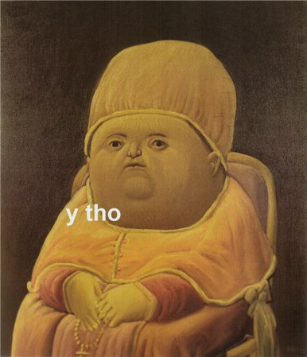
Tools of content marketing - (Řezníček and Procházka, 2014, p. 99-108)
Reviews - if it is independent and sufficiently objective, it can generate a great response.
Podcasts – sound recording. We talk about industry, us, products etc.
Comics - an ideal addition to classic articles, case studies etc.
Creating our own event - create your own event, which will then be covered by other content (PR articles, video, photos).
Slideshare presentation - content similar to Infographic.
Memes - just to complement what we do!

Slide 21
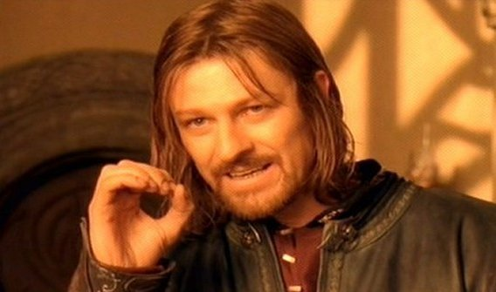
Content Marketing Tools - Text
The most basic tool of content marketing is text!
Text - product description, about us, article, story, post, blog, e-book, title, link, button, perex, keywords, url, metatags etc.
The key question - who will write it? (people can not write or read today!)

Slide 22
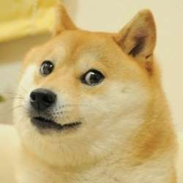
Content Marketing Tools – Text - Copywriting
„Copy“ will do it - we hire a specialist, copywrighter, who will do some copywriting (creating advertising texts for marketing purposes).
Copywriting is not purely writing text to increase sales (sales support) but is used to create content within content marketing, so it becomes a part of our offer (an additional service, or a part of our service / product - for example, I dont sell simple pots, but I offer a solution to the food preparation problem when the pot is supported by an online cookbook with text and video).

Slide 23
Copywriting
The problem of copwriting and, in turn, of all content marketing is that people read the texts differently nowadays, especially on the Internet. Frequently cited facts include (Sálová et al., 2015, p. 21-22):
  People are more likely to "scan", so they only search for interesting parts, do not read the text thoroughly and ignore it.
  Scroll through long texts and search for highlighted passages (tl; dr). That's why we use bullets, bold fonts, pictures, hyperlinks.
  People are looking for interactivity, so we offer them additional audiovisual content, infographics etc.
  There is a banner blindness, ignoring the space around the text and focusing on "authentic" text only. That's why we try to design websites so that the ad and text are not in a classical format.
  They do not want to think, but they want immediate solutions (Google's search offers an immediate answer to simple questions, such as weather).

Slide 24
Blogs
Incredibly successful trend – blogs.
Blog – online diary.
"Bloggers are professionalized and companies take them as their partners."
You also use social media to promote your blog (FB, Insta).
"Women dominate in areas such as cosmetics, fashion, food, cooking and drinks, health and lifestyle, do it yourself (DIY), men dominate technology, society and politics."
Women dominate, the youngest age categories are only women, older men.
Nice example is Tchibo – web vs. blog.
Have blogs moved to social networks (FB)?

Slide 25
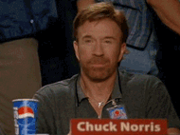
Posts on social networks - GIFs
FB Intelu – boring microprocessors?
Premise – incredible overpressure of content on the user (1.3 million posts on FB every minute), despite the algorithms delivering us personalized content (or because of them!!?) it is necessary to stand out, in other words, attract and engage. Building a long term brand vs. shocking.
GIF (Graphics Interchange Format) - "short video".
Advantages?
Disadvantages?
Ethics! Must agree with the target!
Download here.

Slide 26
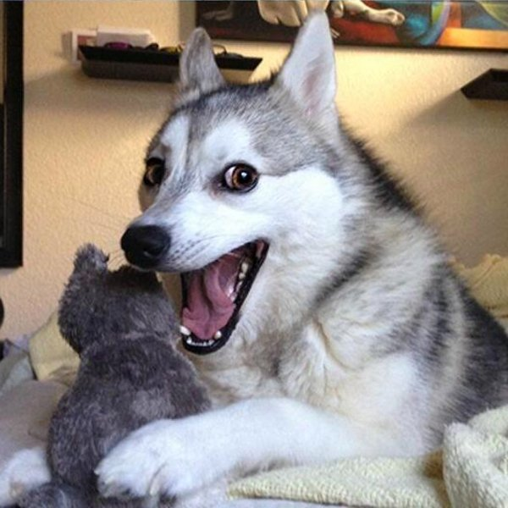
MEMEs
Hard to define ☺ A funny picture that has its meaning and is used to describe a situation and give it additional context.
A nice article on Forbes - given the amount of time we spend every day on the internet, commercial communications are uninteresting.
Advantages?
Disadvantages?
Ethics! Must agree with the target audience!
Another Forbes article – how to.

Slide 27
New FB formats
Premise - everything is developing extremely fast, FB and social networks are generally no exception! Different new forms of content will emerge and disappear annually.
This year, for example, Facebook Canvas and Facebook Instant Articles - both for mobile phones.
Facebook Messanger Chatbot - robot automatically responds according to the pre-specified options. In development - AI is self-learning, but we have seen that sometimes it fails hard (Microsoft Jay). It's not a content, but the user can perceive it as such - it's imperfect, error!
Virtual Reality Video - 360 degree video. A nice summary of how it helps with authenticity and that a selfie-stick can be a good thing for the content from behind the curtains.

Slide 28
Microsite
Microsite is a simple (small) site that serves one particular presentation. It allows us to separately present only one product from our portfolio using different graphic style than our main domain.
Why microsite? It starts with URL, we can tailor it (studujvkarviné.cz). We can choose a completely different presentation style that does not fit into the main style of our website. We will separate part of the content from our brand. Content purely to support one product etc.
Microsite about microsite ☺

Slide 29
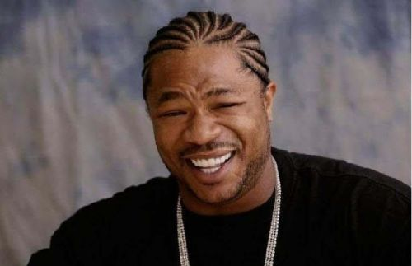
Task – 2nd part
With the newly-achieved knowledge - what content should your selected company do and why?
10 minutes.

Slide 30
4 Creating a content campaign– Marketing Journal
1. Strategy and campaign plan - although we already have some content, we should think about longer-term related activities and design the whole strategy and then create a plan for individual parts. We need to realize what we want to achieve and where it is heading.
2. Setting goals - without them nothing can be measured and evaluated. The goals should be SMART. Let's try to formulate them in the most specific way, so that we do not just have a general goal of revenue growth, but rather focus specifically on the growth of conversions, the increase in the number of web visitors etc.
3. Determination of the target group - in terms of segmentation we want to describe our customers as closely as possible, ideally to create personas and narratives.
Notes:
Zdroj: http://www.m-journal.cz/cs/internet/jak-na-plan-obsahoveho-marketingu-krok-za-krokem----1--cast__s281x12358.html

Slide 31
Creating a content campaign – Marketing Journal
4. Choice of communication style - choose a communication tone, e.g. what language we use for each persona. Ideal is the creation of the so-called stylistic handbook (you will appreciate it in a larger team, ensuring uniformity of communication), where the rules of communication are clearly described.
5. Choosing the type of content - from the objectives and the strategy follows the choice of the message, here we can focus on the thematic areas that we will cover. If we understand our customers and are able to choose a suitable style of communication for them, content creation is an easy task.
6. Channel selection - choose from channels available to us (social networks, newsletter, paid channels etc.).
Notes:
Zdroj: http://www.m-journal.cz/cs/internet/jak-na-plan-obsahoveho-marketingu-krok-za-krokem----1--cast__s281x12358.html

Slide 32
Internal processes for good content – Marketing Journal
Scheduling - how, when, and how regularly will you choose content topics and terms of publishing? Who will choose the form of content and channels?
Content creation - Who and how will create content (texts, graphics, videos) and how much time it takes?
Approval - who and when will approve the content. Proofreading?
Publishing - who is responsible for publishing finished content in selected communication channels? What tools will be used for publishing and when? Who will be responsible for distributing the published content?
Measurement - how will content success be measured? Who, how and how often will evaluate it? What metrics will be tracked?
Optimization - how often will the results be evaluated and compared with the plan and the goals set? Who will be responsible for proposing changes for further communication and content creation?
Notes:
Zdroj: http://www.m-journal.cz/cs/internet/jak-na-plan-obsahoveho-marketingu-krok-za-krokem----1--cast__s281x12358.html

Slide 33
How To Plan A Content Marketing Step By Step - Part 2 by Marketing Journal
Creating topics - based on customer data and their preferences. (based on STDC we create different content in different parts)
Form choices - blog, video, infographics?
Channel selection - web, social networks, affiliate website?
Publishing calendar - an overview of when, where, what, how, who is responsible for it.
Control and optimization - we're trying to understand what works, we're improving upon it accordingly.
Lead Scoring and then we reach customers with personalized content.
Notes:
Zdroj: http://www.m-journal.cz/cs/internet/jak-na-plan-obsahoveho-marketingu-krok-za-krokem----2--cast__s281x12410.html

Slide 34

Task – 3rd part
For your selected company, design a content strategy and what specific content should be done and why.
30 minutes.

Slide 35

End of presentation
Thank you for your attention ☺

