Slide 1

Marketing Communication Policy
Ing. Michal Stoklasa, Ph.D.
Strategic Marketing/subject code

Slide 2
Marketing Communication Policy
Outline of the lecture
Communication, communication model.
Communication strategy - campaign.
Apple PR.

Slide 3
Marketing Communication Policy
1. MARKETING COMMUNICATION
Communication = transactional process between two or more parties whereby meaning is exchanged through the intentional use of symbols.
Marketing communication:
  Broader concept: all planned and unplanned communication at all points of contact with the organization's current and potential customers (product packaging, brand perception, price, place of distribution, advertising, employee behavior, traditions, organization etc.). Leads to integrated marketing communication.
  Narrower concept: marketing communication mix.
Communication has the following features:
  is deliberate - a deliberate effort should bring about the intended reaction, especially if the goal is persuasion.
  the transmission - it is an exchange of messages based on the motivation of all participants.
  is symbolic – uses symbols (words, pictures, etc.).

Slide 4
Marketing Communication Policy
CYBERNETIC COMMUNICATION MODEL
Who says What to Whom through Which channel with What effect? (Laswell)
Sender
Message
Media
Message
Receiver
Encoding
Decoding
Decoding
Feedback
Encoding
NOICE

Slide 5
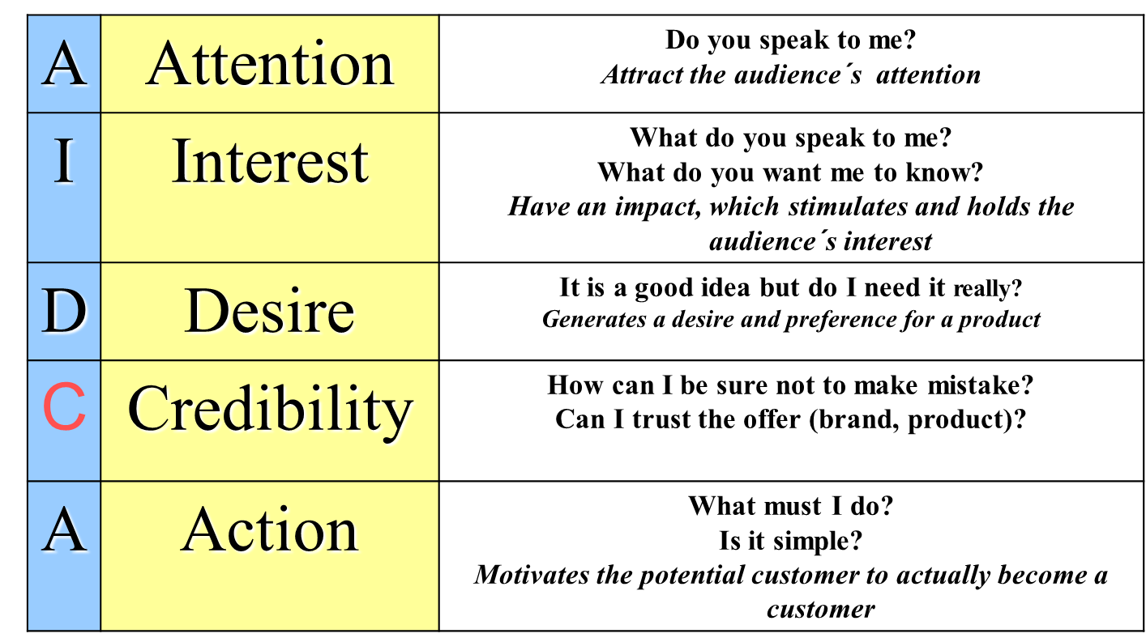
Marketing Communication Policy
AIDA MODEL
Catch the receiver´s attention.
Be understandable.
Meet receiver´s demands.

Slide 6
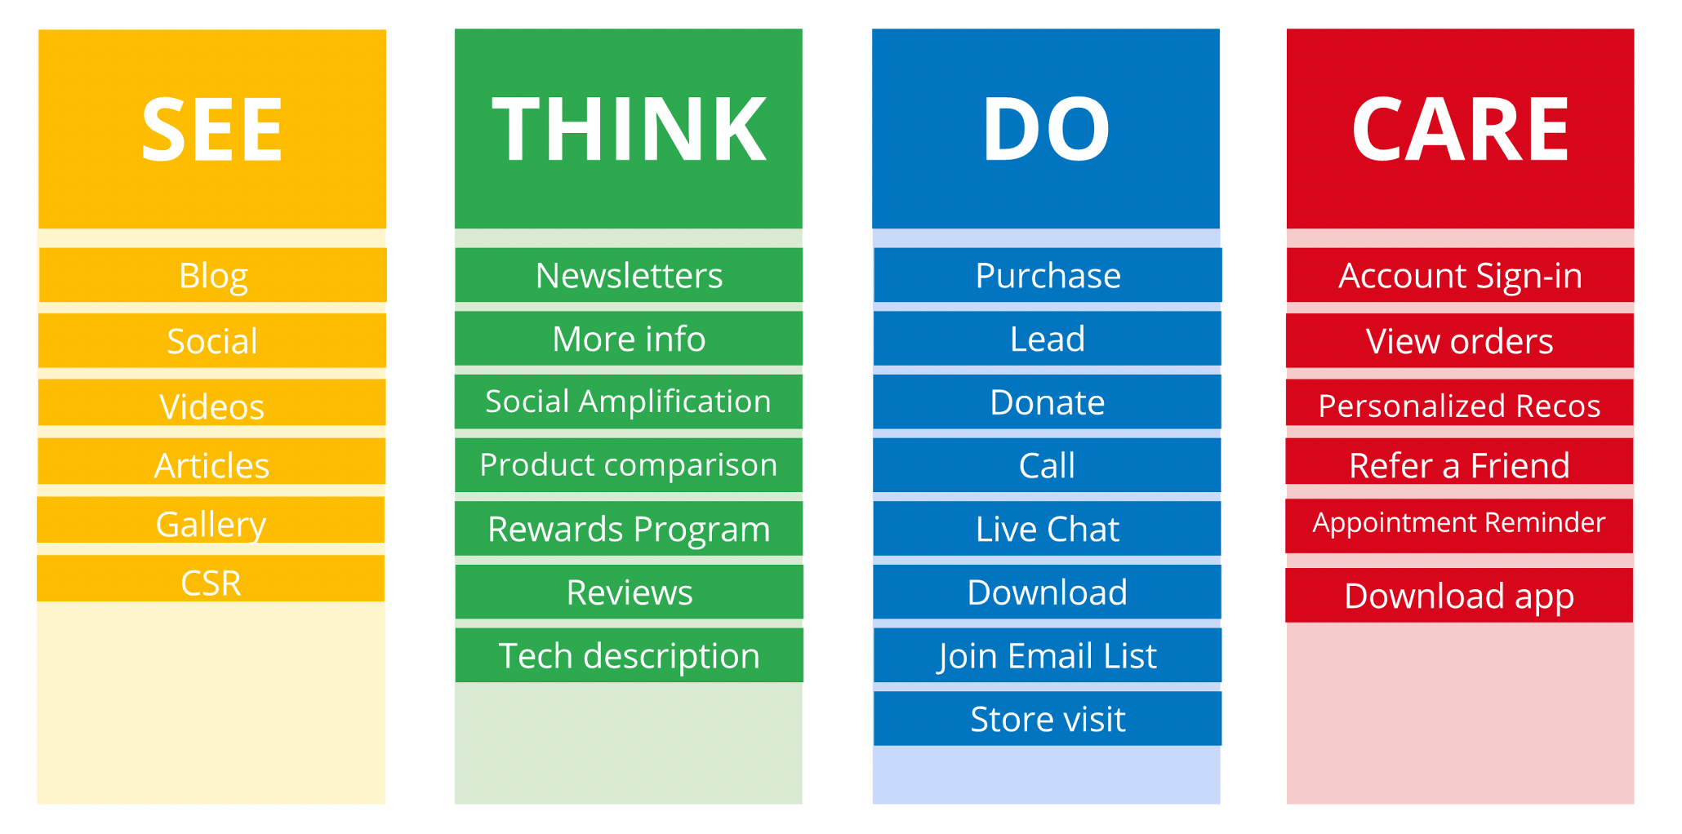
Marketing Communication Policy
STDC FRAMEWORK
Notes:
Picture source: https://digichef.cz/pavrd

Slide 7
Marketing Communication Policy
2. STEPS OF COMMUNICATION CAMPAIGN
Situation analysis
Targets and target groups determination
Budgeting
Marketing communication mix strategy (strategy, elements, media)
Marketing communication coordination and integration
Marketing communication implementation
Marketing communication effectivity testing

Slide 8
Marketing Communication Policy
A. SITUATION ANALYSIS
INTERNAL (good product and its positioning, recognizable and remarkable brand, loyal customers, tradition, financial resources, participation in sponsorship projects, previous communication campaigns etc.)
EXTERNAL (product and comunication activities of competitors, legislation and ethics code of professional associations, popularity and use intensity of various types of media in some region, number and quality of communication agencies etc.)

Slide 9
Marketing Communication Policy
B. TARGETS AND TARGET GROUPS DETERMINATION
(SMART!)
Economical (sales increase, profit increase, market share increase, new product launch, etc.).
Extra-economical (image improvement, brand general knowledge increase, etc.
Specific target groups: children, seniors, potential parents, gays (pink dolar)
See previous lecture – process STP – targeting!!!

Slide 10
Marketing Communication Policy
POSSIBLE COMMUNICATION TARGETS
Based on the goals of the strategy (mission, vision), or targets for product, distribution, price - to increase sales, increase profits, increase in market share.
Purely communication oriented objectives would be:
  Improving the image of the company / product / brand.
  Increasing awareness of the company / product.
  Build new associations with the brand.
  Creating a new positioning.
  Remind the brand.
  Promote immediate (spontaneous) purchase.
  Facilitate the purchase.
  Build TOM (Top of Mind).
  Building relationships with customers.
  Support and maintain customer loyalty.

Slide 11
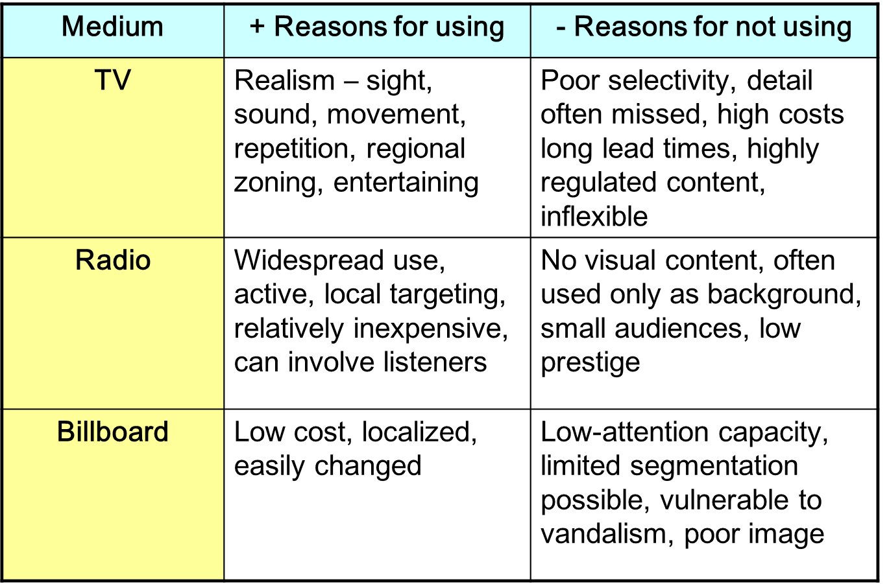
Marketing Communication Policy
BASIC MEDIA 1

Slide 12
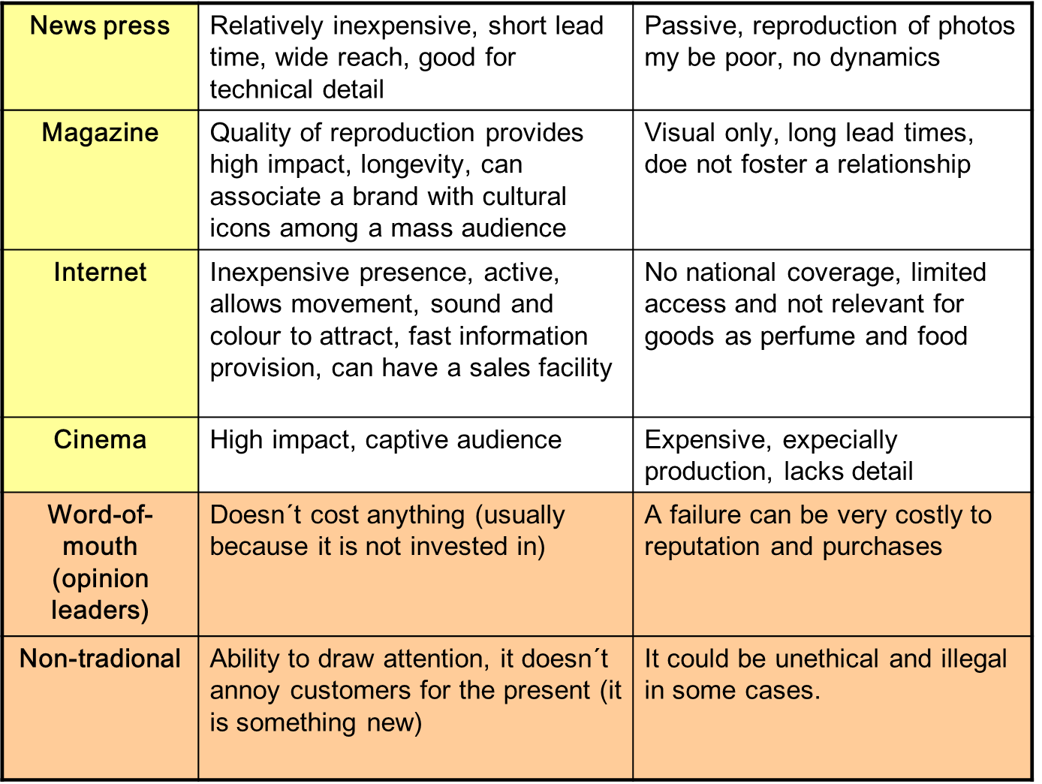
Marketing Communication Policy
BASIC MEDIA 2

Slide 13
Marketing Communication Policy
MEDIA DEVELOPMENT – TOO FAST!
Too rapid development of the media! We teach companies the need for Facebook, how to work with it, how to create content, but consumers are jumping on new trendy networks - Instagram, Pinterest. YouTubers, bloggers.
Growing importance of operating systems - the brand can do more from a list of recommended applications instead of spending millions on TV advertising.
Communication through the application - advergaming. The associated Gamification of everything.
There may be specific media for specific needs - hit of towns and villages is the SMS system (plus FB of course).

Slide 14
Marketing Communication Policy
C. BUDGETING
Method of residual budget – how much money does the company have left. Not really good because it is not alligned with our objectives.
Method of percentage share of turnover – we sat a number of %, it usually is very low such as 0,5% of turnover. Same disadvantage as previously.
Method according to competitive practices – we invest as much as our competition. But we are in a different situation.
Method according to targets – we spend as much as we need to fulfil our communication goal.

Slide 15
Marketing Communication Policy
D. MARKETING COMMUNICATION MIX STRATEGY (STRATEGY, ELEMENTS, MEDIA)
Strategy of marketing communication: push strategy (a set of activities aimed at encouraging members of the distribution channel to stock and sell the product), pull strategy (promoting heavily to end customers and consumers in order to pull products through the distribution channel.
Advertisement
Producer
Supply
Middleman
Demand
Customer

Slide 16
Marketing Communication Policy
COMMUNICATION MIX - ADVERTISING
Advertising is a paid form of impersonal presentation of goods, ideas and services through various media.
Advantages: attracts attention and achieves immediate effect, gives impulse to a purchase. It is flexible, versatile and can be easily combined with other com. elements.
Disadvantages: impersonal, can not show the product, can not force to immediate purchase, difficult measurement of response.
Information vs. emotions (various types). Social advertising. Referrer (various types). Intercultural Communication.
Product, brand, company.
Informative, persuasive, reminding.

Slide 17
Marketing Communication Policy
COMMUNICATION MIX – SALES PROMOTION
Sales promotion is a form of impersonal communication and includes all means of communication leading to short stimulate sales.
Advantages: attract attention and achieve immediate effect, increase sales NOW. It is flexible, versatile and can be well combined.
Disadvantages: easy to imitate by competitors, short-lived, lowers profits and image.
Target audience - customer, distributor, retailer.
Tools - discounts, samples, coupons, bonuses and benefits, packages, loyalty rewards, contests, rebates, trade fairs and exhibitions, events, POP, "3D advertising„, merchandising.

Slide 18
Marketing Communication Policy
COMMUNICATION MIX – PERSONAL SELLING
Personal selling is the process of influencing the customer through personal contact.
Advantages: allows a flexible presentation and getting an immediate response, the possibility of using non-verbal communication, interactivity.
Disadvantages: the cost of contact significantly higher than other forms, difficult to obtain and educate skilled traders, small range of customers surveyed, more difficult control of traders.
Tasks: sell - income, prospecting!, plans and forecasts, monitor competitors, new product development, transfer of information / image, counseling, follow-up services.

Slide 19
Marketing Communication Policy
COMMUNICATION MIX – PUBLIC RELATIONS
P.R. is a form of indirect communication, which aims to build and consolidate the prestige and image of the company as a whole, i.e. create good relations between the company and all market participants such as suppliers, customers, competitors, distributors and the public (media, financial, local, general, internal, professional).
Advantages: high degree of credibility, individualization of action. Long-term effects.
Disadvantages: PR can not be controlled as easily as other forms of communication.
Tools: external - annual reports, charity, press conference / news, interviews, newsletters, open days, road shows, events. - Internal - training sessions, conferences, journal mailbox proposals, teambuilding, corporate days, health care.

Slide 20
Marketing Communication Policy
COMMUNICATION MIX – DIRECT MARKETING
Direct marketing transmits advertising messages directly to an existing or future consumers so that they provoke an immediate response. Also it includes the creation of a database of respondents.
Direct marketing uses mail, telephone, e-mail, direct advertising, personal contacts etc. to find its customers.
Advantages: effective targeting thanks to using a database, flexibility of advertising messages, measurable response.
Disadvantages: costs associated with the acquisition of the database.
Active vs. Passive. Addressable vs. Unaddressable.

Slide 21
Marketing Communication Policy
CLOSER LOOK AT THE MESSAGE
Classic Media - information, persuasion, commenting. But also emotion, loyalty.
Social networks - stories! Entertainment. Customer service. What's happening under the hood. About our values. The goal is not to sell but to tell.
We always have to know the language of our audience.
There are a number of propositions, how to do message, some are inclined to the minimalism communication, some emphasize the importance of information.
Like miniskirts, short to attract, but just long enough for the communication content.

Slide 22
Marketing Communication Policy
E. MARKETING COMMUNICATION COORDINATION AND INTEGRATION
Activities determinations, responsibility for communication campaign (own marketing department x communication agency), schedule, etc.

Slide 23
Marketing Communication Policy
F. MARKETING COMMUNICATION IMPLEMENTATION
Planned communication activities are put in practice.

Slide 24
Marketing Communication Policy
G. MARKETING COMMUNICATION EFFECTIVITY TESTING
The measurement of communication campaign coverage and impact.
Pre-testing (storyboard), post-testing (questioning), concurent testing, tracking studies.
Electronic methods of testing (eye camera, psychogalvanometer, tachistoscope, TV meter, etc.).

Slide 25
Marketing Communication Policy
TEASING
The aim is to draw customers´ attention in the long term.
The advertisement develops slowly. You don´t know the product, brand etc. for the first time – it is the intention.
The advertisement must make people be curious to know what the advertisement is about.

Slide 26
Marketing Communication Policy
EMOTIONAL APPEALS IN ADVERTISING
Emotional appeals attempt to stir up some negative or positive emotions that will motivate purchase
Negative emotional appeals: fear, quilt, shame, drama, etc.
Positive emotional appeals: humour , love pride, joy, erotic, music, warmth, etc.

Slide 27
Marketing Communication Policy
MESSAGE SOURCES IN ADVERTISING (REFFERERS)
Experts who have specialized knowledge - doctors, scientists, professors etc.
Well-known persons who are familiar to the audience (singer, actor/actress, sportsman/sportswoman etc.).
Users of the product who are not well-known persons, but they are representatives of the audience so that the target markets can identify with them.

Slide 28
Marketing Communication Policy
GUERILLA MARKETING
The basic aim is:
  To call attention.
  To shock.
  To surprise.
  To appear unexpectedly without a warning.
  To cause a chaos in public.
These campaigns could break the law and be unethical.

Slide 29
Marketing Communication Policy
VIRAL MARKETING
Viral marketing and viral advertising refer to marketing techniques that use pre-existing social networks to produce increases in brand awareness, through self-replicating viral processes.
Advantages: low costs, quick spread of information, high effectivity of targeting.
Disadvantages: loss of the information control which are spread among people.

Slide 30
Marketing Communication Policy
PRODUCT PLACEMENT
Product placement advertisements are promotional ads placed by marketers using real commercial products and services in media, where the presence of a particular brand is the result of an economic exchange.
Product placement appears in plays, film, television series, music videos, video games and books.
One of the best-known instances of product placement appeared in 1982 movie E.T. the Extra-Terrestrial, which increased sales of Reese's Pieces 80 percent.
In general it is illegal communication activity because it is considered as a hidden advertisement (in some cases PP can be realized).

Slide 31
Marketing Communication Policy
EVENT MARKETING
Event marketing makes customers see brand, company, product as in touch with their interests and lives.
The company is able to acquire new customers and build mutual relationship with the existing customers thanks to emotions.
Concerts, sports events, roadshow, the open-doors, …
The target groups: customers B2C, customers B2B, employees

Slide 32
Marketing Communication Policy
Example - Apple and Media 1
Compared to other large companies Apple does not outsource PR, but does it inhouse - hundreds of employees. Outsource only for small insignificant markets - such as the Czech Republic.
Even in major markets, the rule is minimal communication with the media, only to promote products and company image. If a media scandal occurs, Apple forces everyone to not use its name.
The new strategy - working with bloggers, and the content is only taken by the traditional media after. Controlled releases of new information. The fight against misinformation. (Reuters example, which did not want to quote Cook, bloggers created considerable hate)
PR team monitors competition fails and forward it to their bloggers.

Slide 33
Marketing Communication Policy
Example - Apple and Media 2
PR team consists of 6 teams – interesting is the "Momentum and Buzz Team". It is in charge of indirect marketing, such as the Apple products in the hands of celebrities or in TV shows.
Other teams are based on products they represent.
One team takes care of events, such as the Keynote, which is watched online by dozens of millions of people. The team pursues what is expected and responds to it! Bloggers are evaluated at the keynote, who then receive invitations and background information to build hype. Apple employees then sit in the hall among the audience and are building the enthusiasm! The first pieces of new technology get only to the ones selected by Apple. Reviews are exactly according to Apple's instructions! Dislike? You wont get our product again.

Slide 34
Marketing Communication Policy
THE END
Thank you for your attention.
☺

