Slide 1

Introduction to Strategic Marketing
Ing. Michal Stoklasa, Ph.D.
Strategic Marketing/subject code

Slide 2
Introduction to Strategic Marketing
Outline of the lecture
Basic information – course structure, literature, evaluation.
Marketing – basic revision.

Slide 3
Introduction to Strategic Marketing
TEACHER INTRODUCTION
12th year lecturing at this faculty – teaching marketing courses, such as International Marketing, Marketing Research, Marketing Communication.
Worked as consultant in several small and medium companies, did communication campaigns for municipalities, festival.
Many EU projects, teaching at universities in Glasgow, Nicosia, Joenssu.

Slide 4
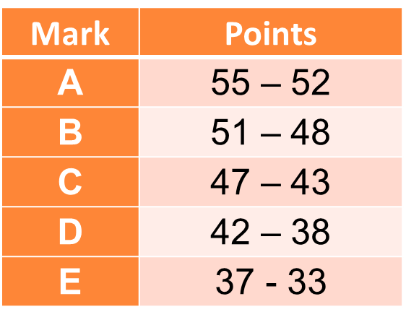
Introduction to Strategic Marketing
COURSE REQUIREMENTS
Attendance in seminars 50 %.
Ongoing test – November, aiming for 8th week of the semester, maximum is 15 points.
Final written exam – January and February, maximum is 40 points.

Slide 5
Introduction to Strategic Marketing
COURSE OBJECTIVES
Strategic marketing builds on the marketing and management courses and develops the knowledge acquired in these subjects. Its aim is to promote theoretical and methodological basis of these disciplines, to support their interdisciplinary links and to get students to be able to comprehensively evaluate complex practical phenomena and processes. The strategic nature of the subject requires students to know the basics of research, problem solving and research activities, and be able to transform the results of research into theory and into practical business and marketing projects. The students in this course address practical examples by utilizing the acquired knowledge. Content of this subject is directly linked to other mandatory and optional subjects including a diploma thesis.

Slide 6
Introduction to Strategic Marketing
COURSE LITERATURE
Presentations are in the IS! Use them.
Books are in the library.
  MOORADIAN, T. A., 2012. Strategic Marketing.
  KOTLER, P. and K. L. LANE, 2012. Marketing Management.
The ongoing and final tests are only from the things covered in presentations, HOWEVER, if you do not understand them properly, read the books! Ask, discuss, consult etc.
I do not need you to memorize definitions, I want you to understand the things we go through and be able to use them in practical examples.

Slide 7
Introduction to Strategic Marketing
STRUCTURE OF LECTURES
Introduction to Strategic Marketing.
Strategic Marketing Management.
Strategic Marketing Process.
External Micro Analysis.
Internal Micro Analysis.
Business to Business (B2B).
Introduction to Strategies.
Product Policy.
Pricing Policy.
Marketing Communications Policy.
Distribution Policy.

Slide 8
Introduction to Strategic Marketing
BE ACTIVE, READ ON THE INTERNET
I can not stress out enough that you should be reading about the things you study on the Internet!
Our own content is unfortunately for you in Czech, but there are plenty of English websites that you can check out and learn about real life examples from this course.
I recommend.
  https://www.ama.org/Pages/default.aspx
  http://www.forbes.com/home_europe/
  http://mashable.com/
  https://www.engadget.com/

Slide 9
Introduction to Strategic Marketing
1. MARKETING - PEOPLE'S OPINIONS
„Marketing is just a scam on people!“ (Karl Skeptic. 2016).
„Marketing are the advertisements in TV, like the cute one with dogs or the annoying one with the Alza ufo.“ (Serious Lee, 2016).
„Marketing are the leaflets in mail boxes, 1+1 discounts for pizza, ads in TV, right?“ (Julia Savingup, 2016).
„Marketing are the tools that allow me to sell more.“ (manager Anton T., 2016)

Slide 10
Introduction to Strategic Marketing
CURRENT MARKETING
Marketing is the activity, set of institutions, and processes for creating, communicating, delivering, and exchanging offerings that have value for customers, clients, partners, and society at large. (American Marketing Association, approved 2017)

Slide 11
Introduction to Strategic Marketing
CURRENT MARKETING
Current marketing must be understood not in the old sense as the ability to "persuade and sell," but the new importance of meeting customer needs. The sale occurred only after the product was manufactured.
Marketing is but a challenge for managers to find out what the needs are, identify their scope and intensity, and decide whether there is a profitable opportunity. (Or create entirely new needs, for example iThings)
Marketing continues throughout the product's lifecycle, trying to attract new customers and retain existing ones through enhancing the appearance and performance of a product, learning from the results of sales and repeating the success.
The aim of marketing is to know and understand the customer so well that the product or service corresponds exactly with their needs. (Kotler et al., 2007)

Slide 12
Introduction to Strategic Marketing
3. BASIC MARKETING CYCLE
Need = a sense of lack.
Wish = formulation of needs (socio-cultural and personal characteristics of consumers).
Demand = request, supported by certain purchasing power (impulse shopping – do I really need this?).
Demand = "summary of products that customers are able to buy."
Value of the product for the customer = customer estimate of the overall potential of the product to satisfy their needs. How to measure it? What is the value for the company? What are the demand drivers (price, brand, certification)?
Types of demand - see further.

Slide 13
Introduction to Strategic Marketing
MARKETING CYCLE
NEEDS, WISHES, DEMAND
MARKETING SUPPLY (PRODUCTS, SERVICES)
VALUE (CUSTOMER SATISFACTION)
EXCHANGE, TRANSACTIONS, CUSTOMER RELATIONSHIP
MARKETS

Slide 14
Introduction to Strategic Marketing
MARKETING MIX – THE 4Ps
Product – products are solutions to customer´s needs. The provider needs to make various product decisions, including functionality, range offered, brand names, packaging, service and support. It is the critical element in the mix.
Price – various price-setting models exist, with decisions relating to factors like market penetration, credit terms, discount policy and cost of provision.
Place – it is about making the product available. Some form of structured network is normally required – a distribution channel.
Promotion – promotion aims to make a target market aware of a product offering, develop a long-term relationship with the customer and create and stimulate demand.

Slide 15
Introduction to Strategic Marketing
MARKETING MIX FOR SERVICES – 7Ps
„4Ps“
Physical evidence – customers look for reassurance relating to required benefits and quality (ambience, fixtures and fittings, appearance/attitude of staff, etc.) as an indicator of likely satisfaction.
Processes – the method by which the services are provided.
People – people are an essential element of the marketing mix. Staff recruitment, training, development and empowerment to deal with problems become a critical element in ensuring a positive customer experience.

Slide 16
Introduction to Strategic Marketing
STRATEGIC AND TACTICAL MARKETING
Strategic marketing decisions:
  Who is our customer?
  What value do we offer?
  How do we ensure their satisfaction?
  How do we maintain a competitive position?
Tactical marketing decisions:
  What product do we offer?
  What will it cost?
  Where, when and how do we promote?
  Where, when and how will it be available to customers?

Slide 17
Introduction to Strategic Marketing
STRATEGIC PROCESS
Vision, Mission
The strategic process has these steps.
Analysis
Strategic goals
Strategy formulation
generating strategy
analyzing alternatives
choosing optimal strategy
Strategy implementation
organizational structure
company culture
motivational system
planning
source allocation
information system
Evaluation and Control

Slide 18


Introduction to Strategic Marketing
THE STP PROCESS
Segmentation
Targeting
Positioning

Slide 19
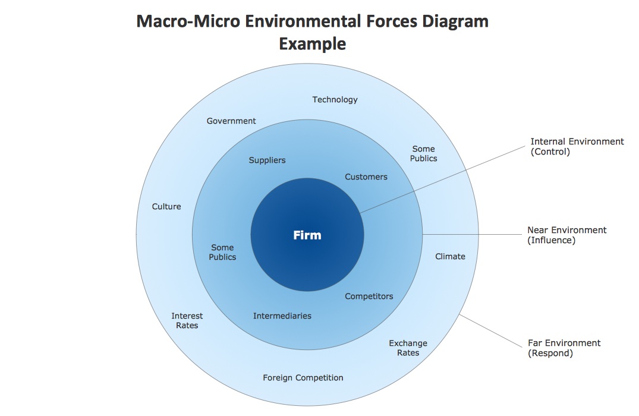
Introduction to Strategic Marketing
MARKETING ENVIRONMENT

Slide 20
Introduction to Strategic Marketing
A. TRENDS IN MACRO ENVIRONMENT (PEST)
Demographic - aging, migration back from the cities, the decline in fertility, singles, families and households character, racial and national structure.
Economical - purchasing power - disposable income, the global economic crisis(?), 4th industrial revolution, unemployment, tax policy, exchange rate.
Legislative and political - instability, EU law.
Natural - ecology, energy prices, climate change.
Technology – digitization, online shopping, shortening cycle, innovation.
Socio-cultural - universal global customs, social communities, life in debt, organic lifestyle, health and beauty, empowerment of women, terrorism, education.

Slide 21
Introduction to Strategic Marketing
MARKET ANALYSIS
Market size: measured in absolute units (sales / market potential, forecasting sales / market), differential (comparing absolute indicators in time), relative (market share, market saturation).
Market Analysis:
  Selecting the relevant market (B2C - education - courses).
  Analysis of the primary demand (evening courses, school).
  Analysis of selective demand (OPF SLU courses).
  Finding a customer market segment (STP).
  Defining potential target markets (MS County).

Slide 22
Introduction to Strategic Marketing
B. MAIN ACTORS AND POWERS ON THE MARKET
Suppliers - companies and individuals who offer enterprise resources. (References, quality, certification, price, terms, contract terms, speed, availability, counseling, guarantees)
Distributors - businesses, organizations, individuals entering between the manufacturer and the customer. (Logistics, traders, the same things as suppliers)
Competitors - offer products satisfying the same need. (Data sources, benchmarking, Porter's five forces analysis)
Customers - consumers, producers, traders, state, foreign customers. (Motivation to buy, place, time)
The public - the impact on the company, but no commercial ties. (Social community, the financial community, mass media, government public, civic associations, public in-house)

Slide 23
Introduction to Strategic Marketing
C. COMPANY ANALYSIS
Analysis of business potential - resources management, financial resources, human capacity, innovation, information.
Marketing mix - 4P vs. 7P vs. 4C.
SWOT analysis - one of the simplest analysis able to provide the basics for decision making.

Slide 24
Introduction to Strategic Marketing
FINAL EXAM
Apply your knowledge of Strategic Marketing on Twigs Ltd., which manufactures wooden chairs in 5 different variants. The company is new, regional, 3rd year on the market. It is growing by 30 % every year. Has 5 employees already. Create for them: vision, mission, suggest what analysis should be done and why, set strategic objectives, what strategy to choose and why, set marketing mix. (20 points)

Slide 25
Introduction to Strategic Marketing
THE END
Thank you for your attention.
☺

