Slide 1

Strategic Marketing Management
Ing. Michal Stoklasa, Ph.D.
Strategic Marketing/subject code

Slide 2
Strategic Marketing Management
Previously
What is marketing.
What are the current trends changing the world.
Final test – practice.
Notes:
This is the final test practice:
Apply your knowledge of Strategic Marketing on Twigs Ltd., which manufactures wooden chairs in 5 different variants. The company is new, regional, 3rd year on the market. It is growing by 30 % every year. Has 5 employees already. Create for them: vision, mission, suggest what analysis should be done and why, set strategic objectives, what strategy to choose and why, set marketing mix. (20 points)

Slide 3
Strategic Marketing Management
Outline of the lecture
Strategic Marketing methodology - introduction.
Development of strategic marketing.
Strategies, tactics.
Principles of strategic thinking.
Hype!
Business Model Canvas.

Slide 4
Strategic Marketing Management
Goals for today
Understand Strategic Marketing.
Know how to use Business Model Canvas.

Slide 5
Strategic Marketing Management
1. STRATEGIC MARKETING METHODOLOGY - INTRODUCTION.
Strategy is overused term (different understanding).
Content of courses - Strategic Marketing vs. "Classic" Marketing vs. Strategic Management.
Definitions of technical terms - a large difference (does Strategic Marketing even exist? Marketing Management? Strategic Management?).

Slide 6
Strategic Marketing Management
MARKETING DEFINITIONS
Marketing is the activity of all individuals and organizations focused on identifying and meeting human needs, based on transaction (Schoel, Guiltinan, 1988).
Marketing is a social and managerial process by which individuals and groups obtain what they need and want through the creation of supply and exchange of valuable products with others (Kotler, 1991).
Marketing is the activity, set of institutions, and processes for creating, communicating, delivering, and exchanging offerings that have value for customers, clients, partners, and society at large. (American Marketing Association, Approved July 2013).

Slide 7
Strategic Marketing Management
DRUCKER ON MARKETING
Book „Marketing IS Management: The Wisdom of Peter Drucker“.
„There is only one valid definition of business purpose: to create a customer… Because it is its purpose to create a customer, any business enterprise has two — and only these two—basic functions: marketing and innovation…“
„Marketing is not only much broader than selling; it is not a specialized activity at all. It encompasses the entire business. It is the whole business seen from the point of view of its final result, that is from the customer’s point of view. Concern and responsibility for marketing must therefore permeate all areas of the enterprise.“

Slide 8
Strategic Marketing Management
STRATEGIC MARKETING DEFINITION
Strategic marketing - is one of the developmental stages of marketing, with strong focus on relation to marketing activities, functions and time horizons.
The development phase of marketing:
  Production marketing concept.
  Product marketing concept.
  Sales marketing concept.
  Marketing concept. (Social - CSR, environmental, global, etc.)
  Strategic Marketing.
  Customer Relationship Management. (Content marketing)
  Holistic marketing - socially responsible + relational + integrated + internal.

Slide 9
Strategic Marketing Management
TRENDS IN MARKETING CONCEPTS
Content marketing - focused on content. Variant "low cost" content marketing.
The transition from mechanical marketing (description of the state) to causal marketing (cause - effect).
The transition from promotional marketing to behavioral (optimization of relations based on observation of behavior).
Creative marketing – experiences, adventures.
Clever marketing - all online, continuous analysis of databases and offering the right value (CRM).
Notes:
Source: Čichovský, 2013, s. 15-17

Slide 10
Strategic Marketing Management
STRATEGIC MARKETING
It can be described as a process, associated in particular with:
  the preparation of analyzes of factors and internal conditions of the company, analyzes of factors of opportunities and threats, analysis of competitive factors,
  participation on setting business objectives and formulating business strategies to achieve them,
  the determination of marketing goals,
  the choice of marketing strategies for achieving these goals,
  the preparation, implementation and monitoring of marketing plans,
  the comprehensive management of the marketing process.

Slide 11
Strategic Marketing Management
STRATEGIC MARKETING
Strategic marketing is associated with the search for competitive advantage. Competitive advantage and results of marketing situational analysis are key elements for selecting and formulating appropriate marketing strategies.
Strategic marketing places great emphasis on the planning stage of the marketing process and has within it a high degree of exposure.
Strategic marketing is related with decision-making processes at the level of senior management – it intervenes in management and decision-making business processes. I gets its strategic character the moment when already in the planning of future activities it will focus on the definition of potential customers and the specification of their needs.

Slide 12
Strategic Marketing Management
2. DEVELOPMENT OF STRATEGIC MARKETING
Marketing development clearly reflects changes in market and business environment.
Against the background of rapidly changing and increasingly complex environment, the awareness of existing problems and strategic issues becomes more pronounced and the effort to solve them intensifies.
Especially since the early eighties, the attention to scientific research and practical application of strategic marketing is increasing.

Slide 13
Strategic Marketing Management
STAGES OF STRATEGIC MARKETING 1
The starting point can be traced back to the end of the fifties when the market changed from seller to buyer's market. Already back then, companies required long-term focus on the supply of demanded goods.
On the threshold of the sixties, Ansoff expressed his fundamental assumptions for selecting marketing strategy (market penetration and expansion, product development, diversification). This (also now) important conceptual focus on structuring strategies of market areas may be designated as the birth of strategic marketing.
In conjunction with diversification and divisionalistic waves in the sixties, main focus is on growth strategies. In connection with the expansion of activities leading to the implementation of new products and entering new markets, attention to the acquisition of synergistic concepts is increasing (Ansoff, 1966).

Slide 14
Strategic Marketing Management
STAGES OF STRATEGIC MARKETING 2
In the early seventies, the portfolio concepts are expanding based on financial - economic considerations of profitability and risk. Originally these concepts were developer by the consultancy firms for entrepreneurs, but in a more accessible and easier form they see rapid expansion in business practice. Especially also because when the concept of experience curve is included, acceptable standardized strategy can be derived.
With increasing predation (competition, company kills another company) in the late seventies, a call is made to develop strategies that can ensure a more stable competitive advantages.

Slide 15
Strategic Marketing Management
STAGES OF STRATEGIC MARKETING 3
Based on the work by Porter, the concept of strategic groups and the so-called analysis of value chains are penetrating into strategic marketing. Value Chain divides the company into its strategically important activities in order to understand the behavior of costs and recognize the existing potential sources of differentiation. The enterprise can enhance its competitive advantage by doing these strategically important activities cheaper and better than its competitors.
The fact that competitive advantages are analyzed, developed and evaluated from the over-the-top perspective leads to overcoming the narrow perspective of marketing management tools focused on the sales policy.

Slide 16
Strategic Marketing Management
STAGES OF STRATEGIC MARKETING 4
In the eighties, parallel to thought characterized by competitive strategies, many markets are transitioning from a multinational to a world-oriented marketing strategy.
At that time, companies realized that when choosing own internationalization strategy situation on international markets plays an important role. There are also new outpacing-strategies that are designed like a dynamic concept of strategic change. Under the influence of TQM there is a new thought that leading position in cost and quality pose no mutually exclusive concepts, but simultaneously feasible option strategies.

Slide 17
Strategic Marketing Management
STAGES OF STRATEGIC MARKETING 5
In the early nineties, integrated approaches to thinking about strategic options are gaining in importance.
A new challenge for strategic marketing appeared in ensuring competitive advantages not only in single companies but also in strategic alliances and mergers.
Suitability of marketing culture and implementation of marketing strategies in hybrid organizational forms are becoming critical success factors.

Slide 18
Strategic Marketing Management
STAGES OF STRATEGIC MARKETING 6
The second half of the nineties sees transition to - Customer Relationship Management (CRM).
It is a customer-oriented approach to management, which is characterized by active formation and maintaining of long-term relationships with customers. These relations must be beneficial for both the customer and the company (i.e. a situation of two winners), which excludes unethical behavior towards customers.
Projected through marketing management into strategic marketing.

Slide 19
Strategic Marketing Management
STRATEGIC VS. TACTIC VS. OPERATIVE MARKETING
Strategic Marketing - performed by the top management of the company / division / SBU - the aim is to develop the company's mission, strategy selection and development of image, dealing with macro-issues.
Tactical marketing – performed by the middle management - the implementation of the strategy at shorter intervals, tactical decisions.
Operational Marketing – carried out by the lower management - coupled with individual specific activities, converts decisions of strategic and tactical marketing into everyday practice.

Slide 20
Strategic Marketing Management
MANAGEMENT LEVELS
TOP
Middle
Operative
Top management
  strategic plans
  managing the whole company
Middle management
  choice of tactics
  coordination within and between in-house departments.
Lower management
  operational decisions
  operational management work

Slide 21
Strategic Marketing Management
3. STRATEGY AND MARKETING STRATEGY
Strategy is generally a way of procedure how to achieve set goals under specific circumstances.
The aim of the strategy is to achieve a proper coordination of all activities of all components of the company and to create a unified whole of its other perspectives.
The notion of strategy has its origins in Greek and means, loosely translated, arts of a commander or general. This term is offened described as the ability to make decisions based on high expertise and professionalism.

Slide 22
Strategic Marketing Management
STRATEGY AND MARKETING STRATEGY
In a general sense, the strategy means a way forward, a plan how to achieve the goals under the circumstances. It represents a set of possible policies and activities that are accepted with the knowledge of partial unknowing of all future conditions, circumstances and contexts, with not recognized all the requirements and facts for the successful implementation of future decisions.
Strategy evolves !!!! Theory of chaos.
Chandles: "... the determination of long-term goals of the company, the course of events and the resources needed to meet these goals."

Slide 23
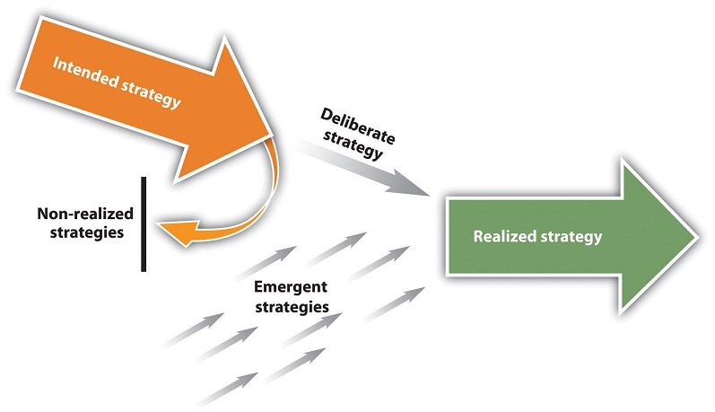
Strategic Marketing Management
STRATEGY BY MINTZBERG

Slide 24
Strategic Marketing Management
MARKETING STRATEGY
In marketing, a marketing strategy focuses on achieving specific marketing objectives in proper marketing environment. The strategy outlines the direction that an organizational unit will follow within a certain time period, and that leads to the most efficient allocation of resources to achieve the marketing goals.
Principles for a particular expression of the concept of marketing strategy can be desribed in two points:
  decisions on using resources efficiently to build a relationship „product – market“ in conformity with defined business objectives,
  creating and maintaining a demonstrable competitive advantage at selected markets.

Slide 25
Strategic Marketing Management
STRATEGY VS. TACTICS
Strategy is the use of the resources, tools, methods, instruments, in the "main direction" to achieve long-term (strategic) goals.
Tactics is detailed use of tools, methods, instruments, means to achieve short-term (operational) goals.
In marketing management, marketing strategy is the use of marketing approach to achieve company objectives. Marketing tactics then is development into a system of marketing tools in the form of marketing mix.

Slide 26
Strategic Marketing Management
STRATEGY AND COMPANY GOAL
To compile (craft) the right strategy, we must know the goal that we want to achieve through it. For the relationship of strategies and objectives, it is essential how to perceive goals from the marketing perspective. (What is first, objective or strategy?)
Goals should be SMART.
  specific, concrete,
  measurable, quantifiable,
  attainable,
  realizable, matching, relevant,
  limited in time (time-bound).

Slide 27
Strategic Marketing Management
4. PRINCIPLES OF STRATEGIC THINKING 1
The principle of variability arises from the fact that we do not know how will the factors influencing business strategy develop over the strategic period (usually 3-10 years).
Company strategy, therefore, must always be prepared in several variants, which are based on knowledge of all these trends, which most likely may occur.
Enterprise faces the so-called strategic surprise that may create a situation where its no longer able to resolve the situation and it may perish.
Variants of the company's strategy have to be compatible, i.e. must be designed so that the company could, if necessary, move from one variant to another without jeopardizing its existence.

Slide 28
Strategic Marketing Management
PRINCIPLES OF STRATEGIC THINKING 2
The principle of permanent work on strategy relates to the previous principle. It means that work on the strategy will never end. It is constantly needed to monitor whether the actual development factors influencing the strategy of the company are in accordance with the assumptions on which the strategy is based and whether and strategic operations of the company are carried out according to schedules and set out plans.
Principle of creative approach is based on the recognition that in today's world, the market will not support any enterprise that does not bring anything new. In the strategy, therefore, is no place for routine repetition of old, or imitating what is already used by others. Succesful are only companies whose strategies are based on bringing new products, new technologies, new ways of meeting the needs of the market, new ways to reduce costs, new methods of sales, stimulation, etc.

Slide 29
Strategic Marketing Management
PRINCIPLES OF STRATEGIC THINKING 3
The principle of interdisciplinarity means the utilization of new knowledge and methods of ALL scientific disciplines while creating the strategy. Experience shows that the greatest effect is achieved by the work of interdisciplinary teams to address certain issues or application of the knowledge of a particular field in a completely different field.
The principle of conscious work with risk is based on the uncertainties about the development of the factors affecting the business strategy and the complexity of the strategic decision-making. No strategic decision has one hundred percent success rate ensured. Each is associated with risk. The risk is reduced by developing more variants and systematic study of information - identified risk is not as great as unknown.

Slide 30
Strategic Marketing Management
PRINCIPLES OF STRATEGIC THINKING 4
The principle of concentration of resources is based on the fact that each strategic decision requires certain, often substantial resources. Their dissipation leads to failure. Conversely, concentration on a small number of strategic goals usually brings success.
The principle of conscious work with time respects the fact that in the modern market society „time is more than money." Radical shortening of deadlines for research, development, construction, production and circulation is therefore essential for the strategy of successful company.

Slide 31
Strategic Marketing Management
PRINCIPLES OF STRATEGIC THINKING 5
The principle of aggregated thinking means you always think in global perspective (general / macro), not dealing with insignificant details (micro).
The principle of feedback thinking lies in the fact that after each step of our strategy we have to return to the previous steps, evaluate them, and if necessary correct them.

Slide 32
Strategic Marketing Management
5. ITS AWESOME, ITS SUPER, ITS HYPED
Hype - is a trick of overstating and anticipation, artificial stimulus or even excessive (unfounded) media coverage.
The term hype had in any case become part of the Internet and the marketing jargon and has been domesticated in other languages.
Now, everyone knows it when something is hyped. But beware, the bubble may burst too soon.
People want to be impressed by new stuff and hope for a better tomorrow. Every week there is at least one futuristic project on Kickstarter. The authors give a short video, a few renderings and promise that within a year they will change the world. Media love this because they know what their readers love to hear, and the spiral of desires and expectations starts - hype.

Slide 33
Strategic Marketing Management
5. ITS AWESOME, ITS SUPER, ITS HYPED
Hype - is a trick of overstating and anticipation, artificial stimulus or even excessive (unfounded) media coverage.
The term hype had in any case become part of the Internet and the marketing jargon and has been domesticated in other languages.
Now, everyone knows it when something is hyped. But beware, the bubble may burst too soon.
People want to be impressed by new stuff and hope for a better tomorrow. Every week there is at least one futuristic project on Kickstarter. The authors give a short video, a few renderings and promise that within a year they will change the world. Media love this because they know what their readers love to hear, and the spiral of desires and expectations starts - hype.

Slide 34
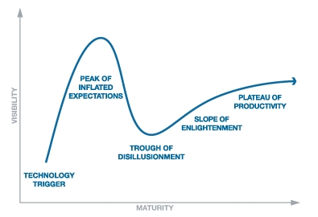
Strategic Marketing Management
GARTNER HYPE CYCLE

Slide 35
Strategic Marketing Management
HOW DOES IT WORK?
Hype before the product launch helps us with funding - even before the launch we have costs (development).
Find the product characteristics that are groundbreaking / needed by customers (marketing creates a need for the product).
Proper market saturation with marketing communications. You need to find Opinion Leaders (Influencers) and people interested in our product. Use social media.
Use spokesperson for the product that will be seen as a trendsetter by the target segment.
Build a sense of lack of product - you need to buy immediately (for pre-order - bonus?).

Slide 36
Strategic Marketing Management
HOW DOES APPLE DO IT?
iPhone 5 sold more than 2 million pieces first day, iPhone 6 10 mil. the first weekend, iPhone 6s 13 mil., iPhone X 20 mil., iPhone 11 almost 25 mil.
What is the secret?
Long-term teasing - creates tension, mystery, buzz months in advance. (Important relationship with the media, social networking, special interest magazines)
Unavailability - insufficient supply, queues in front of shops, auctions on the Internet – creates more buzz and hype.
User friendly in technological progress.
Use product design to differentiate.
They created a hardcore community of fans.
Notes:
http://www.fastcompany.com/3001650/5-marketing-tools-apple-exploits-build-hype

Slide 37
Strategic Marketing Management
6 Business Model Canvas
"The business model is the basic principle of how a company creates, passes on and gains value."
"We can see the business model as a detailed plan for a strategy to be implemented through organizational structures, processes and systems."
The Business Model Canvas has 9 building elements, see further.

Slide 38
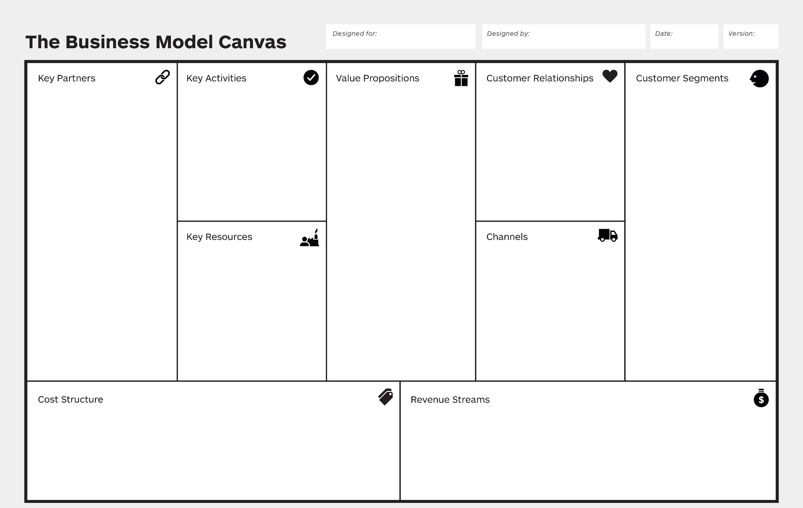
Strategic Marketing Management
Business Model Canvas

Slide 39
Strategic Marketing Management
Customer Segments
"Persons or entities on which the undertaking wishes to target."
We can use classical segmentation (in the course of analysis we will go through STP, archetypes, persona, stories).
Notes:
(Osterwalder a Pigneur, 2010, p. 20-21)

Slide 40
Strategic Marketing Management
Value Proposition
"Combation of products and services that create value for a particular customer segment."
Our offer solves a problem, satisfies the need.
For each customer the value may be different! (See product lecture) But for simplicity, we assume value for the segment.
The value can be anything, eg quantifiable characteristics - speed, performance, price, availability, etc .; or qualitative characteristics - beauty of design, satisfaction, brand, comfort etc.
Notes:
(Osterwalder a Pigneur, 2010, p. 22-25)

Slide 41
Strategic Marketing Management
Channels
"How a business communicates with and treats customer segments to give them a value offer."
Yes, it's both communication and distribution (availability).
We need to know what channels our chosen segment prefers, what are costs and limitations of these channels, what channels we currently have, etc.
We can use a customized purchasing process"channel phases: awareness, rating, purchase, handover, after sale."
Notes:
(Osterwalder a Pigneur, 2010, p. 26-27)

Slide 42
Strategic Marketing Management
Customer Relationships
"The types of relationships the company builds with each customer segment."
Examples of relationship types: personal, individual, self-service, automated, community, co-creation, etc.
Notes:
(Osterwalder a Pigneur, 2010, p. 28-29)

Slide 43
Strategic Marketing Management
Revenue Streams
"The cash that a business generates from each customer segment (revenue - cost)."
We are looking for a value for which the customer is willing to pay (what do they pay for now? How? How would they like to pay? Etc.), so we generate revenue.
We have different price mechanisms (price types).
Fixed vs. dynamic pricing. Calculation + margin, list prices, discounts, prices according to product characteristics, negotiation, current state of the market, auctions, fees, licenses, rentals, subscriptions, etc.
Notes:
(Osterwalder a Pigneur, 2010, p. 30-33)

Slide 44
Strategic Marketing Management
Key Resources
"The most important assets needed to make the business model work."
It can be anything, depending on what we do (chef in a restaurant, a place for a shop, technology for industrial production, a patent, etc.).
We are not only solving key resources for production, but also for creating our value offer (my product is not the best, but it has perfect service - ie the assets are people and not machines, perfectly set up process), channels, relationships, income etc.
It can be simplified into groups: physical resources, mental resources, human resources, financial resources.
Notes:
(Osterwalder a Pigneur, 2010, p. 34-35)

Slide 45
Strategic Marketing Management
Key Activities
"The most important activities a company needs to do in order for its business model to work."
These are the key activities that make our company work. Through these activities we provide our value offer.
What key activities our value propositions require? Channels? Revenue sources?
Notes:
(Osterwalder a Pigneur, 2010, p. 36-37)

Slide 46
Strategic Marketing Management
Key Partners
"It describes the network of suppliers and partners that is needed to make the business model work."
We may want partners for a variety of reasons, sometimes because of resources, sometimes because of complement, or perhaps with competitors to penetrate otherwise unreachable markets, etc.
Who are our key partners? Suppliers? What activities do they provide for us? Resources? Do they help reduce risk and uncertainty?
Notes:
(Osterwalder a Pigneur, 2010, p. 38-39)

Slide 47
Strategic Marketing Management
Cost Structure
"All costs associated with the operation of the business model."
Everything we do creates some costs. Until now, we have been dealing with value offers, relationships, partners and more, all of which represent a cost to us.
We need to know which are most important to us, which are the most expensive, then we can try to optimize them.
Fixed costs, variable, economies of scale, etc.
Notes:
(Osterwalder a Pigneur, 2010, p. 40-41)

Slide 48
Strategic Marketing Management
How do we work with the BMC?
We print as large canvas as possible, buy a lot of sticky papers, colored pens and… let's go ☺
How to design? We talk to customers, use ideas, visual thinking, prototyping, storytelling, scripts, etc.
Suggested process: mobilization (preparatory phase), understanding (analysis), design (creation and testing), implementation (in practice), management (adaptation based on feedback).
Then we should solve the value for the customer and the influence of the environment (and time) in more detail, but we will leave this for the following lectures.
Notes:
(Osterwalder a Pigneur, 2010, p. 26-27)

Slide 49
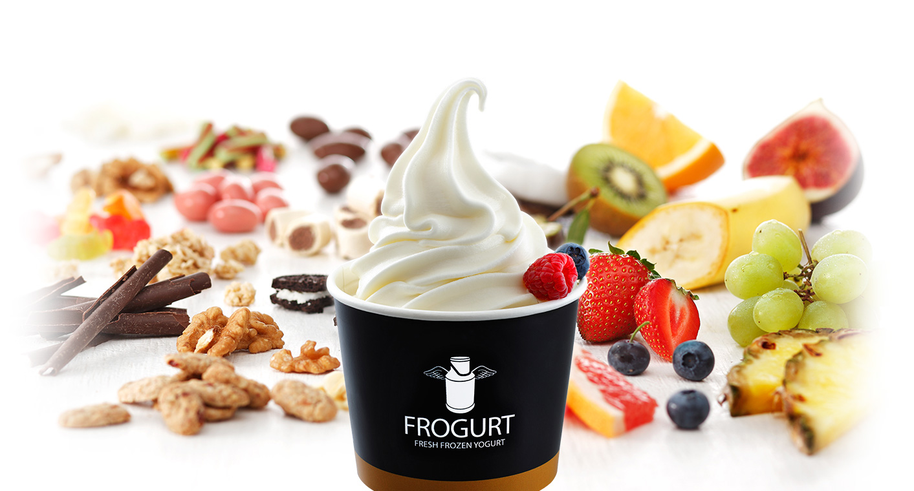
Strategic Marketing Management
BMC – practice example
Frozen Yogurt – healthier atlernative to icecream. You can choose whatever topping you like. Costs 50 CZK/100g.

Slide 50
Strategic Marketing Management
THE END
Thank you for your attention.
☺

