Slide 1

Strategic Marketing Process
Ing. Michal Stoklasa, Ph.D.
Strategic Marketing/subject code

Slide 2
Strategic Marketing Process
Outline of the lecture
Lean Canvas and Value proposition Canvas.
Management and strategic marketing management.
Company's goals, vision and mission.
Planning.
Marketing situational analysis.
Analysis of macro-environment.

Slide 3
Strategic Marketing Process
1. Lean Canvas
Lean Canvas - based on Lean (agile) methodology. It is a canvas of the business model (BMC) that has been adapted to the needs of start-up projects.
It is useful when you are developing your business idea and it makes no sense to write a business plan or even a standard canvas (BMC).
Helps to fail quickly (a very important stage in the development of any business / product idea where you need to try and fail in the early stages to move forward), simply introduce it to other people (hub, accelerator, elevator pitch etc., but if Im going to a bank I need to prepare the whole business plan!).

Slide 4
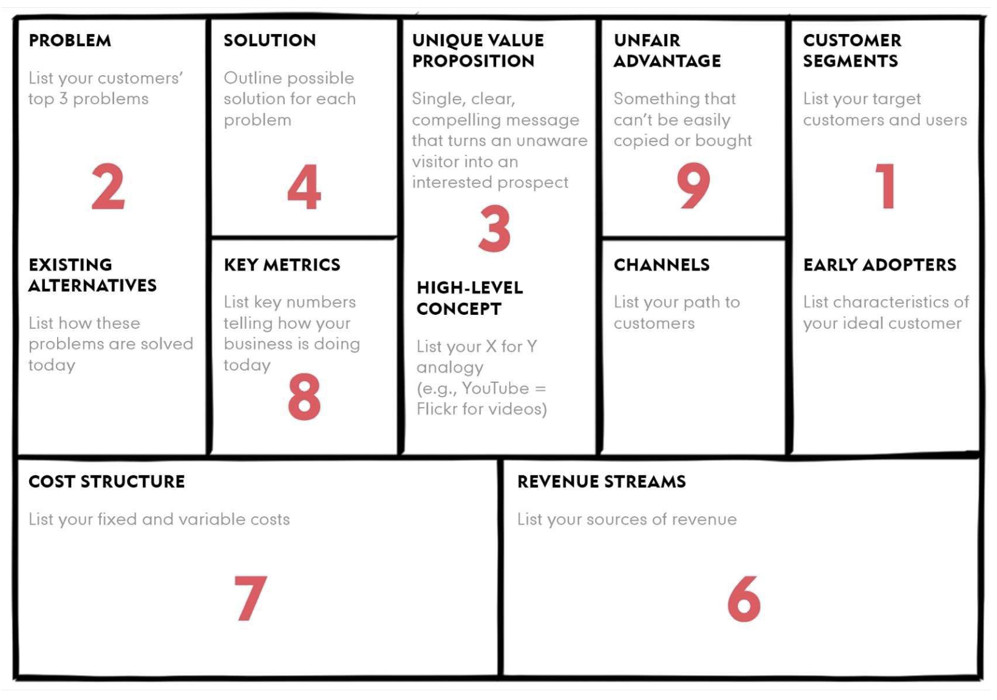
Strategic Marketing Process
Lean Canvas
Notes:
Source: https://blog.leanstack.com/what-is-the-right-fill-order-for-a-lean-canvas-f8071d0c6c8c

Slide 5
Strategic Marketing Process
Business model environment: context, factors, obstacles
BMC is designed and implemented in a certain environment (the company does not work in a vacuum)! The environment actually gives context to our model. Furthermore, the factors that affect it. And of course also obstacles and limitations.
Main trends - trends from PEST, see the first lecture.
Macroeconomic forces - global market conditions, capital markets, economic infrastructure, commodities and other resources.
Sector forces - suppliers and other actors in the value chain, stakeholders, competitors, newcomers, substitution products.
Market forces - market segments, needs and requirements, market factors, transition costs, income assets.

Slide 6
Strategic Marketing Process
Evaluation of the whole BMC
We have a full canvas filled, what now?
Canvas evaluation can be done in 2 ways.
Overall assessment - we evaluate the whole model based on all strengths and weaknesses.
SWOT evaluation - each item is evaluated separately by SWOT analysis.

Slide 7
Strategic Marketing Process
The role of time in the development of BMC
Of course, all the factors in the last slide change over time and affect the chances of our design success!
Therefore, we deal with individual items and their development trend, we forecast development in the short / long term.
We can work with scenarios of the future. We know the classic positive, realistic, negative, but mainly we use contextual situations into which the state can develop.

Slide 8
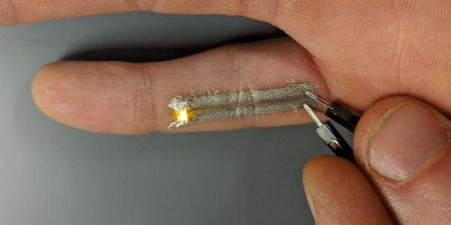
Strategic Marketing Process
Let's practice it
Cheap and fast printing of thin electronics allows extravagant tattoos as well as flexible skin sensors.

Slide 9
Strategic Marketing Process
Value Proposition Canvas (VPC)
Value Proposition Canvas (explanatory video).
It's part of the BMC, offering us the opportunity to go deeper - a powerful tool to understand / propose a value offer. We focus on 2 parts of BMC - value offerings and customer segments.
(a book by Osterwalder et al., which follows the BMC)
"Value Proposition - Describes the benefits a customer can expect from your products and services." (Osterwalder et al., 2016, p. 32)
VP Map - Describes in more structured and detailed ways the characteristics of the specific value proposition of your business model. Value proposition breaks down into products and services, Pain Relievers and Gain Creators. (Osterwalder et al., 2016, p. 34)

Slide 10
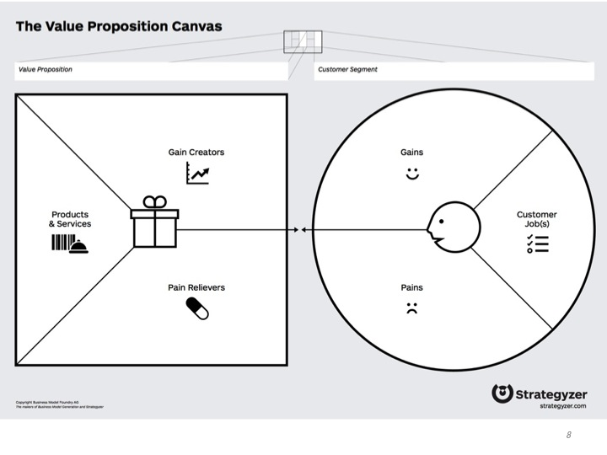
Strategic Marketing Process
Value Proposition Canvas (VPC)
Notes:
Source: strategyzer.com

Slide 11
Strategic Marketing Process
Right part - customer profile
Our goal is to be able to offer a value offer that exactly matches customer needs and solves their problems.
Customers' tasks - everything customers try to do in their lives. Functional tasks (mowing grass), social tasks (acting professionally), personal tasks (feeling of security), support tasks (comparison of offers, product evaluation, product disposal).
Pains - everything that annoys the customer during the task. Risks, obstacles, unwanted results.
Gains - the results and benefits customers want. Benefits required (must have, otherwise does not work), expected, wanted, unexpected.

Slide 12
Strategic Marketing Process
Left part - value proposition
List of products - which products do we offer, what do they bring, what problems do they solve?
Pain relievers - how do we prevent customer difficulties? (saving time, money, energy, feeling better, better quality, performance, lightening things, solving emotional problems, social impacts, eliminating risk, breaking down barriers)
Gain creators - how do we deliver benefits? (dtto)

Slide 13
Strategic Marketing Process
How to do VPC 1
We select the customer segment, identify customer tasks, their pains and gains, then sort by importance.
We create a list of our products and services, describe the solutions to the pains and gains, then evaluate them according to their importance.
We strive to create harmony - we solve a customer's specific task and problems, we create value.
Compliance of problem and solution (on paper, "I get good VPC"), product compliance with the market (I am sure I bring value to the market), business model compliance (a profitable and scalable business model can be built around).
Notes:
Source: Osterwalder et al., 2016, p. 70-75

Slide 14
Strategic Marketing Process
How to do VPC 2
How to do it practically? Print as large canvas as possible, we take a lot of color stickies, colored pens, data and fantasy to the max.
The common procedure for all these canvases is design, test (fail, fail, fail), repetition of both phases (iteration). (it is important to fail quickly and cheaply, so I show my "thing" everywhere and collect feedback)
Design - all kinds of creative techniques (fill-out, drawing, napkins, pitch, scoring, scenes, scenarios), brainstorming, prototyping (paper, plastic, 3D printing, real), understanding of customers.
It helps to have a Minimum Viable Product - a functional product with minimal features, but the customer can use it.
Realizing Unique Selling Point - why people are buying my product.
Notes:
Source: Osterwalder et al., 2016, p. 70-75

Slide 15
Strategic Marketing Process
How to do VPC 3
Proof of Concept - a small, incomplete demonstration that something works.
Understanding customers - data detective (Google trends, search engines, external / internal data), journalist (interview - qualitative, in-depth, we ask why, what if), anthropologist (observation - ghosting, shopping habits, consultation, looking for formulas), imitator (Mystery Shopping), co-creator (we involve them), scientist (experiment).
We must be able to endure criticism - but it is hard to find good criticism (de Bono's six-hat method).
Let's do a workshop! ☺ Color point scoring. Pitch. Plus everything described now.
Lean methodology - Build-Measure-Learn.
Notes:
Source: Osterwalder et al., 2016, p. 70-75

Slide 16
Strategic Marketing Process
2. MANAGEMENT AND STRATEGIC MARKETING MANAGEMENT
Management - in general, its an organized set of knowledge, elaborated by providing instructions for the actions leading to the achievement of company objectives with an efficient use of available resources.
Strategic marketing management - runs as a continuous process, consisting of a series of activities - planning, organizing, decision-making, communication, control - in order to achieve certain benefits through:
  determining the most effective enterprise relation to a specific market in which to implement enterprise products, and efforts to gradually achieve the optimization of financial ratios,
  formation of appropriate strategies to create and support a viable market space for the product in conformity with marketing and business goals.

Slide 17
Strategic Marketing Process
STRATEGIC MARKETING MANAGEMENT
Strategic management process is a set of actions and decisions that lead to the formulation of business plan and its implementation. It includes key decisions and key actions undertaken by management and management of individual business units with a single task - to develop a comprehensive long-term strategy for survival and growth.
  defining objectives,
  a procedure for achieving them,
  realization,
  control.
Systematic and permanent solution constantly emerging conflicts of interest of individuals and interest groups and creating equilibrium acceptable to all.

Slide 18
Strategic Marketing Process
DECISION-MAKING
Significant managerial activity within the management is decision-making. It can occur as:
  one time, or a routine act,
  decision-making process, conducted in a series of steps associated with a series of activities.
Strategic marketing decision-making - builds on strategic goals, is characterized by a long-term comprehensive approach and seeks to ensure a dynamic balance in a changing marketing environment.
Happens in a longer time horizon, the decision focuses on markets and meeting customer needs.

Slide 19
Strategic Marketing Process
STRATEGIC PROCESS
Vision, Mission
The strategic process has these steps.
Analysis
Strategic goals
Strategy formulation
generating strategy
analyzing alternatives
choosing optimal strategy
Strategy implementation
organizational structure
company culture
motivational system
planning
source allocation
information system
Evaluation and Control

Slide 20
Strategic Marketing Process
STRATEGIC PLANNING
The goal is the formulation and modification of activities and products of the company in such a way that it will ensure satisfactory earnings and the stability and growth of the company.
The basis is a clear definition of the mission of the company, determining its objectives, creating a business portfolio strategy and coordination of functional strategies.
Principle - given the resources, find the optimal path to a defined goal (usually more than one), also have the possibility to react to unexpected situations and poorly estimated market developments.

Slide 21
Strategic Marketing Process
3. COMPANY GOAL
To compile the right strategy, we must know the goal that we want to achieve through it. For relationship of strategies and objectives, it is essential to perceive the particular marketing goal.
Usually it is considered that the company's marketing goal is the control of "their" market segment. But what is "our segment"?
To define company objectives we need to know why did we start with the business in the first place (profit? Employment? Improving the condition of the neighborhood? I just enjoy it?)
Notes:
Source: Čichovský, 2013, s. 15-17

Slide 22
Strategic Marketing Process
VISION AND MISSION 1
Vision and Mission have two mutually opposite definitions in the literature!
Vision outlines in general terms and conceptual ideas the future developments and the status of the company. It is up to 10-20 years, general, captures the company's approach.
Mission of the company is based on the vision. It is a brief statement of the company's message to customers, their employees and the public that explains why the company exists. Shorter periods (max. 5 years), communicated to customers, particular.

Slide 23
Strategic Marketing Process
VISION AND MISSION 2
However, a number of large companies have mission and vision defined in the exact opposite. From their perspective:
The mission is justification for our existence in the market, long-term, non-specific (no numbers).
Vision is a specific elaboration of the mission into the procedure of how part of the vision will be achieved.

Slide 24
Strategic Marketing Process
MISSION AND VISION EXAMPLE
Kofola Group's vision is to enthusiastically create attractive brands of beverages, which will offer the consumer such functional and emotional value that it will become an important part of their life.
Kofola Group's mission is to be the preferred choice for customers, employees and shareholders. By 2020 we want to be the overall "number two" on soft drinks market in the Czech Republic, Slovak Republic and Poland. Our goal is to have a brand in each of these countries in the segment of cola drinks and water that will be on the 1st or 2nd position in these segments. In other categories to be within the third place.
On the other hand Coca-Cola.

Slide 25
Strategic Marketing Process
COMPANY MISSION STATEMENTS
Apple is committed to bringing the best personal computing experience to students, educators, creative professionals and consumers around the world through its innovative hardware, software and Internet offerings.
Dell’s mission is to be the most successful computer company in the world at delivering the best customer experience in markets we serve.
Facebook’s mission is to give people the power to share and make the world more open and connected.
Google’s mission is to organize the world‘s information and make it universally accessible and useful.
Microsoft’s mission is to enable people and businesses throughout the world to realize their full potential.
Skype’s mission is to be the fabric of real-time communication on the web.

Slide 26
Strategic Marketing Process
SOLUTION? COMPROMISE!
The solution is to compromise. Let's define a long-term vision of the company and then create it's mission.
Justify the existence of the company.
Questions: Who is our customer? What do they want? Do we produce it for them? What should we do? Are we doing things correctly (efficiently)?
The mission is made up of five elements - history, current preferences of owners and managers, market environment, firms resources (specify if the mission is achievable) and distinctive competencies (i.e. what the company can do best).

Slide 27
Strategic Marketing Process
COMPANY MISSION
It is good to concentrate on a limited number of targets.
Mission should emphasize the main policy and primary value of the company.
It must be clearly defined where the company will operate - the industry competencies, market segments or geographic range.
A company always has a mission, whatever its definition. Realizing we have it is but the beginning of creation of STRATEGY!

Slide 28
Strategic Marketing Process
4 PLANNING
Planning is the process of defining a rational objectives and indicate ways in which these objectives can be achieved.
It is the initial stage of the process of adapting the behavior of the company to changes in its environment (enterprise = open, dynamic system with target-based behavior).
The plan is based on the following two categories:
  Visions - identify the basic functions of the company, its mission and business sense.
  Strategic objectives - represent the final status, toward which all planning activities should be directed.

Slide 29
Strategic Marketing Process
ELEMENTS OF PLAN
Resources - represent tangible and intangible elements (financial resources, manpower, materials, information, infrastructure, etc.).
The plans - are the result of the planning process and include both setting goals and defining the ways to achieve them.
Procedures - are the instructions that detail and accurately determine the way certain activities are to be conducted. They take the form of chronological sequence of actions required.
Rules - determine the way of doing things, without specifying their chronological order.
Programs - are a summary of the objectives, procedures, rules, assigned tasks, necessary steps for utilizing resources and other elements necessary to carry out the sequence of activities.
Budgets - numerical determination of expected results, the expected cash flow, anticipated revenues and expenses.

Slide 30
Strategic Marketing Process
PLANNING PROCESS
Setting objectives which specify the expected results and indicate the endpoint. They can be long and short term.
Prognosis of expected development constraints for the company based on the analysis of external and internal environment of the company.
Identification of alternative procedures, respecting diversity and unreliability of forecasts.
Evaluation of alternative approaches - especially in terms of expected profits and risks, while respecting the possibility of changing customer needs, behavior, suppliers, competitors, all that brings a lot of uncertainty into this process.
The procedures selected for implementation, representing the adoption of the plan as the result of a compromise using available knowledge about the present and future development.

Slide 31
Strategic Marketing Process
THE STRUCTURE OF THE PLAN
Ideally marketing plan will have the the following components:
External analysis.
Internal analysis.
Choice of objectives and strategies.
Detailed development of the plan for each marketing tool.
Implementation, monitoring and adaptations.

Slide 32
Strategic Marketing Process
5. MARKETING SITUATION ANALYSIS
The beginning of the planning process.
We do not operate in a vacuum.
How to do it? Numerous methods: Čichovský 10C, 4C + 5C-7C Jakubíková, 3V Kumar etc. Good old view external + internal macro / micro – easy to explain to anyone!
(0 Global - but due to today's globalization it is in 1)
1. External Macro - survey of macro influences including remote trends. We can not influence.
2. External Micro - analysis and assessment of the effects of micro, emphasis on marketing principles. We can influence, therefore, it enters into strategies as a variable component!
3. Internal Micro - specific, narrowly focused analysis – product, potential, restructuring etc.

Slide 33
Strategic Marketing Process
PURPOSE OF SITUATIONAL ANALYSIS
Recognize the suitability of the current organizational structure and continuity of operations, identification of key activities, resources and effectiveness of their use.
In terms of marketing - cost vs. return of our actions, control of marketing mix etc.
Identify internal and external influences, trends.
Analysis is performed in three time horizons. The procedure is always from past events concerning the company and gradually moves to the current situation. The last is obviously estimate of future development, which the company will take.

Slide 34
Strategic Marketing Process
WHAT DO WE ACHIEVE?
After performing internal and external analysis, the enterprise will be able to understand what is its internal situation (suitability of the organizational structure, capabilities and resources, costs and profits associated with marketing, the effectiveness of marketing mix), and also in what relationship it is to the environment in which it operates (impact of macroeconomic factors and market size, trends, market potential, competition).
It is appropriate to note – many of these analyses have a subjective evaluation of the importance of the factors as part of their process! (therefore, each person will get different results)

Slide 35
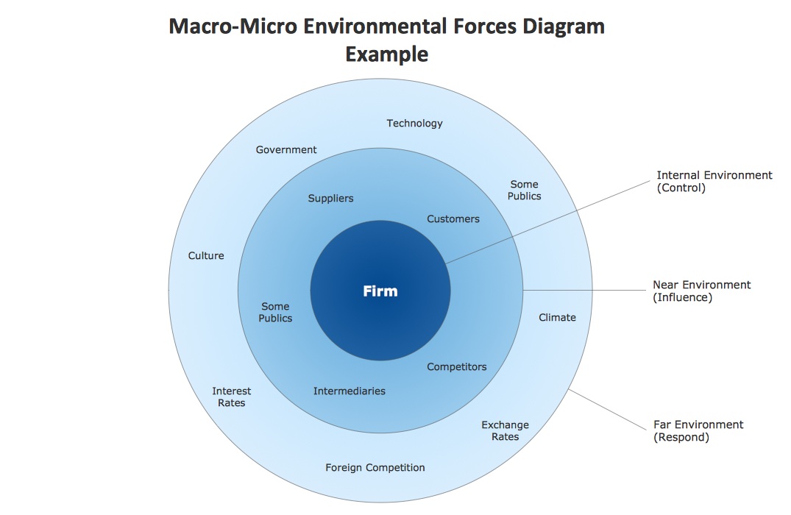
Introduction to Strategic Marketing
MARKETING ENVIRONMENT

Slide 36
Strategic Marketing Process
6. ANALYSIS OF MACRO-ENVIRONMENT
What constitutes macro environment?
Economical - purchasing power, the economic situation of the country and its development, growth rates, inflationary tendencies, unemployment, income level, spending pattern, the consumer price index, resource availability, interest rates, tax and customs conditions.
Demographic - population, age structure, employment, population density, spatial distribution, education, lifestyle, migration.

Slide 37
Strategic Marketing Process
ANALYSIS OF MACRO-ENVIRONMENT
The political situation - the development of legislation, procompetitive and antitrust, legal standards, consumer protection, environment, impact from the interest, civil and political groups.
Cultural and social - basic cultural values of society, its way of life, social environment.
Technology - technological development of the country, adopting new technologies, the pace of technological change.
Natural factors - climate, natural resources, pollution.

Slide 38
Strategic Marketing Process
PEST ANALYSIS
Affects the strategy of the company - whether it will ever be possible to enter the market and in what form (e.g. a big risk - not choose a capital form, but license; high tariffs – local factory).
At high risks and additional costs resulting from the environment - do not enter the market.
PEST analysis is generally very difficult to implement, requires many data sources.
All manuals sound simple - understand PEST, find data, make a decision ... BUT!
Secondary research (from the table), after that primary research.

Slide 39
Strategic Marketing Process
THE END
Thank you for your attention.
☺

