Slide 1

Business to Business (B2B)
Ing. Michal Stoklasa, Ph.D.
Strategic Marketing/subject code

Slide 2
Business to Business
Outline of the lecture
Characteristics of B2B markets and their difference from B2C.
Conditions at B2B + purchasing behavior.
Real B2B market in the Czech Republic - state, Content Marketing, PPC, SEO.

Slide 3
Business to Business
1. B2B MARKET
Business to Business market – B2B – industry market, market of companies.
Business to Customer – B2C – market for final end customers (retail).
Business to Government – B2G – state business.
The business market consists of all the organisations that acquire goods and services used in the production of other products or services that are sold, rented, or supplied to others.
More money is spent on the business market than on the consumer market.
In many ways, business markets are similar to consumer markets. In particular, understanding their customers and what they value is of paramount importance to both.

Slide 4
Business to Business
DIFFERENCES BETWEEN B2C AND B2B MARKETS 1
Meaning of the purchase - purchases are a means to create profits, reduce costs, ensure continuity of production and organizational goals, fulfillment of legal obligations. Not just a spur of a moment thing „oh, ice-cream, lets buy ice-cream“.
System approach to buying - the decision to make a purchase is a logical result of an analysis of needs, opportunities, implications and available resources.
Function of contracts - signed contracts are not only a commitment on the subject, price, quantity, quality and time of delivery, but often a commitment for long-term cooperation, causing changes in the current negotiations between both contractual partners (e.g. long-term contracts create the need for mutual interconnection production and business plans).

Slide 5
Business to Business
DIFFERENCES BETWEEN B2C AND B2B MARKETS 2
Fewer, larger buyers: the business marketer normally deals with far fewer, much larger buyers than the consumer marketer does, particularly in such industries as aircraft engines and defence weapons.
Close supplier-customer relationship: because of the smaller customer base and the importance and power of the larger customers, suppliers are frequently expected to customize their offerings to individual business customer needs. Business buyers often select suppliers that also buy from them. A paper manufacturer might buy from a chemical company that buys a considerable amount of its paper.

Slide 6
Business to Business
DIFFERENCES BETWEEN B2C AND B2B MARKETS 3
Professional purchasing: business goods are often purchased by trained purchasing agents, who must follow their organisation`s purchasing policies, constraints, and requirements. Many of the buying instruments – for example, requests for quotations, proposals, and purchase contracts – are not typically found in consumer buying. Professional buyers spend their careers learning how to buy better. This means business marketers must provide greater technical data about their product and its advantages over competitors’ products.
Multiple sales calls: it takes many more calls to actually finish a business, there are often years between quoting a job and delivering the product.

Slide 7
Business to Business
DIFFERENCES BETWEEN B2C AND B2B MARKETS 4
Multiple buying influences: more people typically influence business buying decisions. Buying committees consisting of technical experts and even senior management are common in the purchase of major goods. Business marketers need to send well-trained sales representatives and sales teams to deal with the well-trained buyers.
Inelastic demand: the total demand for many business goods and services is inelastic – that is, not much affected by price changes. Demand is especially inelastic in the short run because producers cannot make quick changes in production methods. Demand is also inelastic for business goods that represent a small percentage of the item`s total cost, such as shoelaces.

Slide 8
Business to Business
DIFFERENCES BETWEEN B2C AND B2B MARKETS 5
Derived demand: the demand for business goods is ultimately derived from the demand for consumer goods. For this reason, the business marketer must closely monitor the buying patterns of ultimate consumers. Business buyers must also pay close attention to current and expected economic factors, such as the level of production, investment, and consumer spending and the interest rate. In a recession, they reduce their investment in plant, equipment, and inventories. Business marketers can do little to stimulate total demand in this environment. They can only fight harder to increase or maintain their share of the demand.
Notes:
Source: Čichovský, 2013, s. 15-17

Slide 9
Business to Business
DIFFERENCES BETWEEN B2C AND B2B MARKETS 6
Fluctuating demand: the demand for business goods and services tends to be more volatile than the demand for consumer goods and services. A given percentage increase in consumer demand can lead to a much larger percentage increase in the demand for plant and equipment necessary to produce the additional output.
Geographically concentrated buyers: the geographical concentration of producers helps to reduce selling costs. At the same time, business marketers need to monitor regional shifts of certain industries.
Direct purchasing: business buyers often buy directly from manufacturers rather than through intermediaries, especially items that are technically complex or expensive such as mainframes or aircraft.

Slide 10
Business to Business
ADDITIONAL DIFFERENCES OF B2B AND B2C 1
Personal relationships are more important in B2B markets: because of the smaller base of regular buyers, it is important to have good personal relationships. Emerging markets often times require big companies to come again to the level of close friendly relationships (e.g. in China, Russia). For companies it means higher costs because of the added time-constraint on their personnel and added requirement of skills.
B2B buyers are longer-term buyers: it is caused by the fact that businesses buy capital machinery, components and different materials and consumables regularly. This point further strengthens the previous one – the need of great personnel with many skills to build long-term relationships.

Slide 11
Business to Business
ADDITIONAL DIFFERENCES OF B2B AND B2C 2
B2B markets drive innovation less than consumer markets: most innovation is driven by the consumer markets and B2B companies innovate only a response to that. Consequently, B2B companies are only very rarely trend setters.
Consumer markets rely far more on packaging: consumers are less rational than B2B companies about their purchases and thus more susceptible to impulse buying based on “likeliness” of a product (based on the packaging). On B2B markets, packaging has only a functional role.
Assisting customers to manage their business. The strongest and the best relationship with industrial customers will be one in which the seller actually helps shoppers to manage their own business and is actively involved in the process of creating customer value.

Slide 12
Business to Business
2. PURCHASING BEHAVIOR
Marketers want to know how the buyer organization responds to various marketing and other impulses to influence its behavior, and what responses cause. To be able to build effective marketing strategies and transform stimuli into shopping reaction, we must understand what is happening within the organization.
Purchasing activity of organization has two main components - the purchasing department made up of people who are involved in making purchasing decisions and the actual process of purchasing decisions. Both components are influenced by the internal organizational, interpersonal and individual factors as well as external environmental factors.

Slide 13
Business to Business
THE IMPORTANCE OF PURCHASING BEHAVIOR
Ensure the continuity of the production process, which is made by ensuring reliable supplies of materials and services.
Optimally contribute to the company's results and to reduce costs.
Reduce strategic vulnerability on the purchase market. Future deliveries must be fully secured.
Contribute to product innovation and technology. Closely monitor technological developments of our suppliers.
Shape the company's image.
Each saved crown arising from a good purchasing policy contributes directly to higher profits.

Slide 14
Business to Business
PARTICIPANTS OF THE TRADE PURCHASING PROCESS
Initiators: those who begin the purchase process, e.g. maintenance contracts.
Users: Those who actually use the product, e.g. welders.
Deciders: those who have the authority to select the supplier/model, e.g. production managers.
Influencers: those who provide information and add decision criteria throughout the process, e.g. accountants.
Buyers: those who have authority to execute the contractual arrangements, e.g. purchasing.
Gatekeepers: those who control the flow of information, e.g. secretaries who may allow or prevent access to a DMU member, or a buyer whose agreement must be sought before a supplier can contact other members of the DMU.

Slide 15
Business to Business
DECISION MAKING UNIT
An important point to understand in organisational buying is that the buyer, or purchasing officer, is often not the only person that influences the decision, or actually has the authority to make the ultimate decision.
Rather, the decision is in the hands of a decision-making unit (DMU), or buying centre as it is sometimes called.
This is not necessarily a fixed entity. Members of the DMU may change as the decision-making process continues.

Slide 16
Business to Business
BUYING SITUATIONS
Straight rebuy: the purchasing department reorders supplies such as office supplies and bulk chemicals on a routine basis and chooses from suppliers on an approved list. “Out-suppliers” attempt to offer something new or exploit dissatisfaction with a current supplier.
Modified rebuy: the buyer wants to change product specifications, prices, delivery requirements, or other terms. This usually requires additional participants on both sides. The in-suppliers become nervous and want to protect the account. The out-suppliers see an opportunity to propose a better offer to gain some business.
New task: a new-task purchaser buys a product or service for the first time (an office building, a new security system). The greater the cost or risk, the larger the number of participants, and the greater their information gathering – the longer the time to a decision.

Slide 17
Business to Business
PURCHASES IN TERMS OF THEIR LEVEL OF RISK 1
Routine order products: these are used and ordered on a regular basis. The product or service is unlikely to pose any problems regarding its use or performance and is therefore low risk (e.g. office stationery).
Procedural problem products: these products may involve some level of training in order for individuals to successfully adopt them. This will increase the risks associated with the successful introduction of the purchase to the company (e.g. personal computers or word processors).

Slide 18
Business to Business
PURCHASES IN TERMS OF THEIR LEVEL OF RISK 2
Performance problem products: the risks here lie with the question of whether the product can perform at the level required to meet the user’s requirements. There may also be concerns about the product`s ability to be compatible with the company’s existing resources and current equipment (e.g. introducing new technology).
Political problem products: political problems could arise where a purchase takes away resources from another area within the organisation. A high investment in a product for one area of the business may mean that another area has to forgo investment. Political problems can also take place where it is planned that the same product will be used by several different units, each having their own requirements (e.g. a new information system).

Slide 19
Business to Business
INSTITUTIONAL MARKETS
The institutional market consists of schools, hospitals, nursing homes, prisons, and other institutions that must provide goods and services to people in their care.
Many of these organisations are characterized by low budgets and captive clienteles. For example, hospitals must decide what quality of food to buy for patients. The buying objective here is not profit, because the food is provided as part of the total service package, nor is cost minimisation the sole objective, because poor food will cause patients to complain and hurt the hospital`s reputation.
Buyer must therefore find a supplier whose prices are low at acceptable quality of the goods. A number of suppliers have a special department for supplying institutional customers due to their specific requirements.

Slide 20
Business to Business
GOVERNMENT MARKETS – B2G
In most countries, government organisations are a major buyer of goods and services. They typically require suppliers to submit bids and award the contract to the lowest bidder.
Purchases of government are very specialized and specific. The total purchases contribute significantly to country economy. Purchased are large quantities of various goods and services, from military aircraft to machinery, equipment, fuel, energy, office supplies and furniture, and even sculptures and art objects. Government market represents huge sales for each manufacturer and trader.
A major complaint of multinationals operating in Europe is that each country shows favouritism toward its nationals despite superior offers from foreign firms.

Slide 21
Business to Business
SYSTEMS BUYING AND SELLING
Many business buyers prefer to buy a total problem solution from one seller. Called system buying, this practice originated with government purchases of major weapons and communications systems.
The government solicited bids from prime contractors that, if awarded contract, would be responsible for bidding out and assembling the systems subcomponents from second-tier contractors. The prime contractor thus provided a turnkey solution, so-called because the buyer simply had to turn one key to get the job done.

Slide 22
Business to Business
3. CURRENT STATE OF B2B – CZECH EXAMPLE
Communications and its new trends are tremendously important (social networks - LinkedIn, viral, guerilla, live chat etc.) The share of digital media is booming.
The shift in technology - new styles of purchasing.
The importance of innovation.
Importance of using software that is standard in the industry (SAP, CRM).
SEO is important. (but where does it lead?)
Content marketing is perhaps more important than B2C.
Building relationships with customers is essential for B2B!
2021 in Czechia.

Slide 23
Business to Business
CURRENT STATE OF B2B – CZECH EXAMPLE
Website, e-shop, online catalogue.
Social networks – Facebook (85 %), LinkedIn (70 %), YouTube (53 %), Instagram (20 %).
PPC, SEO.
Trade fairs, exbihitions, conferences.
Education – webinars, seminars, workshops.
Gifts! – drinks (wine), food (luxurious), office supplies, clothes (with brand logos, colours etc.), other (electronics, home appliences).

Slide 24
Business to Business
NEW WAYS OF PURCHASING
There are new electronic ways of placing demands on purchases. Shared economy is booming!
Epoptavka.cz is a universal search engine for vendors and buyers in B2B markets. These are mostly smaller demands and thus lower profits, or vice versa spending. You could say that anyone who is not on epoptavka.cz does not exist – 2013 - 38 bill. CZK, 200 thousand companies. In 2015 fail – shady business. Now Amazon B2B, Aukro B2B.
From marketing, commercial, financial and logistical point of view even, this kind of purchasing brings several advantages for entrepreneurs and businesses:
  Accelerate and improve the process of selecting suppliers.
  Ensure the possibility for immediate demand without complicated exploration and search for contacts.
  Enabled the purchase for the bargain price.

Slide 25
Business to Business
CONTENT MARKETING
Content marketing is based on the creation and placement of useful and valuable content that attracts and engages in communication with your desired customers and makes them behave in a ways that will lead to a sale.
Content marketing is basically the ability to communicate with the prospects /suspects / customers your offer in a way that is not perceived as forcing them. Instead of expensive advertising for your products and services - bring valuable and interesting information that help your buyers and educate them.
Content marketing is more than just an internet marketing or the online marketing. The essence of content marketing is that if you regularly provide valuable information to buyers, they will reward you with their purchases and loyalty.

Slide 26
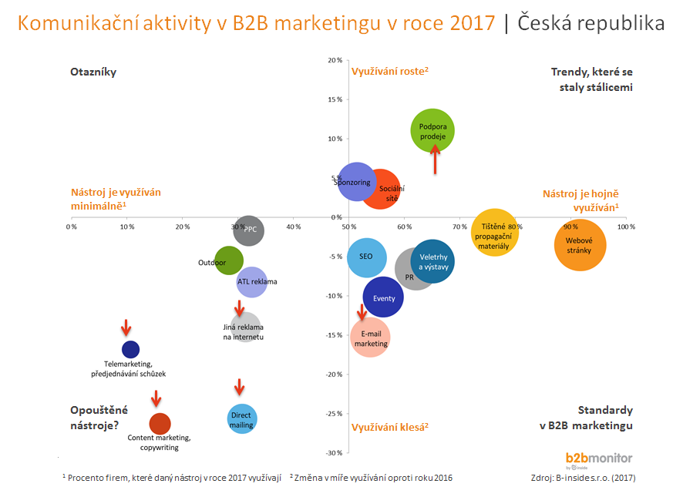
Business to Business
Communication activities in B2B - B2Bmonitor

Slide 27
Business to Business
PAY PER CLICK (PPC)
PPC is an online advertising instrument. The principle of PPC lies in the fact that the advertiser does not pay for each ad impression, but pays up when the ad is clicked. The advantage of PPC advertising is its measurability and ease of planning.
The world's most popular system (though not the oldest) is probably Google AdWords. PPC ads can also be bought through LinkedIn, Yahoo and Facebook.
PPC advertising can be managed by everyone after registration in the PPC system. System operators are trying different ways to educate users to keep using their campaigns to achieve better results. Google AdWords, for example, provides free videos called AdWords Online University.

Slide 28
Business to Business
SEARCH ENGINE OPTIMIZATION (SEO)
Search Engine Optimization is a methodology for creating and editing Web pages in such a way that their form and content are suitable for automated processing in web search engines.
The aim is to obtain a higher ranked search result in search engines, which corresponds to the content of the website ranked higher, and thus more numerous as well as targeted visitors.
However, there is criticism of SEO, which accuses the purposefulness of these measures or their abuse, because the importance of content for the site visitor evaluated indirectly (Google has 207 constantly changing criteria).

Slide 29
Business to Business
AFFILIATE MARKETING
Affiliate marketing (also called partner marketing or a commission system) is an online marketing tool for companies that works on connectedness of seller of products or services with pages that recommend said products or services.
It is a system based on product promotion through the webpages of affiliate partners who then receive a share (commission) from the sale.

Slide 30

Business to Business
TASK FOR SEMINAR
We are selling on B2B - cement, slag, stones, etc. You sell it in (tens) tons.
Design a communication campaign for B2B.

Slide 31
Business to Business
THE END
Thank you for your attention.
☺

