Slide 1
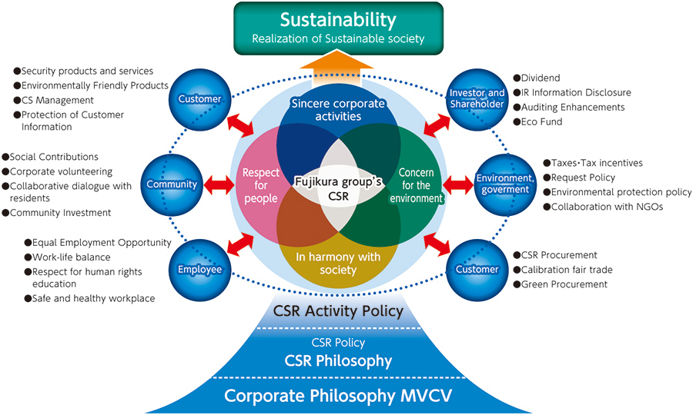
Stakeholderský přístup – Fujikura corporation
Source: http://www.fujikura.co.jp/eng/csr/group_csr/communication.html
Fujikura corporation – stakeholders in detail

Slide 2
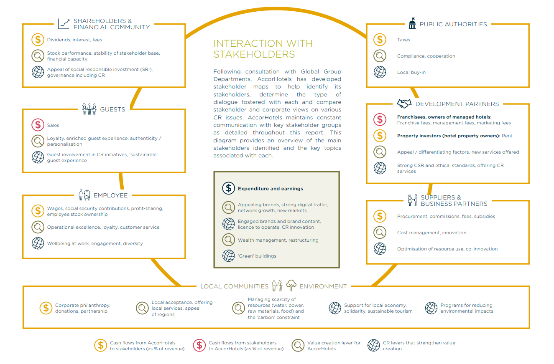
STAKEHOLDER MANAGEMENT AND ENGAGEMENT
1. A stakeholder approach to CSR
Source: https://images.jobsataccor.com.au/wp-content/uploads/AccorHotels-Corporate-Responsibility-Report-2017.pdf
ACCOR HOTELS

Slide 3
STAKEHOLDER přístup – ACCOR Hotels
1. A stakeholder approach to CSR
Source: https://images.jobsataccor.com.au/wp-content/uploads/AccorHotels-Corporate-Responsibility-Report-2017.pdf
ACCOR HOTELS

Slide 4
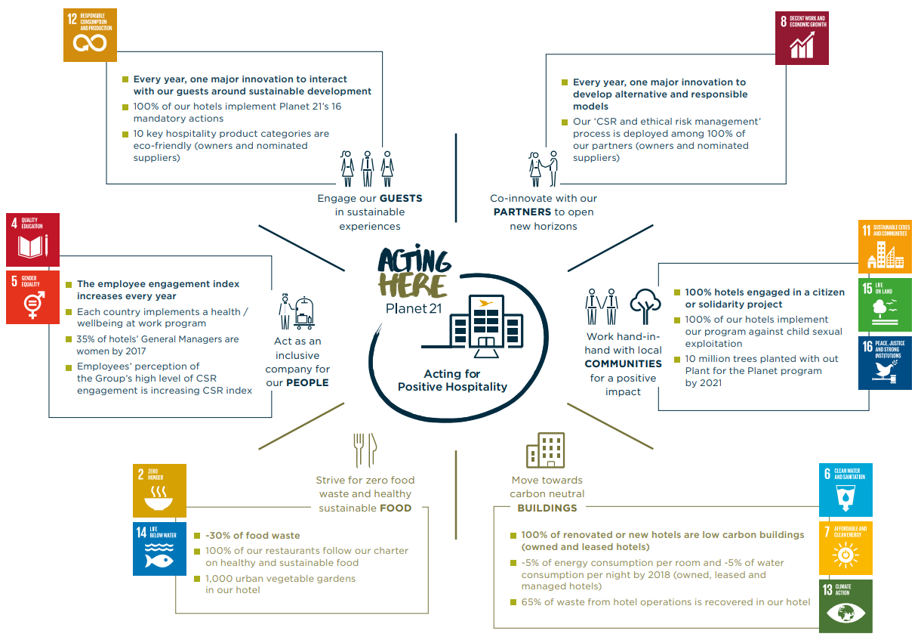
STAKEHOLDER přístup – ACCOR Hotels
1. A stakeholder approach to CSR
Source: https://images.jobsataccor.com.au/wp-content/uploads/AccorHotels-Corporate-Responsibility-Report-2017.pdf
ACCOR HOTELS

Slide 5
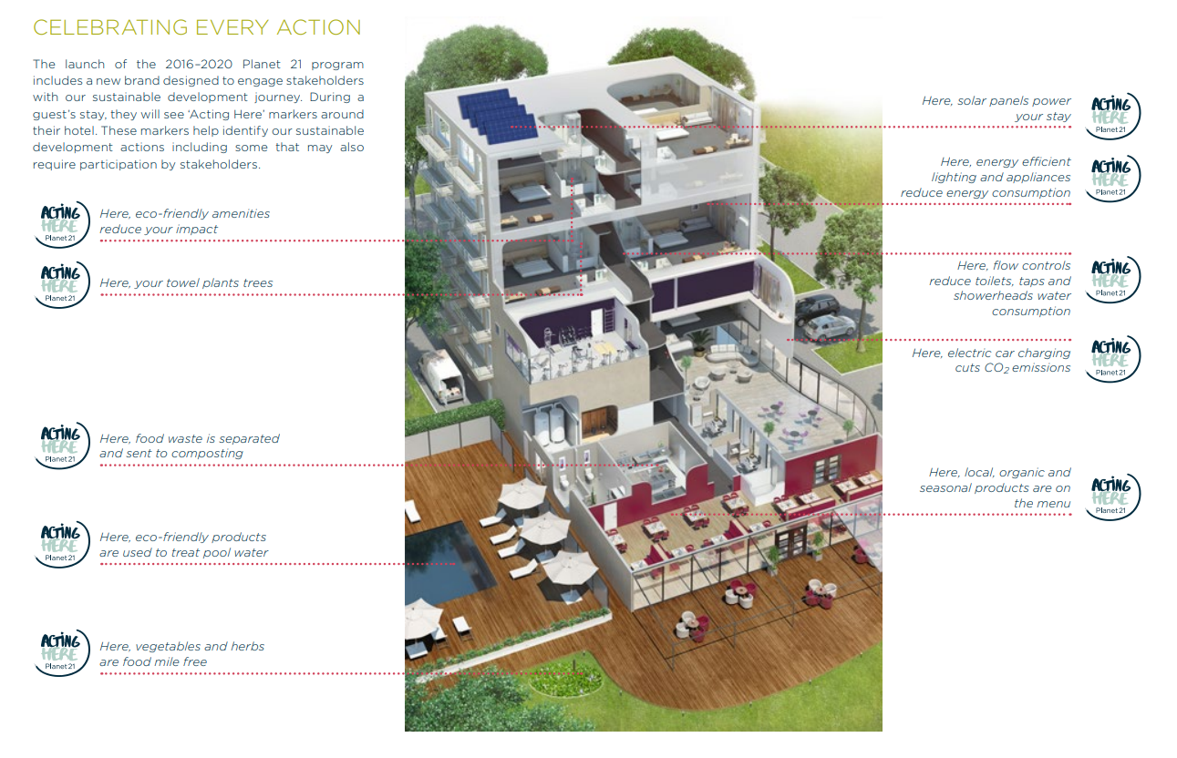
STAKEHOLDER přístup – ACCOR Hotels
1. A stakeholder approach to CSR
Source: https://images.jobsataccor.com.au/wp-content/uploads/AccorHotels-Corporate-Responsibility-Report-2017.pdf
ACCOR HOTELS

Slide 6
STAKEHOLDER MANAGEMENT AND ENGAGEMENT
A practitioner-based model of societal responsibilities
Source: https://www.toshiba/ww/en/csr/engagement/stakeholders.html
TOSHIBA – MAJOR STAKEHOLDERS

