Slide 1
Ing. Patrik Kajzar, Ph.D. Department of Tourism and Leisure Time Activities
The Tourist attractions in the Czech Republic and in the World
Walther 18 294: Non progredi est regredi - Nejít vpřed znamená jít zpět

Slide 2
Contact
Ing. Patrik Kajzar, Ph.D. – lecture, seminar
Office: VB127
kajzar@opf.slu.cz

Slide 3
Content:
1. Introduction to the theory of tourism, the tourism division, tourism potential, a description of specific forms of tourism. 2. Part I - Tourist attractions in the Czech Republic - 7 regions. 3. Part II - Tourist attractions in the Czech Republic - 7 regions. 4. Tourist attractions in Central European Countries: Switzerland and Liechtenstein , Austria , Germany, Poland, Slovak Republic , Hungary. 5. Attractiveness of tourism in the countries of Eastern Europe: Bulgaria , Romania , Lithuania , Latvia , Estonia, Moldova, Ukraine, Belarus, Russia, Georgia… 6. Tourist attractions in Western European countries: UK, Ireland, Benelux. 7. Tourist attractions in the southern European countries: Portugal, Spain and Andorra, France and Monaco, Italy, San Marino, Vatican, Slovenia , Croatia , Bosnia and Herzegovina, 8. Tourist attractions in the northern European countries: Denmark, Norway, Sweden, Finland , 9. Tourist attractions in selected countries of the Asia: Cyprus, Turkey, Israel, UAE, China, Japan, India, Maldives, Malaysia, Singapore, Indonesia, Thailand. 10. Tourist attractions in selected countries of the Africa 11. Tourist attractions in selected countries of the north America: United States, Canada, Mexico and Caribbean islands. 12. Tourist attractions in selected countries of the south America 13. Tourist attractions in the Australia and Oceania.

Slide 4
Selected books:
BONIFACE, B., COOPER, CH., and R. COOPER, 2020. Worldwide Destinations. The Geography of Travel and Tourism. Routlege. ISBN 978-0367200411.
STEVES, R. and H. VIHAN, 2015. Prague and the Czech Republic. ISBN 978-16-312-105-56.
UNESCO, 2018. World Heritage Sites: A Complete Guide to 1073 UNESCO World Heritage Sites. Firefly Books. ISBN 9780228101352.
More books in sylabus…..

Slide 5
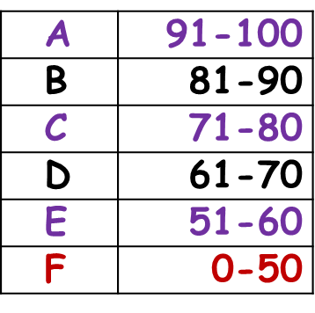
Requirements
During the course you can get 100 points
To get the credit you must score 51
Attendance on seminar 60% (2p. for each news from the field of tourism – statistics, or about selected tourist attractions, or own travel experiences) – max 10 p.
2 test in seminar (6.11. 2023 and 11.12. 2023) – 10 p. and 10 p.
Presentation of selected tourist attractions of your chosen destinations (15 - 20 minutes) – max. 10 points
Written exam – max. 60 points
Walther 18 294: Non progredi est regredi - Nejít vpřed znamená jít zpět
Notes:
csvukrs

Slide 6
Seminar work
Presentation of selected tourist attractions of your chosen destinations e.g. (from Poland to Caribbean islands…..).
In presentation you can use too short video, pictures, figures…..
Word 7 pages (including introduction,… conclusion and used literature) and insert into IS SU - 15.12. 2023

Slide 7
Have a nice day

