Slide 1
Negotiations - roleplays

Slide 2
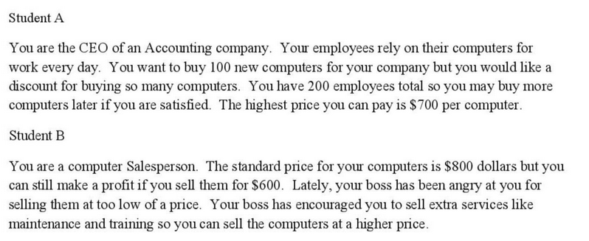

Slide 3
