Slide 1
The Factors of Production: Capital
LESSON 9
MICROECONOMICS
2023/2024

Slide 2
OUTLINE OF THE LECTURE AND STUDY GOALS
Students should be able to:
Define capital, interest income and interest rate.
Understand what causes the differences in interest rates across different types of loans.
Understand the difference between short-run and long-run capital market.
Explain and evaluate the capital returns.
Explain time-value of money, present and future value.
Capital, Money and Interest Rate
Capital Market
Returns on Capital
Time-Value of Money

Slide 3
Capital
Capital - the savings converted into investments
Secondary factor of production
Three forms:
Capital goods (construction, equipment and supplies)
Financial capital (securities)
Money capital (savings)
Money (even in form of paper currency, checking account, cryptocurrencies) is not a resource as you cannot directly produce goods and services with it.
Money is valued because of what it can purchase…

Slide 4
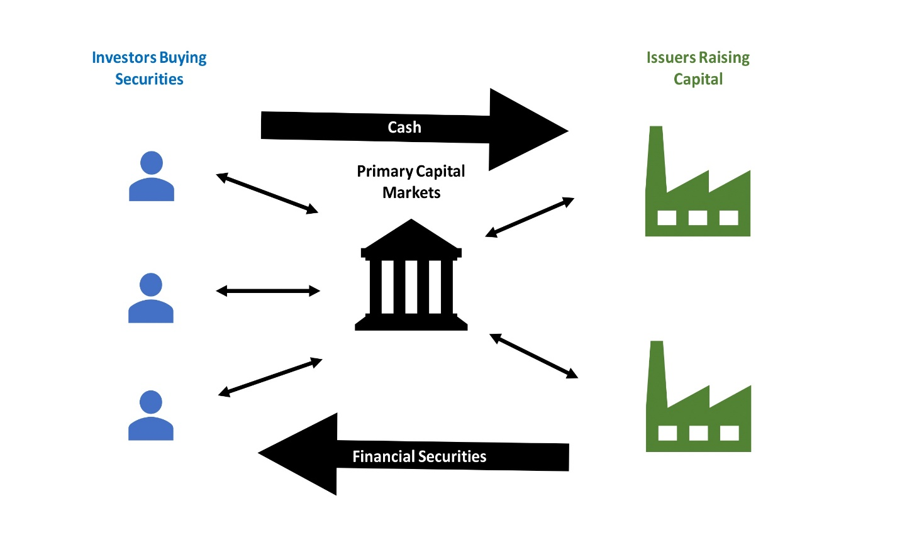
Capital Market
supply of savings (households) meets the demand for these savings (firms)
household savings (current and term deposits, insurance, etc.) receive in the capital market form of capital offered to firms
the demand for capital - given the need to finance the purchase of investment goods
The most common capital markets are stock markets and bond markets. The instruments traded are mainly securities with maturities exceeding one year.
Short-term securities payable in one year or less are traded on what is known as a money market.

Slide 5
What motivates entities to borrow money and pay interest?
Households – would rather consume goods and services now than later.
Firms: acquisition of capital goods (computers, machinery, warehouses);
Firms: funding of research and developments (R&D);
Thus, main motivation: the expansion of business and the increase of profits.

Slide 6
Capital Goods
Capital goods are not consumed in the production process at once = wear out, so that their value is not transferred to the new products at once, but gradually in the form of depreciation or amortization.
Depreciation represent a significant part of production costs and significantly affect the magnitude of profit.
Depreciation represent a significant source of means for the purchase of new capital goods to replace the already worn-out capital goods.
Total new investment in capital goods production (gross (brutto) investment (IB)) is thus divided into two components: restitution and net investment.
$I_{B}$ = $I_{R}$ + $I_{N}$
Capital is an important production factor influencing the overall productivity growth and social wealth.

Slide 7
Interest, Interest Rate and Interest Income
The household must have a motivation to generate savings and lend their money, instead of consumption:
Interest is the price paid for the use of money. The amount of money borrower has to pay to the lender over period of time for the use of their money (paying 100 USD interest to lender for borrowing 1 000 USD).
Interest rate is the price of the use of the money in the form of the percentage of the borrowed money (10 % interest rate).
Interest income is earned by owners of capital for providing capital to the firms.

Slide 8
Range of Interest Rates
There is not a single interest rate in the economy but many.
What affects the range of interest rates offered?
Risk – different borrowers and different purposes carry varying degrees of risk
Maturity – length of loan, longer-term loans carry higher interest rates
Loan Size – the administrative costs are equal for large and small loans but the cost as a percentage of smaller loan is greater
Taxability – interest in state or municipal bonds might be tax free even if they have lower before-tax interest to other bonds

Slide 9
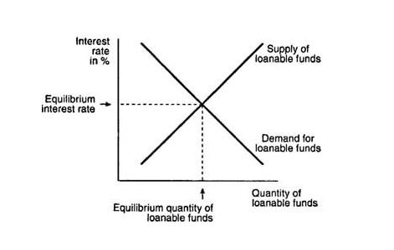
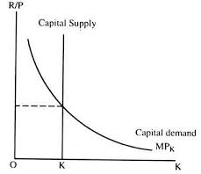
Capital Market Equilibrium
SHORT RUN
Intersection of the demand curve for capital and the supply curve for capital is a short-run point of equilibrium in which is determined short-run equilibrium interest rate at a supply of capital and at a demand function for capital
LONG RUN
In the long term it is expected that households may decide to offer greater savings when the interest rate rises. Supply curve for capital has a positive slope, because with the growth of interest rate increased willingness of households to generate savings

Slide 10
Capital Market Equilibrium
Equilibrium interest rate equalizes savings and investments.
S = I
Interest rate thus fulfills two important functions:
leads the household to sacrifice current consumption, and increased the supply of capital,
encourages firms to seek the most effective investment opportunities.
Saving surpulus → decline of interest rate → decline of savings and increase of capital demand
Savings shortage → increase of interest rate → increase of savings and increase of capital demand

Slide 11
Capital Returns
In deciding whether to invest at all, or where is best to invest, firms need some measure of capital return.
Rate of capital return - shows the net return in monetary units per one year of each money unit of invested capital (% per year)
The estimation of the potential return rates from the investment project:
If a firm receives additional revenue of 110 USD by purchasing machine for 100 USD, it will realize 10% return on investment.
$$\frac{annual net returns}{calculated costs}$$

Slide 12
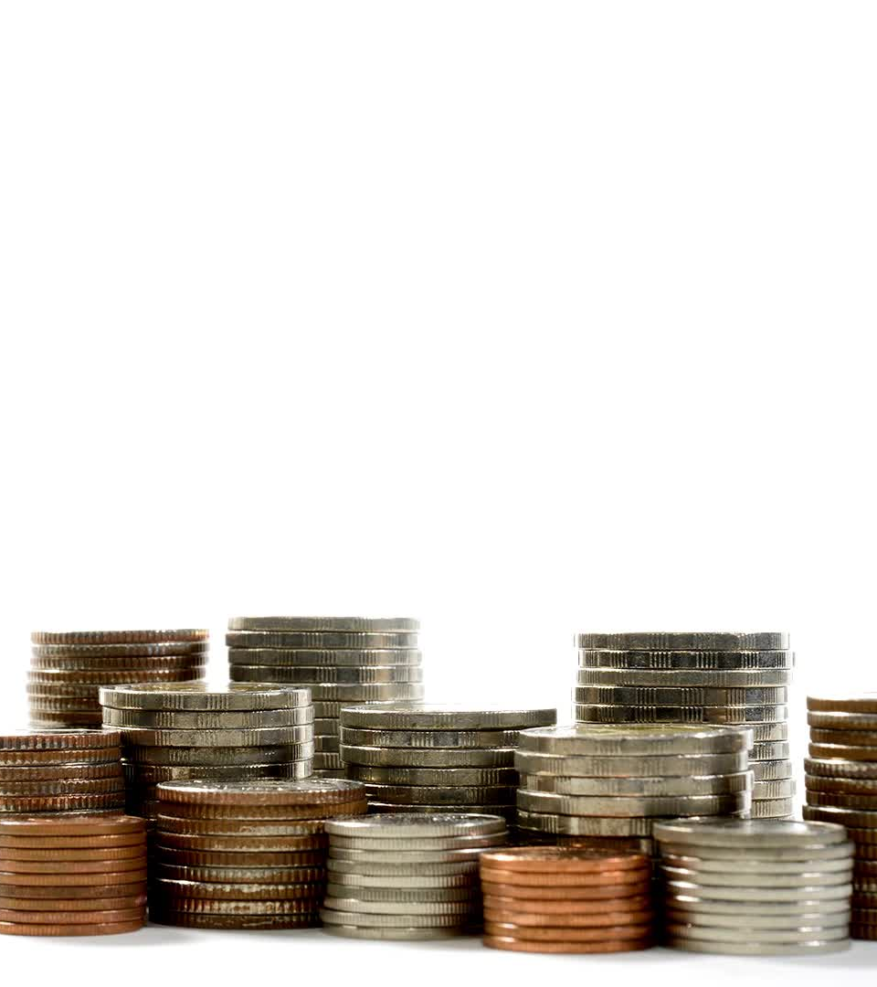
Time-Value of Money
This implies:
- A given amount of money today can be expressed as an equivalent to a larger amount of money in the future (future value).
- A given amount of money in the future can be expressed as an equivalent to a smaller amount of money today (present value).
Specific amount of money is more valuable the sooner it is obtained.
Suppose you should choose between 1 000 CZK today and 1 000 CZK in a year.
If you receive 1 000 CZK today you may invest it at certain interest and it grows into more than 1 000 CZK in a year.

Slide 13
Present and Future Value
Present value PV – The current value of a future sum of investment
$$PV= \frac{FV}{{(1+i)}^{t}}$$
Future value FV – the present value plus interest
$$FV=PV x ({1+i)}^{t}$$

Slide 14
Problem to Solve
Beginning Period Value | Computation | Interest | End Period Value
1 000 CZK
Consider you put 1 000 CZK in a saving account with 10% interest rate p.a.
a) Calculate the future value of your money in three years.
b) Fill in the table, estimating interest and value of your money after every year.

