Slide 1
Market Structures:
Perfect Competition
LESSON 6
MICROECONOMICS
2023/2024

Slide 2
OUTLINE OF THE LECTURE
AND
STUDY GOALS
Students should be able to:
Explain the characteristics of TR, MR, AR and individual demand of a perfectly competitive firm.
Explain the golden rule of profit maximalisation.
Determine whether a firm generates loss, profit or zero profit in short-run.
Determine whether a firm should continue its production or shutdown the production in short-run.
Explain how market supply curve is derived.
Explain why perfectly competitive firms gain zero long-term profit.
Characteristics of Perfect Competition
Golden Rule of Profit Maximalisation
Short-Run Equilibrium
Firm Shut-Down Point
Deriving Supply Curve
Long-Run Equilibrium

Slide 3
MARKET STRUCTURES
PERFECT COPETITION
- an economic model based on the following assumptions:
- homogenous product
- many buyers and sellers without any market power to influence the price
- no entry or exit barriers
- perfect and free informations
IMPERFECT COMPETITION
- monopoly
- oligopoly
- monopolistic competition
Goal of every firm (whether perfectly or imperfectly competitive) is to maximise profit.

Slide 4
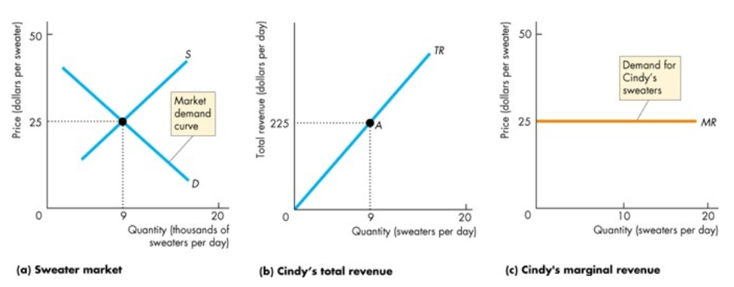
Revenues
Price is formed in perfectly competitive market and firm cannot influence it. Total revenues are linear and individual demand of firm (d) is perfectly elastic.
Every piece of firm production is sold for fixed price (25):
d = P = AR = MR (= 25)

Slide 5
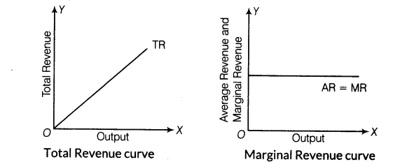
Facts about perfectly competitive firm based on the previous assumptions:
Many firms with homogenous products and consumers having perfect information -> market share of each firm is minimal.
The price is objectively determined by market -> firm is so called "price taker„
Individual demand of firm (demand for the production of one firm) is infinitely elastic - parallel line to the axis "x" at market price
Curves of average and marginal revenues are identical and coincide with the curve of individual demand (d = P = AR = MR)

Slide 6
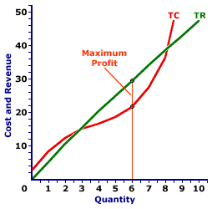
Firm Output in Short Run
The firm chooses its output at which maximizes profit, that‘s where:
the maximum difference between total revenues and total costs, thus:
marginal revenue and marginal cost are equal.
The golden rule of profit maximization:
MR = MC

Slide 7
The golden rule of profit maximization explained:
Marginal cost: cost of producing one more unit of production
Marginal revenue: additional income (price) of selling one more unit
MR > MC – firm is motivated to produce such unit
MR = MC – profit maximalizing output
MR < MC – firm is not motivated to produce such an unit
QUANTITY PRODUCED | MC | MR
1 | 16 | 25
2 | 14 | 25
3 | 18 | 25
4 | 20 | 25
5 | 25 | 25
6 | 28 | 25

Slide 8
Problem 1:
Complete the table calculating the rest of values.
What is the output the firm will be producing if it wants to maximalize the profit?
What will be the profit of the firm?
Make recommendation to the firm based on the result.
QUANTITY PRODUCED | MC | MR | AVC | AFC | ATC | VC | FC | TC | Profit
1 | 16 | 25
2 | 14 | 25
3 | 18 | 25
4 | 20 | 25
5 | 25 | 25 | 20 | 16
6 | 28 | 25

Slide 9
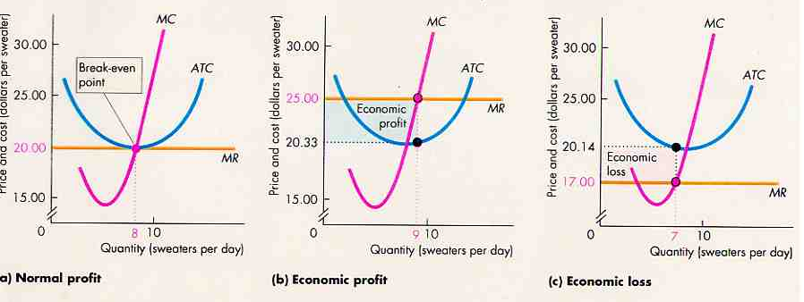
Possible Scenarios For Firm In Short-run:

Slide 10
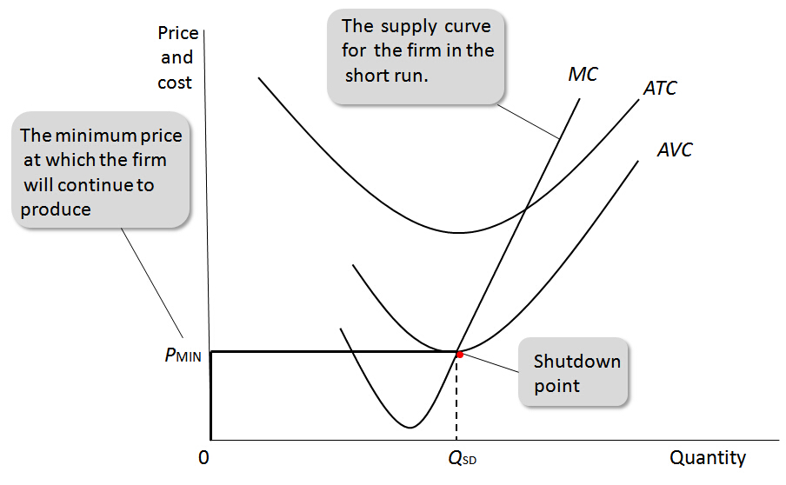
Loss in the Short-Run and Individual Supply of Firm
The firm must cover at least the short-term variable costs (to pay wages, energy, etc.)
Fixed costs (amortization rule) may not be covered in the short run.
If P < ATC – firm is in the loss but it will continue producing as long as: P > AVC (firm covers all variable costs and partly fixed costs)
P ≤ AVC - the firm minimizes the loss by shutting down and not continuing production in short-run (bearing the loss in the level of total fixed costs).
Individual supply curve (supply of the firm) is formed by rising part of the MC curve, bounded point min. AVC.

Slide 11
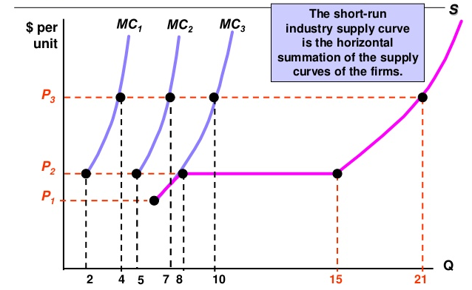
Market Supply:
Market supply is the the horizontal sum of the individual supply curves (rising part of MC curve bounded by the minimum AVC).
S = ∑ MC

Slide 12
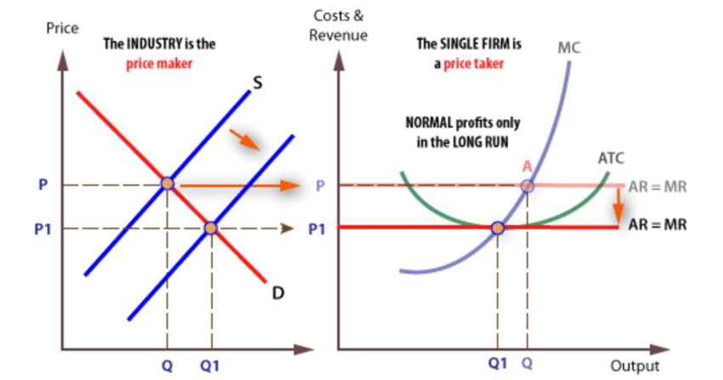
Forming the Long-run Optimum:
Short-Run Equilibriums:
If the market price is higher than the AC, the firm reaches economic profit and profit in industry will attract other firms:
increase in market supply, S -> S1,
decline in market prices.
B) If the market price is lower than the AC, the firm reaches economic losses and firm leaves the industry:
decrease in market supply,
increase in market price.
This market mechanism will repeat until such a price is set that all firms left in the market exhibit zero economic profit (no motivation to leave or enter the market).
Firm in pefect competition has zero long-term economic profit.

Slide 13
FIRM OUTPUT IN LONG RUN
The FIRM may change the volume of all factors of production in the long run;
Optimal output when P = MR = LMC;
Influenced by free access and output into the industry.
Productive and allocative efficiency:
Productive efficiency: the firm produces output with minimal LAC
Allocative efficiency: such an output is produced that consumers want the most - the reallocation of resources will not increase the firm's output nor consumer benefit (absence of expenses deadweight)
P = MC

